Slide 1
ted@econleadership.com

Slide 2
I Have Nothing Profound the Say
Think
…except, many of the things we all used to know we knew, have changed

Slide 3
Today’s Persistent New Reality
The economy changed
Place competition changed
The U.S. workforce has changed
The talent demands changed
Corporate success has changed
Customer demands, expectations and options have changed
The pace of change and everything else changed

Slide 4
How Is The Economy?

Slide 5
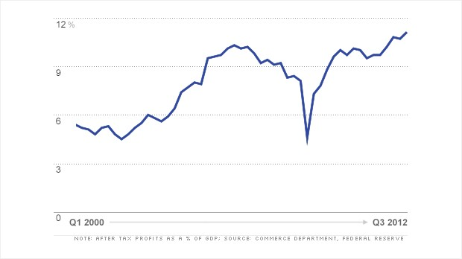
Corporate Profits at All Time High

Slide 6
Stock Market at All Time High

Slide 7
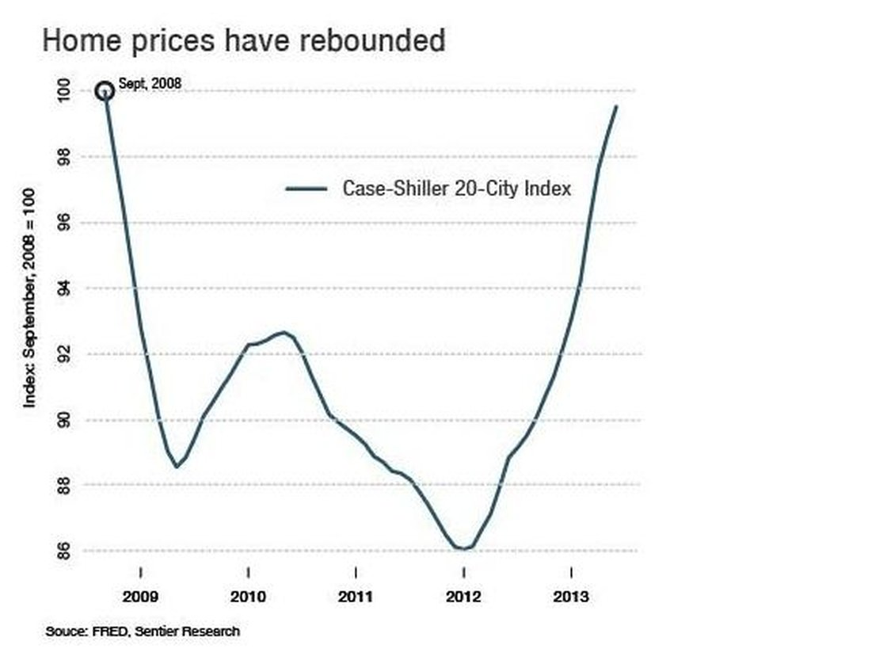

Slide 8
Stagnation of wages and slow growth of jobs
Wide disparity between people and places

Slide 9
Annual U.S. Employment Change
Source: BLS Jan 2014

Slide 10
Annual U.S. Employment Change By Sector December 2012 to December 2013
Source: BLS Jan 2014

Slide 11
Southern States 1-Year Employment Changes Dec 2012 to Dec 2013
Source: U.S. BLS, Jan, Measured Dec 2012- Dec 2013

Slide 12
Southern States 1-Year Employment Changes
Source: U.S. BLS, Dec, Measured Dec 2012 to Dec2013

Slide 13
North Carolina Competitiveness
NC

Slide 14
The Punch Job Change 1990 to 2012
The loss of about 80% of our traditional manufacturing jobs
Source: NCESC.com

Slide 15
NC Employment Changes By Sector 2000-2012
Employees on nonfarm payrolls by state and selected industry sector, seasonally adjusted
Source: QCEW County Sector Data

Slide 16
Prosperity Zone Comparisons Total Manufacturing Growth 2000-2012
Source: QCEW County Sector Data

Slide 17
2013 Economic Strength Ranking for NC Metropolitan and Micropolitan Statistical Areas
Of 366 Metropolitan Areas
Top Third (7)
Middle Third (3)
Bottom Third (4)
Of 576 Micropolitan Areas
Top Third (8)
Middle Third (4)
Bottom Third (14)
Source: Policom.com, 2013

Slide 18
NC Employment Growth
Jan Annual Employment
Source:NCESC.com

Slide 19
NC Real GDP By Industry 2010
Source: Georgetown Public Policy Institute, Carnevale and Smith, July 2012

Slide 20
GDP/Capita Changes in the NC 1997-2011
Source: BEA, Oct 2012

Slide 21
Big Trends

Slide 22
Global Interdependence

Slide 24
Southern States FDI Per Capita
Source: LA Ecoomic Quarterly Q2 2012

Slide 25
North Carolina Exports 2009-2012
In $millions
Source: US Census, 2014

Slide 26
Urbanization
We Are Becoming A World Where People Live in Urban Regions

Slide 28
U.S. Population Concentration Metro-Non-Metro
Almost 60% of US population lives in Cities of 1 million or more
80%
In 2012 over 90% of GDP and 86% of all jobs are in metropolitan areas
Source: Census

Slide 29
Southern States % of Population Rural & Small Cities 2010
Source: U.S. Census 2010, Daily Yonder 2012

Slide 30
NC Metro Employment Growth (November 2012- November 2013)
Source: BLS Dec, 2013

Slide 31
Economic Strength Rankings 2013
Top 10- 2013
Washington DC
Des Moines
Nashville
Austin
Seattle
Madison
San Antonio
Killeen-Fort Hood
Sioux Falls
Kansas City
Source: Policom Corporation, 2013

Slide 32
Economic Strength Rankings 2013 (SC) (Annual Rank of the 366 Metro Areas)
Source: Policom Corporation, 2013

Slide 33
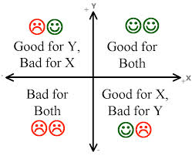
Increased Individual Competition…

Slide 34
Southern States Per Capita Income 1990-2012 (% Different from Nation Change)
U.S. Change 120.6% Inflation 73%
Source: bber, University of New Mexico

Slide 35
NC Per Capita Income Compared to U.S. 1990-2012
Source: bber, University of New Mexico

Slide 36
Southern States Real Personal Income Change 2011
U.S. Change 2.7%
Source: BLS, June 2013

Slide 37
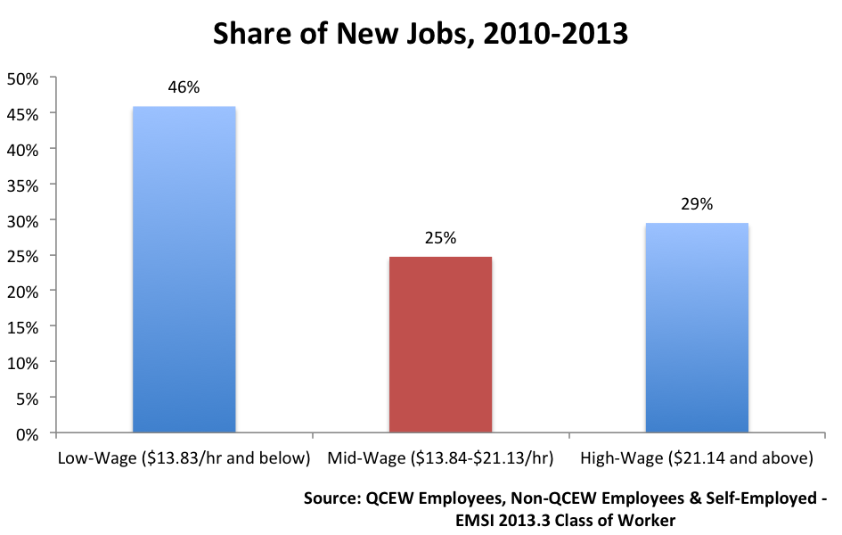
Source: Economicmodeling, Joshua Wright, Oct 3, 2013

Slide 38
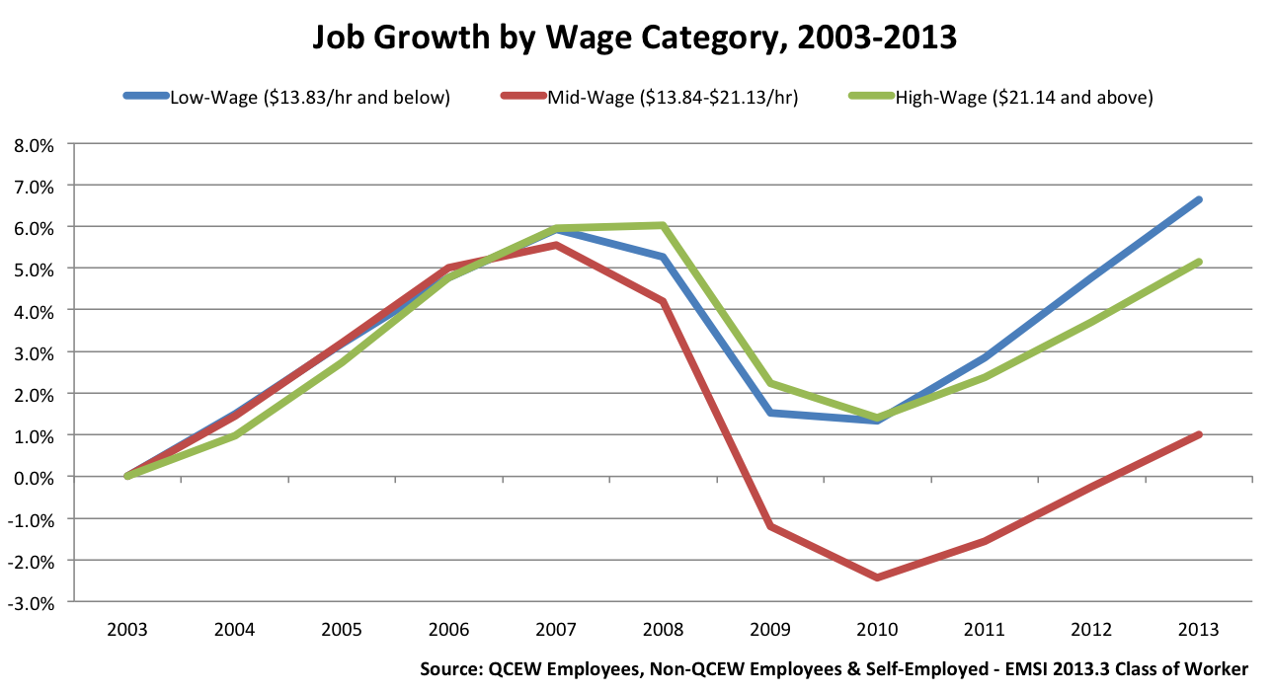
Source: Economicmodeling, Joshua Wright, Oct 3, 2013

Slide 39
Do We Have Enough Good Jobs?
¾ of job openings due to growth and replacement needs over the next 10 years will pay a median wage of less than $35,000/yr.
BLS’s top 3 occupational categories account for 1/3 of the workforce in 2010- 49 million jobs
Office & admin support ($30,710)
Sales and related occupations ($24,370)
Food preparation & serving ($18,770)
Source: Center for Working Class Studies, Jack Metzgar, 2012

Slide 40
Do We Have Enough Good Jobs?
Occupations projected to provide the largest number of new jobs
Child care workers ($19,300)
Personal care aides ($19,640)
Home health aides ($20,560)
Janitors and cleaners ($22,210)
Teacher’s assistants ($23,220)
Source: Center for Working Class Studies, Jack Metzgar, 2012

Slide 41
Southern States Percentage of New Jobs 2010-2013 Paying Middle Wage
Source: The Atlantic, Joshua Wright, Oct, 2013

Slide 42
U.S. Median Household Income
Source: Pew Research Center, 2013

Slide 43
Technology

Slide 44
McKinsey & Company Disruptive Technologies: May 2013
Energy
Mobile Internet
Advanced Materials
Next Generation Genomics
Robotics, Cloud, Digital-intel, 3D Printing

Slide 45
The Talent Bar

Slide 46
US Adults Years School Completed
In 1980, 32% had some college & 17% BA
In 2010, 56% some college & 30% BA

Slide 48
NORTH CAROLINA Department of Commerce
Commerce Tour and Survey 2013

Slide 49
Listening Tour Recap
By the numbers:
8 events
11 weeks
150+ social media mentions
1,100+ assessment surveys
1,000+ participants
1,920 miles traveled

Slide 50
Survey Recap – Top 3
What are you hearing about quality of workforce?
Employers have trouble finding the right technical skills
Employers have trouble finding people with soft skills
Employees have good skills but need retraining for specific job requirements

Slide 51
Survey Recap – Top 3
What is reason for skills gap between workers and available jobs?
Mismatch between what is being taught in K-12 and skills that employers say are necessary
Mismatch between what is being taught in higher ed and skills that employers say are necessary
Demographics – aging population with lack of new skills

Slide 52
Survey Recap – Top 5
What can the state do to help businesses in your region?
Invest more in local infrastructure
Invest more in education
Invest more in job training
Reduce government regulations
Provide more access to capital

Slide 53
Survey Recap – Top 5
What is most important role of state govt. to grow economy and create jobs?
Train and retrain workers
Provide incentives to attract companies
Aggressive marketing and branding
Provide technical assistance to help existing businesses grow
Provide capital to small businesses to help them grow

Slide 54
JOBS NORTH CAROLINA
North Carolina Economic Development Board Recommended Strategies for Economic Growth 2014-2024
Identify key growth industries & develop a brand strategy to maximize statewide growth for high quality, sustainable jobs.
Create a competitive business climate that drives job growth, retention & attraction in every sector of the economy statewide.
Promote innovation, attract early-stage investment and support entrepreneurs.
Attract the creative class and retiree population to North Carolina.
Develop and retain a globally competitive workforce with the knowledge and skills for high quality, sustainable North Carolina jobs.
Spread prosperity, jobs and investment to the rural areas of the state.
Develop programs that provide local communities with the opportunity to thrive.
Streamline economic, workforce and community development functions and measure the effectiveness of state development activities.

Slide 56
“ Leadership and learning are indispensable to each other.”
John F. Kennedy
ted@econleadership.com

