Slide 1
How to Read Body Language
Jerry Balistreri
M.S., M.Ed., ASTD Certified Trainer
(Copyright 2018)

Slide 2
Non-Verbal Communication Professional Uses
Are you good a “reading” people?
When in a meeting can you tell who is bored or wants to leave?

Slide 3
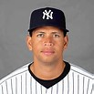
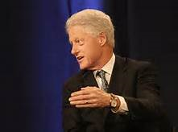
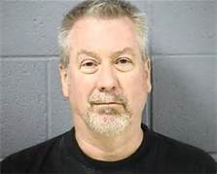
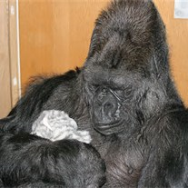
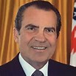
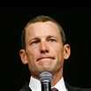
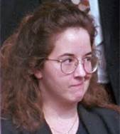
Professional Uses
Can you tell if someone is lying or being deceptive?
Koko & All Ball

Slide 4
Professional Uses
Can you read an interview applicant?
Can you tell if a client is displeased when negotiating a contract?

Slide 5
Non-Verbal Communication Personal Uses
Do you know what to look for if a date
is going well?

Slide 6
Personal Uses
You come home after curfew time and Mom is there to greet you. Can you tell her mood even before she speaks?

Slide 7
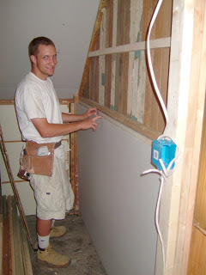
Personal Use
Would you like to know if a person you’re about to hire to come into your home to clean, care for an elderly parent,
or child is deceptive?

Slide 8
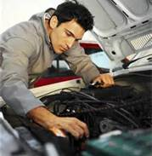
Personal Use
Would you like to know the next time the car repairman says you need to replace
an expensive part?

Slide 9
Objectives
Develop skills in reading non-verbal “tells”.
Understand the limbic system and its role in non-verbal communication.
Identify behavior indicators associated with tension, stress, fear and deception.
Identify the most honest part of the body.
Know how to detect deception.
My Goal

Slide 10
What Part of the Message … Mehrabian, Albert (1971) Silent Message, Wadsworth Publishing Co.

Slide 11
The Limbic System

Slide 12
The Limbic System Continued
It is considered to be the “honest brain” in the non-verbal world (Goleman, 1995, 13-29).
Consequently it gives off a true response to information in the immediate environment.
Why? It reacts instantaneously, real time, and without thought.
In the non-verbal world, the limbic brain is where the “action” is. Many, but not all, non-verbal responses come from here.
The remaining parts of the brain are the thinking and creative parts. These are the non-honest parts of the brain. The brain that can deceive and deceives often (Vrij, 2003, 1-17).

Slide 13
Base Lining
Definition:
Observing a person’s behavior when he or she is under normal, non-threatening circumstances.
When does base lining begin?
(Now - and it never stops)
Why is base lining important?
(When people deviate from their baseline, that is a red flag!)

Slide 14
Base Lining Continued
What to look & listen for:
Speaking tone (engage in chit chat)
Number of words/minute, and word flow
Eye blink rate (normal relaxed rate is 20/M)
Check for limbic reactions
Use of hands while speaking
Use of hands while listening
Where the person’s eyes are when asked a question
Where a person’s eyes are when answering a question
How expressive their face is
Etc.

Slide 15
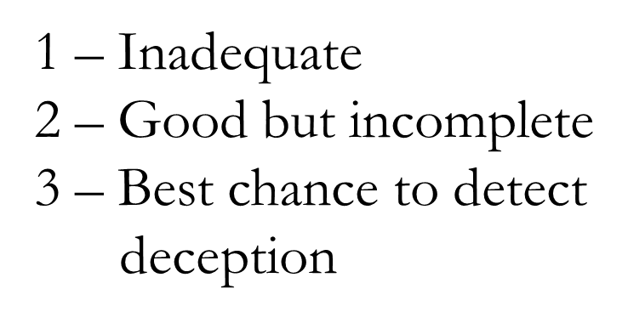
Detecting Deception & Lying Is a Three Pronged Approach

Slide 16
The Science of Lying
Why do people lie?
1. Help someone & make ourselves feel good. (pro-social lie)
Example – Answering, “Does this dress make my back side look big?”
2. Make ourselves look better while not hurting another. (self enhancement lie)
Example – I also have a Ph.D!
3. Personal benefit at the expense of another. (a selfish lie)
Examples – I can’t do this presentation because I have to take
my wife to the airport. Tax preparation.
4. Deliberately damage another. (anti-social lie)
Example – I saw Bob take the money.
Paul Ekman 2001
UC-San Francisco

Slide 17
The Science of Lying Continued
“For every lie told, two to three more must be invented to cover the tracks of the first lie.”
Scientific Content Analysis (SCAN) 1992
Liars must:
Remember the first lie
Create new lies that connect to the first lie
Have a great memory
Sound convincing without deceptive leakage
Truthful people do not have to go through those mental gymnastics!

Slide 18
Content & Structure
What creates content and structure?
YOUR QUESTIONS!
There is no such thing as a bad interviewee.
There are only bad interviewers. Questions
must be structured clear and concise, so there
is no room for the respondent to wiggle out
of.
Example: Do you know the location of the body?

Slide 19
Content & Structure Continued
That was a poorly stated question for the
following reasons:
1. What if an accomplice disposed of the body?
2. What if your suspect dumped the body in a river and the body is now miles downriver from the dump site?
Fraud related questions:
Where did you last see the ring before filing the claim?
What do you know about the fire?
How did you get injured?

Slide 20
Content & Structure Continued
What to look & listen for?
1. Didn’t answer the question.
Example:
Question - “Did you take the wallet?”
Response “Why would I take that wallet? I don’t need to steal, I make good money. I’m not the type of person that would steal.”

Slide 21
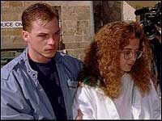
Content & Structure Continued
2. Changes in tenses and nouns.
Susan Smith, TV Appearance October 1994
“I just can't stress it enough that we -- we just got to get them home. We're -- that's just where they belong, with their mamma and daddy.”
Critical Review?
When a pronoun takes
the place of a noun, that’s
an indicator of deceit and
distancing. No first person
usage.

Slide 22
Areas To Look For “Tells”
Face
Hands & Fingers
Arms
Upper Body (chest, shoulders, etc.)
Lower Body (feet & legs)

Slide 23
Body Language
What to look and listen for:
1. Pacifying behaviors. (hands to face, neck, ears, suprasternal notch, etc.)
2. Any “blocking” maneuvers.
3. Question induced responses. (limbic)
4. Change from “baseline”. (breathing, sweating, dry mouth, voice pitch, etc.)
5. Speech errors. (enunciation, hesitations, etc.)
6. Create silent time between questions. (uncomfortable silent and watching induces more detail)
7. Observe the entire body but focus in on face and eyes. (knowing their eyes are being watched induces limbic reactions)
8. Subject asks for questions to be repeated. (thinking time, stalling)

Slide 24
Detecting Deception
Deception and/or lying initiates a stress reaction in most people. The stress is fear of being detected or caught. Stress can be further induced via guilt.
Nervous fingers
Eye contact shifting
Rigid and/or defensive posture
Sweaty palms and/or face
Variations in pitch, amplitude, and rate of speech
Abnormal speech hesitation and speech errors (thinking)
Increased embellishments of story or parts of the story
Inconsistency in story

Slide 25
Deception & Eye Direction

Slide 26
Putting It All Together
Science of Lying (Lied to benefit self, and harm others)
Content & Structure (word usage – tense, pronouns, contractions, etc.)
Body Language (no tears, eyes cast down, pacifying behaviors)

Slide 27
Let’s Practice – Pair & Share (Detecting Deception)
A Rod video

Slide 28
Deception Mastered

Slide 29
Bibliography
2008, Secrets of Body Language, History Channel.
Blair, J.P., Horvath, F. (1996). Detecting of Deception Accuracy Using the Verbal Component of the Behavior Analysis Interview Model, Michigan State University.
Cummings, S. (2008) Mystery at Bootleggers Cove, Dateline TV, NBC.
Ekman P. Telling Lies: Clues to Deceit in the Marketplace, Politics, and Marriage. New York, NY: WW Norton & Company; 2001.
Gallup Poll, Honesty &Ethics, 2012.
Goleman, D. (1995). Emotional Intelligence. New York: Bantam Books.
Lickley, Robin, Who Makes Better Liars, Queen Maragaret University.
Mehrabian, Albert (1971) Silent Messages, Wadsworth Publishing Co.

Slide 30
Bibliography Continued
Meyer. Pamela, (2010) Liespotting, New york, St. Martin’s Press.
Morris, D. (1985) Body Watching. New York; Crown Publishers.
Navarro, J. (2008). What Every Body Is Saying. HarperCollins Publishers.
Pearlman, G. (2007). How To Spot a Liar, The Palm Beach Times.
Smith, D, and Smith, S, Television Interview, 1994.
“The Reid Nine Steps of Interrogation, In Brief.” Practical Aspects of Interviewing and Interrogation. John Reid and Associates, Chicago, IL.
USA Today Poll,
Varsamis, C. (2005). How To Detect Liars In Your Business & Personal Life, Article Alley.
Vrij, A. (2003). Detecting Lies and Deceit: The psychology of lying and the implications for professional practice. Chichester, UK: John Wiley & Sons, Ltd.

Slide 31
Contact Information
Jerry Balistreri
(907) 830-5258
balis@acsalaska.net
www.readingthetells.com
I hope we learned something today?

