Slide 1

The Power of Fiscal Policies
Protecting Your Long-Term Fiscal Health
Financial Management Skills

Slide 2
Keys to Fiscal Success and Sustainability
Financial Management Skills
  Fiscal Policies
  Financial Planning
  Financial Reporting
And an essential fourth “soft skill”
  Public engagement and trust
With trust, anything is possible.
Without it, nothing is.
- Ken Hampian, Retired SLO City Manager

Slide 3

No Immunity from Business Cycles
But can modulate swings and improve recovery

Slide 4
Financial Sustainability
This is a journey, not a destination
  While plans and policies are key elements for success, flexibility and adaptability are our reliable friends on this journey.
  “Change-able” organizations will have the smoothest (although most likely still bumpy) ride.

Slide 5

The New Normal: Responding to Change
It is not the strongest of the species that survive, nor the most intelligent, but the ones most responsive to change.
  Charles Darwin

Slide 6

The Power of Policies
Good times come and go.
But your values shouldn’t.
  And that’s what fiscal policies are all about.

Slide 7
Plans and Policies
“Plans are nothing. Planning is everything.”
  Dwight D. Eisenhower
Plans are good.
  General Plans (and Elements)
  Facility Master Plans (Pavement, Parks, Bicycles, Water, Sewer)
  Long-Term Forecasts
  Multi-Year Budgets
    Operating and CIP
Policies are better.

Slide 8
Fiscal Health
… is a lot like your personal health —it’s not what you live for . . . . but it’s hard to enjoy your life without it.
And like personal health, fiscal health is rarely luck.

Slide 9
Fiscal Policies
The best way to ensure your long-term fiscal health.
  Local economy important
    And no one is immune from economic downturns.
  But not the most critical feature . . . financial management counts!
    Just Think: Orange County
Important in both good times and bad

Slide 10
When do fiscal challenges arise?
Roots of fiscal adversity for most governments take hold in the good times, by making commitments that are not sustainable
Rarely in the bad times, when most agencies act on the “First Rule of Holes”
  When you find yourself in one, stop digging.

Slide 11
Both Preventative and Curative
Clearly articulated policies help prevent problems from arising in the good times.
And help respond to bad times when they do occur.

Slide 12
Take on momentum of their own
What’s the most frequent answer to the question: “Why do we do it this way?”
Provide continuity as elected officials and staff change.
Most powerful when it put in place before the need for them arrives.

Slide 13
An Example of the Power of Policies
Fund Balance Survey: 1996

Slide 14
Plans Versus Policies
Plans change over time as actual results replace assumptions (like, as soon as the laser jet ink is dry).
But policies:
  Are your “north star” guiding preparation of plans.
  Help making tough decisions easier by telling you what your values are before they are put placed under stress by adverse circumstances.
  You might actually do something else, but they are a powerful starting point:
    But for “this,” I would do . . . what?

Slide 15
Fiscal Policies
No right answers.
Only right questions.

Slide 16
Basic Questions
Who prepares them?
Who approves them?
Who’s the audience?
How detailed should they be?
How often are they reviewed and updated?

Slide 17
Two Kinds of Fiscal Policies
High-Level Policies
  Adopted by the Council: set foundation for managing fiscal affairs.
    In San Luis Obispo: Included as an integral part of two-year Financial Plan and Budget.
    Reviewed at least every two years, but ongoing as needed.
Administrative Policies
  Set by City Manager or Finance & IT Director: implement “high-level” policies.

Slide 18
High-Level Policies
Balanced Budget (and what this means)
Multi-Year Budgets
Staff vs Council Budget Authority
Revenue Management
User Fees
Enterprise Funds:
  Do they subsidize the General Fund?
  Does the General Fund subsidize them?
Financial Reporting
Revenue Earmarking
Investments
Appropriations Limit
Minimum Fund Balance
CIP Management
Capital Financing & Debt Management
Human Resources
Contracting-Out
Productivity

Slide 19
Administrative Policies
Financial Management
  Purchasing System
  Standard Bid and Proposal Documents
  Construction Contract Change Orders
  Travel Guidelines
  Budget Amendments
  Accounting for Completed CIP Projects
  Disaster Accounting
Revenue Management
  Cash Management
  Accounts Receivable Delinquency Account Management
  Labor Rates
  Current City Fees
  Master Fee Schedule Resolution

Slide 20
Where to Start
What other agencies do: using benchmarks
What credit rating agencies recommend
GFOA Best Practices

Slide 21
Where to Start? Other Agencies
Five key components for effective benchmarking
  Establish benchmarks
  Identify benchmark group
  Collect data
  Analyze current position
  Incorporate findings into policies
Example: Debt Management Policy

Slide 22
Debt Management Benchmarking
What debt should be included?
What indicators should be used?
  Amount of outstanding debt?
  Annual debt service?
How to develop an effective benchmark group?

Slide 23
❶ What debt should be included?
General obligation debt only?
All tax-secured debt? (short-term notes, special tax, “moral obligations,” tax increment bonds)
Revenue bonds? (water, sewer, power, airports, harbors, parking, golf)
Capital lease debt? (COPs, lease-revenue bonds, lease-purchase agreements)
Pension obligation bonds?

Slide 24
❷ What indicators to use?
Outstanding Debt Indicators
  Net direct debt as % of assessed value or fair value market value
  Net direct debt per capita
  Net direct debt as % of personal income per capita
  Net direct and overlapping debt per capita
  Rate of repayment
    % of principal within 5 years
    % of principal within 10 years
    % of principal within 10 years

Slide 25
❷ What indicators to use?
Annual Debt Service Indicators
  Debt service per capita
  Debt service per capita as % of personal income per capita
  Debt service as % of General Fund revenues
  Debt service as % of operating expenditures
  Debt service as % of property tax revenue

Slide 26
❸ Developing the benchmark group
Similarity based on key criteria
  Form of government
  Population size
  Demographics: age, income
  Geography and weather
  Economy
  Community characteristics: Central City? Suburb? Rural?
  Revenue mix and diversity
  Scope of services delivered

Slide 27
Using Per Capita Comparisons
Simple per capita tempting, but every city has a different story to tell due to:
  Service level expectations
  Daytime versus resident service population
  Fiscal constraints
  Community demographics
  Geography
While imperfect, “per capita” is often the most workable common denominator.
This means using benchmark agencies that are similar.

Slide 28
City of SLO Example: Picking Benchmark Cities
General Criteria
  Full service cities
  County seat (or “big” city for their area)
  Distinct regional identity
  Major employment, commercial, cultural and government centers for their area
  “Quality of life” community
  Midsize cities: populations range from 30,000 to 100,000
And share one or more of the following characteristics
  Coastal
  College town
  Tourism is an important part of the city’s economy
Davis, Monterey, Napa, Palm Springs, Santa Barbara, Santa Cruz, Ventura
Santa Maria

Slide 29
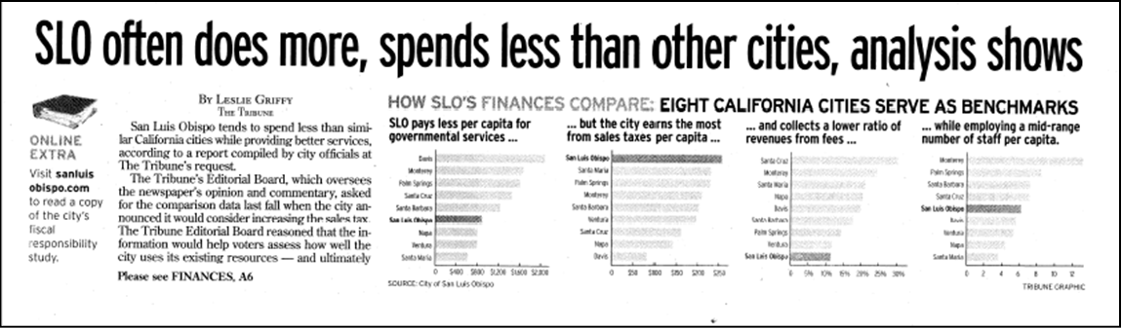
Pretty cool result …

Slide 30
Structured Approach Example
City of Capitola
  Population between 3,500 and 25,000
  “Sense of place/quality of life” community
  Coastal location
  Tourism important (but not large) part of economy
  Similar scope of services (“hybrid delivery”)
    Provides police and parks & recreation
    Does not provide fire, library or enterprise services like water, sewer, transit, harbors or airports
  Reputation for being well-managed/well-governed

Slide 31
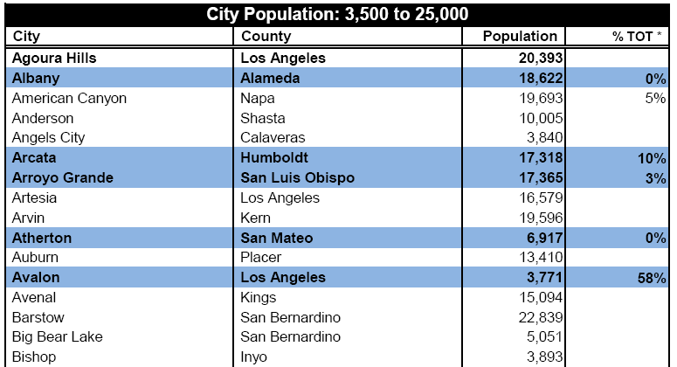
Step 1: Population, Location, Tourism

Slide 32
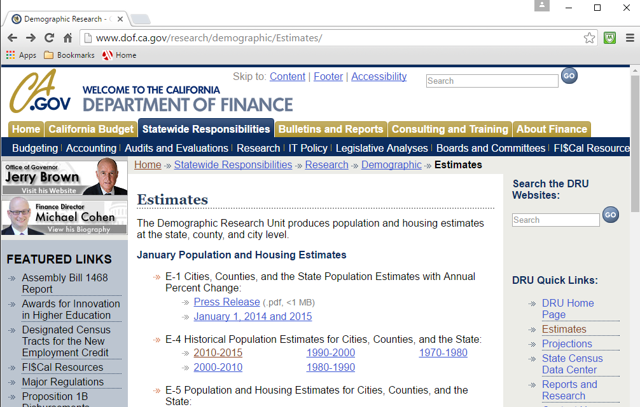
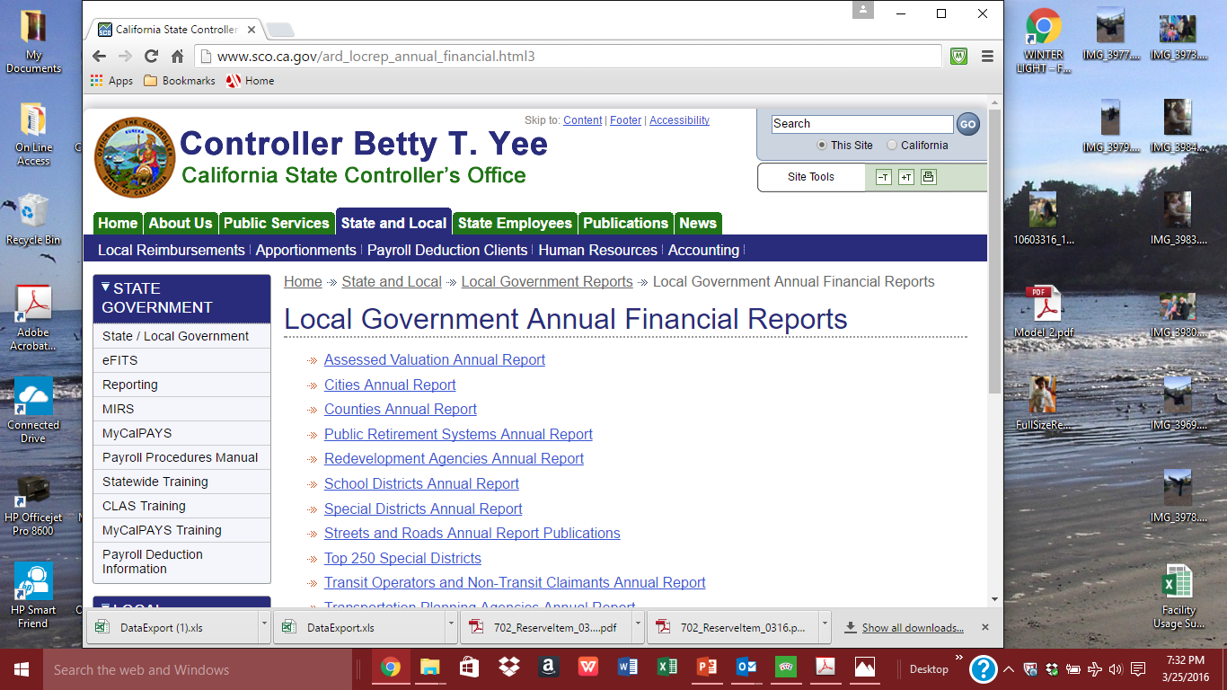
State of California Resources
Demographic Research Unit
  http://www.dof.ca.gov/research/demographic/Estimates
State Controller’s Reports
  http://www.sco.ca.gov/ard_locrep_annual_financial.html

Slide 33
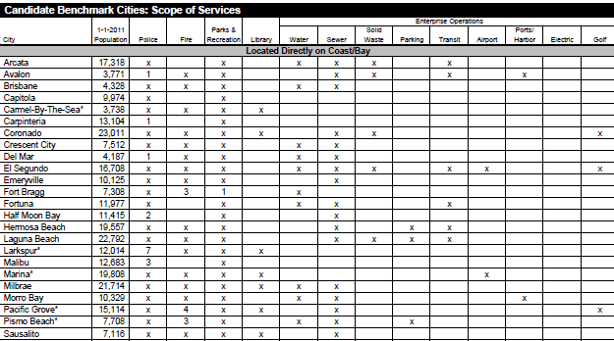
Step 2: Service Scope

Slide 34
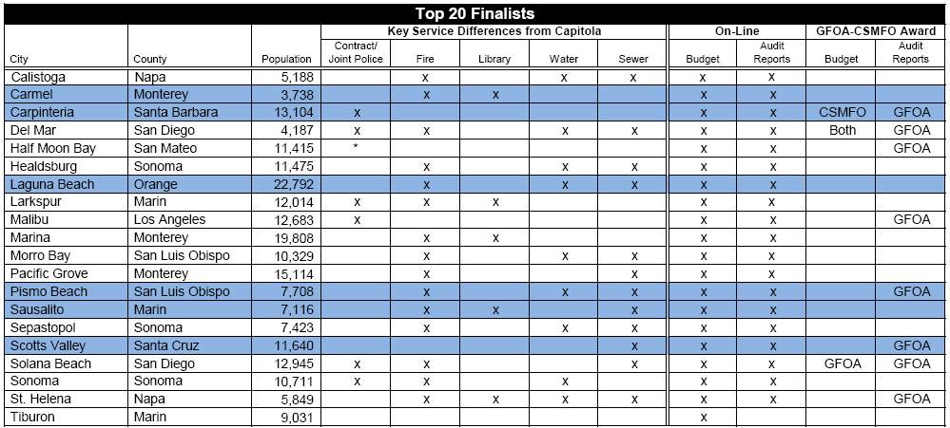
Step 3. Finalists

Slide 35
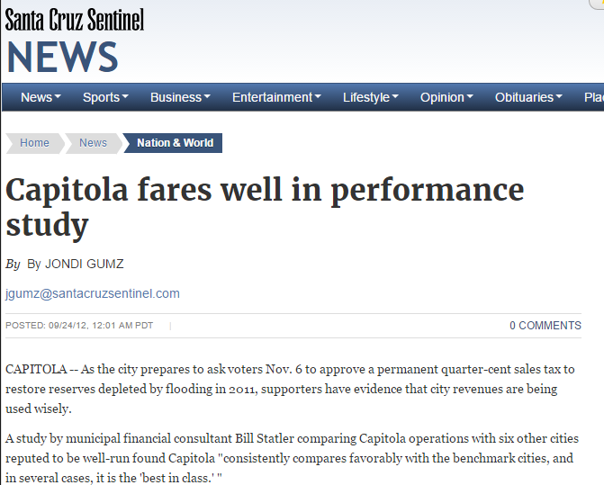
Pretty cool result in Capitola, too …

Slide 36
Conduct Benchmark Analysis
Review most recent CAFR from benchmark agencies
  Likely to include most (if not all) of the needed information
Develop indicators for your agency and the benchmark group
Calculate group mean and/or median based on key indicators
Evaluate the rank/position of your agency to the benchmark group median/mean
  High? low? Goldilocks?

Slide 37
Sample Net Direct Debt Per Capita

Slide 38
Sample Annual Debt Service as % of Revenues

Slide 39
Incorporate into Financial Policies
Where do you want to be relative to benchmark?
  For example, debt service as a percentage of general fund revenue. (This ratio measures the extent to which debt service requirements potentially limit budgetary flexibility.)
    Debt service should not exceed 8% of general fund revenue.

Slide 40
A Few Caveats
Peer group results are static, while values and fiscal condition for agency are not; this can be dealt with by frequently updating the peer group analysis.
  Analysis should be updated annually, or each time jurisdiction goes to market.
Peer analysis is time-consuming and cumbersome.
  Most peers have some uniqueness: police, parks, fire, libraries, utilities either being or not being directly provided.
  So, who does this?
Do you want others driving your financial future?
Be informed by what others are doing but not driven by it.

Slide 41
Rating Agency Guidelines
Ratio of net direct debt to property market value exceeds 6%
Debt retirement is less than 25% in five years and/or 50% in ten years
Net direct debt per capita exceeds $2,500
Ratio of debt service to General Fund revenues exceeds 10% (for cities and counties)

Slide 42
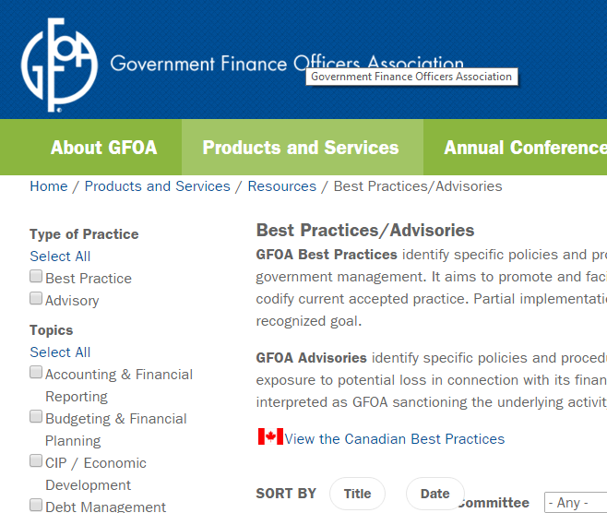
GFOA Best Practices
www.gfoa.org/best-practices

Slide 43
Presentation Focus: High-Level Policies
Preparing and Responding to Downturns
  Budget Purpose, Organization and Administration
  Balanced Budget
  Productivity (Doing More with Less)
  Capital Financing & Debt Management
  Interfund Transactions
  User Fee Cost Recovery
  Financial Reporting
  Minimum Fund Balance

Slide 44
❶ Budget Purpose
Identify community needs for essential services.
Organize programs required to provide these essential services.
Establish program policies and goals that define nature and level of program services provided.
Identify activities performed in delivering program services.
Propose objectives for improving service delivery.
Identify and appropriate resources required to perform program activities and accomplish program objectives.
Set standards to measure and evaluate:
  Output of program activities.
  Accomplishment of program objectives.
  Expenditure of program appropriations.
Link the most important things to accomplish for community with resources needed to do them

Slide 45
Budget Time Frame
Two-Year Budget
  Reinforce importance of long-range planning in managing City's fiscal affairs.
  Concentrate on developing and budgeting for accomplishment of significant objectives.
  Set realistic timeframes for achieving objectives.
  Create pro-active budget that provides for stable operations and assures City's long-term fiscal health.
  Reduce amount of time and resources allocated to preparing annual budgets.
  Promote more orderly spending patterns.
Operating Budget Carryover
  Operating appropriations not spent during first fiscal year may be carried over into the second fiscal year with approval of City Manager.

Slide 46
Budget Administration
Elected Officials: Council may amend or supplement the budget at any time after its adoption by majority vote of the Council members.
Staff: City Manager has the authority to make administrative adjustments to the budget as long as those changes will not have a significant policy impact nor affect budgeted year-end fund balances.

Slide 47
❷ Balanced Budget
Operating revenues must fully cover operating costs.
Ending fund balance (or working capital) must meet minimum policy levels.
This means beginning fund balance can be used – total expenditures can exceed revenue – but only for CIP projects or other “one-time” uses

Slide 48


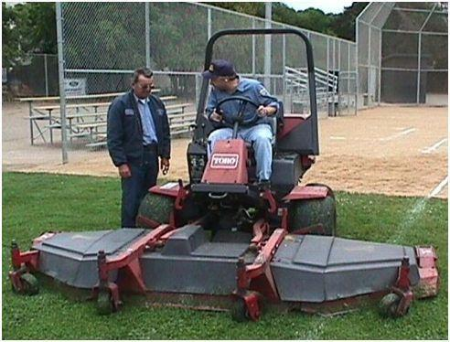




❸ Productivity
Organizational Vitality
Contracting-Out

Slide 49
Contracting-Out: General Policy Guidelines
Contracting with private sector provides City with significant opportunity for cost containment and productivity enhancements.
  So committed to using private sector in delivering services as key element in continuing efforts to provide cost-effective programs.
Private sector contracting includes construction projects, professional services, outside employment agencies and ongoing operating and maintenance services.
Direct, indirect and contract administration considered in comparing costs of private sector contracts with in-house delivery.
Conversions from services currently provided by City employees to contract services will generally be made through attrition, reassignment or absorption by the contractor.
Within general policy guidelines, cost-effectiveness of contract services determined on a case-by-case basis using following criteria

Slide 50
Contracting-Out: Evaluation Criteria
Sufficient private sector market to competitively deliver service and assure reasonable range of alternative service providers?
What are consequences if contractor fails to perform?
  Can contract reasonably be written to compensate the City for any such damages?
Private sector contractor better respond to service expansions, contractions or special requirements?
Can sufficiently define workscope to ensure fair and full evaluation of competing proposals and performance after bid award?
Use of contract services provide opportunity to redefine service levels?
Contracting-out limit ability to deliver emergency or other high priority services?
Overall, can City successfully delegate the performance of service but still retain accountability/ responsibility for delivery?

Slide 51
❹ Capital Financing & Debt Management
Conceptually, no different than personal debt management.
  Long-term, non-recurring costs.
  Not for routine, day-to-day costs.
    Balanced Budget: Do not use debt to cover operating costs. (Mortgages are fine for houses – but not for groceries.)
    How obvious is this? Ask the State or Feds . . .
  Limited capacity.

Slide 52
How much debt can you afford?
“Any idiot can borrow money. The genius part is being able to pay it back.”
  John Dunn, Former SLO City Manager

Slide 53
General Guidelines
Capital financing: Clear bias towards pay-as-you-go
Only consider debt financing when:
  One-time project (lumpy cost)
  High priority project
  Useful life exceeds financing term
  Adequate resources to cover debt service
  Not for recurring purposes or ongoing maintenance
    Exception: Tax and Revenue Anticipation Notes

Slide 54
Tax and Revenue Anticipation Notes
Will only issue to meet legitimate cash flow needs.
Will not use for investment purposes.
Unlikely to need as long as we maintain minimum fund balance policy.

Slide 55
Source of Funding
Whenever specific beneficiaries can be identified use:
  Service fees
  Enterprise funds
  Assessments
  Developer agreements
  Development impact fees
    Consideration: timing and cash flow
  General purpose debt supported by General Fund revenues is “last resort.”

Slide 56
Criteria
Factors Favoring Pay-As-You-Go
  Current sources are adequate and available.
  Current debt is too high.
  Market conditions are not favorable.
  Ongoing capital maintenance: It isn’t a “lumpy” cost.

Slide 57
Criteria
Factors Favoring Debt Financing
  Long-term revenues are adequate to support debt service costs.
  Project will support investment grade credit rating.
  Favorable market conditions.
  Project required by federal or state government, and current sources are inadequate.
  High-priority project that is needed immediately to address capacity, and current sources are inadequate.
  Life of project or asset is ten years or longer.

Slide 58
Intergenerational Equity
One factor not included in the City’s criteria others may want to consider that can favor debt financing: intergenerational equity.
Spreading costs over time helps ensure that those who benefit from long-lived improvements help pay for them.

Slide 59
Debt Management
Avoid obligating the General Fund.
Prepare internal feasibility analysis for each issue: impact on current and future budgets and City services.
General bias: Conduct financings on competitive basis.
Seek investment grade ratings.
Review debt as part of budget process.
Diligently monitor compliance with covenants and regulations.
Maintain good ongoing communication with rating agencies.

Slide 60
Refundings
Standard rule of thumb is to achieve present value savings of 3% to 5% of refunded bond issue.
  You can only do one “advance refunding;” make it count.
  Higher savings appropriate if period to call is long.
  Restructuring opportunity?
  Yield curve management.
San Luis Obispo
  Consider at 3%.
    Compelling public purpose if less than 3%.
  Do at 5%.
Notes:
Brodsly

Slide 61
Debt Capacity: General Fund
Debt capacity is limited, so make it count:
  Funds borrowed for a project today can’t be used for other projects tomorrow.
  Funds committed for debt repayment today can’t be used to fund services tomorrow.

Slide 62
Debt Capacity: General Fund
Determining “capacity” is an art not a science.
You can probably borrow as much as you want, but with:
  Deteriorating credit.
  Increasing interest rates.
  Adverse impacts on future service levels.

Slide 63
Debt Capacity: General Fund
Guidelines
  Annual debt service should not exceed 10% of operating revenues; and never exceed 15%.
  Total direct debt should not exceed 2% of assessed value.
  No more than 60% of four-year CIP will be funded from long-term debt.

Slide 64
Debt Capacity: Enterprise Funds
Whatever we’re willing to set rates at to fully cover cost of operations, maintenance, CIP, administrative (including indirect costs) and debt service (including any coverage requirements).
  Needed rate increases approved before issuing debt.
Political, real-world considerations
  Rates already perceived as too high.
  Rate structure viewed as unfair: who pays the higher cost?

Slide 65
Limited Liability Financings
Land-Based Financings
  Clear Public Purpose
  Active Role by City
  Applicant Credit Quality
  Reserve Fund
  Capitalized Interest
  Value-to-Lien Ratio
    4:1
    3:1 in exceptional circumstances
  Maximum Burden
  Disclosure to Bond Holders and Prospective Owners
Conduit Financings
  What’s the compelling public purpose?
  Is the applicant capable of achieving it?
  What’s the City’s liability?
  Typically two-step process

Slide 66
❺ Interfund Transactions
General Policy
  Funds Should Count: Create only when compelling need to segregate resources
  And if there’s need for segregation, interfund transactions should be limited
Transfers vs Loans
  Transfers
    Resources transferred from one fund to another
    Increases equity in one fund and reduces it in another
    Only occurs pursuant to adopted budget
  Loans
    Temporary borrowing for cash flow purposes
    Does not result in equity changes between funds

Slide 67
Interfund Loan Criteria
Finance & IT Director can approve temporary interfund borrowing for cash flow where short-fall resolution expected within 45 days (like CDBG Fund)
Other borrowings for temporary cash flow approved by Council on case-by-case basis (like Transit Fund)
Transfers between funds where reimbursement is not expected within one fiscal year not recorded as interfund borrowings
  Recorded as transfers that affect equity by moving financial resources from one fund to another.

Slide 68
❻ User Fee Cost Recovery
Why is this important?
  Proposition 218 made sweeping changes in the way that cities manage and control their revenues.
  New standards for voter or property owner approval of
    Assessments.
    Taxes.
    And many (but not all) fees.

Slide 70
So, Take a Close Look
One of the few remaining areas for local elected official judgment.
  And if there are areas where user fees should appropriately fund service costs – but they aren’t – then general-purpose revenues are being used instead.

Slide 71
User Fee Cost Recovery
Key Policy Questions
  What does it cost the City to provide various services?
  Are these costs reasonable?
  What are current cost recovery levels?
  What should the cost recovery level be?
  What fee changes are necessary to implement the City’s cost recovery policies?

Slide 72
Ultimately, A Policy Question
Not a cost accounting one
If services fees are not assessed where they legitimately could be, then general purpose revenues are making-up the difference.
The direct consequence of this is lower levels of service (and in tough times, deeper cuts) in essential programs that have no significant user fee potential, such as police, fire, streets, libraries and parks.

Slide 73
User Fee Cost Recovery
Taxes vs Fees in Financing General Fund Services
  Community-wide vs special benefit.
  Service recipient vs service driver.
  Effect of pricing on services.
  Feasibility of collection and recovery.

Slide 74
User Fee Cost Recovery
General Concepts
  Revenues should not exceed cost.
  Fees based on total cost: direct, indirect, use of facilities.
  Simple assessments and collections.
  Rates sensitive to “market” and smaller, infrequent users.
  Unified, consistent approach.
  Ongoing updates.

Slide 75
User Fee Cost Recovery
Low Cost Recovery
  No intended relationship between payment and benefit
  Collecting fees not practical
  No intent to limit use
  Non-recurring, “peak-demand” service
  Encourage compliance
High Cost Recovery
  Similar to private sector services
  Other service options in-place
  Want a relationship between cost and use (demand management)
  Discourage use
  Recover high regulatory costs

Slide 76
User Fee Cost Recovery
Low Cost Recovery Services
  Delivering public safety emergency response services.
  Maintaining and developing public facilities that are provided on a uniform community-wide basis such as streets and parks.
  Providing social service and economic development programs.
These are what “taxes” pay for.

Slide 77
User Fee Cost Recovery
Recreation Programs
  Directed to adults: relatively high.
  Directed to youth and seniors: relatively low.
  Similar to private sector services: relatively high.

Slide 78
User Fee Cost Recovery
Development Review
  Generally 100% for planning, building & safety, engineering and fire
  Notable exceptions
    Appeal fees
    Low and moderate income housing

Slide 79
User Fee Cost Recovery
Comparability with Other Communities
  Should generally play small role in setting City fees:
    What is their cost recovery goal?
    What costs are considered?
    When did they last look at fees?
    What is their service level?
    What is their rate structure?

Slide 80
Related Issues
Ongoing Updates:
What’s Your Strategy?
  San Luis Obispo prepares comprehensive “cost of services study” every five years, with automatic CPI adjustments in the interim.
Indirect Cost Allocation Plan
  Just because they are “indirect” doesn’t mean they aren’t real.

Slide 81
Timing Is Everything
When do you set policies and do fee studies?
  Policies: Before fee study or as part of it?
  Fee Studies:
    Outside of the budget process, where they can be “dispassionately” viewed on their own philosophical merits?
    Integral part of the budget process, so that the resource trade-offs between setting user fees at an appropriate level versus the ability to fund high-priority initiatives are clear?
    This message may be easier to communicate when the real-world benefits are clear and compelling.

Slide 82
Enterprise Fund Rates and Fees
Full Cost Recovery: Operating (including indirect costs), Capital and Debt Service
  Water, Sewer, Parking
Full Cost Recovery Through Grants and Fees
  Transit
High Cost Recovery
  Golf

Slide 83
❼ Financial Reporting
Annual Reports
  Strive for “unqualified” auditors’ opinion
  Use “GAAP”
  Meet GFOA “excellence” criteria
  Issue within 180 days
Interim Reports
  Timely, accurate
  On-line access “24/7”
  Monthly
  Quarterly
  Focused
    Sales tax
    TOT
    Investments
  Mid-year review
  Interim annual reports

Slide 84
Presenting the Results
Timely, accurate data
is important, but . . .
  What’s it mean?
  What should you do about it? . . . . . . and why?
8 Tips on Telling Your Fiscal Story

Slide 85
❶ Pareto Principle
Find the fewest things that explain the most amount of stuff.

Slide 86
❷ Ask Why to the Fifth Level
“Before we try to explain something, we should be sure it actually happened.”
- Ray Hyman
“It ain’t what you don’t know that will get you in trouble. It’s what you know for sure that just ain’t so.”
- Mark Twain

Slide 87
❸ Zen Data
Data has no meaning unless placed in some context, usually in comparison with something else:
  Others
  Time
  Expectation

Slide 88
Comparisons with Others

Slide 89
Comparisons with Others

Slide 90
Comparisons with Others

Slide 91
Comparisons with Others

Slide 92
Comparisons with Others

Slide 93
Time Series Example

Slide 97
Trend Data: In Relation to What?
Increase in service demand?
  Population?
Increase in costs?
  City costs?
  External index (like CPI)?

Slide 103
Quick Examples of Using Pie Charts and Bar Graphs
Other than for just financial stuff

Slide 104
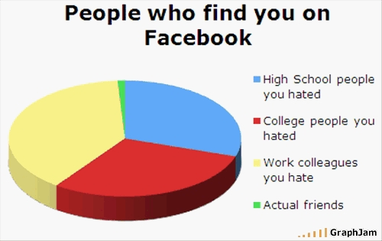

Slide 105
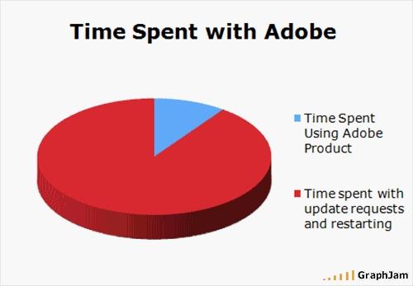

Slide 106
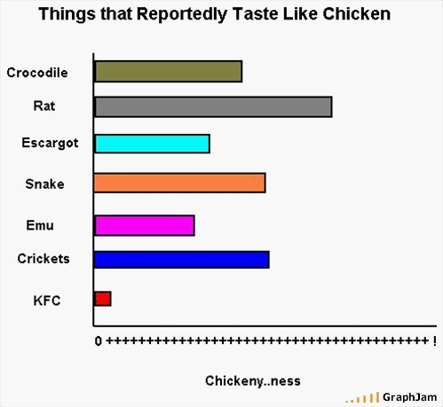

Slide 107
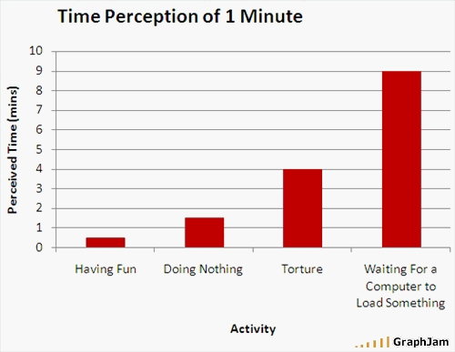

Slide 108
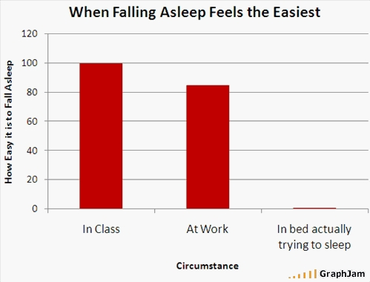

Slide 109
Variance Analysis
What did you expect?
  How does the actual result compare with what you expected?
  Why is it different?
  What’s it mean?

Slide 110
Variance Analysis
* Includes encumbrances of $571,000.

Slide 111
Variance Analysis
* Includes encumbrances of $571,000.

Slide 112
Or …
* Includes encumbrances of $571,000.

Slide 113
Variance Analysis

Slide 114
Variance Analysis

Slide 115
Variance Analysis

Slide 116
❹ Results Aren’t What You Expected
Always assume you're right and the data's wrong.
  See No. 2 for what to do if the data’s right.

Slide 117

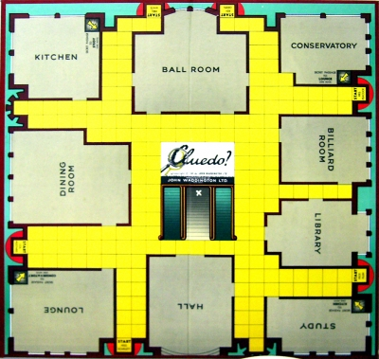


Financial reports and mystery novels

Slide 118
❺ The Data Triangle
❒
Three Chapters in
Your Fiscal Story
Narrative
  Short, punchy
  What’s it mean?
Summary Charts
  The fewest things that explain the most stuff
Raw Data
  Timely, accurate
  Exhibit or “on file”

Slide 119
❻ There’s no good news or bad news
Only unexpected news

Slide 120
❼ Tell your story (in a compelling way)
Know the fiscal story you want to tell.
  And tell that one.
    What’s the plot?
    Who are the characters?
    Why do we care what happens to them?
    What’s the moral?

Slide 121
❽ Communicating Complex Numbers
Don’t communicate complex numbers.
  Communicate what they mean.

Slide 122
CAFR’s are good but …
Sometimes too comprehensive
  Introduction: 20 pages
  Opinion, basic statements: 27 pages
  Notes: 24 pages
  RSI: 7 pages
  Supplemental schedules: 26 pages
  Statistical section: 31 pages
  Total: 135 pages
Solution?
  Great transmittal memo that focuses on key issues—and where you’re at financially (in ways you actually care about).

Slide 123
Transmittal Memo & MD&A
Formal Transmittal
  Legal requirements
  Management’s responsibility
  Internal controls
  Audit requirements
  Reference to MD&A
Government Profile
  Description
  Services provided by the City and others
  Geography, population, history
  Reporting entity
  Budget policy, control and process
  Other key policies (purchasing, personnel, interim reporting)
“Useful Information”
  Local economy
  Long-term financial planning
  Significant projects
  Cash management and investments
  Risk management
  Debt financing
  Pension programs
Awards
Acknowledgements
MD&A
General Fund Budget and Actual: Page 29

Slide 124
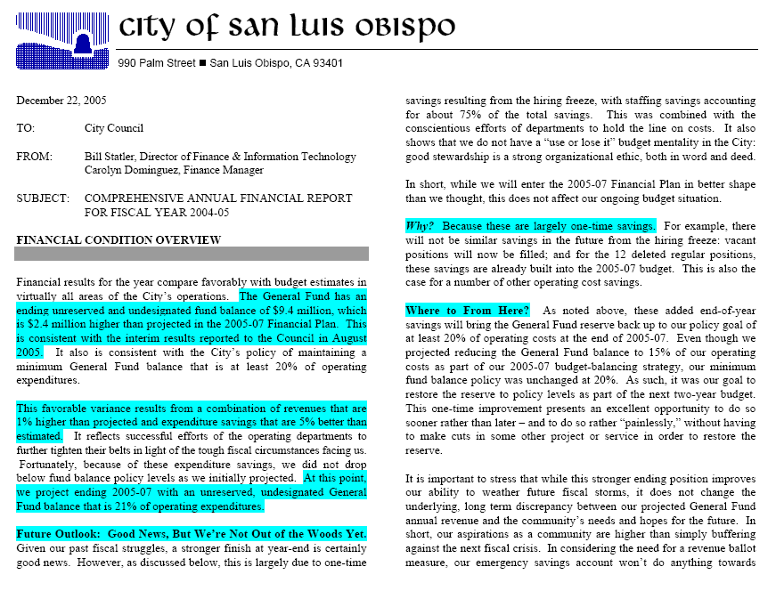

Slide 125
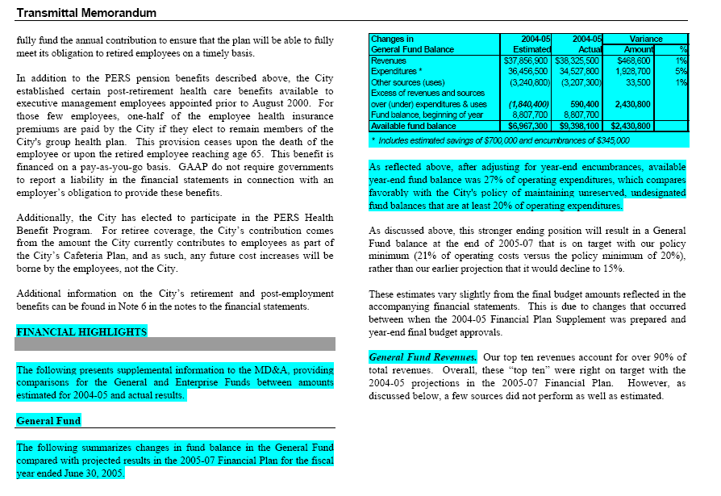

Slide 126
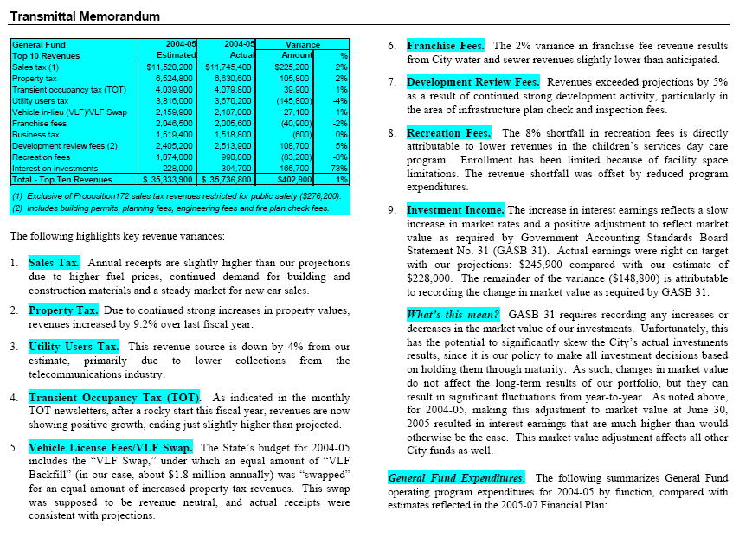

Slide 127
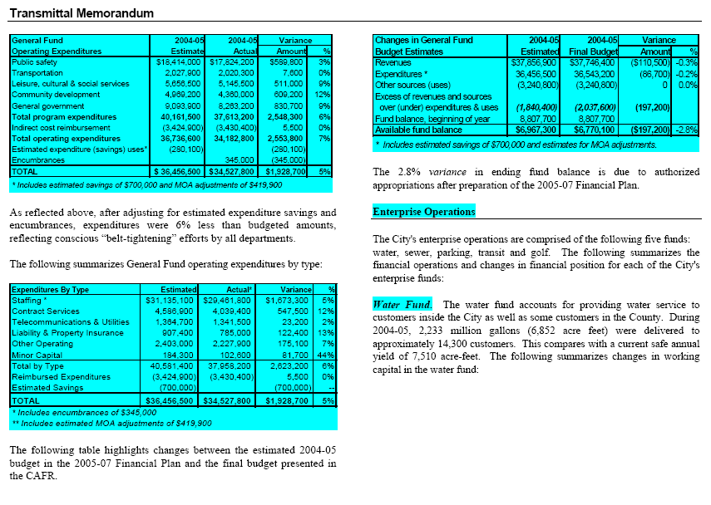

Slide 128
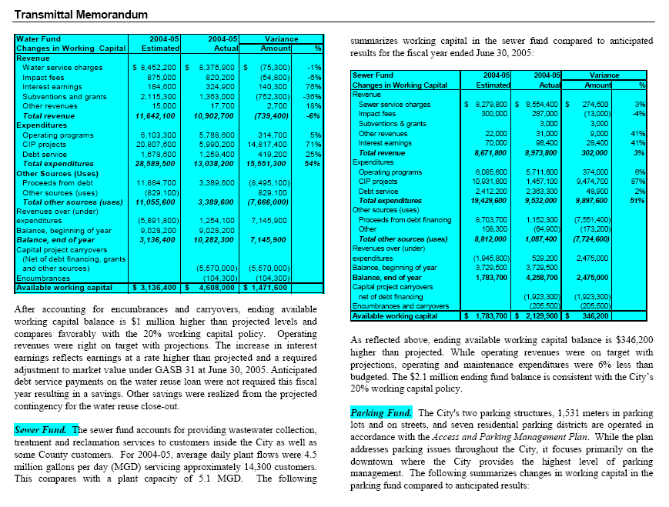

Slide 129
Interim Financial Reporting
No “guidelines” for this.
  No “awards.”
But more important than annual reports.

Slide 130
Interim Financial Reporting
Types
  On-Line “24/7”
  Monthly
  Quarterly
  Special Ad Hoc Reports
  Mid-Year Budget Review
  Budget
Who are they for?
Remember to ask me who I did this for

Slide 131
Monitoring Fiscal Performance
Core Principles in San Luis Obispo
  Strong Systems
  Meaningful Reports
  Timely, Open Reporting
  Audience
  Organizational Responsibility
    Revenues: Finance & IT
    Expenditures: Departments

Slide 132
Quarterly
Financial
Report
Page 1

Slide 133
Quarterly
Financial
Report
Page 2

Slide 134
Interim Year
End Report
Page 1

Slide 135
Interim Year
End Report
Page 2

Slide 136
Interim Year
End Report
Page 3

Slide 137
Quarterly
Sales Tax
Newsletter

Slide 138
Monthly
TOT
Report

Slide 139
Monthly
Investment Report

Slide 140
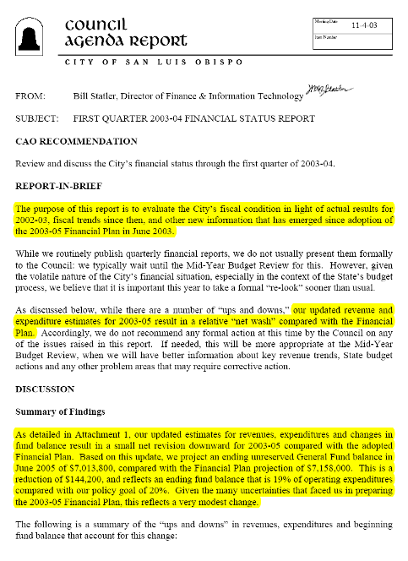
Formal First Quarter Status Report
Don’t usually do this.

Slide 141
Again in
2008

Slide 142
And Again in
2009

Slide 143
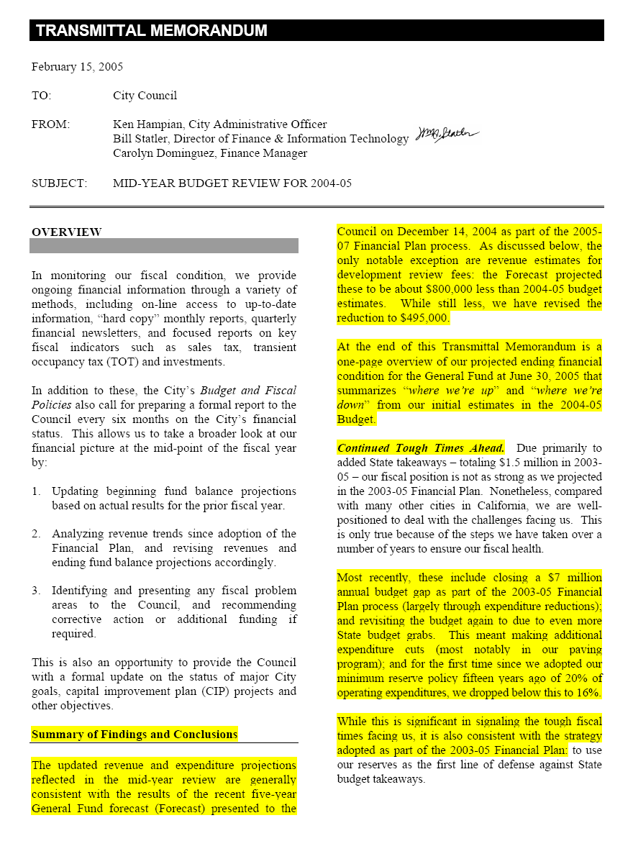
Mid-Year Budget Review

Slide 144
Ups & Downs Summary

Slide 145
Special Reports
Quarterly “Budget Review Team” briefings with City Manager
Year-end expenditure reports by each department
  Compare budget with actual by program and by type.
  Identify reasons for any significant budget overages or underages and analyze their impact on future operating budgets
    Are the variances one-time in nature or will they continue into the foreseeable future?
    If the variances reflect continuing trends, are they reflected in current budgets?
  Comparing operating budget versus actual for the department by program.
  Compare operating expenditures budget versus actual for the department by type.
  Year One Only: Itemizes multi-year carryover amounts and requested general carryover balances.
  Finance & IT prepares summary report.

Slide 146
Year-End Expenditure Report Summary

Slide 147
Fiscal Story Telling Recap
Find fewest things that explain the most amount of stuff.
Ask "why" to the fifth level.
Data only has meaning in context of something else, such as comparisons with others, over time or what you expected.
When results aren't what you expected, always assume you're right and the data's wrong.
The "Data Triangle.“
  Colonel Mustard in the study with a knife
There’s no good news or bad news: just unexpected news
Know the fiscal story you want to tell.
  And tell that one.
Don’t communicate complex numbers
  Communicate what they mean.

Slide 148
❽ Minimum Fund Balance
Why is this important?
  Economic uncertainties
    Local disasters
    Downturns in the economy
    External revenue hits (State takeaways)
  Contingencies for unforeseen operating or capital needs
  Cash flow
What’s the right amount?
  Depends on your unique fiscal circumstances and capacity for risk

Slide 149
Minimum Fund Balance
Ultimately a risk management tool
  How much can things go differently than you thought they would before you have to take corrective action?
  Bridge to the Future: Provides time to develop and implement thoughtful solutions.

Slide 150
San Luis Obispo
20% of Operating Expenditures
  General Fund
  Water Fund
  Sewer Fund
  Parking Fund
Fleet Replacement
Other Policy Designations

Slide 151
When do you use “the minimum?”
Rainy day fund – so must be appropriate to use when it rains
unexpectedly
When is that?
  One-time use
    Forecast shows short-term gap
    Unexpected expenditure or revenue shortfall
  Forecast shows structural gap
    Strategic bridge to the future
Recommend including “when” in the policy

Slide 152
When you shouldn’t …
For rainy days that can be reasonably expected
Avoid use for long-term gap-closing strategies
  Actual is invariably worse the forecast
  Sooner you get to the bottom the sooner you can begin re-building
    Five-year rebuilding plan or five-year “death by a thousand cuts” program?

Slide 153
Setting the Reserve Target
GFOA has developed structured approach in setting minimum reserve targets that assesses risks based on eight factors
Vulnerability to extreme events and public safety concerns
Revenue source stability/volatility
Expenditure volatility
Unfunded liabilities
Liquidity (cash flow)
Dependent funds
Growth/new development
Unfunded high priority capital projects
www.gfoa.org/financialpolicies

Slide 154
Putting Policies in Place
Incremental or big bang?
  City of Bell strategy
When? (Timing is usually everything)
  Ahead of the power curve is better than crisis du jour: key value is articulating values before they are placed under stress
Meaningful engagement by staff
Study session
  Budget season kick-off
General Observation: Elected officials are hungry for this (and city managers, county CAO’s and general managers should be, too.)

Slide 155
Policy Versus Actual
Set policies based on where you want to be – which may not be where you are today.
  Clearly stating where your agency wants to be (versus where it may be today) significantly enhances your ability to get there.
Consider following each policy with a brief “compliance status”
  In compliance
  In progress: what’s the plan for getting there?

Slide 156
City of Bell Example
Based on GFOA structured methodology, recommended minimum General Fund “unassigned” fund balance of 25% of operating expenditures
  12% at the time

Slide 157
Restoration Policy
Restore to policy level within 5 years
As revenues improve, 50/50 split between services and reserve restoration

Slide 158

Important Fiscal Management Policies
Very Significant
  Fund balance policy
  Debt affordability policy
Significant
  Pay-as-you-go capital financing
  Multi-year forecasting
  Quarterly reporting
  Quick debt retirement
Influential
  Contingency plans
  Non-recurring revenue policy
  Depreciation of fixed assets (GASB 34 implementation)
  5 Year CIP integrating operating cost impacts
  GFOA financial reporting award
  GFOA budgeting award

Slide 159

Top Ten Financial Management Practices
Established budget reserve
Regular economic and revenue reviews
Prioritized spending plans and established contingency plans
Formal capital improvement plan
Long-term planning
Debt affordability model
Pay-as-you-go financing
Multi-year financial plan
Effective management and information systems
Well-defined and coordinated economic development plan

Slide 160
S&P Rating Framework
Positive Adjustments
  Very strong income
  Very strong fund balance
Negative Adjustments
  Very weak market value
  Very low fund balance
  Weak liquidity
  Weak management
  Low budget flexibility
  Lack of willingness to pay
  Chronic negative fund balance
  Structural imbalance
Control 60% of factors

Slide 161
Fitch: 13 Worst Things to Do
Cash basis accounting.
Qualified audit opinion for material weakness.
Deficit financing for two of last five years.
Slow debt retirement (less than 35% in 10 years).
Unfunded accrued pension liability (funding ratio less than 60%).
TRANS/RANS growing significantly faster than annual spending.
Debt restructuring that defers more than 35% of current debt service.
Over-reliance on nonrecurring revenue (more than 15%).
Aggressive investment policy for operating funds.
Pension contribution deferral in the current budget year.
Budgetary impasse beyond legal completion date.
Lack of capital improvement plan.
Excess interfund borrowing, with no capacity to repay in near future.

Slide 162
So, does this really work?
Some quick examples: policy vs actual

Slide 163
An Example of the Power of Policies
Remember This?
Fund Balance Survey: 1996

Slide 164
Situation Ten Years Later

Slide 165
Unreserved, Undesignated General Fund Balance

Slide 166
Ratio of General Fund Debt Service to Revenues

Slide 167
Bond Rating Impact
With relatively low per capita income due to high number college students (about one-third of City residents), clear financial policies (and commitment to following them) key factor in raising SLO’s bond rating from Baa to AA.
Does this matter?
  With collapse of bond insurance market, underlying rating more important than ever
  Conservatively assuming 50 basis-points between Baa and AA, this results in saving of $1.2 million over the life $10 million issue of over 30 years ($583,000 in present value savings).
    About the size of recent SLO issue for public safety emergency communications improvements

Slide 168

Summary
Policies Are Powerful
  Fundamental foundation for long-term fiscal health: underlying basis for case-by-case decision-making.
  Articulates your values before they are under stress.
  Provides context for what you would “but for” – should be roadmaps, not straight jackets.
  Essential component of long-term financial planning.
  Key factor in staying out of fiscal trouble and then responding when you are.

Slide 169
For More Information
Attachments
  Fitch Ratings: Impact of Management Practices on Municipal Credit
  Standard & Poor’s: Top Ten Management Characteristics of Highly Rated Credits in U.S. Public Finance
  Monitoring Fiscal Performance
  Year Department Expenditure Reports
  City of San Luis Obispo Budget and Fiscal Policies
  City of Bell Budget and Fiscal Policies
  Setting Reserves “White Paper”
Visit my web site at:
  www.bstatler.com
Email me at:
  bstatler@pacbell.net

