Slide 1
Time Management Techniques

Slide 2
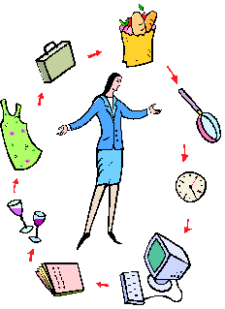
What is Time Management
Time management is the act or process of planning and exercising conscious control over the amount of time spent on specific activities, especially to increase effectiveness, efficiency or productivity.

Slide 3
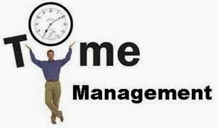
Time Management Tips
The next few slides gives you tips to help you manage your time.

Slide 4
Map Out the Weeks
Every Sunday, take some time to discuss the upcoming week and make a list of things that fall into these categories:
•Need to get done (“Bottlenecks,” that need to get done immediately)
•Would like to get done (Can wait a bit longer)
•Want to do (Recreational things like watching TV)
Write out Monday - Friday and note the amount of hours they have for each. There should be a start and end time for every day. Place the different tasks based on priority and time.

Slide 5
Use Calendar Updates
In today’s world, you are practically glued to your phones, but this dependency can be used to their advantage...because it means they can use calendar updates!
Use the calendar function on your phone, to set up alerts. Make a it habit of transferring info from your planner to your phone calendar every night.

Slide 6
Break Big Tasks in Smaller Ones
When we have a huge task to complete, we tend to put it off because we’re not sure where to start.
For example, “Cleaning the bathroom” can seem like a simple task, but what does it really entail?
•Cleaning the grout
•Washing the rug
•Sanitizing the counter
•Mopping the floor
•Putting everything away
•Emptying the garbage...
No wonder you can’t get around to “simply” cleaning the bathroom, because it’s not simple! You have to break it into smaller, less-intimidating tasks.
Write the big task at the top, and then break it down into littler tasks. Turn these smaller tasks into a checklist that they can follow.

Slide 7
Prep for School the night Before
You may be losing sleep trying to keep track of everything they’ll need for school the next day. You may be skipping breakfast or not packing a lunch because they don’t have enough time in the mornings.
To remedy this, lay out your school clothes, and pack your lunch and backpack before you go to sleep

Slide 8
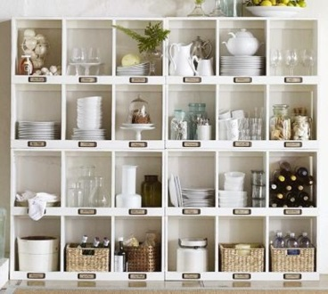
Have A Place for Everything
You may not always understand the importance of having things in order, but this doesn’t mean it won’t significantly improve your life by trying it!
Some tips to help you organize your space:
•Sort your stuff into categories.
•Find a place for each category of things to go
•Use a label-maker for drawers and shelves
•Return things to their proper place

Slide 9
Time Yourself
When you gets a sense for how long things REALLY take versus how long they THINK they take, your productivity will soar.
30/30 is app students can use to time themselves. The Pomodoro method is another optional time management technique, and Toggle is another time-tracking app.

Slide 10
Use Google Docs
Our beloved technology is not as secure as we may think.
For example, you may not realize that a USB is predetermined to self-destruct at any given point, with no warning at all. Phones and computers die.
Your can lose a 5-page research paper if they don’t have it saved at an inopportune moment of reckoning.
Introduce yourself Google Docs so you will never lose another assignment.
If you’re new to Google Docs, it comes with Gmail, and saves your work in real-time. If your computer crashes, you can hop on any other internet-connected computer and pick up right where they left off!

