Slide 1

2017 Legislative Recap

Slide 2
RSAI Capitol Recap of the 2017 Session
Budget and education funding
Flexibility and Home rule bills
State Assessment
Collective Bargaining
School Elections
Setting the stage for 2018
Steps you can take in the interim to keep momentum going on transportation & formula equity and State Penny extension

Slide 3
The budget
Legislature cut $130 million early in the session responding to December REC revenue adjustment . . . then borrowed another $131 million from the State’s rainy day funds to avoid another FY 2017 reduction. PK-12 was mostly spared in those initial reductions. They kept their promise to set SSA early, although low at 1.11%, they kept it there. The plan includes paying back the rainy day funds over two years.

Slide 4
HF 642 Education Appropriations https://www.legis.iowa.gov/docs/publications/NOBA/857483.pdf
$908 million, which is $70 million below FY 2017
New Programs, Services or Activities: (only one) A new appropriation of $250,000 for FY 2019 to DE for the Computer Science PD incentive Fund.
Of the $70 million decrease:
  $52 million is decrease of TLC allocation (really a shift since TLC is totally paid through the school foundation formula beginning in FY 2018. The real reduction of $4 million is due to elimination of the mentoring and induction program mandate).
  $2.0 million is decrease to AEAs (for elimination of TLC support and Iowa Core implementation support)
  The bigger cuts were to state universities and community colleges

Slide 5
FY17 Programs not funded for FY18:
  Already mentioned:
  Teacher Mentoring and Induction.
  AEA: TLC Support System
  AEA: Core Implementation.
  Other programs eliminated:
  Regional Telecommunications Councils.
  Administrator Mentoring and Coaching.
  English Language Learners Grant Program.
  Competency-Based Education.

Slide 6
Policies worthy of mention:
Teacher Shortage Loan Forgiveness Program: no new applicants as they refocus on the Teach Iowa Scholars loan payment program which is funded at $400,000, same as FY 2017)
Summer Reading Programming: eliminates summer reading programs and requirements for 3rd grade retention. Requires that school districts continue interventions for students not proficient in 3th grade and beyond until they reach proficiency.
High Needs Schools Grants: $10 million appropriation delayed (again) until FY 2019.
Iowa School Report Card: although initially eliminated in earlier versions of the appropriations bills, it was restored and is one of the few line items to see a small increase. DE made the case that they need a report card for ESSA compliance and will hopefully proceed to roll these together so schools don’t have to report twice.

Slide 7
SF 274 Governor’s
Computer Science Initiative
  Directs State BOE to set standards for high quality computer science instruction and make rules to Establish computer science endorsements/authorizations for teachers. VOLUNTARY at this time
  Computer science professional development incentive fund (no $ until 2019)
  b. “It is the goal of the general assembly that by July 1, 2019, each accredited high school offer at least one high-quality computer science course, each accredited middle school offer instruction in exploratory computer science, and each accredited elementary school offer instruction in the basics of computer science.”
  District or AEA or group of districts may apply to DE to receive funds to reimburse tuition for teachers’ computer science PD.
  Establishes a work group that makes all kinds of recommendations, including how a high quality computer science course can fulfil and mathematics or science graduation requirement
Although voluntary as this begins, sometimes state policies turn into mandates with future legislative action.

Slide 8
HF 564 Categorical Flexibility
Signed 5/11/17
  PK expansion: translators, safety equipment, snacks, playgrounds, and anything necessary to meet quality preschool program standards and for purposes that directly or indirectly impact benefit PK students. The bill also allows districts to offer PK to a younger or older child, if space and funding are available, including funding from another school district account or fund from which PK program expenditures are authorized by law, but the student isn’t counted for state funding purposes.
  PD expansion: assessment costs to comply with state requirement if PD is included, textbooks/instructional materials if PD is included (beware of charging students fees and also using PD), mentoring and induction (added in the Ed Approps bill.) The bill also prohibits DE from requiring a certain percentage of PD funds to be spent on Iowa Core implementation.
  DoP/At-risk Expansion: Adds counselors to list of staff whose time may be prorated for providing services to at-risk/dropout prevention eligible students, allows DOP funds to be spent on grade level, school wide or district wide prevention that serves students not necessarily eligible for DoP and eliminates the 5% cap for those services, gives the district authority to designate the amount of time/salary/benefits for each such prorated staff position as part of the program plan submitted to DE.
  Safety Equipment: allows a General Fund transfer to the Student Activity Fund for safety equipment required for extracurricular contests (retroactive to FY 2017)

Slide 9
HF 564 Categorical Flexibility
Signed 5/11/17
  District Authority: Directs DE to defer to local decision making in areas of TSS, PD, Early intervention/class size student supplements. The bill prohibits DE guidance that:
    Is inconsistent with any statute, rule, or other legal authority or
    Imposes any legally binding obligations or duties upon any person
    Unless such legally binding obligations or duties are required or reasonably implied by any statute, rule, or other legal authority.
  Guidance issued in violation of this paragraph “b” shall not be deemed to be legally binding.
  Please note: PPEL flexibility for transportation equipment repair was deleted by Senate (House version had repealed the $2,500 threshold for use of PPEL to repair transportation equipment)

Slide 10
HF 565 Education Super
Flex Account
Signed 5/11/17
  First applies to ending balances for the budget year beginning July 1, 2017 (that means no transfer until the 17-18 ending balance for these categoricals is known.)
  The bill allows transfer of ending balances from PD, PK, HSAP or any discontinued program (such as market factor pay) to a flex fund account for several specific purposes (at-risk, TAG, PD, PK, start-up costs for PK, HSAP) or any general fund purpose
  Districts must demonstrate that the original intent of categorical was met:
  School board must pass hold a public hearing and pass a resolution and the bill specifies what has to go in the resolution. At our ISFIS Conference, we will have a template for the resolution and further explanation of the opportunities in this legislation.

Slide 11
HF 573 Home Rule
Signed 5/10/17
The bill grants school districts/school board any broad and implied powers not inconsistent with the laws of the general assembly, or inconsistent with Administrative Rules, related to the operation, control and supervision of their public schools.
Specifically excludes:
  the power to levy any tax unless expressly authorized by the Legislature.
  district ability to charge mandatory student fees not authorized by law,
  District may not adopt a policy that would unreasonably interfere with the duties of a local, state or federal law enforcement agency, and
  If the authority of a school district conflicts with the authority of a municipal corporation, county, or joint county-municipal corporation government, the latter shall prevail within its jurisdiction.
States that Iowa code chapters relating to school boards and districts shall be liberally construed to effectuate the purposes of this bill.

Slide 12
SF 240 Assessments
Signed 5/11/17
    Requires state BOE to approve state assessment first used in 2018-19.
    The bill strikes the requirement for the Legislature to approve the state BOE recommendation.
    All students grades 3-11 take math/reading. Students in 5, 8, 10 take science. Administered in the last quarter of the school year.
    DE is to issue an RFP by July 1, 2017 and it must include growth, align to Iowa core, be capable of measuring student performance in ELA (+ writing), math and science and be available via computer/pencil & paper. (Vendors may collaborate).
    The bill requires evaluation of the proposals based ONLY on these criteria:
        feasibility of implementation by districts,
        costs to schools and state (provide and administer the tests and technical support)
        costs of acquiring infrastructure/technology readiness,
        degree of alignment,
        ability to measure student growth and proficiency,
        ability to meet requirements of ESSA, and
        instructional time required to conduct the test.
    Note: The state BOE/DE must still go through administrative rules process.
    Accredited nonpublic schools may administer the tests (but don’t have to.)

Slide 13
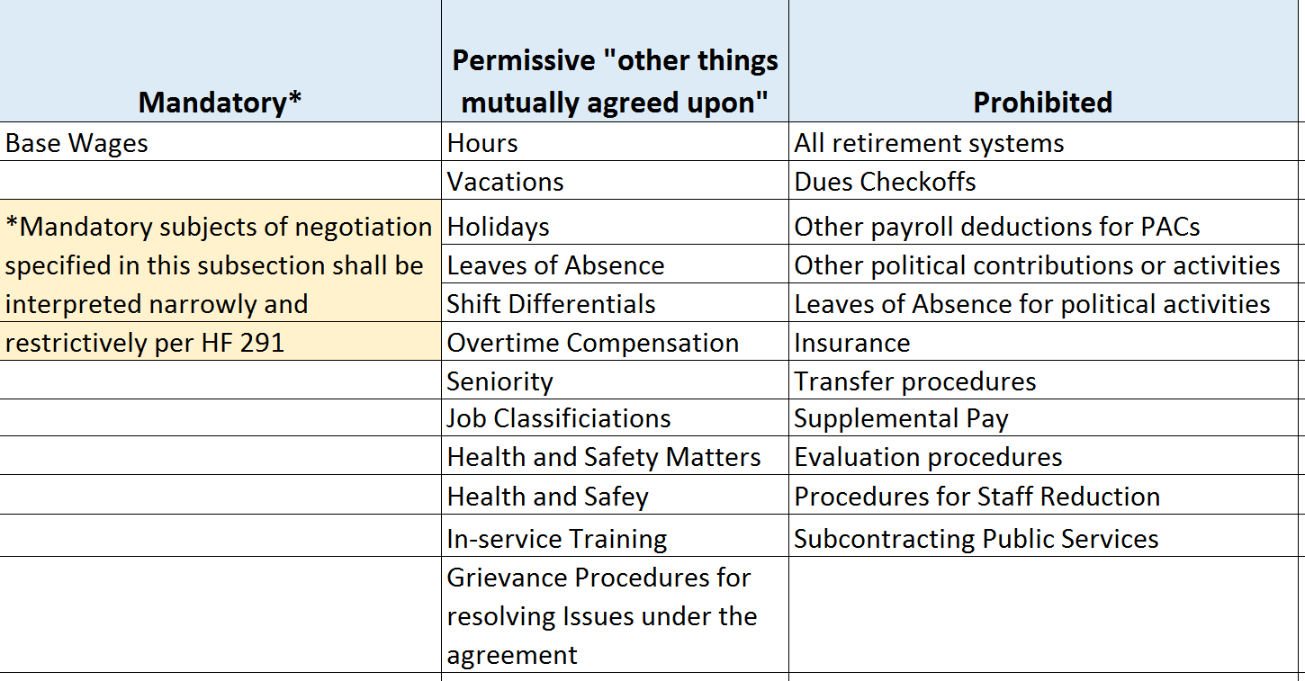
Chapter 20 Subjects of Bargaining HF 291
Public Safety employee organizations exempted, but as far as schools and AEAs go, here are the three categories:

Slide 14
School Elections HF 566
Signed 5/11/17
This bill changes regular school elections, beginning with 2019, to November to coincide with city elections.
Those terms that would be up in September 2019 are extended to November.
Special election dates are changed to March, May, August, November
Costs for the election to schools may actually increase, based on the number of ballots and polling places.
May impact special elections if school districts don’t want to run levies on the November date.
May lower the impact of write-in candidates and raise the petition signature threshold for taking an ISL to the voters.
According to the Secretary of State’s Office, in the last four school elections, the voter turnout average was 6.5%. The average voter turnout for city elections in that same time frame was 21.3%.

Slide 15
2017 ISFIS Conference
Exploring the Opportunities
When: June 7th, 2017
Where: FFA Enrichment Center, Ankeny, IA
Why: To connect with school administrators and policy and finance experts and learn about opportunities following historic 2017 Session
Register today /learn more here: http://www.iowaschoolfinance.com/conference_registration

Slide 16
HF 230 SAVE Extension
2018 Session
The bill extends the sunset from Dec. 2029 to Jan. 1, 2050.
No other changes in use or process.
Current sponsors include: Koester, Dolecheck, R. Taylor, Moore, Salmon, Landon, Mommsen, Gassman, Carlin, Fry, Heartsill and Isenhart.
Status: In House Ways and Means. Still alive for 2018 Session.
Interim advocacy: recruit additional sponsors, ask for support, will have to work with Governor’s office too, so connections with Lt. Gov. in the meantime are important. Business community and Farm Bureau can help.

Slide 17
SF 455 Formula and Transportation Equality
2018 Session
The bill phases in over 10 years,
  State funding for transportation costs
    90% based on last 3 years of transportation expenditures
    10% based on enrollment
  State funding to raise up district cost per pupil to the maximum, eliminating the $175 difference in district cost per pupil
Status: Approved unanimously in the Senate. Approved with only 1 no vote in House Education. Now in House Appropriations and still alive for 2018 Session.
Interim advocacy: Business community and Parents are critical. Continue to build urgency. Will depend on this being more important that other things if the state budget hasn’t yet recovered from the self-imposed tax credit flu.

Slide 18
School Choice Looming
The lowering of revenue estimates by the REC also meant there was no money for vouchers. But nonpublic and home school families are very active advocates. Here are some things to consider:
Public school students are the supermajority of Iowa students, with 94% of Iowa children in public schools.
The state already invests $52 million in nonpublic school and home school support.
There is little or no accountability for various forms of alternatives, meaning further investment doesn’t meet the standard of good stewardship of tax dollars.
Iowa already has several school choice options, from open enrollment, to quality private schools supported by tuition tax credits and school tuition organization tax credits (IA is one of only 5 states in the nation with both of those) and two home school options of competent private instruction and independent private instruction.
With continued budget strife, its fair to say any dollar for school choice is a dollar not available for public schools, unless the legislature proposes a new tax to pay for it.

Slide 19
Student Inequities Remaining
SF 427 English-Language Learner supplementary weighting extension to 7 years. Was approved in Senate Education Committee, sent to Senate Appropriations Committee, did not advance, so sent back to Senate Education Committee for 2018.
SF 8 Low Income Program Supplementary Weighting was introduced by Sen. Quirmbach, but did not have a subcommittee meeting or hearing by the full Education Committee. HF 267, by Nielson et al, same story in the House.
PK weighting: SF 121 by Petersen creates ELL weighting for 4-year-old PK students. Assigned to Senate Education but no subcommittee. HF 564 Categorical Funding, originally had an increase in PK weighting, but that was stripped out in the House before the Committee vote for fear the fiscal note would doom the flexibility provisions of the bill.
Mental Health: No bills introduced in the Education Committees this year.

Slide 20


Questions or Comments?
LARRY SIGEL – ISFIS PARTNER
Cell: 515-490-9951
larry@iowaschoolfinance.com
MARGARET BUCKTON – ISFIS PARTNER
CELL: 515-201-3755
Margaret@iowaschoolfinance.com
Iowa School Finance Information Services
1201 63rd Street
Des Moines, IA 50311
Office: 515-251-5970
www.isfis.net

