Slide 1
SurfCFCC
Secure Wireless Access
For
Students, Faculty, and Staff

Slide 2
What We are Providing
Wireless is now considered part of our production network
The SurfCFCC SSID is present on all 4 campuses
Anyone who logs on to wireless can expect the same access as they have on the wired network

Slide 3
Technologies Used
Aruba for Wi-Fi
Controller based (one per campus)
Aruba ClearPass
RADIUS Server
Active Directory
Users and Groups

Slide 4
Network Concept
LAN
1. Client Authenticates
to Controller
Controller
3. VLAN assigned
based on group,
etc.
AP
RADIUS
2. Authentication Request
and Response
Active
Directory

Slide 5
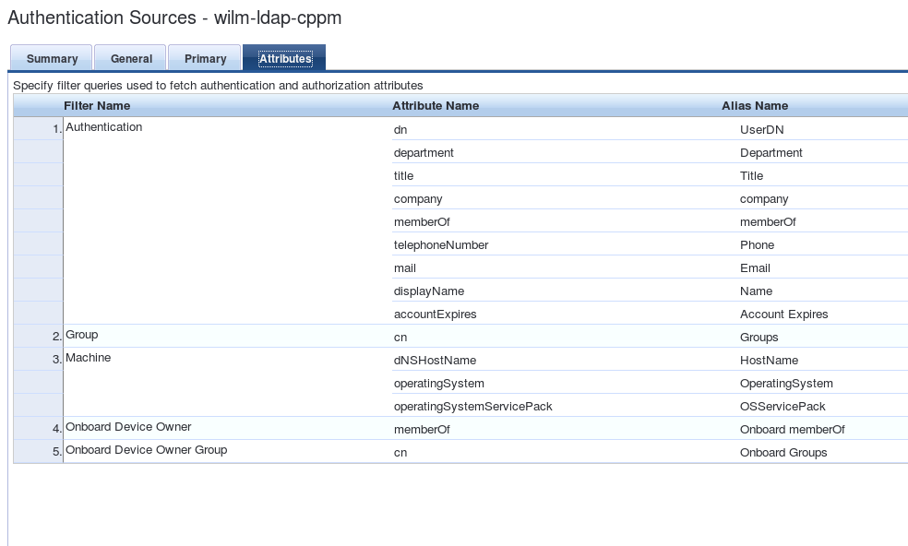
RADIUS Authentication Sources

Slide 6
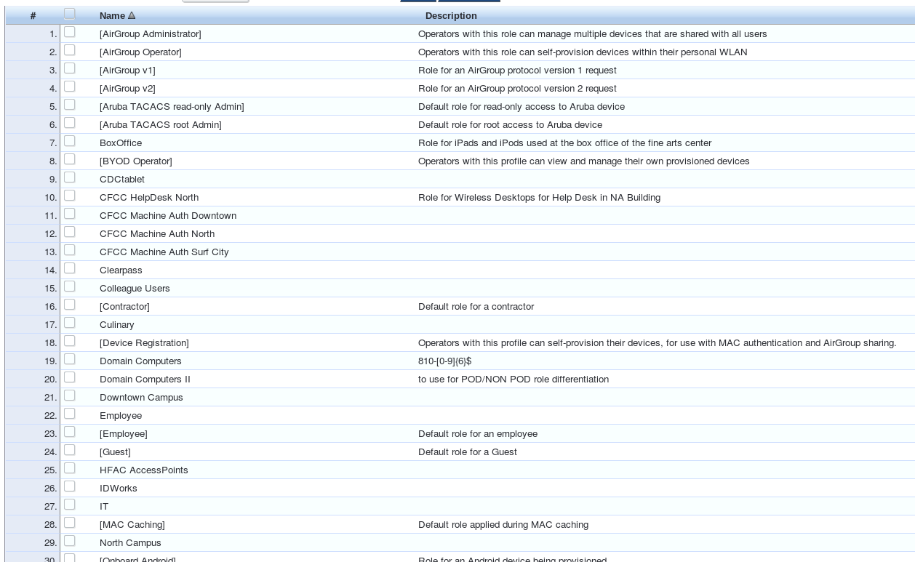
All Roles

Slide 7
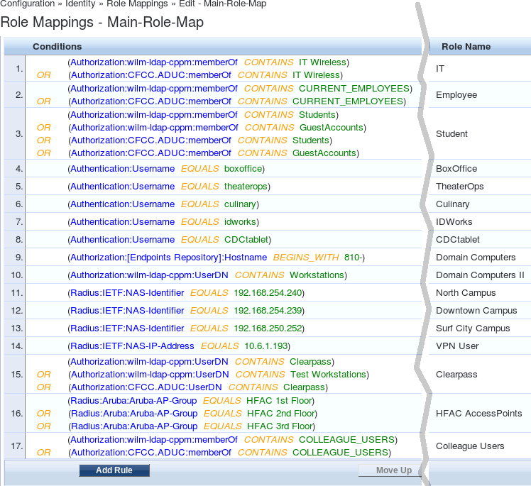
RADIUS Role Mappings

Slide 8
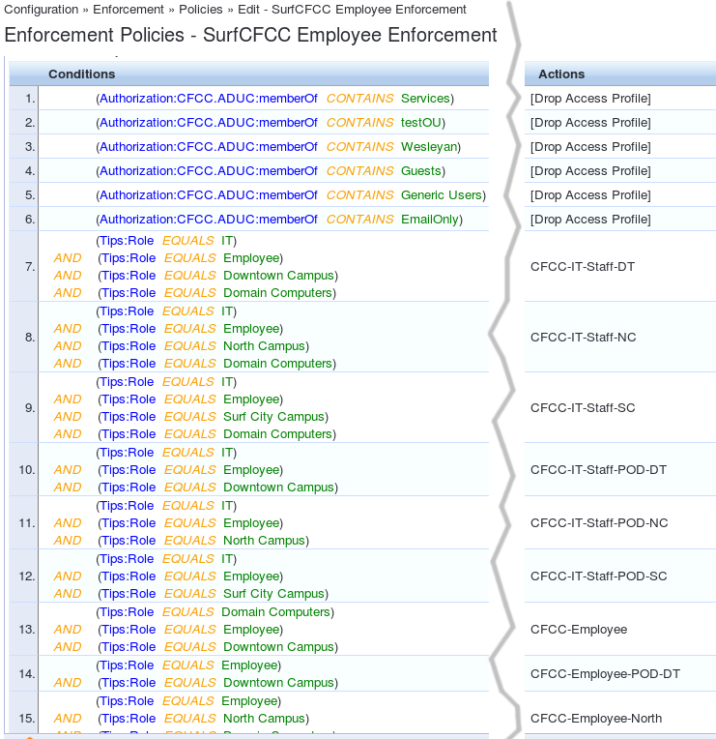
RADIUS Enforcement Rules

Slide 9
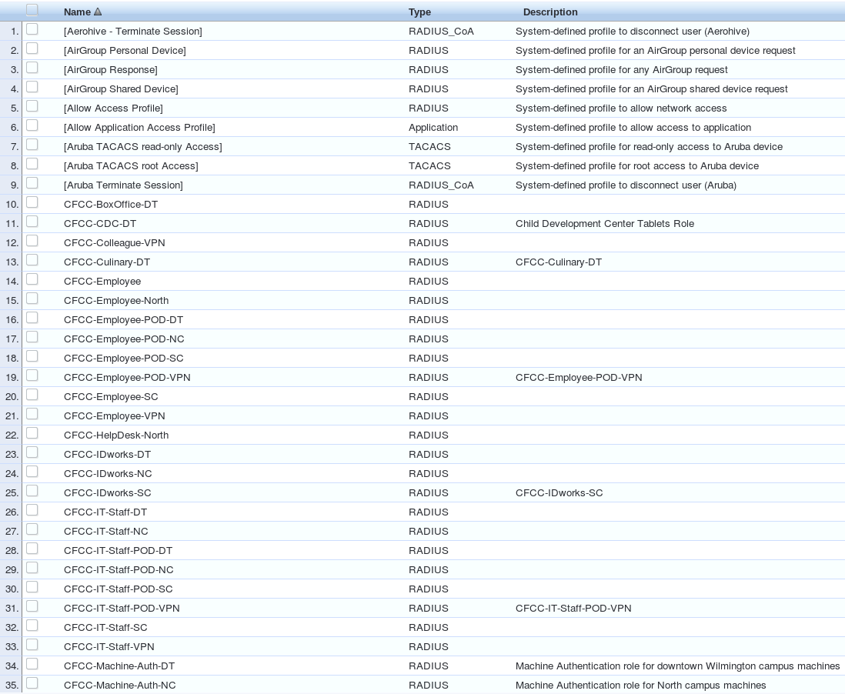
RADIUS Enforcement Profiles

Slide 10
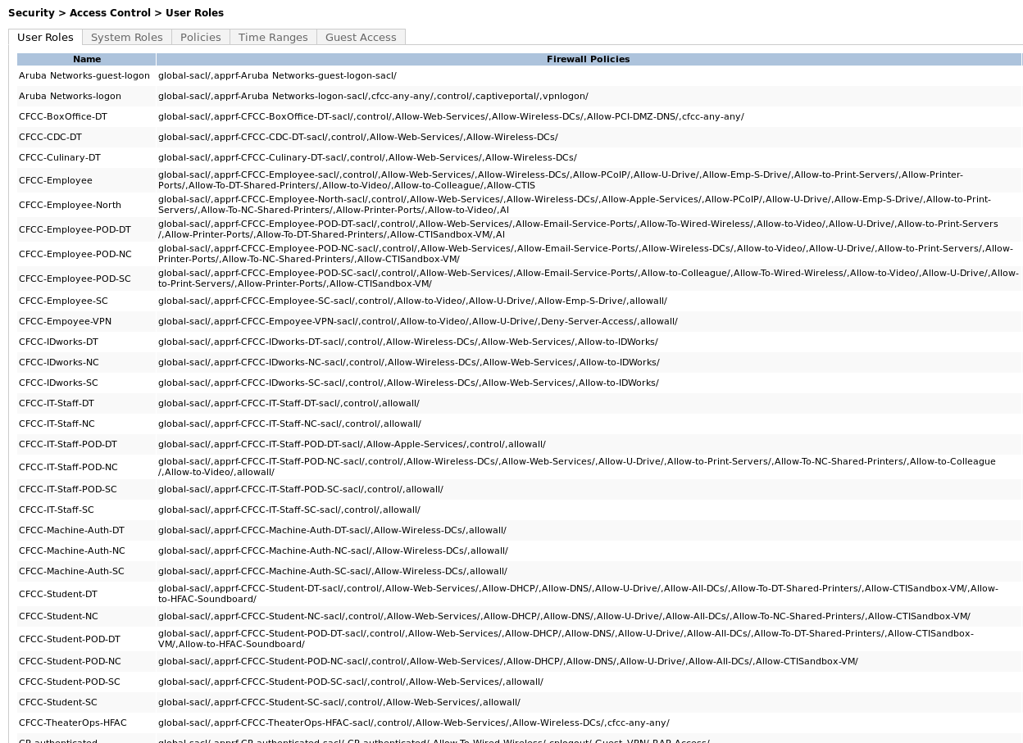
Access Control Lists by Role
These roles are defined on the controller and correspond to the Enforcement Profiles in Radius

Slide 11
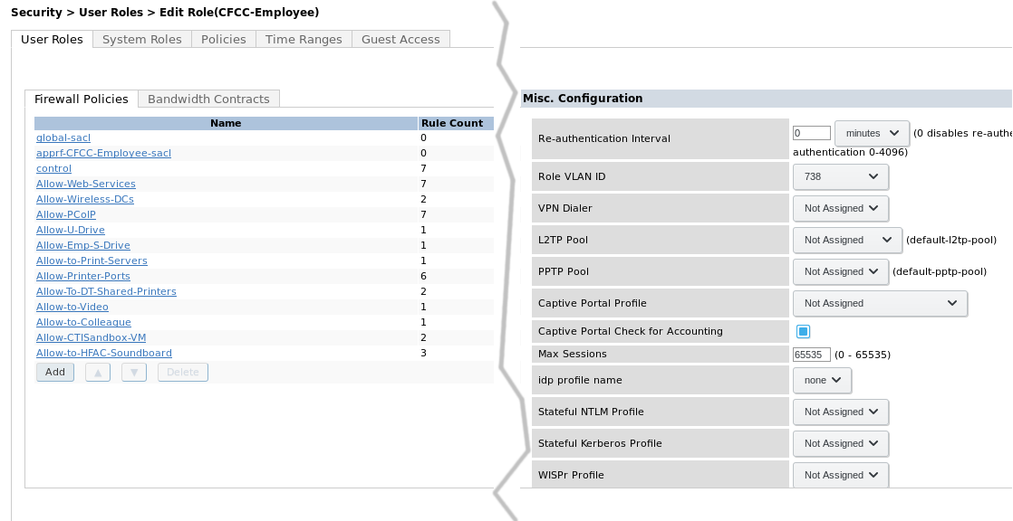
Sample Employee Role

Slide 12
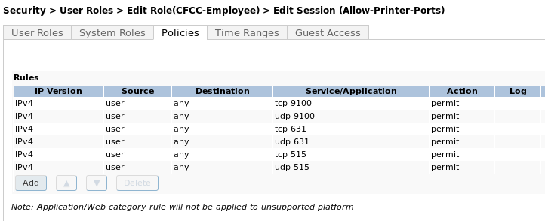
ACLs for Employee Role

