Slide 1
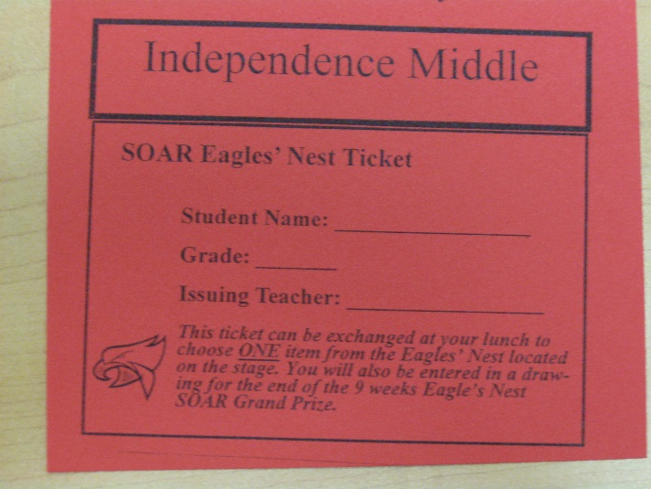
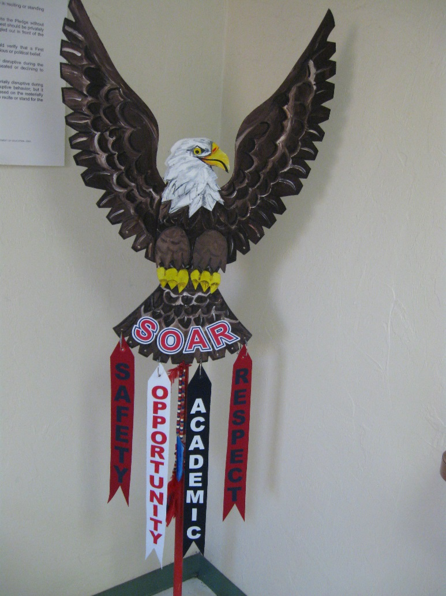
SOAR Tickets and Prizes
Students can earn SOAR tickets from teachers.
SOAR tickets can be earned in some of the following ways:
Academic Achievements
Positive Classroom and Campus wide Actions and Behavior

Slide 2
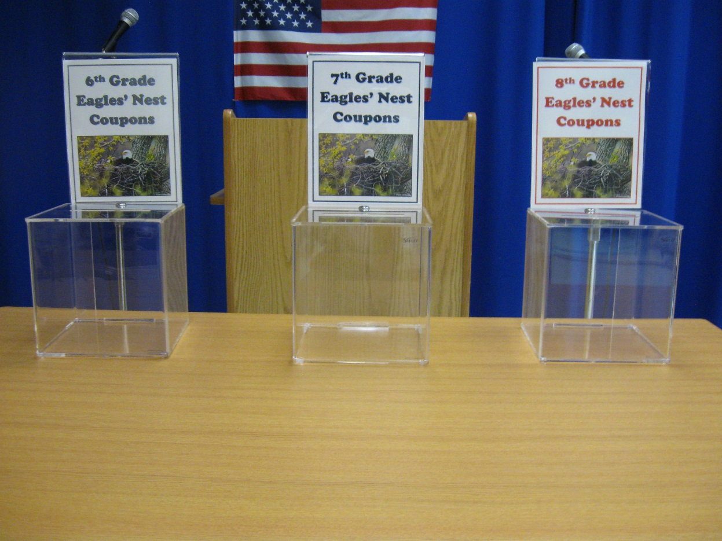
What do I do with the SOAR Ticket?
Once you have earned a SOAR ticket what can you do with it?
Give your ticket to the teacher who is at the stage with the grade level boxes. Do not put the ticket in the box, hand it to the teacher
You will be able to exchange the ticket at your lunch for a choice treat from the Eagle’s Nest.

Slide 3
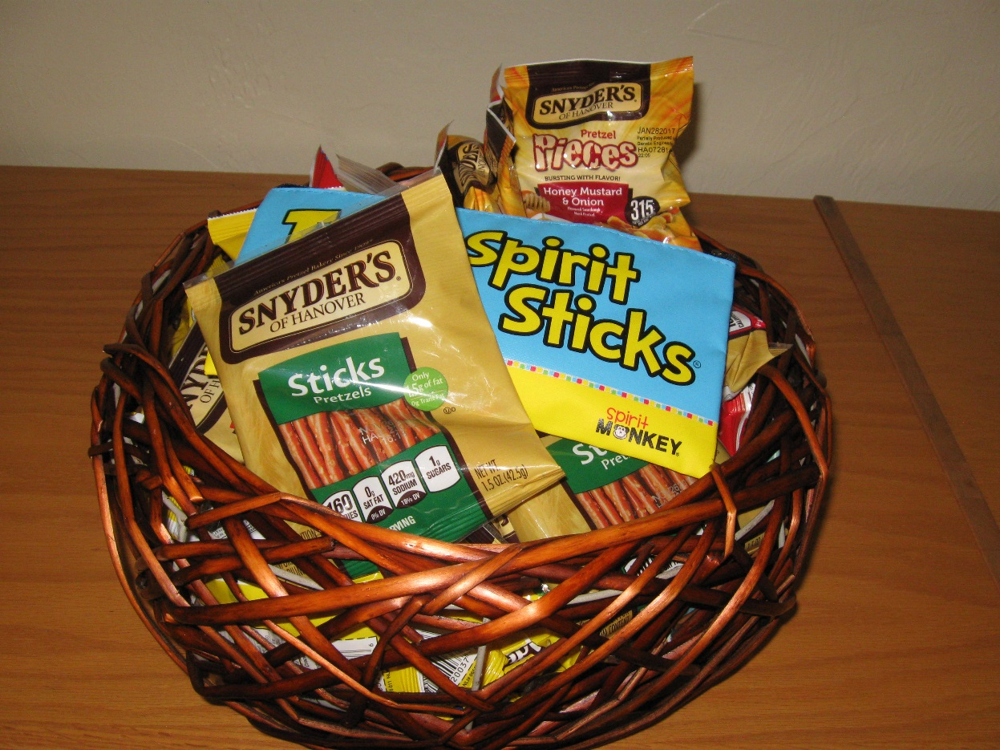
What is the Eagle’s Nest?
The Eagle’s Nest has a variety of items and treats that you may exchange your ticket for, choose wisely!!
But it does not end there!!

Slide 4

The Grand Prize
The Eagle’s Nest treat is not the only prize you can earn.
Twice a 9 weeks, at mid-term and the end of the 9 weeks, there will be a grand prize drawing for an even bigger prize!!
By turning in your SOAR ticket you are automatically entered.
So remember to SOAR everywhere at IMS, you could be rewarded

