Slide 1
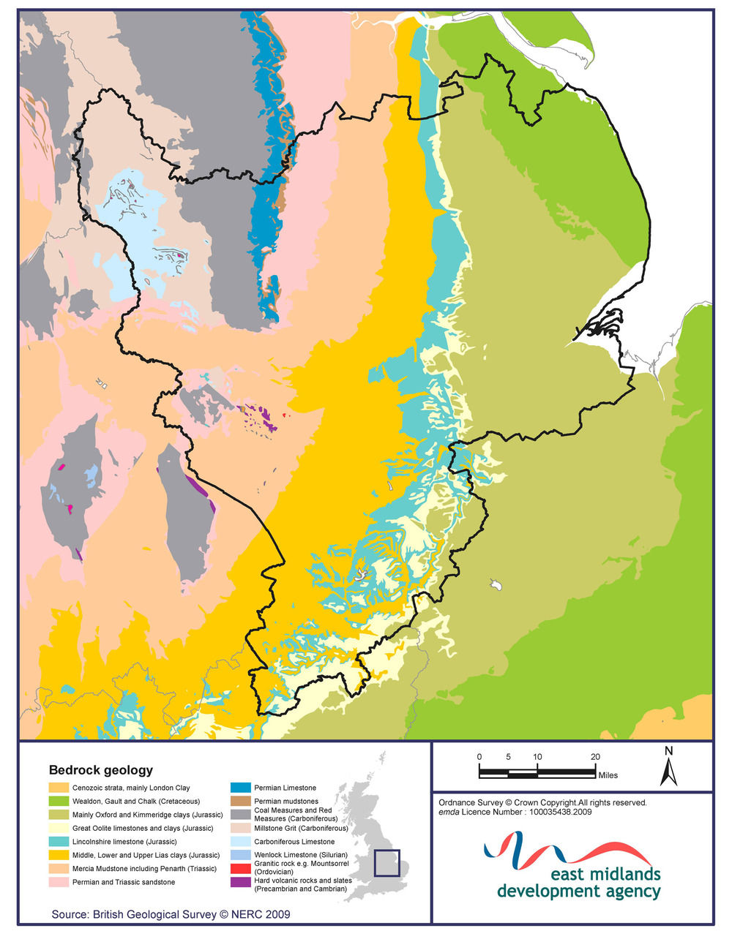
THE LAWS (PRINCIPLES) OF STRATIGRAPHY

Slide 2
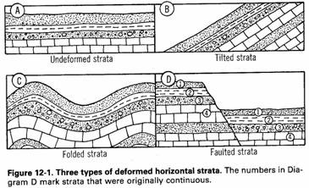
1. ORIGINAL HORIZONTALITY
When sedimentary rocks are deposited this usually occurs in horizontal layers called beds, separated by boundaries called bedding planes
This does not apply in all cases, and not with igneous rocks which may cut at an angle or vertically through horizontal sedimentary beds
Later the rock may be tilted, folded or faulted

Slide 3
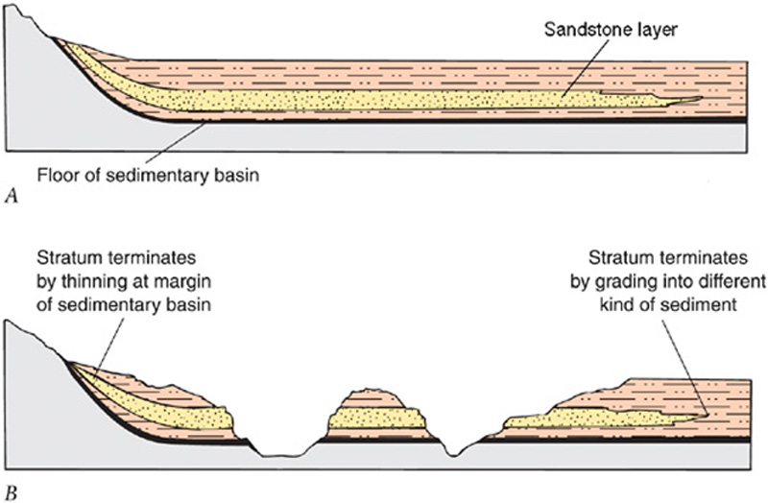
2. LATERAL CONTINUITY
Sedimentary beds usually form in ocean environments and retain similar characteristics over sometimes great horizontal distances

Slide 4
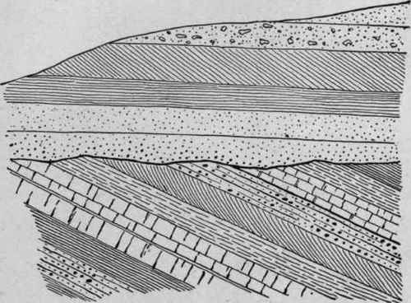
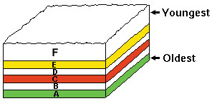
3. SUPERPOSITION
Sedimentary beds are laid down in sequences with the oldest beds lower down and the youngest nearer the surface
This may not be the case if the beds have been overturned as in a fold to give inverted limbs or beds
There may also be a gap in the sequence of beds if there has been a period of non deposition or erosion. This is called an UNCONFORMITY

Slide 5
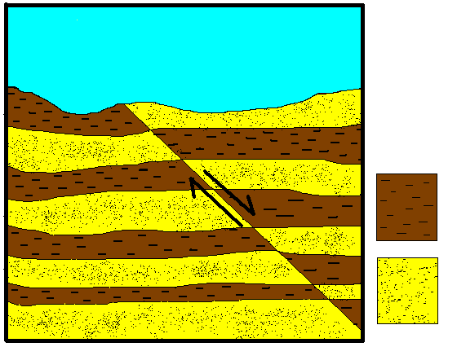
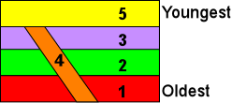
4. CROSS CUTTING
Any feature that cuts through another must be younger than the feature or beds that it cuts through
This could be a fault or an igneous intrusion , particularly a dyke

Slide 6
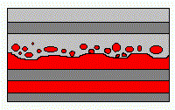
5. INCLUDED FRAGMENTS
Any rock or bed that contains fragments of another must be younger than the fragments it contains
The fragments in a rock are older than the rock containing them

Slide 7
