Slide 1
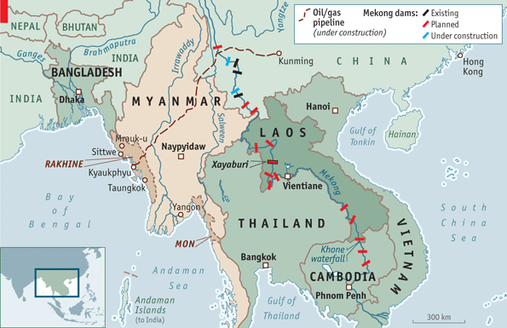
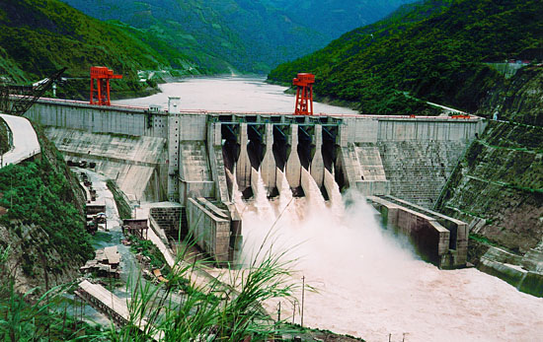
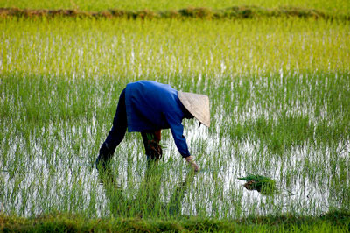
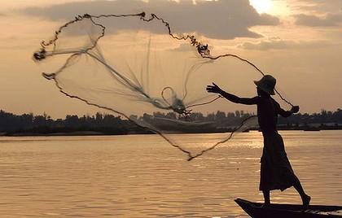
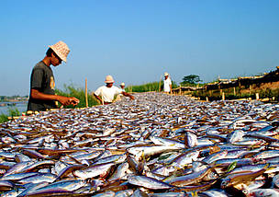
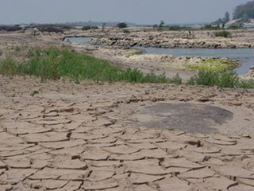
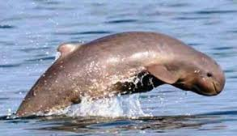

SEDIMENT AND RIVER MORPHOLOGY
Dams limit the normal downstream transport of sediment leading to increased erosion and reduced deposition. This can change the channel and lead to bed instability.
The reduction in flood sediment (the silt brings nutrients) and deposition on the floodplain affects the productivity of the rice paddy fields and brings social and economic risks.
The reduction of sediment to the delta may also increase the chances of floods
on the coast.
FISHERIES
Dams will limit migration of fish and put biodiversity under risk.
This will impact on people (social), livelihoods, food, income and employment.
11 LARGE DAMS ARE PROPOSED IN THE MIDDLE/LOWER MEKONG
THIS WILL BRING HEP. ECONOMIC DEVELOPMENT, SOCIAL DEVELOPMENT, IMPROVED NAVIGATION
MEKONG RIVER COMMISSION (MRC)
(VIETNAM, CAMBODIA, LAOS, THAILAND)
POSSIBLE RISKS/IMPACTS
TRANSBOUNDARY NATURE OF THE RIVER
Dams affect the flow to other countries, lowering the flow, increasing the salinisation of soils, threatening food production.
Dams have already been built in China and are said to be having an impact. Needs cooperation and discussion, one of the MRC goals. Reduction of flow to downstream countries means a loss of water resources, loss of sediment, an impact on fisheries and on the chances/speed of development
WATER QUALITY/POLLUTION
Large reservoirs 100 – 150 km in length will be created by the dams. The reduced flow in the reservoirs will increase sedimentation and concentrate pollution.
Water depths will change having a negative impact on aquatic ecosystems, cause a loss of biodiversity and put an added stress on the 30 already endangered species such as the River Dolphin, leading to loss of species

