Slide 1
Oncology Nurse Insights
Into New Agent Classes
and Research Across
B‐Cell Lymphomas
Practical Issues and Evidence for
the Front Lines of Care
Amy Goodrich, NP
Sidney Kimmel Comprehensive Cancer Center at Johns Hopkins
Baltimore, Maryland

Slide 2
Disclosures
Amy Goodrich, NP, has a financial interest/relationship or affiliation in the form of:
Advisory Board For:
Gilead Sciences, Inc.; Mylan N.V.; and Sandoz AG.
Amy Goodrich, NP, does intend to discuss either non-FDA-approved or investigational use for the following products/ devices: ibrutinib, acalabrutinib, venetoclax, lenalidomide, CAR-T cell therapy, and other novel strategies in various B-cell cancer settings.

Slide 3
Mapping Progress in B-Cell Lymphoma
Through the Emergence of Novel Agent Classes
Obinutuzumab
CLL + chlorambucil, rituximab-refractory FL + BR, then as maintenance, relapsed
FL + bendamustine
Venetoclax
CLL ±Del(17p) ≥1 prior therapy
Axicabtagene ciloleucel
Large B-cell lymphomas; ≥2 prior therapies
Tisagenlecleucel
≥2nd relapsed/refractory B-ALL
R/R large B-cell lymphoma ≥2 lines of therapy (DLBCL NOS, high-grade B-cell lymphoma, DLBCL [arising from FL])
Initial rituximab approval (1997)
Bendamustine
MCL, CLL, indolent B-cell NHL
Bortezomib (MCL)
Alemtuzumab (CLL)
Idelalisib
Relapsed CLL + rituximab, relapsed FL or SLL after ≥2 prior therapies
Before 2008
2013
2014
2016
2017/2018
Acalabrutinib
MCL ≥1 prior therapy
Lenalidomide
Relapsed MCL after ≥2 prior therapies
Ibrutinib
CLL, del(17p) CLL
MCL ≥1 prior therapy
MZL ≥1 prior anti-CD20 therapy
WM
Ofatumumab
CLL+ chlorambucil, relapsed CLL after ≥2 prior therapies, fludarabine/alemtuzumab-refractory CLL
Copanlisib
FL ≥2 prior therapy
Duvelisib
Relapsed/refractory CLL/SLL or FL ≥2 prior therapies

Slide 4
Updated Indications for Treatment of CLL (iwCLL)¹
Progressive marrow failure,
Hb <10 gm/dL
or PLT <100 × 10⁹/L
Progressive lymphocytosis + increase
of ≥50% over 2 months or
lymphocyte doubling time of <6 months
Any one of these criteria should be met to initiate
CLL therapy:
Massive (≥6 cm below left costal margin) or progressive or
symptomatic splenomegaly
Autoimmune complications
of CLL, that are poorly
responsive to corticosteroids
Symptomatic extranodal involvement
(eg, skin, kidney, lung, spine)
Massive (≥10 cm in longest diameter) or progressive or symptomatic lymphadenopathy
Disease-related symptoms, including:
Unintentional weight loss of ≥10% within the previous 6 months
Significant fatigue
Fever ≥38° C for 2 or more weeks without evidence of infection
Night sweats for ≥1 month without evidence of infection
Notes:
Progressive marrow failure, Hb <10 gm/dL or PLT <100 × 10⁹/L
Massive (≥6 cm below left costal margin) or progressive or symptomatic splenomegaly
Massive (≥10 cm in longest diameter) or progressive or symptomatic lymphadenopathy
Progressive lymphocytosis + increase of ≥50% over a 2-month period or lymphocyte doubling time of <6 months
Autoimmune complications of CLL, that are poorly responsive to corticosteroids
Symptomatic extranodal involvement (e.g., skin, kidney, lung, spine)
Disease-related symptoms, including:
Unintentional weight loss of ≥10% within the previous 6 months
Significant fatigue
Fever ≥38 °C for 2 or more weeks without evidence of infection
Night sweats for ≥1 month without evidence of infection

Slide 5
Suggested Treatment Algorithms for CLL in the Modern Era¹
Previously Untreated CLL
TP53 status
TP53 disrupted
Ibrutinib, and refer to cellular therapy expert
TP53 intact
IGHV mutation status
Mutated IGHV
Unmutated IGHV
Young and fit
Old and frail
Young and fit
Old and frail
FCR
(BR if >65 y)
Obinutuzumab
+/- chlorambucil or ibrutinib
Ibrutinib or FCR
(BR if >65 y)
Ibrutinib or obinutuzumab
+/- chlorambucil

Slide 6
Suggested Treatment Algorithms for CLL in the Modern Era¹ (Cont’d)
Relapsed/Refractory CLL
Restage with bone marrow aspirate and biopsy, CT scan, CLL FISH panel, and TP53 mutation study
Exclude Richter’s transformation
Patient has progressive CLL on ibrutinib
No
Yes
Ibrutinib or venetoclax
and rituximab
Venetoclax and rituximab, and refer to cellular therapy expert

Slide 7
Summary of Major Studies With Ibrutinib in CLL
Resonate²
Substantial improvement in PFS
and OS with single-agent ibrutinib
versus ofatumumab
RESONATE-2¹
Substantial improvement in PFS versus chlorambucil
PhaSE 1b/2
PCYC-1102³
Relapsed/
refractory
After 7 years
follow-up, durable responses with stable or improved CR rates, sustained PFS, and OS rates
Newly diagnosed
(elderly patients)
Newly diagnosed
& relapsed/refractory
CLL
Notes:
After 7 years follow-up, durable responses with stable or improved CR rates, and sustained PFS and OS rates
80% and 75% 7-year PFS and OS for first line pts

Slide 8
Is BTK Inhibition Effective Across Genetic/Molecular Subgroups in CLL?¹⁻³
Effectiveness
Supporting Data
PCYC-1102 Study
RESONATE-2
Ibrutinib leads to comparable PFS/OS regardless of IGHV status¹
Effective against del17p CLL
Preservation of PFS in pts with or without del(11q)
RESONATE-17
RESONATE-2

Slide 9
Ibrutinib-Based Therapy Improves PFS vs Bendamustine-Rituximab in Older CLL Patients¹
Phase 3 A041202 Study
Ibrutinib ± rituximab versus BR in older patients with newly diagnosed CLL
Improved PFS with ibrutinib regimens vs BR
  HR for PFS = 0.39 (ibrutinib alone); 0.38 (ibrutinib + rituximab)
No difference in PFS between ibrutinib arms
Patients Who Were Alive and Free
From Disease Progression, %
Time, mo
 | Events/Patients, n | Median, mo (95% CI)
Bendamustine + rituximab | 68/176 | 43 (38-NR)
Ibrutinib | 34/178 | NR
Ibrutinib + rituximab | 32/170 | NR
Take-home point: Ibrutinib therapy improves PFS versus BR in older patients;
no differences in OS noted at this time

Slide 10
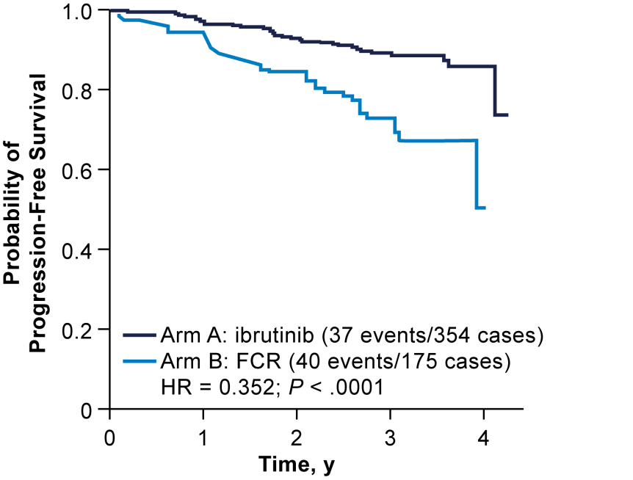
Ibrutinib + Rituximab Improves PFS and OS in Younger Patients With CLL vs FCR¹
Phase 3 E1912 Study
Ibrutinib + rituximab versus FCR in younger patients with newly diagnosed CLL
HR for PFS in ITT population: 0.35
HR for OS in ITT
population: 0.17
PFS in ITT Population
Ibrutinib + rituximab (IR) (37 events/354 cases)
FCR (40 events/175 cases)
HR = 0.35 (95% CI, 0.22-0.5); P < .00001
No. at Risk
IR | 354 | 339 | 298 | 148 | 16
FCR | 175 | 147 | 112 | 50 | 0
Take-home point: Ibrutinib + rituximab more efficacious than FCR as upfront therapy
in younger patients and appears potentially practice changing

Slide 11
Other BTK Inhibitors in CLL: Acalabrutinib¹
Tested in a phase 1/2 study
  R/R CLL, ECOG PS ≤2
  134 patients with R/R enrolled with median of 3 prior therapies, 67% Rai advanced disease, 31% del(17p)
Well tolerated with good safety profile (no atrial fibrillation)
Highly active with ORR of 97%
  Median PFS not reached
  2-year EFS rate, 95%
Notes:
https://ash.confex.com/ash/2018/webprogram/Paper110395.html

Slide 12
Acalabrutinib in Relapsed/Refractory or High-Risk Treatment-Naïve CLL¹
N = 46 (16 treatment-naïve, del17p); no prior BTK therapy; 89% (41/46) remain
on acalabrutinib therapy
Acalabrutinib
Summary in R/R and TN High-Risk Populations
Activity and safety consistent with experience in R/R CLL
ORR was 90% (35/39 pts)
No atrial fibrillation; one grade 1 atrial flutter occurred
Acalabrutinib appears to be a potent, safe
next-generation BTK inhibitor in relapsed/refractory CLL

Slide 13
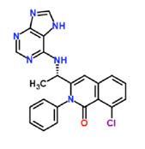
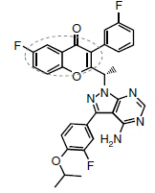
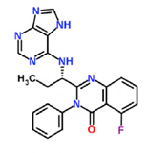
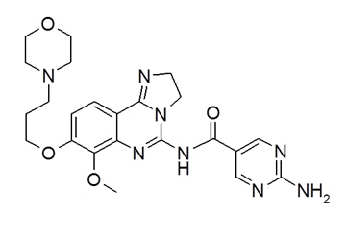
PI3K Inhibitors Are Active in CLL and Other B-Cell Cancers
Idelalisib (IC₅₀-nM)¹ | Duvelisib (IC₅₀-nM)² | Copanlisib (IC₅₀-nM)³ | Umbralisib (IC₅₀-nM)⁴
Oral | Oral | IV | Oral

Slide 14
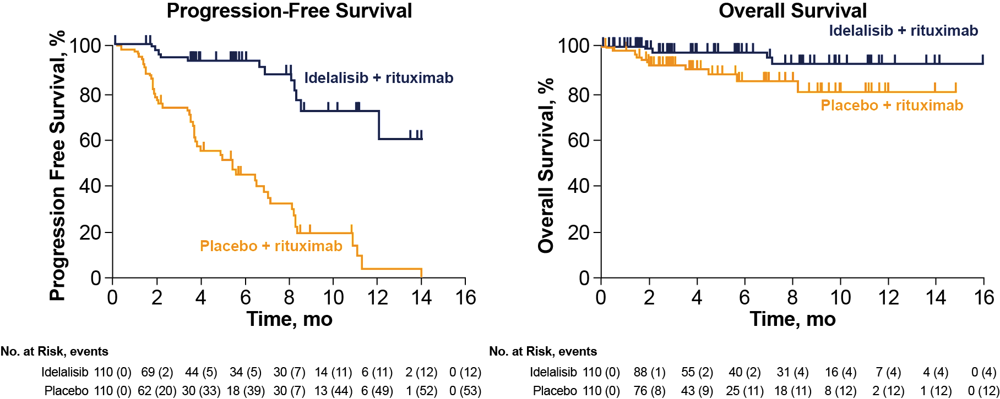

Idelalisib + Rituximab Is Highly Effective in Relapsed/Refractory CLL¹
Idelalisib + rituximab in CLL
Patients with relapsed CLL and comorbid conditions (decreased renal function, previous therapy-induced myelosuppression,
or major coexisting illnesses)
Combination improved PFS versus rituximab alone
Median PFS: NR
HR = 0.15; P <.001
Median PFS: 5.5 mo
Notes:
Patients receiving idelalisib versus those receiving placebo had improved rates of overall response (81% vs. 13%; odds ratio, 29.92; P<0.001) and overall survival at 12 months (92% vs. 80%; hazard ratio for death, 0.28; P=0.02). Serious adverse events occurred in 40% of the patients receiving idelalisib and rituximab and in 35% of those receiving placebo and rituximab.
CONCLUSIONS:
The combination of idelalisib and rituximab, as compared with placebo and rituximab, significantly improved progression-free survival, response rate, and overall survival among patients with relapsed CLL who were less able to undergo chemotherapy

Slide 15
Idelalisib + Rituximab Is Highly Effective in Relapsed/Refractory CLL¹ (Cont’d)
Idelalisib + rituximab in CLL
Combination also improved OS and response versus rituximab alone
ORR: 81% versus 13%;
P < .001
1-year OS: 92% versus 80%; HR = 0.28; P = .02
Take-home point: Idelalisib + rituximab more effective than rituximab
in CLL patients less able to undergo chemotherapy

Slide 16
Other PI3K Inhibitors Also Active in Relapsed/Refractory CLL
Duvelisib¹
  Phase 3 DUO Trial (N = 319) showed improved PFS versus ofatumumab in relapsed/refractory CLL
  Recently FDA approved in R/R CLL/SLL after ≥2 prior therapies
Umbralisib²
  Active in early phase study in patients with relapsed and/or refractory lymphoid cancers, including CLL (≥1 prior treatment regimen)

Slide 17
Obinutuzumab in CLL
Obinutuzumab¹
Next-generation anti-CD20 antibody
Improved OS and PFS in combination
with chlorambucil vs rituximab
plus chlorambucil
  HR for OS = 0.76; P < .0245
  HR for PFS = 0.49; P < .0001
Obinutuzumab + Ibrutinib²
Based on results of the phase 3
iLLUMINATE trial
Recently FDA approved as first-line
treatment for CLL or SLL
Combination provides an alternative first-line treatment option for patients
aged 65 years and older or younger than 65 years with coexisting conditions

Slide 18
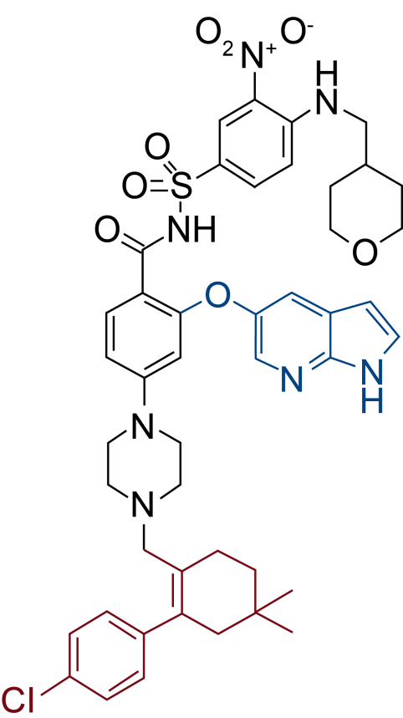
Venetoclax in CLL¹
BH3 mimetic; orally bioavailable
Approved for use in patients with CLL ± del17p who have received at least one prior therapy
Phase 3 MURANO study: venetoclax + rituximab improved median PFS vs BR in relapsed/refractory CLL²
  Median PFS not reached with venetoclax combination versus 18.1 months for BR
Combination recently FDA approved in CLL/SLL with or without 17p deletion after ≥1 prior therapies

Slide 19
Nursing Perspectives on Dosing, Administration, and Safety Management
Novel Agents in CLL

Slide 20
Ibrutinib Dosing and Administration¹
Dosing for CLL Differs From MCL
CLL 420 mg by mouth once daily (as single agent or combined with BR or obinutuzumab) Administer ibrutinib before rituximab or obinutuzumab when given on the same day
MCL 560 mg by mouth once daily
Administration Issues
Administer at approximately the same time each day with a full glass of water If administered with CYP3A inhibitors, consult prescribing information for dose modifications
Dose Reductions
Reduce dose to 140 mg once daily for mild hepatic impairment and to 70 mg once daily for moderate hepatic impairment
1. Imbruvica (ibrutinib) capsules. Prescribing Information. www.imbruvica.com/docs/librariesprovider7/default-document-library/prescribing-information.pdf.
Accessed March 30, 2019.

Slide 21
Acalabrutinib Dosing and Administration¹
Approved Dosing in MCL and Dose Studied in CLL
MCL 100 mg by mouth every 12 hours
CLL 100 mg twice a day and 200 mg every day, tested in clinical trials
Administration Issues
Administer with a full glass of water with or without food If a dose is missed by more than 3 hours, it should be skipped with next dose taken on regular schedule
Dose Reductions
Avoid concomitant use with strong CYP3A inhibitors; if moderate CYP3A inhibitor, dose is 100 mg once daily Avoid concomitant use with PPIs; take dose 2 hours before H2 receptor antagonist and antacids
1. Imbruvica (ibrutinib) capsules. Prescribing Information. www.imbruvica.com/docs/librariesprovider7/default-document-library/prescribing-information.pdf.
Accessed March 30, 2019.

Slide 22
Adverse Event Monitoring and Management
During Use of BTK Inhibitors¹⁻³
BCR inhibitors overall: watch for transient lymphocytosis
Ibrutinib
Grade >2 bleeding noted, monitoring recommended
  Consider risks/benefits in patients on anticoagulant
  therapy
Monitor for fever and infections and evaluate promptly
Acalabrutinib
Grade ≥3 bleeding events noted; may further increase the risk of hemorrhage in patients receiving antiplatelet or anticoagulant therapies; monitor for bleeding
Monitor for infection and treat as appropriate; consider prophylaxis in patients at increased risk for opportunistic infections
Monitor for atrial fibrillation and atrial flutter, manage as appropriate
Protection from sun exposure is advised

Slide 23
Idelalisib Dosing and Administration¹
Approved Dosing
R/R CLL 150 mg by mouth twice daily combined with rituximab
R/R FL In patients after ≥2 prior therapies, 150 mg by mouth twice daily
Administration Issues
Not indicated or recommended combined with bendamustine and/or rituximab to treat FL Contraindicated in patients with a history of serious allergic reactions
Dose Reductions
Avoid concomitant use with other drugs, including alcohol, that may cause liver toxicity and with other drugs that cause diarrhea
1. Zydelig (idelalisib) capsules. Prescribing Information. www.gilead.com/~/media/Files/pdfs/medicines/oncology/zydelig/zydelig_pi.pdf. Accessed March 29, 2019.

Slide 24
Monitoring for Infection With Idelalisib
AEs, such as infection, have been noted with idelalisib therapy, including in combination with rituximab or regimens such as BR¹
iwCLL recommendations (2018)
Monitor for
Autoimmune colitis, pneumonitis
Infection
(eg, CMV reactivation, herpes zoster)

Slide 25
Duvelisib Dosing and Administration¹
Approved Dosing
R/R CLL After ≥2 prior therapies, 25 mg by mouth twice daily
R/R FL After ≥2 prior therapies, 25 mg by mouth twice daily
Administration Issues
If dose is missed by fewer than 6 hours, take missed dose; if missed by more than 6 hours, wait and take the next dose at the usual time Provide prophylaxis for Pneumocytis jirovecii during treatment; after treatment, continue until CD4⁺ T-cell count ≥200 cells/mcL
Dose Reductions
Reduce dose to 15 mg by mouth twice daily when used with strong CYP3A4 inhibitors

Slide 26
Safety Summary for Use of PI3K Inhibitors in CLL¹⁻³
Idelalisib
Monitor for GI events, hepatotoxicity, pneumonitis, intestinal perforation
  Interrupt, consider steroids, then reduce or discontinue agent
Potential for infections, including opportunistic infections such as CMV and PJP
Duvelisib
Monitor hepatic function and blood counts
Advise patients of potential risk to a fetus and to use effective contraception
Monitor for GI events, hepatotoxicity, pneumonitis, intestinal perforation
  Interrupt, consider steroids, then reduce or discontinue agent

Slide 27
Venetoclax Dosing and Safety
(Based on the CLL Experience)¹
Monotherapy
20 mg once daily for 7 days, followed
by a weekly ramp-up dosing schedule
to recommended daily dose of 400 mg
In combination with rituximab: administer rituximab after the 5-week venetoclax ramp-up schedule
Continue venetoclax for 24 months from cycle 1 day 1 of rituximab
Most Common AEs (≥20%)
Neutropenia, diarrhea, nausea, anemia, upper respiratory tract infection, thrombocytopenia, and fatigue
Monitor for neutropenia, with medical management as appropriate
Assess TLS risk in all patients
Premedicate with antihyperuricemics and ensure adequate hydration
More intensive measures (IV hydration, frequent monitoring, hospitalization) as overall TLS risk increases
1. Venclexta (venetoclax) tablets. Prescribing Information. www.rxabbvie.com/pdf/venclexta.pdf. Accessed April 8, 2019.

Slide 28
Novel Agent Classes in FL
The Role of Antibodies, IMiDs, and
PI3K Inhibitors

Slide 29
Guidance for FL Treatment Decisions
Patient comorbidities
Aggressiveness/ grade of disease
Goals of treatment/ patient preference
GELF criteria
GELF Criteria (Indications for Treatment in FL)¹
Any nodal or extranodal tumor mass ≥7 cm
≥3 nodal sites, each >3cm
Presence of B symptoms
Splenomegaly
Compression or vital organs compromise
Significant serous effusions; lymphocyte count >5.0 x 10⁹/L
Cytopenia (granulocyte count <1.0 x 10⁹/L and/or platelets <100 x 10⁹/L)

Slide 30
Many Novel Agent Classes Now Included in Recommendations for FL Therapy (NCCN)¹
First Line
First-Line Consolidation or Extended Dosing
Second-Line or
Subsequent Therapy
Preferred
Bendamustine + obinutuzumab or rituximab
R-CHOP or G-CHOP
R-CVP or G-CVP
Other recommended
Lenalidomide + rituximab
Rituximab
Alternative strategies available for elderly
or infirm if above unlikely
to be tolerable
Rituximab
Obinutuzumab
RIT (ibritumomab tiuxetan)
Preferred
Bendamustine + obinutuzumab or rituximab
R-CHOP or G-CHOP
R-CVP or G-CVP
Lenalidomide ± rituximab
Rituximab
Other recommended
Ibritumomab tiuxetan
Idelalisib
Copanlisib
Duvelisib
Options for second-line consolidation or extended dosing include: rituximab, obinutuzumab, HDT + autoSCT, alloSCT for selected patients

Slide 31
GADOLIN: Obinutuzumab + Bendamustine
Continues to Show Benefit for R/R FL¹
After median follow-up of 31.8 months, analysis confirms that obinutuzumab + bendamustine substantially prolongs PFS versus bendamustine in the overall indolent NHL population and in FL
Substantial OS benefit also was also shown in this study
Outcome, mo | Obinutuzumab + Bendamustine | Bendamustine | HR | P
PFS, ITT (indolent NHL) | 25.8 | 14.1 | 0.57 | <.001
PFS, FL | 25.3 | 14.0 | 0.52 | <.001

Slide 32
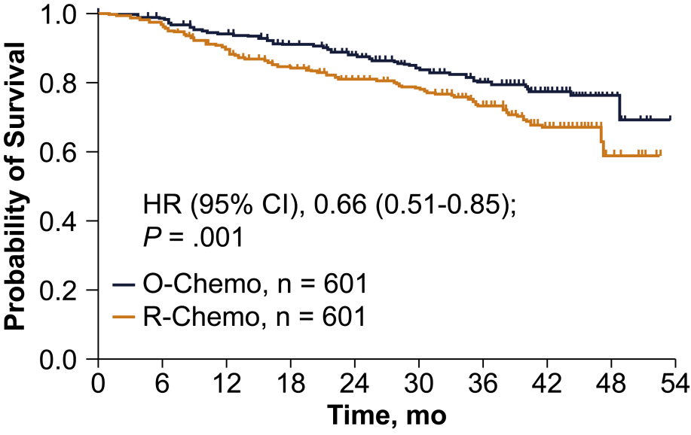
GALLIUM: Obinutuzumab Improves PFS vs Rituximab for Previously Untreated FL¹
Obinutuzumab-based immunochemotherapy and maintenance substantially prolonged PFS versus rituximab-based therapy
High-grade AEs more common with obinutuzumab therapy
  Infection/infestation, cytopenias, and infusion reactions
Primary Endpoint: Investigator-Assessed PFS
Survival, Probability
HR: 0.66 (95% CI, 0.51-0.85)
P = .001
3-year PFS
80.0%
73.3%
O-chemo, n = 601
R-chemo, n = 601
Take-home point: Rituximab can be replaced with obinutuzumab
in upfront treatment protocols for patients with FL

Slide 33
Immunomodulatory Agents in Hematologic Cancers
Lenalidomide
Thalidomide
Pomalidomide
Avadomide
(cereblon modulator)
Agent
Approved
in myeloma, MCL, MDS
Phase 3 testing in NHL
Approved
in myeloma
Approved
in myeloma
Clinical trials in NHL and solid tumors
Current Status/
Indications

Slide 34
Phase 3 Evidence Supports the Use of Lenalidomide + Rituximab in Relapsed NHL
Phase 3b MAGNIFY study¹
Tested lenalidomide + rituximab (R²) induction → R² versus rituximab maintenance in R/R NHL
  R² regimen was active in FL patients who were double-refractory (DR) or who had early relapse (<2 y) after initial diagnosis
  R² active regardless of number of lines of prior therapy

Slide 35
Phase 3 Evidence Supports the Use of Lenalidomide + Rituximab in Relapsed NHL (Cont’d)
Phase 3 AUGMENT study¹
N = 358, 82% with FL; median number of prior systemic treatments = 1
R² regimen associated with improved PFS in R/R FL vs rituximab alone
  Meaningful improvements with R² versus R in ORR, CR, DOR, and TTNLT
Patients, n
178
180
Median PFS, mo (95% CI) 39.4 (22.9-NE)
14.1 (11.4-16.7)
R²
R-Placebo
Progression-Free Survival,
Probability (IRC Assessment)
P < .0001
HR: 0.46 (95% CI, 0.34-0.62)
Months From Randomization
No. at Risk
R²
Rituximab + placebo
178 | 148 | 124 | 91 | 59 | 39 | 20 | 7 | 0
180 | 132 | 92 | 58 | 40 | 26 | 10 | 4 | 0
Take-home point: An important new chemo-sparing treatment option in
patients with previously treated FL/MZL, with meaningful advantages over
single-agent rituximab

Slide 36
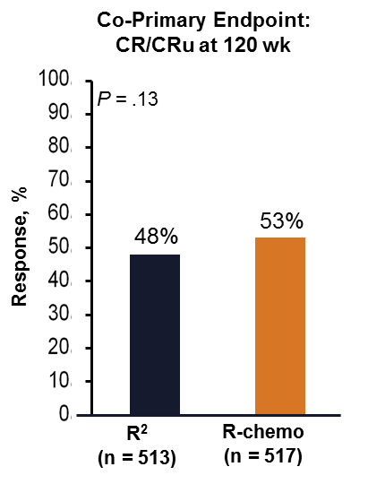
Chemo-Sparing Options in Newly Diagnosed FL:
R² and the RELEVANCE Study
Similar efficacy results between R² and
R-chemo (based on PFS and mature CR data at 120 weeks)¹
Safety differences between treatment arms
  R-chemo: more frequent neutropenia, FN, growth factor usage, nausea, vomiting, neuropathy, alopecia
  R²: more frequent cutaneous reactions, tumor flare, diarrhea
Ultimately, R² is a potential first-line option in patients with FL requiring treatment
 | R² (n = 513) | R-Chemo (n = 517)
Events, n (%) | 119 (23) | 111 (21)
3-y PFS (95% CI) | 77% (72-80) | 78% (74-82)
HR (95% CI); P | 1.10 (0.85-1.43); 0.48

Slide 37
PI3K Inhibitors in Relapsed/Refractory FL
Duvelisib¹
Based on results of the phase 3 DYNAMO study, duvelisib was recently FDA approved for use in R/R FL after ≥2 prior therapies
Copanlisib²
Intravenously administered PI3K agent tested in CHRONOS-1 trial
FDA approved for R/R FL after ≥2 prior therapies

Slide 38
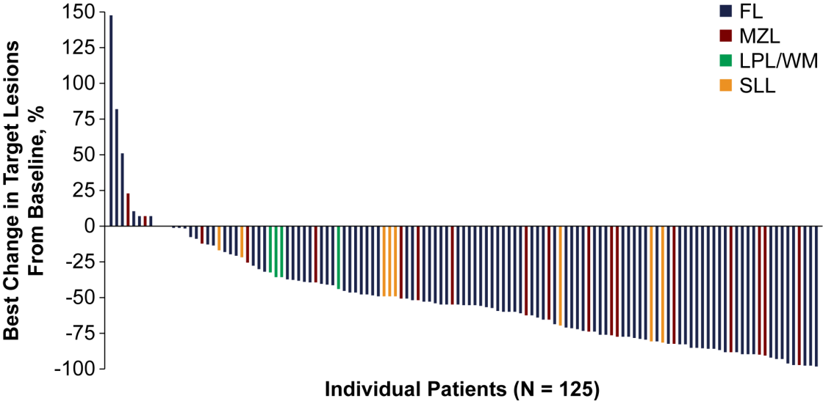
Evidence From CHRONOS-1 Led to FDA Approval of Copanlisib in R/R FL¹
Phase 2 study
142 patients with relapsed or refractory indolent lymphoma after ≥2 lines of therapy
Copanlisib 60 mg intravenously on days 1, 8, and 15 of a 28-day cycle
Copanlisib active in R/R indolent NHL with an objective response rate: 59% (84 of 142 patients)
Activity confirmed in updated analysis²
Median PFS of 11.3 mo
Notes:
In this phase II study, 142 patients with relapsed or refractory indolent lymphoma after two or more
lines of therapy were enrolled to receive copanlisib 60 mg intravenously on days 1, 8, and 15 of a 28-
day cycle. The primary end point was objective response rate; secondary end points included
duration of response, progression-free survival, and overall survival. In addition, safety and gene
expression were evaluated.

Slide 39
Evidence From CHRONOS-1 Led to FDA Approval of Copanlisib in R/R FL¹ (Cont’d)
Low rate of individual severe toxicities overall, lack of late-onset toxicities with long term follow up (29.6% with >1 year) suggests that intermittent IV dosing may contribute to favorable safety profile for copanlisib
SAEs included: pneumonia 11.3%, hyperglycemia 4.9%, pneumonitis 4.2%, neutropenia 2.8%, and diarrhea 2.8%
Take-home point: Copanlisib is active in R/R FL
and represents a different way of administering PI3K therapy

Slide 40
Copanlisib Dosing, Administration, and Safety¹
Approved Dosing
For patients with relapsed FL who have received ≥2 prior therapies 60 mg administered as a 1-hour infusion on days 1, 8, and 15 of a 28-day treatment cycle on an intermittent schedule (3 weeks on, 1 week off)
Administration Issues
Monitor patients for signs and symptoms of infection, withhold treatment for infections ≥grade 3 until resolution Monitor for hyperglycemia and hypertension
Dose Reductions
Reduce dose to 45 mg if a strong CYP3A inhibitor must be used
1. Aliqopa (copanlisib). Prescribing Information. http://labeling.bayerhealthcare.com/html/products/pi/Aliqopa_PI.pdf. Accessed March 29, 2019.

Slide 41
Special Considerations for Use of Novel Anti-CD20 Antibodies¹⁻³
Obinutuzumab
Minimize infusion reactions
Divide initial dose over 2 days
Premedicate patients with steroids/antihistamines
Anticipate TLS: Premedicate patients with antihyperuricemics and adequate hydration, especially those with high tumor burden and/or high circulating lymphocyte count
Monitor for infections, cytopenias,
GI events
Dosing:
CLL: 100 mg on d 1 + 900 mg on d 2 of cycle 1 + 1,000 mg on d 8 + 15 of cycle 1 + 1,000 mg on d 1 of cycles 2-6
FL: 1,000 mg on d 1, 8, 15 of cycle 1 + 1,000 mg on d 1 of cycles 2-6 or cycles 2-8, and then 1,000 mg every 2 mo for up to 2 y
Notes:
CLL: 100 mg on d 1 + 900 mg on
d 2 of C 1 + 1,000 mg on d 8 + 15
of C 1 + 1,000 mg on d 1 of C 2-6
• FL: 1,000 mg on d 1, 8, 15 of C1 +
1,000 mg on d 1 of C 2-6 or C 2-8,
and then 1,000 mg every 2 mo
for up to 2 y

Slide 42
Clinical Considerations With IMiDs (Lenalidomide)¹
MCL
Starting dose 20-25 mg/day by mouth,
days 1-21 (28-day schedule) in MCL
Dose used for R² regimen in FL (AUGMENT):
20 mg/day on days 1-21 (28-day schedule)
for 12 cycles
10 mg if CrCl was 30-59 mL/min
  Dose modification recommended to manage grade 3/4 neutropenia or thrombocytopenia; initial dose adjustments recommended in cases of renal impairment
Thromboprophylaxis Recommended
In AUGMENT study, anticoagulation or antiplatelet therapy used for patients
at risk
GFS (based on ASCO/ESMO guidelines)
also used
Monitor for TLS/tumor flare; monitor liver function
Patient education and supportive care for AEs such as fatigue, rash, neutropenia, and GI events

Slide 43
MCL: Novel Agents and Implications for
Patient Care

Slide 44
To Date, Most Novel Agents Have Applications as Second-Line Therapy in MCL (NCCN)¹
Induction Therapy
Second-Line Therapy
Aggressive
CALGB regimen
Hyper-CVAD + rituximab
NORDIC regimen
Sequential R-CHOP/RICE
Alternating R-CHOP/
R-DHAP
Less Aggressive
BR
R-CHOP → consolidation with rituximab maintenance
Lenalidomide + rituximab
VR-CAP
Modified hyper-CVAD + rituximab → rituximab maintenance (age >65 y)
RBAC
Short Response
After Prior Therapy
Preferred
Acalabrutinib
Ibrutinib ± rituximab
Lenalidomide ± rituximab
Venetoclax
Other
Ibrutinib + rituximab + lenalidomide
Venetoclax + ibrutinib
Extended Response After Prior Therapy
Preferred
BRª
Bortezomib ±rituximab
Other
Small molecule inhibitors
Bendamustine, bortezomib, rituximab
PEPC ± rituximab
R-CHOP,ª VR-CAP
First-line consolidation: HDT + autologous stem cell rescue or rituximab if not eligible for SCT
Second-line consolidation: AlloSCT (myeloablative or nonmyeloablative)
Notes:
Bortezomib ± rituximab (2006)
Bendamustine ± rituximab (2008)
Ibrutinib (2013)
Lenalidomide ± rituximab (2013)

Slide 45
Ibrutinib in MCL^{1,2}
Single-agent ibrutinib active in R/R MCL (N = 111)
560 mg/day (dose differs from that used in CLL)
ORR, 67%; median PFS, 13 months; median OS, 22.5 months
Most common AEs: diarrhea, fatigue, and nausea, with grade 3 hematologic toxicity uncommon (<20%)
Ibrutinib-based combinations also active in MCL³
Ibrutinib + venetoclax with ~70% ORR
Ibrutinib is approved for use in patients with MCL
who have received at least one prior therapy

Slide 46
Acalabrutinib in MCL^{1,2}
Acalabrutinib active in R/R MCL based on phase 2 data
ORR was 81%, with 40% attaining a CR
Similar safety profile to that seen in CLL
Acalabrutinib approved for use in adult patients with MCL
who have received at least one prior therapy
Notes:
ACE-LY-004

Slide 47
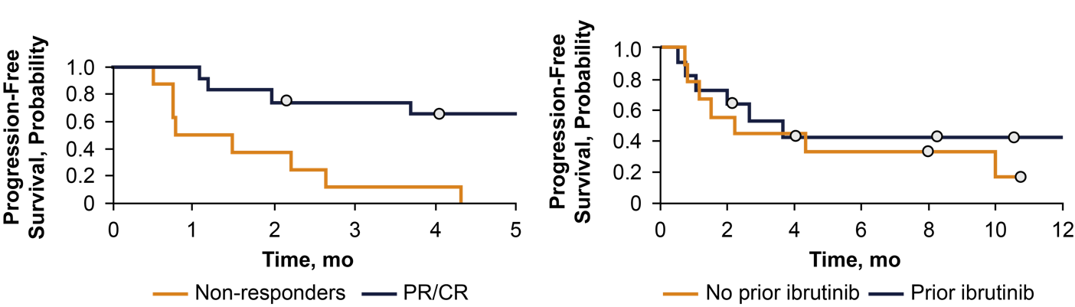
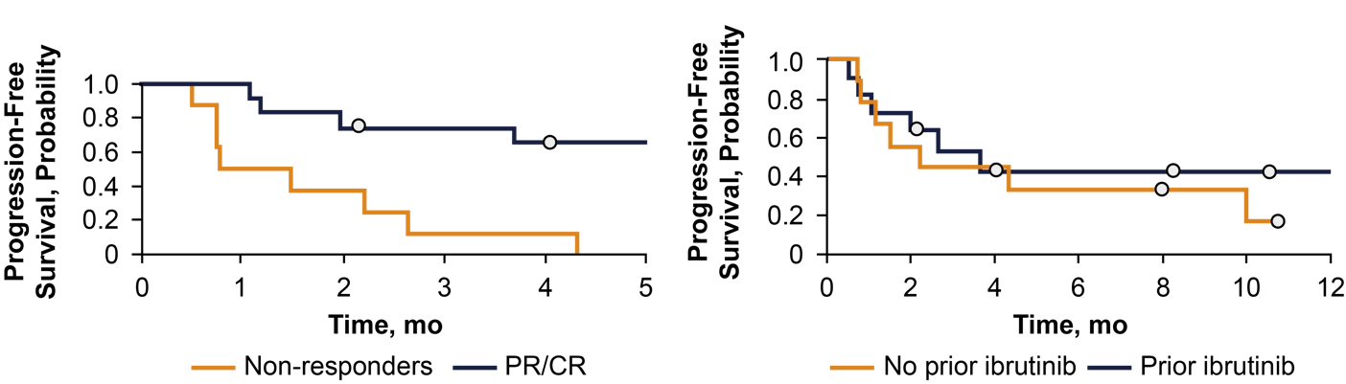
Evidence Suggests Venetoclax Can Be Used
After a BTK Inhibitor in Relapsed MCL1
In a recent study, venetoclax monotherapy was associated with an ORR of 60% in patients with poor-risk R/R MCL previously treated with a BTK inhibitor
Duration of Response
(PR/CR vs Non-Responders; P = .001)
Progression-Free Survival
by Prior Ibrutinib Response (P = .558)
Phase 3 SYMPATICO study now testing venetoclax + ibrutinib in R/R MCL

Slide 48
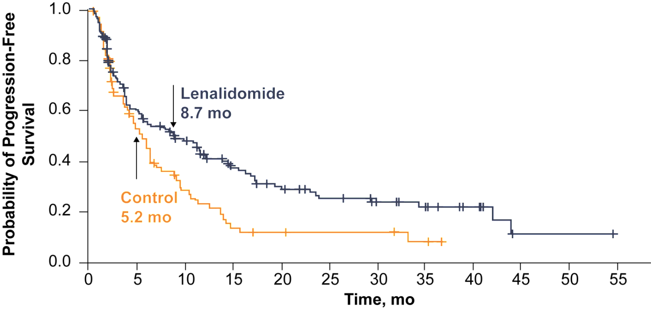
SPRINT: Lenalidomide vs Investigator’s Choice for Relapsed/Refractory MCL¹
Approved in R/R MCL; recommended starting dose 25 mg/d by mouth, day 1-21
Take-home point: Lenalidomide reduced the risk for PD or death by 39% versus
investigator’s choiceª, reflected as an estimated improvement in median PFS of 3.5 mo

Slide 49
Lenalidomide + Rituximab as Initial and Maintenance Therapy Is Active in MCL¹
5-year follow-up data available for lenalidomide + rituximab doublet in newly diagnosed MCL (n = 38)
Regimen tested as induction and maintenance, with treatment continuous until progression
  3-year PFS and OS were 80% and 90%
  5-year estimated PFS and OS of 64% and 77%
  AEs included those typically noted with IMiD therapy, including cytopenias
Take-home point: LR shows durable responses and manageable safety
as initial induction and maintenance therapy for MCL
Notes:
We report 5-year follow-up of a multicenter phase 2 study of lenalidomide plus rituximab (LR) as initial treatment of mantle cell lymphoma (MCL). The regimen includes induction and maintenance with the LR doublet. Treatment was continuous until progression, with optional discontinuation after 3 years. The median age of the 38 participants was 65 years, with MCL international prognostic index scores balanced among low, intermediate, and high risk (34%, 34%, and 32%, respectively). Twenty-seven (75%) of the 36 evaluable patients completed ≥3 years of study treatment. At a median follow-up of 64 months (range, 21-78), the 3-year progression-free survival (PFS) and overall survival (OS) were 80% and 90%, respectively, with 5-year estimated PFS and OS of 64% and 77%, respectively. During maintenance, hematologic adverse events (AEs) included asymptomatic grade 3 or 4 cytopenias (42% neutropenia, 5% thrombocytopenia, 3% anemia) and mostly grade 1 or 2 infections managed in the outpatient setting (45% upper respiratory infection, 21% urinary tract infection, 13% sinusitis, 11% cellulitis, 8% pneumonia). Nonhematologic AEs, such as constitutional and inflammatory symptoms, occurred at reduced frequency and intensity compared with induction. A peripheral blood minimal residual disease (MRD) assay (clonoSEQ) showed MRD-negative complete remission in 8 of 10 subjects who had completed ≥3 years of treatment and with available samples for analysis. With longer follow-up, LR continues to demonstrate durable responses and manageable safety as initial induction and maintenance therapy for MCL

Slide 50
Novel Therapies for DLBCL
Recent Evidence on CAR-T Therapy

Slide 51
Progress in Integrating Novel Agents Into DLBCL Management Has Been More Incremental¹
Summary of Current NCCN Recommendations
Induction Therapy
First-line therapy largely remains focused on R-CHOP (category 1)
No clinical consensus on dose-dense R-CHOP14; R-EPOCH an alternative first-line options
Anthracycline-sparing immunochemotherapy for patients with poor left ventricular function
eg, RCEEP, DA-EPOCH, RCEOP, and many others
Modified immunochemotherapy also available for frail or very elderly patients (>80 years of age)
with comorbidities (eg, R-miniCHOP)
First-Line Consolidation
Lenalidomide maintenance in patients ages 60-80 years
Age-adjusted high-risk IPI: HDT + ASCT
Notes:
Bortezomib ± rituximab (2006)
Bendamustine ± rituximab (2008)
Ibrutinib (2013)
Lenalidomide ± rituximab (2013)

Slide 52
Progress in Integrating Novel Agents Into DLBCL Management Has Been More Incremental¹ (Cont’d)
Second-Line and Subsequent Therapy
HDT candidates: Multi-agent chemotherapy (DHAP, ICE, ESHAP, others) ±rituximab
Non-HDT candidates: Chemotherapy (DA-EPOCH, bendamustine, CEPP, others) ±rituximab
Several investigational strategies noted as potential options in non-HDT candidates
Brentuximab vedotin for CD30-expressing disease
Ibrutinib (non-GCB disease)
Lenalidomide ± rituximab (non-GCB disease)
Axicabtagene ciloleucel
  R/R large B-cell lymphomas ≥2 prior therapies (DLBCL NOS, high-grade B-cell lymphoma, primary mediastinal large B-cell lymphoma, DLBCL [arising from FL])
Tisagenlecleucel
  R/R large B-cell lymphoma ≥2 lines of therapy (DLBCL NOS, high-grade B-cell lymphoma, DLBCL [arising from FL])
CAR-T cell therapy approved after
several lines
of prior therapy
Notes:
Bortezomib ± rituximab (2006)
Bendamustine ± rituximab (2008)
Ibrutinib (2013)
Lenalidomide ± rituximab (2013)

Slide 53
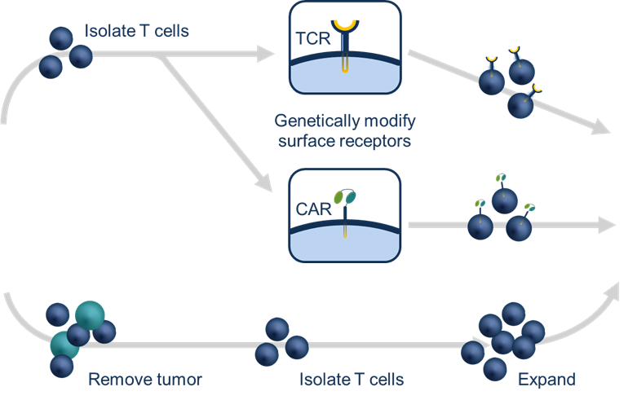

Understanding CAR-T Cell Therapy in NHL¹
T cells isolated and genetically engineered
to express a modified T-cell receptor
2
Engineered cells given back to the patient, where they often expand in response to exposure to the tumor
T cells taken from patient with cancer
1
3
2 weeks
Tumor infiltrating leukocytes
Patient
2-3 months
Patient

Slide 54
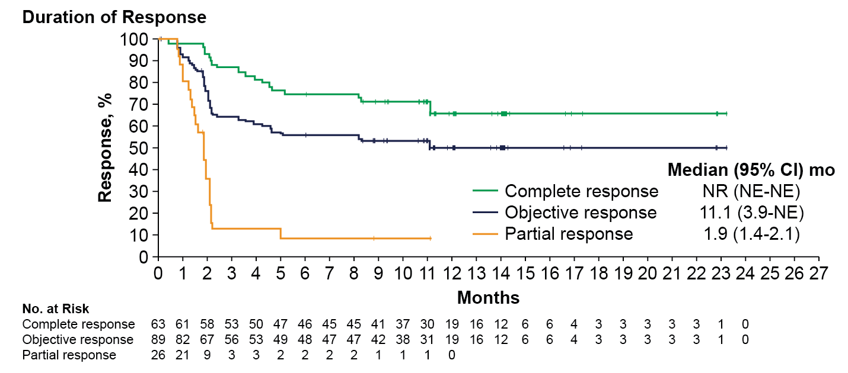
What Are the CAR-T Options?
Axicabtagene Ciloleucel in Refractory NHL¹
Axicabtagene ciloleucel: autologous
anti-CD19 tested in ZUMA-1 trial
  N = 111 patients with refractory
  large B-cell lymphoma after the
  failure of conventional therapy
  ORR of 82%, CR of 54%
  Higher CAR-T cell levels in blood
  associated with response
  OS at 18 months: 52%
Grade 3 or higher CRS and neurologic events in 13% and 28% of the patients, respectively
Take-home point: Axi-cel is associated with high levels of durable response;
it is FDA approved for R/R DLBCL after ≥2 prior therapies
Notes:
Tisagenlecleucel is a CD19-directed genetically modified autologous T-cell immunotherapy (CAR T-cell therapy)

Slide 55
Tisagenlecleucel in R/R NHL
Tisagenlecleucel (CTL019) in R/R DLBCL or Transformed FL¹
Assessed in JULIET trial
Median DOR not reached
  DOR similar by age group (≥65 vs <65 y) and by relapsed or refractory status
Estimated RFS rate: 6 months: 66%; 12 and 18 months: 64%
Median OS, 11.1 months for all patients who received infusion
  Not reached for patients in CR
  Estimated OS rate: 12 months, 48%; 18 months 43%
No patients proceeded to allogenic SCT or ASCT while in remission
FDA approved for R/R DLBCL, high grade B-cell lymphoma,
and DLBCL arising from FL after ≥2 prior therapies
Notes:
Tisagenlecleucel is a CD19-directed genetically modified autologous T-cell immunotherapy (CAR T-cell therapy)

Slide 56
TRANSCEND NHL 001: Lisocabtagene Maraleucel (JCAR017) in R/R DLBCL¹
In total, 37 patients with R/R DLBCL received the pivotal dose of liso-cel: single dose of 1×10⁸ cells
  ORR at 6 months was 49%, with 46% CR
  Toxicities were well managed
  Only 1% of patients experienced grade 3 or higher CRS;13% experienced grade 3 or 4 neurotoxicity
Duration of Response (CORE; all DL)
100
80
CR: NR (95% CI, 5.0-NR)
60
Survival, %
40
All: 9.2 months (95% CI, 3.7-NR)
20
0
+ Censored
PR: 2.1 months (95% CI, 1.0-5.0)
0
3
6
9
12
15
No. at Risk
Time, mo
CR
PR
All
36
16
52
22
2
24
12
0
12
7
7
1
1
1
1
Take-home point: Liso-cel shows durable responses in patients with heavily pretreated R/R DLBCL; observed acute toxicities have been manageable at all DLs tested
1. Abramson J et al. ASCO 2018. Abstract 7505.

Slide 57
Challenges to the Wider Implementation of
CAR-T Therapy
Patient-specific therapy
  Patient characteristics can effect their ability to generate cells and those characteristics are likely important in the development of toxicities
Current products and products under development for NHL are quite different, and this aspect may translate into clinical effectiveness and toxicity. Differences include:
  May have different biological characteristics (CD28 vs 4-1BB)
  May contain different mixtures of T-cell subsets
  May have be grown and produced using different technology
  May be administered at different doses
Toxicity management recommendations across products is NOT the same
  Risk Evaluation and Mitigation Strategy (REMS) program required
  Can require administration and management in specialized centers with experience

Slide 58
Assessment and Management of Acute Toxicities With CAR-T Cell Therapy¹
Three-Step Approach
Determine T-Cell Toxicity
Step 1
CRS
Fever
Hypotension
Hypoxia
Organ toxicity (cardiac, respiratory, GI, hepatic,
renal, dermatologic, coagulopathy)
CRES
CARTOX-10 (orientation/alertness, name objects, writing, counting)
Seizures (convulsive, nonconvulsive)
Increased ICP (CSF opening pressure, papilloedema,
cerebral edema)
Motor weakness
HLH/MAS
Ferritin level
Hepatic toxicity
Renal toxicity
Pulmonary toxicity
Hemophagocytosis
Step 2
Grade CRS
Grade CRES
Grade organ toxicity
as per CTCAE
Step 3
Manage according
to grade of CRS
Manage according
to grade of CRES
Manage HLM/MAS
as per algorithm

Slide 59
Example of Nurse Checklist for Use of CAR-T Cell Therapy (Axi-Cel)¹
For a patient preparing
for CAR-T cell therapy
Not indicated for the treatment
of patients with
primary CNS lymphoma
Target dose
is 2 × 10⁶
(max 2 × 10⁸)
CAR-positive viable T cells per kg body weight
Administer a lymphodepleting regimen of cyclophosphamide
and fludarabine before infusion; premedicate with acetaminophen and an H1-antihistamine
Do not administer to patients
with active infection
or inflammatory disorders
Treat severe or life-threatening CRS with tocilizumab ± corticosteroids
Monitor for neurologic toxicities
and provide supportive care and/or corticosteroids, as needed

Slide 60
Conclusions
Ongoing, positive results from multiple clinical trials have led to the approval of several novel agent classes across a range of B-cell malignancies (CLL/SLL, FL, MCL, DLBCL)
  BTK, PI3K, and Bcl-2 inhibitors
  IMiDs
  Next-generation antibodies
  CAR-T cell therapy
Much work needs to be done to optimize their use, including:
  Understanding & managing unique safety profiles that differ from traditional immunochemotherapy
  Application of successful patient education strategies to increase compliance with and adherence to novel regimens for B-cell lymphoma

Slide 61

Audience Q&A

Slide 62
Please remember to complete and submit your Post-Test and Evaluation for CME/CNE credit.
Missed anything?
Visit us at: PeerView.com/NHLnurse
Download slides and Practice Aids
Request a live meeting at your institution
Thank you and good day.

