Slide 1
Savannah River Site
Mike Budney
DOE-SR Manager
National Cleanup Workshop
September 12, 2019

Slide 2
Teaming to Tackle Complex Challenges
DOE-EM Environmental Management
DOE-NNSA National Nuclear Security Administration
Savannah River Nuclear Solutions (SRNS) Management & Operating Landlord Services • SRNL EM Cleanup (excl. Liquid Waste) NNSA Activities
U.S. Forest Service
Savannah River Remediation (SRR) Liquid Waste Operations
Parsons Salt Waste Processing Facility (SWPF)
Centerra-SRS Site Security
University of Georgia Savannah River Ecology Lab
Ameresco Biomass Cogeneration Facility
219
59
74
2,604
6,578
M&O coordinates landlord services for SRS tenants
598
Key
Federal Agency
Contractor
674
117
SRS Total Workforce = 11,093 (inclusive of permanent, support service, craft, part-time & grad students) 06/30/19
26

Slide 3
Major Acquisitions Ahead
NUCLEAR MATERIALS | SOLID WASTE | SOIL AND WATER REMEDIATION & FACILITY D&D | LIQUID WASTE STABILIZATION AND DISPOSITION
Savannah River Nuclear Solutions (including Savannah River National Laboratory) |  |  | Savannah River Remediation | Parsons SWPF
Awarded FY08 @ contract value of $5.4B Latest 14-mos. extension covers 8/1/19 – 9/30/20 With two 12-mos. options (10/1/20 – 9/30/22) Extension enables SRNS to maintain management and operating services while DOE develops an acquisition strategy and contract competition for these services |  |  | Awarded FY09 @ contract value of $4.9B Latest 18-mos. extension covers 3/31/19 – 9/30/20 New Integrated Mission Completion contract to include current LW scope, plus H Canyon and L Basin | Awarded FY02 to design, build and operate SWPF for one year Current contract value of $2.2B Anticipated contract completion in March 2021 Planned future integration into new SRS Integrated Mission Completion contract
Centerra – SRS Paramilitary Security Services
Awarded FY09 @ contract value of $989M Expires 10/7/19; Notice of Intent issued to extend contract 4 mos. through 02/07/20 with two 4-mos. options Final RFP issued 03/06/19; bids currently under evaluation

Slide 4
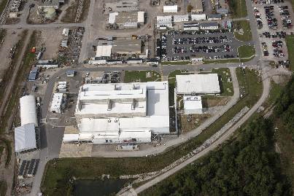
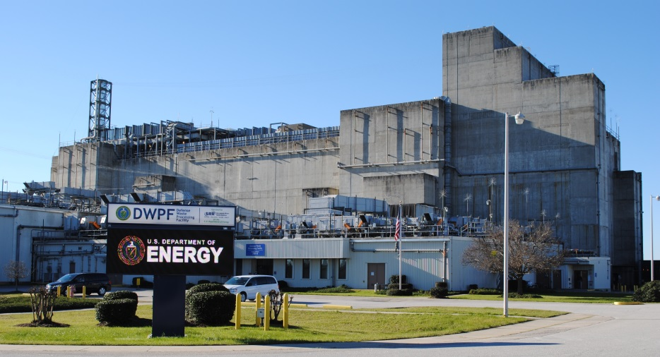
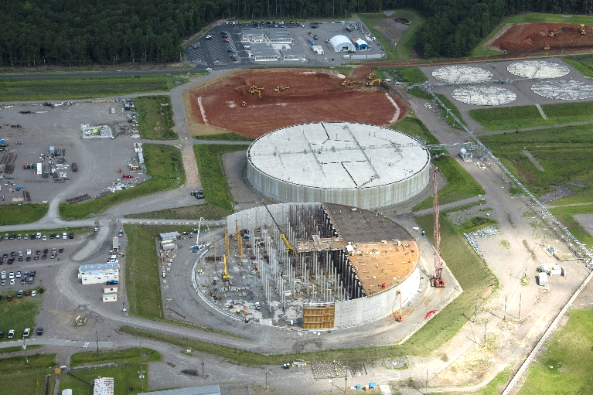
Remarkable Risk Reduction Results:
Salt Waste Processing Facility (SWPF)
Getting Cleanup Closer to Completion
Tank Waste Management/Closures provide safe treatment and disposition of 35Mgal liquid waste (LW) inventory stored in Tank Farms
SRS has closed and grouted 8 tanks since 2012
Only tank closures in DOE Complex
  SWPF will separate 90% inventory of tank salt waste into high-radioactive waste and decontaminated salt solution at a nominal operating capacity of up to 9 Mgal/yr
  SWPF startup is scheduled for 2020 and will be a major step toward emptying and closing the Site’s remaining 43 high-level waste tanks
DWPF continues vitrification of radioactive sludge waste within 10-ft tall stainless steel canisters
Over 4,200 canisters produced in 23 years of operations
Nation’s only operating vitrification plant
  New 32Mgal mega-vault Saltstone Disposal Units (SDUs) provide safe long-term storage of decontaminated salt solution grouted with cementitious materials
Defense Waste Processing Facility (DWPF)
SDU8
SDU6
SDU7

Slide 5
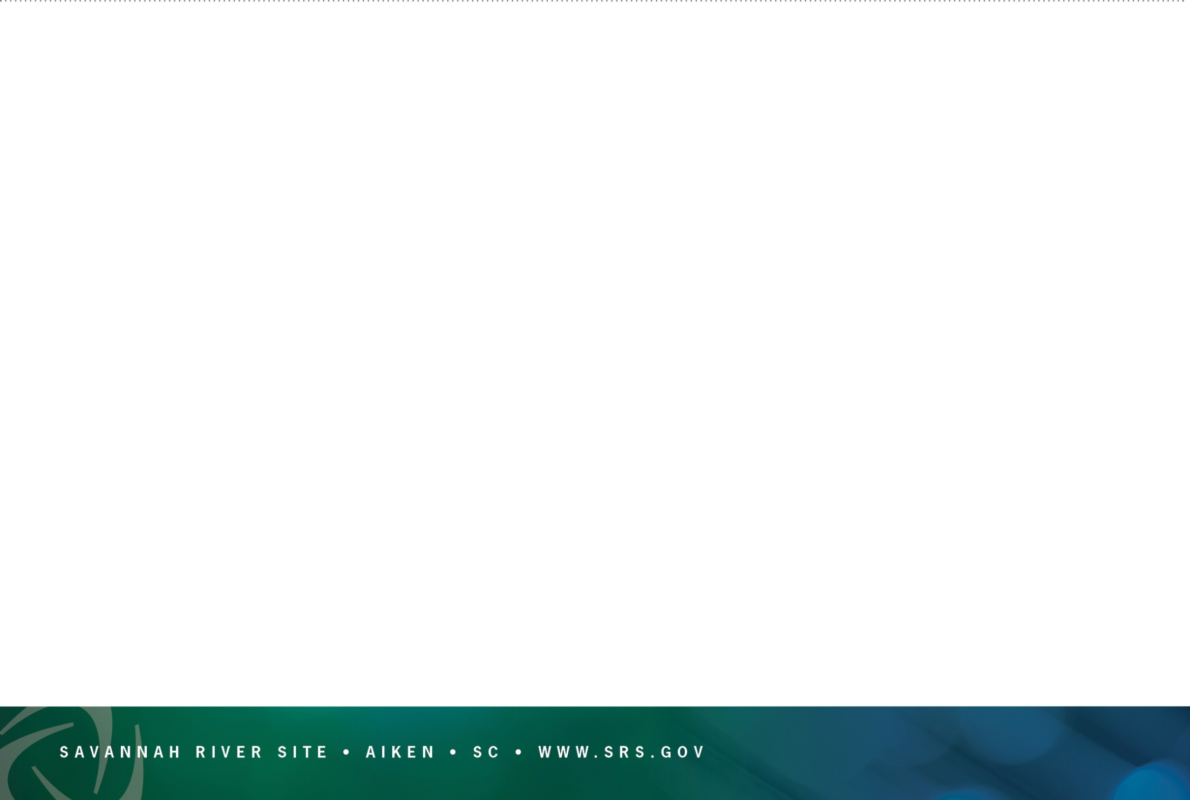
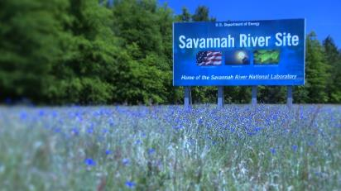
SRS Looking to the Future
  Continue legacy of safety and protecting the public, our employees and the environment
  Continue effective treatment and disposition of liquid waste inventory
  **SRS is uniquely positioned for a complete LW cleanup solution ― once SWPF is operational, all pieces will be in place
Evaluate opportunity to further accelerate LW cleanup based on re-interpretation of certain wastes
Assure ability to maintain unique nuclear materials processing capabilities
Determine future of H Canyon
Address SRS common infrastructure needs (many SRS common infrastructure > 45-60 years old)
  Integrate plutonium down-blend program with TRU waste program
  Continue soil and water remediation activities and decontamination and decommission of excess facilities
  Continue growth of SRNL expertise to advance national programs and priorities
  Continue increased focus on STEM initiatives and building next generation SRS workforce
5
5

