Slide 1
Why PARCC Matters – Even if it is Going Away.

Slide 2
PARCC – Background
Standardized Testing
Required by Federal Mandate (ESSA)
Determined by States (MSDE, for Maryland)
In 2010, 24 states adopted PARCC; 2018, 7 still using
Implemented by Districts (MCPS, Howard, PG, etc.)
Partnerships for Assessing Readiness for College and Careers (PARCC) replaced Maryland State Assessments (MSA)
Provided better, more comprehensive assessment
Time consuming testing instrument – ?? Value ??

Slide 3
Why PARCC is Important
External Assessments are Important!
Grades are an important factor in student growth, but are subjective.
PARCC (or whatever instrument we adopt) lets us look across a large system and identify gaps.
PARCC gives us insight in our Students’ abilities
If a student does really well in the class but does dismally on the test, it could be an indication of other issues.
PARCC gives us opportunity to ask about (and understand) our particular School’s approach
Does PARCC score influence next course?
Should it?

Slide 4
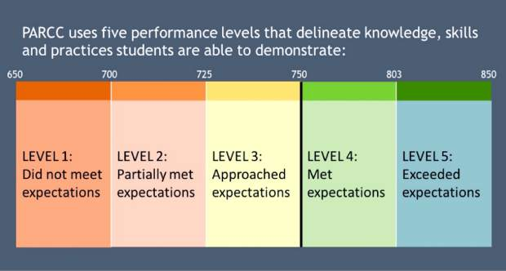
PARCC Scale --

Slide 5
When I look at the PARCC data...
 |  |  | 1 | 2 | 3 | 4 | 5 |  | % of 4/5 | % 3/4/5 | % Not passing
2018 Algebra 1 |  |  | 2090/16826 12.4% | 3731/16826 22.2% | 4180/16826 24.8% | 5956/16826 35.4% | 869/16826 5.2% |  | 40.6% | 65.4% | 34.6%
2017 Algebra 1 |  |  | 1503/14246 10.6% | 2970/14246 20.8% | 3670/14246 25.8% | 5464/14246 38.4% | 639/14246 4.4% |  | 42.8% | 68.6% | 31.4%
2016 Algebra 1 |  |  | 1417/12470 11.4% | 2633/12470 21.1% | 2900/12470 23.3% | 5099/12470 40.9% | 421/12470 3.3% |  | 44.2% | 67.5% | 32.5%
2015 Algebra 1 |  |  | 818/10860 7.5% | 2937/10860 27% | 2922/10860 26.9% | 3911/10860 36% | 272/10860 2.5% |  | 38.5% | 65.4% | 34.6%

Slide 6
When I look at the PARCC data...
 |  |  | 1 | 2 | 3 | 4 | 5 |  | % of 4/5 | % 3/4/5 | % Not passing
2016 8th ELA |  |  | 1542/11004 14% | 1736/11004 15.8% | 2455/11004 22.3% | 4333/11004 39.4% | 938/11004 8.5% |  | 47.9% | 70.2% | 29.8%
2018 10th ELA |  |  | 2073/13325 15.6% | 1558/13325 11.7% | 2205/13325 16.5% | 4341/13325 32.6% | 3148/13325 23.60% |  | 56.2% | 72.7% | 27.3%
 |  |  | 1 | 2 | 3 | 4 | 5 |  | % of 4/5 | % 3/4/5 | % Not passing
2016 8th ELA |  |  | 59/389 15.2% | 55/389 14.1% | 104/389 26.7% | 142/389 36.5% | 19/389 4.9% |  | 41.4% | 68.1% | 29.3%
2018 10th ELA |  |  | 121/484 25% | 77/484 15.8% | 72/484 14.9% | 159/484 32.9% | 55/484 11.4% |  | 44.3% | 59.2% | 40.8%

Slide 7
Questions I would ask...
Since passing Algebra 1 PARCC and PARCC English 10 are both HS graduation requirements, parents whose children aren’t PASSING should understand...
Should a child repeat Algebra 1 in 9th grade if they didn’t pass the Alg 1 PARCC in 8th?
Maybe... Good conversation to have!
Is the trajectory to Calc realistic? Is there a better path?
What is the prep to retake ELA10?
What is the “bridge project” option and how does that work?

Slide 8
At Elementary Levels...
I follow the cohort – looking at how same cohort performed to see if there is a pattern...

Slide 9
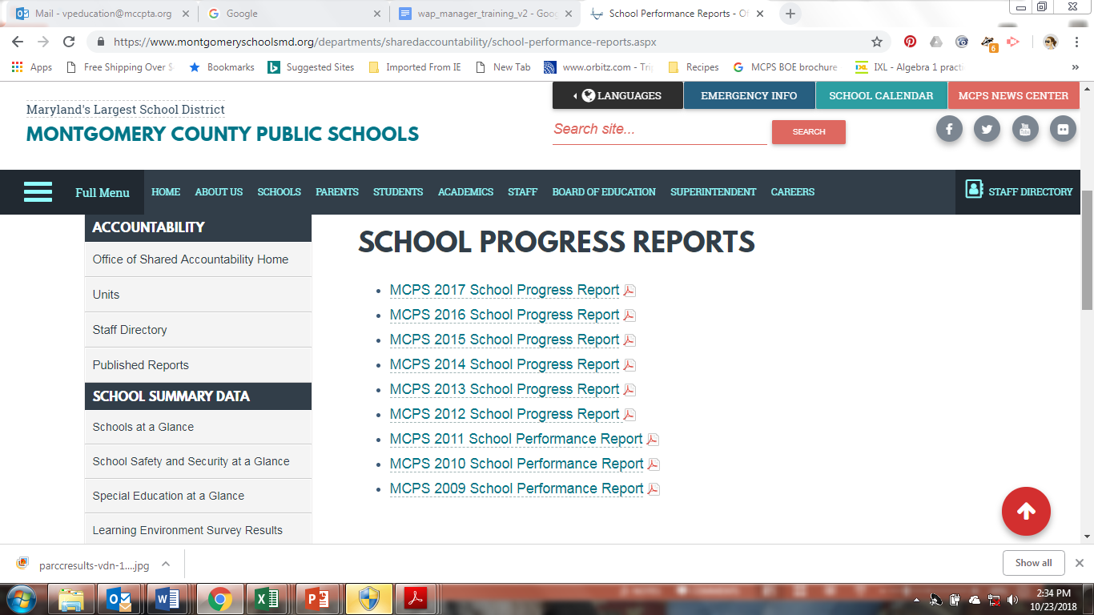
How Can I Find Out More??
https://www.montgomeryschoolsmd.org/departments/sharedaccountability/school-performance-reports.aspx

Slide 10
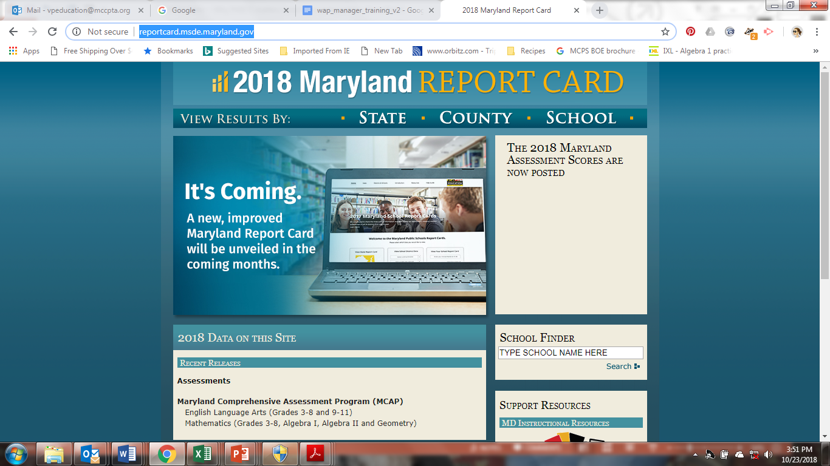
Still Want More??
http://reportcard.msde.maryland.gov/

