Slide 1

Low Slope Roofing Systems
The University of Wisconsin Madison
Madison, Wisconsin – November 30-December 1, 2021
Codes and standards presented by
Mark S. Graham
Vice President, Technical Services
National Roofing Contractors Association
Rosemont, Illinois

Slide 2
Definitions
Standard: something established for use as a rule or basis of comparison in measuring or judging capacity, quantity, content, extent, value or quality.
Code: 1) a body of laws, as a nation, city, etc., arranged systematically for easy reference; 2) any set of principles or rules of conduct (e.g., the moral code).

Slide 3
Roofing-related standards
Promulgators: AAMA, ASCE, ASTM, CSA, CSSB, FM, SPRI, UL and WDMA
Types of standards:
  Test method (e.g., ASTM E108)
  Specification/product standard (ASTM D6878)
  Practice (ASTM D7186)
  Guide (ASTM D6630) – Not enforceable

Slide 4
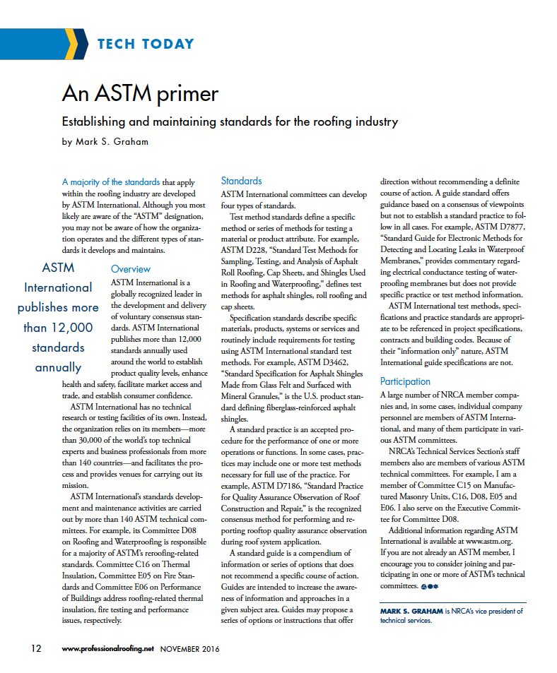
Professional Roofing,
November 2016
Link

Slide 5
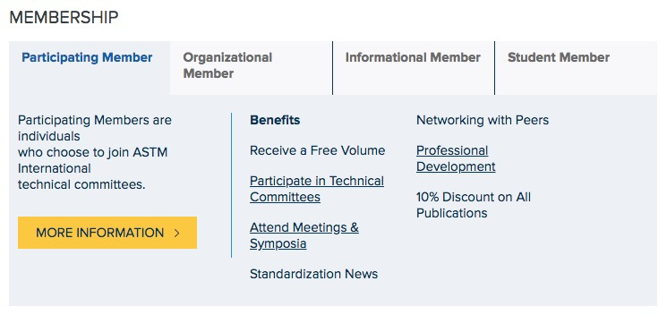
Consider becoming an ASTM member… www.astm.org
Most roofing-related standards are developed/maintained by Committee D08. Most roofing-related standards are contained in Vol. 4.04

Slide 6
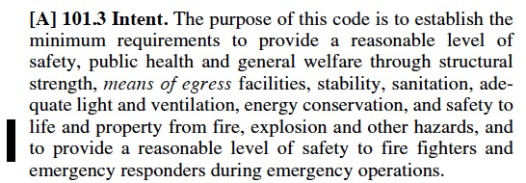
The purpose of the code
International Building Code, 2018

Slide 7
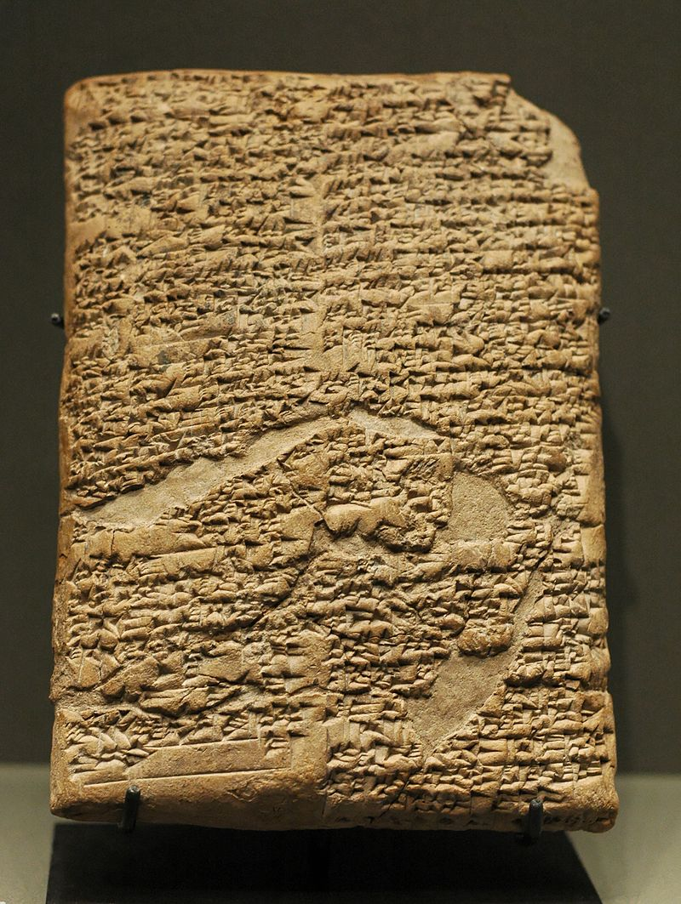
Code of Hammurabi
Babylonian empire (1754 BC)
282 laws, scaled punishment
“…an eye for an eye, a tooth for a tooth…”
Specific provisions to construction and contracts

Slide 8
Legacy codes
Early 1900s up to 1999
Building Officials and Code Administrators International (BOCA)
  The BOCA National Building Code
Southern Building Code Congress International (SBCCI)
  The Standard Building Code
International Conference of Building Officials
  Uniform Building Code

Slide 9
I-code publication cycle
2000 edition
2003 edition
2006 edition
2009 edition
2012 edition
2015 edition
2018 edition
2021 edition (Currently being published)
Three-year code development
and publication cycle

Slide 10
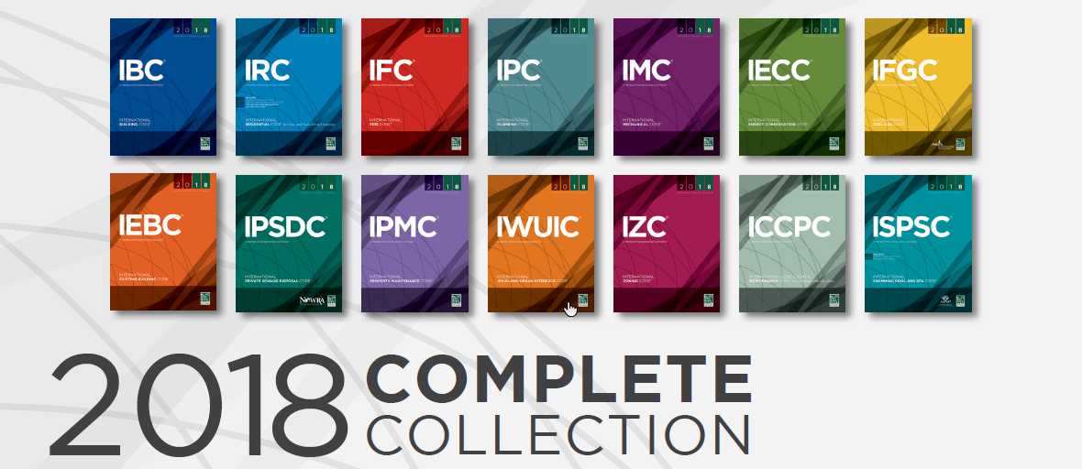

Slide 11
Some background
Current code concept
The I-codes are “model codes” developed by the International Code Council (ICC)
Model codes serve as the technical basis for state or local code adoption
The code provides the minimum legal requirements for building construction…and operation
The code is enforced by the “authority having jurisdiction” (AHJ)
The code can also provide a basis for construction claims-related litigation

Slide 12
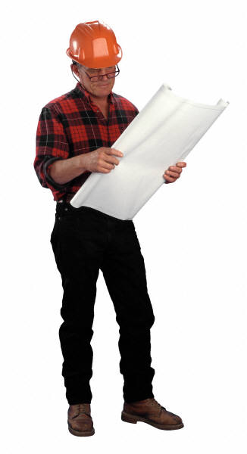

Code enforcement
Code official
Construction litigation

Slide 13
Legal considerations
“In most states, a building code violation is considered to be evidence of negligence. In some situations, a building code violation may be considered negligence per se…”
--Stephen M. Phillips
Hendrick, Phillips, Salzman & Flatt

Slide 14
Who is responsible?
The building owner
And, everyone else involved

Slide 15
AIA General Conditions
AIA A201 – General Conditions of The Contract for Construction
Article 3 Contractor
3.2.3 The Contractor is not required to ascertain that the Contract Documents are in accordance with applicable laws, statues, ordinances, codes, rules and regulations, or lawful orders of public authorities, but the Contractor shall promptly report to the Architect any nonconformity discovered by and made known to the Contractor as a request for information in such a form as the Architect may require.

Slide 16
AIA General Conditions
AIA A201 – General Conditions of The Contract for Construction
Article 3 Contractor
3.2.3 The Contractor is not required to ascertain that the Contract Documents are in accordance with applicable laws, statues, ordinances, codes, rules and regulations, or lawful orders of public authorities, but the Contractor shall promptly report to the Architect any nonconformity discovered by and made known to the Contractor as a request for information in such a form as the Architect may require.

Slide 17
AIA General Conditions
AIA A201 – General Conditions of The Contract for Construction
3.2.4 …If the Contractor fails to perform the obligations of Sections 3.2.2 or 3.2.3, the Contractor shall pay the costs and damages to the Owner as would have been avoided if the Contractor had performed such obligations. If the Contractor performs those obligations, the Contractor shall not be liable to the Owner or Architect for damages …for nonconformities of the Contract Documents to… codes…

Slide 18
AIA General Conditions
AIA A201 – General Conditions of The Contract for Construction
3.2.4 …If the Contractor fails to perform the obligations of Sections 3.2.2 or 3.2.3, the Contractor shall pay the costs and damages to the Owner as would have been avoided if the Contractor had performed such obligations. If the Contractor performs those obligations, the Contractor shall not be liable to the Owner or Architect for damages …for nonconformities of the Contract Documents to… codes…

Slide 19
So, it pays to know...
or, if you don’t know, I can cost you.

Slide 20
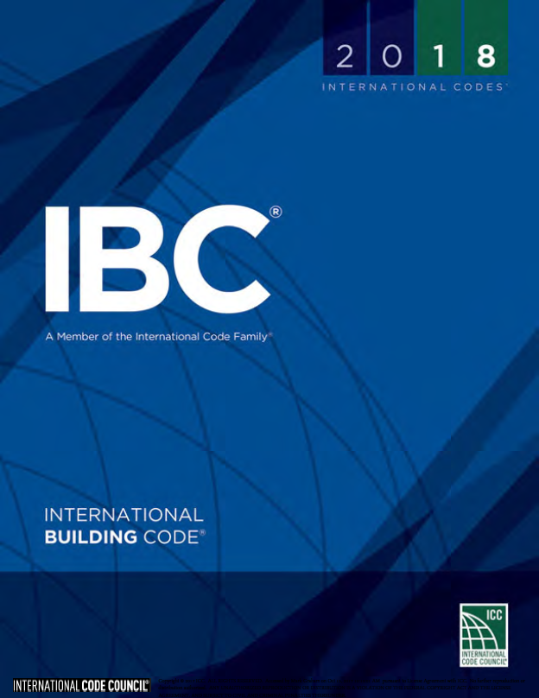
International Building Code, 2018 Edition
Applicable to all buildings and structures, excepts those applicable to IRC 2018
Roofing-related requirements:
  Ch. 10-Means of egress
  Ch. 12-Interior environment
  Ch. 13-Energy efficiency
  Ch. 15-Roof assemblies and rooftop structures
  Ch. 16-Structural design
  Ch. 20-Aluminum
  Ch. 22-Steel
  Ch. 24-Glass and glazing
  Ch. 26-Plastic

Slide 21
Significant roof requirements
International Building Code, 2015 Edition
Wind resistance
Fire classification
Installation requirements
Prescriptive requirements
Reroofing

Slide 22
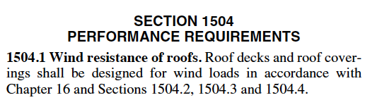
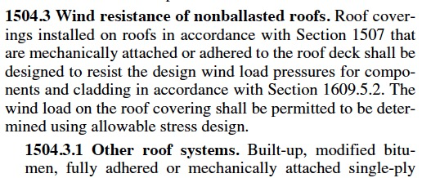

Wind resistance
International Building Code, 2018 Edition

Slide 23
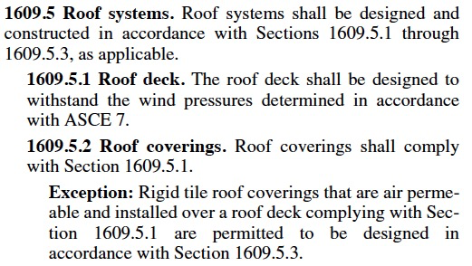

Slide 24
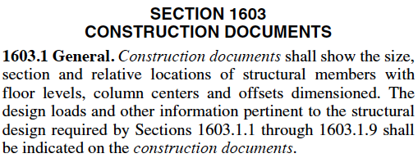
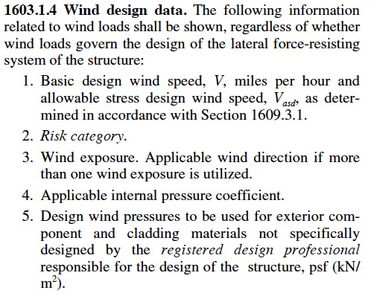

Slide 25
Professional Roofing
March 2014
Link

Slide 26
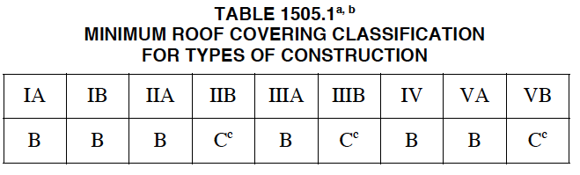
Fire classification
International Building Code, 2018 Edition, Sec. 1505-Fire Classification
Roof assemblies shall be tested and listed:
Class A: Severe fire-exposure
  Exceptions: Brick, masonry, exposed concrete deck; metal shingles or sheets, tile or slate on non-combustible decks; and copper or slate on non-combustible decks
Class B: Moderate fire-test exposure
Class C: Light fire-test exposure
[Footnoted omitted for clarity]

Slide 27

Look for listing or certification marks

Slide 28
Installation requirements
International Building Code, 2018 Edition, Sec. 1506-Materials
“…Roof coverings shall be applied in accordance with this chapter and the manufacturer’s installation instructions....”

Slide 29
Prescriptive requirements
International Building Code, 2018 Edition, Sec. 1507-Requirements for Roof Coverings
Deck
Slope: ¼” per ft., ⅛” per ft. for coal tar BUR
Material standards: Typically ASTM standards
Installation

Slide 30
Reroofing
International Building Code, 2018 Edition, Sec. 1511-Reroofing
“…recovering or replacing an existing roof covering shall comply with the requirements of Chapter 15....”
Exceptions:
Roof slope: “positive drainage” instead of ¼”per ft.
Secondary roof drains: Not required

Slide 31
Professional Roofing
February 2019
Link

Slide 32
International Residential Code, 2018 Edition
Applicable to one- and two-family dwellings and townhouses no more than three stories in height
Roofing-related requirements:
  Ch. 8-Roof/ceiling construction
  Ch. 9-Roof assemblies

Slide 33
Ch. 9-Roof assemblies
International Residential Code, 2018 Edition
Ch. 9 closely mirrors IBC Ch. 15’s requirements
Except IRC only requires fire classified roof assemblies where:
  Required by local ordinance
  Roof edge is less than 3 ft. from the lot line

Slide 34
IECC 2018:
Commercial buildings:
All except “Residential Buildings”
Residential buildings:
One- and two-family dwellings, multiple single-family dwellings and Group R-2, R-3 and R-4 buildings three stories or less

Slide 35
Roof requirements:
R-value
Roof reflectivity
Air retarder

Slide 36
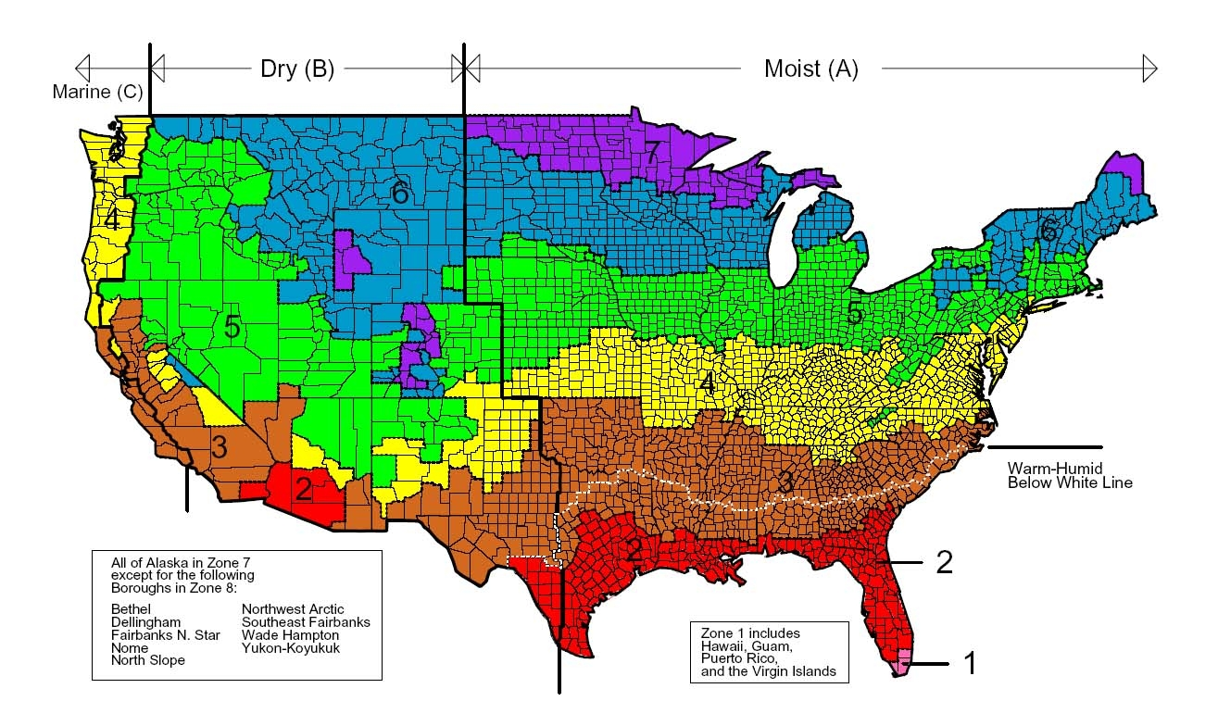
IECC 2018, Fig. C301.1-Climate zones
Fig. R301.1 (residential climate zones) is similar

Slide 37
Minimum R-value
IECC 2018: Commercial Buildings (Insulation component R-value-based method)
Climate zone | Assembly description
 | Insulation entirely above deck | Metal buildings | Attic and other
1 | R-20ci (all other) | R-19 + R-11 LS | R-38
 | R-25ci (Group R)
2 | R-25ci
3
4 | R-30ci |  | R-38 (except Marine 4)
5 |  |  | R-38 (all other) R-49 (Group R, Marine 4)
6 |  | R-25 + R-11 LS | R-49
7 | R-35ci | R-30 + R-11 LS
8
ci = Continuous insulation; LS = Liner system

Slide 38
Comparison of IECC’s various editions
Commercial Buildings (Insulation component R-value-based method)
Climate Zone | IECC 2003 | IECC 2006 | IECC 2009 | IECC 2012* | IECC 2015* | IECC 2018*
1 | R-12 ci | R-15 ci | R-15 ci | R-20 ci | R-20 ci | R-20 ci
2 | R-14 ci |  | R-20ci |  | R-25 ci | R-25 ci
3 | R-10 ci
4 | R-12 ci |  |  | R-25 ci | R-30 ci | R-30 ci
5 | R-15 ci | R-20 ci
6 | R-11 ci
7 | R-15 ci | R-25 ci | R-25 ci | R-30 ci | R-35 ci | R-35 ci
8
* Applies to roof replacement projects
ci = continuous insulation

Slide 39
Reflectivity
International Energy Conservation Code, 2018 Edition (Commercial)
C402.3 Roof solar reflectance and thermal emittance. Low-sloped roofs directly above cooled conditioned spaces in Climate Zones 1, 2 and 3 shall comply with one or more of the options in Table C402.3.
Exceptions: [omitted for clarity]
TABLE C402.3 MINIMUM ROOF REFLECTANCE AND EMITTNCE OPTIONS
Three-year solar reflectance of 0.55 and 3-year aged thermal emittance of 0.75
Three-year-aged solar reflectance index of 64
[Footnotes omitted for clarity]

Slide 40
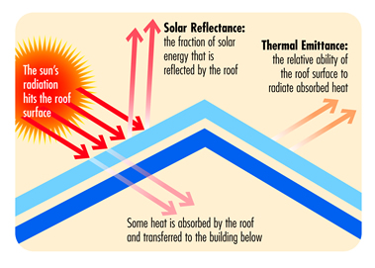
Courtesy of the Cool Roofs Rating Council

Slide 41
Definitions
Solar reflectance: The fraction of solar flux reflected by a surface expressed within the range of 0.00 and 1.00.
Thermal emittance: The ratio of radiant heat flux emitted by a surface to that emitted by a black body radiator at the same temperature expressed within a range of 0.00 to 1.00.

Slide 42
Definitions – cont.
Solar reflectance index (SRI): The relative steady-state surface temperature of a surface with respect to the standard white (SRI = 100) and standard black (SRI = 0) under standard solar and ambient conditions.
--ASTM E 1980

Slide 43
Air barriers
International Energy Conservation Code, 2018 Edition (Commercial), Sec. C402.5
“A continuous building envelope air barrier shall be provided throughout the building envelope….” (Except 2B)
Test methods:
Whole building: Not greater than 0.40 cfm/ft³
Assembly: Not greater than 0.04 cfm/ft³
Material: Not greater than 0.004 cfm/ft³
  Deemed to comply: BUR, MB, adhered single ply and SPF
Air barrier not required in reroofing projects unless also recladding (IECC 2018: Sec. C503.3.1 and C504.2)

Slide 44
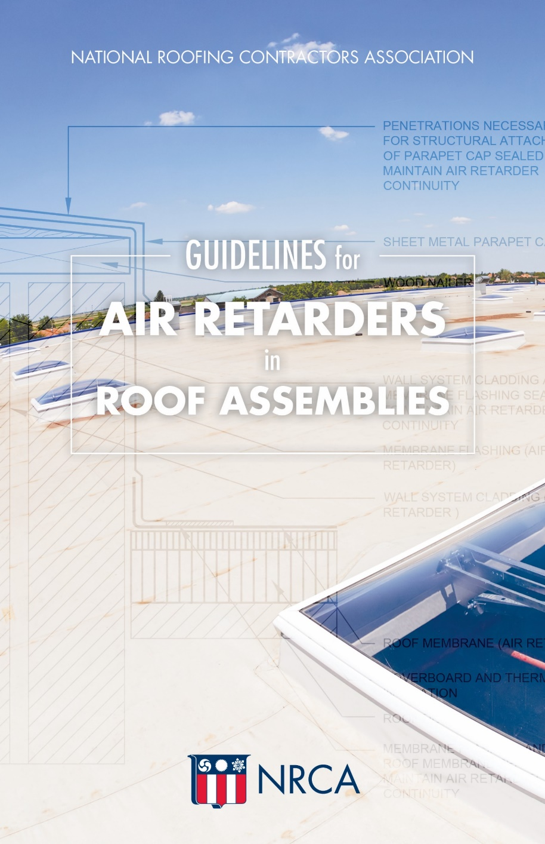
Guidelines for Air Retarders
in Roof Assemblies
Ch. 1: IECC and ASHRAE
Ch. 2: Industry research
Ch. 3: Recommendations
Link

Slide 45
International Existing Building Code, 2018 Edition

Slide 50
Professional Roofing,
September 2016

Slide 51

International Fire Code, 2018 Edition
Applicability:
  Structures, facilities and conditions
  Existing conditions and operations

Slide 52
Roofing-related provisions
International Fire Code, 2018 Edition
Sec. 303-Asphalt kettles
Sec. 317-Rooftop gardens
Sec. 1204-Solar photovoltaic systems
Sec. 3317-Safeguarding roofing operations

Slide 53
International Plumbing Code, 2018 Edition
Applicable to all plumbing systems, except those applicable to IRC 2018
Roofing-related requirements:
  Ch. 11-Storm drainage

Slide 56
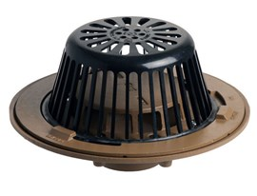

Slide 58
How should I deal with alternatives to what is permitted by the Code?

Slide 59
Alternative materials, design and methods of construction and equipment
IBC 2018, Sec. 104.11
IRC 2018, Sec. R104.11
IECC 2018, Sec. C102 and Sec. R102
IEBC 2018, Sec. 104.11
IFC 2018, Sec. 104.9
IPC 2018, Sec. 105.2

Slide 60
Professional Roofing
April 2019
Link

Slide 61
lCC/NIBS survey
Link

Slide 62
A typical code official
Between the ages of 55 and 64
A jurisdiction employee (rather than third-party provider)
Works in a one- to nine-person jurisdiction, less than 75,000 in population
Earns between $50,000 and $75,000 (mean 2012 salary was $51,017 according to the U.S. Census Bureau)
Has 26 to 35 years of experience in the building industry, but only five to 15 years as a code official
Entered the code profession in their 30s; held one to three prior jobs; first job was as a tradesperson

Slide 63
A typical code official - continued
May possess a bachelor’s degree (27 percent), or have no additional education beyond high school (25 percent)
If they hold a bachelor’s degree, it is probably in engineering, but it could be in management, accounting, finance, etc.
Holds a professional license, certificate, certification or other credential
Current role is as an inspector, plan reviewer or department manager; possibly all these roles
Expect to leave the profession in the next five to 15 years.

Slide 64
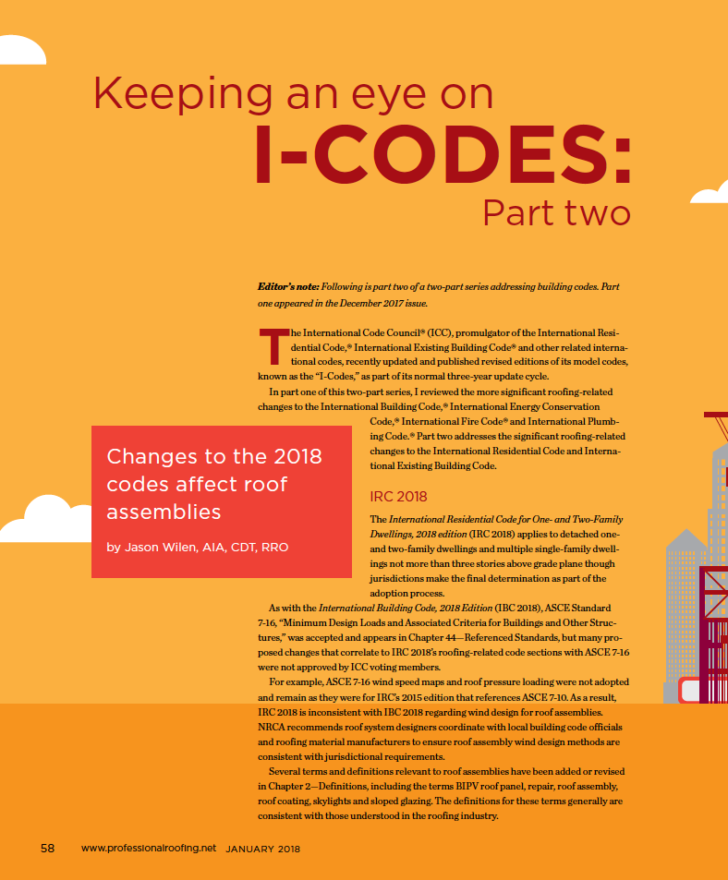
Professional Roofing, December 2017
Link to access this article
Professional Roofing, January 2018
Link to access this article

Slide 65
Code compliance is becoming increasingly challenging and presents significant liability risks

Slide 66

Consider joining ICC
Membership categories:
Corporate member: $450 (complete collection)
Building safety professional member: $170 (1 code)
http://www.iccsafe.org/Membership/Pages/join.aspx

Slide 67
Mark S. Graham
Vice President, Technical Services
National Roofing Contractors Association
10255 West Higgins Road, 600
Rosemont, Illinois 60018-5607
(847) 299-9070 mgraham@nrca.net www.nrca.net
Personal website: www.MarkGrahamNRCA.com

