Slide 1
Bhagavad Gita
Song of Bhagavan

Slide 2
Bhagavad Gita (also Gita)
Which Hindu epic is the Gita part of?
Which two central characters of the epic does Gita involve?

Slide 3
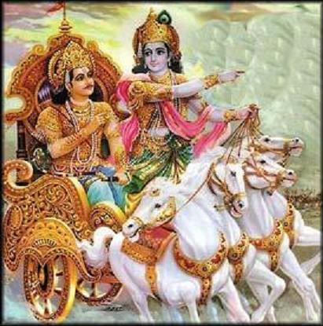

Slide 4
Bhagavad Gita
In the epic Mahabharata a conflict between the Pandavas and their cousins Kauravas results in the Kurukshetra war.
Pandavas (five brothers): Yuddhishtira, Bhima, Arjuna, Nakula & Sahadeva
Kauravas (100 brothers): Oldest two – Duryodana and Dushyasana
In the war, Lord Krishna helps the righteous Pandavas – he does not fight but, serves as Arjuna’s charioteer. Krishna is a cousin to both Pandavas and Kauravas.
During the war, Arjuna, skilled archer puts his bow and arrow down and expresses his inability to carry on with the war.

Slide 5
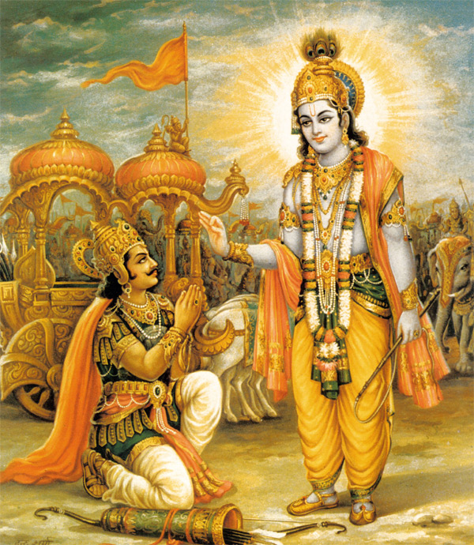
Bhagavad Gita
Krishna explains to Arjuna his duties or Dharma as a warrior and prince in the Gita.
The philosophical concepts in Gita explains the importance of dedication and self-sacrifice, as the dharma, or "holy duty" of each person.

Slide 6
Bhagavad Gita
What language is the Gita written in?
18 chapters – 700 verses of poetry makes up the entire Gita.
Bhagavad Gita’s call for selfless action inspired Mahatma Gandhi – he called it his spiritual dictionary
The Gita has been translated to many languages and is widely read and discussed in modern times.

Slide 7
Bhagavad Gita
Message or teaching of the Gita:
SELFLESS ACTION – performing your duty without expectation of rewards.
Karmanye Vaadhika-raste, Maa Phaleshu Kadachana
Maa karma-phala-hetur-bhoorma, MaTe sangostwakarmini.
कर्मण्ये वाधिकारस्ते मा फलेषु कदाचन, मा कर्मफलहेतुर्भूर्मा ते संगोस्त्वकर्मणि ।
Your right is to work only, but never to its fruits.
Let not the fruits of action be thy motive,
Nor let thy attachment be to inaction.

