Slide 1
Reformation Lessons from history
The British “Two Pound Coin”

Slide 2
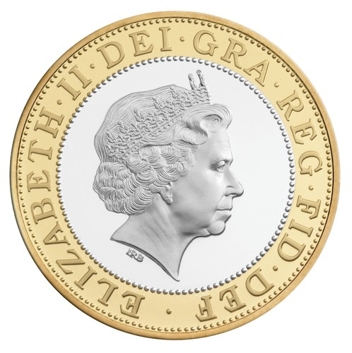
Most definitely not our currency!

Slide 3
So what does the inscription mean?
Elizabeth II = current monarch
“DEI GRA REG FID DEF” = Latin for “Dei Gracia Regina Fidei Defensor”
Meaning: “by the Grace of God, Queen, and defender of the faith.”

Slide 4
History of the “title”
October 31, 1517, the Lutheran Reformation begins with the nailing of the 95 theses to the door of the Wittenburg Cathedral
Fearing spread of Reformation to England, Pope Leo X grants title “Defender of the Faith” to King Henry VIII October 11, 1521, after publication of “In Defense of the Seven Sacraments”

Slide 5
Short-lived effort, however!
1530, Henry VIII breaks with Rome, declaring himself to be the head of the church of England.
Pope Paul III demands the title back, but Henry refuses and keeps title.

Slide 6
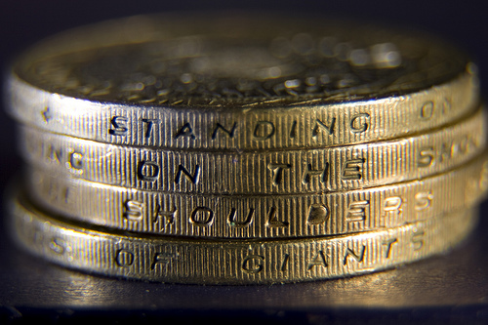
The story continues…
On the edge of the coin is an inscription attributed to Sir Isaac Newton, originally from Bernard of Chartres circa 12th century):

Slide 7
Essentially, it means that the Royalty (and the British Nation) cannot continue without building upon the foundation of the greats who have gone before them. Essentially, don’t forget where you’ve come from, and respect the history which brought you here!

Slide 8
What do we take from it?
Today, we never forget those who have gone before us, from the early church Fathers and Apostles, to the Reformers and beyond.
A great tradition has been handed to us to protect and preserve, all the while bringing it into the 21st century.
We are called, more than ever, to be “Defenders of the Faith!”

