Slide 1
Parenting Proficiency: How to find (and use) the Data

Slide 2
Housekeeping Items:
Sign in – Data divers? Data Divas?
Who’s in the Room?

Slide 3
Wha? Huh?
Lilienthal’s rule: If you want to fit a straight-line to your data, be certain to collect only two data points. A straight line can always be made to fit through two data points!

Slide 4
How Most of Us Understand:
Frames in thought consist of the mental representations, interpretations, and simplifications of reality.
What makes sense to most parents is understanding:
Where a child is, relative to the school
Where the school is, relative to the county
Where the county is, relative to the nation
And, many of the resources show us, just that!

Slide 5
In my child’s file:
Individual Reference Data
Report Cards (quarterly)
MAP Data Points (annually)
InView (2nd grade)
PARCC Scores (annually)
MSA/HSA Scores (as taken)
Transcripts, by Semester (semi-annually)
PSAT/SAT/ACT/AP Scores (as taken)
Notes:
Each of these are standard reports EXCEPT Map – (for now)

Slide 6
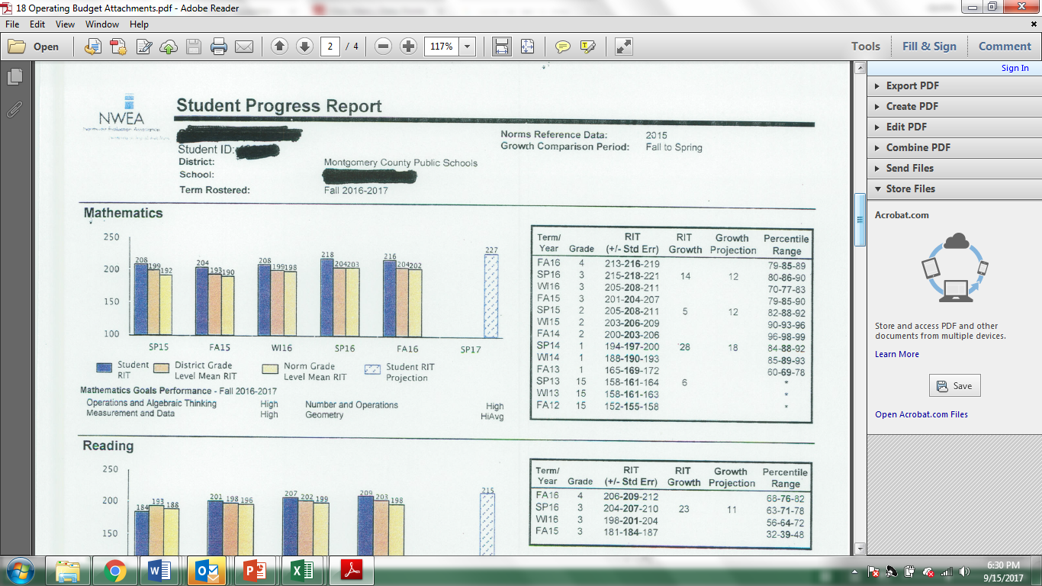
What every parent should have:
MAP scores (from the beginning)
NWEA Student Progress Report – Growth Comparison Data – Not a MCPS Requirement (but I wish it was!)

Slide 7
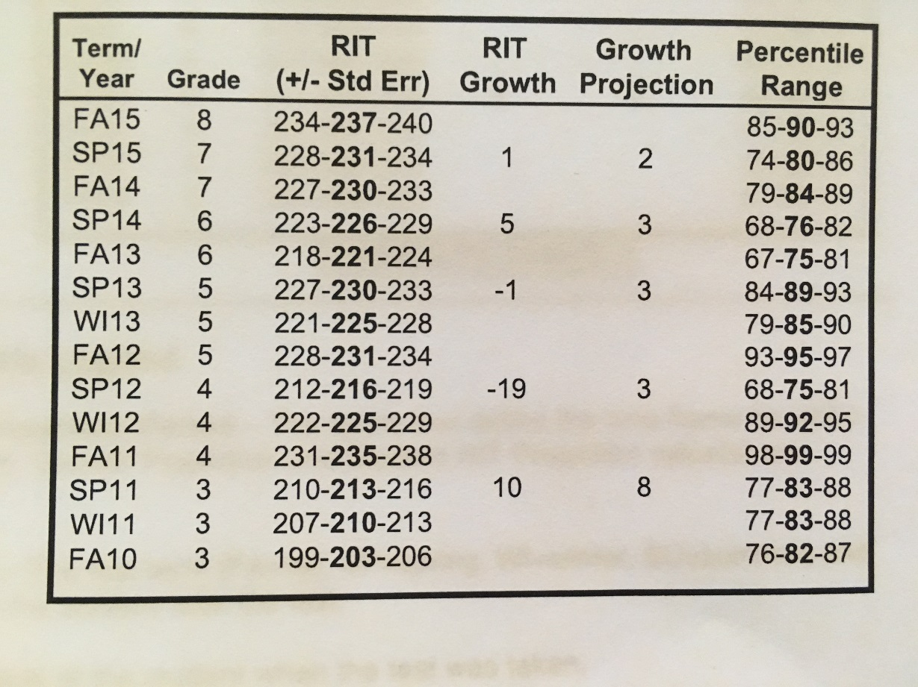
But, be responsible!
Don’t over-react! “One point data concerns” drive everyone crazy! Good or Bad points!

Slide 8
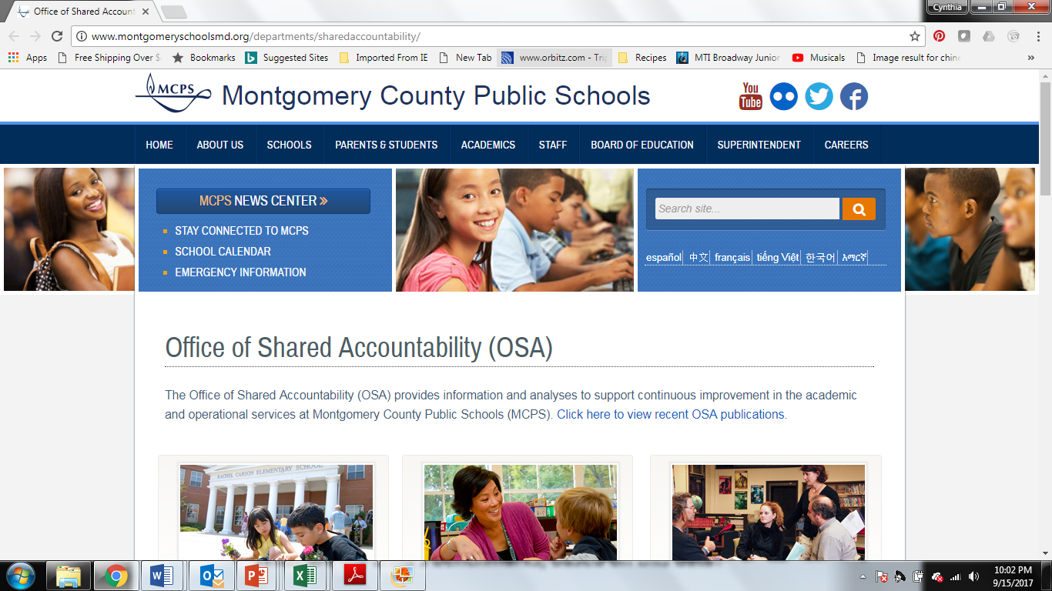
Favorite “Data” Sites:
REQUIRED MINING (in my opinion)!!!

Slide 9
Favorite “Data” Sites:
MCPS – Office of Shared Accountability
http://www.montgomeryschoolsmd.org/departments/sharedaccountability/
How did the kids in my school, county, nation do on AP tests last year?
Compared to other schools with similar impacts, how’d we do? If not as well as expected, what changes occurred/are planned?
Official Enrollment Numbers and Demographics
If school is overcrowded, underutilized... Are the demographics shifting or staying constant – year over year. What’s trending?
SAT Performance and Participation
Looking at year after year – are those scores flat? Going up, going down? Participation changes?
Study on Correlation between PARCC and MAP
Do my students follow same pattern as demonstrated in study? What are my child’s benchmarks, based on this data?

Slide 10
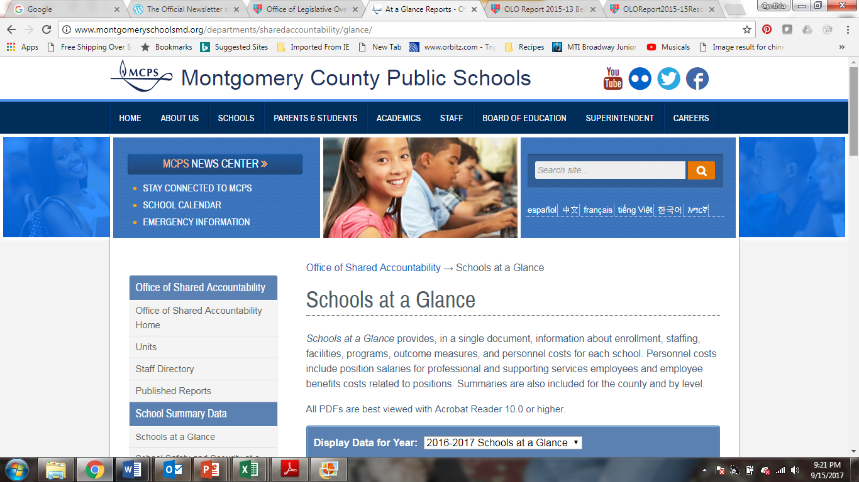
More “favorites”:
Schools at a Glance Reports (Year over Year Data Available)
Why did MCPS remove “Passing with C or Better?”
What explains 2016 graduates ~20-30 Point Drop on College Standards?

Slide 11
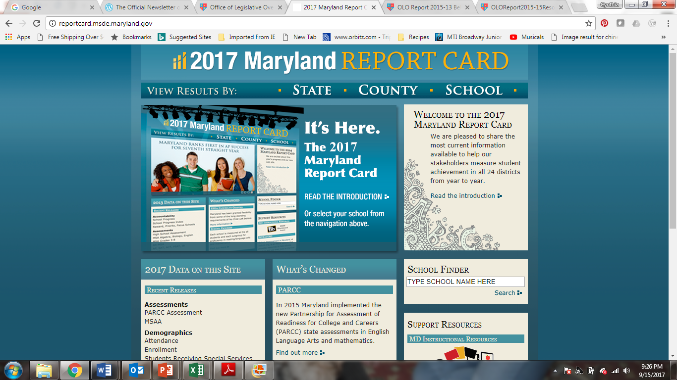
More “favorites”:
Compared to 2016… how’d my child, school, county do?
How does PARCC scores correlate to “Passing with C” data on Glance?

Slide 12
More “favorites”:
https://data.montgomeryschoolsmd.org/

Slide 13
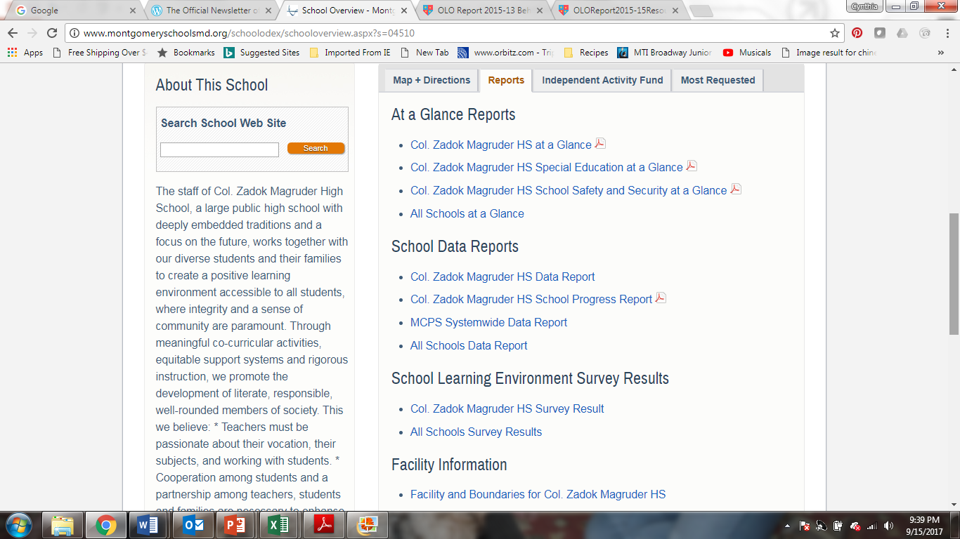
AND, more “favorites”:
School level reports – found through the MCPS site, search on school!

Slide 14
Thought Provoking Sites:
MC Office of Legislative Oversight Reports
http://www.montgomerycountymd.gov/OLO/Reports/CurrentOLOReports.html
School-to-Prison Pipeline in Montgomery County
How does this frame my opinion of school discipline?
Resources and Staffing among MCPS Schools
Do I see evidence of resources placed to narrow gap?
Two Generation Approaches to Poverty
Afterschool Programming – Excel Beyond the Bell
What affect does after school programming have on gap?
Behavioral Health in Montgomery County
Are we providing the supports within the school system? How are recovery kids/depression handled in the context of schools?
School Systems with Office of Inspector General
Does MCPS have the accountability systems in place without an IG?

Slide 15
Data I find, piece by piece…
Some questions require good old fashioned, site-by-site research to gather the information to ask the question:
Why is there such a huge difference between the summer packets required from one HS to another?
What is included in the Student Improvement Plan (SIP) of neighboring school? How does that compare to us?
What courses are being offered at other Middle Schools?
What courses are being offered at other High Schools?

Slide 16
So… what do you do with it?
Use it well! Data should be used as a tool, not a weapon (though it is tempting)!!
Data can help highlight what is fact vs. opinion
This grouping is good for the students…
Kids do better when…
Our school is doing great…
Use to highlight policy/process concerns
Overcrowding and disproportionate referral increases
Use to be a good steward
Half our county coffers are used for this purpose? How are we doing?

Slide 17
You know more than you think!
MCPS is MASSIVE with lots of layers and it may seem overwhelming, but, we believe -- the more engaged parents/guardians are in a student’s academic career, the better they will do.
You’ve got this!

