Slide 1
Emergency Medical Responder
Chapin Area Rescue Squad

Slide 2
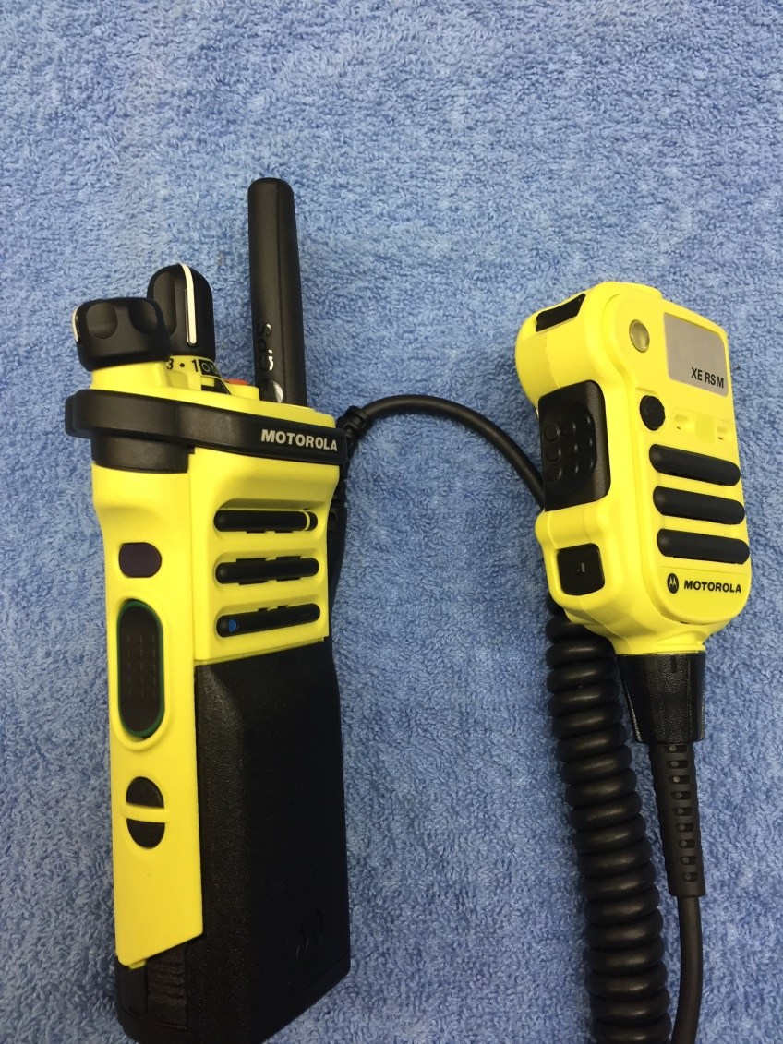
Chapter 4: Communication and Documentation

Slide 3
Objectives
Understand how to use the CARS radio system
Demonstrate the ability to use different radio types
Identify the sequence for communicating with Control
Identify how to communicate with different patients
Discuss the importance of documentation

Slide 4
Introduction
Communications Basics
  The dispatcher must communicate the location and type of call to responders.
  EMRs need to communicate with patients, bystanders, family members, dispatchers, and members of the public safety community.
  After a call, you must document the condition of the patient and the treatment given.

Slide 5
Radio Communication
Pagers
Portable Radios
Mobile Radios
Base Stations
Fax/Data communications

Slide 6
Radio Communication with Control
Control dispatchers over MCERN
One person advises the page was received
Ambulance goes enroute- advise Control
Arrival on scene- advise Control
Any additional resources- again, Control
Enroute to Hospital- you guessed it
Available- on the phone or via radio

Slide 7
Communication with Patients
Introduce yourself by name and title.
Ask the patient’s name and use it.
Make and keep eye contact.
Use language the patient can understand.
Speak slowly, clearly, and distinctly.
Tell the truth.
Allow time for the patient to respond.
Limit the number of people talking with the patient.
Be aware of your body language.
Act and speak in a calm, confident manner

Slide 8
Documentation
Proper documentation includes:
  The age and sex of the patient
  The history of the incident
  The condition of the patient when found
  The patient’s description of the injury/illness
  The patient’s chief complaint
  The patient’s level of responsiveness
  The status of initial and subsequent vital signs
  The results of the physical examination
  Pertinent medical conditions using the SAMPLE format
  The treatment you gave the patient

Slide 9
Review
You must take special care of individuals such as children, geriatric patients, hearing-impaired and visually impaired patients, non–English-speaking patients, developmentally disabled patients, and persons displaying disruptive behavior.

