Slide 1

Social Media

Slide 2
Social Media The Tool
Social Media can be a powerful tool when used correctly. It gives the ability to connect, inform , advertise and relay your personal brand. However when used incorrectly it can have a negative effect. Use the media correctly and guard yourself from any damaging things that could effect you negatively. Most Companies ,Colleges and Other Organizations use Social Media. They also have the ability of using Social Media as it relates to you and checking on your character. Always keep this in mind, people view what you have on Social Media as a snapshot of who you are. So be careful of your connections and what they may have on their Social Media because it may be a reflection of you.

Slide 3
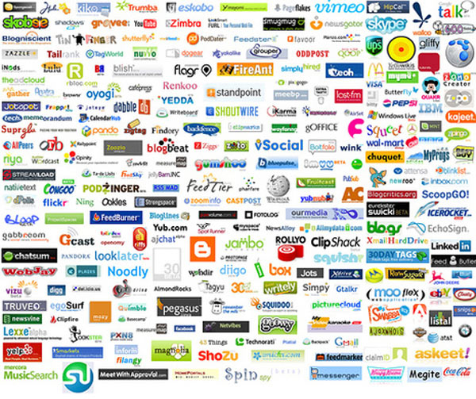
Social Media The Tool

Slide 4
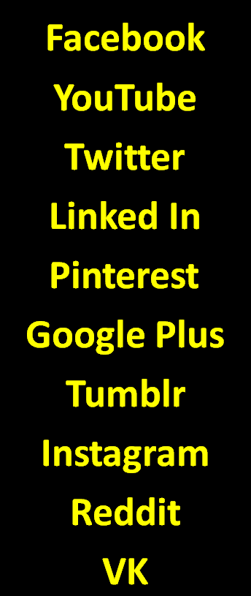
Top 10 Social Media Sites For Youth

Slide 5
Top 10 Social Media Sites Businesses/Colleges/Other Orgnaizatins Use to Reach The Youth
Facebook
Google Plus
Yelp
Instagram
Twitter
YouTube
Pinterest
Linked In
Meet-Up
Vine

Slide 6
Make Sure You Are Not Getting
Missed and Can Be Found
Top 10 Media Sites For Youth
To 10 Social Media Site Businesses Use To Reach The Youth
Facebook
YouTube
Twitter
Linked In
Pinterest
Google Plus
Tumblr
Instagram
Reddit
VK
Facebook
Google Plus
Yelp
Instagram
Twitter
YouTube
Pinterest
Linked In
Meet-Up
Vine

Slide 7

BBV2M-BrothersBrooksVision2MissionLLC.com
BBV2MLLC@gmail.com

