Slide 1

Notes:
Introductions

Slide 2
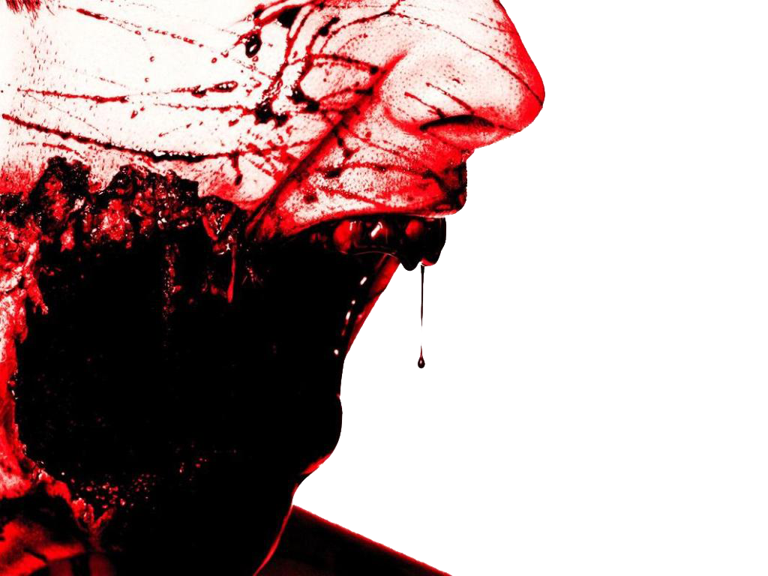



How to Survive a Zombie Apocalypse and Save your friends and family from turning into ZOMBIES
By Liisa Jackson

Slide 3
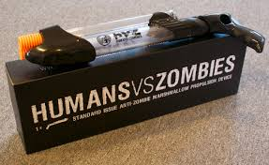
Person or Zombie
Zombies are no minded living dead walkers that want to eat your brains.
People have vital signs and we need to save them so they don’t turn into zombies.
Notes:
They are extremely stupid and quite clumsy because the lack of barely or no brain activity
. These zombies are more dangerous than normal zombies because they are much smarter and clever.
This form of zombie can spread the mutation by biting its victims. They are oblivious to most injuries and can only be stopped by destroying the brain.

Slide 4
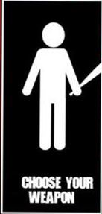
Weapons
When it comes to weapons its all about precision and accuracy. The weapons of choice for most zombie enthusiasts is a high powered Marshmallow gun that will stop the Zombie in its tracks!
Zombies are afraid of Marshmallows, but there is some drawbacks.
You may eat all the marshmallows before you see a Zombie
Marshmallow guns are short range so you have to get close to the Zombie
Your hands get sticky when loading the gun
Notes:
Some of the best weapons to have are a 9mm pistol or a pump shotgun.
But another weapon to considor is the flamethrower. Most zombies are afraid of fire, but there is some drawbacks.
Heavy
Short range compared to the range of a pistol or rifle
Small fuel container

Slide 5
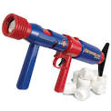
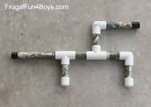
2 types of marshmallow guns: store bought or homemade!
Notes:
Heres a clip of a flamethrower

Slide 6
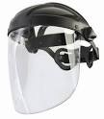
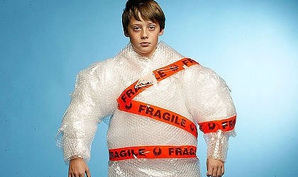
Armor
Perhaps the best way to prepare for the Zombies is to assemble the perfect zombie fighting attire.
To avoid marshmallow sludge when blasting zombies is by wearing a full face mask.
Use bubble wrap to make a bite-proof body suit.
Notes:
Avoid brain spray-back by wearing goggles and covering your face with a non-porous material. Use plate mail or leather to create a bite-proof body suit.

Slide 7
Home
A building that’s secure, but also has escape routes in case there's a problem.
A secure home requires all entrances to be blocked or protected by marshmallow barriers.
Always have a survival bag packed and ready to go in case of an emergency
Have your marshmallow gun and plenty of marshmallows

Slide 8
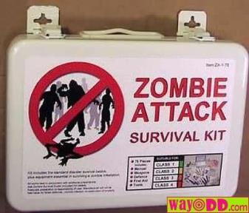
Survival kits
One gallon of water per person
3 day supply of food
Hand Crank powered radio
Flashlight
First aid kit
Map
Wrench
Whistle
Books
Notes:
A gallon of water per person
Suplly of food
Hand crank radio
Flashlight
First aid
Map
Wrench
Whistle to signal for help if needed
to keep your sanity

Slide 9
Our primary goal is to stop people from becoming Zombies!
We can save people by doing rapid triage
To prepare for Z-Day know how to tell if someone will turn into a Zombie through this triage class
Once someone dies they become a Zombie and you will have to shoot them with the marshmallow gun so they don’t bite a person and we end up with more zombies!
Notes:
If you have no one to trust you will most likely die very quickly
One thing to always think about is who you would want to survive a z-day with. You need to pick people that you can trust your life with, and that you can depend on to keep you safe.
By picking who you would survive best with means your one step closer to living longer

Slide 10

Checklist
Keep yourself safe
Marshmallow guns
Armor
Secure your home
Prepared survival kits
How to save people
Notes:
So the things you need to keep in mind is:
Know your classes
Weapons to survive with
Armor to keep you safe
Survival kits
And trust.

Slide 11
Why field triage?
Incidents which produce multiple human casualties are somewhat rare but do occur and must be planned for. A multiple or mass casualty incident can be defined as any incident in which more casualties are present than an initial response assignment can reasonably handle.
We will need your help!

Slide 12
Triage Unit Leader
Triage: A rapid approach to prioritizing
a large number of patients
Casualty
Collection
Point
Simple Triage And Rapid Treatment
Incident Site
Notes:
INSTRUCTOR NOTES:
This subject matter should be familiar to the student and is provided here as both a brief refresher and to tie together the components of the training program.

Slide 13
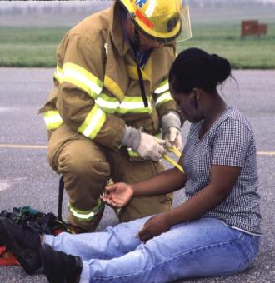
Triage
Triage should be performed RAPIDLY
Utilize START Triage to determine priority
30–60 seconds per patient
Affix tag on left upper arm or leg
Notes:
INSTRUCTOR NOTES:
MOVE QUICKLY!
Use S.T.A.R.T. to determine the priority of the patient:
No more than 30–60 seconds per patient
Check:
Respiration
Pulse
Mental Status
Attach ribbon to UPPER ARM, if possible. The next option would be HIGH on a THIGH. The goal is to be consistent so they are easily recognized as the priority flag.

Slide 14
START – Triage
Clear the “walking wounded” with verbal instruction:
  If you can hear me and you can move, walk to…
Direct patients to the casualty collection point (CCP) or treatment area for detailed assessment and medical care
Green Minor Manager will be the area to control patients and manage area
Green tag will be issued at the CCP
These patients may be classified as MINOR
Notes:
INSTRUCTOR NOTES:
Talk the students through the triage process using these guidelines. Essentially, if a patient can hear you, understand and follow your commands, and has the physical ability to walk on their own, their injuries are non-emergent and can be tended to later. Of course, triage is a dynamic process and these patients should be re-assessed at the treatment area for any deterioration in their condition. The action of moving the MINOR patients from the scene also helps clear space and reduce confusion so the remaining patients can be quickly categorized.

Slide 15

START-Triage
Now use START to assess and categorize the remaining patients…
USE Color System
Notes:
INSTRUCTOR NOTES:
Basic, quick patient care

Slide 16
START-Triage
Categorize the patients by assessing each patient’s RPMs…
Respirations
Pulse
Mental Status
Notes:
INSTRUCTOR NOTES:
These are the three decision criteria to be used in categorizing those patients who have not already been determined to be “walking wounded.”

Slide 17
START—RPM
RESPIRATIONS
Is the patient breathing?
Yes
Adult – respirations > 30 = Red/Immediate
Pediatric – respirations < 15 or > 45 =
Red/Immediate
Adult – respirations < 30 = check pulse
Pediatric – respirations > 15 and < 45 = check
pulse
Notes:
INSTRUCTOR NOTES:
Address respirations first. Many triage decisions can be made on this assessment alone. This corresponds to the “A” and “B” of the ABCs of patient care.

Slide 18
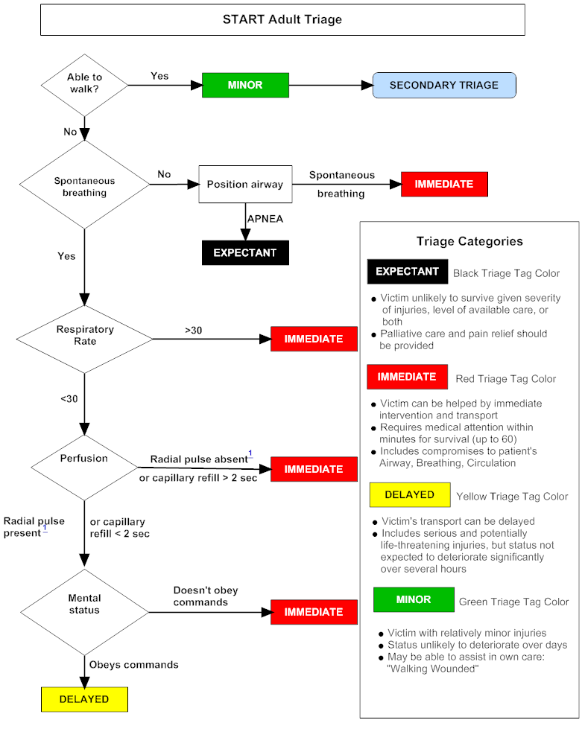
START—RPM
RESPIRATIONS
Is the patient breathing?
No
Reposition the airway…
Respirations begin = IMMEDIATE/RED
If patient doesn’t breath
  Adult – deceased = BLACK-Zombie
  Pediatric: Pulse Present – give 5 rescue breaths
    respirations begin = IMMEDIATE/RED
    absent respirations – deceased = BLACK
Notes:
INSTRUCTOR NOTES:
Address respirations first. Many triage decisions can be made on this assessment alone. This corresponds to the “A” and “B” of the ABCs of patient care.
18

Slide 19
START—RPM
PULSE
Is the RADIAL pulse present?
Is capillary refill (CR) LESS than < 2 seconds?
Yes
Check mental status
No
Adult: Pulse absent or CR > 2 seconds patient = IMMEDIATE/RED
Pediatric: No palpable pulse patient = IMMEDIATE/RED
Notes:
INSTRUCTOR NOTES:
This assessment corresponds to the “C” of the ABCs.

Slide 20
START-RPM
MENTAL STATUS…
Can the patient follow simple commands?
Yes
Adult = DELAYED / YELLOW
Pediatric: alert, verbal, or pain response is appropriate
= DELAYED / YELLOW
No
Adult = IMMEDIATE / RED
Pediatric – “P” pain causes inappropriate posturing or “U” unresponsive to noxious stimuli = IMMEDIATE/ RED
Notes:
INSTRUCTOR NOTES:
Patients that have respirations more than 30/minute and capillary refill greater than 2 seconds, but who can follow commands, are still categorized as IMMEDIATE.

Slide 21
START Triage
If the patient is IMMEDIATE/RED upon initial assessment…then, before moving the patient to the treatment area, attempt only life-saving interventions:
Airway, Tourniquet, Antidote
DO NOT ATTEMPT ANY OTHER
TREATMENT AT THIS TIME
Notes:
INSTRUCTOR NOTES:
Only emergent and immediately life-saving interventions should be performed at this stage. All other interventions should be made at the treatment area.

Slide 22
START Triage
CAN YOU
YES
MINOR
SECONDARY TRIAGE
**
**
Using the JS algorithm
WALK
?
evaluate all children first
who did not walk under
NO
their own power.
BREATHING
Evaluate infants first in
Breathing
?
NO
Position Upper Airway
IMMEDIATE
secondary triage using
entire JS algorithm
!
APNEIC
ADULT
PEDIATRIC
HAS A
NO PULSE
PULSE
APNEIC
PEDI Neurological Assessment
YES
5 Rescue Breaths
Expected /
Deceased
A
Alert
BREATHING
Responds to
IMMEDIATE
V
Verbal Stimuli
>
30
ADULT
P
Responds to
Respiratory
IMMEDIATE
Painful Stimuli
Rate
?
45 > OR < 15
PEDI
Unresponsive
<
30
ADULT
U
To Noxious
15
-
45
PEDI
ADULT
CR >2 Sec or NO PALPABLE PULSE
Stimuli
Perfusion
?
IMMEDIATE
PEDI - NO PALPABLE PULSE
YES
“P” INAPPROPRIATE POSTURING OR “U”
DOESN’T OBEY COMMANDS
(
PEDIATRIC
)
Mental
IMMEDIATE
Status
?
ADULT
OBEY COMMANDS
-
ADULT
DELAYED
“A”
,
“V”
,
OR “P”
)
PEDIATRIC
(
APPROPRIATE
-
Http
://
www
.
starttriage
.
com
Http
://
www
.
jumpstarttriage
.
com
Notes:
This is the combination START/JumpSTART algorithm. Separate START and JumpSTART algorithms are located at the end of this slide show, but hidden from the regular slide show.

Slide 23
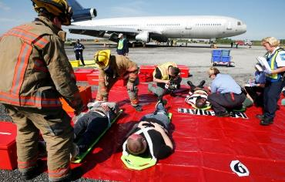
RED Triage Category (Immediate)
Adult
Respirations > 30 BPM
CR > 2 seconds or
no palpable radial pulse
Cannot follow simple
commands
Collapsed lung
20% blood loss
Closed Head Injury
Pediatric
Respirations < 15 or > 45
CR > 2 seconds or no palpable radial or brachial pulse
Inappropriate “Pain”
(e.g., posturing) or “Unresponsive”
Notes:
INSTRUCTOR NOTES:
The RED category is also referred to as IMMEDIATE and follows START criteria.
Requires medical attention within minutes for survival (up to 60 minutes)
Victim can be helped by immediate intervention and transport
Includes compromises to patient’s Airway, Breathing and Circulation

Slide 24
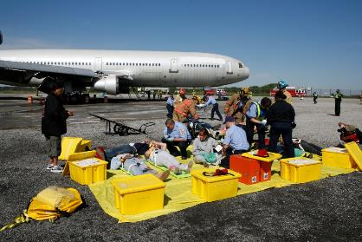
YELLOW Triage Category (Delayed)
Adult: respirations, capillary refill, and mentation are normal
  Isolated burns
  Extremity fractures
  Stable other trauma
  Most patients with
  medical complaints
Pediatric: “A,” “V,” or appropriate “P”
(e.g., withdrawal from pain stimulus)
Notes:
INSTRUCTOR NOTES:
The YELLOW category is also referred to as DELAYED.
• Victim’s transport can be delayed
Includes serious and potentially life-threatening injuries, but status not expected to deteriorate significantly over several hours

Slide 25
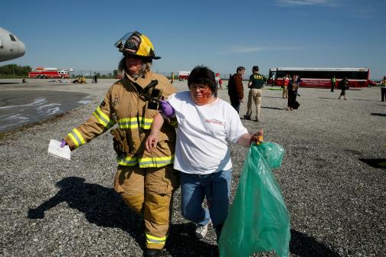
GREEN Triage Category (Minor)
“Walking wounded”
Psychological casualties
Always look for children being carried and assess them
Notes:
INSTRUCTOR NOTES:
The GREEN category is also referred to as MINOR.
Victim with relatively minor injuries
Status unlikely to deteriorate over days
May be able to assist in own care
“Walking Wounded”

Slide 26
Black/Expectant Triage Category
(will a be a Zombie)
    Black is for the patient that is not likely to survive even with emergent interventions
    Injuries incompatible with life
    Brain matter visible
    Obvious mortality or death
    (pulseless and apneic)
Notes:
INSTRUCTOR NOTES:
GREY is the new category for patients who are encountered alive but not expected to survive. This may be very short term survival (minutes) or may also include patients that could live for hours (such as extensive third degree burns), but ultimately not survive. It is anticipated that the GREY category will ultimately be adopted nationally but, until it is, will not be employed until notice is given by MIEMSS. There are no Grey ribbons in use currently.

Slide 27
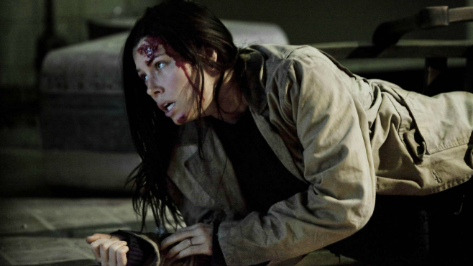
Patient #1
Visible head trauma
Unable to walk
Can follow simple commands

Slide 28
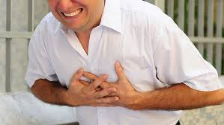
Patient #2
Complaining of chest pain
Can walk
Can follow simple commands

Slide 29
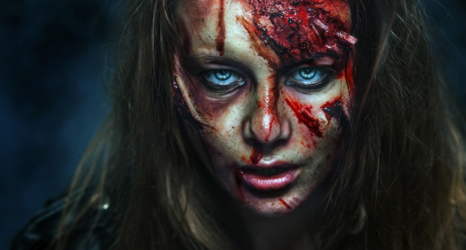
Patient #3
No Respirations
Brain matter showing
Mumbling brains

Slide 30
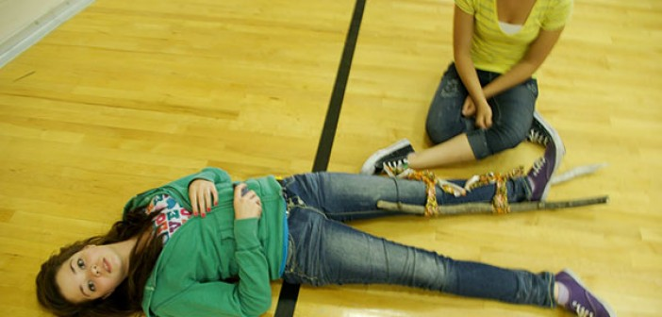
Patient #4
Broken leg set by friend
Not able to walk
Not able to follow simple commands

Slide 31
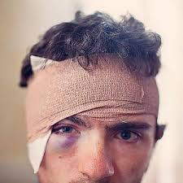
Patient #5
Head Trauma
Slurred speech
Falling every time he stands up

Slide 32
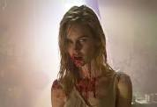
Patient #6
More than 3/4 loss of blood
Lunging at you trying to eat your brains

Slide 33
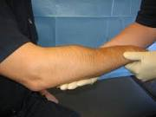
Patient # 7
Obvious broken arm
Able to walk
Can follow simple commands

Slide 34
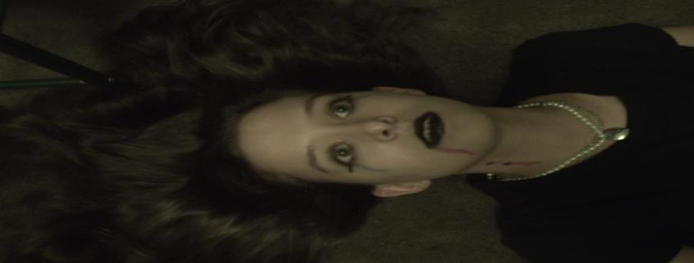
Patient # 8
Not breathing
No pulse
When airway is opened no respirations

Slide 35

Congratulations you can now survive a Zombie Apocalypse

