Slide 1
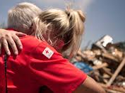
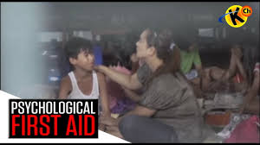
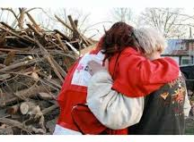
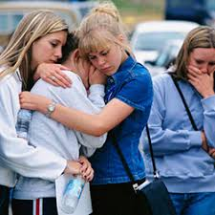
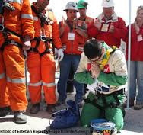
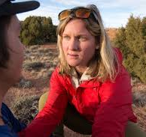

Slide 2
Introductions
Name and position
What is your role in a disaster professionally?
Are you prepared at home to ensure your family is safe?
What kind of disaster scares you the most?

Slide 3

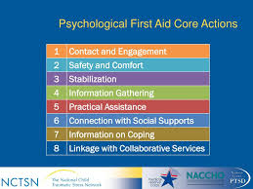
PSYCHOLOGICAL FIRST AID
Liisa Jackson
Medical Reserve Corps Director-Coordinator

Slide 4

What is Psychological First Aid?
The common image of a first responder is someone with a snappy set of gloves smoothly bandaging a spurting wound or administering an EpiPen to a having an anaphylactic reaction. Injuries, we imagine, are easy to see and easy to fix.
While treating physical wounds seems like the most important way a first responder can help , there’s a lot that we can do to care for a person ’s mental health, especially during and right after a traumatic event.

Slide 5
PFA Core actions
Contact and engagement
Safety and comfort
Stabilization
Information gathering
Practical assistance
Links to social supports
Information on coping
Links to services

Slide 6
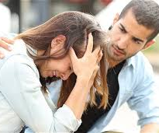

Create a Sense of Safety
Creating a sense of safety means you communicate to the brain’s fight or flight system that the stressful situation is over.
You can do that by shielding them from a disturbing scene or explaining to the individual that they’re safe.
Reinforce this by showing them what you’ve done to make the scene safe.

Slide 7

Create Calm
This is important both before and while responding.
Speaking and acting calmly can show they’re in a safe place and they can start calming themselves.
If you’re struggling to calm yourself -use simple tools like taking a deep breath, counting to four, then letting your breath out slowly, and coaching the person you are helping to do the same.
It’s hard to calm someone else when you don’t feel calm yourself, so check your own composure before helping.

Slide 8

Create Self and Collective Efficacy
Efficacy is your ability to produce a desired result. You can help foster self-efficacy.
Remind the person you are helping of their existing strengths, allow them to care for themselves or help their companions, and involve them in decisions about their care.
This helps them overcome the feeling of helplessness that sometimes comes with a traumatic event.
They’re no longer a victim, but a part of the team.

Slide 9
Create Connection
Creating connection helps them tap into the social supports that surround them. You can create connection by building an on-scene relationship with the person you are helping.
Use their name and build a feeling of understanding.
This also includes connecting the person with loved ones or even pets.

Slide 10
Create Hope
Hope in this context means the belief that, although the current situation may be grim, it can get better
To build hope, point to specific, accurate, and positive facts about the event, and discuss next steps that are realistic and predictable.
Maintaining hope is as important for the individual as it is for your team, as you provide care.

Slide 11
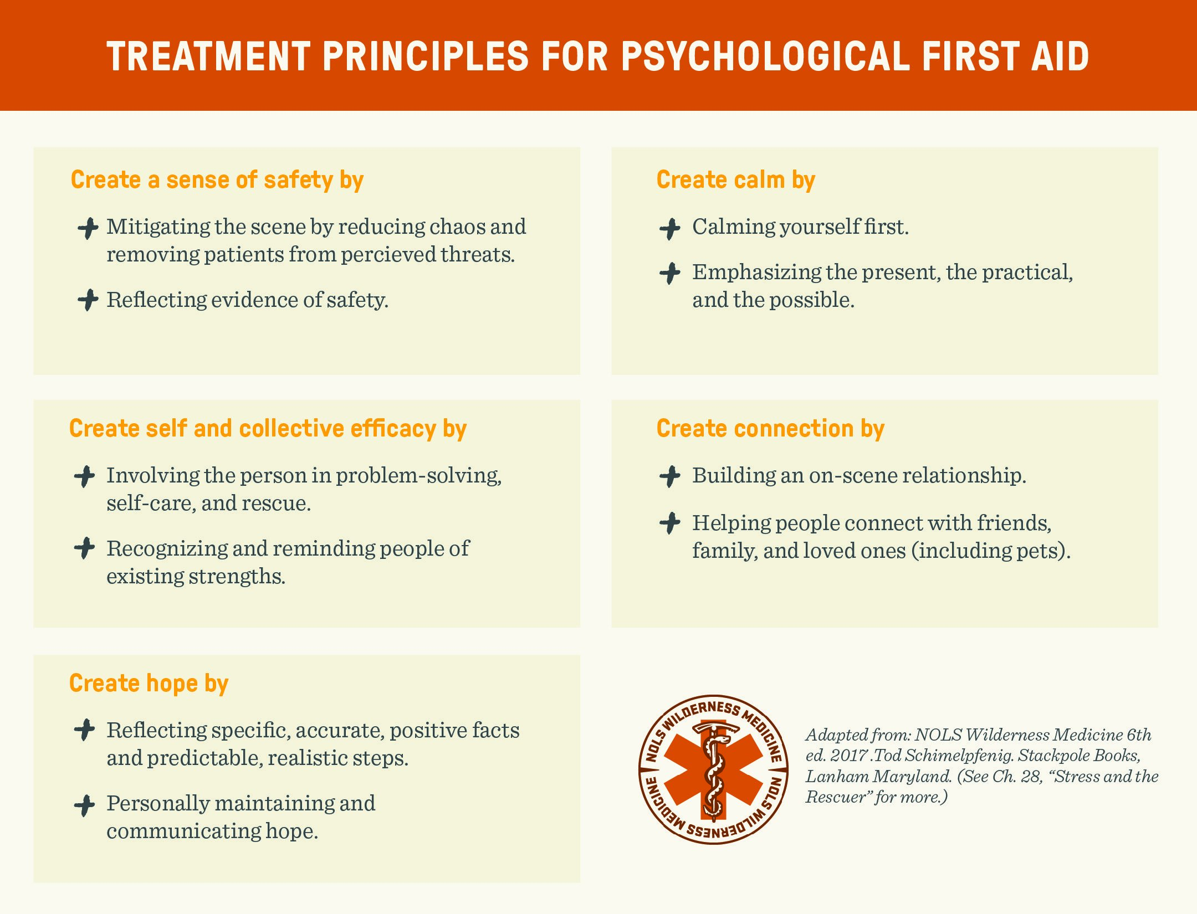
Treatment principals
Create sense of safety
Create calm
Create self and collective efficacy
Create connection
Create Hope

Slide 12
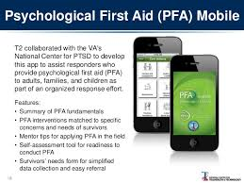
PFA Mobile

Slide 13
Let’s practice
One person play the victim
One person play the responder
Then switch
Remember: Create sense of safety
Create calm
Create self and collective efficacy
Create connection
Create Hope

Slide 15
Scenario
Wildfires are surrounding us.
People are being evacuated from their homes and need to be sheltered.
You may or may have to evacuate your home the fires are close to your neigborhood
You are asked to come to the local shelter to help with operations
How do you support those in need?
How do you support your coworkers?
How do you support your family?

Slide 16
Scenarios
Pick a scenario that could happen in your community
Think about how you would be affected by this event?
What would your professional role be to support response efforts?
How would you support your coworkers?
How would you take care of yourself during this incident?
How would you take care of yourself, family and pets during this disaster?

Slide 17
Breakout
Discuss the following with your group:
What if this happened while we are at work?
How would we handle our roles in the response efforts?
If you aren’t part of the response team, what would you do to help yourself, your family, your neighbors and friends?
What will you do to prepare for the long term affects of this disaster?

Slide 18
Provide feedback to the group!
What were the professional responsibilities within your group?
What actions did you take to help yourself, family, friends, neighbors and co-workers?
What are the long term affects of this situation at work and at home?
How will you adapt to the new reality?

Slide 19
Video
https://video.search.yahoo.com/yhs/search?fr=yhs-fc-1_15&ei=UTF-8&hsimp=yhs-1_15&hspart=fc&param1=7&param2=eJwtj9tqwzAMhl%2FFly3UqXyOnauGZA8wdrXSCy9xUpMjOZCxp5%2B9FYH%2BX%2BKTkFpf37PHe0EABDB9vzzGUAep%2F6UKonXs%2BzlYKoEYosFwAENsSE2qtKmJYCaFtDHCygi3bgr0vga72%2BCG6cf3vb2KBNDp8GM9HSsaN0QggQyFhuQZ%2Bpb8jOw89%2B5wX53froKphEl06p7b0F9Q7zuHWld10xlVz2Ua3JWwsCAGWm1jF%2F8aieeu%2FvXCvrrlzxclVWWuAKtbSjEh5RvOy4JiqW5QKCXyQqrIVxGmQDkGjSn%2FINwwbYRMGFWfv2upVz0%3D&p=Pycological+first+aid+scenarios&type=fc_A23B324045A_s69_g_e_d_n_c999#id=4&vid=afd76a92cbf261d937ee47f734c49537&action=click

Slide 20
PFA video online
https://video.search.yahoo.com/yhs/search?fr=yhs-fc-1_15&ei=UTF-8&hsimp=yhs-1_15&hspart=fc&param1=7&param2=eJwtj9tqwzAMhl%2FFly3UqXyOnauGZA8wdrXSCy9xUpMjOZCxp5%2B9FYH%2BX%2BKTkFpf37PHe0EABDB9vzzGUAep%2F6UKonXs%2BzlYKoEYosFwAENsSE2qtKmJYCaFtDHCygi3bgr0vga72%2BCG6cf3vb2KBNDp8GM9HSsaN0QggQyFhuQZ%2Bpb8jOw89%2B5wX53froKphEl06p7b0F9Q7zuHWld10xlVz2Ua3JWwsCAGWm1jF%2F8aieeu%2FvXCvrrlzxclVWWuAKtbSjEh5RvOy4JiqW5QKCXyQqrIVxGmQDkGjSn%2FINwwbYRMGFWfv2upVz0%3D&p=Pycological+first+aid+scenarios&type=fc_A23B324045A_s69_g_e_d_n_c999#id=1&vid=1944af2b8400351995ca3b1e254fd067&action=click

