Slide 1
A toolkit for the independent investigation

Slide 2
The independent investigation
The independent investigation features in all
A level geography specifications. It is sometimes called the non-exam assessment (NEA).
This resource uses a toolkit to take you through the basics of how to tackle different stages in the investigation.
© Geographical Association, 2020

Slide 3
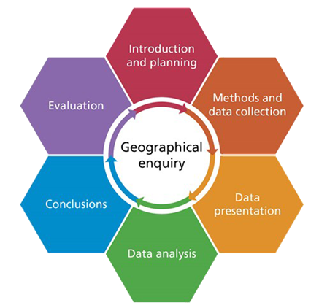
What you need to know
A clear structure is vital. The stages in geographical enquiry will be familiar from GCSE – from the introduction, planning and enquiry questions,
through to conclusions and evaluation.
At A level there is a new
requirement – a literature review.
You have a deadline to meet, so being well-organised will help you do this. You might find this action plan will help you to set your own targets and dates.
© Geographical Association, 2020
Notes:
FSC own the graphic

Slide 4
Getting started
Your investigation must relate to a topic in the geography specification you are studying.
Another key point – this is an independent investigation, not an individual one.
Independent means:
You must carry out your enquiry without relying on teachers and other students.
You do not need to work in isolation, or have a unique title for your investigation.
You can draw on advice (e.g. from teachers) to become an independent and critical thinker.
© Geographical Association, 2020

Slide 5
Introduction and planning 1
Your most important task is to devise a central question or hypothesis to guide your investigation.
Poor questions lead to poor investigations:
  What is a groyne?
  This is not a good question at A level – think about why not.
A good question is one which is focused.
  To what extent does the character of the Mumbles change with increasing distance away from Oyster Wharf?
  This is better – think about why.
This question generator is one way to help you think of better questions
Activity
Look out of your window.
Fill in each cell in the generator with a question.
Which question has the most scope for an independent investigation, and why?
© Geographical Association, 2020

Slide 6
Introduction and planning 2
Now you need to do some reading around. What have other geographers published that’s relevant to your investigation? What processes and key ideas do they help you understand?
This is your literature review: it sets your investigation in a wider theoretical context.
You might need to read more later, and it’s easy to lose sight of your readings, so keeping a literature log is one way to keep focused.
© Geographical Association, 2020

Slide 7
Methods and data collection
You need to decide which methods to use independently.
Work out which are the most useful and appropriate methods. Which are essential? How many are realistic? The methodology card sort may help.
Think through how your methods will work and the evidence they will bring in: creating a mind map might help.
Collect secondary as well as primary data: a secondary data log could help you record what you use.
Activity
Write a list of secondary sources of data which might be useful for your enquiry.
Swap your list with a friend and discuss.
© Geographical Association, 2020

Slide 8

Data presentation
It is helpful to think of this at the same time as you plan your methods: you can match the method and the presentation style, while thinking of their advantages and disadvantages.
There are many different possibilities for data presentation: this card sort may help you choose.
Some methods may seem obvious – but you could discuss your choice with a critical friend to check.
Resource
has some great resources supporting you in creating your own maps. Check if your school has an account.
© Geographical Association, 2020

Slide 9
Data analysis
Here you’re looking at your findings, thinking about them and how to show what they tell you about your enquiry question.
You’ll need to write about this: structuring your writing will help show your thinking clearly. Double bubble and Argument frames are two ways that may help.
Check the mark scheme in the specification to see what level you are working at and how you can improve – you could work with a partner on this.
© Geographical Association, 2020

Slide 10
Conclusion and evaluation
Your conclusion needs to be:
  linked to your key question or hypothesis
  clear and concise.
Evaluation is about:
  the whole investigation, not just methods and data
  the validity, reliability, limitations and ethics of your enquiry: check you’re sure about the differences between these.
Retrofitting this thinking is tricky. It is better to think of these from the start: keeping a research diary helps you to evaluate as you go along.
Activity
Try the 5-4-3-2-1 approach.
Start with five sentences, then boil them down in stages to one.
You now have a key finding to hang the whole conclusion on.
© Geographical Association, 2020

Slide 11
Before you finish...
Just to focus your thinking, you might share and present your findings to your class: e.g. on one ppt slide, in a one-page document, in a one-minute talk.
Do a final check: try this checklist and perhaps check your work with a critical friend.
You can download an adapted version of the article on which this presentation is based.
© Geographical Association, 2020

Slide 12
Links
From the awarding bodies:
From the GA and the FSC:
Student guide to the NEA
GA specs summary
AQA specification support and example NEA
Eduqas specification , investigative and research and data analysis skills
Edexcel specification , exemplars and maths support
OCR specification and NEA support.
FSC guide to geographical investigations
GA shop: Fieldwork at A level: your guide to the independent investigation
Journals (your school needs to subscribe to these) including feedback from the examiners
GA conference 2018: look for session #10 and #22
Bundles of articles from Geography on A level themes from the GA shop.
© Geographical Association, 2020

Slide 13
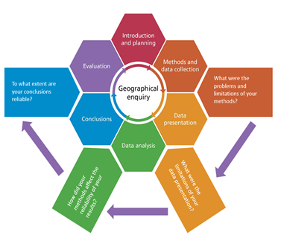
More on geographical enquiry
Here’s a summary of the enquiry process: thinking about evaluation concerns many of its stages.
© Geographical Association, 2020
Notes:
©FSC/Becky

