Slide 1

Financial Understanding

Slide 2
In all we do there is financial component tied to it. Businesses, Government, Non-Profits and Churches all need finances to sustain its existence to operate from an economic point of view.

Slide 3
So What is Finance?
Finance is a field that is concerned with the allocation of assets and liabilities over space and time, often under conditions of risk or uncertainty. Finance can also be defined as the science of money management. Market participants in the market aim to price assets based on their risk level, fundamental value, and their expected rate of return. Finance can be broken into three sub-categories: public finance, corporate finance and personal finance

Slide 4
Why is it important?
If you are an organization that has a goal of making money then understanding finance is important. As an entrepreneur you will want to know how to increase your revenue (sales/cash intake), reduce your costs and budget correctly so you can make a profit or sustain the longevity of your business.

Slide 5
There 3 Key Financial Statements that will be important for your business.
Every business wants to know its overall financial health, where is its money coming from, where does it spend its money and how much profit did I make.
These three statements are essential to any organization and doesn’t matter if you are publicly traded or just a local mom and pop store or a lawn care provider.
These financial statements are called the Income Statement, Balance Sheet and Cash Flow Statement.

Slide 6
Income Statement
The income statement tell you if you are making a profit – that is, whether it has a positive or negative net income. This statement is sometimes called the profit and loss statement. It shows the business’s profitability throughtout the year – typically, b presenting monthly, quarterly and year to date summaries of the business’s operation. In addition the income statement tells you how much money business spends to make that profit – that is, what its profit margins are

Slide 7
How Does the Income Statement work?
It starts with business’s revenue – how much money has come in from its operations (what ever it (product) is you are selling). Various cost - from the cost of making and storing your product, to even more advance things such as the depreciation of plant and equipment to interest and taxes. These cost are then subtracted from your revenue and what is left over is your net profit (if money is left over).

Slide 8
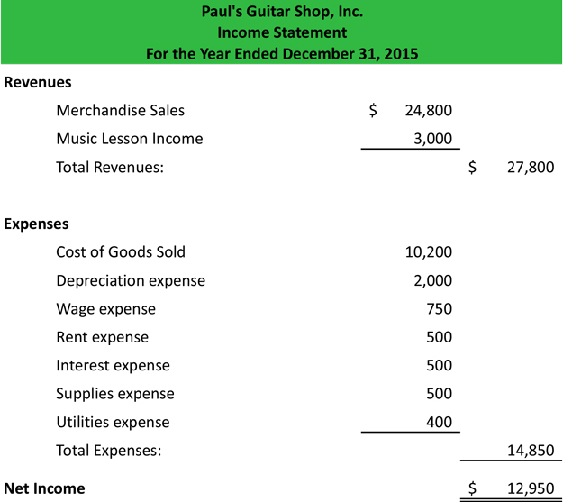
Income Statement Example

Slide 9
Balance Sheet
The balance sheet is a snapshot of the current health of your organization at a particular time.
A balance sheet uses double-entry accounting – a system that ensures that each transaction balances. The system relies on the following basic equation:
Assets – Liabilities = Owner’s Equity

Slide 10
How Does the
Balance Sheet work?
Assets are things that a business invest in so it can conduct business – examples include:
Financial Instruments
Land
Building
Equipment
Commodities
Liabilities are usually those things for example money that may have been borrowed in order to purchase an asset. Credit that may be extended to pay for an asset. Your accounts payable are noted here in this section
Owner’s Equity is what is left over after the total liabilities is subtracted from the total assets.

Slide 11
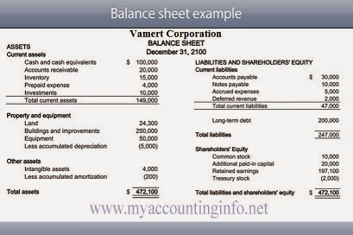
Balance sheet Example

Slide 12
Cash flow statement
A cash flow statement gives you a peek at your business overall cash health. Like a bank statement, it tells how much cash was on hand at the beginning of the period, and how much was on hand at the end of the period. It also describes how the business spent its cash. Like a checkbook uses of cash are recorded as negative figures and sources of cash are recorded as positive figures.

Slide 13
Why is it important?
If your cash is tight then you may want to be conservative in your spending. It is key to stay up to date on your cash flow if you are definitely a small business or if your cash receivables are slow (people are slow on paying you what you owe) or your cash payables are fast (people demanding what you owe them on fast pace)

Slide 14
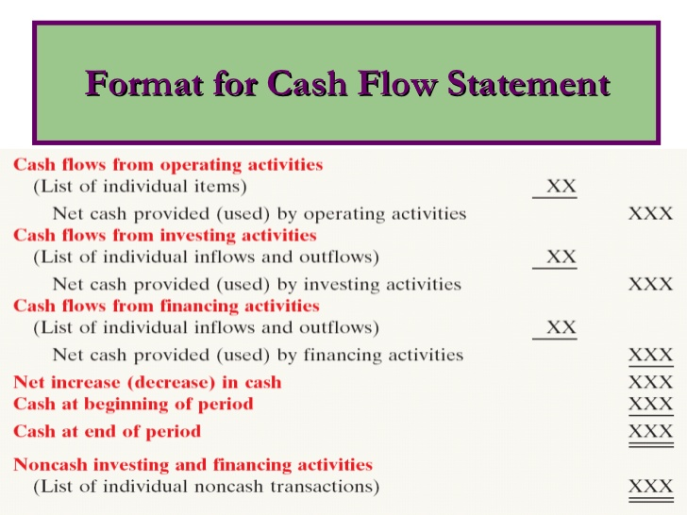
Cash flow Example

Slide 15
Recap of the
3 financial statements
The Income Statement shows the bottom line: it indicates how much profit or loss a business generates over a period of time – month, quarter or a year. The income statement tells whether your company is making a profit.
The balance sheet shows a business’s financial position at a specific point in time. That is it gives a snapshot of the business’s financial situation – its assets, liabilities and equity on a given day. The balance sheet tells you efficiently a business is utilizing its assets and how well managed it is managing its liabilities in pursuit of profits.
The cash flow statement tells where the company’s money comes from, and where it goes – in other words, the flow of cash in, through and out of the company.

Slide 16
Budget
A budget for your business is a blueprint for achieving specific goal. Knowing the big picture of what it is you want to achieve is key to creating budget.
Here a some key things to keep in mind when building a budget:
  Watch the overall economic picture
  Stay of top of industry trends
  Steep yourself in business values
  Conduct a SWOT analyses

Slide 17
Watch the overall economic picture
Businesses follow different strategies during good times and bad times. See what other like business are doing and observe. Take note of the information from Government and other sources that may have a direct impact on your business.

Slide 18
Stay of top of industry trends
Even when the economy is booming, some businesses are going bust. What is the outlook in the business sector that you are in? Get a thorough understanding of any trends financially, technically, legally, competition wise, etc.

Slide 19
Steep yourself in business values
Every business has a culture. If you are aiming to be an entrepreneur then you are the one that sets that culture. The values that an organization brings to the table that are legal and ethical ensures that they will do business in the right way. Businesses make decision everyday based upon their values just as individuals do. If your budget is running a foul against business values then stop and rethink the choices that you are making.

Slide 20
Conduct a SWOT analyses
Every business has it strengths, weaknesses, opportunities and threats. It is key that you keep these things in mind when developing your budget. The only way to keep them in mind is if you have did a swot analysis on your business.

Slide 21
Budgeting importance
Remember budgeting isn’t just a set of numbers; it’s on part in your company’s blueprint for success. Knowing the big picture is key creating a useful budget

Slide 22

BBV2M-BrothersBrooksVision2MissionLLC.com
BBV2MLLC@gmail.com

