Slide 1
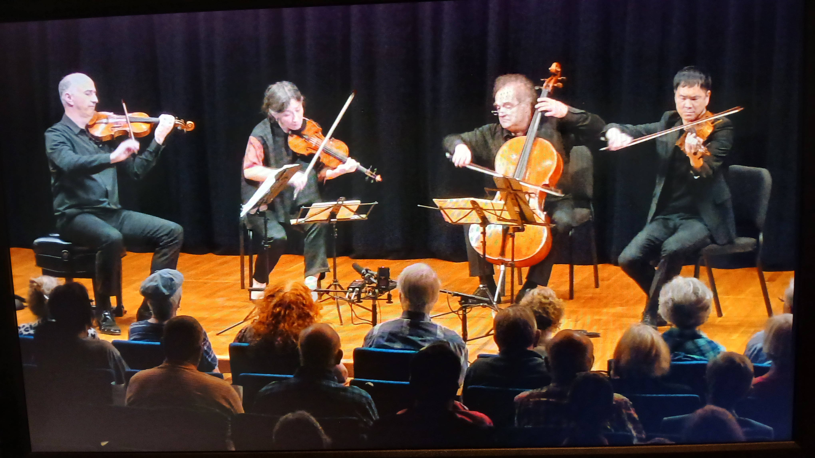
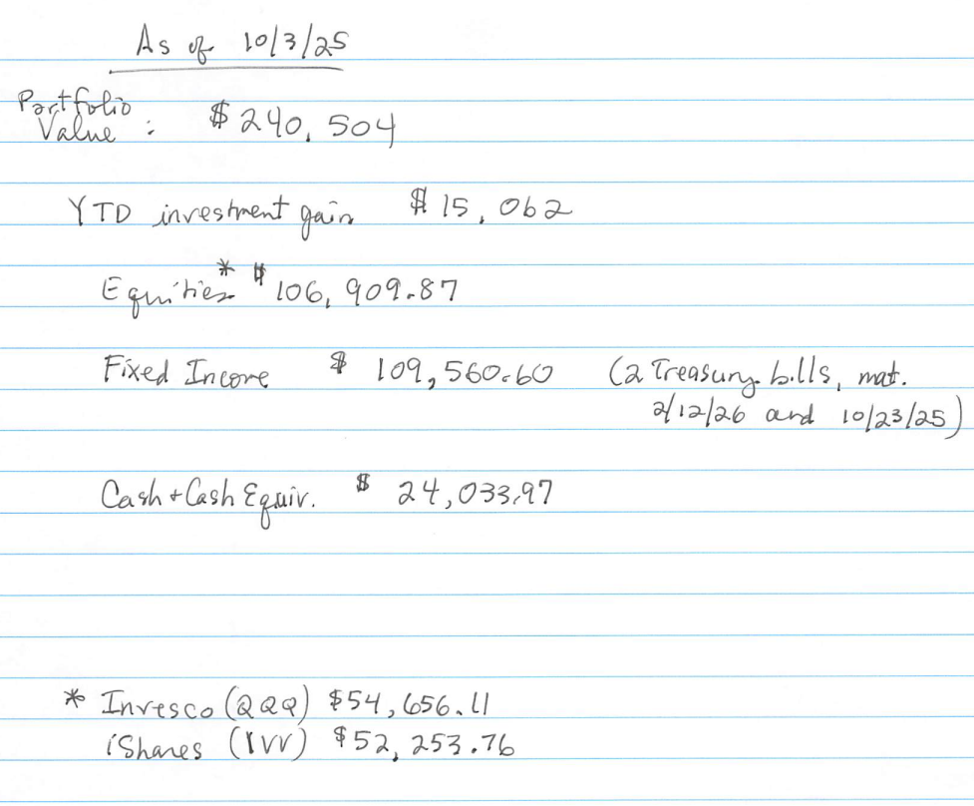
Basic presentation
CHAMBER MUSIC RALEIGH
BOARD BRIEFING
OCTOBER 6, 2025

Slide 2
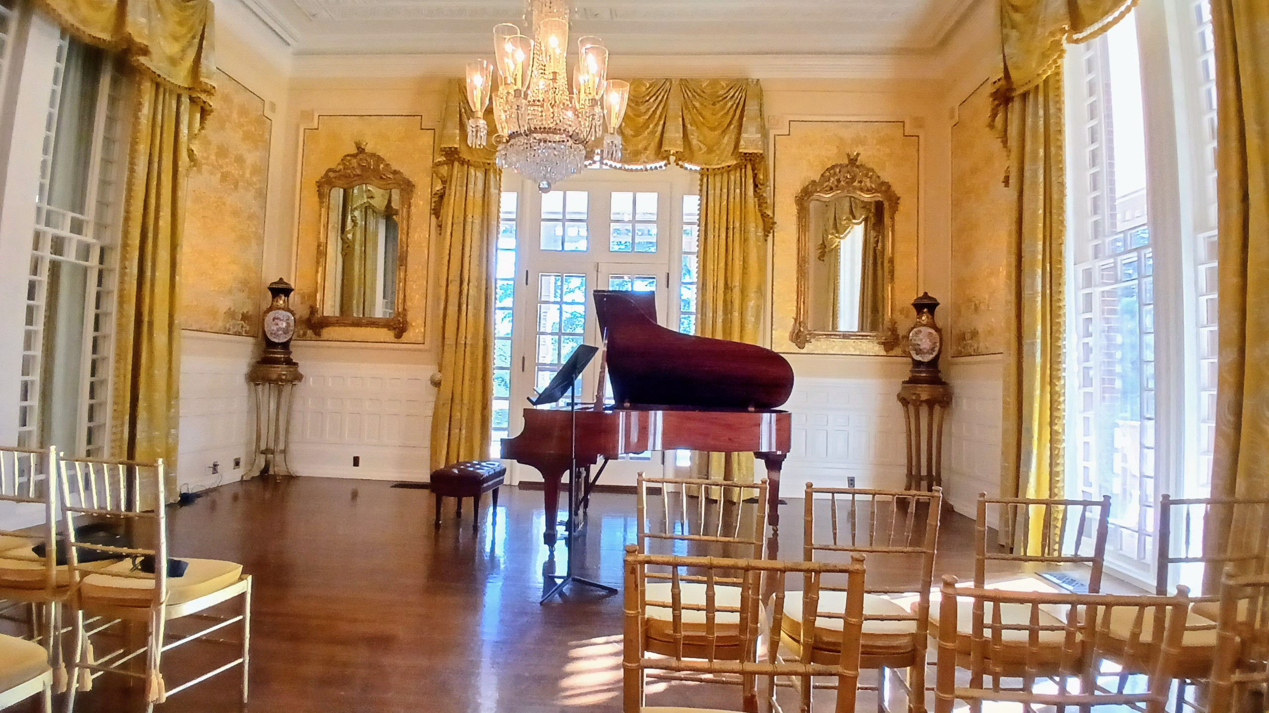
CMR
Board
Briefing
Artists $3000
Mansion Fee $3200
Hotels $ 550
Glasses $ 330
Photographer $ 300
Marketing $ 860
$8240
1915 Steinway Model M
$8,250 Sales
$8,240 Expenses
$10 NET

Slide 3
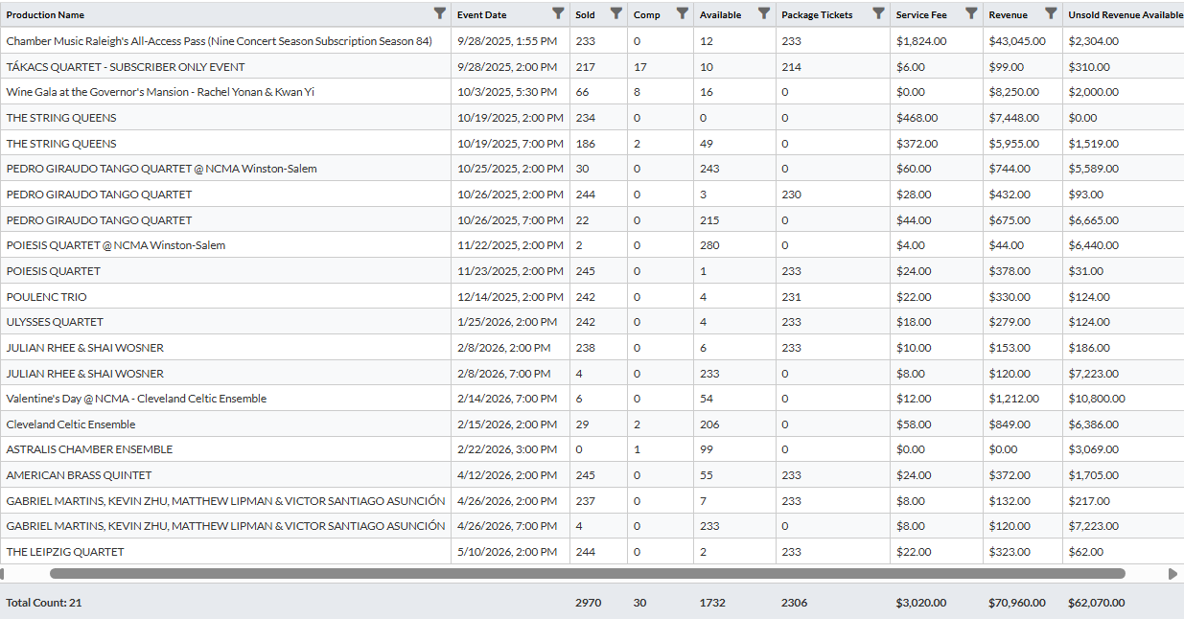
TICKET SALES BUDGET $126,500
SUBSCRIPTIONS $ 43,045
TICKET FEES $ 3,020
RUNOUT FEES $ 36,000
STRING QUEENS (NCMA) $ 13,403
7 PM CONCERTS (X3) $ 1,035
WINSTON-SALEM $ 788
CLEVELAND CELTIC $ 2,061
SMEDES PARLOR $ 0
$ 99,352
Unsold Revenue $ 54,914
50% Capacity $ 27,457
126,809

Slide 4



NCMA-WS LIST 3300
PURCHASED 5000
TOTAL 8300 POSTCARDS
THIS WEEK
RALEIGH MARKET CARD
TOTAL 5000 POSTCARDS
NEXT WEEK

Slide 5
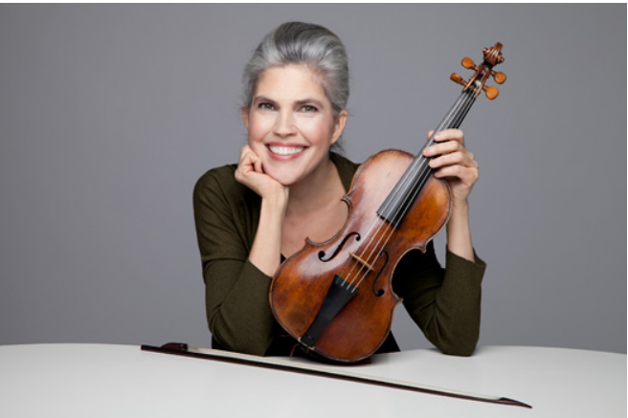
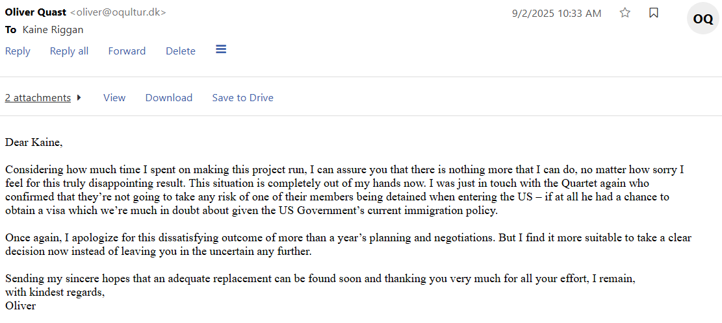
Programming
New Developments
Ingrid Matthews, Baroque Violinist (ensemble program)
Seattle Baroque Orchestra
Indiana University Faculty
daughter of pianist Clifton Matthews, retired from UNCSA
$10K Lambert Sponsorship Stands

Slide 6
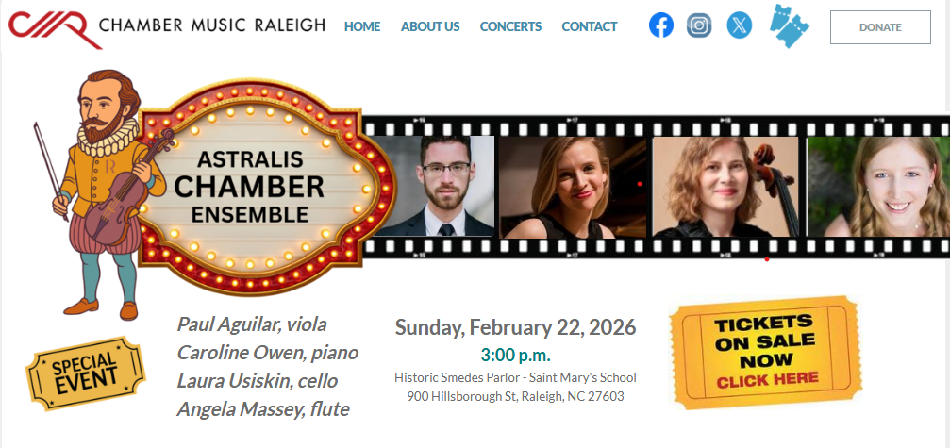

Programming
New Developments
$2k + Lodging

Slide 7
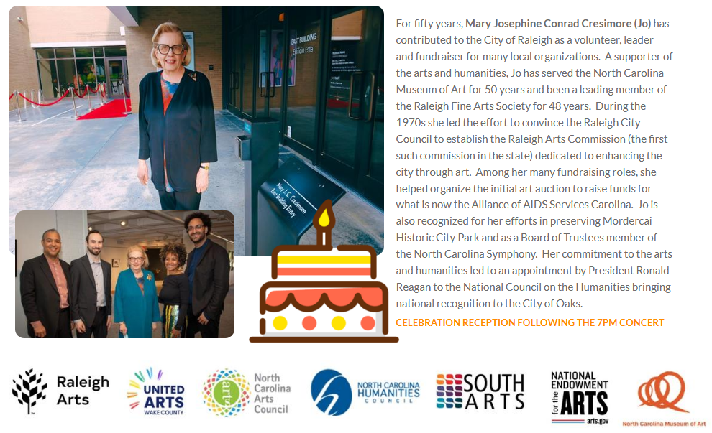
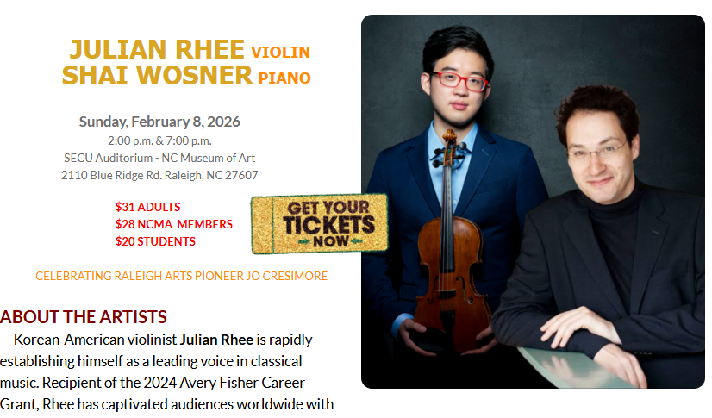
Programming
New Developments

Slide 8
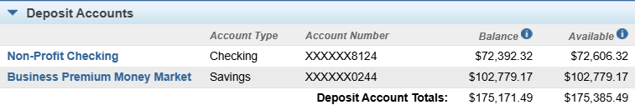
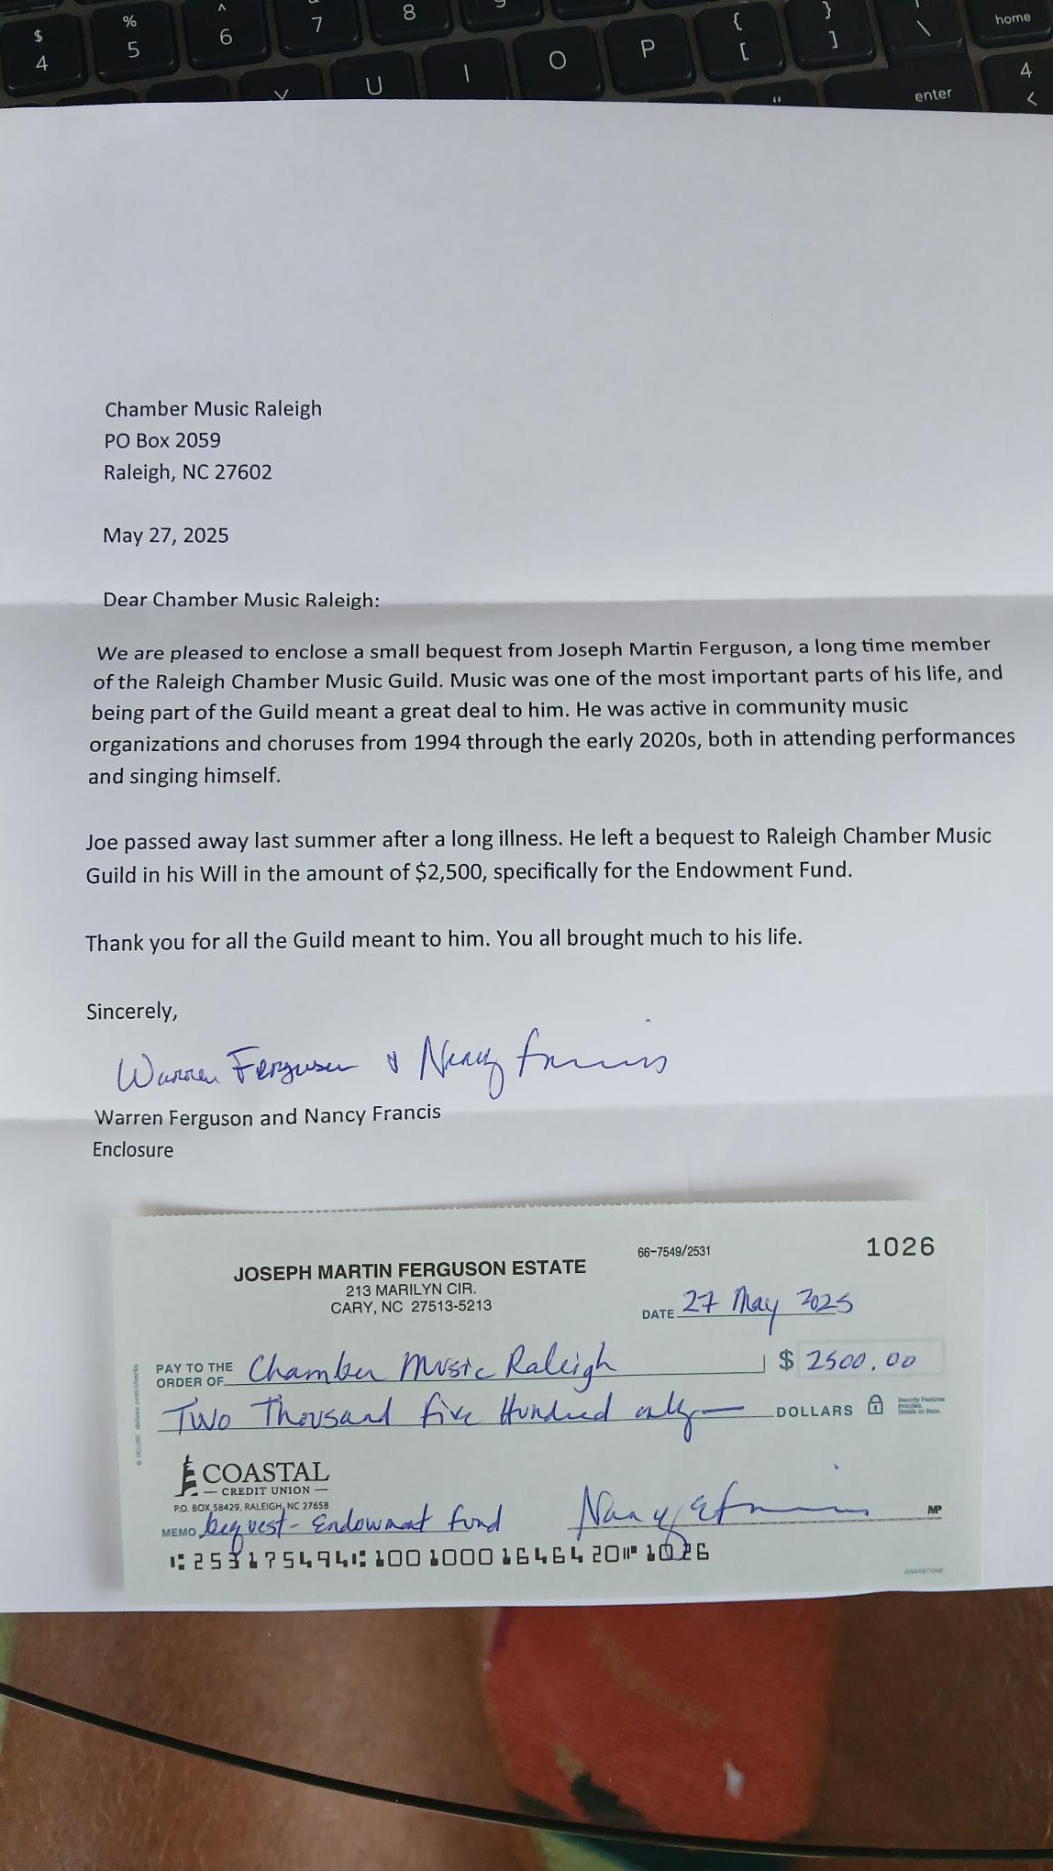
Board Action
Financial Update

Slide 9
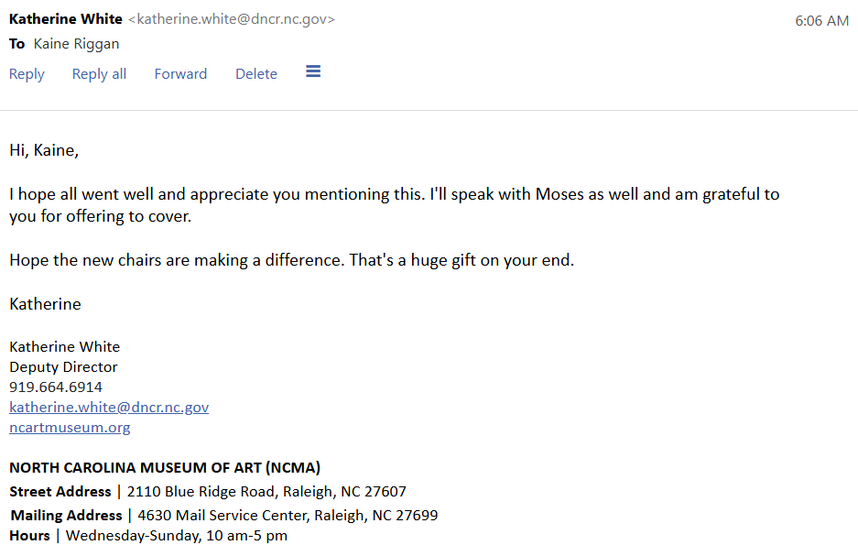
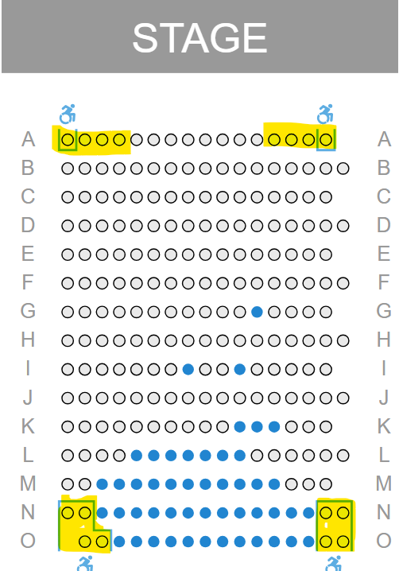
Adding Value
As An NCMA Partner

Slide 10

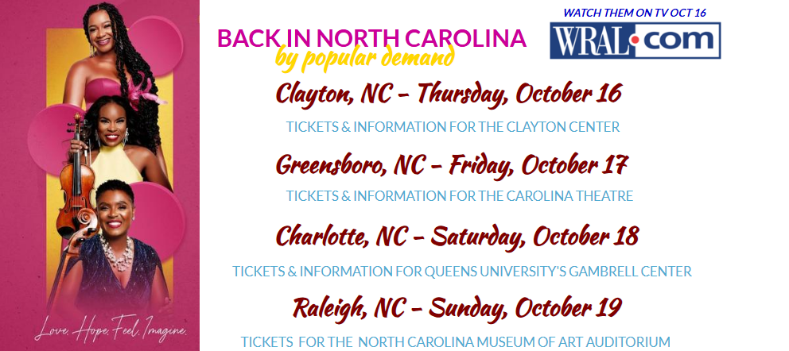
16 CONCERTS & A TELEVISION BROADCAST
IN THE NEXT EIGHT WEEKS

Slide 11

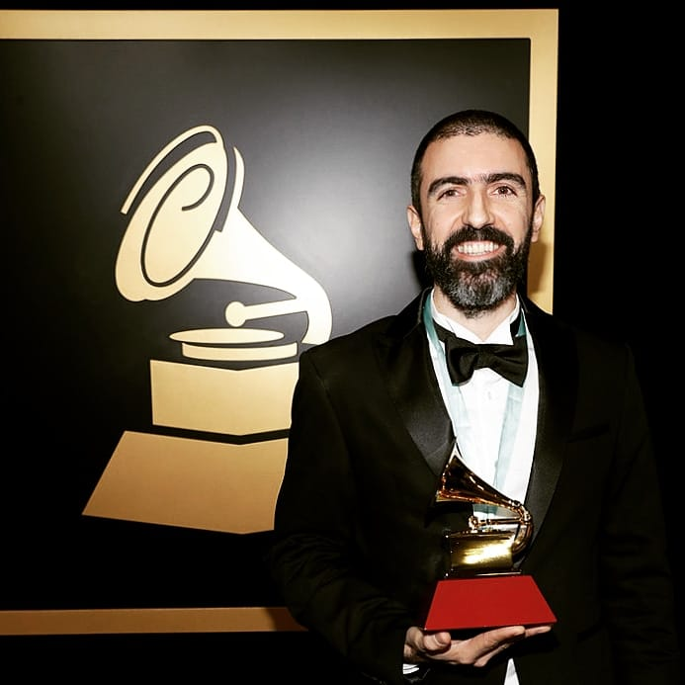

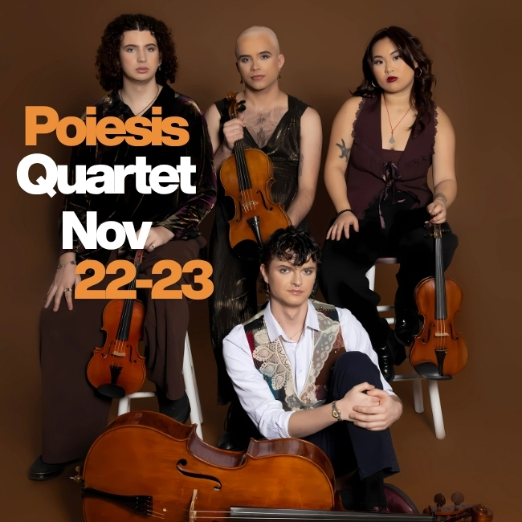
Pedro Giraudo Tango Quartet

Slide 12
NOVEMBER 3 AUDIT STARTS COMMERCECPA.COM
NOVEMBER 28 ANNUAL CAMPAIGN LETTERS
DECEMBER 1 CMR BOARD MEETING

Slide 13
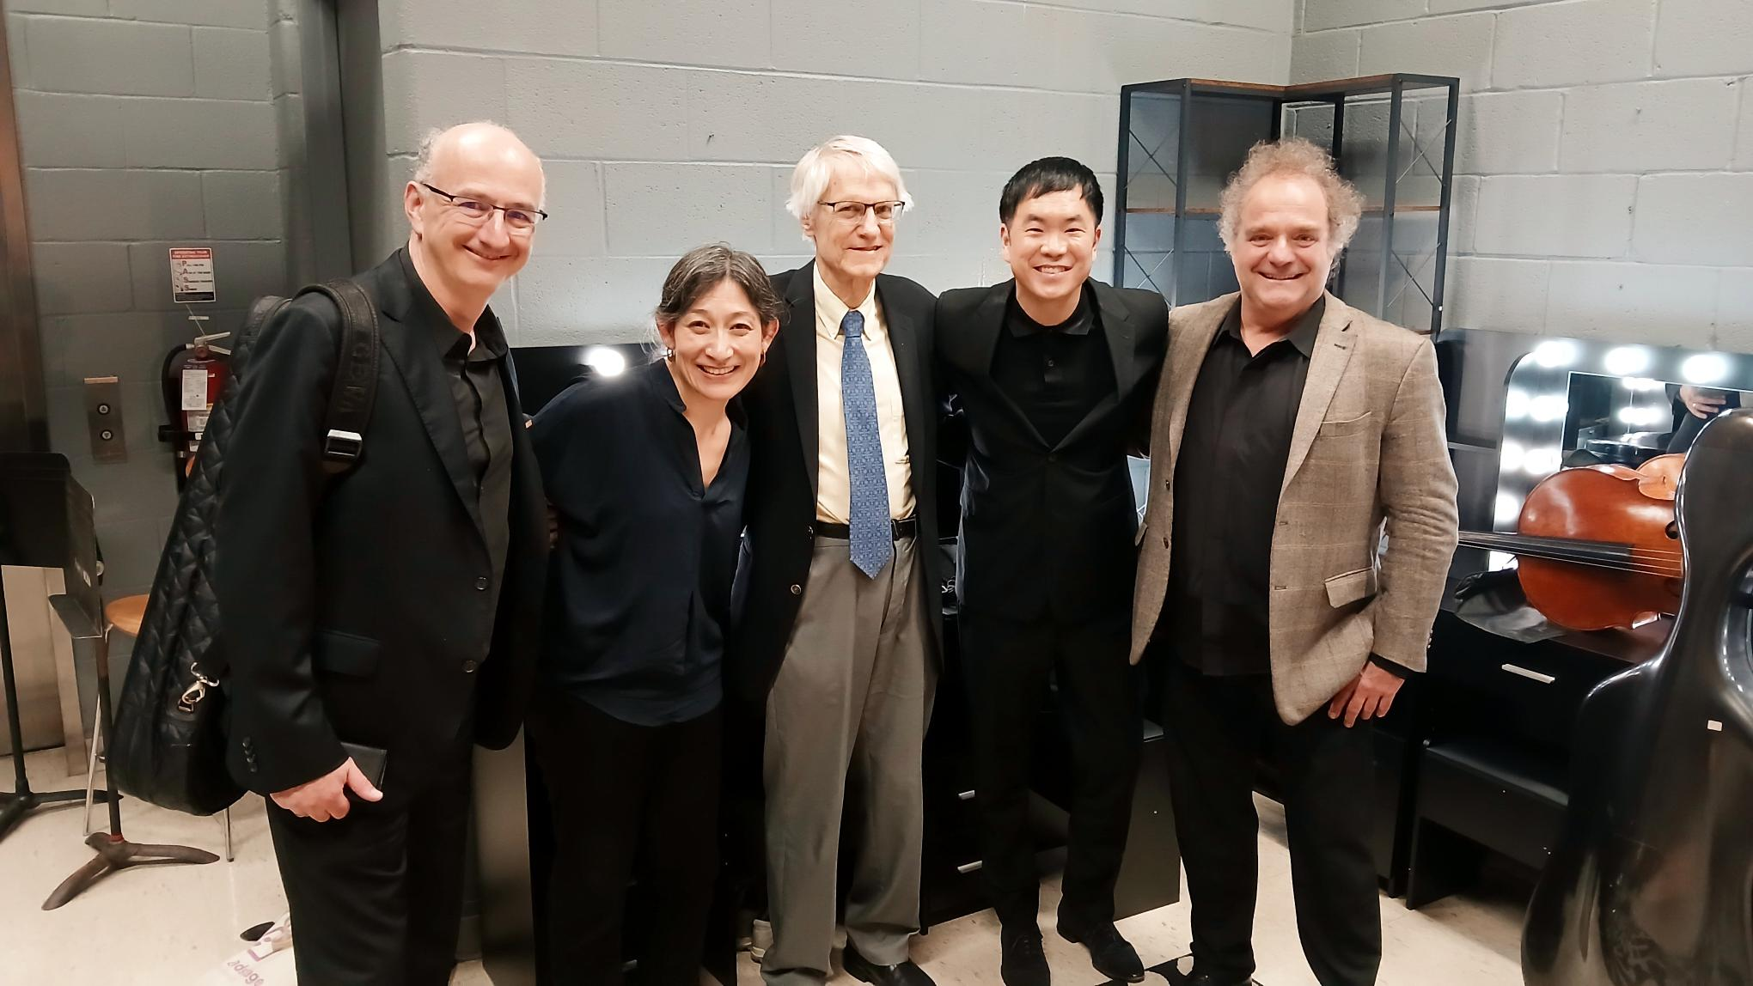

Thank you
Brita Tamm
502-555-0152
brita@firstupconsultants.com
www.firstupconsultants.com

Slide 14

Power of communication

Slide 15

Overcoming nervousness
Confidence-building strategies

Slide 16
Effective delivery techniques
This is a powerful tool in public speaking. It involves varying pitch, tone, and volume to convey emotion, emphasize points, and maintain interest:
  Pitch variation
  Tone inflection
  Volume control
Effective body language enhances your message, making it more impactful and memorable:
  Meaningful eye contact
  Purposeful gestures
  Maintain good posture
  Control your expressions

Slide 17
Navigating Q&A sessions
Know your material in advance
Anticipate common questions
Rehearse your responses
Maintaining composure during the Q&A session is essential for projecting confidence and authority. Consider the following tips for staying composed:
  Stay calm
  Actively listen
  Pause and reflect
  Maintain eye contact

Slide 18

Speaking impact
Your ability to communicate effectively will leave a lasting impact on your audience
Effectively communicating involves not only delivering a message but also resonating with the experiences, values, and emotions of those listening

Slide 19
Dynamic delivery
Learn to infuse energy into your delivery to leave a lasting impression.
One of the goals of effective communication is to motivate your audience.
Metric | Measurement | Target | Actual
Audience attendance | # of attendees | 150 | 120
Engagement duration | Minutes | 60 | 75
Q&A interaction | # of questions | 10 | 15
Positive feedback | Percentage (%) | 90 | 95
Rate of information retention | Percentage (%) | 80 | 85

Slide 20
Final tips & takeaways
Consistent rehearsal
  Strengthen your familiarity
Refine delivery style
  Pacing, tone, and emphasis
Timing and transitions
  Aim for seamless, professional delivery
Practice audience
  Enlist colleagues to listen & provide feedback
Seek feedback
Reflect on performance
Explore new techniques
Set personal goals
Iterate and adapt

Slide 21
Speaking engagement metrics
Impact factor | Measurement | Target | Achieved
Audience interaction | Percentage (%) | 85 | 88
Knowledge retention | Percentage (%) | 75 | 80
Post-presentation surveys | Average rating | 4.2 | 4.5
Referral rate | Percentage (%) | 10 | 12
Collaboration opportunities | # of opportunities | 8 | 10

