Slide 1
Strategies for Using the Common Core to Strengthen the Education of Students with Special Needs
Julie M Keegan, Esq.
Disability Rights New York
5 Clinton Square, Albany NY 12207
http://www.disability-advocates.org/programs.html

Slide 2
Common Core State Standards
Set of universal standards applicable to students across the country, including students with disabilities
Focus on English Language Arts and math skills needed for 21st century employment
Periodic assessments of all students to monitor progress and drive modifications to instruction; accommodations available to students in participating in those assessments
Currently implemented in all but 4 states
Class of 2022 will be first class required to pass 5 common-core based Regents exams to graduate

Slide 3
Where Do Students with Disabilities Fit In the Common Core?
Special education experts part of the Common Core development team
CCSS apply to all students, including students with disabilities
“Promoting a culture of high expectations for all students is a fundamental goal of the CCSS” Standards.
CCSS is consistent with IDEA & NYS Special Ed Laws

Slide 4
IDEA & CCSS

Slide 5
1. Emphasis on General Education and Productive Outcomes
CCSS: Students must be challenged to excel within the general curriculum and be prepared for success in their post-school lives, including college and/or careers
IDEA – free appropriate public education for students with disabilities that emphasizes special education and related services designed to:
meet their unique needs and
prepare them for employment, secondary education, and independent living

Slide 6
2. Goal-Oriented IEP
CCSS: “IEP includes annual goals aligned with and chosen to facilitate the student’s attainment of grade-level academic standards”
IDEA/NY Law: Goals on IEPs are required to focus on those skills that compromise the student’s ability to access the general education curriculum

Slide 7
3. Supports & Related Services
CCSS: Designed to meet students’ unique needs and enable their access to the general education curriculum
IDEA/NY: “A student with a disability shall be provided the special education specified on the student’s IEP to be necessary to meet the student's unique needs.” (8 NYCRR 200.6)

Slide 8
4. Effective Instruction
CCSS: Teachers and specialized instructional support staff who are prepared and qualified to deliver high-quality, evidence-based, individualized instruction and support services.
IDEA: . . . supporting high-quality, intensive pre-service preparation and professional development for all personnel who work with children with disabilities in order to ensure that such personnel have the skills and knowledge necessary to improve the academic achievement and functional performance of children with disabilities, including the use of scientifically based instructional practices, to the maximum extent possible . . . (20 USC 1400[c][5])

Slide 9
UDL-Based Instruction (as appropriate)
Instructional strategies based on the principles of Universal Design for Learning (UDL)
A scientifically valid framework for guiding educational practice that (a) provides flexibility in the ways information is presented, in the ways students respond or demonstrate knowledge and skills, and in the ways students are engaged; and (b) reduces barriers in instruction, provides appropriate accommodations, supports, and challenges, and maintains
Notes:
Applicable to students more significantly impacted by disability

Slide 10
5. Assistive Technology
CCSS: Instruction, testing and support should include, where appropriate, assistive technology devices and services that enable access to the standards.
IDEA/NY: consider whether the student requires assistive technology devices and services, including whether the use of school-purchased assistive technology devices is required to be used in the student’s home or in other settings in order for the student to receive a free appropriate public education (8 NYCRR 200.4)

Slide 11
6. Accommodations
CCSS, IDEA/NY and Section 504 require that students with disabilities are provided accommodations to ensure equal access to all opportunities in the learning environment.

Slide 12
What About Students Severely Impacted by Disability?
“Some students with the most significant cognitive abilities will require substantial supports and accommodations to have meaningful access to certain standards in both instruction and assessment, based on their communication and academic needs. These supports and accommodations should ensure that students receive access to multiple means of learning and opportunities to demonstrate knowledge, but retain the rigor and high expectations of the Common Core State Standards.”
Common Core - Application to Students with Disabilities

Slide 13
The Take Home Message . . .
Common Core sets high standards and expectations.
IDEA provides the legal foundation to ensure students meet those standards and expectations.

Slide 14
“Common” Concerns of Parents
My student can’t meet these standards!
Testing is causing my student anxiety!
The school is recommending a self-contained classroom!

Slide 15
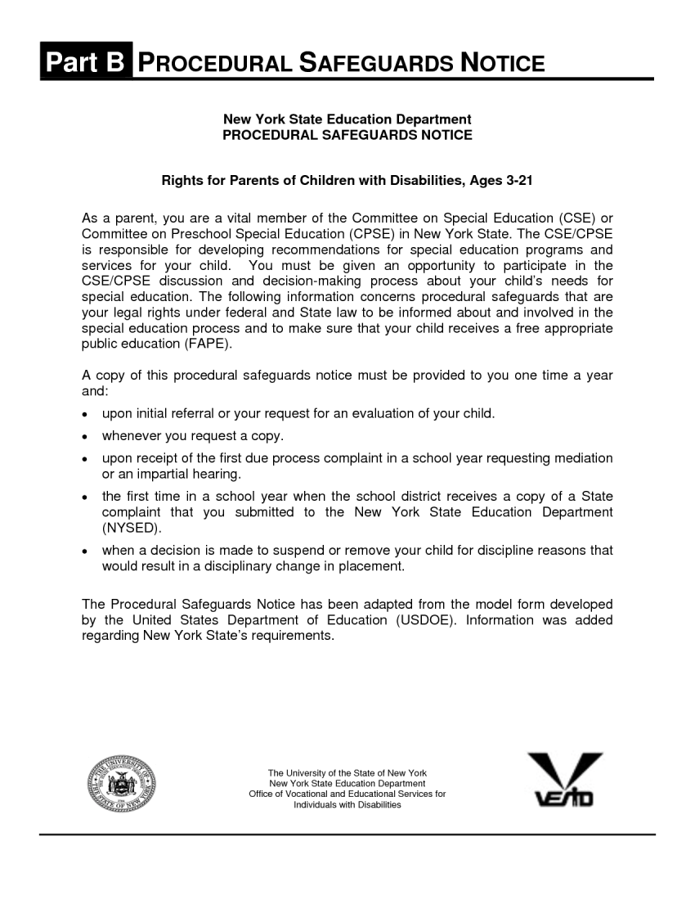
IDEA provides Procedural Safeguards to meet all of these changes!

Slide 16
My student can’t meet these standards!
Don’t compromise! Ask: WHY NOT???
CCSS and IDEA require research-based, individualized instruction, services & supports, & accommodations including assistive technology
STRATEGY:
Evaluation: thorough, accurate and precise understanding of the student’s:
Cognitive strengths & weaknesses
Current academic abilities
Learning style & instructional needs
Related Needs (e.g., speech, OT, PT, social, social-emotional)
Behavior (if impeding learning)

Slide 17
Independent Educational Evaluation (IEE)
Evaluation at District expense conducted by a person chosen by the parent
Triggered whenever parent disagrees with evaluation conducted by the District (i.e. “second opinion”)
Upon parent’s written request, District must either (& without delay):
Agree or
Initiate due process hearing to show its evaluation is appropriate or that evaluation sought by parent doesn’t meet district criteria
IEE must be considered by CSE

Slide 18
Choosing the Evaluator
Ask for suggestions from other parents and advocates
Interview potential evaluator(s):
Familiarity with common core curriculum?
In-school observations?
Specific written recommendations for delivery of instruction, services, supports & accommodations?
Willingness to participate in CSE meeting?

Slide 19
Use the Student’s IEP
Document learning needs in Present Levels
Annual Goals . . . “must be related to meeting:
the student’s needs that result from the student’s disability to enable the student to be involved in and progress in the general education curriculum; and
each of the student’s other educational needs that result from the student’s disability.”
Guide to Quality IEP Development & Implementation, NYS Educ. Dept
Services, Supports & Accommodations

Slide 20
Services, Supports & Accommodations
Instructional supports for learning― based on the principles of Universal Design for Learning (UDL)2 ―which foster student engagement by presenting information in multiple ways and allowing for diverse avenues of action and expression.
Instructional accommodations ―changes in materials or procedures― which do not change the standards but allow students to learn within the framework of the Common Core.
Accommodations Finder - free database of accommodation ideas to help students to attain the CC standards: http://www.interventioncentral.org/teacher-resources/learning-disability-accommodations-finder

Slide 21
Testing is Causing Too Much Anxiety!
WHY??? – Remember purpose of testing
Are all appropriate and available testing accommodations being used?
Exceptions: Accommodations v. Modification
Need help?
Test Access & Accommodations for Students with Disabilities http://www.p12.nysed.gov/specialed/publications/policy/testaccess/policyguide.htm

Slide 22
The school is recommending a self-contained classroom!
The placement of an individual student with a disability in the least restrictive environment must:
. . . provide for education of the student to the maximum extent appropriate to the needs of the student with other students who do not have disabilities; and be as close as possible to the student’s home (8 NYCRR 200.6)
Placement of students with disabilities in special classes, separate schools and other removal from general ed occurs only when the nature or severity of the disability is such that, even with the use of supplementary aids and services, education cannot be satisfactorily achieved
Have all supplementary aids, services, support, AT, etc been tried?

Slide 23
Examples of Aids, Supports, Services
Consultant teacher (push-in)
Supplemental special ed instruction (e.g. specialized reading instruction, resource room)
Direct special ed instruction (ind./group)
Aide (individual or shared)
Curriculum modification
Instructional Accommodations
Testing Accommodations
Behavior Plan
Assistive Technology
Related servi ces

Slide 24
What else can I do?
Partner with school to advocate for:
Funding
Universally-designed instructional materials
Funding
Training on research based instructional strategies
Funding
Increased research-based special education services and supports
Funding
Widespread use and support of Assistive Technology
Funding ☺

Slide 25
What if Parent and School Disagree?
For more detailed information and guidance, see Special Education in Plain Language, www.nyspecialedtaskforce.org

Slide 26
Prior Written Notice
If school is refusing to provide evaluation, supports and services, or insisting on more restrictive environment, request prior written notice, including:
Explanation of why the action is proposed or refused
Description of each evaluation procedure, assessment, record, or report used in the decision to propose or refuse the action:

Slide 27
Mediation
Procedure must be in place
Voluntary
Can be pursued prior to or in addition to request for impartial hearing
Mediator must have some training in special education
Confidential; can’t be used in due process hearing or civil proceeding
Written agreement is binding & enforceable
Useful when disagreement over scope/intensity of services and/or poor communication/relationship with District staff

Slide 28
State Complaints
Can be made by individual or organization
Filed with NYSED w/in ONE year of disputed act
NYSED investigates & issues final determination
If complaint is founded, school must remediate denial of services; SED monitoring +/or intervention
Can’t file for impartial hearing on same issue at the same time
Useful when district is not following the law or is ignoring your rights

Slide 29
Complaint to US Office of Civil Rights
OCR charged with enforcing Section 504 and the ADA
OCR will review and investigate if it appears a violation may have occurred
Parent files complaint in writing or online.
http://www.ed.gov/about/offices/list/ocr/complaintprocess.html
Effective for violations of Section 504 of the Rehabilitation Act (discrimination and/or failure to provide accommodations)

Slide 30
Impartial Hearing
Initiated via Due Process Complaint Notice
Must be based on failure to provide a free appropriate public education (FAPE)
2 year statute of limitations (some exceptions)
Burden of proof on districts in most cases
Pendency – existing placement/services remain in place until hearing is complete (some exceptions)

