Slide 1
NFHS Basketball Legal Uniforms

Slide 2
Basketball Uniforms Legal Styles/Designs
Uniform jerseys must comply with all rules listed in 3-4, 3-5 and 3-6
Uniform rules are concise and clear regarding what is, and what is not, permissible on the jersey
Coaches and school administrators must ensure that legal uniforms are being ordered and purchased from manufacturers/distributors
Notes:
Uniform jerseys must comply with all rules listed in 3-4, 3-5 and 3-6
Uniform rules are concise and clear regarding what is, and what is not, permissible on the jersey
Coaches and school administrators must ensure that legal uniforms are being ordered and purchased from manufacturers/distributors

Slide 3
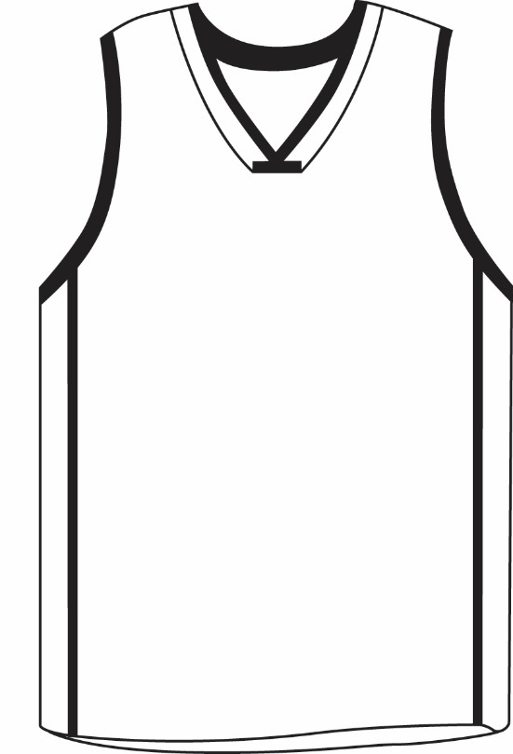
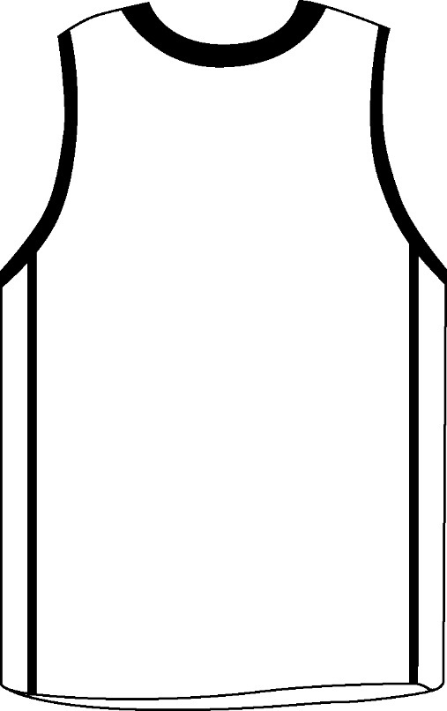
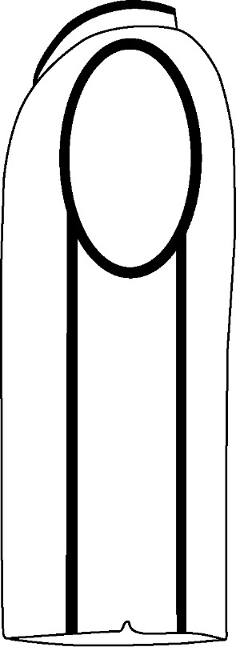
Basketball Uniforms Legal Styles/Designs
E
D
D
E
High School Name or Mascot/Logo Image
Last Name
C
C
25
25
A
B
B
B
A
A
C
Front View Back View Side View
Notes:
All three views – front, back and side – must be available to determine the legality of any uniform.

Slide 4
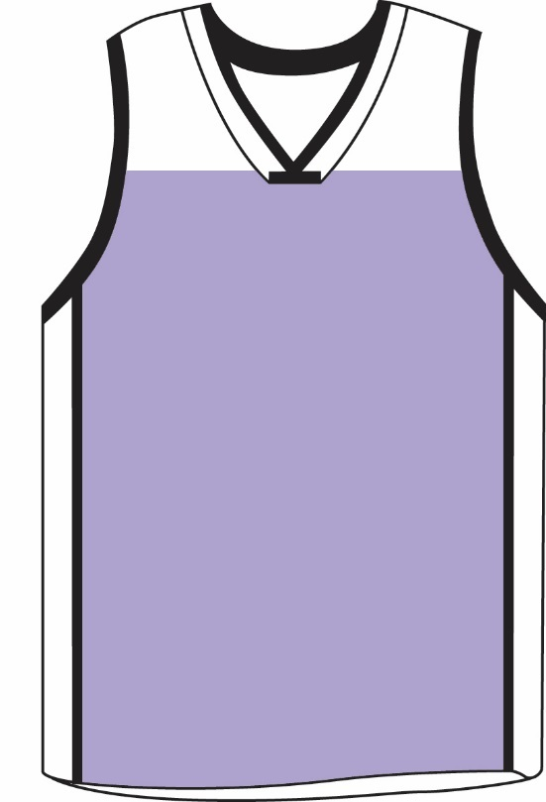
Basketball Uniforms Front View
A. JERSEY COLOR
The torso of the jersey must be a single solid color with no designs in the fabric (white for home and a dark color clearly contrasting white for visitor).
If gray is a color choice, it must be for the away jersey and must be closer to black at least by 70%.
Light colors (i.e., yellow or gold) that do not clearly contrast with white are not compliant away uniform colors.
A
Notes:
A. JERSEY COLOR
The torso of the jersey must be a single solid color with no designs in the fabric (white for home and a dark color clearly contrasting white for visitor).
If gray is a color choice, it must be for the away jersey and must be closer to black at least by 70%.
Light colors (i.e., yellow or gold) that do not clearly contrast with white are not compliant away uniform colors.

Slide 5
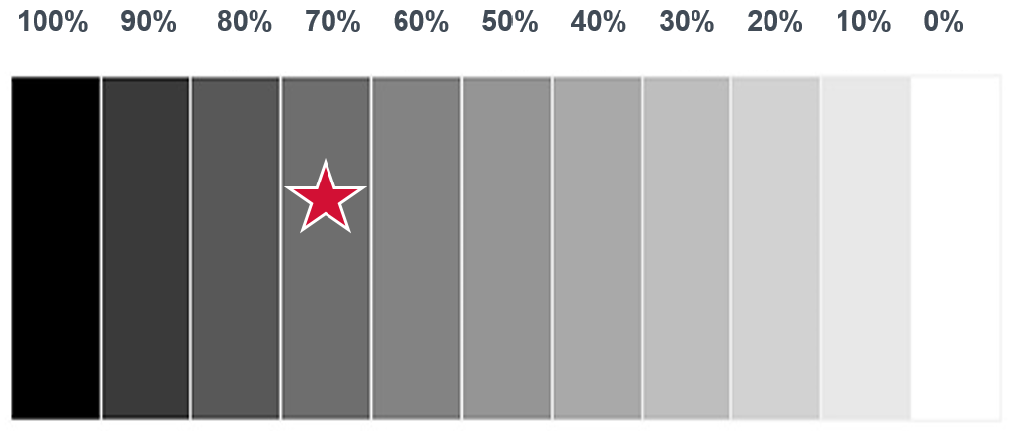
Home Team Jerseys Gray Color Spectrum Chart
When gray is being used for an away jersey, it cannot go below 70% shading to be considered clearly contrasting from white.
Notes:
Comment on Slide:
When gray is being used for an away jersey, it cannot go below 70% shading to be considered clearly contrasting from white.

Slide 6
Basketball Uniforms Front View
A. JERSEY COLOR
The “torso” is the portion of the jersey from an imaginary horizontal line at the base of the neckline extending to each armhole, down to the bottom hem of the jersey and from side seam to side seam.
A
Notes:
A. JERSEY COLOR
The “torso” is the portion of the jersey from an imaginary horizontal line at the base of the neckline extending to each armhole, down to the bottom hem of the jersey and from side seam to side seam.

Slide 7
Basketball Uniforms Front View
B. FRONT NUMBER
The number on the front shall be at least 4 inches high, not less than ¾ inch wide (excluding the border) and centered vertically and horizontally on the portion of the visible part of the jersey.
Numbers shall be plain Arabic numerals and must be the same style and color as the number on the back of the jersey.
25
B
Notes:
B. FRONT NUMBER
The number on the front shall be at least 4 inches high, not less than ¾ inch wide (excluding the border) and centered vertically and horizontally on the portion of the visible part of the jersey.
Numbers shall be plain Arabic numerals and must be the same style and color as the number on the back of the jersey.

Slide 8
Basketball Uniforms Front View
B. FRONT NUMBER
Legal numbers are: 0, 1, 2, 3, 4, 5, 00, 10, 11, 12, 13, 14, 15, 20, 21, 22, 23, 24, 25, 30, 31, 32, 33, 34, 35, 40, 41, 42, 43, 44, 45, 50, 51, 52, 53, 54, 55. A team member list shall not have both numbers 0 and 00.
No more than three colors may be used on the number. The style must be clearly visible and conform to the provisions of NFHS Rule 3-4-3e.
25
B
Notes:
B. FRONT NUMBER
Legal numbers are: 0, 1, 2, 3, 4, 5, 00, 10, 11, 12, 13, 14, 15, 20, 21, 22, 23, 24, 25, 30, 31, 32, 33, 34, 35, 40, 41, 42, 43, 44, 45, 50, 51, 52, 53, 54, 55. A team member list shall not have both numbers 0 and 00.
No more than three colors may be used on the number. The style must be clearly visible and conform to the provisions of NFHS Rule 3-4-3e.

Slide 9
Basketball Uniforms Front View
A solid contrasting color with no more than two solid color ¼-inch borders around the entire number. If a team color is used as a border, it must be counted as one of the allowed colors.
A solid contrasting color with a “shadow” trim of a contrasting color on part of the number not to exceed ½ inch in width and may be used with one ¼-inch border.
25
B
Notes:
A solid contrasting color with no more than two solid color ¼-inch borders around the entire number. If a team color is used as a border, it must be counted as one of the allowed colors.
A solid contrasting color with a “shadow” trim of a contrasting color on part of the number not to exceed ½ inch in width and may be used with one ¼-inch border.

Slide 10
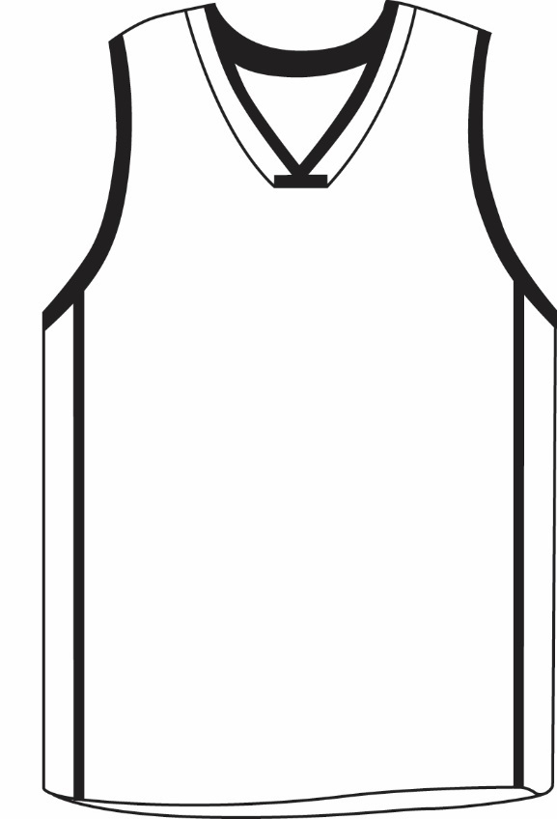
Basketball Uniforms Front View
C. IDENTIFYING NAME/SCHOOL MASCOT/LOGO
Lettering with school name, school’s nickname, school logo name, and/or abbreviation of the official school may be placed on the front of the jersey.
Lettering must be placed horizontally and may be arched. Names may also be on multiple lines.
High School Name or Mascot/Logo Image
C
25
Notes:
C. IDENTIFYING NAME/SCHOOL MASCOT/LOGO
Lettering with school name, school’s nickname, school logo name, and/or abbreviation of the official school may be placed on the front of the jersey.
Lettering must be placed horizontally and may be arched. Names may also be on multiple lines.

Slide 11
Basketball Uniforms Front View
C. IDENTIFYING NAME/SCHOOL MASCOT/LOGO
The first and last letters, either above or below the number, must be on the same horizontal plane. When above the number, the plane may not be below a plane extending through the top of the number(s). When below the number, the plane may not be above a plane extending through the bottom of the number(s).
Any point on any letter shall not be closer than one inch to any point on any number(s).
High School Name or Mascot/Logo Image
C
25
Notes:
C. IDENTIFYING NAME/SCHOOL MASCOT/LOGO
The first and last letters, either above or below the number, must be on the same horizontal plane. When above the number, the plane may not be below a plane extending through the top of the number(s). When below the number, the plane may not be above a plane extending through the bottom of the number(s).
Any point on any letter shall not be closer than one inch to any point on any number(s).

Slide 12
Basketball Uniforms Front View
C. IDENTIFYING NAME/SCHOOL MASCOT/LOGO
Any form of decorative accent (i.e., paw, halo, crown, star, etc.) in a name or abbreviation is only permitted above the number.
If a tail is used in the lettering of an identifying name or abbreviation, the name or abbreviation must be located below the number.
High School Name or Mascot/Logo Image
C
25
Notes:
C. IDENTIFYING NAME/SCHOOL MASCOT/LOGO
Any form of decorative accent (i.e., paw, halo, crown, star, etc.) in a name or abbreviation is only permitted above the number.
If a tail is used in the lettering of an identifying name or abbreviation, the name or abbreviation must be located below the number.

Slide 13
Basketball Uniforms Front View
A school logo/mascot may be centered directly above the number in place of identifying name(s) on the front of the jersey.
High School Name or Mascot/Logo Image
25
C
Notes:
A school logo/mascot may be centered directly above the number in place of identifying name(s) on the front of the jersey.

Slide 14
Basketball Uniforms Front View
D. ABOVE THE NECKLINE
There are no restrictions in the area of the jersey from an imaginary horizontal line at the base of the neckline extending to each armhole, up to the shoulder seam, except identifying names.
The imaginary line shall not extend beyond 1½ inches from the lowest point of the neckline apex/opening.
D
High School Name or Mascot/Logo Image
25
Notes:
D. ABOVE THE NECKLINE
There are no restrictions in the area of the jersey from an imaginary horizontal line at the base of the neckline extending to each armhole, up to the shoulder seam, except identifying names.
The imaginary line shall not extend beyond 1½ inches from the lowest point of the neckline apex/opening.

Slide 15
Basketball Uniforms Front View
D. ABOVE THE NECKLINE
Different colors and/or designs may be used in this area.
By state association adoption, one commemorative/memorial patch (not to exceed 4 square inches or include a number), if worn, must be in this area or in the side insert.
A school or conference logo/mascot may be located at the apex/ opening of the neckline, in the corresponding area on the back of the jersey and/or in either side insert.
D
High School Name or Mascot/Logo Image
25
Notes:
D. ABOVE THE NECKLINE
Different colors and/or designs may be used in this area.
By state association adoption, a commemorative/memorial patch (not to exceed 4 square inches), if worn, must be in this area or in the side insert.
A school or conference logo/mascot may be located at the apex/opening of the neckline, in the corresponding area on the back of the jersey and/or in either side insert.

Slide 16
Basketball Uniforms Front View
E. ARMHOLE TRIM
Trim, piping or an accent color differing from the torso shall not exceed 1 inch around the arm openings.
Except in the area above the neckline – where there are no color or design restriction.
E
High School Name or Mascot/Logo Image
25
Notes:
E. ARMHOLE TRIM
Trim, piping or an accent color differing from the torso shall Not exceed 1 inch around the arm openings.
Except in the area above the neckline – where there are no color or design restriction.

Slide 17
Basketball Uniforms Back View
A. JERSEY COLOR
The back torso of the jersey must be the same single color as the front, no designs are allowed in the fabric.
The back “torso” is the portion of the jersey from the bottom of the back panel, if used, down to the bottom hem of the jersey and from side seam to side seam.
A
Notes:
A. JERSEY COLOR
The back torso of the jersey must be the same single color as the front, no designs are allowed in the fabric.
The back “torso” is the portion of the jersey from the bottom of the back panel, if used, down to the bottom hem of the jersey and from side seam to side seam.

Slide 18
Basketball Uniforms Back View
B. BACK NUMBER
The number on the back shall be at least 6 inches high, not less than ¾ inch wide (excluding the border) and centered vertically and horizontally on the portion of the jersey that is intended to be visible.
The back numbers shall meet all the remaining specifications of the front number as previously noted (Front View, B.2-B.4).
Last Name
25
B
Notes:
B. BACK NUMBER
The number on the back shall be at least 6 inches high, not less than ¾ inch wide (excluding the border) and centered vertically and horizontally on the portion of the jersey that is intended to be visible.
The back numbers shall meet all the remaining specifications of the front number as previously noted (Front View, B.2-B.4).

Slide 19
Basketball Uniforms Back View
C. IDENTIFYING NAME
School name, school’s nickname, school logo name, player’s name and/or abbreviation of the official school name may be placed horizontally on the back of the jersey.
Lettering on the back of the jersey shall meet all the specifications of the front lettering as previously noted (Front View, C2-C.6)
Last Name
C
25
Notes:
C. IDENTIFYING NAME
School name, school’s nickname, school logo name, player’s name and/or abbreviation of the official school name may be placed horizontally on the back of the jersey.
Lettering on the back of the jersey shall meet all the specifications of the front lettering as previously noted (Front View, C2-C.6)

Slide 20
Basketball Uniforms Back View
D. BACK PANEL
There are no color or design restrictions in the corresponding area – base of the neckline to the shoulder seam – on the back of the team jersey, except for identifying names.
D
Last Name
25
Notes:
D. BACK PANEL
There are no color or design restrictions in the corresponding area – base of the neckline to the shoulder seam – on the back of the team jersey, except for identifying names.

Slide 21
Basketball Uniforms Back View
E. ARMHOLE TRIM
Trim shall not exceed 1 inch around the arm openings. Except in the area above the neckline – where there are no color or design restriction.
E
Last Name
25
Notes:
E. ARMHOLE TRIM
Trim shall not exceed 1 inch around the arm openings. Except in the area above the neckline – where there are no color or design restriction.

Slide 22
Basketball Uniforms Side View
A. LOCATION
Side inserts must be centered vertically below the armpit.
B. WIDTH
Side inserts, including trim/piping/accent color(s), must be a maximum of 4 inches (2 inches on each side of the seam).
A
B
Notes:
A. LOCATION
Side inserts must be centered vertically below the armpit.
B. WIDTH
Side inserts, including trim/piping/accent color(s), must be a maximum of 4 inches (2 inches on each side of the seam).

Slide 23
Basketball Uniforms Side View
C. STYLE/DESIGN
Side inserts may be of any color or design.
Side inserts must be the same width for all team jerseys.
By state association adoption, one commemorative/memorial patch (not to exceed 4 square inches), if worn, must be in this area or in the area above the neckline on the front or back of the jersey.
C
Notes:
C. STYLE/DESIGN
Side inserts may be of any color or design.
Side inserts must be the same width for all team jerseys.
By state association adoption, one commemorative/memorial patch (not to exceed 4 square inches), if worn, must be in this area or in the area above the neckline on the front or back of the jersey.

Slide 24
Basketball Uniforms Side View
NOTES:
A single manufacturer’s logo/trademark/reference (not to exceed 2 ¼ square inches with no dimension more than 2 ¼ inches long) may be placed anywhere on the jersey provided placement does not interfere with the visibility of the uniform number.
The American flag may be worn anywhere on the team jersey provided it does not exceed 2 x 3 inches and does not interfere with the visibility of the player’s number.
C
Notes:
NOTES:
A single manufacturer’s logo/trademark/reference (not to exceed 2 ¼ square inches with no dimension more than 2 ¼ inches long) may be placed anywhere on the jersey provided placement does not interfere with the visibility of the uniform number.
The American flag may be worn anywhere on the team jersey provided it does not exceed 2 x 3 inches and does not interfere with the visibility of the player’s number.

