Slide 1


2017
PARAMEDIC REFRESHER COURSE

Slide 2
Paramedic Refresher
Module IV
Trauma triage cns injury hemorrhage control acute abdomen fluid resuscitation

Slide 3
Module IV Objectives

Slide 4
Module IV Objectives

Slide 5
Trauma Triage
In the United States unintentional injury is the leading cause of death for persons aged 1 – 44 years
Ensuring that severely injured trauma patients are treated at trauma centers has a profound impact on their survival
The National Study on the Costs and Outcomes of Trauma (NSCOT) reported a 25% reduction in mortality for severely injured adult patients who received care at a level 1 trauma center rather than receiving care at a non-trauma center

Slide 6
Trauma Triage
The CDC guidelines are designed for use with individual injured patients and provide guidance for EMS providers
The guidelines provided by the CDC are not intended for mass casualty incidents

Slide 7
Trauma Triage
CDC Guidelines
  Physiologic criteria
    Step 1
      Intended to allow for rapid identification of critically injured patients by assessing:
        Level of consciousness (GCS score)
        Systolic BP
        Respiratory rate
    These criteria demonstrate high predictive value for severe injury

Slide 8
Trauma Triage
CDC Guidelines
  Anatomic criteria
    Step 2
      Recognizes that certain patients present with normal physiology but have an anatomic injury that might require the highest level of care.
      Consider transport to a trauma facility if patient is found with
        Penetrating injuries above the knee
        Unstable chest wall
        ≥ 2 or more proximal long bone fractures
        Extremity that is crushed, degloved, mangled, or pulseless
        Amputation proximal to wrist or ankle
        Pelvic fractures
        Skull fractures
        Paralysis

Slide 9
Trauma Triage
CDC Guidelines
  Mechanism of injury criteria
    Step 3
      An injured patient who does not meet steps 1 or 2 should be evaluated in terms of mechanism of injury to determine if the injury might be severe enough for concern
      A study found that approximately 1,000,000 trauma patients were under triaged when using only physiologic and anatomic criteria
      Another study determined that MOI was an independent predictor of mortality and functional impairment of blunt trauma patients for around 500,000 patients

Slide 10
Trauma Triage
CDC Guidelines
  Mechanism of injury criteria
    Falls
      Adults > 20ft
      Children > 10ft or > 2x child’s height
    Auto crash
      Intrusion > 12in where occupied or > 18in on any side
      Partial or complete ejection from vehicle
      Death in the same vehicle
    Vehicle telemetry data that indicates high risk of injuries
      Pedestrian/bicycle vs vehicle
      Thrown
      Run over
      Impact > 20mph
      Motorcycle crash > 20mph

Slide 11
Trauma Triage
CDC Guidelines
  Special considerations
    Step 4
      EMS personnel must determine whether persons who have not met criteria
        Physiologic
        Anatomic
        Mechanism steps
      But have underlying conditions and other factors that place them at high risk of injury
        Osteoporosis
        Osteogenesis imperfecta
        Bleeding disorders
      Persons who meet step 4 criteria might require trauma center care

Slide 12
Trauma Triage
CDC Guidelines
  Special considerations
    Step 4
      Consider priority transport to a trauma facility if patient meets these special considerations
        Older adults
          ≥ 55 years have increased chances of injury/death
          ≥ 65 years my present with shock is systolic BP is < 110mm/Hg
          Mechanism is low impact (ground level falls)
        Children
          Consider transporting all children to pediatric trauma centers

Slide 13
Trauma Triage
CDC Guidelines
  Special considerations
    Step 4
      Anticoagulants and bleeding disorders
        Head injuries may present with rapid deterioration
        Burns
          No other trauma, triage to a burn facility
          Other trauma findings, triage to a trauma center
        Pregnancy
          > 20 weeks
        Provider judgement
          Using prior experience and thorough patient assessment decide the best destination for your patient
        When in doubt transport to a trauma center

Slide 14
Trauma Triage
Field trauma triage
  Field triage of critically injured trauma patients and their transport to an appropriate level trauma center is often vital to their survival
  Patients meeting P1 or P2 criteria should generally be transported to the highest level trauma center within 30 minutes
  Assess for P1 Criteria
    Respiratory compromise or intubated
    Systolic BP < 90 at any time in adults, or age specific hypotension in children
    GCS < 9
    GSW to neck, chest, abdomen or extremities proximal to the elbow/knee

Slide 15
Trauma Triage
Field trauma triage
  Assess for P2 (Physiologic or Anatomy) Criteria
    Respiratory Rate <10 and >29 Infants with RR<20 if
    <1 year old.
    GCS ≥9 and <14
    Penetrating injuries to head, neck, torso or extremities proximal to elbow or knee (other than GSW to neck, chest, abdomen or proximal to the elbow/knee)
    Chest wall instability (e.g. flail chest)
    Two (2) or more proximal long-bone fractures
    Crush, degloved, or mangled extremity
    Amputation proximal to wrist or ankle
    Pelvic fracture
    Open or depressed skull fracture
    Paralysis
    Time sensitive extremity injury

Slide 16
Trauma Triage
Field trauma triage
  Assess for P2 (Mechanism) Criteria
    Falls
      Adults > 20 feet;
      Children >10 feet or 2-3 times the height of the child.
    High Risk Auto Crash
      Ejection
      Intrusion, including roof: >12 inches, occupant site >18 inches, any site
      Death in same passenger compartment
      Vehicle telemetry data (if available) consistent with high risk of injury
    Auto vs. Pedestrian/Bicyclist
      thrown
      run over
      significant impact (≥ 20 mph)
    Motorcycle or ATV crash > 20 mph

Slide 17
Trauma Triage
Field trauma triage
  If patient meets any of the Priority 1 criteria
    Request Priority 1 Trauma Team activation
    Consider immediate aeromedical evacuation, or transport the patient to the highest level trauma center within 30 minutes transport via ground or air
    If time is >30 minutes to a designated trauma center, transport the patient to the nearest facility capable of resuscitation and stabilization

Slide 18
Trauma Triage
Field trauma triage
  If patient meets Priority 2 criteria for physiologic or anatomic
    Request Priority 2 Trauma Team activation
    Consider immediate aeromedical evacuation, or transport the patient to the highest level trauma center within 30 minutes transport via ground or air
    If time is >30 minutes to a designated trauma center, transport the patient to the nearest facility capable of resuscitation and stabilization

Slide 19
Trauma Triage
Field trauma triage
  If the patient meets Priority 2 criteria for mechanism
    Request Priority 2 Trauma Team activation
    Transport the patient to the highest level trauma center within 30 minutes transport
    If time is >30 minutes to a designated trauma center, transport the patient to the nearest facility capable of resuscitation and stabilization

Slide 20
Trauma Triage
West Virginia Trauma Centers
  Level 1
    CAMC - General Hospital Charleston
    WVU Jon Michael Moore Trauma Center Morgantown
  Level 2
    Cabell Huntington Hospital Tri-State Trauma Center Huntington
    St. Mary's Medical Center Tri-State Trauma Center Huntington
    Ohio Valley Medical Center Joint Community Trauma Program Wheeling
    Wheeling Hospital Joint Community Trauma Program

Slide 21
Trauma Triage
West Virginia Trauma Centers
  Level 3
    Berkeley Medical Center Martinsburg
    Camden Clark Medical Center Parkersburg
    Raleigh General Hospital Beckley

Slide 22
CNS Injury
Traumatic brain injury (TBI)
  Traumatic brain injury is a major cause of death and disability
  Multi trauma patients with a traumatic brain injury have a death rate twice as high as those with no central nervous system injury present
  Early recognition and transport to a trauma center capable of definitive surgery is key to traumatic brain injury management

Slide 23
CNS Injury
Traumatic brain injury
  Two components of TBI
    Primary injury
      Immediate damage as a result of the mechanism of injury
        Concussion
        Penetrating trauma to brain
    Secondary
      Results from hypoxia/decreased perfusion to the brain
        Increased intracranial pressure
        Shock

Slide 24
CNS Injury
Traumatic brain injury
  Physical symptoms of TBI
    Headache
    Nausea
    Vomiting
    Equilibrium variances
    Dizziness
    Visual disturbances
    Fatigue
    Photosensitivity
    Misophonia
    Numbness/tingling

Slide 25
CNS Injury
Traumatic brain injury
  Cognitive symptoms
    Mental fogginess
      Unsure about events leading up to
    Difficulty concentrating
      Unable to focus on the situation at hand
    Difficulty remembering
      Unable to remember recent events
      Can be difficult to prove in patients with dementia
    Altered level of consciousness is a severe sign

Slide 26
CNS Injury
Traumatic brain injury
  Emotional symptoms
    Irritability
      Should be an early indicator
      Be alert for other signs of neuro issues
    Sadness
      Depression is a symptom of chronic issues, be sure to obtain a thorough history if possible
    Heightened emotions
      Patients could have an overexaggerated response
      Be alert for exacerbation of underlying issues (i.e.: anxiety)
    Nervousness

Slide 27
CNS Injury
Traumatic brain injury
  Assessment
    Glasgow coma scale
      The Glasgow coma scale can be a reliable indicator to the level of a TBI
        GCS Score 13-15 = minor brain injury
        GCS Score 9-12 = Moderate brain injury
        GCS Score 3-8 = Severe brain injury

Slide 28
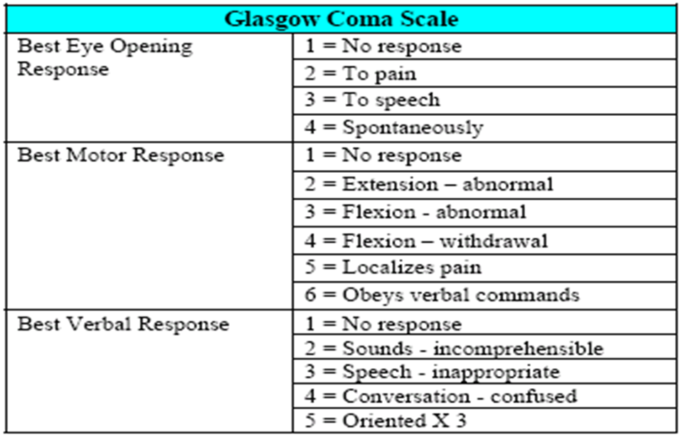
CNS Injury
Traumatic brain injury
  Glasgow coma scale

Slide 29
CNS Injury
Traumatic brain injury
  Anatomy of the head
    Skull
      Fixed bone casing with minimal space available for swelling of the bain
    Meninges
      Dura mater
      Arachnoid mater
      Pia mater
    Cerebrospinal fluid

Slide 30
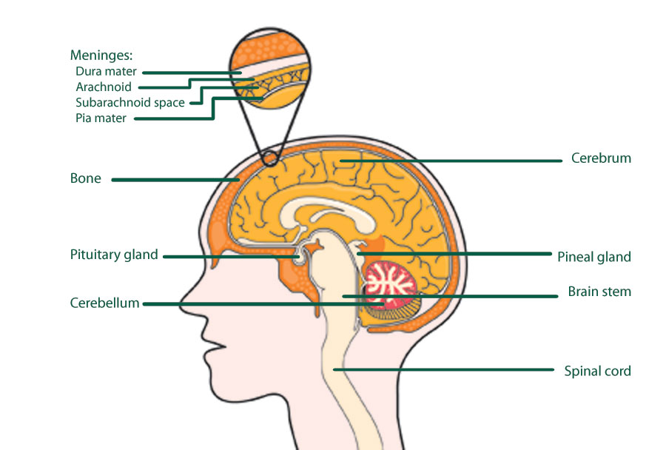
CNS Injury
Traumatic brain injury
  Anatomy of the head

Slide 31
CNS Injury
Traumatic brain injury
  Cerebral herniation
    The brain adjusts it’s blood flow to address metabolic needs. Auto regulation of blood flow is adjusted by carbon dioxide levels in the blood.
    The normal carbon dioxide levels are 35-45.
    A decrease in the carbon dioxide level leads to vasoconstriction of the vessels in the brain. Vasoconstriction will lead to devastating ischemia of the brain.
    An increase in the carbon dioxide level can lead to vasodilation which will increase the swelling of the brain.

Slide 32
CNS Injury
Traumatic brain injury
  Cerebral herniation
    The measurement of ETCO2 is an important tool in traumatic brain injuries
    The target ETCO2 level in traumatic brain injury should remain 35-45 UNLESS a CNS herniation is suspected
    A CNS herniation is a result of brain swelling and/or intracranial hemorrhage
    The increased intra-cranial pressure can force portions of the brain through the tentrium cerebella and/or the foramen magnum which will cause increased pressure to the brain stem

Slide 33
CNS Injury
Traumatic brain injury
  Cerebral herniation
    Signs and symptoms
      Decrease level of consciousness
      Dilation of one pupil
      Paralysis on the opposite side of the injury
      Decerebrate/Decorticate posturing

Slide 34
CNS Injury
Traumatic brain injury
  Cerebral herniation
    Cushing’s reflex
      Increase of systemic blood pressure
      Bradycardia
      Irregular breathing
    Aggressive management is needed when these symptoms are present

Slide 35
CNS Injury
Traumatic brain injury
  Cerebral herniation
    Management
      Maintain a patent airway
      Administer O2
      Prevent and/or treat hypotension
      Positive pressure ventilation
      ETCO2 monitoring to maintain a level between 30-35
      Rapid transport to a trauma center

Slide 36
CNS Injury
Spinal cord injury
  Should be assumed in presence of a traumatic brain injury
  Primary spinal cord injury
    Occurs at time of trauma when the spinal cord is cut, torn, or crushed
  Secondary spinal cord injury
    Occurs from poor perfusion, generalized hypoxemia, swelling, compression of the cord due to surrounding hemorrhage, or injury to the cord from movement of the unstable spinal column

Slide 37
CNS Injury
Spinal cord injury
  Mechanism of injury
    Hyperextension
      Excessive posterior neck movement
        MVC, sports injuries
    Hyperflexion
      Excessive anterior neck movement
        Rider thrown from horse or motorcycle
    Compression
      Head driven into the stationary neck
        Dive injures
        Fall of > 10-20ft onto head or legs

Slide 38
CNS Injury
Spinal cord injury
  Mechanism of injury
    Rotation
      Excessive rotation of spinal column
        Rollover MVC
    Lateral stress
      Direct lateral force to spinal column
        T-Bone MVC
    Distraction
      Excessive stretching of column and cord
        Hanging

Slide 39
CNS Injury
Spinal cord injury
  Signs and symptoms
    Pain
    Numbness
    Tenderness on palpation
    Deformity
      Bony prominence
      Step off
    Wound/bruise in area of spine
    Paralysis

Slide 40
CNS Injury
Spinal cord injury
  Anatomy of the spine
    Spinal column
      A bony tube composed of 33 vertebrae
        7 cervical
        12 thoracic
        5 lumbar
        5 sacral
        5 coccygeal
      The spinal column supports the body in an upright position and supports the delicate spinal cord

Slide 41
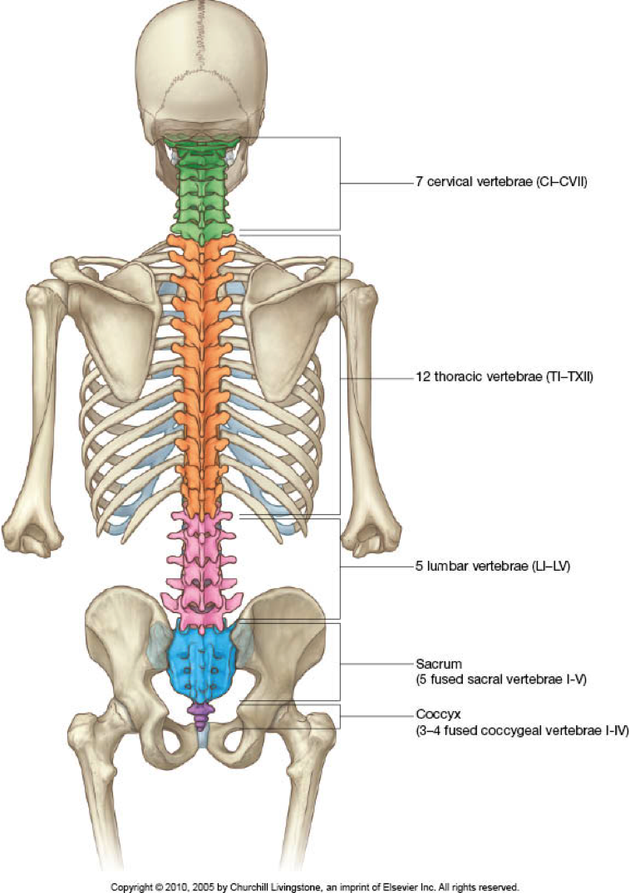
CNS Injury
Pic of spinal column

Slide 42
CNS Injury
Spinal cord injury
  Anatomy of the spine
    Spinal cord
      Electrical conduit composed of nerve tracts that serve as an extension of the brain stem
      Spinal cord is soft an flexible, bathed in cerebrospinal fluid that provides some protection of the cord from injury

Slide 43
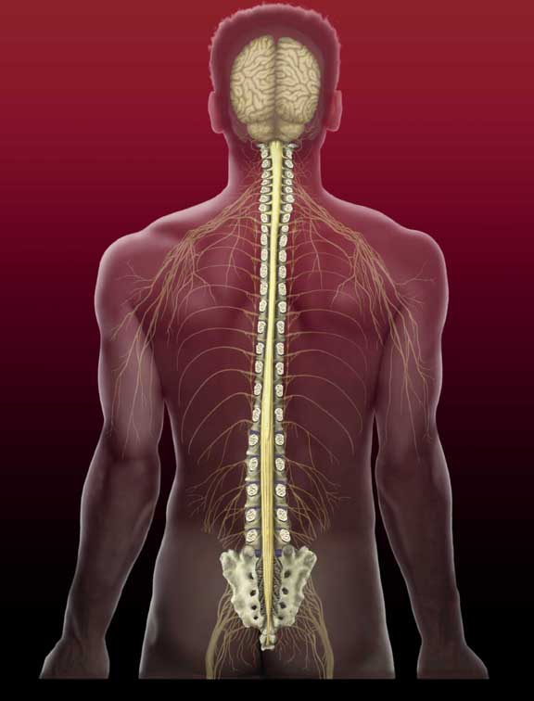
CNS Injury

Slide 44
CNS Injury
Neurogenic shock
  High spaced, distributive shock that occurs after injury to the spinal cord
  An injury to the spinal cord will prevent the brain from releasing catecholamines and sending a sympathetic response to manage the injury

Slide 45
CNS Injury
Neurogenic shock
  Signs and symptoms
    Hypotension
    Normal skin color and temperature
    Bradycardia

Slide 46
CNS Injury
Neurogenic shock
  Management
    Fluid resuscitation
      If hypotension (BP < 90 systolic) and other signs and symptoms of shock persist after administration of second 20 ml/kg normal saline bolus
      Reassess that shock is not from untreated hypovolemia
    Dopamine
      Contact Medical Command and consider Dopamine IV drip infusion at 5 mcg/kg/minute per MCP order
      Titrate Dopamine drip at 5 - 20 mcg/kg per minute in an effort to improve perfusion per MCP order

Slide 47
CNS Injury
Spinal injuries
  Management
    Maintain a patent airway
    Administer O2
    Positive pressure ventilation may be necessary
    Prevent further spinal column and/or cord injury

Slide 48
CNS Injury
The concussion patient
  A concussion is a traumatic brain injury that affects your brain function
  Concussions are usually caused by a blow to the head
    Violently shaking the head and upper body also can cause concussions
  Some concussions cause you to lose consciousness, but most do not
  Effects are usually temporary but can include
    Headaches
    Problems with concentration
    Problems memory
    Problems balance and coordination

Slide 49
CNS Injury
The concussion patient
  Signs and symptoms of a concussion may include
    Headache or a feeling of pressure in the head
    Temporary loss of consciousness
    Confusion or feeling as if in a fog
    Amnesia surrounding the traumatic event
    Dizziness or "seeing stars"
    Ringing in the ears
    Nausea
    Vomiting
    Slurred speech
    Delayed response to questions
    Appearing dazed
    Fatigue

Slide 50
CNS Injury
The concussion patient
  You may have some symptoms of concussions immediately. Others may be delayed for hours or days after injury
    Concentration and memory complaints
    Irritability and other personality changes
    Sensitivity to light and noise
    Sleep disturbances
    Psychological adjustment problems and depression
    Disorders of taste and smell

Slide 51
CNS Injury
The concussion patient
  Children
    Head trauma is very common in young children, concussions can be difficult to recognize in infants and toddlers because they can't describe how they feel. Concussion clues may include:
      Appearing dazed
      Listlessness and tiring easily
      Irritability and crankiness
      Loss of balance and unsteady walking
      Crying excessively
      Change in eating or sleeping patterns
      Lack of interest in favorite toys

Slide 52
CNS Injury
The concussion patient
  Return to play
    Requires specialized assessments that are usually considered beyond the scope of EMS providers
    Medical Time Out education and checklist should be monitored by the Squad Training Officer and Squad Medical Director
    Procedures for head and neck injury should be reviewed with the captain assigned for Cspine control, face mask removal equipment, and agreed technique for boarding

Slide 53
CNS Injury
The concussion patient
  West Virginia 2013 legislation on sports concussion return to play requires mandatory removal from contest in all cases of suspected head injury identified by sideline physician, athletic trainer or coach
  Return to play guidelines require a 5 day progression after symptom resolution and neuropsychological testing with physician involvement
  EMS intervention is typically requested in cases with loss of consciousness or worsening symptoms
  During transport a symptom checklist should be recorded and provided to the receiving Emergency Department
  https://www.cdc.gov/headsup/pdfs/schools/tbi_schools_checklist_508-a.pdf

Slide 54
Hemorrhage Control
Hemorrhage control
  Management of severe external bleeding is and important step in treating trauma. Severe life threatening hemorrhage should be addressed immediately
  Remember to use proper BSI and infection control precautions
  Causes of external bleeding can be managed with direct pressure over the source of bleeding

Slide 55
Hemorrhage Control
Hemorrhage control
  In the event that direct pressure with severe bleeding is ineffective other methods should be used
    Commercial tourniquets
    Junctional tourniquets
    Hemostatic agents
    TXA

Slide 56
Hemorrhage Control
Commercial tourniquet
  A commercial tourniquet’s purpose is to restrict distal arterial flow in the event bleeding cannot be controlled by other means
  Apply the tourniquet 2-3in proximal to the source of bleeding
  Avoid any joints on the extremity
  Always note the time of application
  Never cover the tourniquet

Slide 57
Hemorrhage Control
Commercial Tourniquet
  After application
    Reassess for bleeding
    Apply a second tourniquet proximal to the location of the first if necessary
    Limit application time
      Permanent damage can start to take place if a tourniquet is in placed for ≥ 2 hours

Slide 58
Hemorrhage Control
COMMERCIAL TOURNIQUET VIDEO AND OR PIC

Slide 59
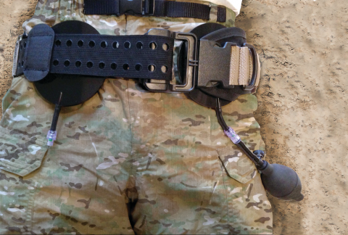
Hemorrhage Control
Junctional Tourniquet
  Junctional tourniquets are used in episodes of severe bleeding where a commercial tourniquet cannot be applied
    Inguinal
    Axial

Slide 60
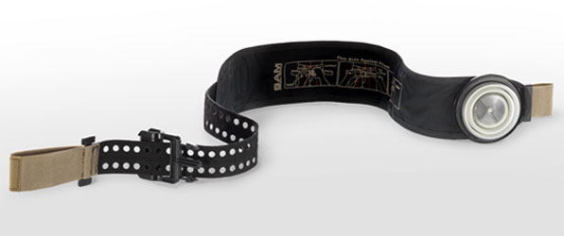
Hemorrhage Control
Junctional Tourniquet
  SAM Junctional Tourniquet (SJT)
    Band with a separate pneumatic compression device that is designed to stop the bleeding when placed above the injury site
    The SAM junctional tourniquet has also been approved by the FDA as a pelvic immobilization device

Slide 61
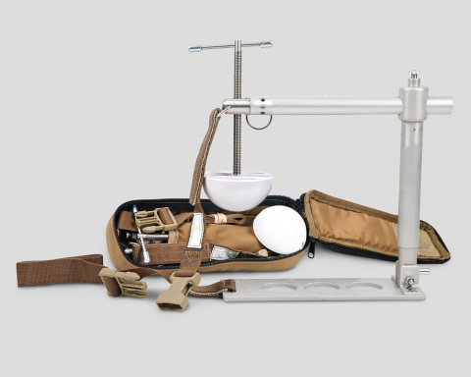
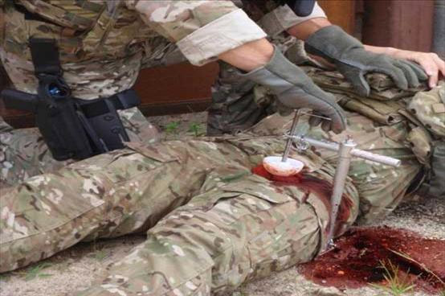
Hemorrhage Control
Junctional Tourniquet
  Combat ready clamp
    A viselike clamp to control hemorrhage at junctional locations

Slide 62
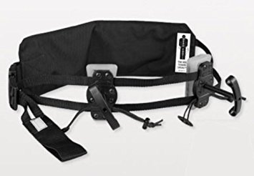
Hemorrhage Control
Junctional Tourniquet
  Junctional emergency treatment tool
    A belt like device with two pressure pads that can be applied directly on the wound site to occlude the hemorrhage

Slide 63
Hemorrhage Control
Hemostatic agent
  Promotes clotting at the site of the wound. The hemostatic agent must be placed directly at the source of the bleeding
  Remove any prior bandages from the wound prior to application and apply direct pressure
  Work well to manage bleeding at junctional locations where a commercial tourniquet cannot be used
  Used for management of uncontrolled hemorrhage

Slide 64
Hemorrhage Control
Tranexamic Acid (TXA)
  Used for decades as a preoperative medication to help control bleeding in surgery
  TXA is used widely in European hospitals and pre-hospital for trauma management with positive results
  A comprehensive study revealed a 30% mortality reduction in severe trauma patients when TXA was administered within 3 hours of injury
  The greatest reduction of mortality was noted when TXA was given within the first hour of injury

Slide 65
Hemorrhage Control
Tranexamic Acid (TXA)
  Antifibrinolytic synthetic amino acid
  Prevents breakdown of blood clots
  TXA is NOT a thrombogenic
    Does not create clots
  Increases preservation of blood clots
    Allows body to control bleeding itself to create hemostasis

Slide 66
Hemorrhage Control
Tranexamic Acid (TXA)
  Should be administered to a patient with high suspicion of major internal hemorrhage
  Receiving hospital must have access to TXA and continue the TXA maintenance dose administration
  TXA is not indicated for pediatrics
  Contraindicated for use in pregnant women

Slide 67
Hemorrhage Control
Tranexamic Acid (TXA)
  Administration
    1g over 10 minutes
      EMS loading dose
    1g over the next 8 hours
      Hospital maintenance dose
    Adverse effects and increased mortality have been noted if the patient received the loading dose after the fist 3 hours of injury

Slide 68
Acute Abdomen
Acute abdomen
  Abdominal injuries have high mortality rates due to the difficulty of recognizing symptoms early
  Large amounts of blood can collect in the peritoneal cavity without any significant finding on the physical exam

Slide 69
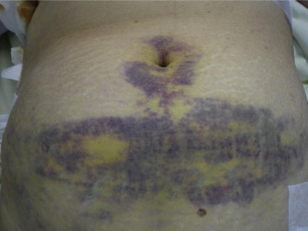
Acute Abdomen
Abdominal injuries
  Blunt force trauma
    Liver and spleen are the to most affected organs
    Most common cause is blunt for trauma

Slide 70
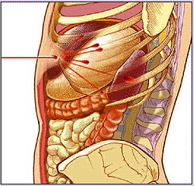
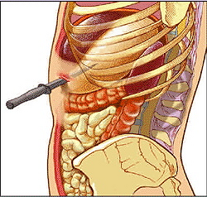
Acute Abdomen
Abdominal injuries
  Penetrating trauma
    Gunshots and stabbing are two most common causes

Slide 71
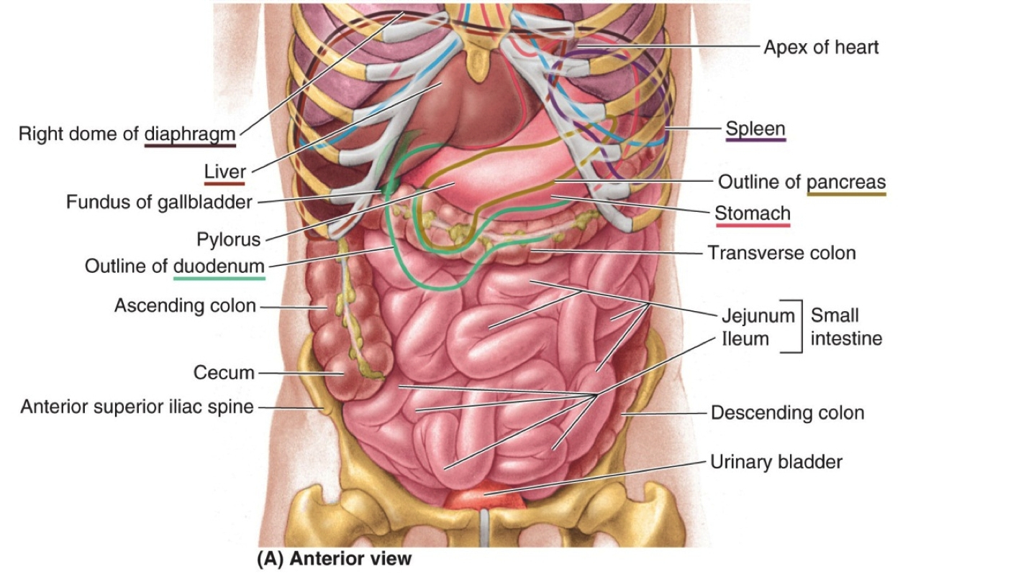
Acute Abdomen
Abdominal injuries
  Anatomy of the abdomen

Slide 72
Acute Abdomen
Abdominal injuries
  Anatomy of the abdomen
    Abdominal organs
      Digestive
        Mouth, esophagus, stomach, small intestine, large intestine
      Reproductive
        Ovaries, uterus, testes, prostate
      Vascular
        circulatory system
      Endocrine
        Hypothalamus, pituitary, thyroid, adrenal glands

Slide 73
Acute Abdomen
Abdominal injuries
  Anatomy of the abdomen
    Four quadrants of the abdomen
      Right upper quadrant (RUQ)
        Liver
        Right kidney
        Small intestine
        Large intestine
      Left upper quadrant (LUQ)
        Liver
        Stomach
        Spleen
        Pancreas
        Left kidney
        Small intestine
        Large intestine

Slide 74
Acute Abdomen
Abdominal injuries
  Anatomy of the abdomen
    Four quadrants of the abdomen
      Right lower quadrant (RLQ)
        Appendix
        Small intestine
        Large intestine
        Right ovary (female)
        Right ureter
      Left lower quadrant (LLQ)
        Small intestine
        Large intestine
        Left ovary (female)
        Left ureter

Slide 75
Acute Abdomen
Abdominal injuries
  Abdominal organs
    Solid organs
      Liver
      Spleen
      Pancreas
    Hollow organs
      Gall bladder
      Intestines
      Stomach

Slide 76
Acute Abdomen
Abdominal injuries
  Abdominal organs
    Solid organs
      Bleed as the result of injury
      Blood in the abdominal cavity can present with
        Pain
        Rebound tenderness
        Distention
        Discoloration

Slide 77
Acute Abdomen
Abdominal injuries
  Abdominal organs
    Hollow organs
      Rupture as the result of trauma
      Spill contents into the abdominal cavity
      Contents in the abdominal cavity may cause
        Pain
        Tenderness
        Infection

Slide 78
Acute Abdomen
Abdominal injuries
  Mechanism of injury
    Obtain as much information about MOI as possible
      Clues from MOI will help to identify possible injury
      Blunt
        Steering wheel deformity
        Dash deformity
        Seatbelt use
      Penetrating
        Distance object travelled
        Speed object travelled
        Length of object
        Path of travel

Slide 79
Acute Abdomen
Abdominal injuries
  Abdominal assessment
    Requires a thorough exam
    Repeated exams should be completed if time permits
    Inspect abdomen for
      Bruising
      Abrasions
      Cullen’s Sign
      Grey-Turner’s sign
      Bleeding
      Evisceration
      Impalement

Slide 80
Acute Abdomen
Abdominal injuries
  Treatment
    Maintain a patent airway
    Administer O2 as necessary
    Control bleeding
    Appropriately cover evisceration
    Secure impaled objects
    Manage for shock

Slide 81
Fluid resuscitation
Trauma fluid resuscitation
  Trauma continues to be the leading cause of death for individuals aged 1-44
  The goal of fluid resuscitation is to maintain vital organ perfusion
  Longtime treatment for hypotension induced by trauma has been the aggressive technique of infusing large volumes of crystalloid fluids to improve the blood pressure
  Studies have shown this practice is detrimental to patient outcomes

Slide 82
Fluid resuscitation
A National Institute of Health (NIH) study concluded that early aggressive fluid administration with high volume led to significantly high rates of multi organ failure, acute respiratory distress syndrome, and acute lung injuries

Slide 83
Fluid resuscitation
Trauma fluid resuscitation
  Crystalloid administration
    Excessive administration can lead to
      Disrupt the physical formation of a clot
      Disrupt physically formed clots
      Dilution of clotting factors
      Dilution of platelets
      Expand the area of vascular defect as BP increases
      Anemia which can lead to hypoxia

Slide 84
Fluid resuscitation
Trauma fluid resuscitation
  Crystalloid administration
    Excessive administration can lead to
      Hypothermia
        If fluids are at room temperature the infusion of large amounts of fluid can lower the core body temperature leading to further complications
      Acidosis
        Crystalloids have an acidic pH that can lead to metabolic acidosis if large amounts are given

Slide 85
Fluid resuscitation
Trauma fluid resuscitation
  United States Army
    Actively use permissive hypotension with patient’s mental status being a determinate for fluid resuscitation.
    Only enough fluid will be given to restore the patient’s mentation

Slide 86
Fluid resuscitation
Trauma fluid resuscitation
  Mean Arterial Pressure (MAP)
    Better assessment to determine perfusion to vital organs compared to the systolic blood pressure
    The targeted mean arterial pressure for permissive hypotension is 60-65mm/Hg during fluid therapy
    MAP
      diastolic blood pressure + 1/3 pulse pressure
    Pulse pressure
      Difference in systolic and diastolic BP

Slide 87
Fluid resuscitation
Trauma fluid resuscitation
  Mean arterial pressure
    Example
      BP = 120/80
      MAP = 80+[(120-80)/3]
      MAP = 80+[40/3]
      MAP = 80+13.3
      MAP = 93.3

Slide 88
Fluid resuscitation
Trauma fluid resuscitation
  Permissive hypotension
    Remember that permissive hypotension is a temporary measure until the patient has access to definitive surgical care
    Animal studies have shown negative effects associated with permissive hypotension over 90 minutes

Slide 89
Fluid resuscitation
Trauma fluid resuscitation
  Permissive hypotension
    Contraindications
      Traumatic brain injuries
        Permissive hypotension is contraindicated in patients with a suspected traumatic brain injury. Traumatic brain injury patients cannot tolerate hypotension and decreased cerebral perfusion.
      Preexisting hypertension
        The permissive hypotension can shift the autoregulatory curve for patients with pre-existing hypertension

Slide 90
Fluid resuscitation
Shock
  Shock, or hypoperfusion, is decreased effective circulation causing inadequate delivery of oxygen to tissues
  Signs of early (compensated) shock include
    Tachycardia
    Poor skin color
    Cool/dry skin
    Delayed capillary refill
    Systolic blood pressure is normal in early shock

Slide 91
Fluid resuscitation
Shock
  In late (decompensated) shock perfusion is profoundly affected.
  Signs include
    Low blood pressure
    Tachypnea
    Cool/clammy skin
    Agitation
    Altered mental status

Slide 92
Fluid resuscitation
Shock
  Treatment of hypovolemic shock
    Maintain a patent airway
    Administer O2
    Monitor vital signs, ECG, and pulse oximeter
    Expedite transport
    As soon as possible, and without delaying transport, establish 2 IV lines of normal saline with as large a catheter as possible up to a 14 gauge

Slide 93
Fluid resuscitation
Shock
  Treatment of hypovolemic shock
    If systolic blood pressure < 90 or patient has other signs and symptoms of shock
      administer 20 ml/kg normal saline IV up to a maximum of 2 liters and reassess
      If on reassessment blood pressure is still < 90 or other signs and symptoms of shock are still present, then contact Medical Command and reconsider causes
      If still felt to be hypovolemic shock repeat 20 ml/kg normal saline IV per Medical Command
      If blood pressure is > 90 systolic and patient has no other signs or symptoms of shock, administer 100 ml/hour normal saline IV and continue to monitor patient

Slide 94
Fluid resuscitation
Shock
  Treatment of distributive shock
    If anaphylaxis or allergic reaction
    Initial treatment same as hypovolemic shock
      If hypotension (BP < 90 systolic) and other signs and symptoms of shock persist after administration of second 20 ml/kg normal saline bolus
      Reassess that shock is distributive and not from untreated hypovolemia
      Contact Medical Command and consider Dopamine IV drip infusion at 5 mcg/kg/minute per MCP order
      Titrate Dopamine drip at 5 - 20 mcg/kg per minute in an effort to improve perfusion per MCP order

Slide 95
Fluid resuscitation
Shock
  Treatment of cardiogenic shock
    Maintain a patent airway
    Administer O2
    Immediate transport
    Establish IV normal saline and administer fluid bolus of 250 ml assessing for signs of fluid overload
    Reassess appearance, vital signs, and signs and symptoms of shock
    If there is no rhythm disturbance and patient remains poorly perfused after the initial fluid bolus
      Contact Medical Command and consider repeat 250 ml fluid bolus or Dopamine IV drip infusion at 5 mcg/kg/minute per MCP order
      Titrate Dopamine drip at 5 - 20 mcg/kg per minute in an effort to improve perfusion per MCP order

