Slide 1
Welcome To
Dancing
Unlimited
Hurricane WV
2016 – 2017
Dance Season

Slide 2
Abour Our Studio
Dancing Unlimited is owned and operated by Beverly Hauldren Barnett and is currently celebrating 32 years of dance instruction in the Hurricane community. Dancing Unlimited is a full-service dance studio offering instruction in Ballet, Tap, Jazz, Hip-Hop, Pointe, Gymnastics and Technique.
Dancing Unlimited offers over 35 classes per week, ages pre-school to adult including beginner to advanced students. Additionally, we also offer weekly classes to students with Special Needs of all ages and Mom and Me for children ages 18 months to 3 years.
We have three competitive dance teams.
Also continuing this year, is our Musical Theater performance group offering students the opportunity to develop skills in singing, acting and dancing.
Our goal is to bring the joy of dance to everyone that walks in the front door of our studio. At Dancing Unlimited, everyone matters! We strive to make everyone their personal best. We provide a safe and nurturing environment for our dancers as we develop our students in confidence, character and creativity. It doesn't matter where you begin but where you finish!

Slide 3
Policies
•No food or drink in the dance studio rooms (except water)
•The waiting area is not a playroom. Please be responsible for
your children not taking classes.
•Please use the observation windows to watch your child.
•Dress Code, please refer to Curtain Call For Class.
•All hair is to be pulled up and out of face.
•You are responsible for personal belongings.
•Tuition is due on the first of the month. Refunds or reductions are
not given for missed classes.
•You may withdraw from a class at any time by giving the
instructor written or verbal notification by the end of the month.
•Recital-Each spring the students will present a recital for family
and friends. A recital fee will be charged for each family
•Please notify us with changes in contact information.
We only accept Debit/Credit which will be automatically drafted from card on file at the studio.
Each Additional Class or Additional child in the same family:
1 hour reduces to $28 per month
1.5 hour reduces to $39 per month
****Spring Recital Fee charged per family TBA****
The following classes are not subject to any Reduction:
Dance Team $20 per month
Competition Groups $90 per month
6% Sales Tax Added to ALL classes
Fees
90 minute class | $78 per month
60 minute class | $53 per month
45 minute class | $48 per month

Slide 4
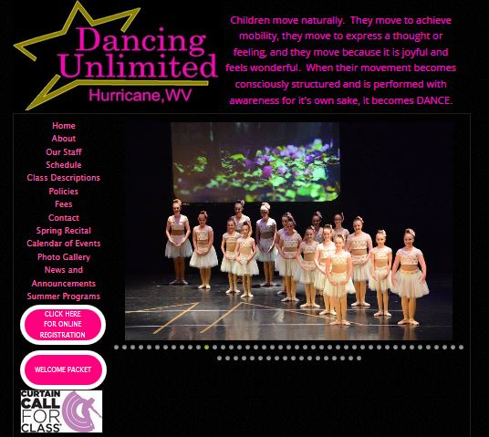
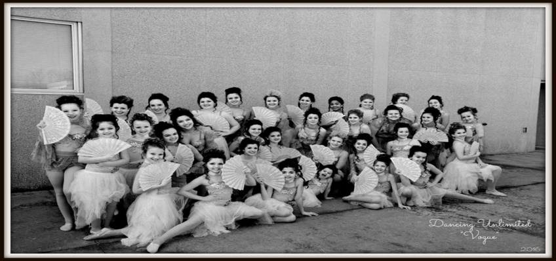
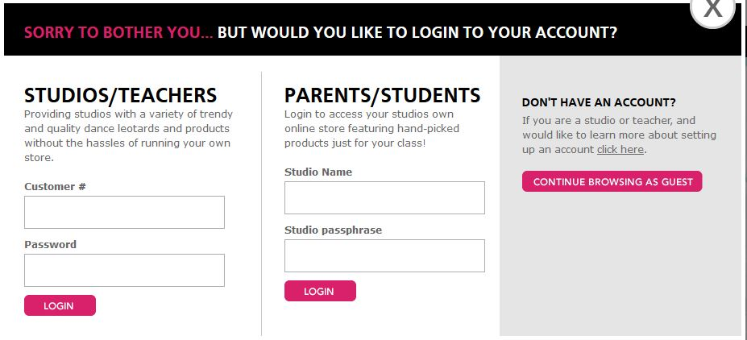
Curtain Call For Class
Go to Dancing Unlimited’s website
www.dancingunlimtedwv.com
And click on Curtain Call For Class link
Enter studio name and passphrase

Slide 5
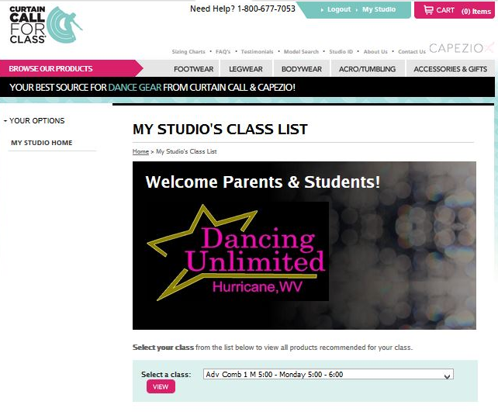
Curtain Call For Class
Select your class from drop menu
And click “ View”
Then order all required class dancewear.
Sizing kits will be available at open house
On August 9 & 11 if you are not sure
what size you will need.

