Slide 1
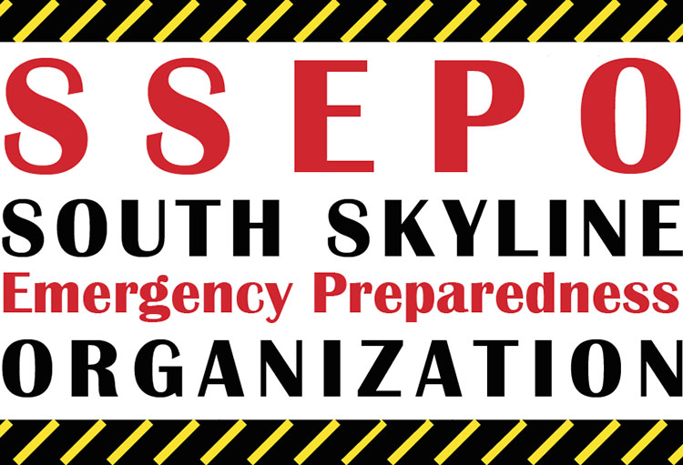
SOUTH SKYLINE EMERGENCY PREPAREDNESS ORGANIZATION
Notes:
South Skyline Emergency Preparedness Organization – it’s a mouthful. From here on out, we’ll call it SSEPO. Intros if not already done.

Slide 2
South Skyline Association
SSA
South Skyline Fire Safe Council
South Skyline Emergency Preparedness Organization
Independent 501c3 Organizations
Notes:
Before talking about SSEPO, we need to talk a little about the South Skyline Association. Although both the Fire Safe Council and SSEPO are supported by the South Skyline Association, they are independent 501c3 organizations which operate separately from SSA.

Slide 3
South Skyline Association (SSA)
Established 1969
Over 1900 households
Mostly SPUG – Skyline Propane Users Group
Area covers Skyline Blvd (Hwy 35) from Los Gatos to Sky Londa and several miles down both sides Hwy 9
3 Counties
Keep residents informed of public agency actions
Protect rights of area residents
Provide grants to support the interests of residents
Notes:
SSA has been around for a long time and now has over 1900 members. Most people belong to SSA in order to get better prices on their propane. The area known as South Skyline covers a very large geographic area – Sky Londa to Los Gatos and down both sides of Hwy 9 to about Saratoga Springs on the east and the junction of Hwy 9 and 236 – Big Basin – to the west. Their primary purpose is to keep residents informed of public actions which may affect them and to intercede in those actions when appropriate and to protect both the rights of residents and the environment in which we live. They charge a small membership fee annually and those funds go into grants which provide benefit to the residents; things like brush and tree clearing, equipment for volunteer fire departments and repeaters for radio use.

Slide 4
SSEPO
Established 2000
Primary focus of Emergency Preparedness
Early accomplishments:
Developed two stations equipped with medical supplies and emergency communication capability
MROSD Skyline Field Office (Alpine / Hwy. 35)
Community of Las Cumbres
Built a neighborhood emergency preparedness model
Notes:
Around 2000, a handful of SSA members decided that we need a separate organization that focuses on helping South Skyline residents be better prepared for a disaster. Its very likely that in the case of a large scale disaster, these residents will be on their own for weeks. For the first 5 or 6 years, SSEPO worked on building an emergency station at two locations: the Ranger Station at Alpine and Hwy. 35 and in the community of Las Cumbres. They also built a model for how a neighborhood can be best prepared. This model was adopted in the neighborhood of Portola Heights / Castanea Ridge.

Slide 5
SSEPO
Established 501c3 Organization in 2016
Non-Membership Organization
Board of Directors:
President
Treasurer
Secretary
Medical Director
Communications Director
Neighborhood Coordinators
Notes:
In 2016, SSEPO really took off. We established a 501c3 non-membership organization. The board consists of the usual President, Treasurer and Secretary positions, but also a Medical Director, a Communications Director and Neighborhood Coodinators for the defined communities along the South Skyline corridor. We will talk more about neighborhoods in a moment.

Slide 6
SSEPO Goals and Objectives
Promote Emergency Preparedness and Response Capability at the NEIGHBORHOOD level
Expand medical operations and emergency communications
Facilitate cooperation between tri-county emergency response organizations
Provide emergency preparedness education and training
GIS Mapping of residences
Notes:
The primary goals of today’s SSEPO are to identify and organize all of the neighborhoods along the South Skyline corridor, expand our medical and communications operations to more locations, facilitate cooperation between San Mateo, Santa Cruz, and Santa Clara county OES organizations, provide emergency preparedness education and assist in the GIS mapping of residences. I will talk about each of these in a moment.

Slide 7
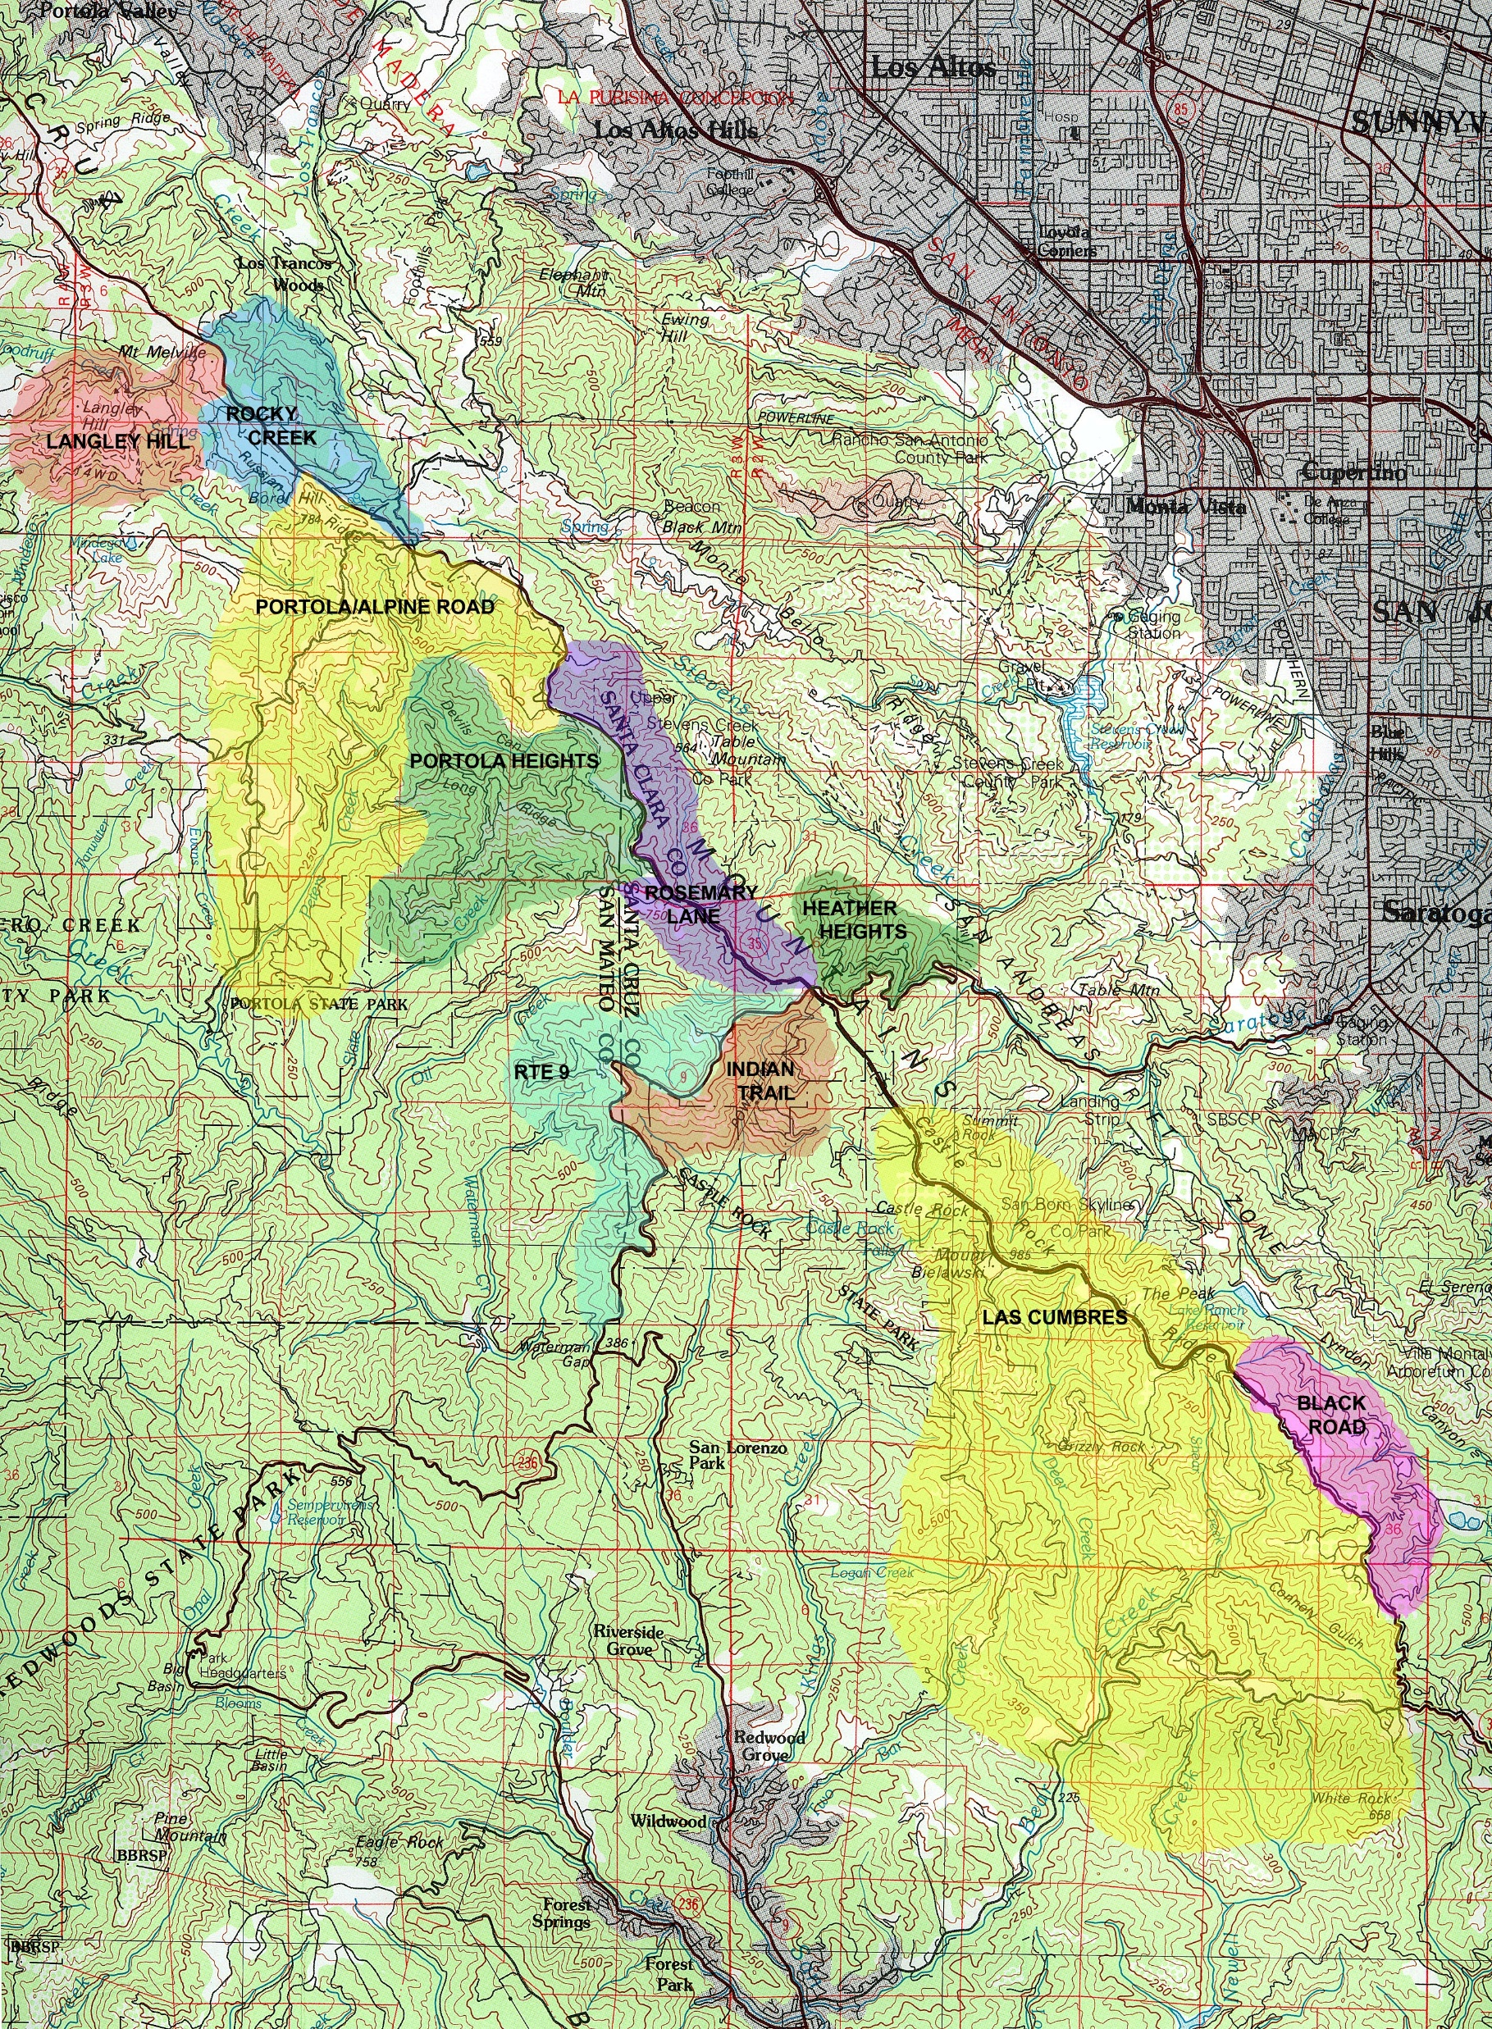
The Neighborhoods
Notes:
As already stated, we believe that the best disaster preparedness comes from organizing the neighborhoods and giving them the necessary tools to take care of themselves for long periods of time. A continuing effort of SSEPO is to identify the neighborhoods. So far, the colored areas represent the neighborhoods that have been identified. We do not yet have Neighborhood Coordinators for every one of these. Most of these neighborhoods consist of 6 to 30 homes; in some cases the homes are separated by up to 40 acres. The one community that is more suburbia-like is Las Cumbres, which consists of over 150 homes and has a well defined infrastructure – community center, shared water, volunteer fire department, etc. The others are on large wooded lots, with limited access routes. We hope to identify a Neighborhood Coordinator for each community. So far, we have seven identified. The Neighborhood Coordinator role is critical in establishing an efficient emergency preparedness model.

Slide 8
SSEPO Accomplishments
Training / Guidelines for creating The Neighborhood Model:
An identified coordinator
Phone tree
Radio communications
Emergency Plan – Unique to each community
Practice!!!
Notes:
We have developed guidelines and provided training on the Neighborhood Model for Emergency Preparedness. Critical to success is establishing an efficient model is to have an identified coordinator for each neighborhood. We currently have coordinators for 6 of our identified neighborhoods. Each neighborhood then needs to have a phone tree for notifying residents of an emergency and when the phones fail (or don’t exist in normal times) we need radio communications to check on the welfare of our neighbors. And, of course each neighborhood needs its own emergency plan – each community is unique. And, of course you need regular practice of that emergency plan. In Portola Heights / Castanea Ridge for example: we have about 40 households, most with 40 acres, so no visibility to each other. We have an overall coordinator, but because of its number of households and large geographic area, we have divided the community into 5 groups, each with their own coordinator. It’s much more efficient for 1 person to contact 6 - 8 neighbors then it is for 1 person to contact 40. Once an emergency is imminent or has happened, the 30+ residents with GMRS (General Mobile Radios), tune into a specified frequency. The radios allow for an efficient way to communicate information to a large group and for reporting problems or requests for assistance. We currently have 8 HAM operators within this neighborhood, who can then relay the traffic from the GMRS radios up to the Emergency Operations Center here in Half Moon Bay. We conduct a drill or exercise annually and radio drills monthly. We basically have one way in and out of the community, on a very narrow, windy road. Some of the fire roads surrounding the community are accessible by 4 wheel drive vehicles. We make sure the residents know which roads are accessible, that they have keys to the locked gates to those roads and then every couple years we practice driving out those roads.

Slide 9
SSEPO Accomplishments
Comprehensive Website: www.ssepo.org
Extensive information on how to be prepared for different kinds of disasters
Emergency planning: Go Kits, prepare to stay or leave
Education on how to organize a neighborhood
Information on area volunteer groups: CERT, CEC, LAEG, ARES, Medical operations
Emergency communications – who to call, radio communication
Notes:
A couple years ago, SSEPO developed a very comprehensive website. This website has everything you need to know about disasters and emergencies: different kinds of disasters, how to take care of your family, your pets and large animals, how to organize your neighborhood, how to be prepared to stay for a long period or leave, information on the local volunteer groups and how to get involved, and emergency communications – the phone numbers you need to know, the radio frequencies you need, etc., etc. We are very proud of this website.

Slide 10
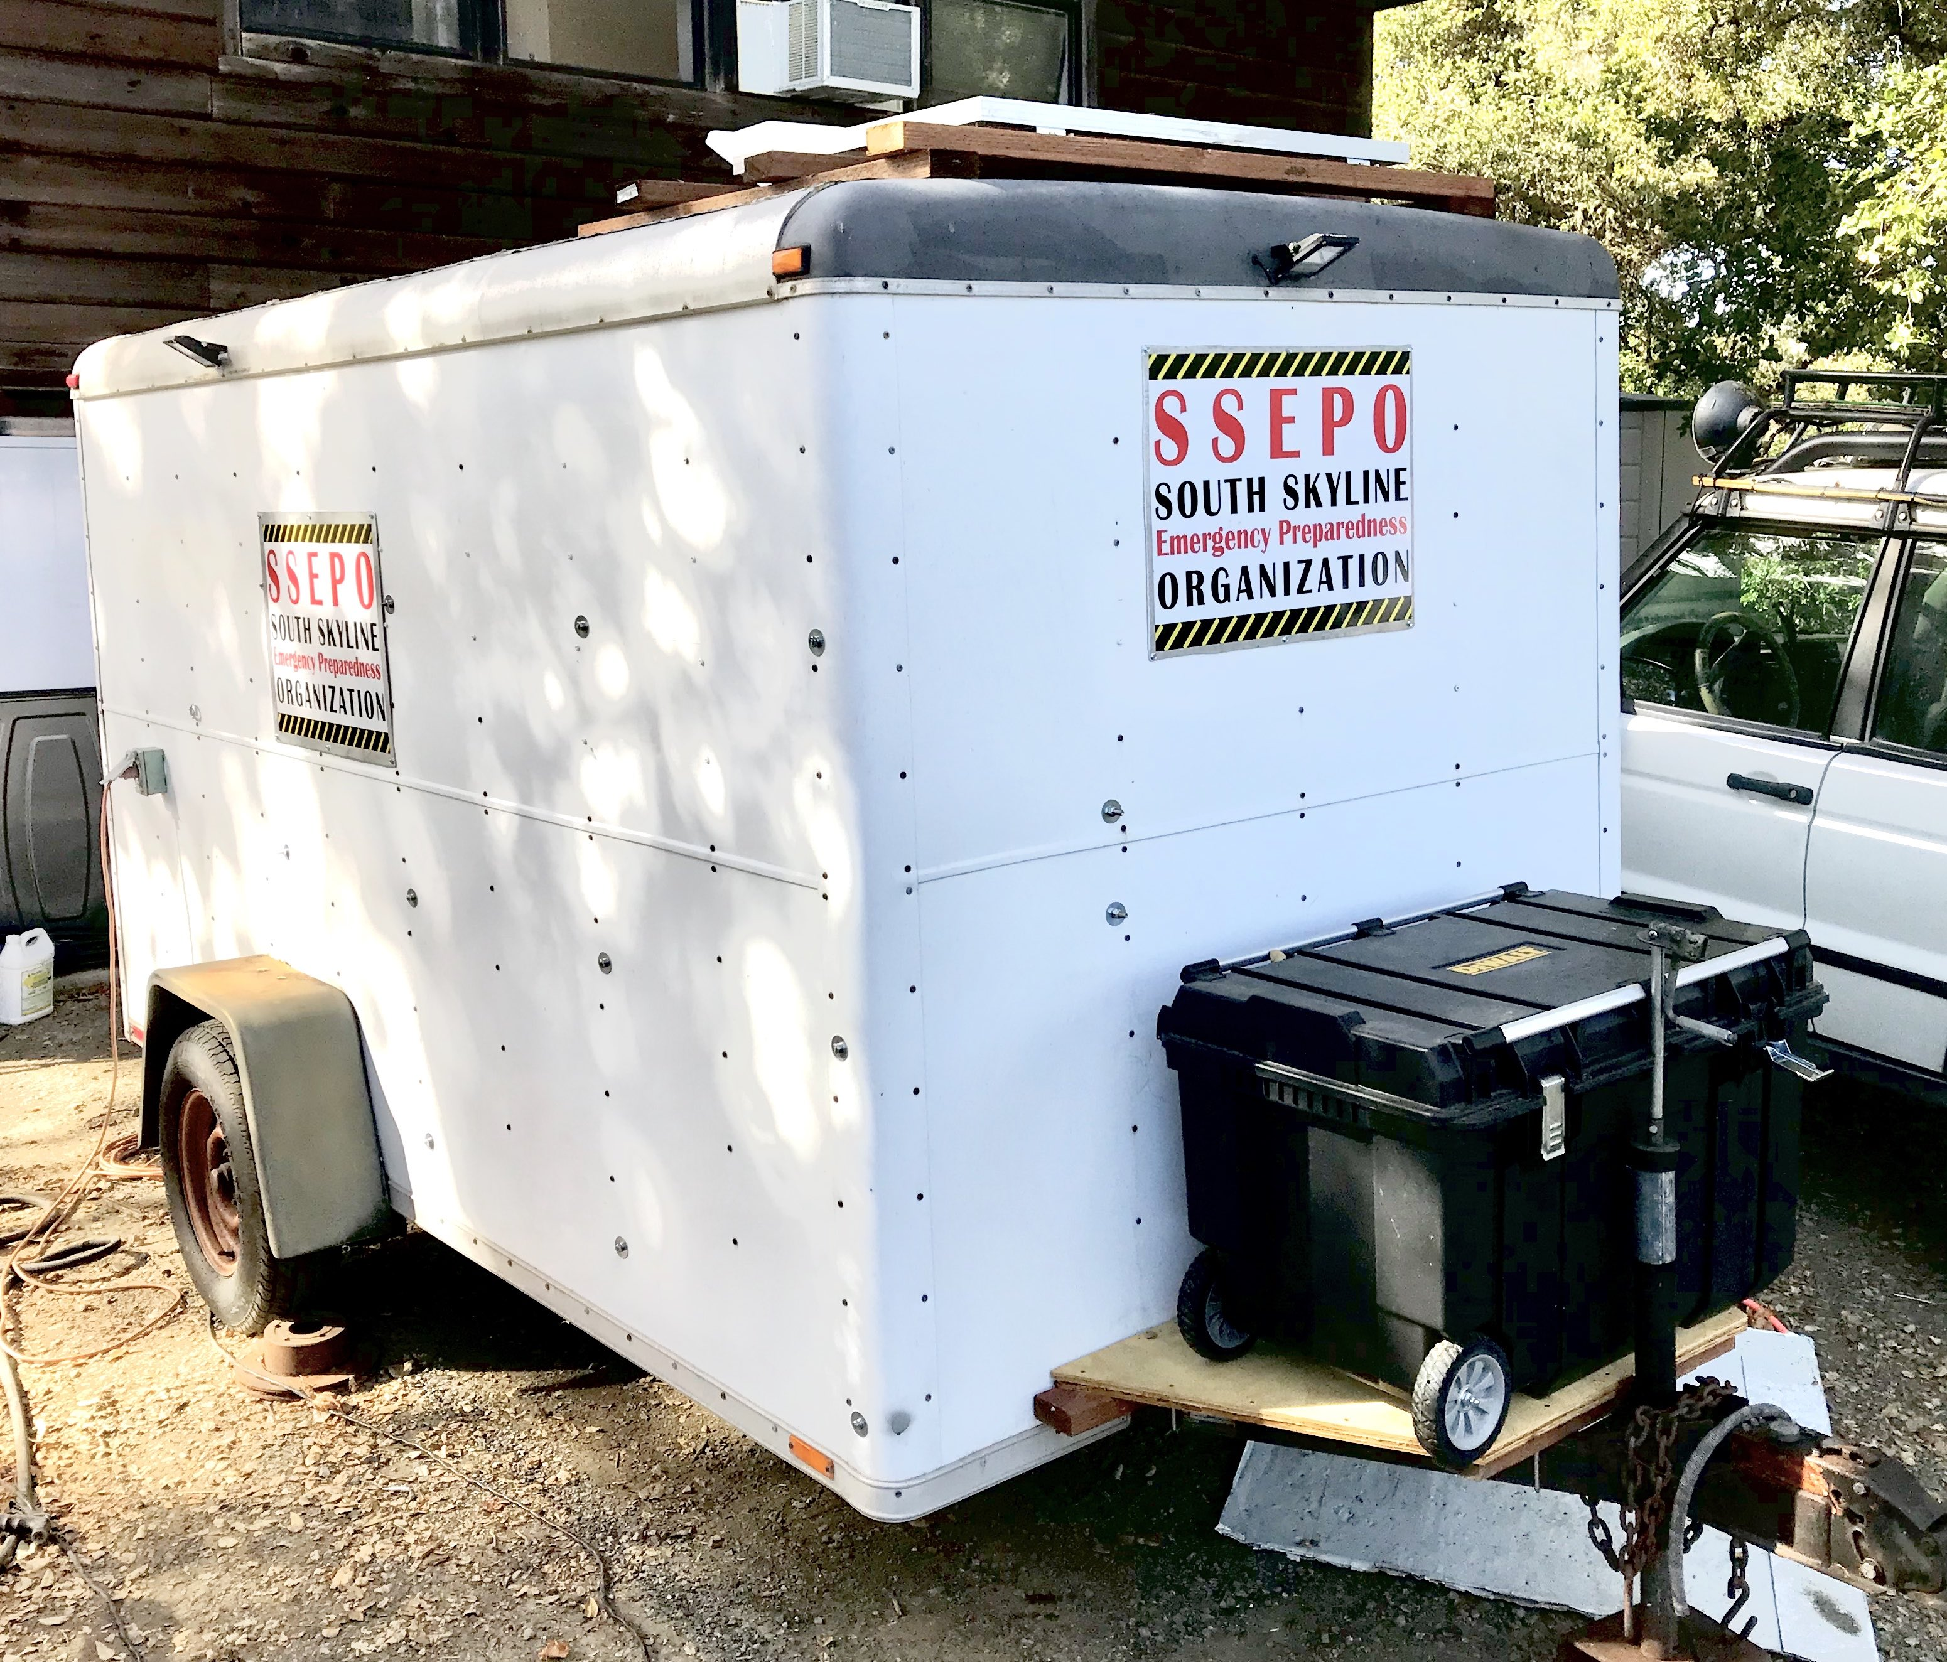
SSEPO Accomplishments
Medical Response Team:
Identifying medical personnel in area
Medical supplies at 2 (soon to be 3) locations
Mobile medical response trailer
Emergency Communications:
Provided grants to purchase GMRS (General Mobile Radio Service) radios to 5 neighborhoods
Set up GMRS Repeater for Inter-Neighborhood communications
Established South Skyline Emergency Communications Plan for HAM and GMRS radios
HAM radio communication stations at 2 (soon to be 3) locations
Notes:
Additional accomplishments include increasing our ability for providing medical assistance. Dr. Rich Lee is our Medical Director. He is identifying medical personnel – doctors, nurses, EMTs – in the area that he can call on in an emergency. I mentioned that we have medical supplies at 2 locations. We are working on creating another Department of Operations at the Saratoga-Summit fire station. Just two weeks ago, we unveiled our medical response trailer – started with an old, unused Red Cross trailer. It is now equipped with medical supplies, filtered water, area for 2 patients and much, much more. Battery / solar powered. This will allow us to take the medical aide required to the patient or neighborhood in need. SSEPO has provided grant money to purchase approximately 30 additional GMRS radios for 5 neighborhoods. Each neighborhood has their own frequency for communications within their community, but we also need to communicate across neighborhoods. So, we recently installed a GMRS Repeater which links neighborhood communications. And, we will soon have ham radio capability at the new DOC at Saratoga-Summit.

Slide 11
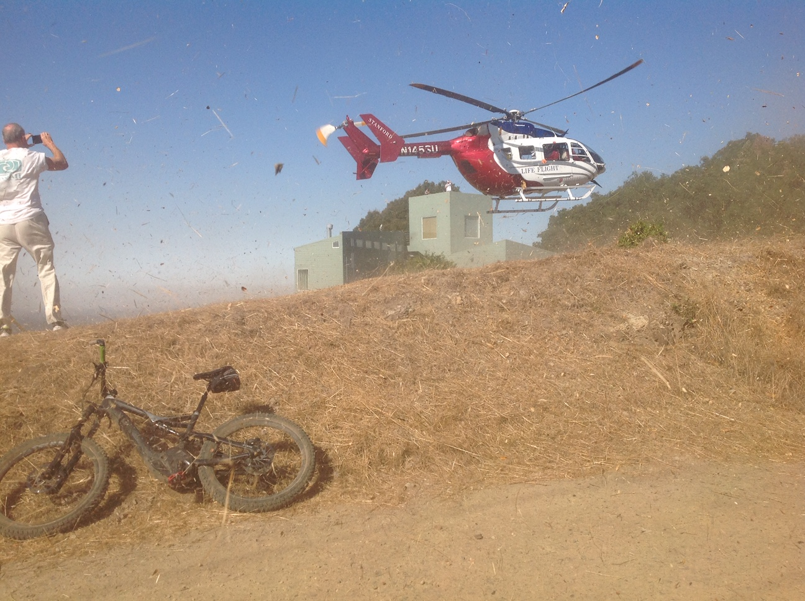
SSEPO Accomplishments
GIS Mapping
Established South Skyline CERT (Community Emergency Response Team)
Quarterly training
Facilitated Tri-County Office of Emergency Services communications
Assisted in the building of new Helicopter Landing Zone
Conduct annual drills involving CERT, HAM (ARES) and GMRS radio communications, Medical and other volunteer groups such as Large Animal Evac.
Notes:
A couple of years ago, we partnered with La Honda Fire to do GIS mapping of the residences. The mapping data is everything the emergency response teams need to know before going in: where the house and other buildings are, water sources, propane tanks, electrical shut-offs, codes to locked gates, length of driveways for laying out hoses, etc. This data is captured on iPads, which will be in the fire trucks and will replace the very old, very outdated hard copy maps that exist today. Some years ago, a house burned down in our community because the firefighters couldn’t figure out how to get to the house. We recently established our own South Skyline CERT, led by Peggy. This was a unique challenge because South Skyline is in 3 counties and each one of those counties has a very different Office of Emergency Services structure and relationship with CERT activation. Peggy plowed through that mess by organizing the first ever meetings of the 3 OES leaders. We coordinated 5 or 6 of these meetings. The heads of these 3 OES organizations now at least know each other and are sharing experiences and ideas. It was not an easy task. SSEPO conducts at least one drill per year. This year, we partnered with the annual ARES (Amateur Radio Emergency Services) simulated emergency test on Oct. 20, with the support of La Honda Fire and Saratoga-Summit Cal Fire. The scenario for the drill was 3 days after a large-scale earthquake. The Ham radio communications trailer was dispatched to the staging area at Skyline Ridge Preserve, where they set up the DOC. The drill included the landing of the Stanford LifeFlight helicopter at a new Landing Zone in Castanea Ridge, paid in part by SSEPO. It was amazing to watch that thing land in such a small space. The drill also included Southcoast CERT and South Skyline CERT who were deployed to 5 neighborhoods to conduct damage assessment and the deployment of San Mateo Large Animal Evac to evacuate 6 horses. In many ways, SSEPO is similar to the CEC. We help coordinate the efforts of all of the volunteer groups: CERT, LAEG, Medical, etc.

Slide 12
SSEPO Future Goals
Continue to identify Neighborhood Coordinators
Continue GIS Mapping efforts
Strengthen Medical Response Team
Establish third medical and communications station at Saratoga-Summit Fire
Assist Fire with Neighborhood Evacuation Planning
Notes:
SSEPOs future is to keep doing what we’re doing. Still have Neighborhood Coordinators to identify, GIS mapping to complete, continue identifying medical personnel and establishing a DOC at Saratoga-Summit Fire. Fire owns evacuation planning. Phase 2 of the GIS mapping project is to assist Fire in any way we can to accomplish that task.

