Slide 1
SPIRITUAL SANSKRIT WORDS

Slide 2
Spiritual Words
Shanthi Ahimsa
Dhyana Sathya
Jnana Swasti
Aathma Shubham/Mangalam
Bhakthi
Mukthi/Moksha
Dharma and Karma

Slide 3
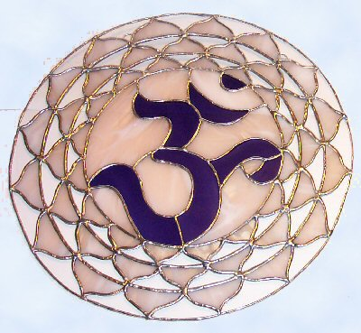
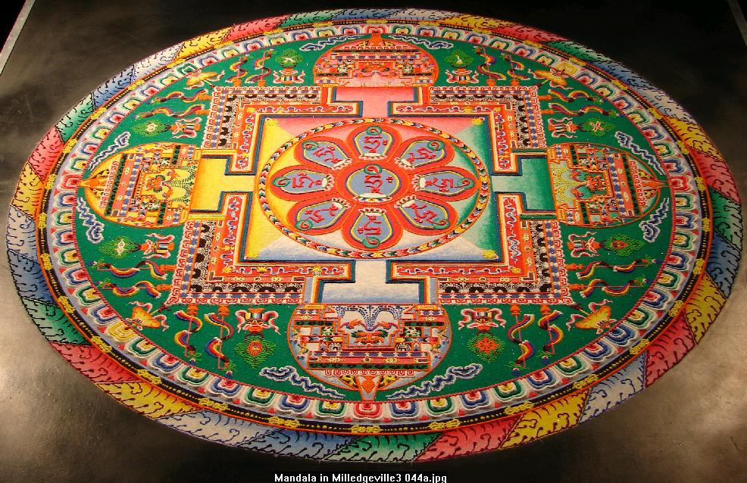
SHANTHI
Peace, rest, calmness, tranquility, bliss
Om Shanthi Shanthi Shanthi Hi – the three shanthis chanted at the end of mantras is a prayer for peace in the world around us.

Slide 4


DHYANA
Meditation
Meditation often involves invoking and cultivating a feeling or internal state of contemplation.
Dhyana mantras are chanted to enter a deep state of meditation
Dhyani – A person in meditation

Slide 5
JNANA
In general - Knowledge or Wisdom or Intellect
Particularly refers to a divine knowledge that relates the individual to the universe as a whole
JNANI– A person with the divine knowledge

Slide 6
AATHMAN
Also - Aathma
SOUL (an inner consciousness)
Philosophical term in Hinduism to identify the soul whether in global sense (world’s soul) or in individual sense (of a persons own soul).

Slide 7
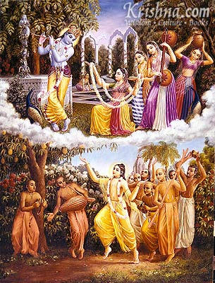
BHAKTI
Devotion
Bhakti or devotion is expressed is commonly through prayers, songs, dance, and serving people around us
Bhakta - Devotee

Slide 8
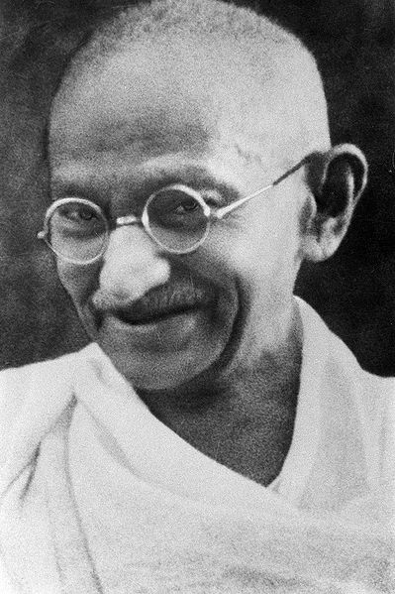
AHIMSA
Ahimsa literally means to do no harm or to avoid violence (to include physical and verbal) The practice of Ahimsa requires kindness towards all living beings including animals.
This principle of non-violence was popularized by Mahatma Gandhi in India’s fight for independence against the British.
Jainism and Buddhism preach Ahimsa
Antonym: Himsa – to do harm (violence)

Slide 9
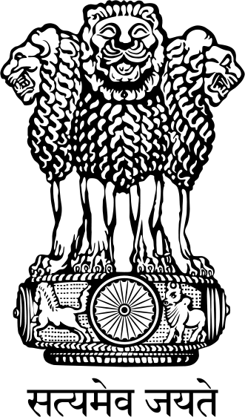
SATHYA
Sathya means Truthfulness
Sathyameva Jayathe – Truth Alone Triumphs
is the national motto of India
and is inscribed on the national emblem.
Antonym: Asathya - Untruth

Slide 10
DHARMA
Righteousness or Duty
There is no proper equivalent word in English for Dharma. Although, generally defined as ‘righteousness’ or ‘duty’, Dharma includes all external deeds as well as thoughts that tend to elevate the character of man.
Adharma: Antonym

Slide 11
KARMA
Action or Deed
There is no proper equivalent word in English for Karma.
Although, it means action or deed, Karma is sometimes used in reference to a "moral law of cause and effect." The moral law of Karma maintains that good deeds will be returned with good; evil deeds with evil

Slide 12
MUKTI/MOKSHA
Mukti or Moksha literally means ‘to release’ or ‘to let go’ or Liberation
Reincarnation is believed to occur when the soul or spirit, after the death of the body comes back to life in a newborn body. Hinduism, as well as other Indian religions such as Jainism, Buddhism and Sikhism believe in reincarnation. Hinduism believes that the universal cycle of death and rebirth, governed by Karma.
Moksha/Mukti means liberation from the cycle of births and deaths. (Also, Nirvana or Salvation)

Slide 13
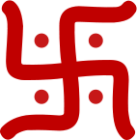

SWASTI
Auspiciousness or a state of wellbeing
Su – “good, well” Asti – “to be”
Su + Asti = Swasti means wellbeing
Swastika is used as symbol of well-being by Hindus. Its use traces back to at least 3,000 years. It was also used as a good luck charm in antique ornaments found in Greece, Rome and certain other parts of Europe.
The Swastika was adopted as the emblem of the Nazis
in Germany, and since the 1930s has been associated with
Hitler’s Anti-Semetism. Today, the Nazi Swastika is a taboo
in the western culture and its use is banned in Germany.

Slide 14
MANGALAM SHUBHAM KALYANAM
Auspiciousness or a sense of wellbeing
Mangalam/Shubham/Kalyanam are often used in prayers
Eg. Sarvesham Mangalam Bhavatu means may the sense of well being pervade everything around us.

Slide 15
??????
SOUL (an inner consciousness)
Philosophical term in Hinduism to identify the soul whether in global sense (world’s soul) or in individual sense (of a persons own soul).

Slide 16
?????
Peace, rest, calmness, tranquility, bliss
the three ????? chanted at the end of mantras is a prayer for peace in the world around us.

Slide 17
???????
Meditation
Meditation often involves invoking and cultivating a feeling or internal state of contemplation.
?????? mantras are chanted to enter a deep state of meditation
???? – A person in meditation

Slide 18
?????
In general - Knowledge or Wisdom or Intellect
Particularly refers to a divine knowledge that relates the individual to the universe as a whole
?????– A person with the divine knowledge

Slide 19
??????
Devotion
????? or devotion is expressed is commonly through prayers, songs, dance, and serving people around us
?????- Devotee

Slide 20
??????
Righteousness or Duty
There is no proper equivalent word in English for ?????. Although, generally defined as ‘righteousness’ or ‘duty’, ????? includes all external deeds as well as thoughts that tend to elevate the character of man.
?????: Antonym

Slide 21
??????
Action or Deed
There is no proper equivalent word in English for?????.
Although, it means action or deed, ????? is sometimes used in reference to a "moral law of cause and effect." The moral law of ????? maintains that good deeds will be returned with good; evil deeds with evil

Slide 22
???????
???? Or ????? literally means ‘to release’ or ‘to let go’ or Liberation
Reincarnation is believed to occur when the soul or spirit, after the death of the body comes back to life in a newborn body. Hinduism, as well as other Indian religions such as Jainism, Buddhism and Sikhism believe in reincarnation. Hinduism believes that the universal cycle of death and rebirth, governed by Karma.
??????? means liberation from the cycle of births and deaths. (Also, Nirvana or Salvation)

Slide 23
?????
???? literally means to do no harm or to avoid violence (to include physical and verbal) The practice of ???? a requires kindness towards all living beings including animals.
This principle of non-violence was popularized by Mahatma Gandhi in India’s fight for independence against the British.
Jainism and Buddhism preach ?????
Antonym: ?????– to do harm (violence)

Slide 24
??????
???? means Truthfulness
Sathyameva Jayathe – Truth Alone Triumphs
is the national motto of India
and is inscribed on the national emblem.
Antonym: ???? - Untruth

Slide 25
?????
Auspiciousness or a state of wellbeing
Su – “good, well” Asti – “to be”
Su + Asti = ???? means wellbeing
Swastika is used as symbol of well-being by Hindus. Its use traces back to at least 3,000 years. It was also used as a good luck charm in antique ornaments found in Greece, Rome and certain other parts of Europe.
The Swastika was adopted as the emblem of the Nazis
in Germany, and since the 1930s has been associated with
Hitler’s Anti-Semetism. Today, the Nazi Swastika is a taboo
in the western culture and its use is banned in Germany.

Slide 26
???????? ???????? ????????
Auspiciousness or a sense of wellbeing
???????? are often used in prayers
Eg. Sarvesham Mangalam Bhavatu means may the sense of well being pervade everything around us.

