Slide 1
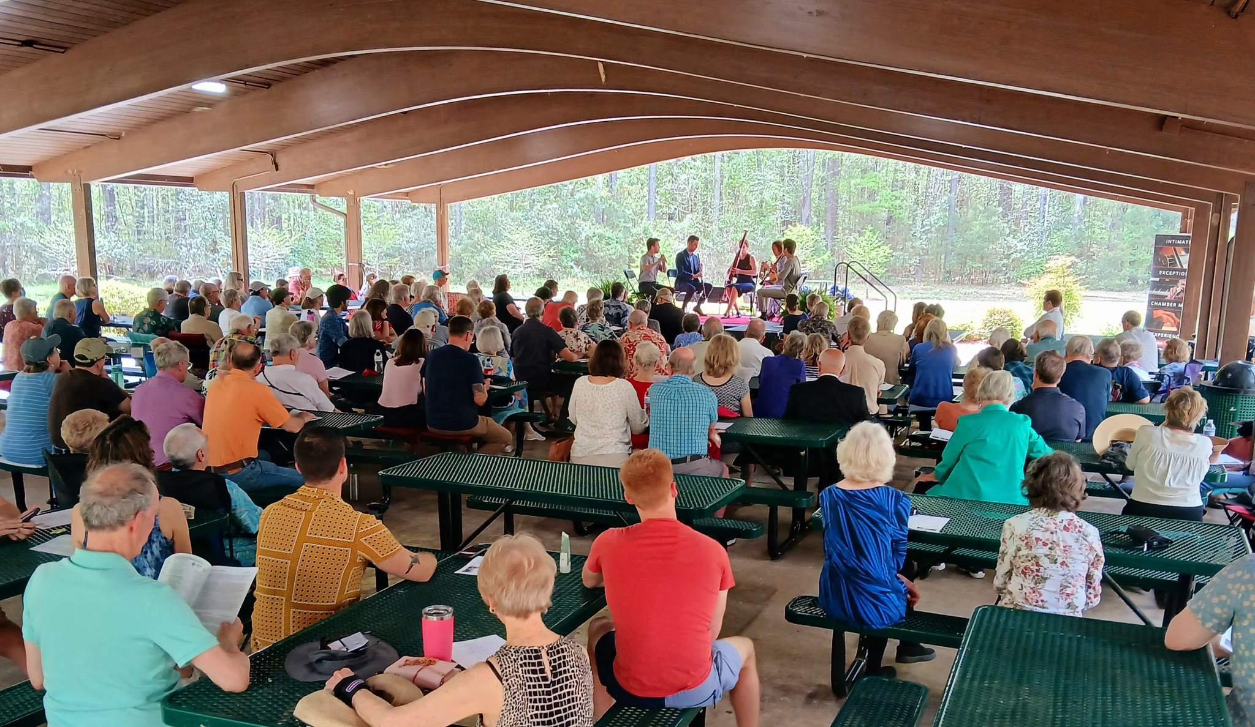
CMR Board Briefing
APRIL 2025

Slide 2


Slide 3
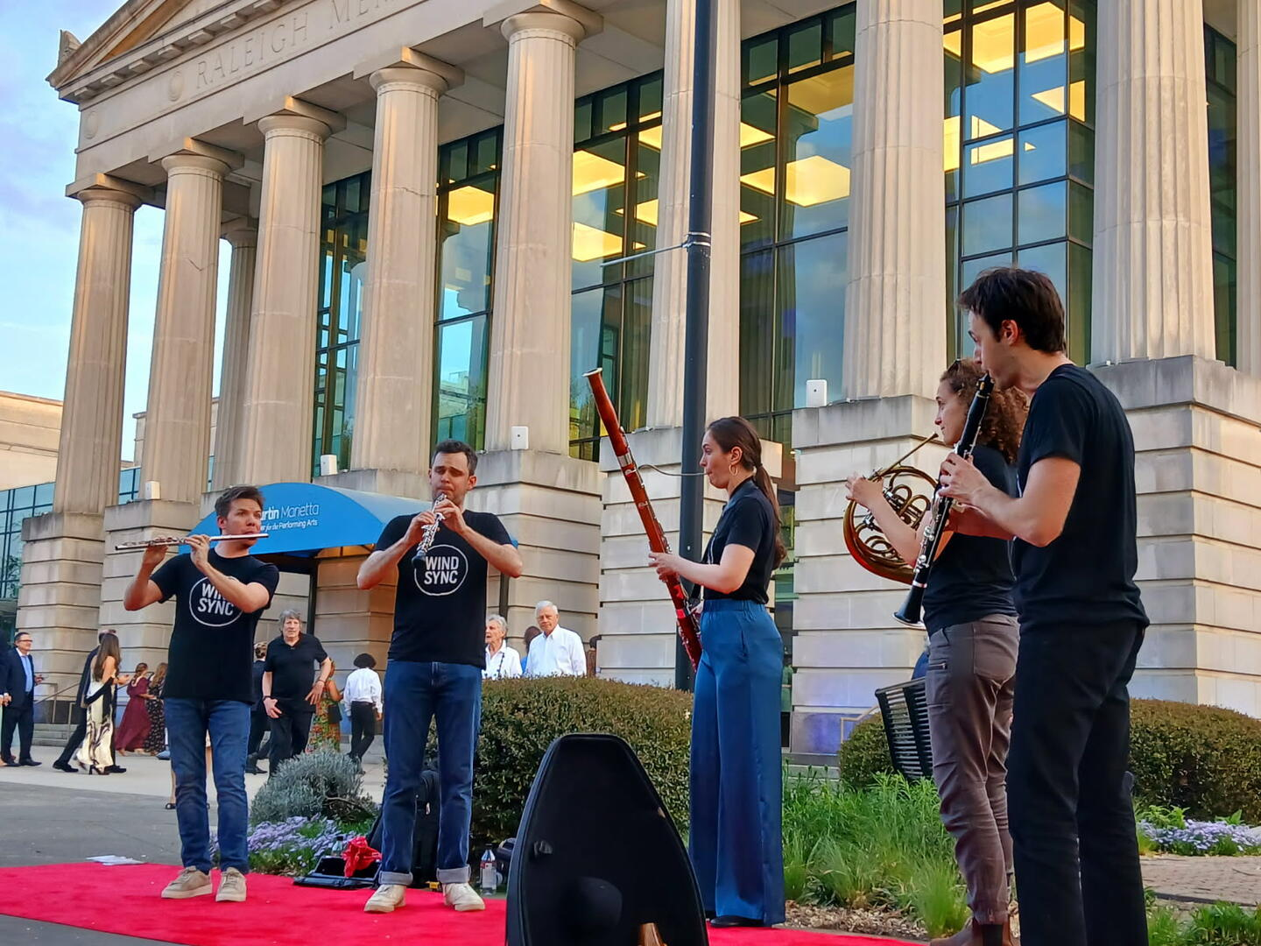

FRIDAY
POP-UP CONCERT
Martin Marietta Center of the Performing Arts
6:00 – 6:50
Meymandi Hall
The McElroys – My Brother, My Brother & Me
7:00 – 7:25 NC Opera
Marriage of Figaro
THE VENUE WANTS MORE

Slide 4
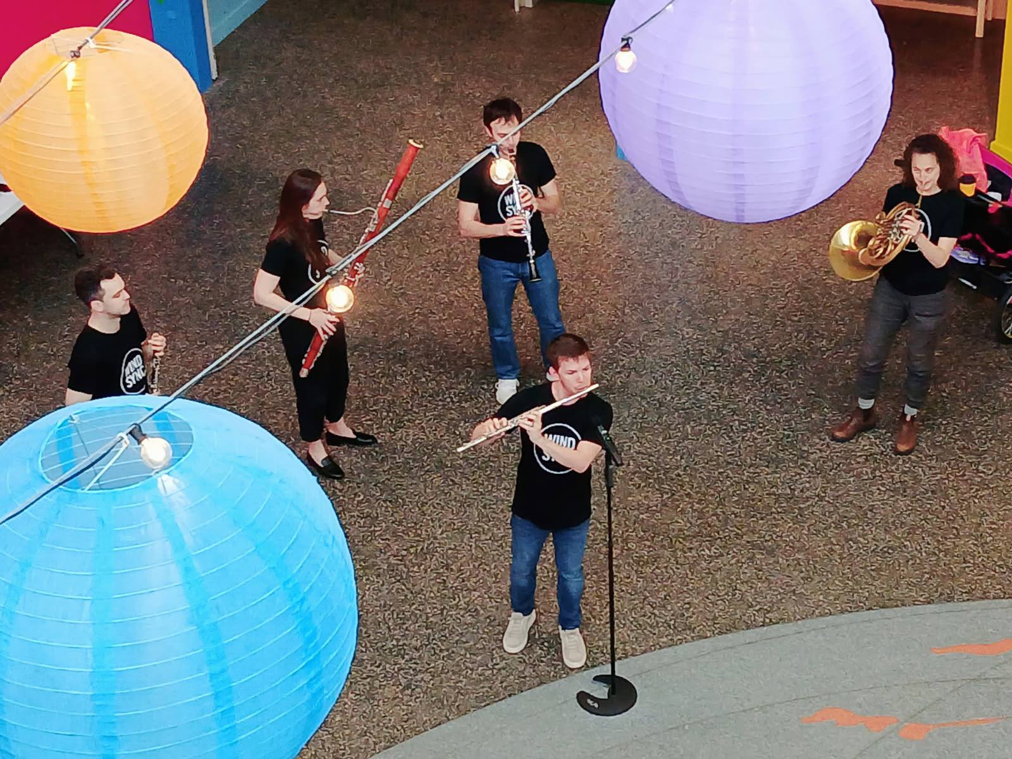
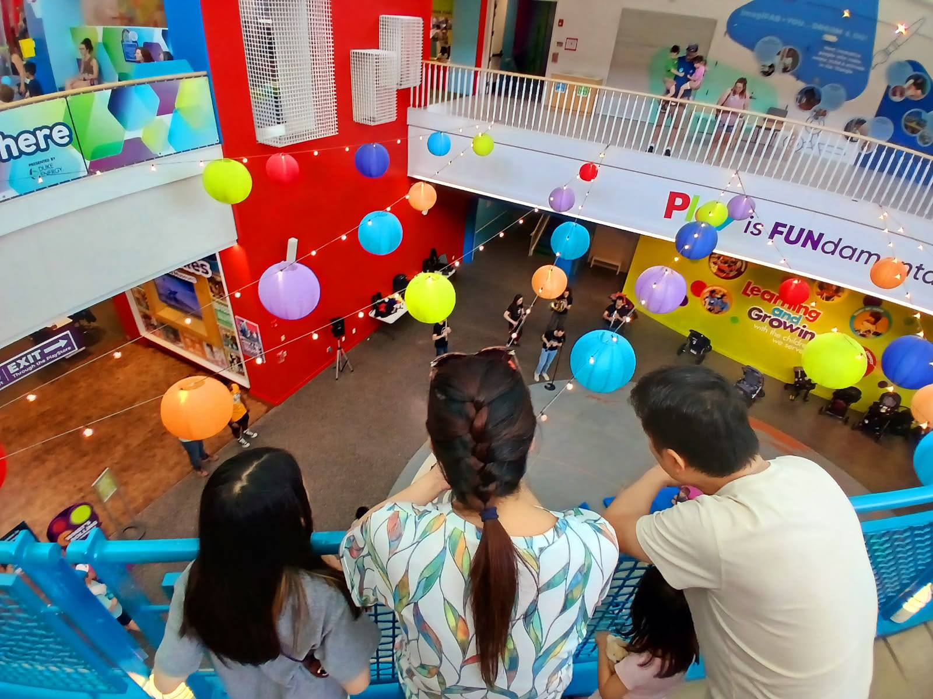
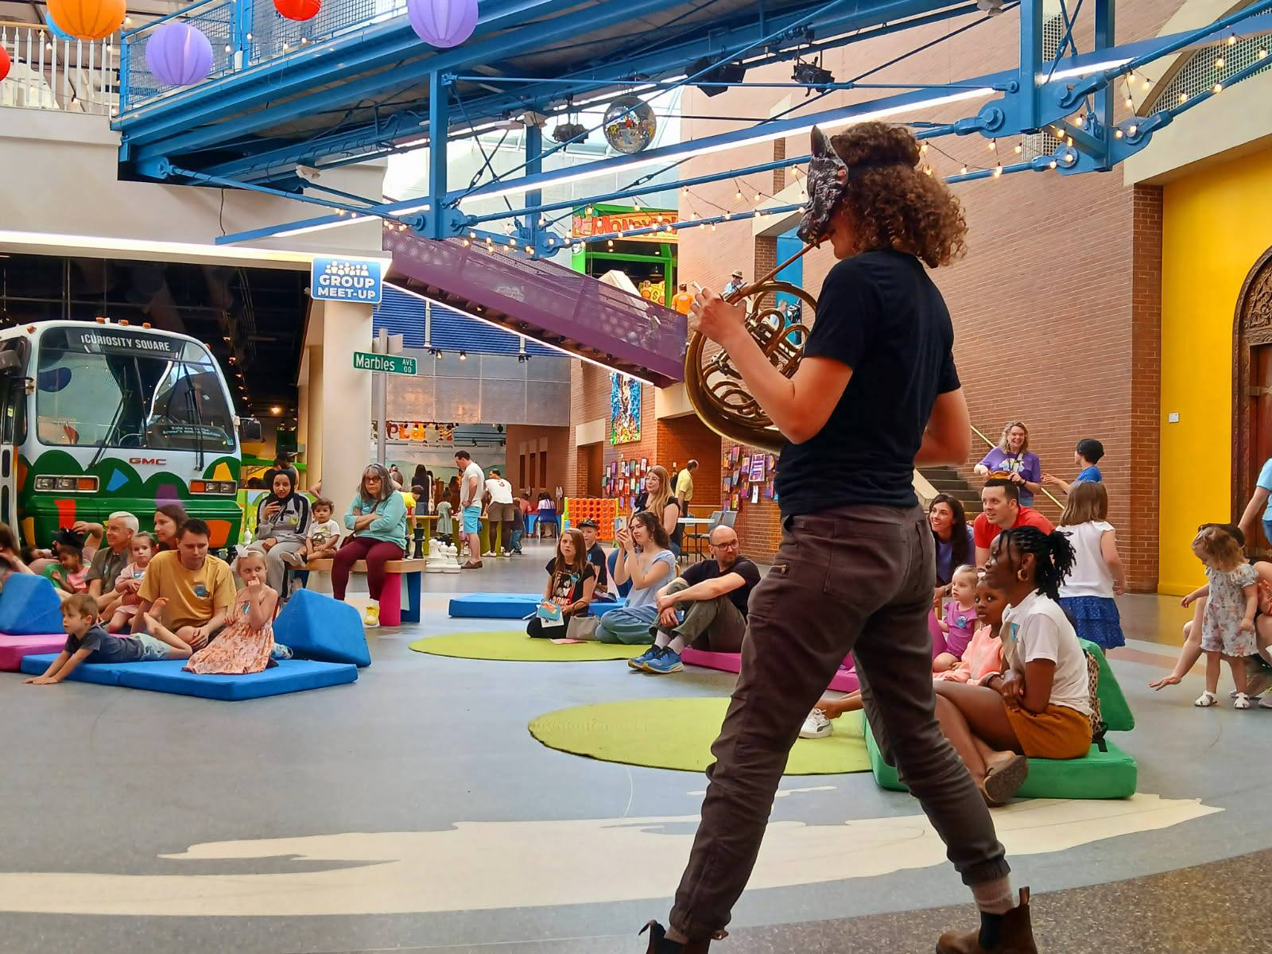

Slide 5
1:00 Marbles “Peter & the Wolf”
3:00 Marbles “Peter & the Wolf”
5:00 NCCMI Master Class

Slide 6
1:00 Marbles “Peter & the Wolf”
2:00 Marbles “Peter & the Wolf”
5:00 NCCMI Master Class

Slide 7
Sold 242 Seats

Slide 8
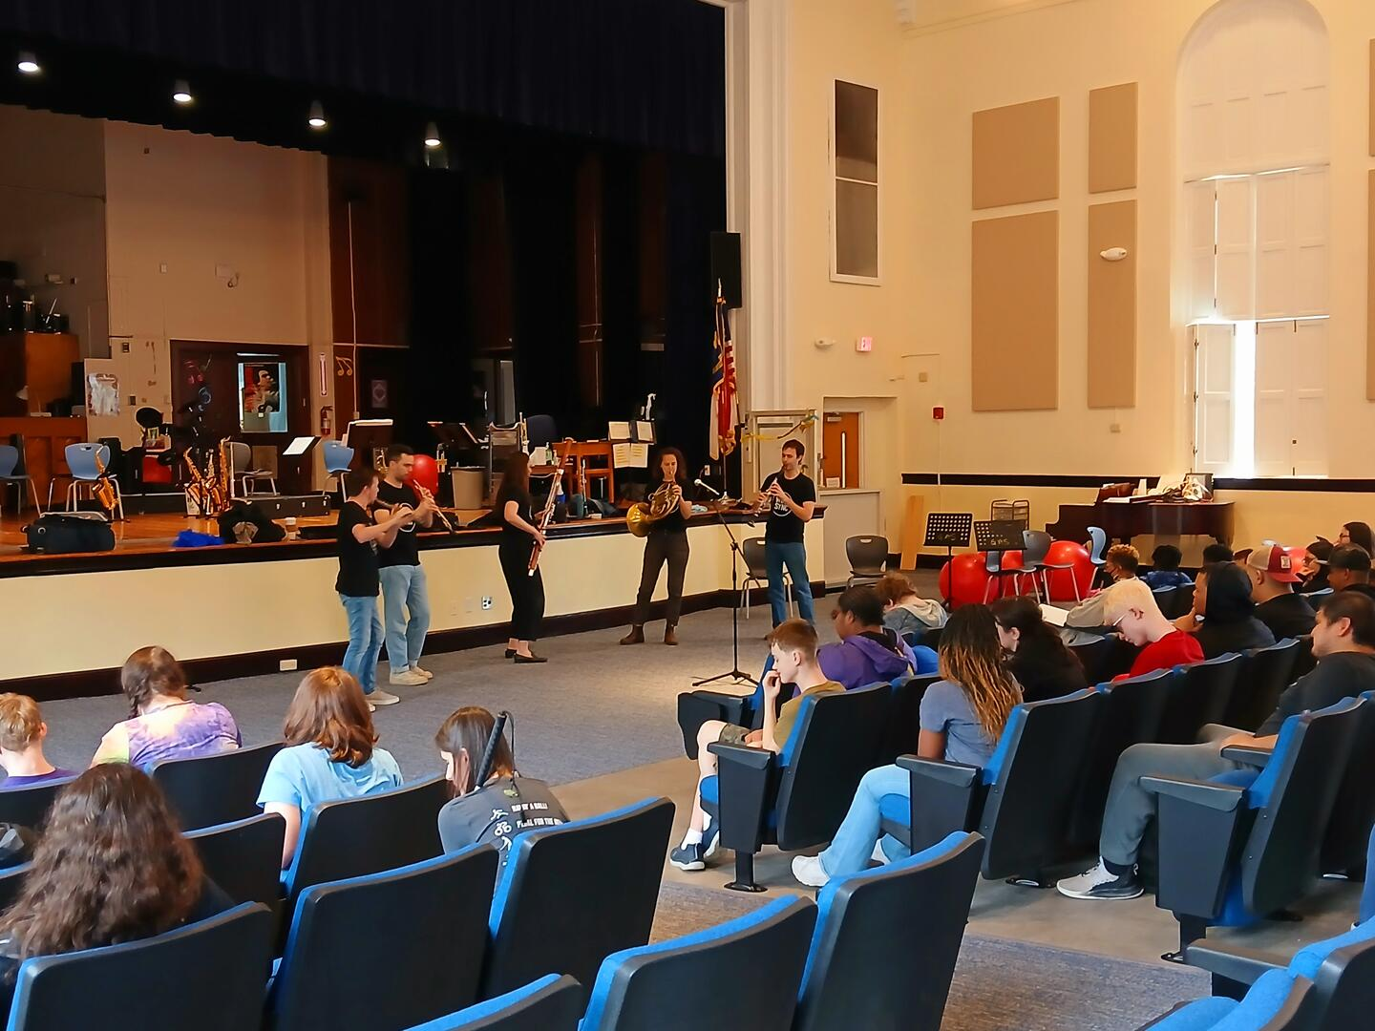
Governor Morehead School for the Blind

Slide 9
Expenses
$10,000 Artist Fee
$ 2,614 Lodging
$ 500 Rental Car Reimbursement
$ 600 Hospitality (Lunch & Dinner on Saturday)
$13,714
Income
Season 83 Subscriptions 212 $35,882
$3,987 Subscription Sales (1 of 9)
$1,300 Individual Ticket Sales
$7,000 Joe Kahn (in memory of Elizabeth Kahn)
$12,287
$10,113 United Arts Grant (for Wake County programming outside of Raleigh)
Thanks to Joe Kahn for donating WordPros Income since closing company $1600+ already
WindSync Mini-Residency

Slide 10

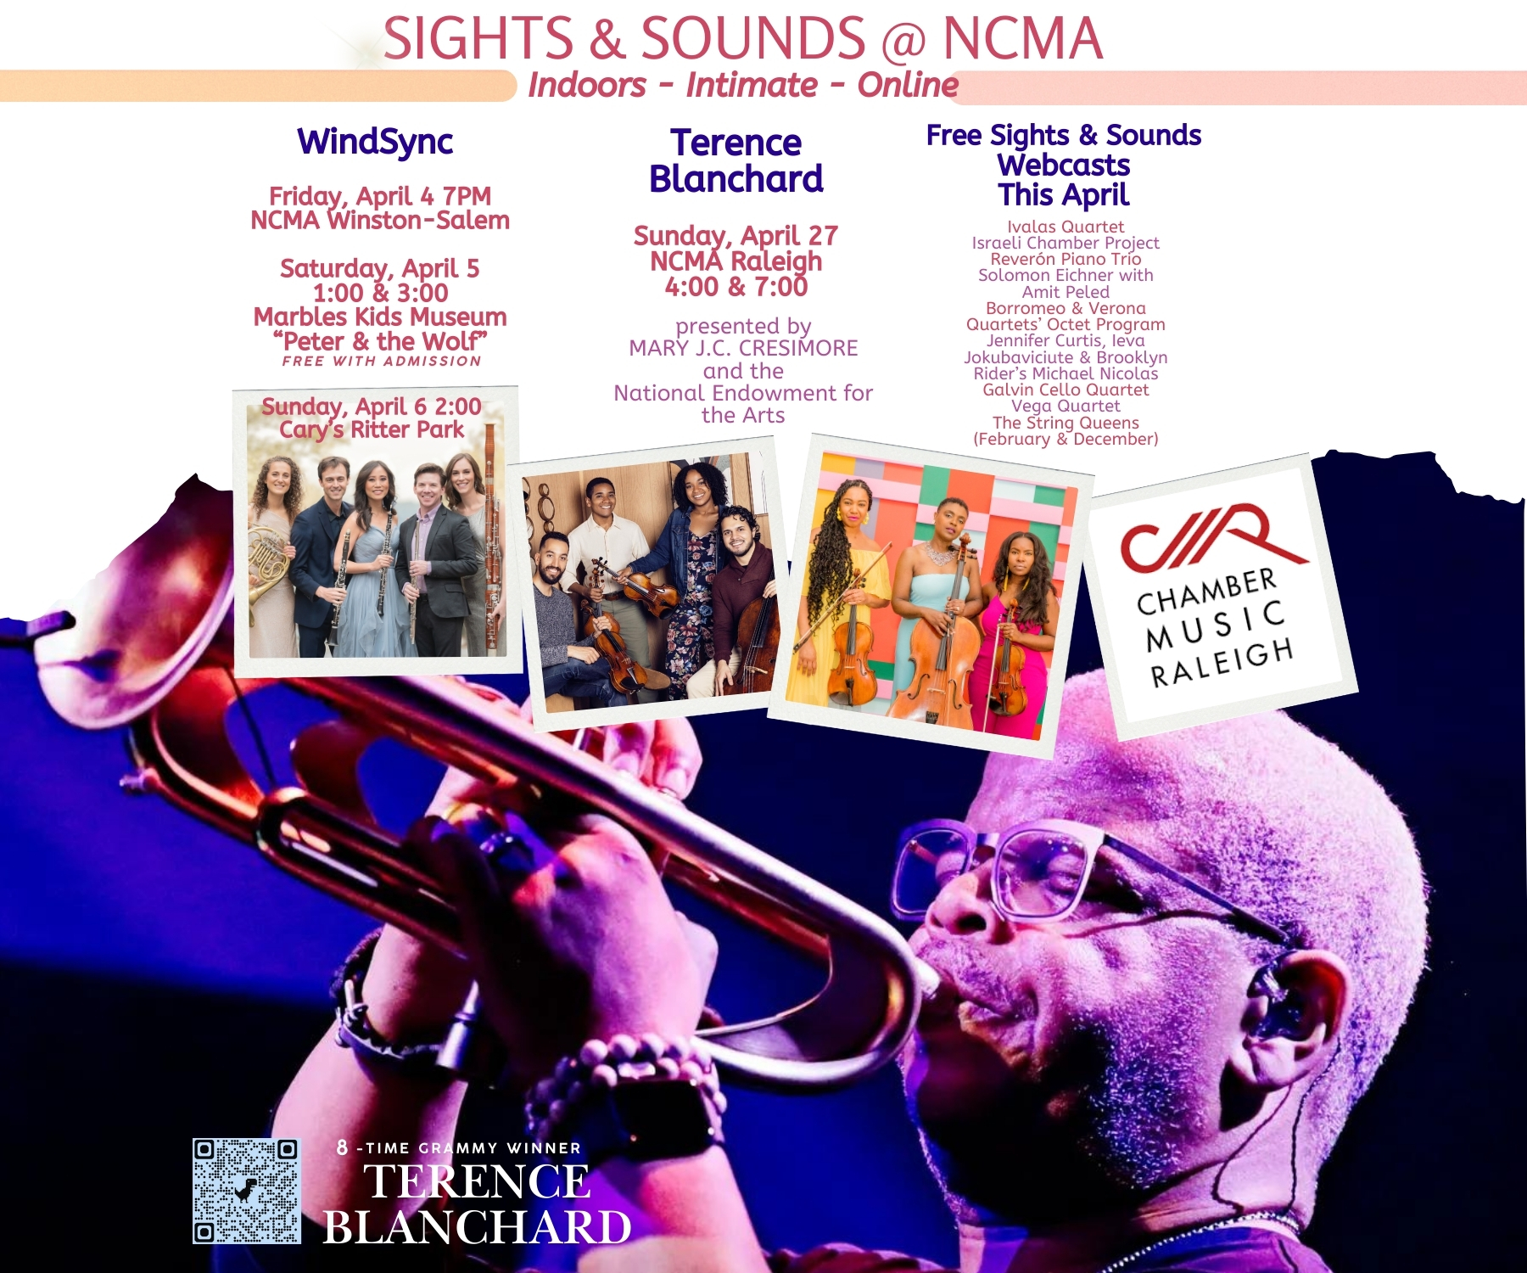
17,657 Households
$997 CES Mail
$2049 TheFlyerLab + Shipping
$2612 USPS Postage
$5658 TOTAL
.32 per household

Slide 11
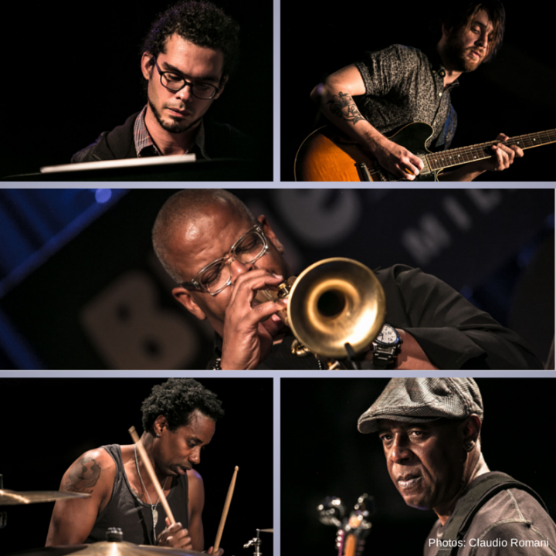
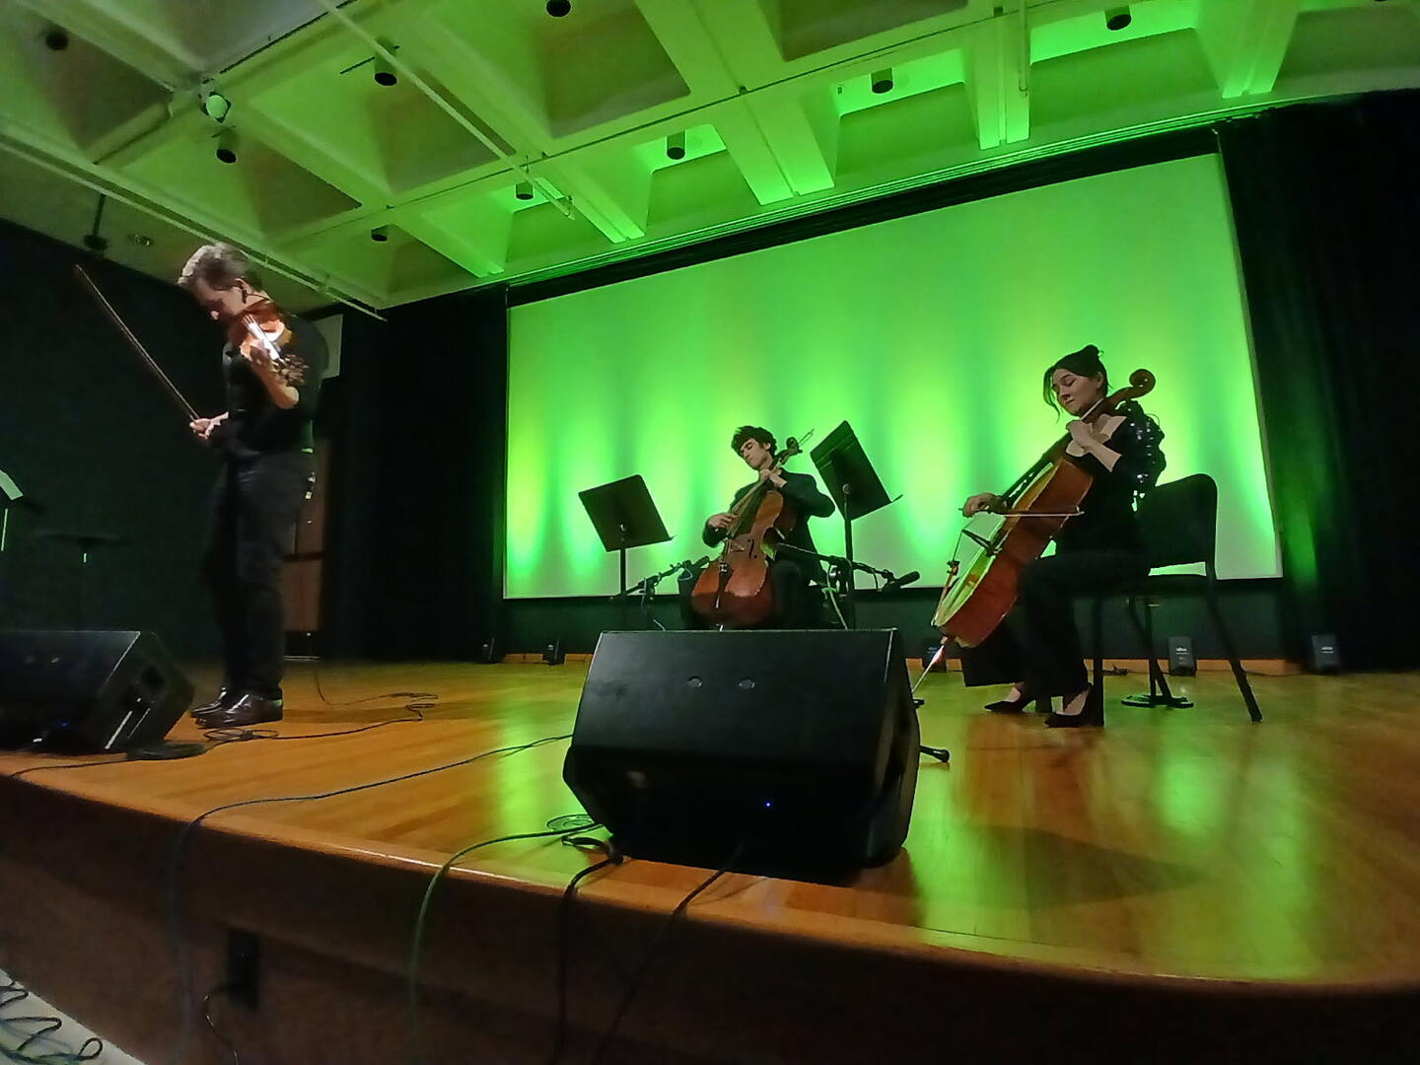
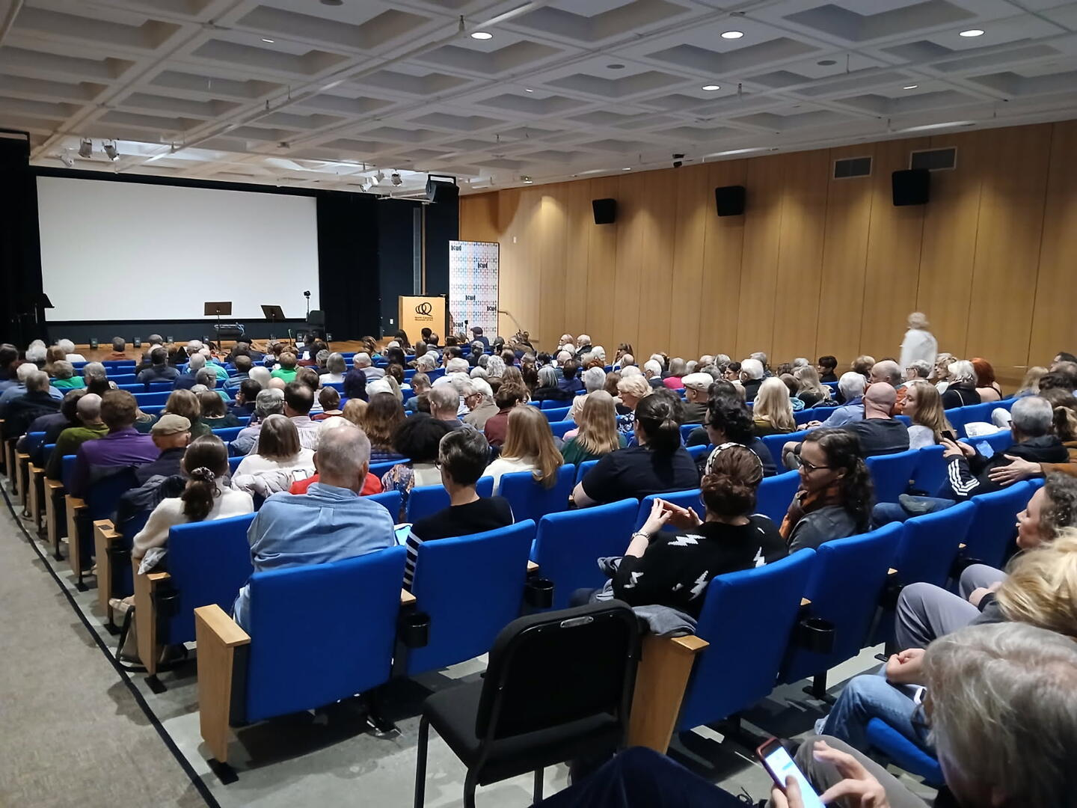
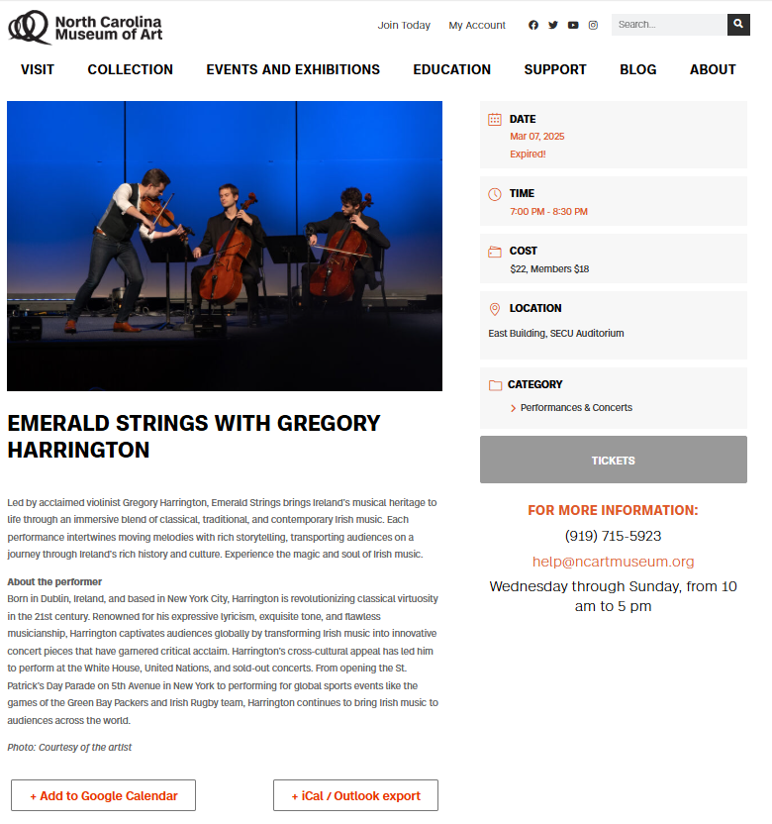
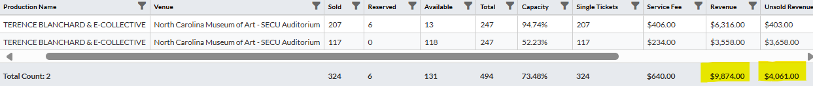

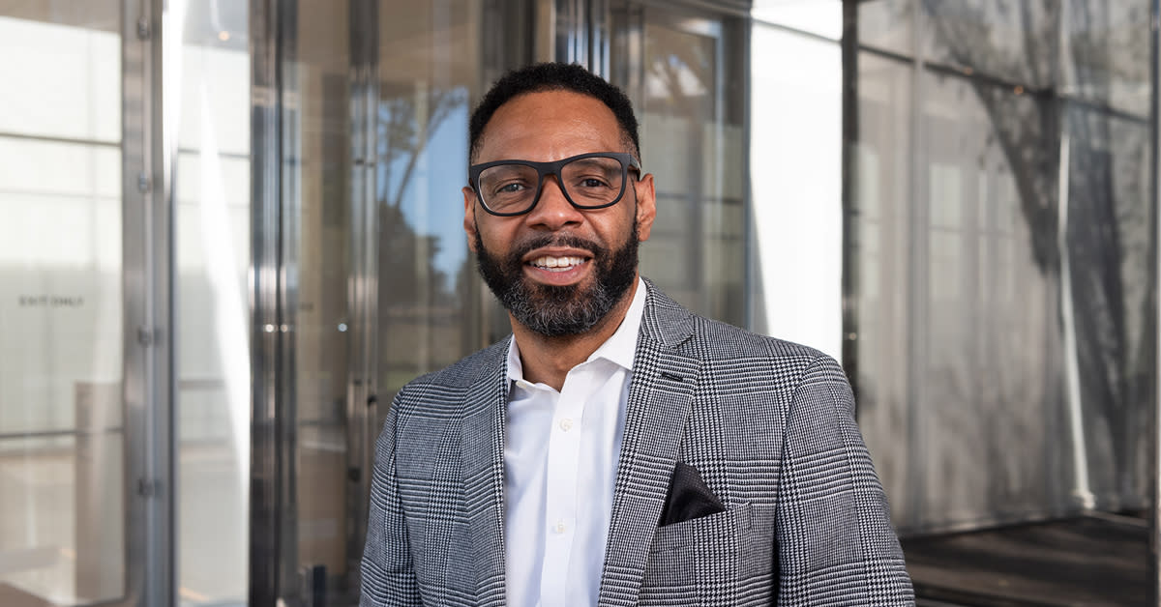
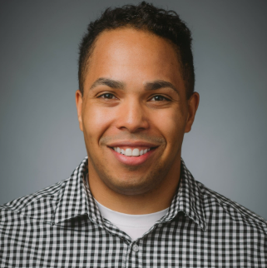
BLANCHARD SALES
DISCUSSION?
New Music Person – Jeffrey Yelverton
Moses T. Alexander Green – Dir. Perform Arts
They are producing chamber music concerts

Slide 12
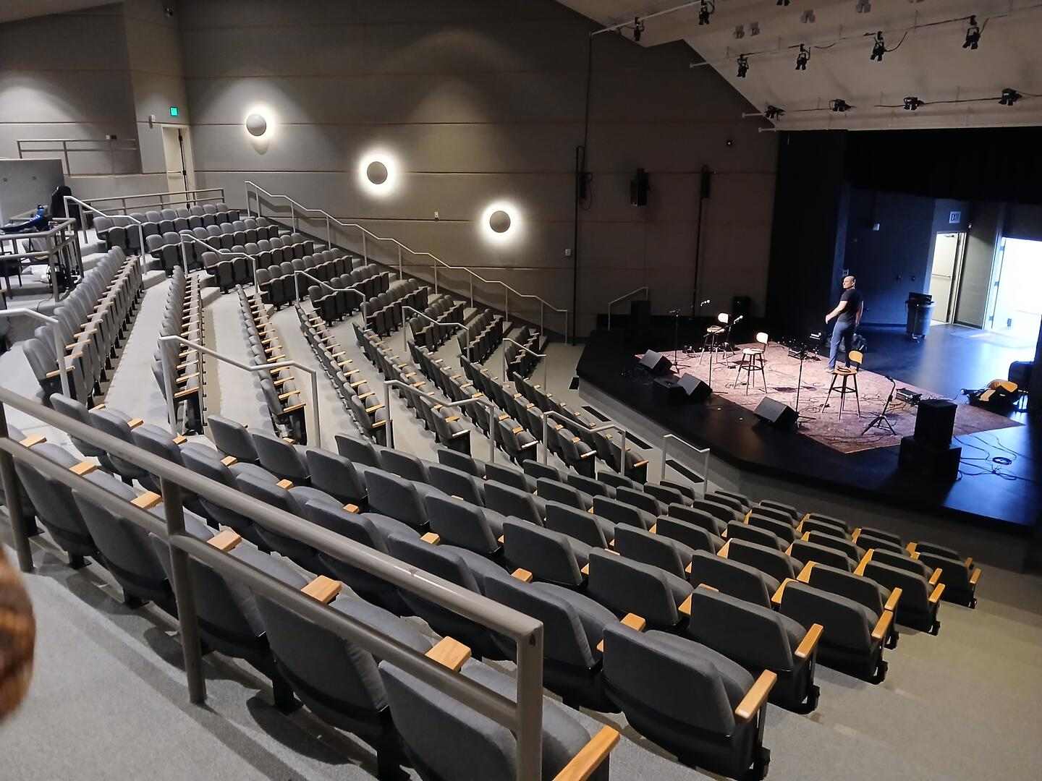
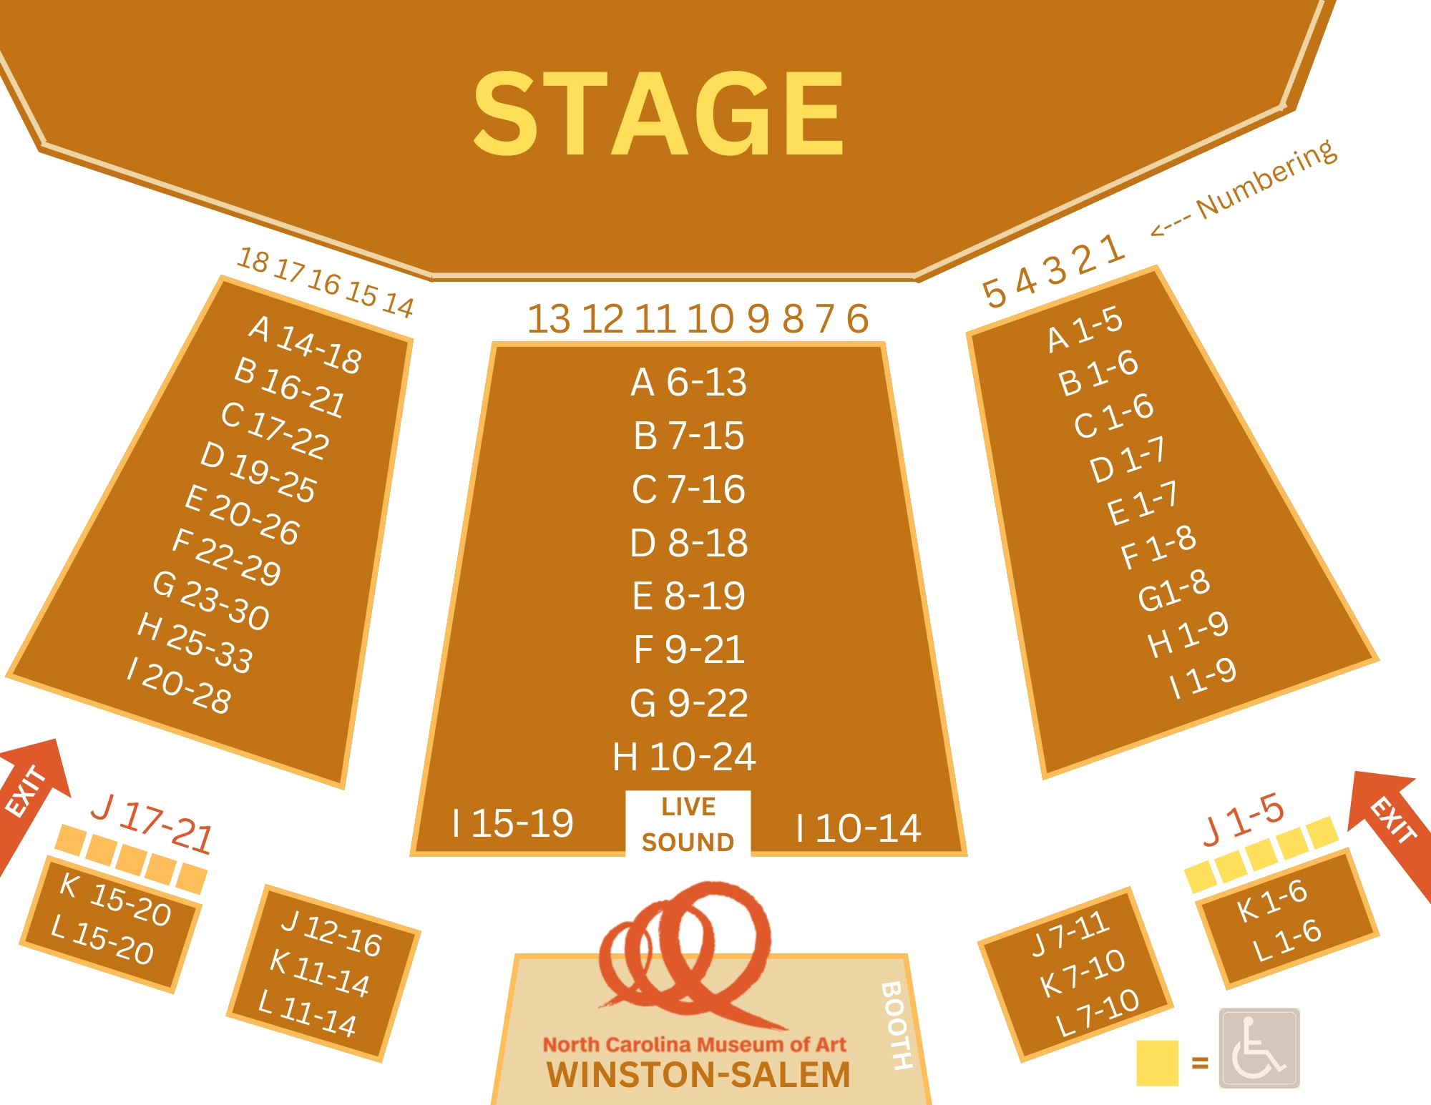
FEB 15 MET WITH
NCMA WINSTON-SALEM STAFF
ABOUT WINDSYNC APR 4
KATHERINE & VALERIE
ENCOURAGED
SIGHTS & SOUNDS WINSTON-SALEM
MUSIC PERSON AT SECCA
POSITION IN FLUX
TERRITORIAL
RECEPTION
HELD OFF ON APRIL START
OCT 25 – Pedro Giraudo $2K

Slide 13
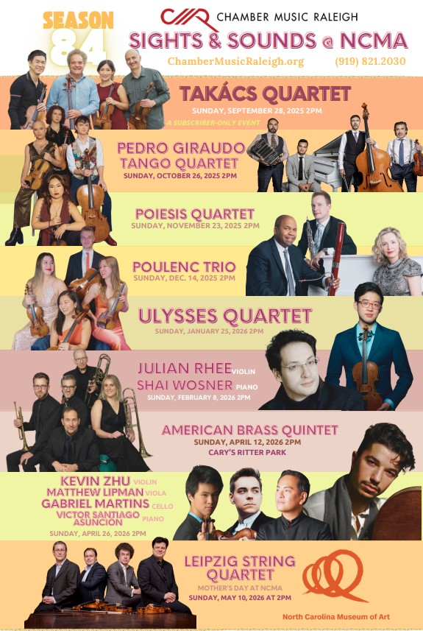

BOARD ACTION ITEM:
SEASON 84
ARTIST ROSTER
SEASON 84 BUDGET
NOT READY YET
COMING BY EMAIL
VOTE OR DISCUSS
AT JUNE MEETING

Slide 14
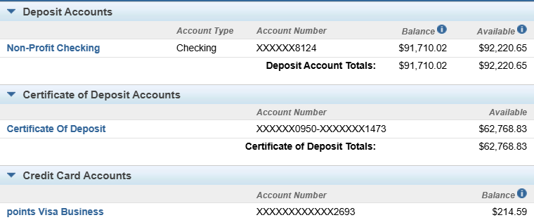

Slide 15


Key Upcoming Dates
April 7 – NEA Grant Due Today
April 13 – Rowena Mariano @ NCMA
Raleigh French Alliance
e
April 15 – Goal Date for Artist Contracting &
Subscription Renewals
a
April 27 – Terence Blanchard @ 4 & 7
May 11 – Neave Piano Trio (Mother’s Day)
9 Tickets Left
a
May 15 – Subscription Renewal Deadline
May 22 – Season 83 Brochures Arrive USPS
June 2 – Next CMR Board Meeting

Slide 16


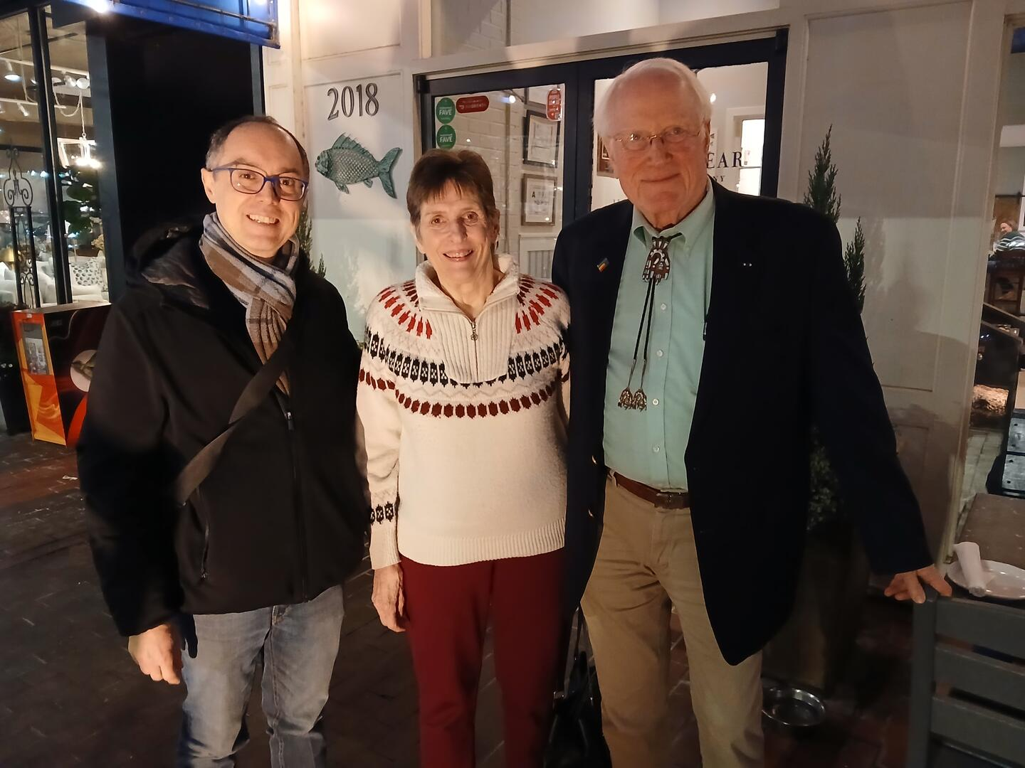
EXPENSES REIMBURSED WITH ADDITIONAL CORAC GRANT

Slide 17
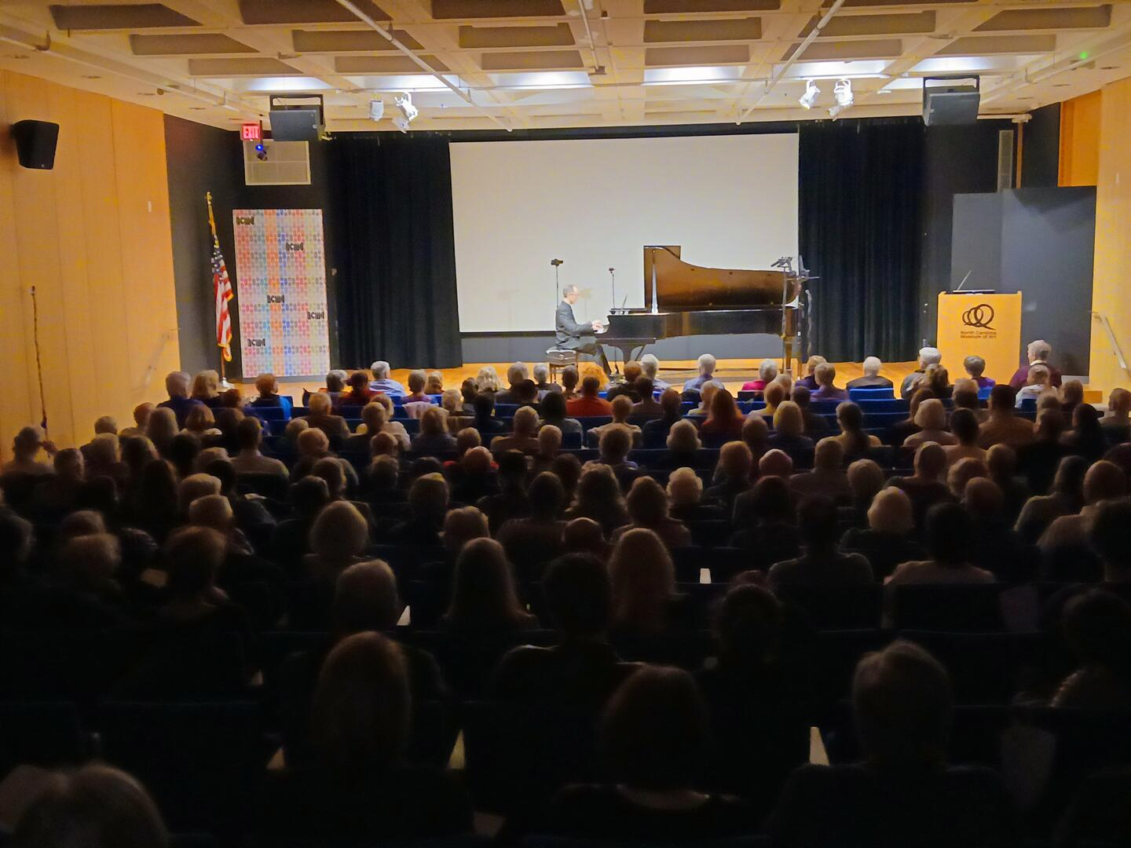
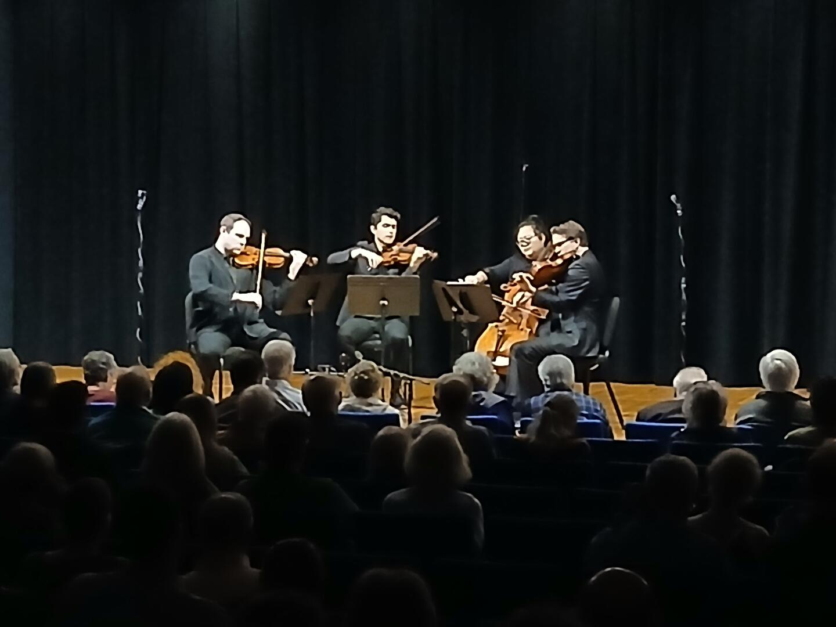

Slide 18


