Slide 1
Native History
JOM Schools
Tonya Still
Cultural Specialist
Cherokee Nation
tonya-still@Cherokee.org

Slide 2
Cherokee Culture Enrichment in Schools (CCES)
Day 1 Mississippian Times
Day 2 Contact
Day 3 Forced Removal
Day 4 Statehood

Slide 3
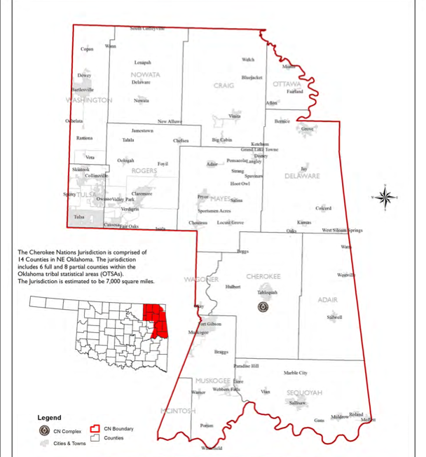
Address your Student’s needs
Unique traits of your Tribal History
The audience you will be targeting
The Schools in your Tribal Boundaries
The State Curriculum Standards

Slide 4
Why is Native History Important?
Gives Native Students a sense of Identity
Allows Native Students to understand the diversity their ancestors have overcome
Let’s Native Students know that they are not alone
Let’s Native Students see others from their Tribe that have made impacts on our society and they can make the same difference

Slide 5
Statistics
Native Students will graduate from High School at 65% of the Native population vs. 75.2% of Non-Native population
Native Students will graduate from College at 9.3% of the Native population vs. 20.3% of Non-Native population.
Cultural differences between Non-Native teachers and Native Students impede learning in the classroom.
The Median Income for Natives living within the Reservation is $29,097
The Median Income for Natives living outside of the Reservation is $40,315

Slide 6
Native History in American Classrooms
American History tends to focus very little on Native History
Address Stereotypes of Native Americans
Present History from Tribal Perspective
Present Accurate Culture from your Tribe
Give the Native Students within your JOM Schools a voice

