Slide 1
Why Should Christians Care About Work and Economics?
Craig Vincent Mitchell, PhD
Associate Professor of Christian Ethics

Slide 2
Reasons that Economics does not Matter
Shouldn’t we be concerned about eternal things rather than temporal wealth?
Economics is only about business
I don’t have any money
Economics have no effect on me
God doesn’t care about such things
Economics are amoral

Slide 3
Macroeconomic Questions
Is high unemployment a good state of affairs?
Is high inflation desirable?
Is low or no economic growth a good thing?
If you answered no to any of these questions, then economics is important

Slide 4
Taxation Questions
Should the government redistribute wealth?
Should the government tax all of us equally?
How much should the government take from people.
Are there things that the government must spend money on?
Are some things the government spends on that are only luxuries?
How do we decide which is which?
Should everyone have to work?

Slide 5
The Nature of Economics
Economics is a social science that is concerned with the allocation of scarce resources.
Economics is concerned with choices
Economics is the most empirical and mathematical of the social sciences: sociology, political science
Economics has plenty of applications to politics and business

Slide 6
The Bible and Economic Thought
Thou shalt not steal implies property rights
Buying and selling are legitimate activities
Weights and measures used in markets should be “righteous” or accurate
The Bible encourages work to gain wealth
The government is allowed to tax, but there is no endorsement of government based redistribution of wealth in the Bible
Wisdom literature teaches that wealth is gained by virtue, and poverty results from vice.

Slide 7
Oikonomia- Divine Economy
The stoic “philosophers came to speak of a management of the universe_ God’s household management of the world, if you please. In the orderly arrangement of all things, each person has his or her own place within this administration, under the Master of the house.”
John Reumann, Stewardship and the Economy of God (Grand rapids: Eerdman’s , 1992), 24

Slide 8
Oikonomia- Divine Economy
“Early Christians of the post- New Testament period inherited from Stoicism and Greek thought generally the idea of a divine economy.
“The New Testament references, especially in Paul, encouraged them (the Church) to think of an oikonomia of God, of which the apostles, church leaders and all Christians might be a part. All could think of themselves as oikonomoi stewards or administrators of God’s saving plan.”
Latin- dispensatio
Reuman, 26.

Slide 9
Oikonomia- Divine Economy
Oikonomia
Creation
Redemption

Slide 10
Oikonomia- Divine Economy
Reumann. 121
Creation
Redemption
There is a stewardship based on creation, justice, self-interest, creaturely concerns, self-love and involvement. This endeavor is part of receiving life and being human at it’s fullest.
There is a stewardship based on redemption, the gospel, God’s saving righteousness, our response, and love to God, in ecclesial community. This endeavor comes from having received the Life of God’s new age.

Slide 11
Christian Worldview
Oikonomia
Work:
Household
Stewardship:
Church
Political Economy:
State

Slide 12
Christian Worldview: Work
God
Individual
Family

Slide 13
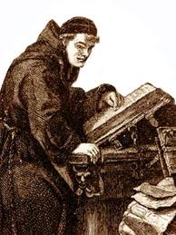
Christian Worldview: Work
Brother Lawrence wrote Practicing the Presence of God, it was published in 1693.
He wrote, “One must serve God in a holy liberty and do one’s work without distress or anxiety, calling the soul gently and quietly back to God so soon as we find it drawn away from Him”

Slide 14

Christian Worldview: Work
Martin Luther believed that vocational calling extended beyond just theGospel ministry. He believed that God gifts men to do different kinds of work and that they should glorify Him in their work

Slide 15
Christian Worldview: Stewardship
God
Individual
Church

Slide 16
Christian Worldview: Stewardship
Baptist Faith and Message XIII. Stewardship
God is the source of all blessings, temporal and spiritual; all that we have and are we owe to Him. Christians have a spiritual debtorship to the whole world, a holy trusteeship in the gospel, and a binding stewardship in their possessions. They are therefore under obligation to serve Him with their time, talents, and material possessions; and should recognize all these as entrusted to them to use for the glory of God and for helping others. According to the Scriptures, Christians should contribute of their means cheerfully, regularly, systematically, proportionately, and liberally for the advancement of the Redeemer's cause on earth.

Slide 17
Christian Worldview:
Political Economy
God
State
Political Economy

Slide 18
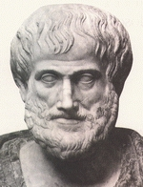
The History of Economics
The first person to write on the subject of economics was Aristotle.
Aristotle wrote The Politics and The Economics
Aristotle understood that politics and economics are different aspects of moral philosophy

Slide 19
The History of Economics
While Aristotle thought little of merchants, he understood that they served an important role
Aristotle believed in free trade and free markets
Aristotle believed that governments should not spend more than they take in

Slide 20
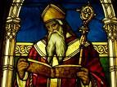
The History of Economics
Augustine of Hippo wrote about economic theory in his City of God.
His theory of personal distribution explains how the tradesmen serves their customers and their families

Slide 21
The History of Economics
Augustine’s theory of personal distribution explains how people are motivated by self love and by the love for his neighbor
The tradesman loves his customers with benevolence (wishing good to them) and not with beneficence because of scarcity.
The tradesman loves his family with both benevolence and beneficence (doing good to them).
The tradesman sells his product to customers to earn the means to provide for himself and his family.

Slide 22
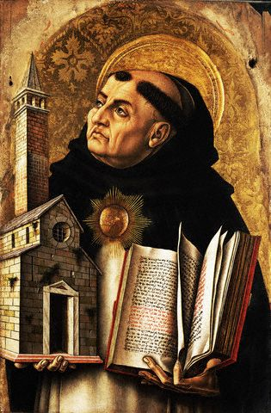
The History of Economics
Aquinas combined the theology of Augustine with the philosophy of Aristotle
Aquinas wrote a commentary on Aristotle’s Politics and further developed a Christian view on political economy.
Aquinas’ work led to the founding of the Salamanca School of Economics

Slide 23
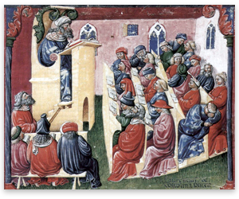
The History of Economics
14th century Medieval Christian scholars developed economic theory after studying Thomas Aquinas’ commentary on Aristotle’s Politics.
They understood that God ordered everything and that economics is an ethical discipline
They also believed that governments should do certain things and refrain from doing other things if the common good was to be served.

Slide 24
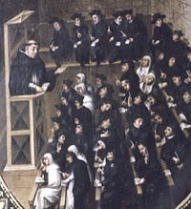
The History of Economics
Francisco de Vitoria started the Salamanca School of Economics at the University of Salamanca, Spain.
It was started by the Dominican Order
They argued for the importance of free markets and against government intervention in the economy

Slide 25

The History of Economics
The Salamanca school of economics extended to the University of Coimbra, Portugal.
The Dominicans were joined by the Franciscans as well as the Jesuits in the development of free market economics

Slide 26
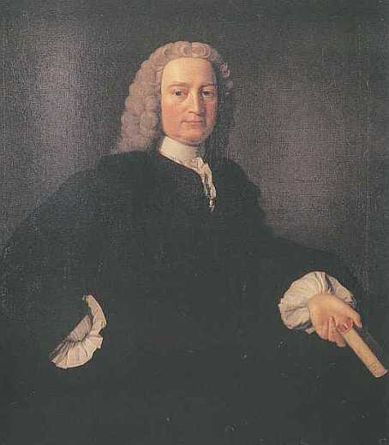
The History of Economics
Frances Hutchinson was a professor of Moral Philosophy at the University of Glasgow (Scotland)
He was also a Presbyterian minister.
He developed the concept of the division of labor

Slide 27
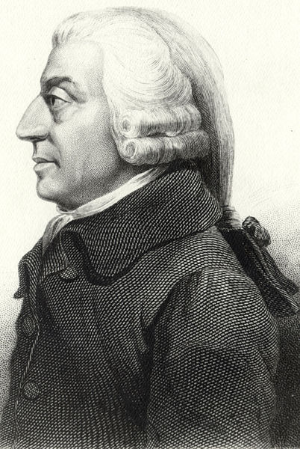
The History of Economics
Adam Smith was a student of Francis Hutchinson
He was also a professor of Moral Philosophy at the University of Glasgow
He wrote The Wealth of Nations

Slide 28
The History of Economics
Adam Smith believed that a free market economy with a laissez faire government was the system that best promoted virtue and minimized vice.
In this kind of system those who exercise virtues are most likely to prosper.
Those who are vicious are most likely to end up in poverty

Slide 29
The History of Economics
Adam Smith believed that government should ensure that the marketplace was a level plying field by punishing fraud
Government should allow free trade between nations
Governments should only spend money on public works, national defense, and a judicial/ legal system.

Slide 30
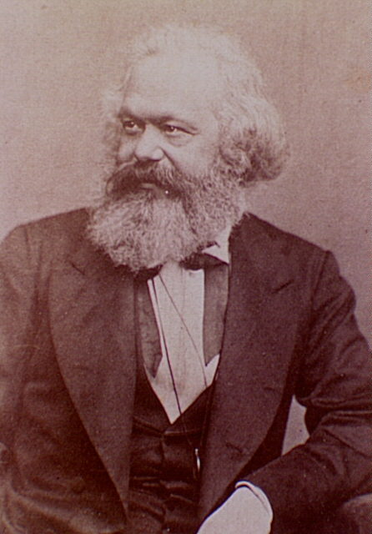
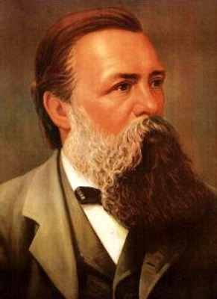
The History of Economics
Karl Marx
Friedrich Engels

Slide 31
The History of Economics
Marx and Engels wrote The Communist Manifesto and Das Kapital
Theirs is an atheistic system based on metaphysical materialism
They desired to get rid of private ownership and give the state the means of production
Socialism is the halfway house in their goal of a worldwide system
They endorsed a worldwide revolution to install their system

Slide 32
The History of Economics
Fascism
Communism
Fascism is national socialism
Fascism is only one step on the way to communism
Examples include: Nazi Germany, Italy under Musolini
Fascist governments are often dictatorships
Communism is worldwide socialism
Examples include: USSR, Cuba, China
Communist governments are often dictatorships

Slide 33
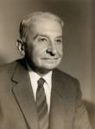
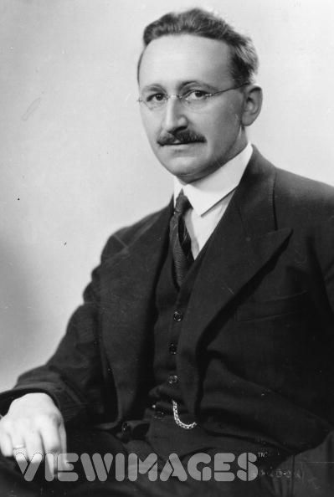
The History of Economics
Ludwig von Mises
Friedrich von Hayek

Slide 34
The History of Economics
Karl Menger started the Austrian School of Economics
It is a free market approach to economics
They more closely followed the ideas of the Salamanca School of Economics than Adam Smith did
They believed that morality and economics are entwined
Ludwig von Mises and Friedrich von Hayek both won the Nobel prize in economics

Slide 35
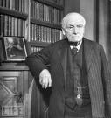
The History of Economics
John Neville Keynes was a professor of political economy at Cambridge University
He divided economics into positive, normative, and practical economics

Slide 36
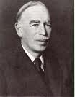
The History of Economics
John Maynard Keynes is the son of John Neville Keynes
He wrote The General Theory of Employment , Interest and Money
He invented the field of macroeconomics

Slide 37

So How does it all Work?

Slide 38
The 20th Century Debate in Economics
John Maynard Keynes
Friedrich von Hayek
Keynes was a socialist
Aggregate markets work differently from individual markets
The government can control the economy by raising and lowering taxation and consumption
The government should also control interest rates
Markets are irrational
He rejected Adam Smith
Hayek hated socialism
Market forces always operate in the same manner.
Business cycles result from government intervention
Markets work and governments do not
Market forces result in spontaneous order, which is efficient
Markets are rational

Slide 39
The 20th Century Debate in Economics
Keynesian economics reigned from the 1940s until the 1980s.
Both Margaret Thatcher and Ronald Reagan were followers of Hayek and institutionalized his ideas.
There was an economic boom from the 1980s until 2008.
Both George Bush and Barack Obama brought Keynes’ ideas back into vogue.

Slide 40
Explaining the Economic Disaster
Market Failure
Asymmetrical Information
Externalities

Slide 41
Explaining the Economic Disaster
Asymmetrical Information
Adverse Selection
Moral Hazard

Slide 42
Explaining the Economic Disaster
The federal government forced banks to make loans to those without good credit (Community Re-investment Act and the Graham, Leach, Bliley Act of 1999) thereby forcing adverse selection.
Fannie Mae and Freddie Mac (quasi- government agencies) made bad decisions
AIG insured investors against default
The government then bailed out banks that were “too big to fail” thereby engaging in moral hazard.

Slide 43
Results of the Economic Disaster
Higher national debt (5 trillion increase since 2008) 16 trillion dollars total
Higher unemployment (10.1 %)
Slower economic growth
Eventually inflation or deflation
All of these things have a direct impact upon you and your local church!

Slide 44
Why Economics Matters
In 1986 Blank and Blinder found that an increase in the unemployment rate for males of 1% increased the poverty rate by .7%
Far fewer women than men are able to earn enough money to escape poverty.
The poverty rate in 2007 was 12.5% of the population and rose to the present figure of 14.3% (43 million people)

Slide 45
Why Economics Matters
Difficult times mean more opportunities for ministry
Difficult times means less money for churches and denominations
Difficult times means less money for missions
Difficult times mean less money for seminaries
We should pray that the Lord will empower us to do His work

Slide 46
Solutions: Socialism
Socialism attempts to spread the wealth through redistribution.
This redistribution takes the form of a progressive tax (the more you make, the more they take)
Progressive taxes are another form of stealing
Socialism reduces individual freedom and gives more power to the state

Slide 47
Solutions: Liberation Theologies
Liberation theologies divide people into two groups, oppressors and the oppressed
Christ is with the oppressed and against the oppressors
The oppressors cannot know truth meaning or morality
The oppressed should overthrow the oppressors and redistribute wealth in some kind of socialist scheme

Slide 48
Solutions: Free Market Economics
This approach causes economic growth, so that everyone benefits
It results in lower unemployment, lower inflation, and higher economic growth
It increases individual freedom
It reduces the number of people in poverty
It is consistent with a biblical Christian worldview

Slide 49
Conclusions
All economic policies are not of equal value
Free markets work and governments don’t
Not all economic policies are consistent with a Christian worldview
The Church has a traditional role of taking care of the poor, while preaching the Gospel
Our work matters for our growth in Christ, as well as for our own wealth and poverty

