Slide 1
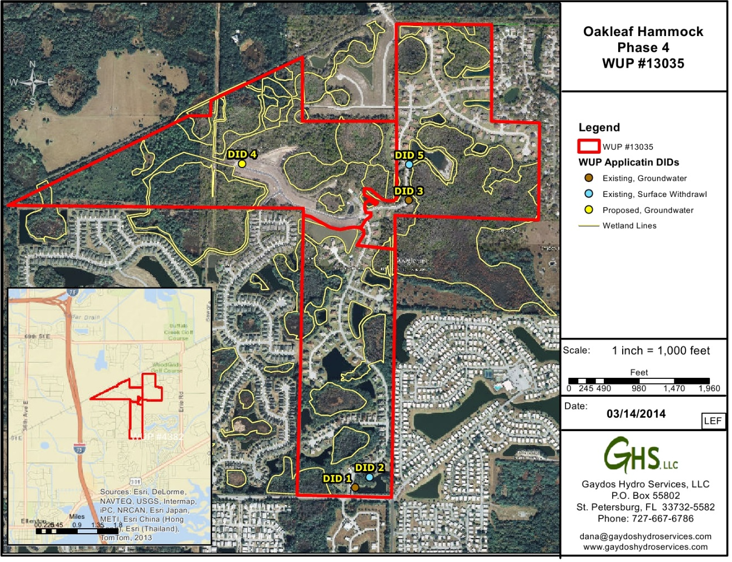
GHS Environmental
Anything Water!

Slide 2
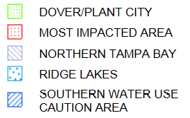
SWFWMD’s WUCA Locations
http://www21.swfwmd.state.fl.us/maps/pages/viewer_general.html

Slide 3
What is the MIA?
The MIA stands for the Most Impacted Area.
This is a region where heavy groundwater pumpage from inland activities such as agriculture, potable water supply, industry, mining, and other uses such as irrigation of lawn and landscape has caused the Floridan Aquifer groundwater levels to decrease and may cause higher saltwater intrusion from the Gulf of Mexico to contaminate this aquifer.
Because of this, SWFWMD has regulations in place that restrict groundwater use in order and reduce groundwater withdrawals in order to minimize further potential impacts of salt water intrusion.
One major regulation that was passed includes that no NEW groundwater is permitted in this area.

Slide 4
Irrigation Calculations

Slide 5
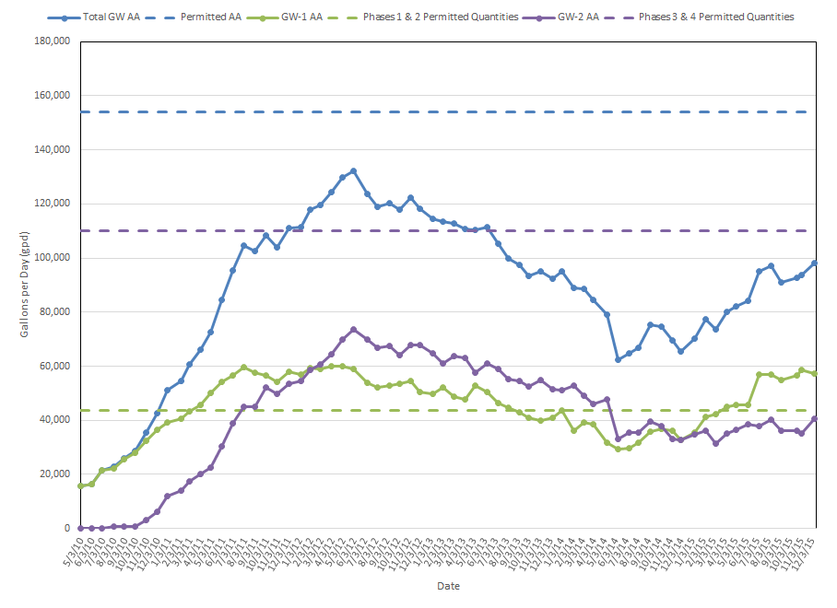
Historical Water Use

Slide 6
What does that mean for Oakleaf Hammock?
Oakleaf Hammock cannot simply apply for new groundwater quantities. Groundwater quantities must be transferred from another existing WUP that Oakleaf is a co-permittee, and the transfer must be in the direction from west to east. It cannot be EAST to WEST. Oakleaf is not a co-permittee with any other permit, but it can be done with time and money.
OR Alternative Water Sources (AWS) may be used and include:
Surface water (already in use)
Reclaimed water (not available at Oakleaf Hammock)
Seawater desalination (not cost effective for irrigation)
Brackish water (not viable source for irrigation)
Other options???
Share between all Phases – Water Optimizer

Slide 7
Water Optimizer Plan
The Water Optimizer was introduced as a means to follow SWFWMD’s rules and to allow for potential sharing among residents in this restricted water use caution area, the MIA.
The Water Optimizer will allow each resident to increase irrigation to twice per week at shorter batches (~2 hours twice a week).
The Water Optimizer will eliminate the current once per week watering schedule and will ensure that the Water Use Permit remains in compliance.
The Water Optimizer is the cheapest alternative compared to finding an existing water use permit in which to transfer quantities from, paying an attorney to develop a temporary lease agreement , paying a consultant to prepare and obtain the modified permits, paying permitting fees, etc…

Slide 8
Old Mill Preserve Addition
Two phases
Existing Irrigation System Includes:
Reclaimed
Surface Water
Groundwater (backup)

Slide 9
Other Resources
SWFWMD MIA presentation:
https://www.swfwmd.state.fl.us/files/database/calendar/MIA_Third_Meeting_Recap_Presentation.pdf
SWFWMD’s Mapping Gallery:
http://www.swfwmd.state.fl.us/data/gis/gallery.php
SWFWMD WMIS System:
http://www18.swfwmd.state.fl.us/search/search/searchwupsimple.aspx

