Slide 1
Pithlachascotee River Basin Study
by:
&
Prepared for:
The City of New Port Richey
Anything Water!

Slide 2
Introduction
Objective
Past and present activities include:
Orange Lake Feasibility Study
Sims Park Improvements
Orange Lake Restoration Project
Heights Stormwater Improvements
Meadows Rehabilitation Project
North Park Stormwater Improvements
The purpose of this study was to identify which areas of the stormwater system within the City of New Port Richey are largest nutrient and pollutant contributors to the Cotee River.
The results of the study will provide the City with an outline and information for the next strategic plan.

Slide 3
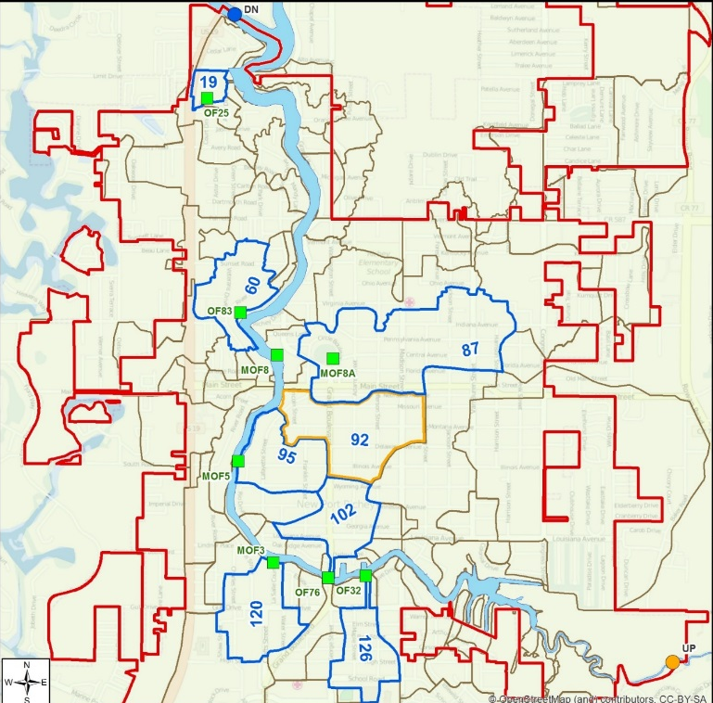
Methods
Reviewed all stormwater basin, outfall diameters, and total number of outfalls per basin.
One upstream location and 7 outfalls were sampled a total of 10 times during both the wet and dry seasons.
Locations include: Upstream of NPR, DB#126, DB#102, DB#120, DB#95, DB#87, DB#60, and DB#19.

Slide 4
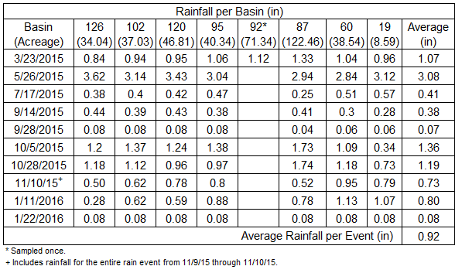
Analysis
Heavy metals, nutrients, biologicals, and other indicator parameters were analyzed every sampling event.
Herbicides and pesticides were analyzed in 4 events.
Rain data was collected from the city’s system.
Land use data was reviewed in association with the contamination results.

Slide 5
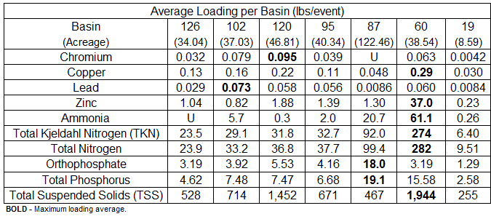
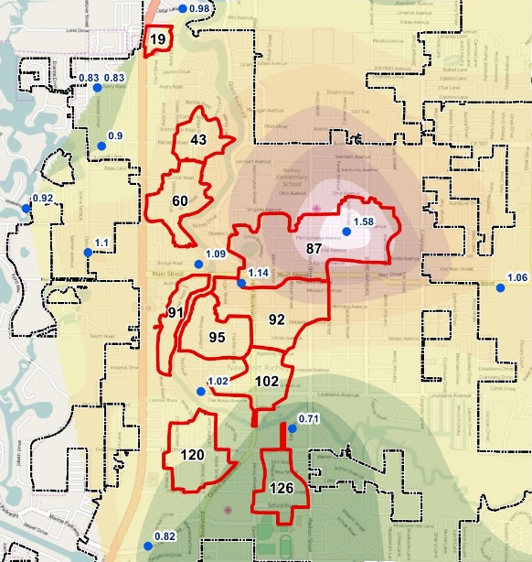
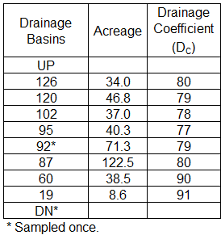
Average Loading
Runoff Coefficients

Slide 6
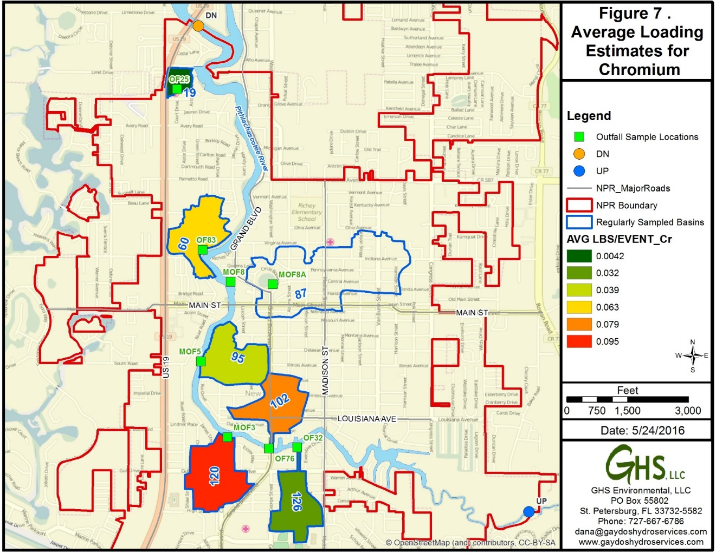
Chromium
Main Source:
Gasoline combustion
Other Sources:
Electro-plating
Paints
Preservatives

Slide 7
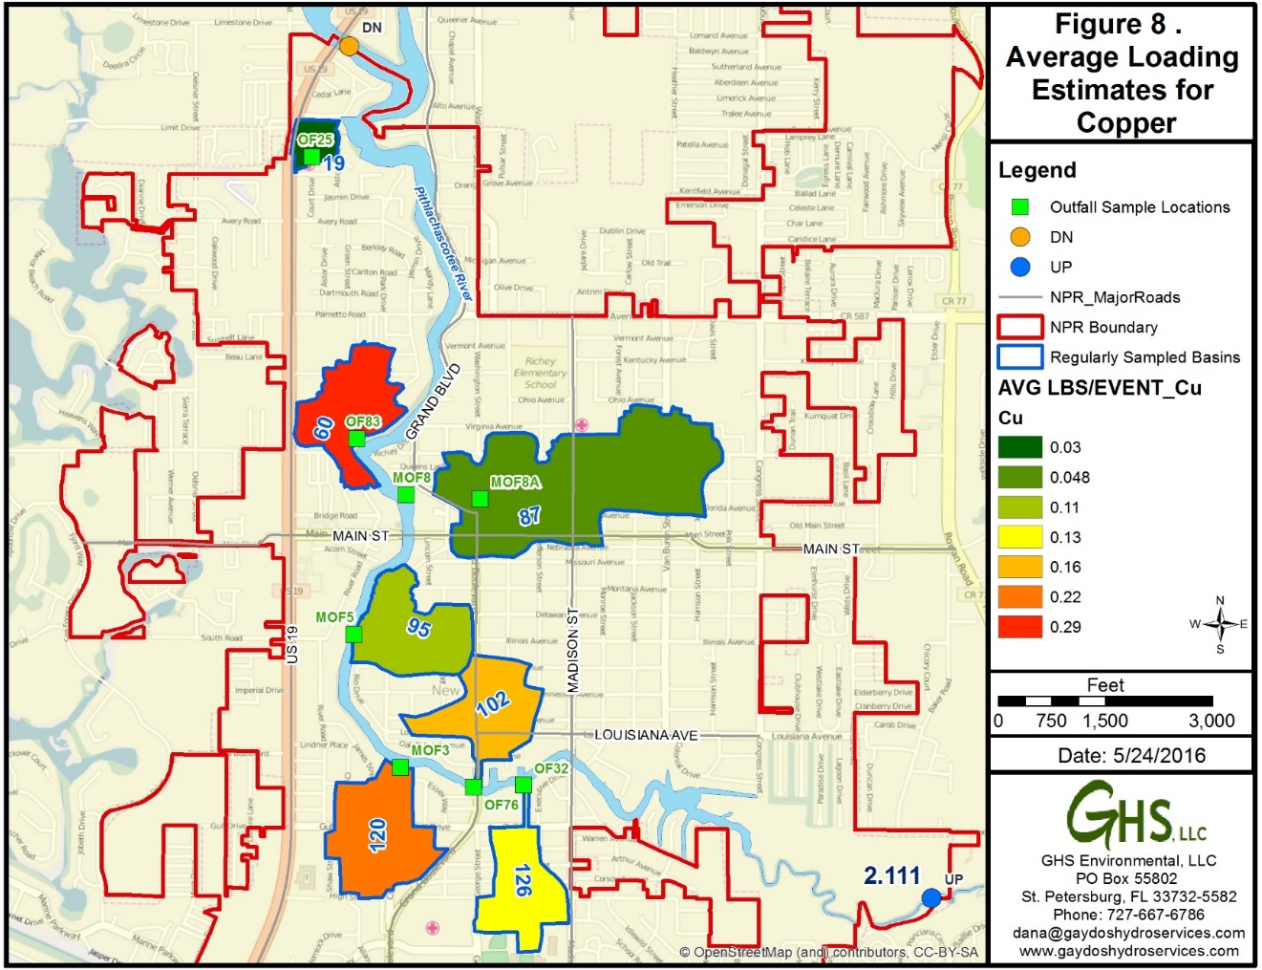
Copper
Main Source:
Gasoline Combustion
Vehicle brake pads
Architectural copper
Algaecides
Other Sources:
Roof top materials
Marine anti-fouling agents
Vehicle service & cleaning products
Wood preservatives
Exceeded the Class III Standard

Slide 8
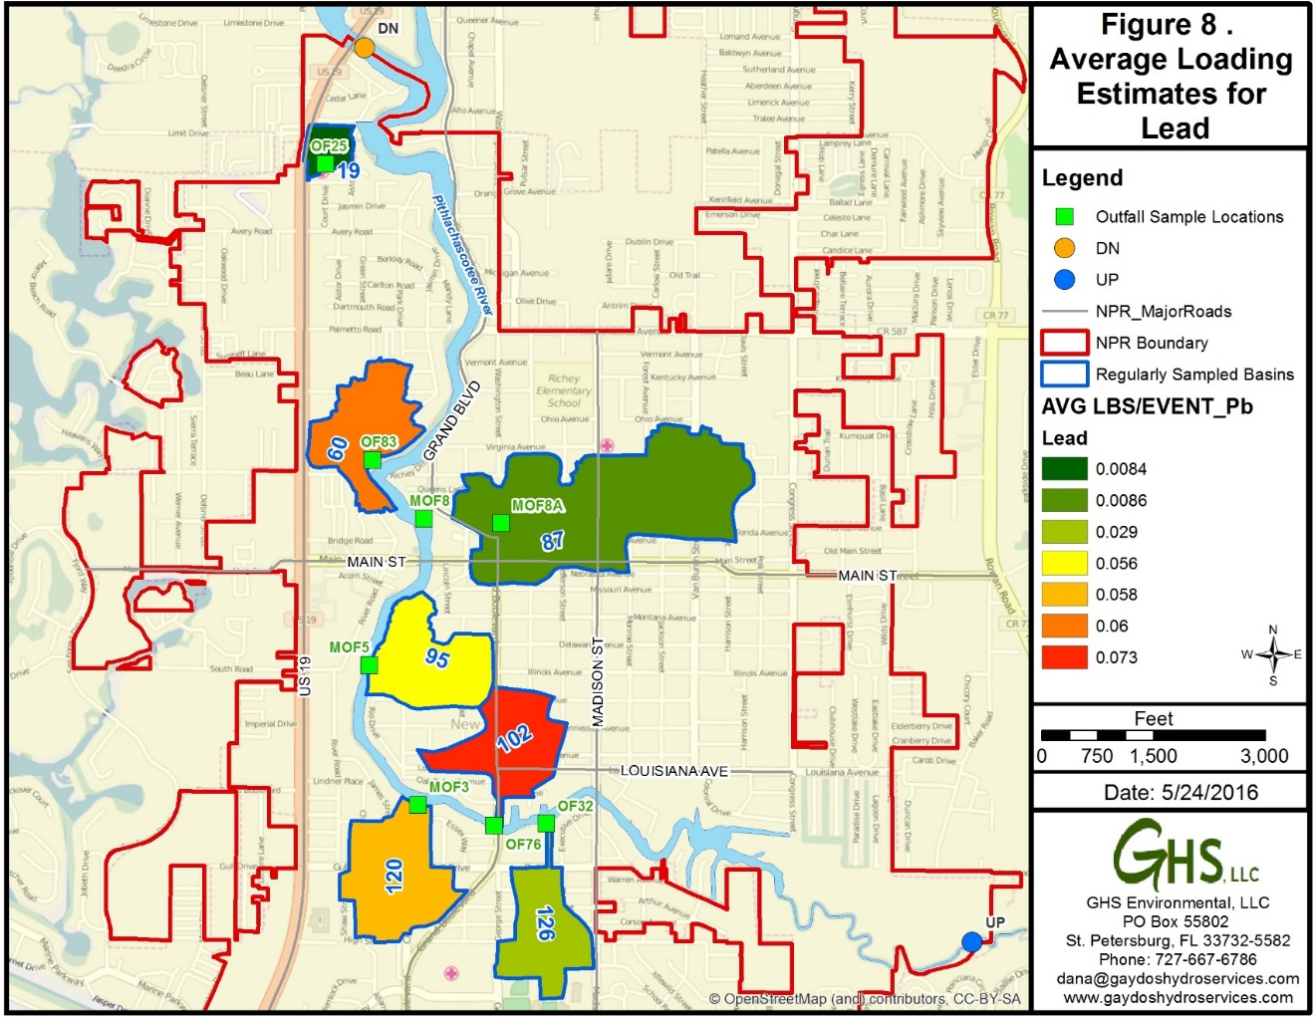
Lead
Main Source:
Gasoline Combustion (former additive)
Contaminated Soils
Paint

Slide 9
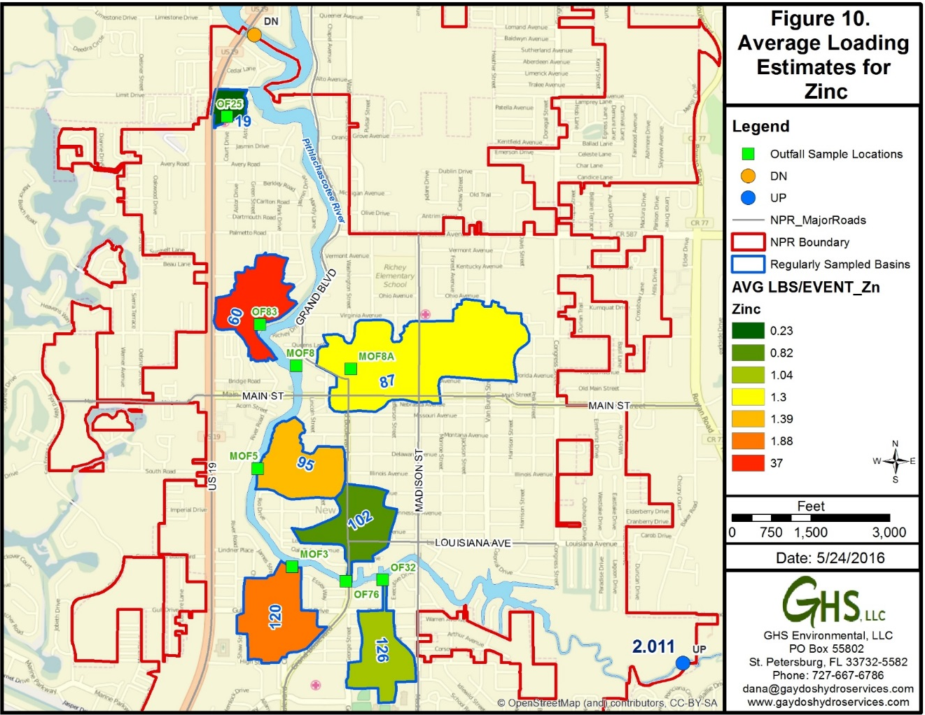
Zinc
Main Source:
Galvanized metal surfaces
Roof Gutters
Motor oil & Hydraulic fluid
Tire wear
Brake pad dust
Other Sources:
Fertilizers & pesticides
Paints
Wood preservatives
Exceeded the Class III Standard

Slide 10
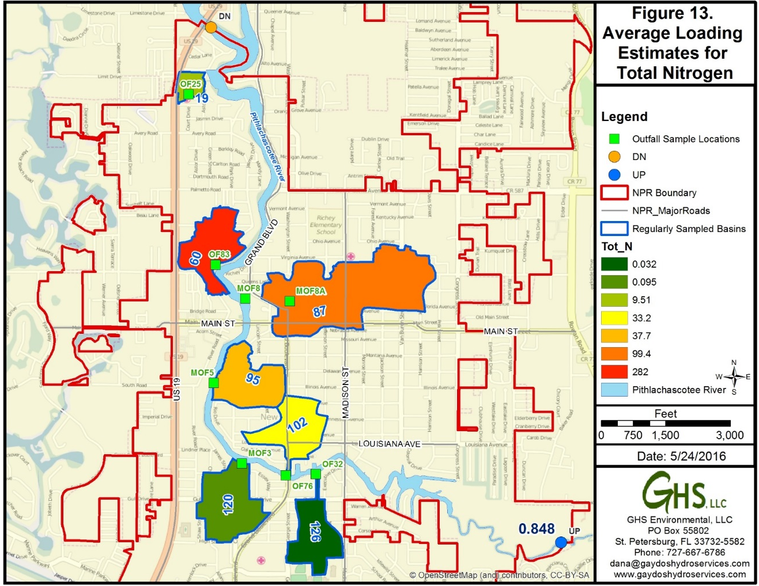
Nitrogen
Nitrogen Species:
Ammonia
Nitrate
Nitrite
Sources:
Pet & Animal Waste
Fertilizers
Failed Septic Systems
Atmospheric deposition
Exceeded the NNC

Slide 11
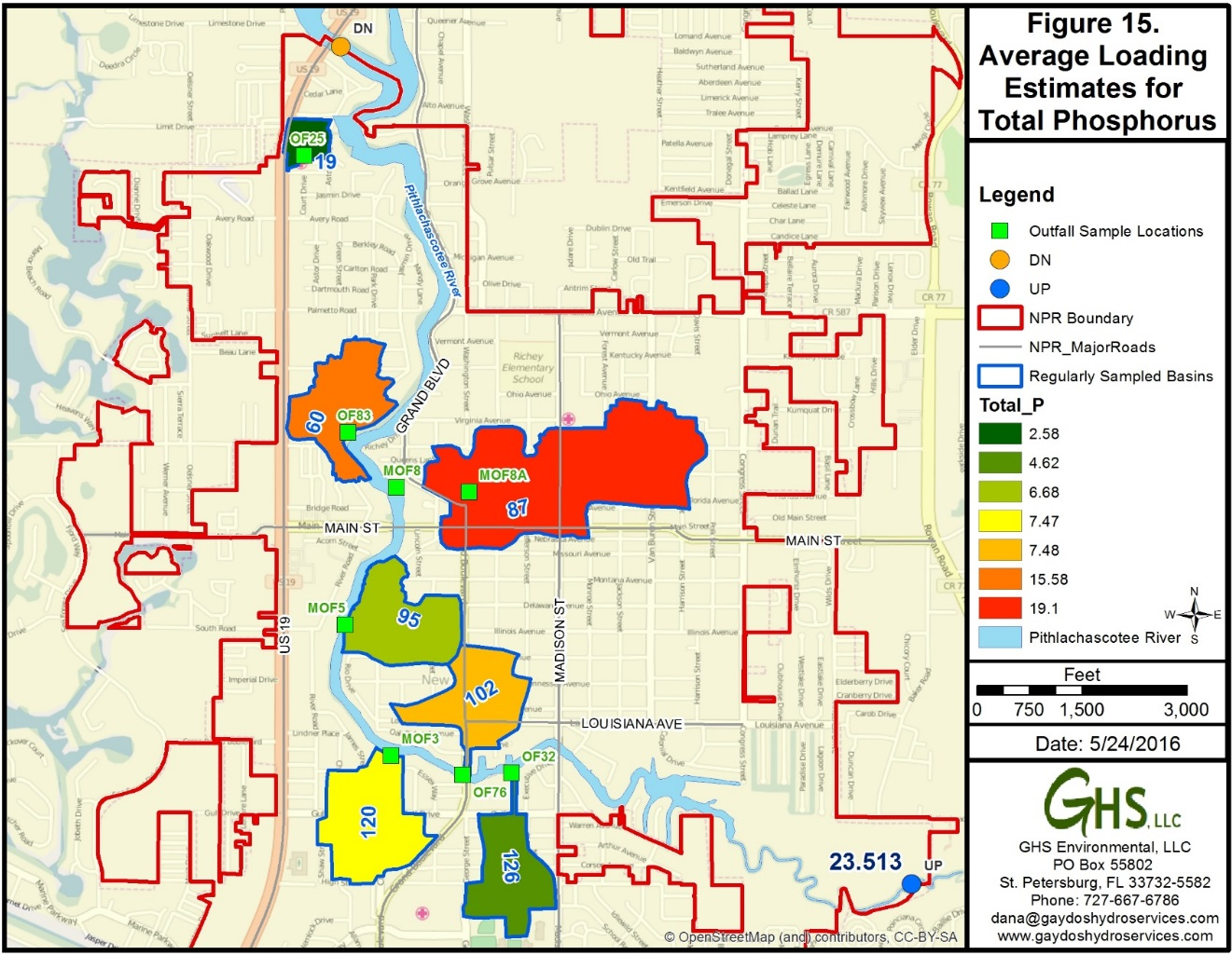
Phosphorus
Phosphorus Species:
Orthophosphate
Total Phosphorus
Sources:
Fertilizers
Vegetation decomposition
Gas combustion

Slide 12
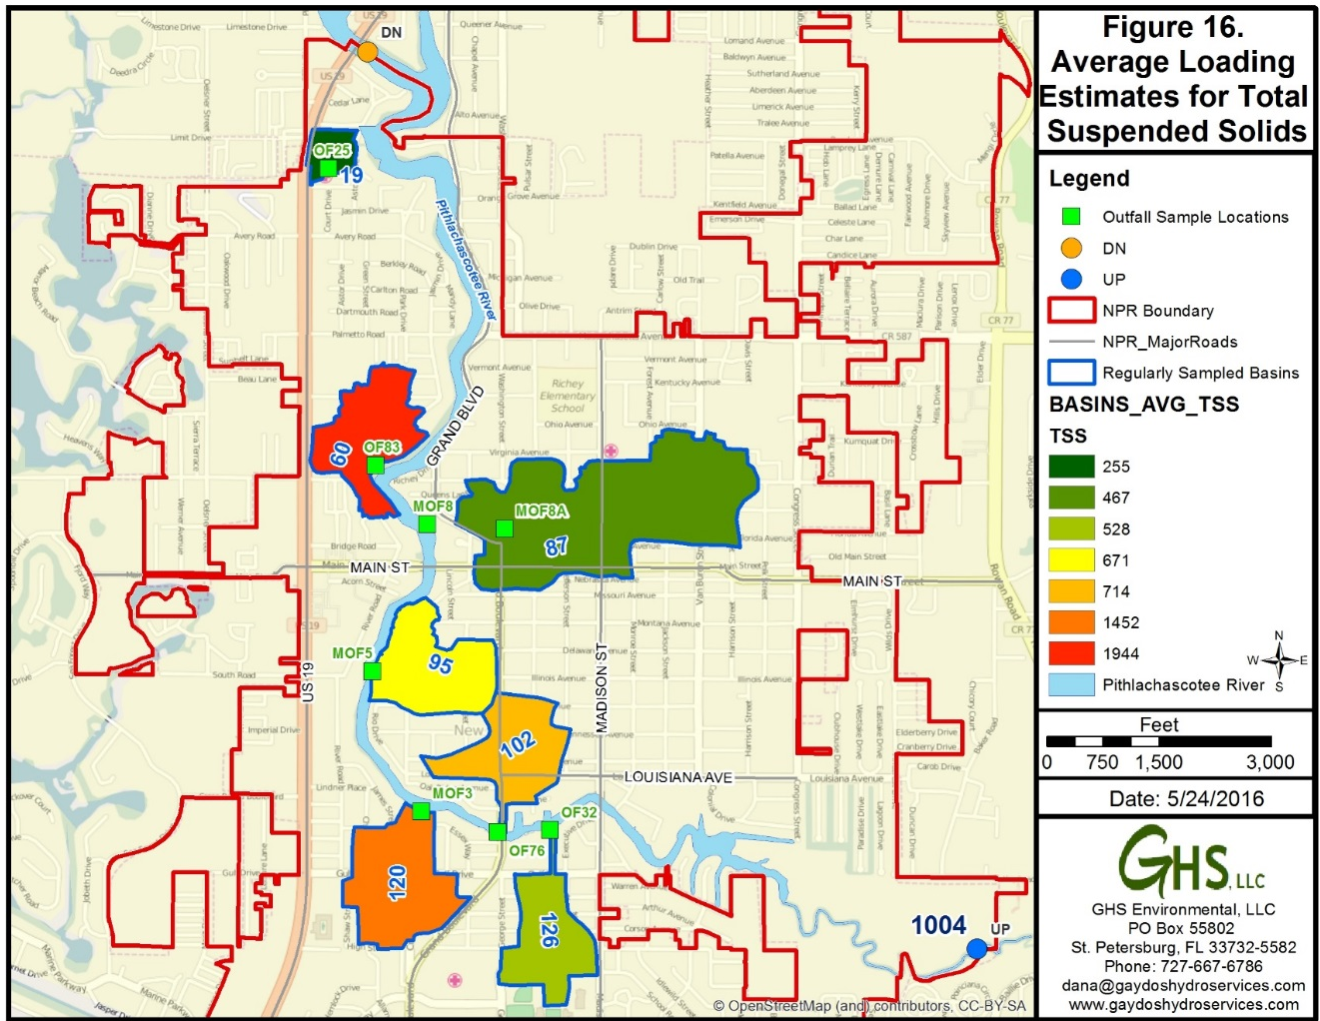
TSS
Total Suspended Solids:
All solid material flushed from roadways and paved areas, eroded land areas, and organic debris into the stormwater system
Sources:
Erosion of
pavement and soils
Pedestrian litter
Gas combustion
Construction materials
Road paint
Vegetative litter

Slide 13
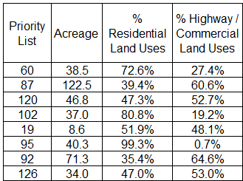
BMP Development Table

Slide 14
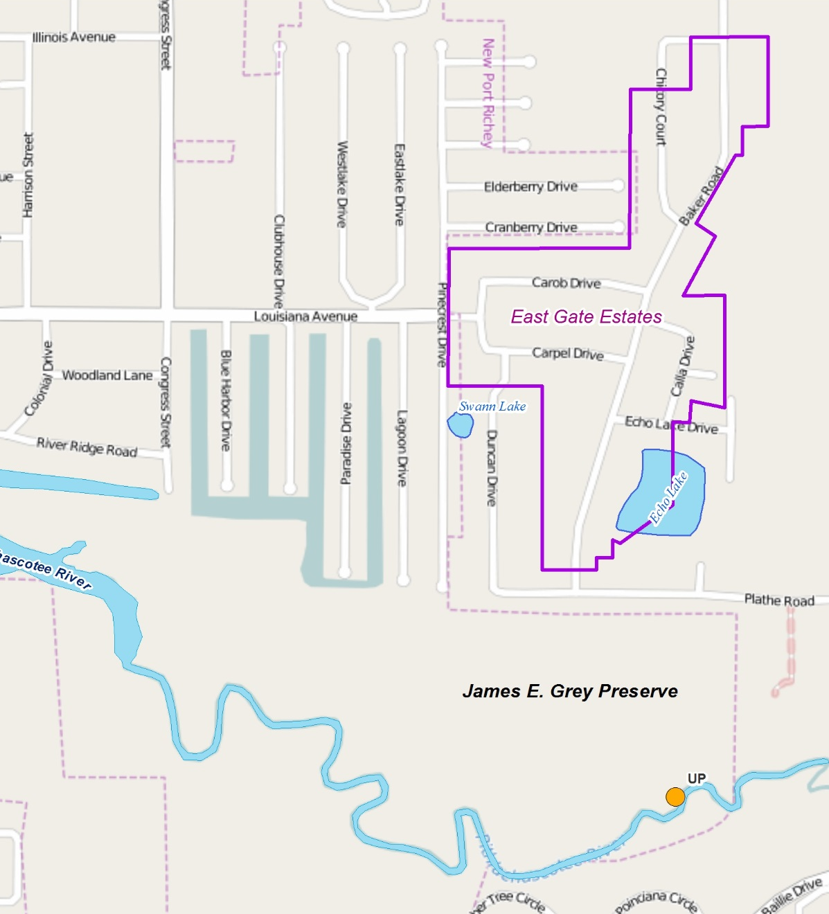
East Gate Estates
Echo Lake = 84 ng/l
Swan Lake = 150 ng/l

