Slide 1
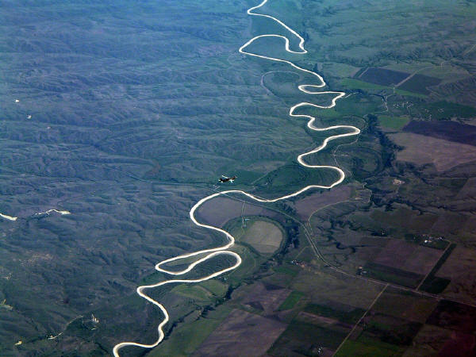

Slide 3
I've known rivers:
I've known rivers ancient as the world
and older than the flow
of human blood in human veins.
My soul has grown deep like the rivers.
I bathed in the Euphrates when dawns were young.
I built my hut near the Congo and it lulled me to sleep.
I looked upon the Nile and raised the pyramids above it.
I heard the singing of the Mississippi
when Abe Lincoln went down to New Orleans,
and I've seen its muddy bosom turn all golden in the sunset.
I've known rivers:
Ancient, dusky rivers.
My soul has grown deep like the rivers.

Slide 4
THE NEGRO SPEAKS OF RIVERS by Langston Hughes
ALL: I've known rivers:
GIRLS: I've known rivers ancient as the world
and older than the flow of human blood in human veins.
ALL: My soul has grown deep like the rivers.
Solo 1: I bathed in the Euphrates when dawns were young.
Solo 2: I built my hut near the Congo and it lulled me to sleep.
Solo 3: I looked upon the Nile and raised the pyramids above it. t
Solo 4: I heard the singing of the Mississippi
when Abe Lincoln went down to New Orleans,
Solo 5: and I've seen its muddy bosom turn all golden in the sunset.
ALL: I've known rivers:
BOYS: Ancient, dusky rivers.
ALL: My soul has grown deep like the rivers.

Slide 5
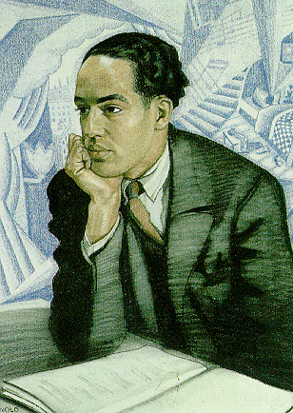
What do you think?
Did Langston Hughes
ever question
whether he
could be a poet?
HE DID!
On that train ride to Mexico in 1920 and on his first attempt at college, he chose engineering rather than writing.
Langston Hughes
1902—1967

Slide 6
I Speak of …
I've known
I've known
My
I
I
I
I
and I've
I've known
I've known
?

Slide 8
