Slide 1
In light of recent events, I've created a short presentation explaining how to download your government records (SF50, SF51, Awards, etc.) from eOPF and transfer them to your personal computer using DoD Safe.
For smaller files, you can try emailing them directly to your personal account. However, using DoD Safe is recommended for larger files.

Slide 2
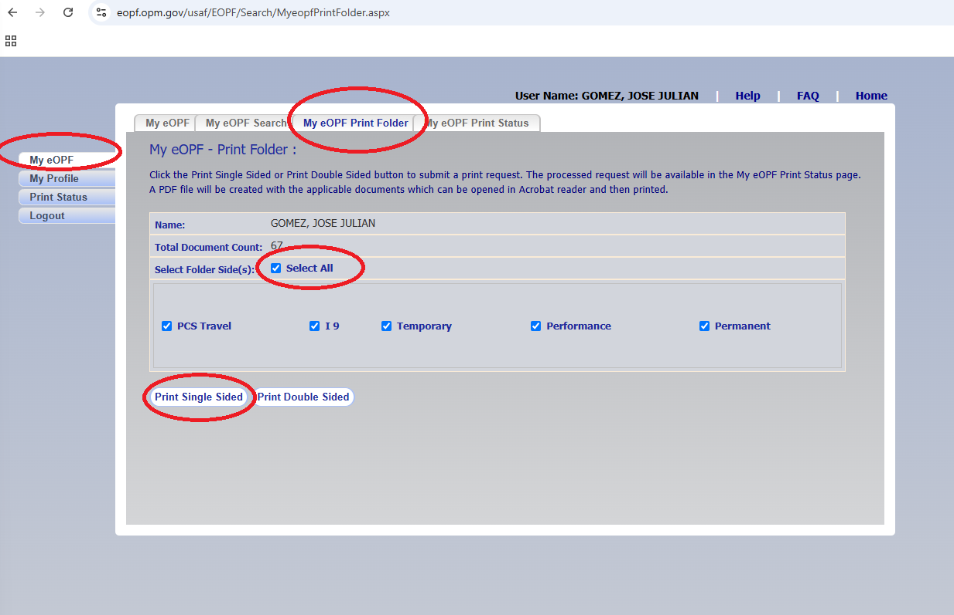
Go to https://eopf.opm.gov/usaf/
Click the first option in the left menu: My eOPF
Click the third option in the action menu: My eOPF Print Folder
Select all
Choose single sided

Slide 3
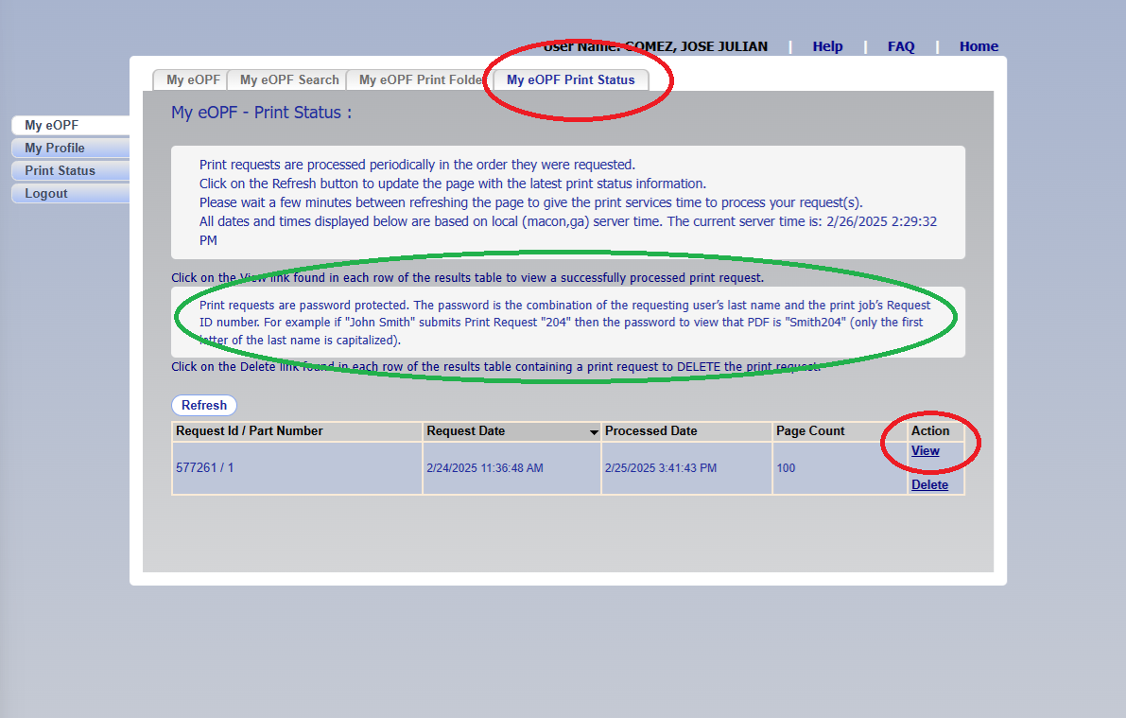
This process will complete your request, and you will be put in a waiting line to download your records, it could take up to 48 hours. Once the request is completed, you will received instructions to download it Go to the fourth option in the action menu: My eOPF Print Status

Slide 4
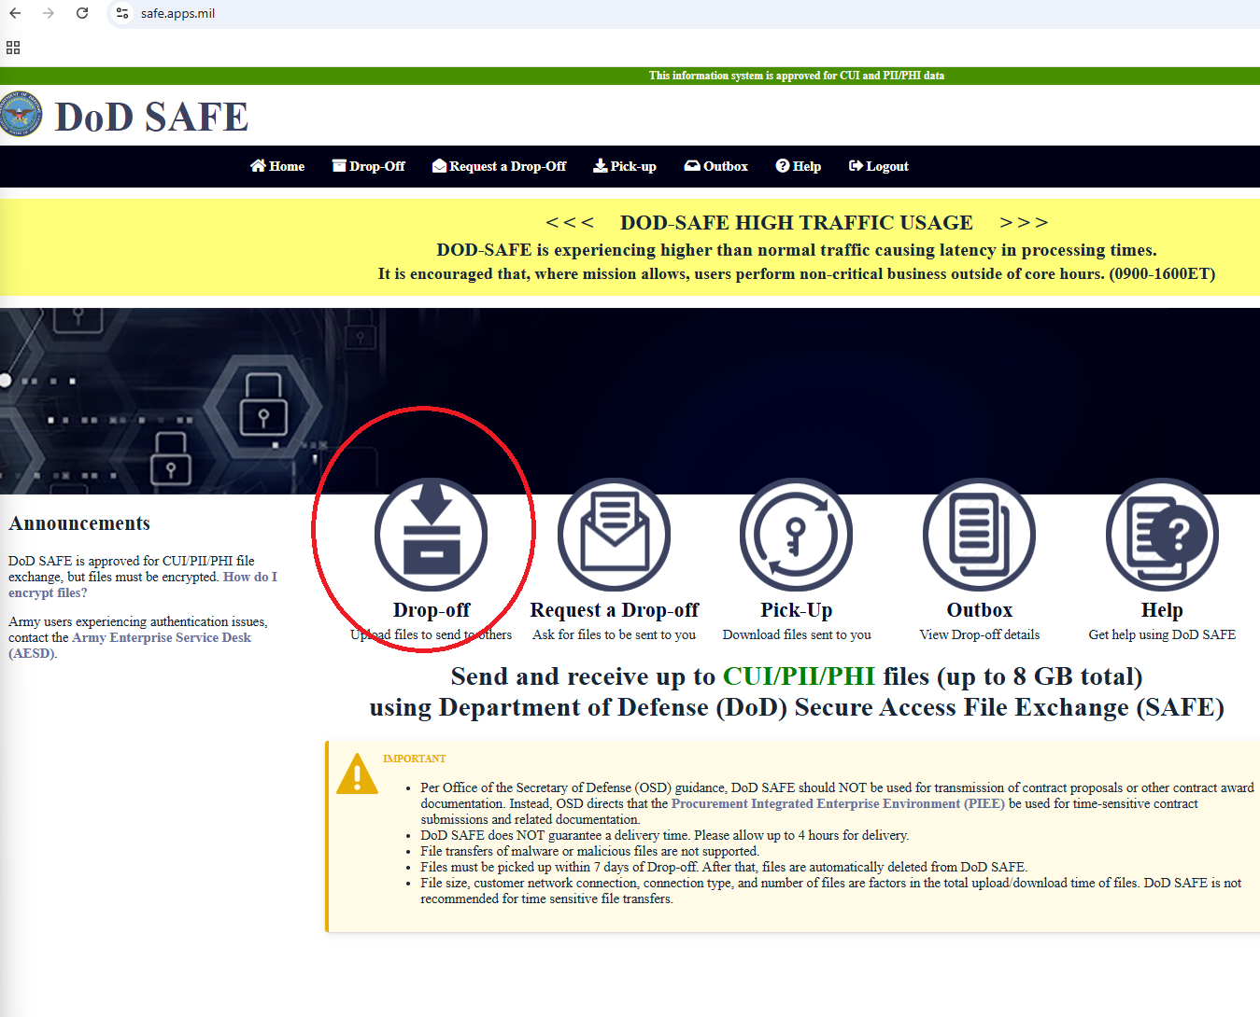
The file will be encrypted. Don’t forget to save your password. My best advice is to rename the file with your password. The instructions are in the green oval. (see previous screenshot)
With your files in your government laptop, the next is to transfer it to your personal computer.
For smaller files, you could send it to yourself to your personal email. However, for bigger files (those of you will 20+ years of federal service), you will use DoD Safe.
Go to https://safe.apps.mil/ and click the option Drop-Off

Slide 5
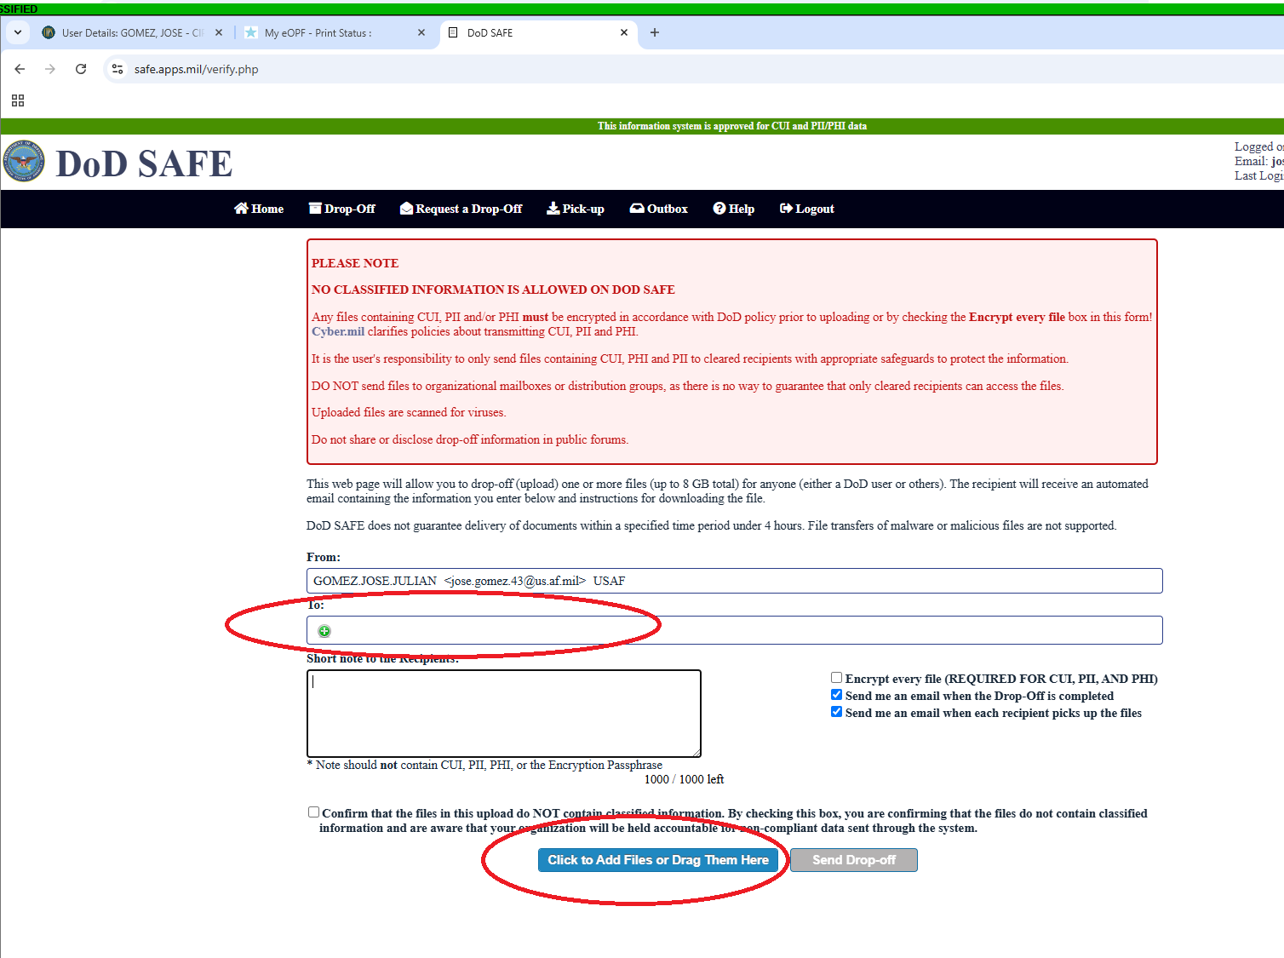
Follow the instructions to add your personal email and upload the files.

Slide 6
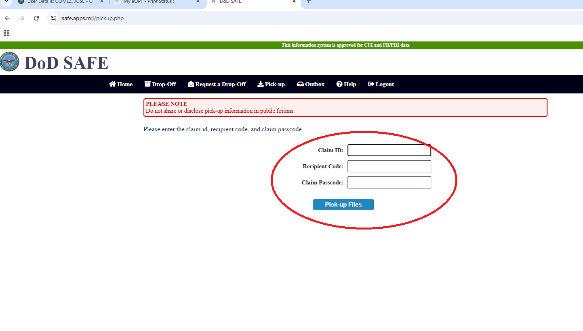
You will receive a notification to both your personal and government email with the claim ID, recipient code and claim password.
Go to your personal computer and log in again to https://safe.apps.mil/
Click the Pick -Up option and enter the information

