Slide 1
STATISTICS IN GEOGRAPHY
STANDARD DEVIATION

Slide 2
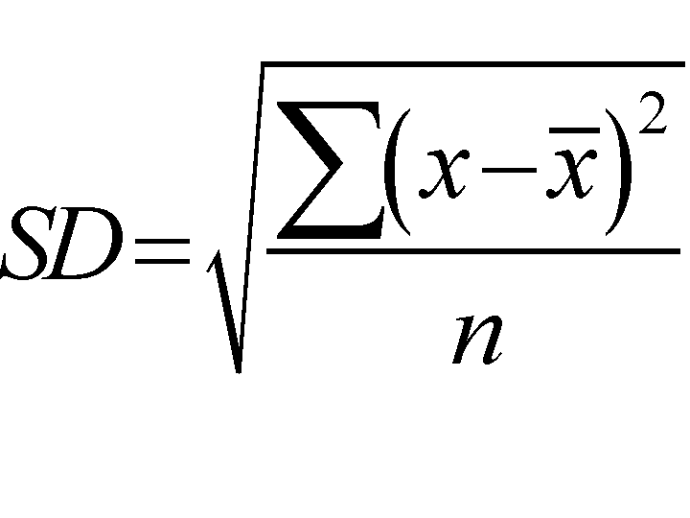
When data has been collected in a geographical investigation we need to describe it using simple statistical values. This is particularly useful if you have two or more sets of data and want to compare them.
The mean or average will tell you about the middle of the data but we sometimes need to see how the data is spread about the mean and for this we use the STANADARD DEVIATION

Slide 3
Imagine we collected a random bedload sample of 10 from 2 sites along a river, A and B. We measured the long axis of each in mm and the values were as below:-
SITE A
6
10
15
20
18
33
5
4
25
24
SITE B
8
6
9
5
2
4
3
11
12
10
The standard deviation will tell us how much the data spreads around the mean or how well sorted the data is. Which looks to be better sorted, and which sample do you think is taken from further downstream?

Slide 4
Let’s do the standard deviation for sample A :-
Bedload size mm | x - x̄ | (x - x̄ )²
6 | -10 | 100
10 | -6 | 36
15 | -1 | 1
20 | 4 | 16
18 | 2 | 4
33 | 17 | 289
5 | -11 | 121
4 | -12 | 144
25 | 9 | 81
24 | 8 | 64
x̄ = 16 |  | ∑ = 856
Now let’s apply the formula

Slide 5
∑ (x - x̄ )² = 856
∑ (x - x̄ )² = 85.6
n
Now square root of 85.6 = 9.25
The standard deviation Ϭ = 9.25

Slide 6
Let’s do the standard deviation for sample B :-
Bedload size mm | x - x̄ | (x - x̄ )²
8 | 1 | 1
6 | -1 | 1
19 | 2 | 4
5 | -2 | 4
2 | -5 | 25
4 | -3 | 9
3 | -4 | 16
11 | 4 | 16
12 | 5 | 25
10 | 3 | 9
x̄ = 7 |  | ∑ = 110
Now let’s apply the formula

Slide 7
∑ (x - x̄ )² = 110
∑ (x - x̄ )² = 11
n
Now square root of 11 = 3.32
The standard deviation Ϭ = 3.32

Slide 8
So sample A had a standard deviation of 9.25 showing that the values spread quite widely around the mean and the bedload was not well sorted (poorly sorted) there.
At sample B the standard deviation was much smaller at 3.32 showing that the spread around the mean was far less and the bedload was well sorted.

Slide 9
If the bedload sizes are normally distributed, and we can assume that for the thousands of pebbles at each river site then:-
68% of them will have sizes of mean + or – 1 standard deviation
95% will be + or – 2 standard deviations
99% will be + or – 3 standard deviations

