Slide 1
Challenges in the Intensive Care:
Management of
Pain, Agitation and Delirium
This slide set has been prepared by Orion Pharma

Slide 2
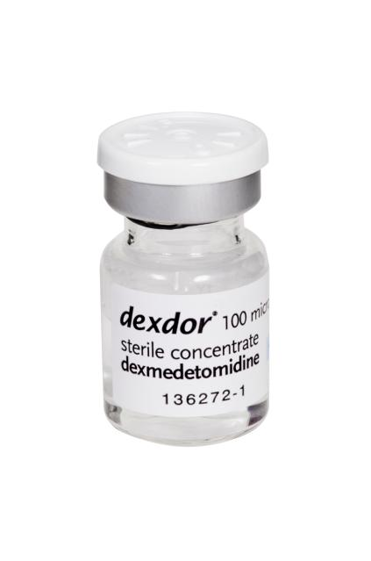
Dexmedetomidine
Dexmedetomidine: A selective alpha-2-receptor agonist
Indication: For sedation of adult ICU patients requiring a sedation level not deeper than arousal in response to verbal stimulation (corresponding to RASS score 0 to -3)
Presentation:
ampoule of 2 ml
vials of 4ml and 10 ml
each containing dexmedetomidine 100 mcg/ml concentrate

Slide 3
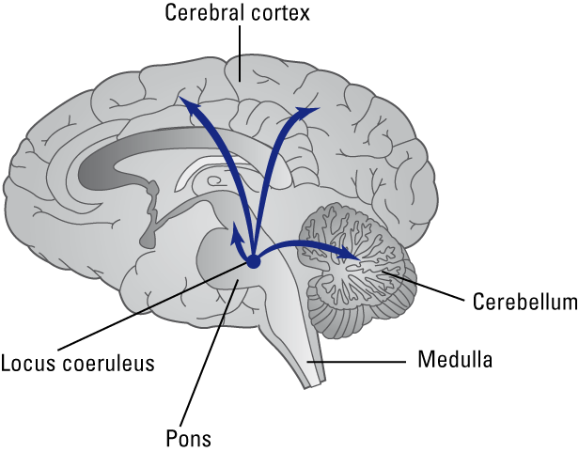
Mechanism of dexmedetomidine-induced sedation
Stimulation of α _{2A}- adrenoceptors in locus coeruleus in the brainstem
Decreased release of Noradrenaline in sympathetic nerve endings
Sedation

Slide 4
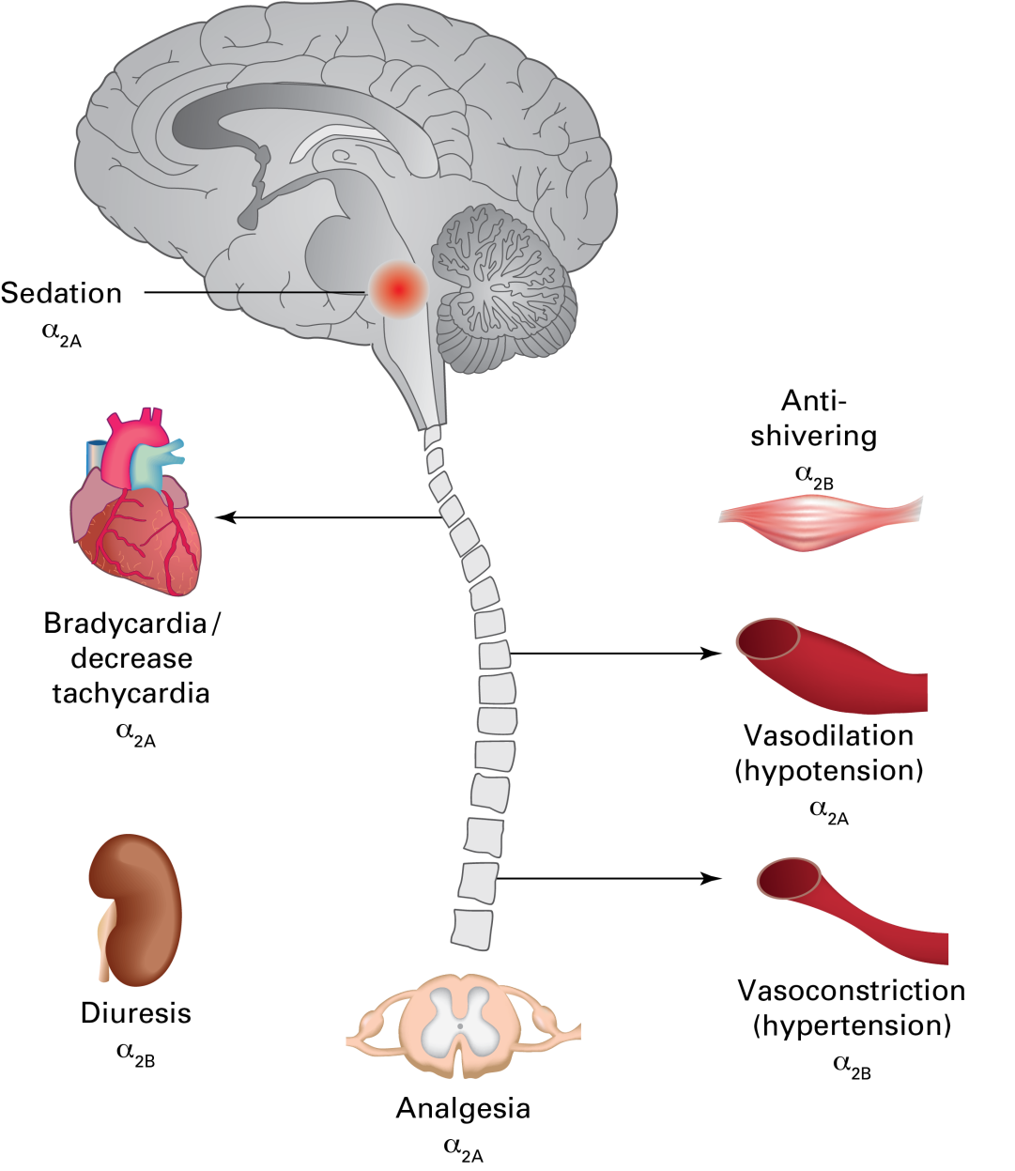
Pharmacology of dexmedetomidine
CNS¹
Sedation
Anxiolysis
Analgesia (at spinal level)
Resembles NREM sleep²
Cardiovascular system¹
Blood pressure (BP) and heart rate ↓
(central effect)
BP↑ at high doses
(peripheral vasoconstriction)
Cardiac output and oxygen need ↓
Other¹
Diuresis ↑
Salivation ↓
Intraocular pressure ↓
Shivering threshold temperature ↓
Insulin secretion ↓
Secretory and motor function of gut ↓
European Public Assessment report (EPAR) 2. Huupponen E et al. Acta Anaesthesiol Scand. 2008;52:289-94

Slide 5
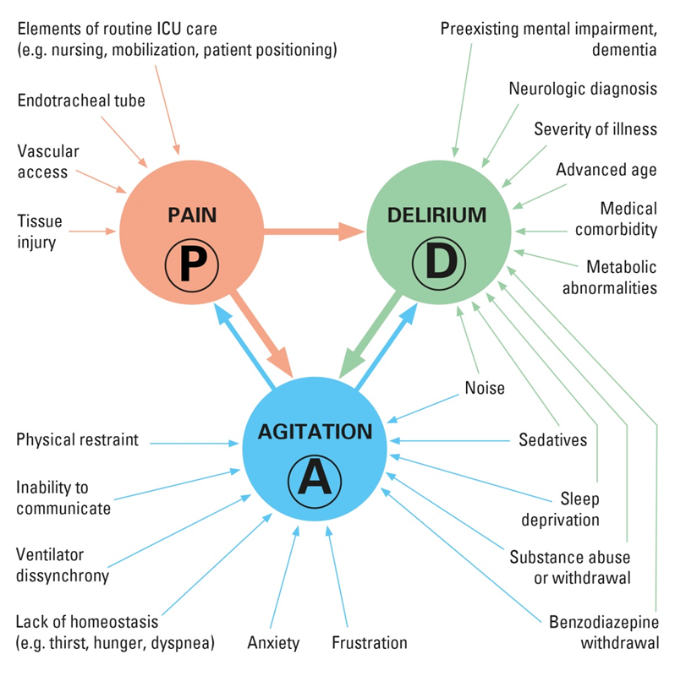
Challenges in the intensive care
Pain, agitation and delirium are major stress factors for ICU patients¹
Adapted from Reade MC et al. N Engl J Med. 2014;370(5):444-54

Slide 6
Dexmedetomidine helps to improve communication and management of pain
Pain
Ability to communicate pain, arousability and cooperatives of ICU patients¹
Dexmedetomidine (N = 251)
Propofol (N = 247)
Dexmedetomidine (N = 249)
Midazolam (N = 251)
P < 0.001
P < 0.001
Adjusted mean VAS* score 1-100 points
*Visual Analogue Scale (VAS). The VAS score represents the nurse‘s subjective estimate on the measured endpoint, ( e.g. arousability or pain) on a scale of 1-100. The nurse instructions for the VAS score define the endpoints as follows: arousability as the ease at which the patient awakens from, or as if from sleep; communication as the patient‘s capacity to communicate pain and the need (or not) for additional analgesia (but does not measure pain itself); cooperativeness as an assessment of how well the patient assists the nurse, (e.g. moves upon request).
Jakob SM et al. JAMA. 2012; 307(11): 1151-60

Slide 7
Dexmedetomidine facilitates management of agitation: under light sedation patients are responsive, aware and able to follow commands
Agitation
dexdor® can assist in the achievement and maintenance of Rass 0 to -1¹
Patients in light sedation (mean RASS 0 to -1) during MIDEX and PRODEX
Dexmedetomidine (N = 247)
Midazolam (N = 250)
Dexmedetomidine (N = 246)
Propofol (N = 247)
P<0.001
P<0.001
% of patients
Jakob SM et al. JAMA. 2012; 307(11): 1151-60

Slide 8
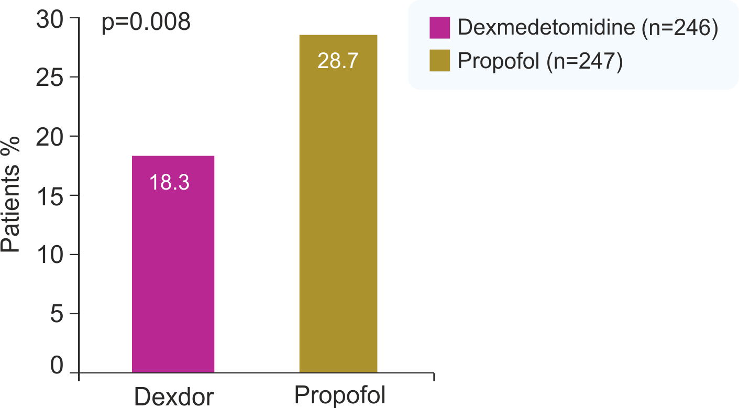
Fewer ICU patients sedated with dexmedetomidine experienced delirium or related adverse events than ICU patients who received propofol¹
% patients who experienced delirium
Jakob SM et al. JAMA. 2012; 307(11): 1151-60

Slide 9
Dexmedetomidine improves cognitive function compared to propofol
Delirium
Dexmedetomidine may possess neuroprotective properties^{1,2}
Cognitive function has been shown to improve in ICU patients receiving dexmedetomidine for sedation whereas it worsened when patients received propofol³
Dexmedetomidine
Propofol
P < 0.001
Adapted Cognitive Exam (ACE) is a 100-point scale test designed for assessing cognition in ICU patients that are both intubated and non-intubated. The exam assesses cognition through orientation, language, registration, attention, calculation, and recall. No verbal communication is required from patients who are able to signal responses in a yes/no format through multiple-choice questions and simple motor tasks. ANIST was a randomized, double-blind, cross-over trial in 30 critically ill intubated patients.
Mean change in adjusted ACE scores*
Ma D et al. Eur J Pharmacol. 2004;502:87-97 2. Sanders RD et al. Acta Anaesthesiol Scand. 2010;54:710-6 3. Mirski MA et al. Intensive Care Med. 2010 Sep; 36: 1505-13

Slide 10
What to expect from dexdor®
A calm comfortable patient who can be easily aroused
Improved co-operation and communication compared with other sedatives¹
Cardiovascular effects:
Bradycardia – this does not normally require treatment, but has commonly responded to anti-cholinergic medicine or dose reduction where needed
Hypotension – This does not normally require specific treatment but, where needed, clinicians should be ready to intervene with dose reduction, fluids and/or vasoconstrictors
Hypertension – Treatment has generally not been necessary but decreasing the continuous infusion rate may be advisable
Jakob SM et al. JAMA. 2012; 307(11): 1151-60

Slide 11
Contraindications
Hypersensitivity to the active substance or to any of the excipients
Advanced heart block (grade 2 or 3) unless paced
Uncontrolled hypotension
Acute cerebrovascular conditions

Slide 12
PRESCRIBING INFORMATION
Dexdor 100 micrograms per ml concentrate for solution for infusion (dexmedetomidine) Prescribing Information
Indication: Sedation of adult ICU patients requiring sedation level not deeper than arousal in response to verbal stimulation (RASS 0 to -3). Dosage and administration: Hospital use only, by healthcare professionals skilled in management of patients requiring intensive care. Administer only as diluted intravenous infusion using controlled infusion device. Dexmedetomidine is very potent and the infusion rate is given per hour. Switch patients already intubated and sedated to dexmedetomidine with initial infusion rate of 0.7 micrograms/kg/h and adjust stepwise within range 0.2 to 1.4 micrograms/kg/h to achieve desired sedation level. Consider lower starting infusion rate for frail patients. After dose adjustment, new steady state sedation level may not be reached for up to one hour. Do not exceed maximum dose of 1.4 micrograms/kg/h. Switch patients failing to achieve an adequate level of sedation with maximum dose to an alternative sedative agent. Loading dose not recommended. Administer propofol or midazolam if needed until clinical effects of dexmedetomidine established. No experience in use of Dexdor for more than 14 days. Use for longer than this period should be regularly reassessed. Elderly: No dosage adjustment required. Renal impairment: No dosage adjustment required. Hepatic impairment: Caution advised; consider reduced dose. Paediatric population: Safety and efficacy have not been established. No recommendation can be made. Contraindications: Hypersensitivity. Advanced heart block (grade 2 or 3) unless paced. Uncontrolled hypotension. Acute cerebrovascular conditions. Pregnancy. Warnings and precautions: Intended for use in intensive care setting, use in other environments not recommended. Continuous cardiac monitoring required. Monitor respiration in non-intubated patients. Do not use as induction agent for intubation or to provide sedation during muscle relaxant use. Dexmedetomidine reduces heart rate and blood pressure but at higher concentrations causes peripheral vasoconstriction and hypertension. Not suitable in patients who will not tolerate lack of deep sedation and easy rousability. Users should be ready to use alternative sedative for acute control of agitation or during procedures, especially during the first few hours of treatment. Caution with: pre-existing bradycardia; high physical fitness and slow resting heart rate; pre-existing hypotension, hypovolaemia, chronic hypotension or reduced functional reserve; severe ventricular dysfunction; the elderly; impaired peripheral autonomic activity (e.g. due to spinal cord injury); ischaemic heart disease or severe cerebrovascular disease; severe hepatic impairment; severe neurological disorders such as head injury and after neurosurgery. Reduce dose or discontinue if signs of myocardial or cerebral ischaemia. Additive effects may occur with other substances with sedative or cardiovascular actions. Some patients receiving dexmedetomidine have been observed to be arousable and alert when stimulated; this alone should not be considered as evidence of lack of efficacy. Do not use as sole treatment in status epilepticus. Consider possibility of withdrawal reaction if patient develops agitation and hypertension shortly after stopping dexmedetomidine. Not recommended in malignant hyperthermia-sensitive individuals. Discontinue treatment in event of sustained unexplained fever. Undesirable effects: Very common (>1/10): Bradycardia, hypotension, hypertension. Common (1>100 to <1/10): Hyperglycaemia, hypoglycaemia, agitation, myocardial ischaemia or infarction, tachycardia, respiratory depression, nausea, vomiting, dry mouth, withdrawal syndrome, hyperthermia. Uncommon (1>1,000 to <1/100): Metabolic acidosis, hypoalbuminaemia, hallucination, atrioventricular block first degree, cardiac output decreased, dyspnoea, apnoea, abdominal distension, drug ineffective, thirst. See SPC for further details. Legal category: POM. Presentations, basic NHS costs and marketing authorization numbers: Dexdor 2 ml ampoule x 5, £78.30, EU/1/11/718/001; EU/1/11/718/002; Dexdor 4 ml vial x 4, £125.28, EU/1/11/718/004; Dexdor 10ml vial x 4, £313.20, EU/1/11/718/006. Distributed by: Orion Pharma (UK) Ltd. Oaklea Court, 22 Park Street, Newbury, Berkshire, RG14 1EA, UK. Full prescribing information is available on request. Dexdor is a registered trademark. Date of Prescribing Information: September 2016.
Adverse events should be reported. Reporting forms and information can be found at www.mhra.gov.uk/yellowcard. Adverse events should also be reported to Orion Pharma (UK) Ltd on 01635 520300.
Item date March 2017 DEX4699b(1)a(2)

