Slide 1
Angelic Powers
Craig Vincent Mitchell
Assistant Professor of Christian Ethics
Southwestern Baptist Theological Seminary

Slide 2
Angelic Powers
They are personal, powerful, and spiritual beings
They influence events on earth, especially events within nature.
Both Jews and Greeks believed in angelic powers
Scripture always identifies angels as male
Demons are fallen angels

Slide 3
Angelic Powers and Creation
Angelic Powers were created to be the guardians of the created order
Angelic Powers are the framework of the created order
Angelic Powers protect the created order from chaos
Angelic Powers protect both the natural order and the social order

Slide 4
Angelic Powers and Creation 2 Enoch 19:4-5
This gives a description of the various types of angels
Angels who are appointed over seasons and years, the angels who are over rivers and sea, and who are over the fruits of the earth, and the angels who are over every grass, giving food to all, to every living thing, and angels who write all the souls of men, and all their deeds and all their lives before the Lord’s face.

Slide 5
Angelic Powers and Creation Book of the Jubilees 4:15
Angelic Powers (watchers) are supposed to instruct men in justice and righteousness
They influence morality, politics, and economics
They also influence class, social struggle, public opinion and ideas of decency

Slide 6
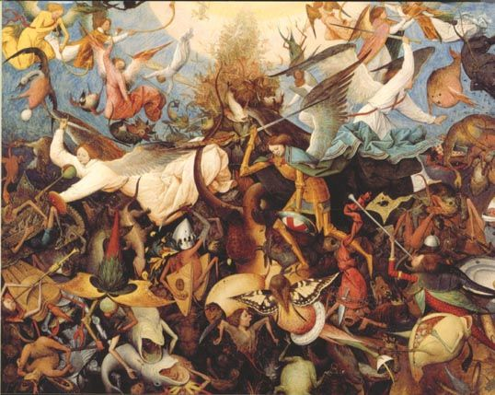
Angels in the Fall

Slide 7
Angelic Powers and the Fall
1 Enoch explains that a fallen angel known as Satan (accuser) led a group of angels known as “satans.”
1 Enoch 69:6 explains that a satanic messenger named Gader’ el tempted Eve in the garden of Eden.
Other angels include: Asmodeus, Shemihaza (Semyaza), Azazel, Mastema, Beliar, Satan, Sammael, and Satanail

Slide 8
Angelic Powers and the Fall 1 Enoch 6-11
The rebellious chief angel Shemihaza (or Semyaza) led other “sons of God” into cohabitating with human women and producing half angel/human children who were giants.
1 Enoch 6-36 tells the story of 200 angels led by Shemihaza (Semyaz), who engaged in sexual activity with human women.
These 200 were divided into groups of 10 with a prince over each group
These princes include Arakeb, Rame’ el and
Tam’ el

Slide 9
Angelic Powers and the Fall 1 Enoch 15: 8-12
But now the giants who are born from the union of the spirits and the flesh called evil spirits upon the earth, because their dwelling shall be upon the earth and inside the earth. Evil spirits have come out of their bodies… The spirits of the giants oppress each other; they will corrupt, fall, be excited, and fall upon the earth, and cause sorrow. They eat no food, nor become thirsty, nor find obstacles. And these spirits will rise up against the children of the people and against the women, because they have proceeded forth from them.

Slide 10
Angelic Powers in the Fall
Fallen angelic powers lead people into sexual promiscuity, jealousy, idolatry and strife
1 Enoch 8:1 explains that Azazel, taught mankind to make metal and weapons like swords, knives, shields, and breastplates
Jubilees 11:4-5 explains that Mastema led the Chaldeans into idolatry
1 Enoch 19:1 relates how the spirits of angels led the people into sacrificing to demons
1 Enoch 7-8 and Jubilees 11:1-8 fallen angels taught people magic, astrology and alchemy
Testaments of the Twelve Patriarchs tells of how Beliar (the devil) deceives people

Slide 11
Angelic Powers and the Fall Genesis 6
The “sons of God” took the daughters of men for wives.
Their offspring were giants
This is why God sent a worldwide flood
Jude 6 says that these rebellious angels are bound in everlasting chains under darkness for the judgment
Rabbinic literature affirms this supernatural interpretation of this scripture

Slide 12
Angelic Powers and the Fall Genesis 19
Genesis 19 tells us about Sodom and Gomorrah
The citizens of these cities wanted to have sexual relations with angelic beings
Jude 7 compares this to Genesis 6

Slide 13
Paul, the Apostle
He refers to angelic beings primarily as “powers” (exousia). Romans 8:38, 1 Corinthians 15:24-26, Ephesians 1:20, Ephesians 2:1, Ephesians 3:10, Ephesians 6:12, Colossians 1:16, Colossians 2:15.
He also refers to them as rulers(archai), authorities (exousiai), world powers (kosmokratores), dominions, might, principalities and thrones.
He refers to some as stoichaea

Slide 14
Paul, the Apostle
Powers are super earthly realities
They are rulers of this age 1 Corinthians 2:8.
These invisible higher Powers crucified the “Lord of Glory” through human authorities.
The Powers rule over human life outside of Christ and in public opinion.
They are manifested in human traditions, in public opinions, and the doctrines of men.

Slide 15
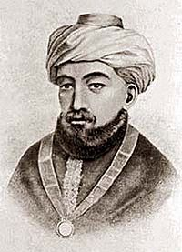
Hebrew Hierarchy of Angels
Yad ha Chazakah
Moses Maimonides
1 Chayot Ha Kodesh – living ones
2 Ophanim - wheels
3 Erelim- thones, See Isaiah 33:7
4 Hashmallim, brilliant ones See Ezekiel 1:4
5 Seraphim- burning ones, see
Isaiah 6
6 Malakhim Messengers, angels
7 Elohim "Godly beings"
8 Bene Elohim "Sons of Godly beings"
9 Cherubim- strong ones, see Talmud Hagigah 13b
10 Ishim "manlike beings", see Daniel (10:5)

Slide 16
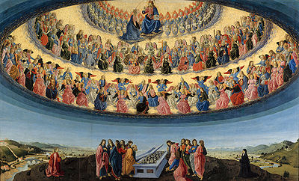
The Hierarchy of Angels
First Sphere (Old Testament sources)
Seraphim
Cherubim
Thrones/Ophanim (Greek. thronoi) (also New Testament sources)
Second Sphere (New Testament sources)
Dominions (Gr. Kyriotetai)
Virtues (Gr. Dynamai)
Powers (Gr. Exusiai)
Third Sphere
Principalities (Gr. Archai)
Archangels - Archangeloi
Angels - Angeloi

Slide 17
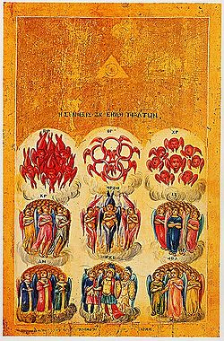
Hierarchy of Angels
The Eastern
Orthodox Church
Icon of the
Nine Orders of Angels
The Eastern Orthodox Church held to the same three orders of angels

Slide 18
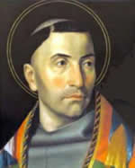
The Hierarchy of Angels
Bonaventure of Bagnoregio refers to the first order of angels as the Epiphania.
The second order of angels is the Hyperphania.
The third order is known as the Hypophania.

Slide 19
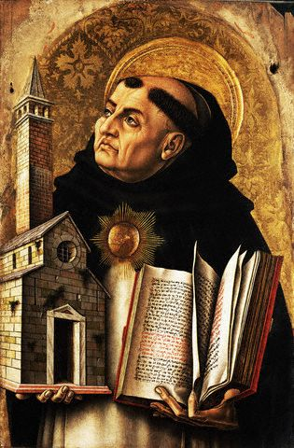
Thomas Aquinas on Angelic Powers
Aquinas wrote the Summa Theologiae
He wrote about angelic powers in volume 9: Angels, and volume 15: The World Order

Slide 20
Thomas Aquinas Summa Theologiae (Volume 15: The World Order) Question 110: How the Angels Act On Material Things
Article I. Are material things controlled by angels? Yes
Article 2. Do material things obey the will of angels? No.
Article 3. Do material things obey the angels with respect to local movement? Yes.
Article 4. Can angels work miracles? Only if God allows

Slide 21
Thomas Aquinas Summa Theologiae (Volume 15: The World Order) Question 111:How Angels Act on Men
Article 1. Can angels enlighten men? Yes.
Article 2. Can angels change man’s will? No.
Article 3. Can angels change man’s imagination? Yes.
Article 4. Can angels change man’s senses? Yes

Slide 22
Thomas Aquinas Summa Theologiae (Volume 15: The World Order) Question 112: The Angels’ Mission
Article 1. Are angels sent forth on missions? Yes.
Article 2. Are all the angels sent forth on missions? The higher angels are never sent on external ministries.
Article 3. Do the angels sent forth remain present to God? Yes.
Article 4. Are all angels of the second hierarchy sent forth? No.

Slide 23
Thomas Aquinas Summa Theologiae (Volume 15: The World Order) Question 113: The Guardianship of the Good Angels
Article 1. Are men guarded by angels? Yes.
Article 2. Is each individual guarded by a particular angel? Yes.
Article 3. Is the guardianship of men the sole task of the lowest order of angels? The guardianship of the human race is the job of the order of principalities or perhaps archangels who are called angelic princes.

Slide 24
Thomas Aquinas Summa Theologiae (Volume 15: The World Order) Question 113: The Guardianship of the Good Angels
Article 4. Are angels deputed to be guardians of all men? Guardian angels are given to each man while he is a wayfarer in this life. However, when he reaches the end of the road he will no longer have a guardian angel. Instead, he will have an angel reigning with him in the kingdom of heaven or a demon to punish him in hell.
Article 5. Is an angel appointed to look after a man right from birth? Yes.

Slide 25
Thomas Aquinas Summa Theologiae (Volume 15: The World Order) Question 113: The Guardianship of the Good Angels
Article 6. Do angel guardians ever forsake men? No.
Article 7. Do angels grieve over the ills of those they guard? The angels do not will men’s sins and punishments, but they do will that the disposition of the divine justice in accordance with which some men are subjected to punishment and are allowed to sin, should be fulfilled.
Article 8. Can there be strife or discord among the angels? All angels agree about the fulfillment of the divine decrees.

Slide 26
Thomas Aquinas Summa Theologiae (Volume 15: The World Order) Question 114: Demonic Attacks
Article 1. Are men subjected to demonic attacks? Bad angels attack men in two ways: 1. inciting them to sin. 2. punishing men in accordance with God’s will.
Article 2. Is tempting the special job of demons? Yes.
Article 3. Are all sins due to the demons’ tempting? No.

Slide 27
Thomas Aquinas Summa Theologiae (Volume 15: The World Order) Question 114: Demonic Attacks
Article 4. Can demons lead men astray? In the strict sense of miracle the demons cannot work miracles, nor can any creature do so except God alone… Demons can perform miracles which men marvel at because they go beyond their knowledge and capabilities.
Article 5. Are demons who are vanquished by men stopped from further attacks? No.

Slide 28
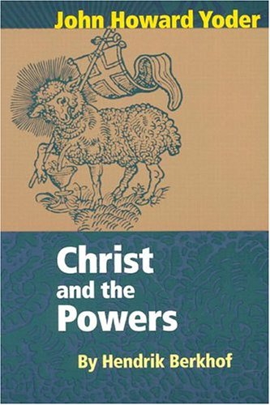
Contemporary Scholarship Hendrik Berkhof

Slide 29
Hendrik Berkhof Christ and the Powers
The Powers are no longer instruments, linkages between God’s love, as revealed in Christ, and the visible world of creation. In fact, they have become gods (Galatians 4:8), behaving as though they were the ultimate ground of being, and demanding from men an appropriate worship. This is the demonic reversal which has taken place on the invisible side of creation. No longer do the Powers bind man God Together; they separate them. They stand as a roadblock between the Creator and his creation. (page 30)

Slide 30
Hendrik Berkhof Christ and the Powers
The Powers continue to fulfill one half of their function. They still undergird human life and society and preserve them from chaos. But by holding the world together, they hold it away from God, not close to Him. They are the rulers of this age (1 Corinthians 2:6) In their desire to rule, they are in enmity toward the Lord of glory, who can only suffer them as instruments, not as Lords.

Slide 31
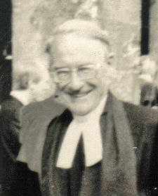
Contemporary Scholarship G. B. Caird
G. B. Caird
Principalities and Powers
The idea of sinister world powers and their subjugation by Christ is built into the very fabric of Paul’s thought, and some mention of them is found in every epistle except Philemon. ..Paul believed these powers were created beings, created in and for Christ, whether thrones, or lordships or principalities or authorities and that it was God’s purpose that they should be reconciled to him by the blood of the Cross, that angelic as well as human tongues should confess Jesus as Lord.

Slide 32
Contemporary Scholarship Oscar Cullman

Slide 33
Oscar Cullman Christ and Time
Very important for the close connection which exists on one and the same redemptive line between the process of creation and nature on the one hand and historical events on the other is the teaching, taken over from Judaism, concerning the angelic powers, the invisible beings who are at work behind all visible occurrences. How important this faith is for Primitive Christianity becomes clear from the fact that in all the ancient confessions of faith, from the first and the opening of the second century, it is said in a decisive place that Jesus through his deed has defeated and subjected these invisible powers. The faith in the existence of invisible powers represents in the New Testament more than merely a “concession to Jewish contemporary thought.”
Page 103.

Slide 34
Oscar Cullman Christ and Time
The existence of these powers Paul regards as certain, even if they have no significance as mediators between God and us (1Corinthians 2:8). As far as their character is concerned, he indeed presupposes much as known, since he here is dealing with views current in late Judaism. His readers obviously know better than we do what is meant when he speaks of “principalities, powers, rulers, thrones, lordships.” Hence we should pay more attention than is usually given to the late Jewish teaching concerning these angelic powers. Page 191-2.

Slide 35
Contemporary Scholarship John Howard Yoder

Slide 36
John Howard Yoder The Politics of Jesus
Sometimes “power” is distinguished from “force” as being somehow more general or more justified or less overt; again they are sometimes identified. The concern for precision and the concern to observe generalities and commonalities constantly cross over and overlap, with linkages being different within every school of thought and every language. Something of the same stimulating confusion is present in the thought of the apostle Paul as he applies some of the same thought patterns to different challenges in different contexts. He speaks of “principalities and powers,” and of “thrones and dominions,” thus using language of political color. But he can use cosmological language like “angels and archangels,” “elements.” “heights and depths.” Or the language can be religious: “law,” “knowledge.” Sometimes the reader perceives a parallelism in all these concepts, sometimes not. Page 137.

Slide 37
John Howard Yoder The Politics of Jesus
Most of the references to the “Powers” in the New Testament consider them as fallen. It is important therefore to begin with the reminder that they were part of the good creation of God. Society and history, even nature, would be impossible without regularity, system, order- and God has provided for this need. The universe is not sustained arbitrarily, immediately, and erratically by an unbroken succession of new divine interventions. It was made in an ordered form and “it was good.” The creative power worked in a mediated form, by means of the Powers that regularized all visible reality. Page 141.

Slide 38
Albert van den Heuvel These Rebellious Powers
Between God and man live the powers, the angels or the demons, the authorities or principalities, or whatever you want to call them. God rules the world through them. They are his emissaries.…

Slide 39
Albert van den Heuvel These Rebellious Powers
The in between powers are of various sorts. They can be the embodiment of nationalism, so that each region has its “power” or “angel”; they can be religious powers that bind man to certain obligations.
They can be (and very often are) powers of nature- the snow angel, the hail angel, the thunder power. Their function was not only to rule the world; they could help man to liberate his divine spark from the earthly prison.
(p44-45)

Slide 40
Albert van den Heuvel These Rebellious Powers
Powers can stand for the impersonal rulers of our society- economy, propaganda, sex, public opinion, religious sentiments, racial predjudice, nationalism, or colonialism, all those things that undoubtedly exist in, influence, and sometimes dominate our lives without ever being fully visible. Consider, for example, the powers behind the scenes in plans to help developing countries. The West has spent billions of dollars in these programs

Slide 41
Albert van den Heuvel These Rebellious Powers
, but the inequality between the haves and the have- nots is growing rather than diminishing. Supra personal powers are at work, which make it impossible to act quickly and decisively. Colonialism and nationalism, inflation and oversaturated markets suddenly start playing a role. Education, and even a sense of history, differing among people different people, become powers that prevent an equitable distribution of wealth. (p. 41)

Slide 42
William Stringfellow “Traits of the Principalities”
Principalities are legion in species , number, variety and name.
Principalities are creatures
Principalities are fallen
Principalities dominate human beings
They are never benign
They are aggressors

Slide 43
William Stringfellow “Traits of the Principalities”
Principalities victimize people
Principalities have people who are their eager slaves.
They are rival and competitive powers
The state is the pre eminent principality
The milieu of powers and principalities is chaos

Slide 44
William Stringfellow “Stratagems of Demonic Powers”
Denial of the truth
Doublespeak and overtalk
Secrecy and boasts of expertise
Surveillance and harassment
Exaggeration and deception
Cursing and conjuring
Usurpation and absorption
Diversion and demoralization

Slide 45
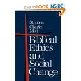
Contemporary Scholarship Stephen Charles Mott

Slide 46
Stephen Charles Mott Biblical Ethics and Social Change
In Ephesians 2:2 it is stated that our individual sins were patterned not only after the evil social order, but also “according to the ruler (archon) of the domain of the air.” Evil exists external to the individual not only in the order of society but also in the social and political roles of powerful supernatural beings. We are to put on the armor provided by God because “our battle is not with flesh and blood, but with the rulers (archai), the authorities (exousiai), the rulers of the order (kosmokratores) of darkness” (Ephesians 6: 11-12) They are “the powers.” Their titles denote that they wield great power. Page 7

Slide 47
Contemporary Scholarship Walter Wink

Slide 48
Walter Wink
Wink is known for his trilogy on angelic powers
The first book is Naming the Powers
The second book is Unmasking the Powers
His third book is Engaging the Powers
These books won numerous awards in 1993.
He is neo-orthodox in his approach and views the Powers as impersonal forces

Slide 49
Walter Wink Naming the Powers
The language of power pervades the whole New Testament (7).
The language of power in the New Testament is imprecise, liquid, interchangeable, and unsystematic (9).
Despite all this imprecision and interchangeability, clear patterns of usage emerge (10).
Because these terms are to a degree interchangeable, one or a pair or a series can be made to represent them all (10).
These powers are both heavenly and earthly, divine and human, spiritual and political, invisible and structural (11).
These powers are good and evil (12)
Unless the context further specifies, we are to take the terms for power in their most comprehensive sense, understanding them to mean both heavenly and earthly, divine and human, good and evil powers (39).

Slide 50
Contemporary Scholarship Clinton E. Arnold

Slide 51
Clinton E. Arnold Powers of Darkness
It is often thought there is virtually no demonology in the Old Testament, and it is only when we turn to the New Testament that we find any substantial teaching on this theme. While the issue of the demonic is no more to the forefront in the New Testament, demonology is not absent from the Old Testament. The Old Testament writers assume the existence of a major figurehead of evil and a plethora of evil spirits. The authors spend no more time reflecting on the nature of this realm. Satan, demons or evil spirits suddenly make an appearance from time to time in the text as hostile opponents to the people of God, with the writers giving very little description of their identity or how they operate. The Old Testament authors apparently felt little need to explain what these beings were; rather, writers and readers apparently shared a common awareness of the distinctive traits of this realm.
Page 56

Slide 52
Contemporary Scholarship Tom Yoder Neufeld

Slide 53
Tom Yoder Neufeld Ephesians, Believer’s Church Bible Commentary
Power language draws attention to how pervasive an insidious these powers are. As social, political, and economic realities the powers are diffused throughout the culture. Their demonic character rests not so much in their transcendent nature or personal agency, as in their capacity to control the imaginations and behavior of human beings, individually and communally. Page 463

Slide 54
Contemporary Scholarship Marva Dawn

Slide 55
Contemporary Scholarship Marva Dawn
The biblical understanding of power stands in sharp contrast to that of the early Greeks, who saw power as a cosmic principle and, as such, synonymous with the idea of god.
The world was perceived as a manifestation of myriads of forces working in, by, and on it. Human beings had to find means to participate in these forces in order to survive– as can be seen in the many Greek and Roman myths about the relationships of human beings with various gods. The world of the First Testament was radically different primarily because of the Hebrew witness to the character of God

Slide 56
Contemporary Scholarship Marva Dawn
Knowing YHWH primarily as a God of history, rather than only of nature, gave rise to Israel’s trust in a personal and caring God. Power was exercised by this God on behalf of the people, especially in the foundational event of the Exodus. Similarly, in the New Testament, the climactic event of the resurrection, coupled with the entire narrative of the passion, demonstrates God’s power on behalf of the people who are thereby liberated.
Marva J. Dawn, Powers, Weakness, and the Tabernacling of God (Eerdmans, Grand Rapids: 2001, 35-36).

Slide 57
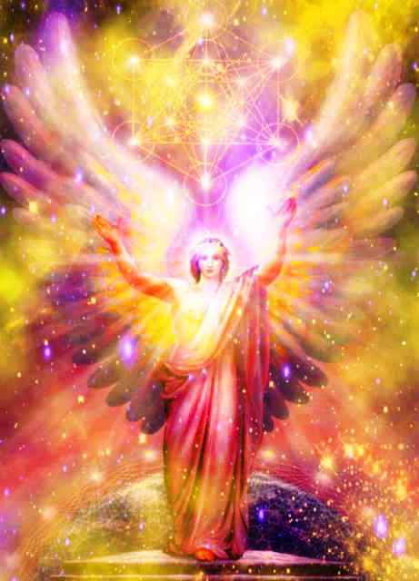
Warnings!
All angels are glorious creatures
Demons can appear as angels of light
They are not to be worshipped
They are not to be railed against, belittled or played with (Jude 8-10)

Slide 58
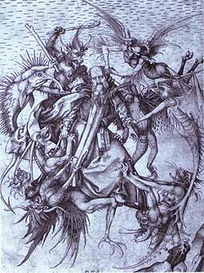
Warnings!
Demonic attack can take the forms of : possession, oppression, obsession, and depression. For more information check the following
Kurt Koch wrote numerous books on demonic attacks
C. Fred Dickason in his book Angels: Elect and Evil
David Powlinson has also written in this area

Slide 59
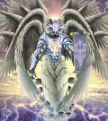
Warnings!
Fallen angelic powers are powerful and dangerous.
We should not try to talk to them, command them, or bind them.
Exorcism should be attempted by a very few qualified people
We should merely pray and ask the Lord to take care of these things for us!

