Slide 1

QUALIFIED TO BE PRESIDENT: IDENTIFYING THE BEST CANDIDATE

Slide 2
§113.14. Social Studies, Grade 3
(b) Knowledge and skills.
(9) Government. The student understands the basic structure and functions of various levels of government. The student is expected to:
(B) identify local, state, and national government officials and explain how they are chosen;
§113.14. Social Studies, Grade 4
(18) Citizenship. The student understands the importance of effective leadership in a constitutional republic. The student is expected to:
(A) identify leaders in state, local, and national governments, including the governor, local members of the Texas Legislature, the local mayor, U.S. senators, local U.S. representatives, and Texans who have been president of the United States; and
(B) identify leadership qualities of state and local leaders, past and present.
§113.14. Social Studies, Grade 5
(19) Citizenship. The student understands the importance of effective leadership in a constitutional republic. The student is expected to:
(C) identify and compare leadership qualities of national leaders, past and present.
§113.14. Social Studies, Grade 3
(9) Government. The student understands the basic structure and functions of various levels of government. The student is expected to:
(B) identify local, state, and national government officials and explain how t hey are chosen;
§113.14. Social Studies, Grade 4
(18) Citizenship. The student understands the importance of effective leadership in a constitutional republic. The student is expected to:
(A) identify leaders in state, local, and national governments, including the governor, local members of the Texas Legislature, the local mayor, U.S. senators, local U.S. representatives, and Texans who have been president of the United States; and
(B) identify leadership qualities of state and local leaders, past and present.
§113.14. Social Studies, Grade 5
(19) Citizenship. The student understands the importance of effective leadership in a constitutional republic. The student is expected to:
(C) identify and compare leadership qualities of national leaders, past and present.
§113.44. United States Government (One-Half Credit)
(10) Government. The student understands the processes for filling public offices in the U.S. system of government. The student is expected to:
(A) compare different methods of filling public offices, including elected and appointed offices at the local, state, and national levels

Slide 3
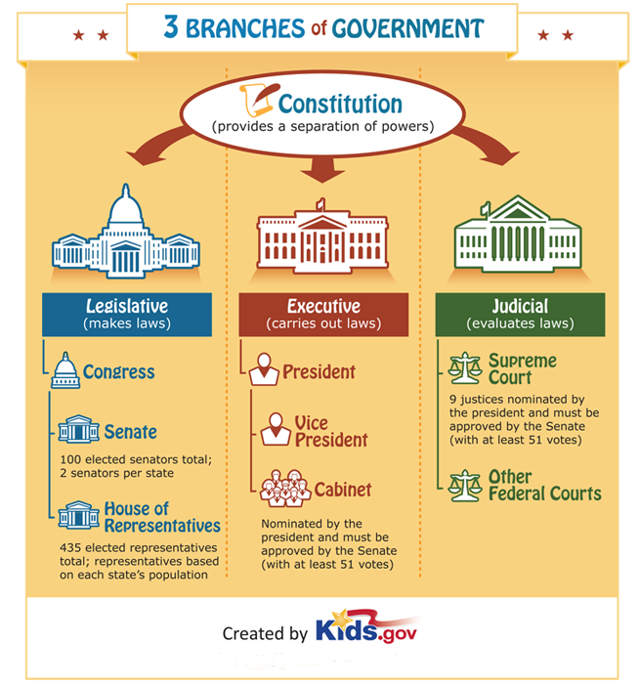
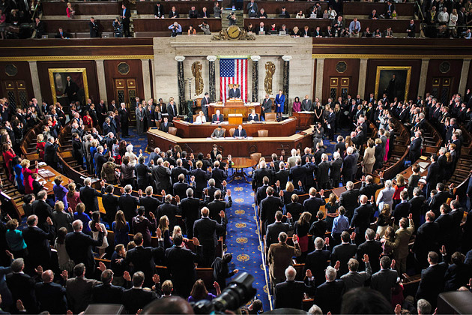
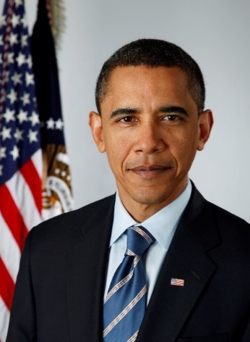
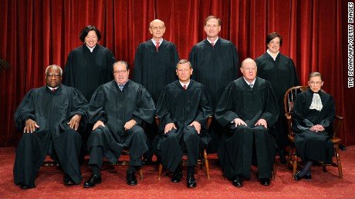
https://kids.usa.gov/three-branches-of-government/index.shtml

Slide 4
Seven Roles of One President
1. Chief of State, example for American people, symbol of the nation.
2. Chief Executive, boss for government workers in Executive Branch.
3. Chief Diplomat, makes foreign policy and decides what diplomats say to foreign governments.
4. Commander-in-Chief, commands armed forces.
5. Chief Legislator, urges Congress to pass new laws.
6. Chief of Party, helps party members get elected or appointed.
7. Chief Guardian of the Economy, contributes to employment, taxes, business profits.
http://www.scholastic.com/teachers/article/seven-roles-one-president

Slide 5
What are the Constitutional qualifications a candidate must meet in order to run for the office of President?

Slide 6
QUALIFICATIONS FOR THE OFFICE OF PRESIDENT
CITIZENSHIP & AGE
US Constitution, Article II, Section 1
No person except a natural born citizen, or a citizen of the United States, at the time of the adoption of this Constitution, shall be eligible to the office of President; neither shall any person be eligible to that office who shall not have attained to the age of thirty-five years, and been fourteen years a resident within the United States.

Slide 8

Atychiphobia
Agoraphobia
Enochlophobia
Glossophobia

Slide 9
Atychiphobia – fear of failure
Agoraphobia – fear of open spaces - public
places
Enochlophobia – fear of crowds
Glossophobia – fear of speaking in public
How might these conditions affect a possible presidential candidate?

Slide 11
CANDIDATE A
Age: 51 White
Marital Status: Married
Children: 4
Religion: Christian-Baptist/Nondenominational
Education: Home Schooled
Internship with Law Firm
Work Experience: Farmer, Store Clerk, Attorney
Military Experience: National Guard-Captain (No Battle Experience)
Non-Profit Exp: Pro Bono Law Work
Awards: None
Recognition: Trial Attorney
Presented cases before State Supreme Court
Political Experience:
Lost six elections
Elected State Legislature
Elected U.S. Congress
Travel: United States
Publications: Newspaper interviews

Slide 12
CANDIDATE B
Age: 43 White
Marital Status: Married (First Wife Died/Remarried)
Children: 6
Religion: Christian-Dutch Rerformed
Education: Home Schooled
Private University-A.B.
Work Experience: Rancher, Civil Service Commission,
City Police Commissioner,
Assistant Secretary of the Navy
Military Experience: National Guard-Captain,
U.S. Army-Lieutenant Colonel
Non-Profit Exp: Volunteer-Political Campaigns, Sunday School Teacher
Awards: None
Recognition: College Rowing & Boxing Teams
Political Experience:
Elected State Assembly (3 Terms)
Lost Election as City Mayor
Elected State Governor
Travel: United States, Central America
Publications: 13 Books-Navy History, Outdoor Life, History, Biographies

Slide 13
CANDIDATE C
Age: 60 White
Marital Status: Married
Children: 1
Religion: Christian-Presbyterian, Baptist
Education: Public High School
Commercial College (1 Semester)
City Law School (2 Years Night Classes)
Work Experience: Railroad Timekeeper, Farmer, Store Clerk,
Salesman, Director-State/Federal Agency
Military Experience: Missouri National Guard, U.S. Army
World War I-Artillery, Army Reserve
Non-Profit Exp: Volunteer with local and state political campaigns
Awards: None
Recognition: None
Political Experience:
Elected County Court Judge
Elected U.S. Senate
Travel: United States, Europe
Publications: Newspaper Interviews

Slide 14
CANDIDATE D
Age: 53 White
Marital Status: Married
Children: 4
Religion: Christian-Baptist
Education: Public High School
Public Colleges
Military College
Work Experience: Peanut Farmer, U.S. Navy Officer
Military Experience: U.S. Navy-Officer, U.S. Navy Reserve
Non-Profit Exp: Volunteer with non-profit boards:
Schools, Libraries, Hospitals
Awards: Military Service Medals
Recognition: High School Basketball Team, Three Honorary Degrees
Political Experience:
Lost First Election as State Governor
Elected State Governor (2 Terms)
Travel: Europe, Asia
Publications: Newspaper/Magazine Interviews

Slide 15
CANDIDATE E
Age: 49 White
Marital Status: Married
Children: 2
Religion: Christian-Episcopal, Methodist
Education: Private High School
Private University-B.A.
Private Graduate School-M.B.A.
Work Experience: Oil Industry, Professional Sports Team Owner
Military Experience: National Guard (6 years)
Non-Profit Exp: None
Awards: None
Recognition: High School & College Baseball Teams
Political Experience:
Lost election for State Representative
Volunteered-Presidential Campaign
Advisor-Presidential Campaign
Elected Governor of State (Two-Terms)
Travel: United States, Europe, Middle East
Publications: None

Slide 16
CANDIDATE F
Age: 48 African American
Marital Status: Married
Children: 2
Religion: Christian-United Church of Christ
Education: Private High School
Private Colleges
Private Law School
Work Experience: Business Corporation, Community Organizer, Associate-Law Firms, Law Professor, Attorney
Military Experience: None
Non-Profit Exp: Voter Registration Campaigns
Awards: None
Recognition: None
Political Experience:
Elected State Senate (2 terms)
Lost Election as Congressman
Elected U.S. Senate
Travel: United States, Asia
Publications: Book on Race Relations

Slide 18
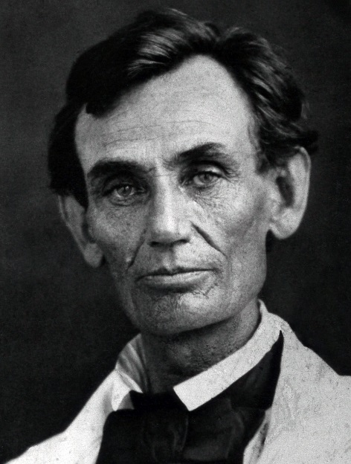
CANDIDATE A
Age: 51 White
Marital Status: Married
Children: 4
Religion: Christian-Baptist/Nondenominational
Education: Home Schooled
Internship with Law Firm
Work Experience: Farmer, Store Clerk, Attorney
Military Experience: National Guard-Captain (No Battle Experience)
Non-Profit Exp: Pro Bono Law Work
Awards: None
Recognition: Trial Attorney
Presented cases before the Illinois Supreme Court
Political Experience:
Lost six elections
Elected State Legislature
Elected U.S. Congress
Travel: United States
Publications: Newspaper interviews
https://en.wikipedia.org/wiki/Abraham_Lincoln
Abraham Lincoln
16th President
https://upload.wikimedia.org/wikipedia/commons/7/7e/Abraham_Lincoln_by_Byers,_1858_-_crop.jpg

Slide 19
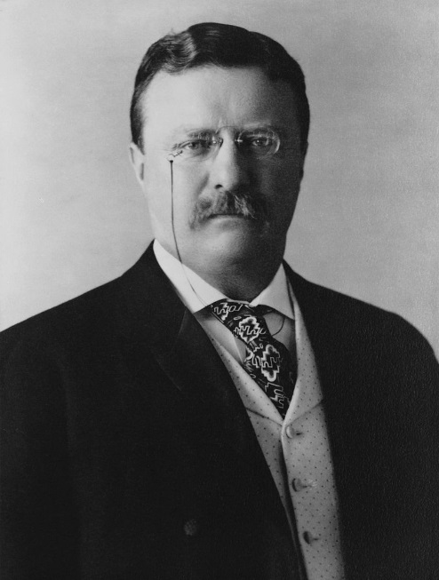
CANDIDATE B
Age: 43 White
Marital Status: Married (First Wife Died/Remarried)
Children: 6
Religion: Christian-Dutch Rerformed
Education: Home Schooled
Harvard University-A.B.
Work Experience: Rancher, Civil Service Commission,
New York City Police Commissioner,
Assistant Secretary of the Navy
Military Experience: New York National Guard-Captain,
U.S. Army-Lieutenant Colonel
Non-Profit Exp: Volunteered-Political Campaigns
Awards: None
Recognition: College Rowing & Boxing Teams
Political Experience:
Elected New York State Assembly (3 Terms)
Lost Election as Mayor of New York City
Elected Governor of New York
Travel: United States, Europe
Publications: 13 Books-Navy History, Outdoor Life, History, Biographies
https://en.wikipedia.org/wiki/Theodore_Roosevelt
Theodore Roosevelt
26th President
https://en.wikipedia.org/wiki/Theodore_Roosevelt#/media/File:President_Theodore_Roosevelt,_1904.jpg

Slide 20
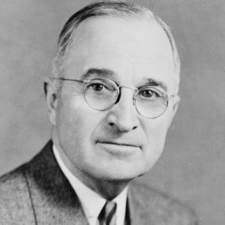
CANDIDATE C
Age: 60 White
Marital Status: Married
Children: 1
Religion: Christian-Presbyterian, Baptist
Education: Independence High School-Independence, MO
Spalding’s Commercial College (1 Semester)
Kansas City Law School (2 Years Night Classes)
Work Experience: Railroad Timekeeper, Farmer, Store Clerk,
Salesman, Director-State/Federal Agency
Military Experience: Missouri National Guard, U.S. Army
World War I-Artillery, & Army Reserve
Non-Profit Exp: Volunteered with local and state political campaigns
Awards: None
Recognition: None
Political Experience:
Elected to County Court Judge
Elected U.S. Senate
Travel: United States, Europe
Publications: Newspaper Interviews
https://en.wikipedia.org/wiki/Harry_S._Truman
Harry S. Truman
33rd President
http://a2.files.biography.com/image/upload/c_fill,cs_srgb,dpr_1.0,g_face,h_300,q_80,w_300/MTE5NTU2MzE2MzkwNTI0NDI3.jpg

Slide 21
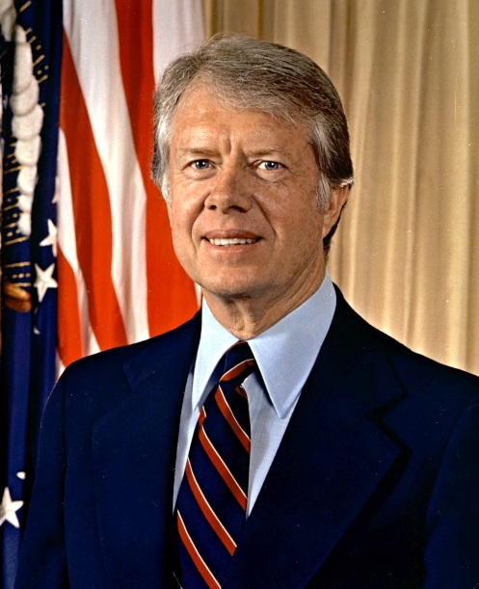
CANDIDATE D
Age: 53 White
Marital Status: Married
Children: 4
Religion: Christian-Baptist
Education: Plains High School-Plains, GA
Georgia Southwestern College
Georgia Tech
U.S. Naval Academy-B.S.
Work Experience: Peanut Farmer, U.S. Navy
Military Experience: U.S. Navy-Officer, U.S. Navy Reserve
Non-Profit Exp: Volunteered with non-profit boards:
Schools, Libraries, Hospitals
Awards: Military Service Medals
Recognition: High School Basketball Team, 3 Honorary Degrees
Political Experience:
Elected Georgia State Senate (2 Terms)
Lost First Election as Governor
Elected State Governor (2 Terms)
Travel: United States, Europe, Asia
Publications: Newspaper/Magazine Interviews
https://en.wikipedia.org/wiki/Jimmy_Carter
Jimmy Carter
39th President
https://en.wikipedia.org/wiki/Jimmy_Carter#/media/File:JimmyCarterPortrait2.jpg

Slide 22
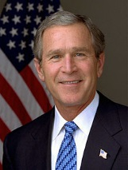
CANDIDATE E
Age: 49 White
Marital Status: Married
Children: 2
Religion: Christian-Episcopal, Methodist
Education: Phillips Academy (High School)–Andover, MA.
Yale University-B.A.
Harvard Business School-M.B.A.
Work Experience: Owner-MLB Texas Rangers, Oil Industry
Military Experience: National Guard (6 years)
Non-Profit Exp:
Awards:
Recognition: High School & College Baseball Teams
Political Experience:
Elected Governor of a Texas (Two-Terms)
Advisor-George H. W. Bush Second Presidential Campaign
Volunteered-George H.W. Bush First Presidential Campaign
Lost Election for State Representative
Travel: Europe, Middle East, U.S.
Publications:
https://en.wikipedia.org/wiki/George_W._Bush
George W. Bush
43rd President
https://en.wikipedia.org/wiki/George_W._Bush

Slide 23
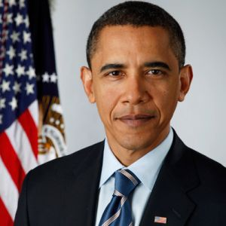
CANDIDATE F
Age: 48 Black
Marital Status: Married
Children: 2
Religion: Christian-United Church of Christ
Education: Panahou High School-Hawaii
Occidental College-Los Angeles, CA
Columbia University-B.A.
Harvard Law School-J.D.
Work Experience: Business Corporation, Community Organizer,
Associate-Law Firms, Law Professor-
University of Chicago Law School, Attorney
Military Experience: None
Non-Profit Exp: Voter Registration Campaigns
Awards: None
Recognition: None
Political Experience:
Elected Illinois State Senate (2 terms)
Lost Election as Illinois Congressman
Elected U.S. Senate
Travel: United States, Asia
Publications: Book on Race Relations
https://en.wikipedia.org/wiki/Barack_Obama
Barack Obama
44th President
http://a5.files.biography.com/image/upload/c_fill,cs_srgb,dpr_1.0,g_face,h_300,q_80,w_300/MTE4MDAzNDEwNzg5ODI4MTEw.jpg

Slide 24
SUMMARIZE LEARNING:
What are the official qualifications for the office of president?
What are some unspoken qualifications that should be considered? Why?

