Slide 1
BETTER OUTCOMES THROUGH STRATEGIC GOVERNANCE
HELPING MUNICIPALITIES ACHIEVE A DESIRED FUTURE
NHMA CONFERENCE
NOVEMBER 2018

Slide 2
How Local Officials Are:
Setting smart priorities,
Make better decisions,
Building voter support,
Achieving resident-focused outcomes that their communities value
All to intentionally create a desired future.

Slide 3
Financial Perspective
NH residents spend $3 billion a year in taxes.
$1 billion for municipal government
$2 billion for schools
Strategic governance can help ensure that those dollars are being spent wisely -- or saved -- to deliver excellent value and outcomes for taxpayers.

Slide 4
Speakers
Mike Akillian: Director and Senior Strategist at the Center for Strategic Governance
Ryan Aylesworth: Town Manager, Enfield NH
Sarah Marchant: Director of Nashua NH’s Office of Community Development and Senior Strategist at the Center

Slide 5
Topics
Defining strategic governance.
Amherst NH case study (6-year perspective)
Enfield NH case study (launched in 2018)
Applying strategic governance more broadly for better community-wide outcomes
Questions & Discussion

Slide 6
1. strategic governance defined

Slide 7
The Association of Governing Boards of Universities and Colleges recommends this approach as best practice for its 1,900 member institutions and 40,000 individual members.

Slide 8
STRATEGIC Thinking + Operational GOVERNANCE =
STRATEGIC GOVERNANCE
Applied Leadership for Municipalities and Schools

Slide 9
A Framework for Strategic Governance
What to Achieve How to Achieve it
STRATEGIC Thinking Operational GOVERNANCE
Vision
Measurable Goals
Strategic Initiatives
Implementation & Oversight
Citizen Ideas
Research/Data
Department Input
Balanced Views
Defining Success in Citizen Outcomes
Specific, Measurable, Achievable, Challenging (SMAC)
Program Plans
Costs
Roles
Timing
Dependencies
CIP
Department Plans
Board Plans
Ongoing Updates
Progress Reviews
Measurement
Plan Adjustments
Constituent Communications

Slide 10
An Ongoing Cycle
Manage the Present
Manage the Present
Strategic Thinking & Planning
Strategic Thinking & Planning
Understand the Past
Envision the Future
Envision the Future
Understand the Past
Year 1
Year 2…
… or sooner, as needed.

Slide 11
Key Activity Areas
Understand the Past
Clear understanding of historical demand and performance, drivers of success, key environmental trends, critical issues.
Clarified mission, values, SWOTs. Relevant vision of a desired future -- outcomes. Proposed actions, initiatives, investments with rationale. Prioritized tradeoffs. Effective engagement with voters.
Set of tools (dashboard metrics, strategic budgets) to manage initiatives and actions, and to continually measure progress toward citizen-focused outcomes.
Envision the Future
Manage the Present

Slide 12
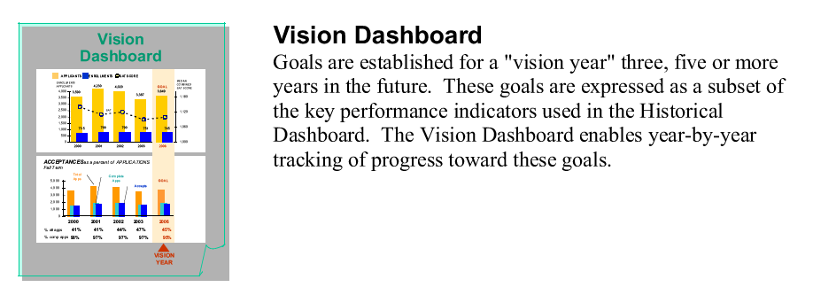
Dashboards for Each Part of the Cycle

Slide 13
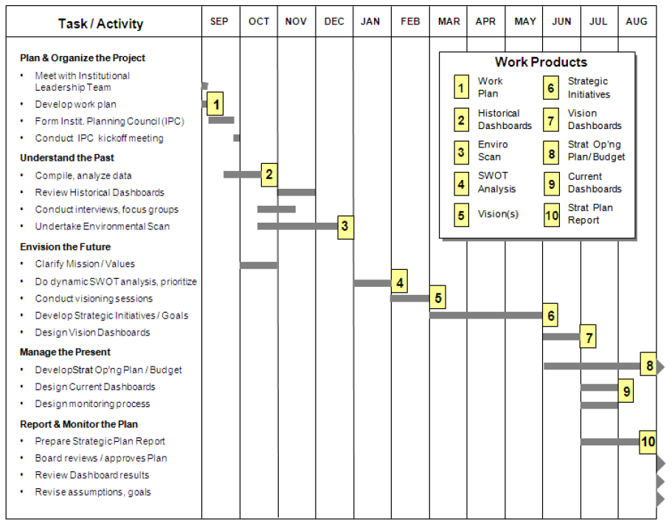
Phased process and workflow
Work Plan
Strategic Thinking*
Operational Governance
* Amherst & Enfield did this in four months.

Slide 14
The Process
Start Here

Slide 15
Not All Goals Are Outcomes
Inputs
Outcomes
Add a new police officer.
Increase the DPW budget by $2.4 million annually.
Acquire accounts receivable software.
Institute full-day kindergarten.
Reduce property crime 15%.
By 2030, 70% or more of Amherst roads are rated good or better by the industry standard PCI index.
Maintain a tax collection rate of greater than 94%.
Prepare children for success in the first grade.
Typically, no single outcome conveys the whole story, so it is good to identify several outcomes from different perspectives to provide a clearer picture.

Slide 16
Elements of a Sound Strategic Plan
Mission – Why the organization exists (enduring purpose).
Vision – How the mission will be achieved over time.
Outcomes – Constituent-centered results to be achieved.
Investments – Initiatives/resources to achieve outcomes.
Structures and Staffing – How to organize to do work.
Operations and Procedures – Best practices.
Schedule – Timeline to achieve planned outcomes.

Slide 17
Quality of Life Factors
Public health & safety (Police, Fire, EMS)
Infrastructure, facilities and technology
Community/economic development
Financial condition/affordability
Environment/landscapes
Historic/heritage
Town character
Recreation
Housing
Schools

Slide 18
Hallmarks of This Approach
Is rooted in meaningful data.
Is about strategic thinking, not just planning.
Focuses on achieving outcomes that benefit residents.
Reinforces the municipality’s culture and values.
Empowers all personnel to do their best.
Links the strategic with the operational and measurable.
Is a repeatable process that communities can learn to do on their own.

Slide 19
2. What amherst has achieved

Slide 20
Early Issues
In the five years prior to adopting strategic governance in 2013, Amherst had three default budgets.
Why:
No longer-term vision for the town (context)
Lack of clearly defined issues and outcomes made justifying budgets difficult
A “Let’s guess what the voters will give us” approach
A perceived a lack of transparency
Micro-management, rather than strategic governance, was the norm

Slide 21
Actions
The selectmen adopted strategic governance in April’13
All town departments developed strategic plans in four months (May-August). (Fire, Police, EMS, DPW, Community Development, Recreation, Library, Town Clerk, Administration, Tax, Finance)
They used strategic thinking as the basis for multi-year outcomes, initiatives, operational plans, and budgets.

Slide 22
Actions
Departments presented their plans to the BOS in September 2013 and used their proposed 2014-15 annual operating plan/budget as the first plan year.
BOS used real-time tools to make tradeoffs, set priorities, and discuss impacts -- publicly.
BOS communicated a lot with residents.
Departments measured and reported progress towards key goals via quarterly departmental updates to the BOS.
All plans have been refreshed annually.
BOS has framed town-wide priorities and engaged citizens.

Slide 23
Examples of DPW Strategic Outcomes
Outcome #1: Roads:
70% or greater of Amherst roads are rated good according to industry standard (pavement condition index (PCI)) by 2030.
Outcome #2: Bridges
By 2025, all Amherst bridges/water crossings are built and maintained to last 50+ years.
Outcome #3: Town Buildings
By 2025 all Amherst town buildings and outbuildings are functionally sound and compliant will all appropriate regulations and codes.
Strategic analysis and proposal for all town buildings including DPW facilities is completed in FY18 by a multi-disciplinary group, including residents.
Outcome #4: DPW Management Systems
By 2020, Amherst DPW will achieve work force productivity of 90%.
Outcome #5: Stormwater
Amherst will continue to comply with evolving requirements of the Clean Water Act under the Municipal Separate Storm Sewer System permit issued by the EPA.
Notes:
While Pavement Condition Index (PCI) might be foreign to this audience, it is the industry standard used to formulate road repair strategies. Examples will be shown later in this presentation.
To minimize costs, conventional wisdom by NHDOT in the 80’s was to replace failed bridges with large metal culvert pipes. Unfortunately, only thirty years later, this has been proven a fallacy. Almost without exception, Amherst bridges needing replacement are metal pipes.
We will show that investments over the years in our municipal buildings have made great improvements, but there is work still to be done and improvements still to be made.
In my mind, the single most important revelation from the Matrix Report was the need to modernize the manner in which we chart employee’s time and equipment and materials used.
Under the Clean Water Act of 1972, EPA is tasked with regulating how NH communities address “Stormwater”. Forty six other states are regulated by their equivalent of NH Department of Environmental Services

Slide 24
Recreation Department Vision Dashboard
Acarage

Slide 25
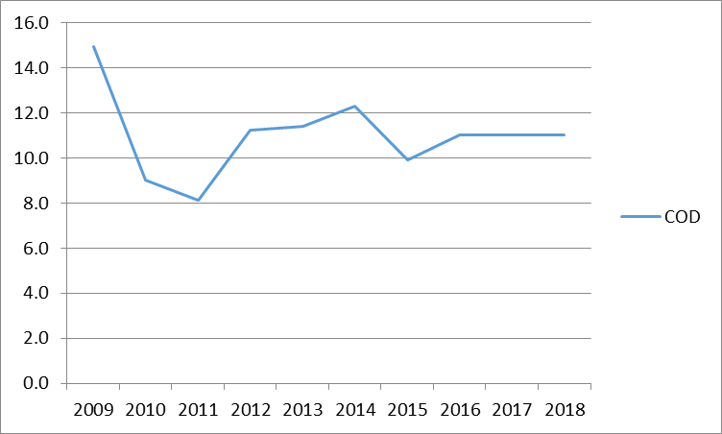
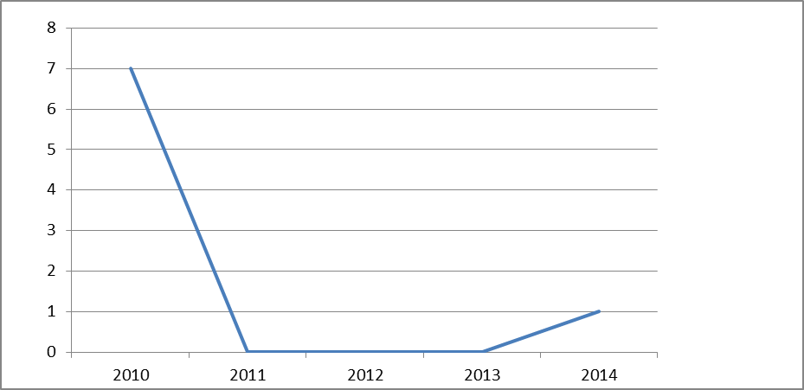
Tax Department Vision Dashboard
TAX LIENS – DOWNWARD TREND
DRA - COEFICIENT OF DISPERSION RATING
CYCLICAL REVIEW OF ASSESSMENT DATA
Notes:
The vision dashboard for the tax and assessing department as shown on this slide represents the success of the continued efforts of our staff as well as our contracted assessors. Collection rates are well maintained, tax liens continue to be on a downward trend, the department is maintaining an acceptable COD rating from DRA, and the cyclical review of assessment data is within the acceptable range as well. Our Goals are targeted to maintain these levels and meet our mission and vision statement to provide fair and equitable taxation for all Amherst properties.

Slide 26
Police Dept. Vision Dashboard

Slide 27
See All Amherst Strategic Plans
https://www.amherstnh.gov/board-selectmen/pages/strategic-planning-budget-process

Slide 28
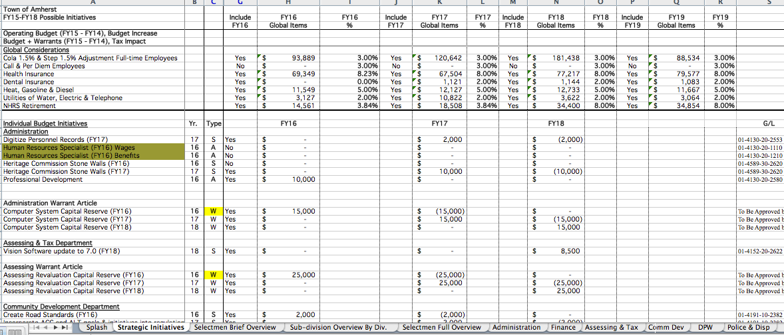
Strategic Budgeting
With specialized tools, government officials can assess in real time the impact of combinations of proposed strategic initiatives.

Slide 29
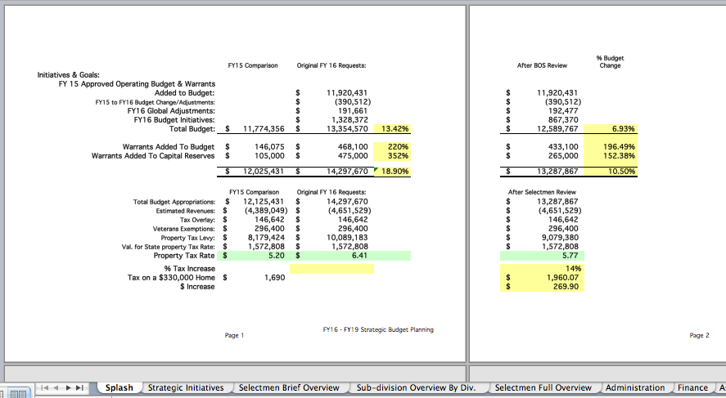
Real-Time Tax Impact Analysis

Slide 30
Overall Impact
Since 2014, voters have passed all annual budgets by a wide margin.
Of the 83 articles proposed since 2014, voters have passed 82 (by a 3:1 to 7:1 margin).
Amherst has been investing in town services while maintaining the 8th lowest municipal tax rate of all 31 Hillsborough County municipalities.
This represents an exceptional value for taxpayers.
There is also alignment on what won’t be done.

Slide 31
Overall Impact
Residents feel the town officials are delivering excellent services.
Residents always:
Know where things stand,
See the underlying rationale for town decisions,
Engage in shaping the future they want for Amherst.
Other town committees, commissions, and boards have been adopting strategic governance.

Slide 32
Quality of Life Factors for Amherst
Public health & safety (Police, Fire, EMS)
Infrastructure, facilities and technology
Community/economic development
Environment/landscapes
Financial condition/affordability
Historic/heritage
Town character
Recreation
Housing
Schools
2018-23 priority areas for the BOS

Slide 33
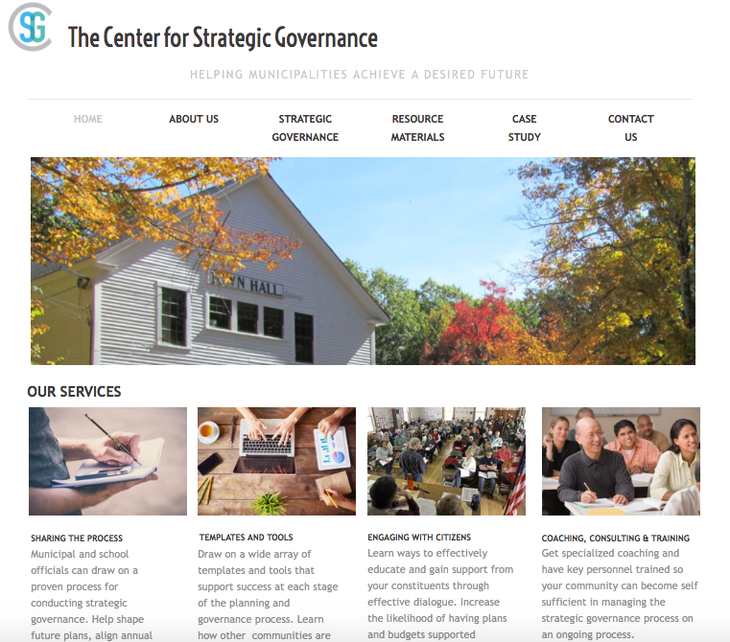
See what Amherst officials think about strategic governance.
strat-gov.com

Slide 34
3. Enfield NH: Adopting Strategic governance in 2018

Slide 35
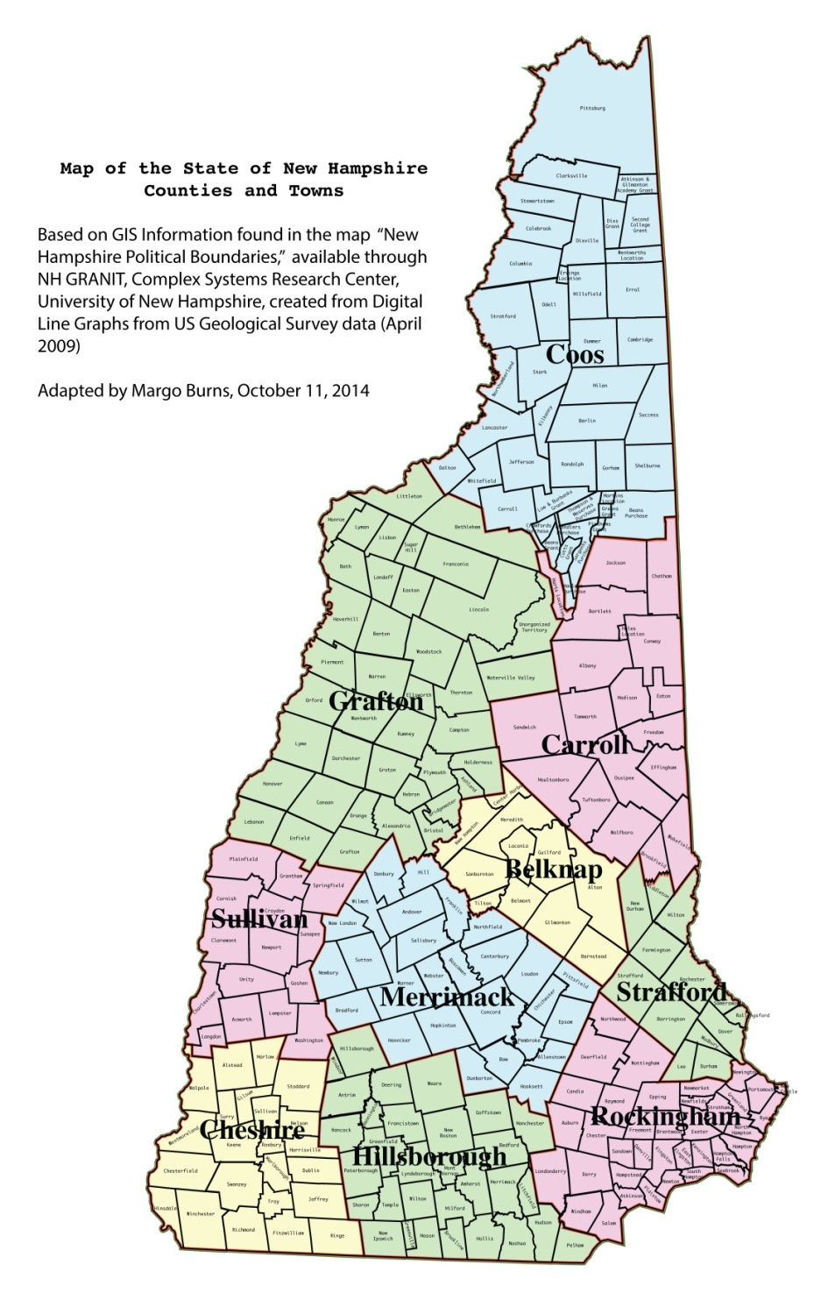
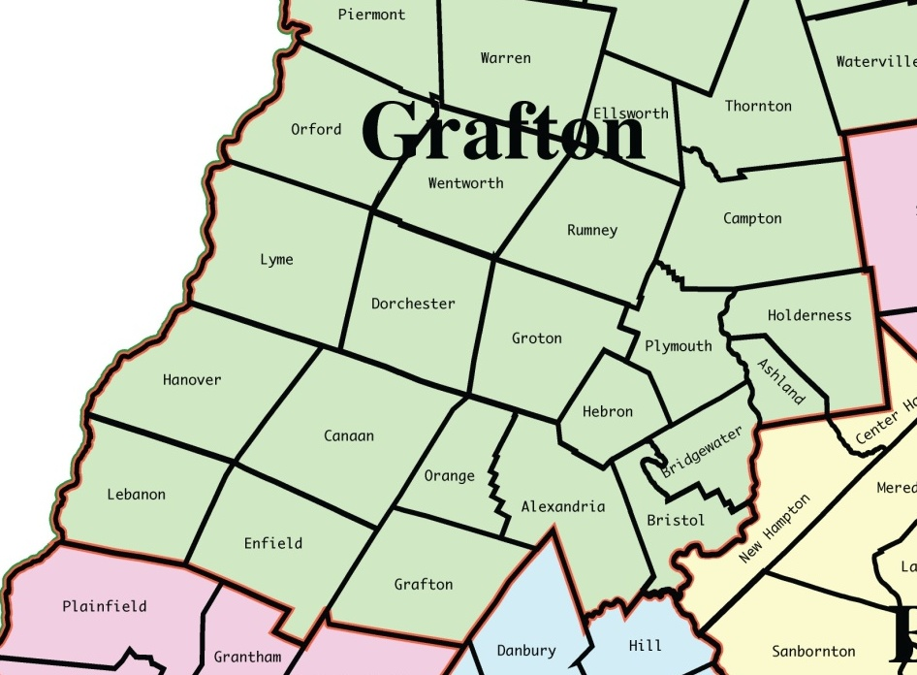
Where’s Enfield?

Slide 36
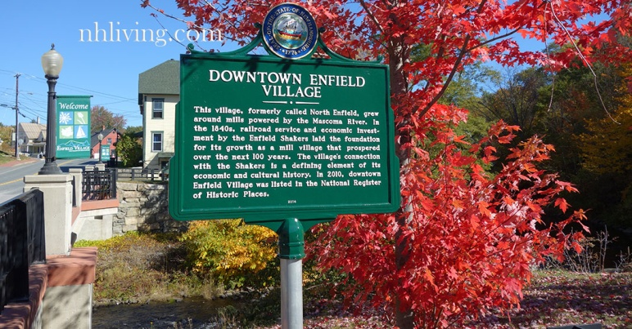
Enfield – A Brief Overview (1 of 2)
~ 4,600 permanent residents (population increases considerably during the summer months)
Adjacent to Lebanon and Hanover (population centers)
Assets include natural and cultural resource attractions
Mascoma Lake, Crystal Lake, 3,000+ acres of public land
Enfield Shaker Museum, Shrine of Our Lady of La Salette
Whaleback Mountain Ski Area, Montcalm Golf Club
Close to Dartmouth College, Dartmouth-Hitchcock Medical Center, Northern Stage, shopping centers, etc.

Slide 37
Enfield – A Brief Overview (2 of 2)
Roughly $6.5 million annual operating budget
35+/- FT employees; 30-40 PT & seasonal employees
Form of Government
Representative Town Meeting (although Enfield was an SB2 Town for three years in the early 2000s)
Town Meeting = Legislative Body
Governing Body = 3-Member Board of Selectmen
Town Manager (RSA 37)
Town Manager is the administrative head of all municipal departments and responsible for their efficient administration
Town Manager is the hiring authority and signs contracts
Town Manager reports to and is appointed by the BOS

Slide 38
Municipal Services
Office of the Town Manager
Municipal Management
Tax & User Fee Collection
Assessing
Accounting/Bookkeeping
Public Safety
Police
Fire
Ambulance
Public Works
Highway
Solid Waste
Buildings & Grounds
Water & Sewer
Office of the Town Clerk
Recreation
Planning & Zoning
Community and Economic Development
Inspection Services
Building
Health
Fire
Public Library
Human Services
Cemeteries

Slide 39
2018 Municipal Budget Distribution

Slide 40
Humble Beginnings
New Town Manager and elected officials confronting financial challenges (i.e., deficits in the GF and Sewer Fund) and a need to address public concerns about accountability/transparency
Municipal department heads and their departments had never participated in strategic planning
Town last completed an official update to the Master Plan in 1997 (proposed updates in 2008 never adopted)
Town had not prepared a CIP since 2004
Increased concerns about the efficacy of the Fire Department and Ambulance (both volunteer-based)
Multiple economic development plans prepared in the last 10-15 years, but, somewhat lacking with little implementation

Slide 41
Strategic Governance Applied in Enfield

Slide 42
Department-level Strategic Plans
Governance, Administration & Finance
Public Works
Police
Fire
Ambulance
Library
Recreation
Economic & Community Development
DHs instructed to “think big” (not just do the best with what they get) and develop plans that call for investment in all areas needed to deliver citizen desired outcomes

Slide 43
Shift from Vertical to Horizontal
Fire
Public health & safety (Police, Fire, EMS)
Infrastructure/Built Environment/Technology
Financial Condition
Community/ Economic Development
Town Character
Environment/Landscapes
Historic/Heritage
Housing
Recreation
Education
Police
Library
Ambulance
Recreation
Public Works
Community/Economic Dev.
Governance, Admin, Finance
www.enfield.nh.us/strategic-governance-enfield

Slide 44
Strategic Governance Roles in Enfield
Whose role is it to chart the future of Enfield?
Do citizens view the Select Board as stewards of the town? If not, whom?
Is there clarity on the Budget Committee’s role in budget development?
Has past practice diverged from the RSA’s?
How are opposing positions resolved?

Slide 45
Managing Dualities
Constraining Inputs Managing Outcomes
Grass Roots Government
Tradition Innovation
Planning Implementation
Silos Integration
Econ. Development
Preservation

Slide 46
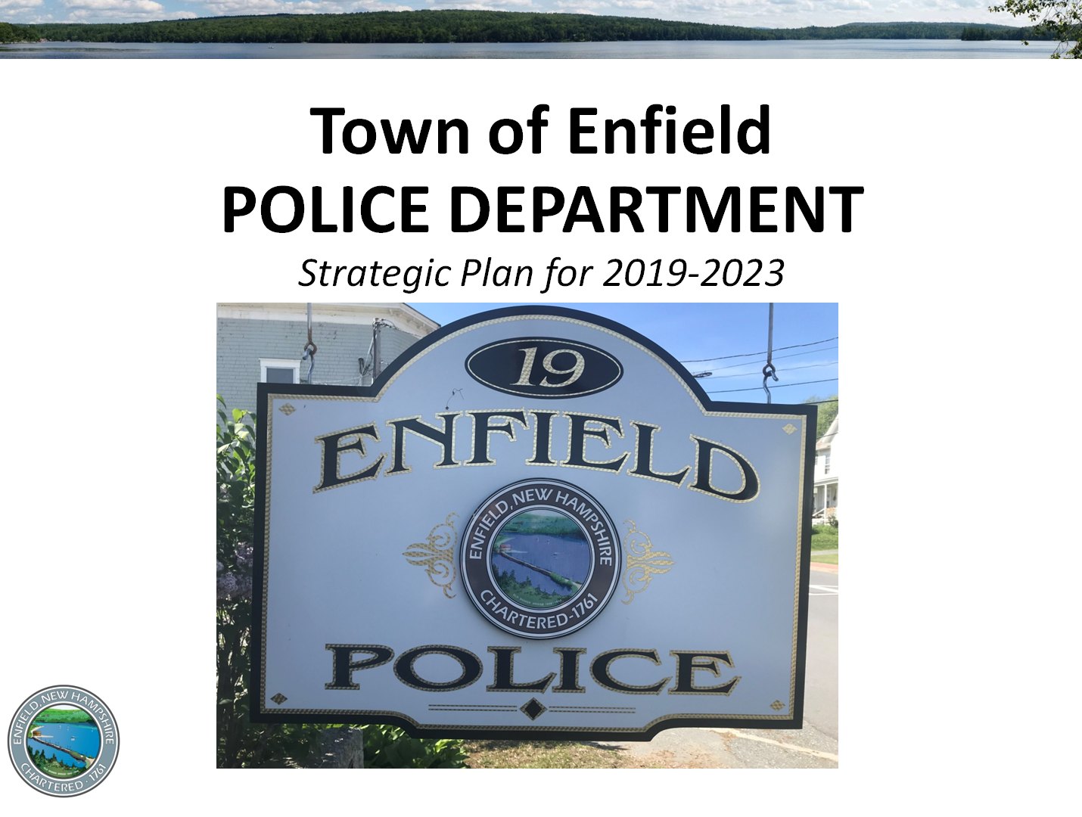
So, what sorts of components are included in the operating department plans?

Slide 48
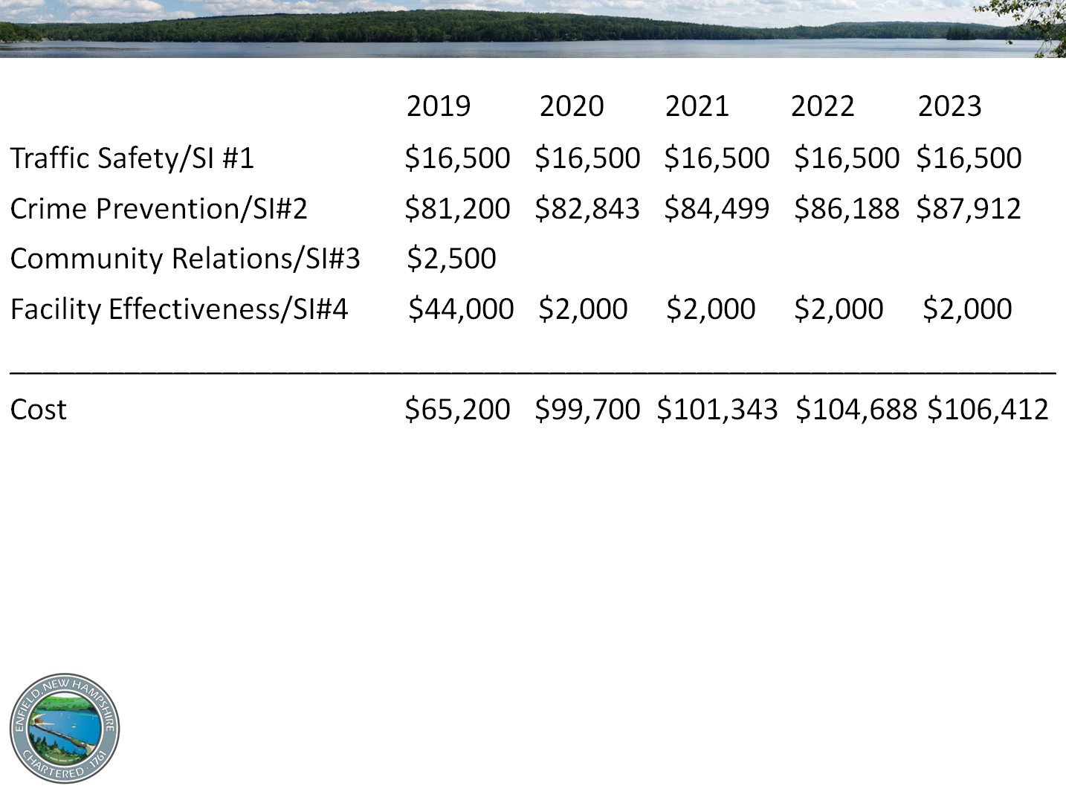
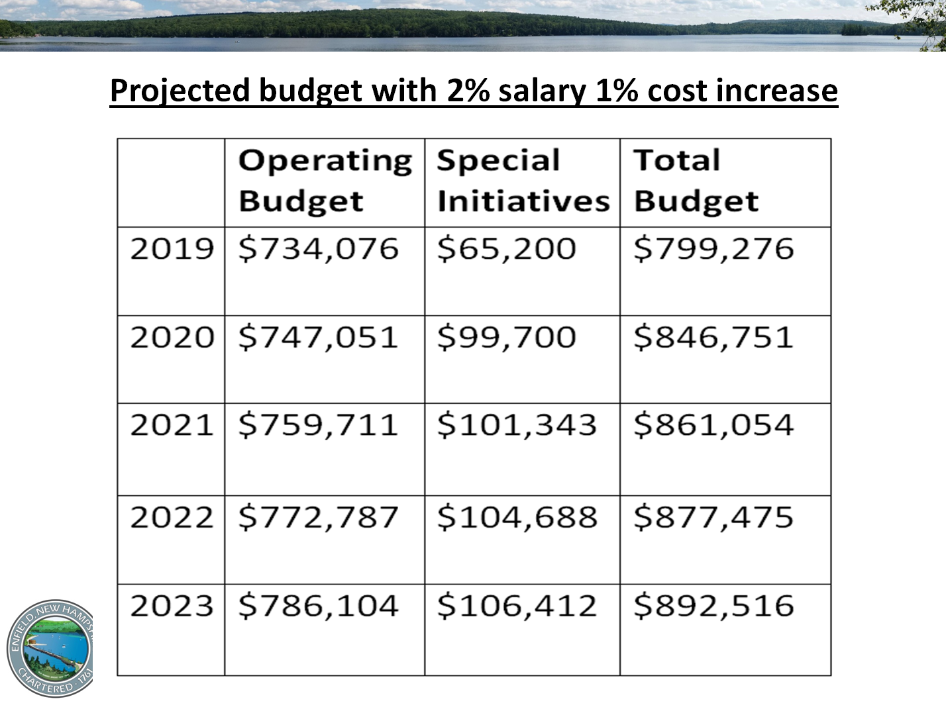

Slide 50
Tax Rate “Sensitivity Analysis” Tool

Slide 51
Proposed Vision
Retain Enfield’s town character, sense of community, natural environment, and heritage, because residents generally like the town as it is. [while focusing on the priorities below]
www.enfield.nh.us/strategic-governance-enfield
Priorities (in rank order of overall importance)
Improve the following aspects that shape quality of life:
Financial condition/affordability
Public health & safety (Police, Fire, EMS)
Infrastructure, facilities and technology
Community/economic development & Housing

Slide 52
Priorities (More Detail)
Infrastructure, Facilities and Technology (3)
Buildings/Facilities
Most departments cite that substandard buildings/facilities limit fulfilling their mission.
They have requested $296,500 in upgrades over the next five years that still won’t create truly effective space.
Through a Municipal Facilities Optimization Study to be completed by December, we are identifying costs for either building a new municipal complex with enough shared space to serve all departments or completing major designs and renovations to existing Town buildings.

Slide 53
Priorities (More Detail)
Infrastructure, Facilities and Technology (3)
Water System
A Water Asset Planning/Management Study funded with a NH Department of Environmental Services (DES) matching grant will tell us by December 2018 whether DPW will need to rebuild some or all of the 10-mile long water supply system originally built in 1903.
Replacing this infrastructure could cost $3 million in today’s dollars.
We’re also analyzing the existing water rate structure to ensure that the Town’s fees are fair, equitable, and financially sustainable.

Slide 54
Priorities (More Detail)
Infrastructure, Facilities and Technology (3)
Wastewater System
We are launching:
An analysis of our wastewater assets (including ways to reduce stormwater/groundwater infiltration),
A rate study to ensure that user fees are promoting financial sustainability within the Sewer Fund,
A feasibility analysis of constructing and operating our own municipal wastewater treatment plant. This should be completed by Spring 2019.

Slide 55
Strat. Gov. Project Timeline 2018 (1 of 2)
January – CSG invited to provide an overview of the strategic governance process to Enfield officials and start building “buy-in” to the concept
March – Town Meeting approves funding for the project
April – Project kicks off with a full day of meetings with DHs, elected officials and other key stakeholders
April-July – DHs prepare operating plans via an intensive iterative process with CSG and Town Manager
August – Department operating plans are presented in public meetings with the BOS and Budget Committee (content well-received) and posted to Town website

Slide 56
Strat. Gov. Project Timeline 2018 (2 of 2)
September – BOS and Budget Committee confront tradeoffs and wrestle with vision/priorities
October 1 – DHs transmit operating and capital budget requests to Town Manager that fund the elements of their proposed operating plans
October – Consensus on vision and broad priorities
Early-November – Stated priorities and other information published on Town’s website and promoted via a variety of media
November/December – Budget development and capital planning continues; more in-depth evaluation of FD/ambulance alternatives; public input opportunities

Slide 57
Initial Outcomes
Improved clarity of (shared) vision for Town
Building a culture of accountability and creativity among Department Heads for strategic thinking/operations
Development of better tools/processes for evaluating the financial impact of various initiatives over a multi-year time horizon (work in progress)
Increased public awareness/engagement in municipal decision-making; better articulation of what/how/why services are being provided; adapt to public needs
Setting citizen expectations for what can/will be delivered
Growing public trust and confidence in municipal gov.
Vision, priorities, and dept. operating plans will help inform upcoming updates to the master plan (Planning Board)

Slide 58
Stakeholder Reactions
"I welcome the progress our Town has made in the past year in moving forward with a planning process for the future of Enfield.” Meredith Smith, BOS Chair
“This has been an excellent exercise for us all to go through, with all departments and major committees being involved. It is encouraging us to ‘think outside the box’, see several common areas of concern, and identify issues that need further study.” John Kluge, BOS Member
“This process is helping the PD articulate a vision and challenge us to use objective data and analysis in evaluating our progress toward achieving goals.” Roy Holland, Chief of Police
“Strategic governance is helping DPW set more ambitious goals, but it is giving us the tools to better communicate with residents.” Jim Taylor, Public Works Director

Slide 59
4. Applying strategic governance more broadly for better community-wide outcomes

Slide 60
Budget Committee Assessment
Select Board, Town Manager, other groups, and residents shape broader
goals
Departments propose vertical strategies
Budget Committee assesses financial impact and decides on a proposed budget
Planning Board develops master plan and CIP based on those goals
Notes:
Horizontal Assessment –budget committee utilizes dynamic tools and assess financial impacts of vertical strategies, with horizontal - broad goals defined by BOS and Town Administration

Slide 61
Multi-Year Financial Analysis
Roll up five years of proposed budgets and evaluate potential tax impact (dynamic spreadsheet tool)
Prioritize annual plans and budgets with horizontal priorities and current vision
Explore/evaluate financing options to moderate tax spikes
Translate annual plans and budgets into visual

Slide 62
Single-Year Financial Analysis
Focus in on next fiscal year budget
Evaluate potential tax impact
Compare to past historical budgets
Develop prioritized annual plan and budget
Develop default budget for comparison
Communicate with the community on annual plan, priorities and how they relate to budget

Slide 63
Engaging the Planning Board & CIP Committee
Select Board, Town Manager, other groups, and residents shape broader
goals
Departments propose vertical strategies
Budget Committee assesses financial impact and decides on a proposed budget
Planning Board develops master plan and CIP based on those goals
Notes:
Horizontal Assessment –budget committee utilizes dynamic tools and assess financial impacts of vertical strategies, with horizontal - broad goals defined by BOS and Town Administration

Slide 64
Master Plans – NH RSA 674:2
Two Required Chapters: Vision and Land Use
Optional Chapters:
Transportation
Community Facilities
Economic Dev.
Natural Resources
Natural Hazards
Recreation Utility & Public Service
Cultural, Arch & Historical
Regional Concerns
Neighborhood Plan
Community Design
Housing
Implementation
Energy
Coastal Management

Slide 65
Purpose – NH RSA 674:3
“…the best and most appropriate future development …under the jurisdiction of the planning board, to aid the board in designing ordinances that result in preserving and enhancing the unique quality of life and culture of New Hampshire, and to guide the board in the performance of its other duties…”
“…to give legal standing to the implementation [land use] ordinances…”

Slide 66
Master Plan & Strategic Thinking
Strategic Governance = larger framework
Vision Chapter
Mission and Vision defined in Strategic Plan
Tools Historical, Vision and Current Dashboards
Human-centered outcomes
Land Use Chapter
Bridging land use goals and outcomes
What to Achieve

Slide 67
Goals vs Data based Outcomes
GOAL: Preserve Character
OUTCOME:
2013 – Increase preserved open space from 13% to 18% of land area
2017 – Actively manage preserved open space including woodlands, grasslands, wetlands, wildlife corridors and agriculture.
GOAL: Diversify Tax Base
OUTCOME:
2013 - Increase total commercial and industrial property valuation from 12.2% to 14%
2017 – Understand costs of installing sewer to C/I corridor to allow community to balance costs of services vs increase in valuation.

Slide 68
CIP & Operational Governance
CIP = How to Achieve It
Provides at least 6 yr (RSA 674:5) prospective budgeting tool
Includes all capital projects from municipal and school district(s)
The multi-year financial analysis completed in strategic budgeting process, serves as basis
Moves from plan to implementing success!

Slide 69
Re-Adjusting Department Plans
Select Board, Town Manager, other groups, and residents shape broader
goals
Departments propose vertical strategies
Budget Committee assesses financial impact and decides on a proposed budget
Planning Board develops master plan and CIP based on those goals
Notes:
Horizontal Assessment –budget committee utilizes dynamic tools and assess financial impacts of vertical strategies, with horizontal - broad goals defined by BOS and Town Administration

Slide 70
Revise Department Strategic Plans
Based on multi-year decisions/priorities and those from the annual planning and budgeting process, department heads revise and share their plans
Restate goals/outcomes, initiatives, and costs
Align expectations regarding what will – and will not – be achieved.

Slide 71
5. Questions & discussion

Slide 72
Ongoing Benefits of Strategic Governance
Shared community values
Decision making framework
Broader perspectives
Clear rationale
Transparency
Better decision making
Fiscal accountability
Resident-focused outcomes
Effective communication
Ongoing voter support

Slide 73
Resource materials.
strat-gov.com

Slide 74
BETTER OUTCOMES THROUGH STRATEGIC GOVERNANCE
HELPING MUNICIPALITIES ACHIEVE A DESIRED FUTURE
NHMA CONFERENCE
NOVEMBER 2018

