Slide 1
virtual
Annual General Meeting 2020
October 8, 2020

Slide 2
Housekeeping
~Thank you Stephen Dasko and team for hosting.
~Thank you neighbours for taking the time to support your community.
~Huge thanks to the SHORA Family for all your efforts in 2019 - 2020.
~Thank you to our SHORA advertisers.
Confidential - Sherway Homeowner’s and Recreation Association
Notes:
2

Slide 3
Agenda
- Nomination results / Elections
- SHORA Financials
- Year in review
Guest Speaker Councillor Stephen Dasko, - Ward 1 Updates / SHORA Updates
- Question and Answer Session
Confidential - Sherway Homeowner’s and Recreation Association

Slide 4
SHORA Board Nominations / Election
2020 SHORA Executive Election - Ryan Enright, SHORA Past President SHORA Board of Director Positions:
President
Vice-President
Secretary
Treasurer
Next SHORA Meeting / SHORA Volunteering Opportunities
Confidential - Sherway Homeowner’s and Recreation Association
Notes:
4

Slide 5
SHORA Financials 2019 - 2020
October 2019 Starting Balance = $5,296.74 Cash Flow In = $1,157.60 Cash Flow Out = $1,313.84 September 2020 Closing Balance = $5,140.50 Difference of $156.24
Confidential - Sherway Homeowner’s and Recreation Association
Notes:
5

Slide 6
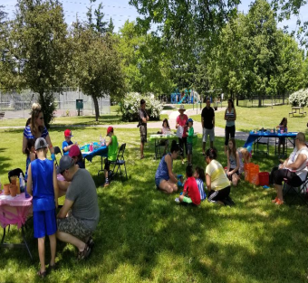
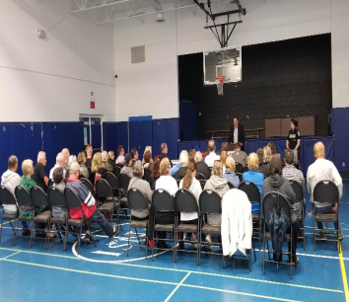
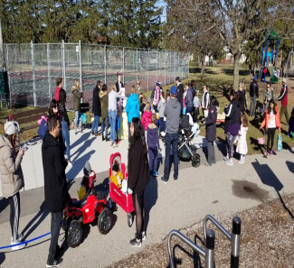
SHORA Year in Review
SHORA Events: Deck the Streets Dec 2019
Easter Egg Hunt Cancelled
Spring Clean Cancelled
Community Safety Meeting Cancelled
Community Garage Sale Cancelled
Art in the Park Cancelled
Wood Clean Up Cancelled
Looking Forward: Venta Development (Virtual) Oct 21st 6:30-8:00PM Halloween / Pumpkin Walk ?
Natural Ice Rink Laughton Park is Registered
MTO Public Consultation Mid to late 2021
Confidential - Sherway Homeowner’s and Recreation Association
Notes:
6

Slide 7
Community Updates MTO Contract 2 (East of Cawthra to East of Dixie) -Contract 2 work expected to commence 2022 and last for 3-4 years. -Community input sessions won’t start until 2021.
Location of Construction yard unknown.
Communications with MTO remains limited Tonolli Monitoring -Tonolli is not willing to invest presently in additional air monitoring station
-Tonolli is open to soil testing in Sherway.
2207 Dixie Road (@ Venta) Application 4 four-storey townhome dwellings)
Virtual Meeting Scheduled for Oct 21st. Look for notices on FB, Website, email. (from Residential Low to Medium Density. Change zoning from R3-75 (Detached Dwellings –
Exception) to RM4-Exception (Townhouses – Exception)
2101 Dixie Rd (@ Sherway Dr.) Daycare
- variance application for a daycare was approved. Pre-covid the new owners reached out to SHORA and requested a meeting. We asked for answers to key questions affecting the intersection and have not received any response.
Confidential - Sherway Homeowner’s and Recreation Association

Slide 8
Guest Speaker – Councilor Stephen Dasko
Mississauga Ward 1 City Councilor
- Ward 1 Updates / SHORA Updates
- Question and Answer Session
Confidential - Sherway Homeowner’s and Recreation Association
Notes:
8

Slide 9
Closing Comments
Adjournment
Confidential - Sherway Homeowner’s and Recreation Association
Notes:
9

