Slide 1
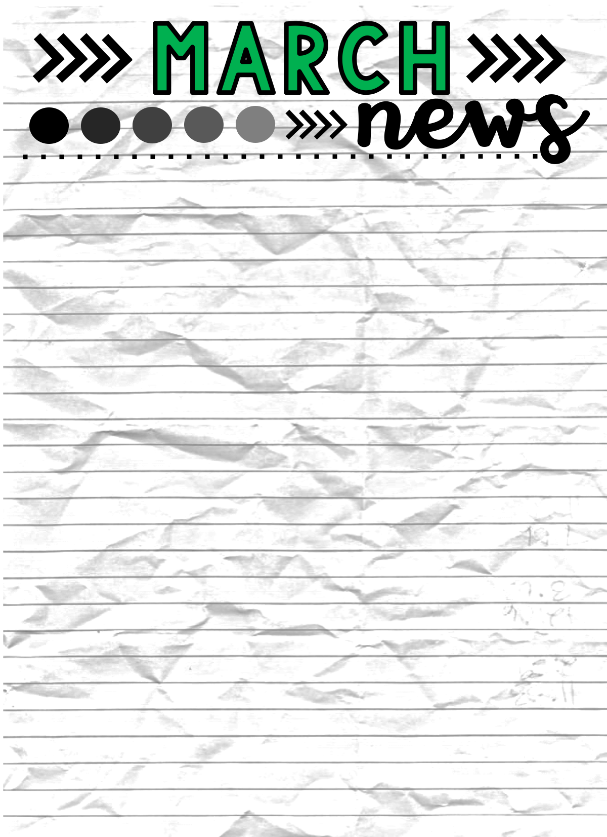
Here’s What We’re Learning
Dates to Remember
BIG SCHOOL
Healthy Eating
Wind
Spring
Water & Rain Cycle
LITTLE SCHOOL
Pond Life
Spring
Spiders
LETTERS
E, K, I, Z,
Date 1: Wed. March 11th
School Pictures
Date 2: April 6th - 10th
School Closed for
Spring Break
Date 3: April 13th
Return to School
OTHER HAPPENINGS
BOOK ORDERS
Kindergarten registration is under way. Please check with your neighborhood school for exact dates.
March book orders are due Thursday March 12th.
Remember to sign your child in and out when dropping off and picking
up your child, this is a state licensing requirement. Also please write
your child’s name on jackets and water bottles.

