Slide 1
“It’s All About JAZZ “!
Sponsored by “The Steinway Society of Riverside”
Mr. McSymphony’s
A Mr.McSymphony™ Program
©2015 all right reserved
1

Slide 2
JAZZ WORDS
IMPROVISE
GIG
WA-WA
SCAT
JAM SESSION
2

Slide 3
Slaves’ Voyage from Africa to New Orleans
3

Slide 4
African Workers Would Sing While Working
Workers picking cotton.
4

Slide 5
Scott Joplin
Wrote Maple Leaf Rag.
5

Slide 6
Improvise
To make something up on the spot, or figure it out as you go.
Listen to Mr. Morton improvise
“Maple Leaf Rag”
6

Slide 7
Jelly Roll Morton
Funny name because he wrote “Jelly Roll Blues”
7

Slide 8
Thomas Wright aka “Fats Waller”
8

Slide 9
Sidney Bechet – “Blue Horizon” (pronounced beh-shay)
9

Slide 10
King Oliver – Dixieland Jazz
King Oliver holding his trumpet
Listen for the wa-wa sound
10

Slide 11
Big Band Era – popular because good rhythm to dance to.
11

Slide 12
Count Basie
The King of Swing
12

Slide 13
Lionel Hampton – Vibraphone (Marimba)
What is the difference between a
Xylophone and a Vibraphone?
13

Slide 14
Duke Ellington
14

Slide 15
Benny Goodman
Listen for the Wa Wa sound
15

Slide 16
Blues -- sadness
Some Africans wear blue to funerals as a sign of respect.
16

Slide 17
Charlie “Yardbird” Parker
17

Slide 18
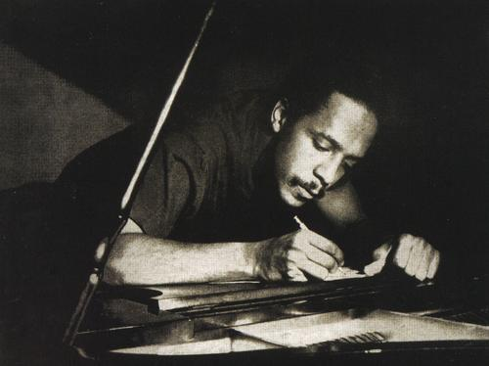
Bud Powell writes BOP music
18

Slide 19
Doc Severinsen
Doc plays his
Pocket Trumpet
19

Slide 20
Steve Tyrell
20
Listen to Steve Jazz up a well known song made popular by
Gene Autry

Slide 21
Gene Autry – Singing Cowboy
21

Slide 22
Rudolph – the Red-nosed Reindeer
22
Introduced the song Rudolph and it became an instant hit!

Slide 23
Bessie Smith “Empress of the Blues”
23

Slide 24
Billie Holiday Jam Session
24

Slide 25
Ella and Louis together
25

Slide 26
Scat – jazz sung without real words: “ba-ba-beep-do-dat-dee-dee”
Ella Fitzgerald singing “scat”
26

Slide 27
Sarah Vaughan
Sang Jazz and played the piano.
Her nickname was “Sassy”
27

Slide 28
THE GOLDEN EAGLE JAZZ BAND
FEATURING THE JAZZ SINGER
CHRIS NORRIS
28

Slide 29
Al Hirt
Dixieland Jazz – music that is so lively, you can’t sit still.
29

Slide 30
When the Saints Go Marching In
Dixieland Band
30

Slide 31
The End
31

