Slide 1
2019 National Cleanup Workshop
Jim McConnell
Associate Administrator for
Safety, Infrastructure, and Operations
National Nuclear Security Administration
September 12, 2019

Slide 2
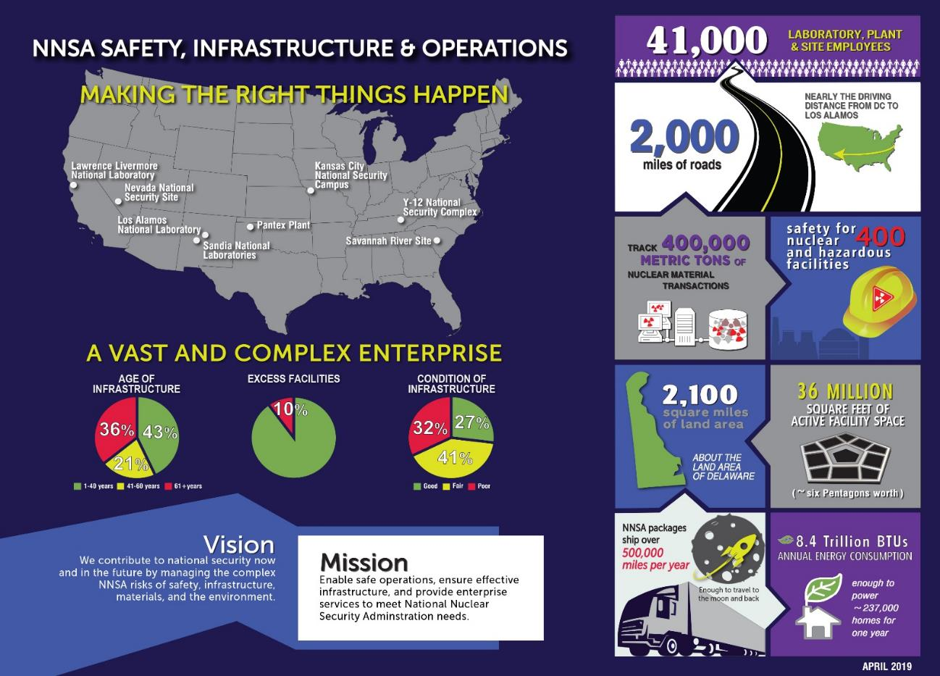
Overview

Slide 3
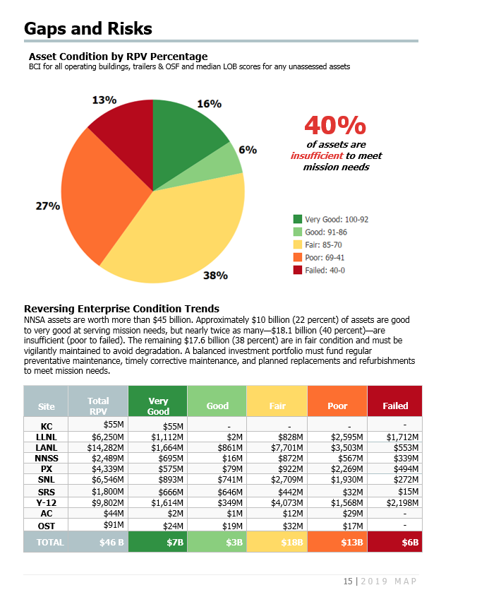
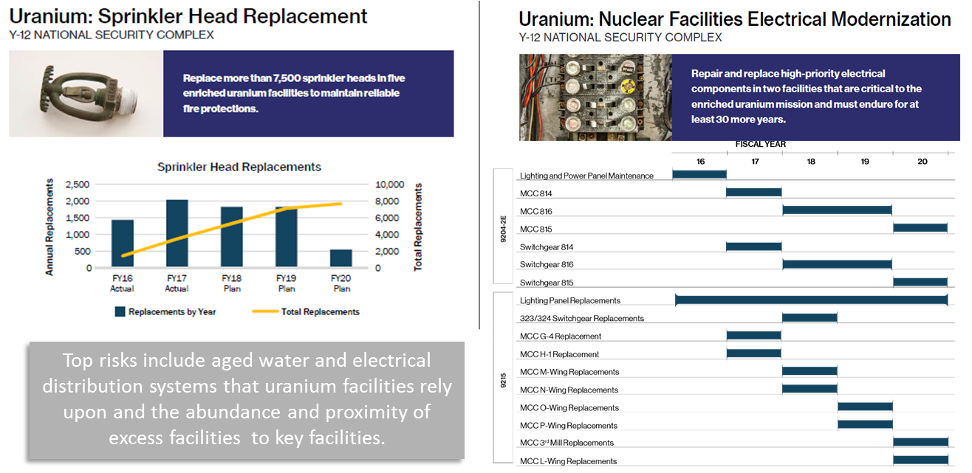
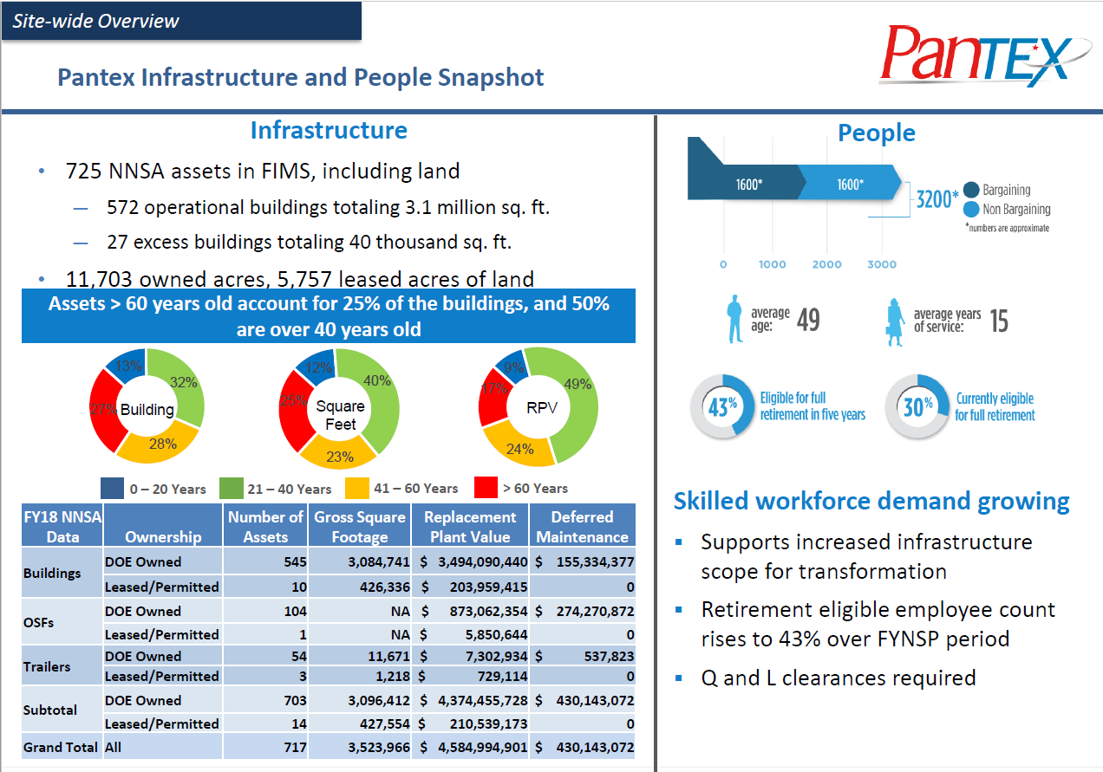
Infrastructure Revitalization Goal
A science-based infrastructure stewardship approach using risk-based, data-driven metrics to prioritize investments in order to enable the mission.
Master Asset Plan
Tools
  BUILDER
  Mission Dependency Index (MDI)
  Enterprise Risk Management
  Excess-Facility Risk Index
  G2 Program Management System
  Prioritization Methodologies
Planning
  Strategic Integrated Roadmap
  SSMP Chapter 4
  Master Asset Plan (MAP)
  Deep Dives
  CapAx
  Area Plans
  Disposition Strategic Plan
Deep Dives

Slide 4
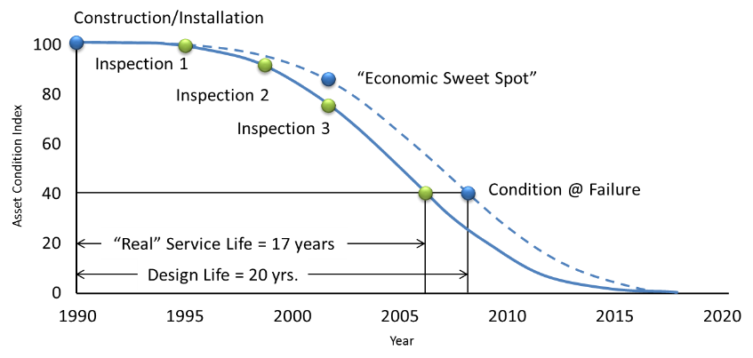
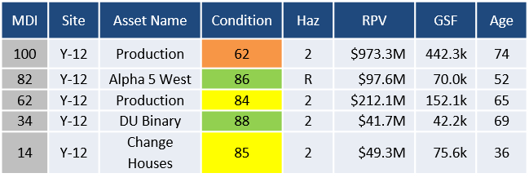
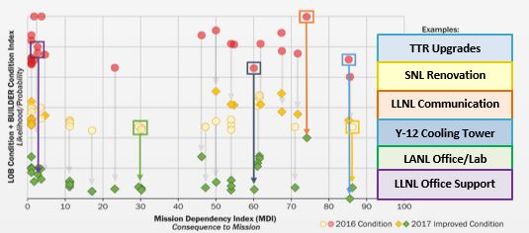
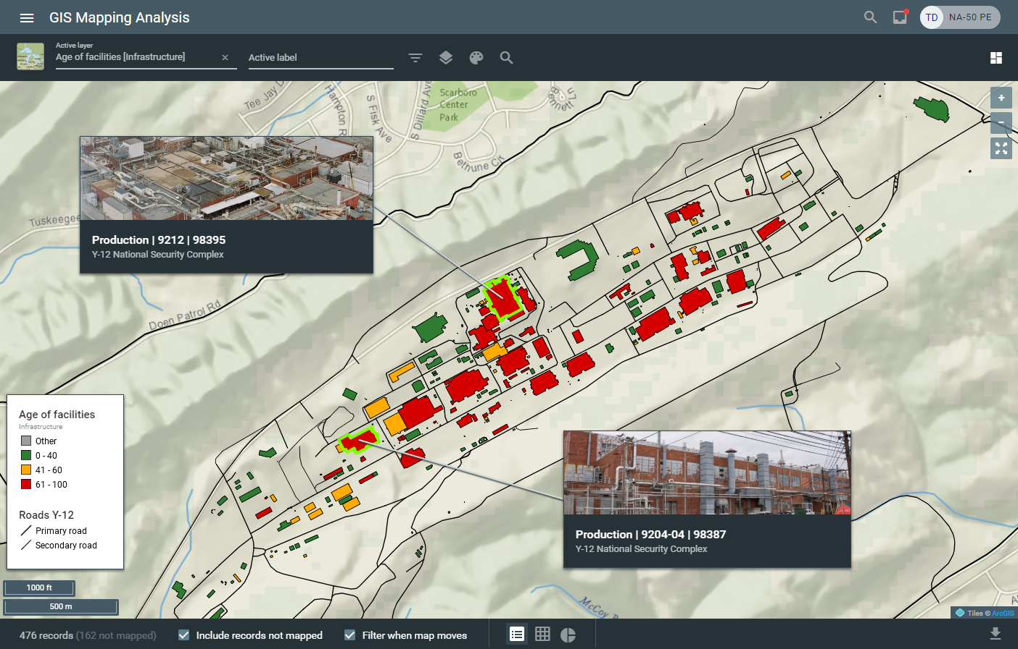
Tools
A science-based infrastructure stewardship approach using risk-based, data-driven metrics to prioritize investments in order to enable the mission.
BUILDER
Mission Dependency Index
Measures likelihood of losing a facility
Measures mission impact if a facility is lost
Enterprise Risk Management (ERM)
G2
Highlights the risk posed by each asset and risk trending across the enterprise
Award-winning program management system
and Program Management Plan (PMP)

Slide 5
Planning
NNSA is using our new tools to develop strategic and area plans in order to drive prioritized, integrated infrastructure investments across the enterprise.
Prioritizing investments with the greatest impact on mission via new tools
Conducting Deep Dives at each site to better understand the long-term, requirements-based needs
Publishing an annual Master Asset Plan (MAP) which is the integrated, NNSA-wide infrastructure strategic plan
Developing detailed Area Plans to synchronize Maintenance, Recapitalization, Line-Item, and Leasing investments
Increasing emphasis on timely Disposition of excess facilities to reduce mission risk, unencumber valuable site real estate, and save cost
Emphasizing greater project-level planning prior to submission on funding

Slide 6
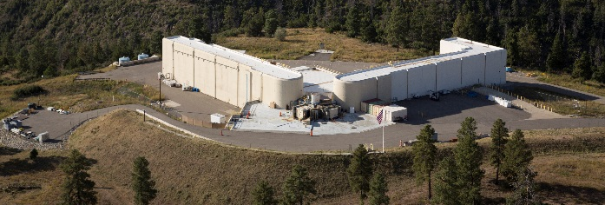
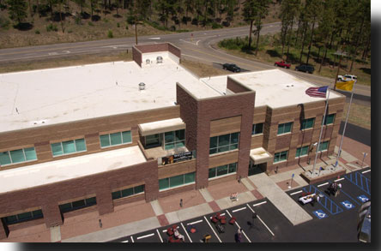
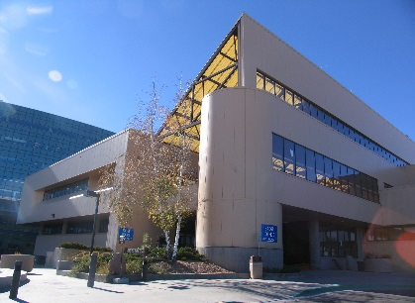
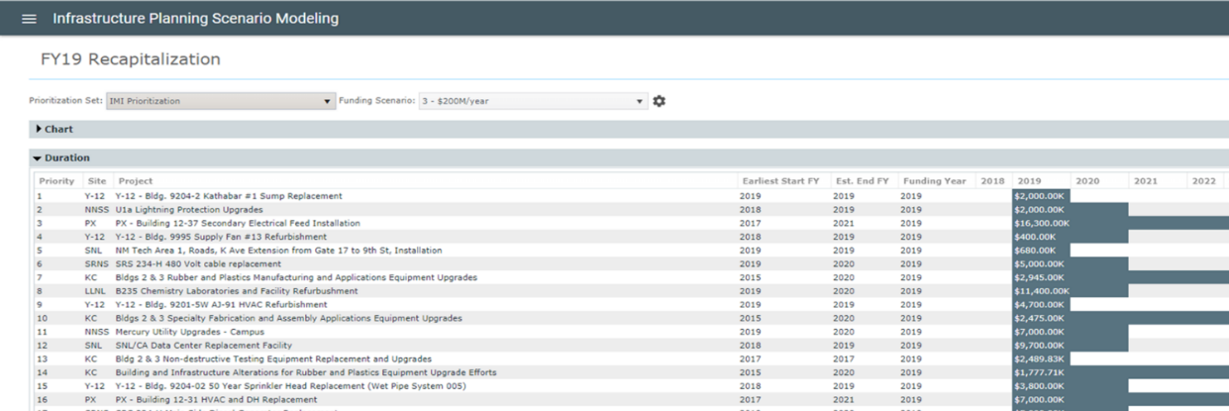
Prioritization
A science-based infrastructure stewardship approach using risk-based, data-driven metrics to prioritize investments in order to enable the mission.
Maintenance Prioritization
MDI & BUILDER Standards & Policies
Mission Dependency
Index (MDI)
LANL Facilities
Standard |  | Policy
Level | CI | MDI | Building System
Very High | 90 | 40-100 | Fire Protection
High | 80 | 1-39 | Fire Protection
 |  | 75-100 | Conveying
 |  | 75-100 | Roof
Medium | 70 | 1-74 | Roof
 |  | 40-74 | Conveying
Low/Default | 60 | 1-39 | Conveying
No repair/End of Life | 0 | 1-100 | Basement Construction
DARHT
MDI 99
EOC
MDI 47
Otowi Building (Office Space) MDI 13
Recapitalization Prioritization

Slide 7
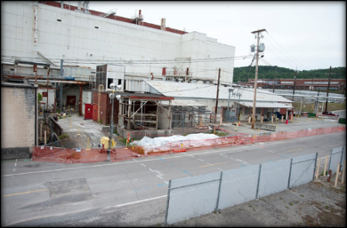
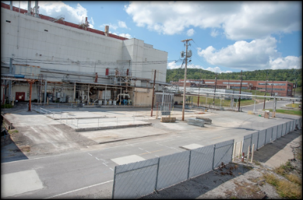
NNSA Facility Disposition
2001 – 2013: Facilities and Infrastructure Recapitalization Program (FIRP) was NNSA’s method for funding disposition
  FIRP’s focus on footprint and deferred maintenance reduction meant higher risk excess assets were not addressed
In FY 2014, NA-50 reinvigorated direct funded disposition
  2014: $1.04M to disposition Y-12’s 9744
  2015: $2.5M to disposition Y-12’s 9808
  2015: $3M to disposition LANL’s CASAs 2 and 3
  Annual funding of ~$50M starting in 2017
  NNSA has disposed of 5.7M GSF since 2014
9808 Before and After

Slide 8
Management Improvements
NNSA is deploying new data-driven, risk-informed tools to create a science-based infrastructure stewardship model, which is being applied to facility disposition
The tools include:
  Excess-facility Risk Index – 1-100 score for excess facilities calculating the risk posed by structural and safety conditions; potential impact of contaminants; and proximity of the excess asset to workers, public, environmental receptors, and high importance facilities
  Disposition Strategic Plan – annual plan laying out an integrated, enterprise-wide approach to address NNSA’s aging Excess infrastructure reflecting the priorities documented in NNSA’s Master Asset Plan
An ERI score of 70 – 100 indicates a High-Risk Facility

Slide 9
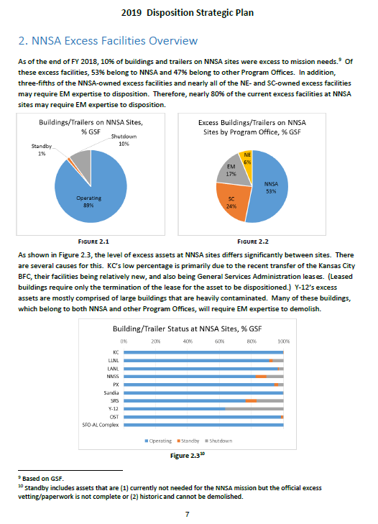
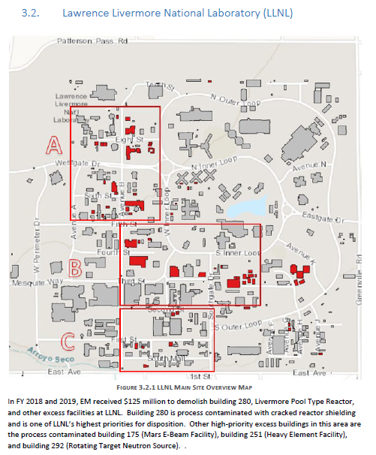
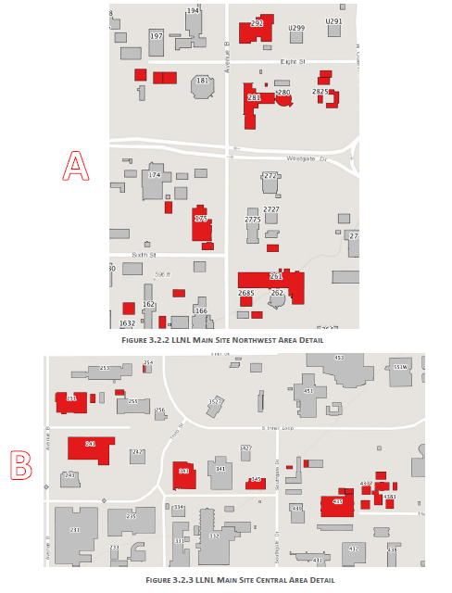
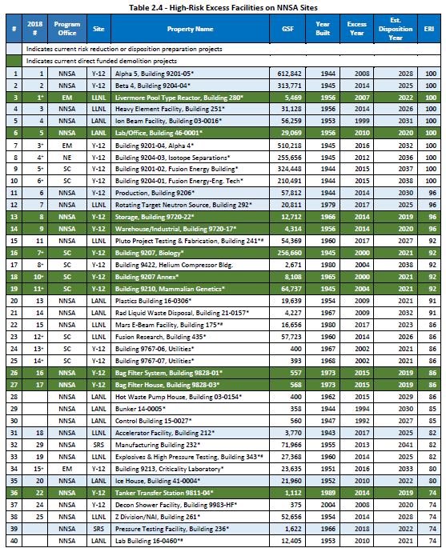
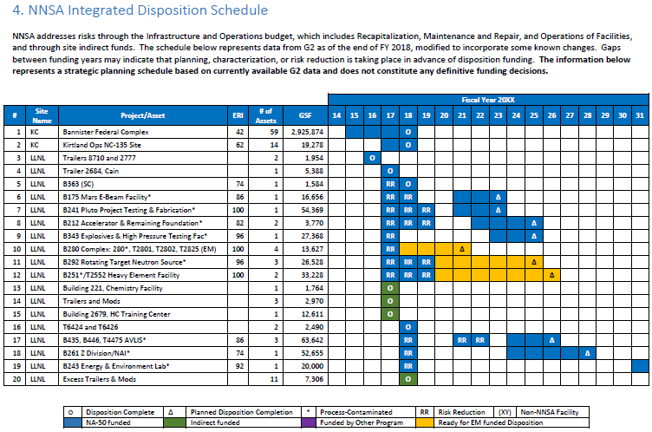
Disposition Strategic Plan
NNSA is using our new tools and authorities to develop strategic and area plans in order to drive prioritized, integrated infrastructure investments across the enterprise.

Slide 10
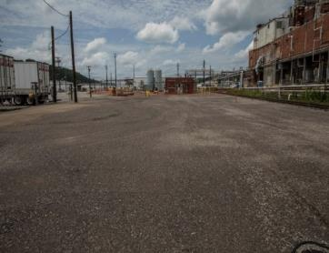
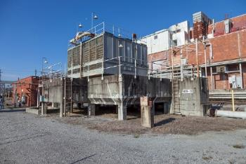
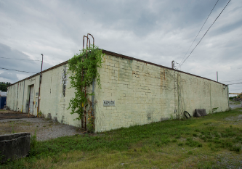
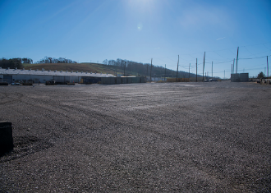
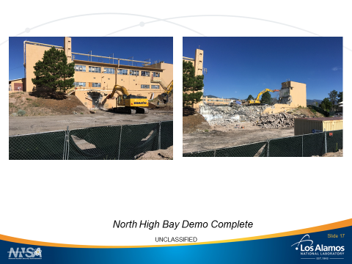
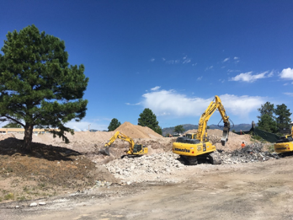
New Authority
PROCESS-CONTAMINATED DISPOSITION
Before
After
Before
After
Y-12 Building 9404-20
Y-12 9720-24 Demolition
Before
After
Before
After
July 2019
LANL TA-46-0001
LANL TA-16-0280
In FY 2018, NNSA received authority to disposition process-contaminated facilities under $50M to help:
  Reduce risk to mission by disposing of small excess facilities near mission work
  Freeing up prime real estate for NNSA to build new facilities on
Most of these disposition projects are in the $2M to $3M range
Notes:
The authority to dispose of process-contaminated facilities under $50M is helping us reduce risk to mission by disposing of excess facilities near mission work and freeing up prime real estate for us to build on. Most of our disposition project fall in the $2M to $3M range.

Slide 11
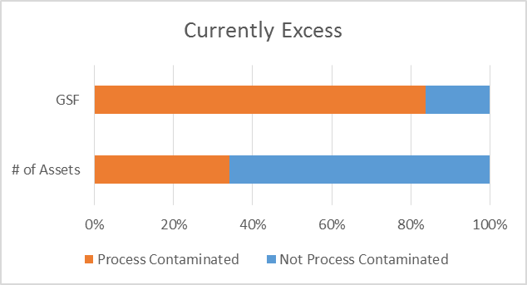
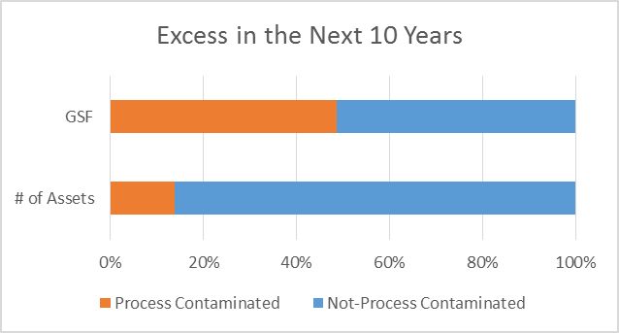
Disposition Next Steps
Continue to stabilize and reduce risk at process-contaminated facilities until EM can address them
Current excess on NNSA Sites
  3.5M GSF
  384 assets
  84% GSF process-contaminated
Excess in the next 10 Years will add
  2.3M GSF
  413 facilities
  >50% GSF process-contaminated

Slide 12
Conclusion
Data-Driven, Risk-informed Planning
Real World Changes
Increase in Resources, Support, and Authority
Continuous Improvement
Still More to Do
We did not get into the situation overnight
And we will not get out of it overnight.

