Slide 1
Chapin Area Rescue Squad 2017 EMR
Chapter 10: Poisoning and Substance Abuse

Slide 5
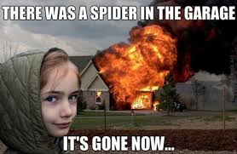
Spider and Insect Bites
All spiders are poisonous
Insect stings and bites are rarely dangerous
Anaphylactic shock
is a major concern
Remove stinger
quickly

Slide 6
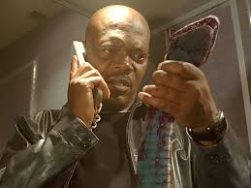
SNAKES
Require special care but are not usually life-threatening
Death is not sudden unless anaphylactic shock develops
Stay calm
Keep patient calm
and at rest

Slide 7
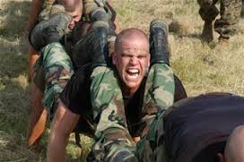
Marine Life
Can occur in variety of ways
  Eating improperly prepared seafood or poisonous organisms
  Stings and punctures
Fresh water activates toxins on skin, increasing pain
Use salt water to rinse affected area

