Slide 1

Writing for the 2014 GED® Workshop
Strategies to Improve Your Student’s Writing Scores
Presented to Central Alabama Community College
By: Karen Welch
April 10, 2015

Slide 2

Workshop Objectives
Outline strategies & tools
Provide resources
Polish writing techniques
Build confidence!
Notes:
This workshop should help you outline some strategies and tools you can use to strengthen your students writing, provide some resources,

Slide 3

Writing Requirements
Scoring Rubric
RLA Prompt
SS Prompt
Science Short Answers

Slide 4

Notes:
We will be using a variety of exercises in this workshop. Feel free to write on anything marked handout on the cover. For the practice prompts, I ask that you NOT write on these as I use them for other workshops and that you turn them back in when we are finished.

Slide 5


Reading & Writing on the
2014 GED® Test
Read Like a Detective
Write Like an Investigative Reporter

Slide 6

Work in Progress

Slide 7
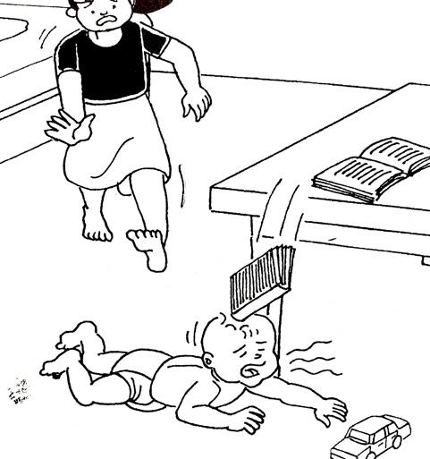
Practice + Patience

Slide 8
Extended Response Writing
Makes up 15-20% of the total score
No deductions for incorrect responses
Reading passages are 450-650 words
Notes:
The extended response writing prompts are important because they make up anywhere from 15-20% of a students total score. The GED does not penalize students for incorrect responses, but they also do not award points if the response is missing some important elements. The reading passages are complex and are between 450-650 words for the RLA and the SS prompts

Slide 9

1 question
45 minutes
3 traits measured
12 points

Slide 10

Understanding the Scoring Rubric

Slide 11
TRAIT 1:
Creation of Argument and Use of Evidence
Measured for both RLA and SS
Worth=2pts.

Slide 12

Argument
Validity
Integration/Analysis
Notes:
The GED wants to see that writers have stated which argument they support, have validated that argument with specific support and evidence drawn from the sources. Further they want to see that writer has analyzed the argument and integrates that into their writing.

Slide 13

Framing Your Response: Trait 1
Notes:
What does a good thesis statement do? It directly answers the question asked of the writer and makes a claim.

Slide 14



Use of Evidence
Supports argument
Evidence is analyzed
Notes:
Furthermore, the RLA response should use explicit claims drawn from the text, show a clear understanding of the argument they in support of and detail for the reader how the evidence relates to and supports their argument and that they’ve analyzed the evidence.

Slide 15
TRAIT 2:
Development of Ideas and Organizational Structure
Worth = 2 pts. RLA/1 pt. SS

Slide 16
Write with Purpose!
Multiple Ideas Flushed out
Logical Progression
Employ Transitional devices

Slide 17
TRAIT 3:
Clarity and Command of Standard English Conventions
Worth = 2 pts. RLA/1 pt. SS

Slide 18
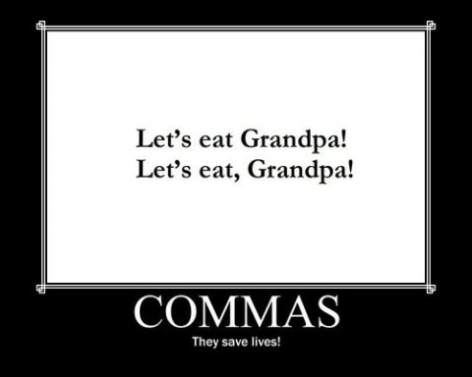
Things to Avoid
Notes:
This is your Let’s Eat Grandpa! Versus Lets eat, Grandpa! Trait!

Slide 19

Also Avoid:
Wordiness
Run-ons and comma splices
Faulty Parallelism
Misplaced modifiers
Using the wrong verb form
Incorrect or unclear pronouns
Apostrophe & Capital errors
Notes:
Major writing blunders to avoid!

Slide 20
Non-Scorable Items
(0) points awarded:
  Response exclusively contains text copied from source text(s) or prompt
  Response shows no evidence that the test-taker has read the prompt or is off-topic
  Response is incomprehensible
  Response is not in English
  Response has not been attempted (blank)
Notes:
Lastly, writers will receive 0 points for the following items.

Slide 21

Common Test-taker Mistakes
Thesis statement missing
Claim not clearly stated or validated
Flip between claims
Evidence not specified
No analysis of the supported claim
Insert personal opinion
Must be 250-300 wpm
Notes:
In reviewing some GED responses, here is what most writers fail to do.

Slide 22
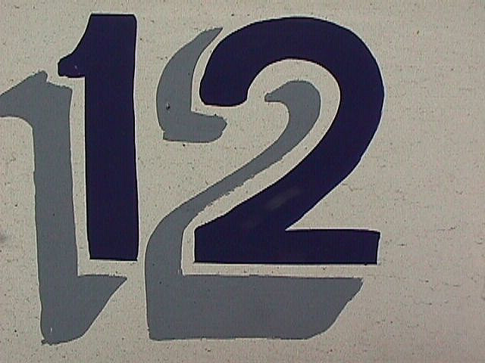
Getting to
Notes:
Let’s talk about how you can get your students as close to 12 points as you can.

Slide 23
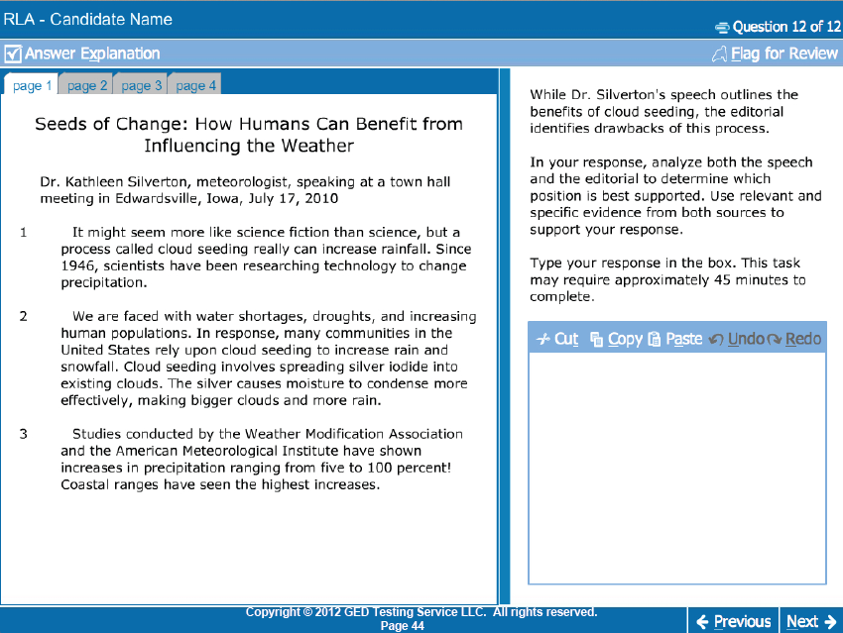
You Are Here
x
Notes:
Each RLA prompt will look similar to this one. The prompt is located above the text box. Multiple tabs on the right display the opposing views—so be sure your students read all tabs! Your students should be prepared to write as soon as they enter this section.

Slide 24
Steps for Responding to the RLA ER on the 2014 GED® Test
  Read the prompt first
  Read the passages and take notes (tab/paragraph)
      Build a short list of strengths/weaknesses during you first reading pass. Along the way:
        Look for study dates; put the most recent first
        Look for significant statistics or details-use for support
        Check for source credibility
        Question motives of cited studies
  Pick a side
  Construct a thesis statement
  Add three supporting details (use notes for citations)
  Write a conclusion
Notes:
Reading the prompt is important—it allows the writer to understand the topic and which side each of the opposing views will be on.

Slide 25
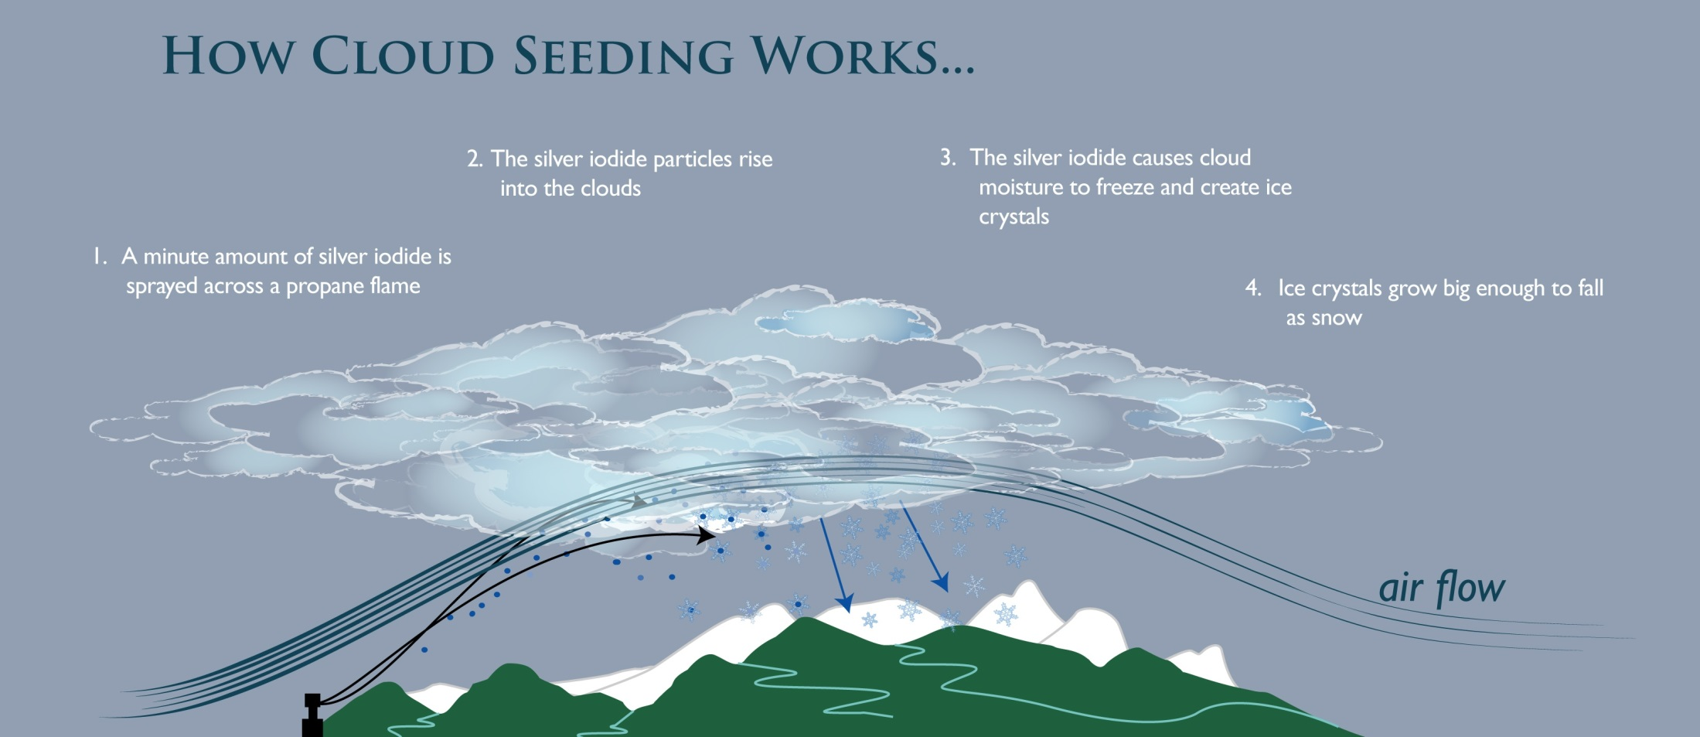

Slide 26
Seeds of Change:

Slide 27
Read and Deconstruct the Prompt
While Dr. Silverton’s speech outlines the benefits of cloud seeding, the editorial identifies the drawbacks of this process. In your response, analyze both the speech and the editorial to determine the best supported position. Use relevant and specific evidence from both sources to support your response.
Do | What
Analyze | Both the speech and the editorial
Determine | The best supported position
Use | Relevant and specific evidence from both sources to support your response

Slide 28

Take Note:
Author’s names/publications
Studies/Reports
  Dates /organizations who conducted the studies
  Stats/figures
Credibility of sources
Bias/Emotion
Quotes to use or paraphrase

Slide 29
Seeds of Change Notes:
Dr. Kathleen Silverton, meteorologist
Glass County Gazette editorial (author unknown)
Cloud Seeding Benefits:
  Practice in use since 1946 (1.1)
  Provides drinkable water (2.4)
  Water for crops/reduce crop damage (2.5)
  Low cost power option (2.4)
  Low risk level from chemicals (2.6)
Studies
  Weather Modification Association (date unknown) (1.3)
  American Meteorological Institute (date unknown) (1.3)
  U.S. Public Health Services-dates not given; toxicity levels below risk level (2.6)
Quote:
  “As growing populations create higher demand for both water and power, this provides an optimal solution.” (2.4)
Cloud Seeding Dangers
  Chemicals used are poisonous and harmful to plants and animals (4.9)
  Long-term effects not known (3.8,4.9)
Studies:
  Weather Modification Association is a private company-stake in outcome?? (4.9)
  University of MI-no date given; level of long-term risk unknown (4.9)
  2010 Australian Study-long-term build-up crucial and unknown (4.9)
Quote:
  “If the poison is in the does, no one yet knows what the does of harmful chemicals from cloud seeding is.” (4.9)

Slide 30
Thesis Statement Examples
For Dr. Silverton:
Cloud seeding is a viable solution for communities as it contributes many positive benefits. Dr. Silverton presents a stronger argument because, as she notes, cloud seeding delivers significant benefits for communities like drinkable water sources and power for hydroelectric dams, while the short-term risks are few.
Topic is stated in the thesis statement
Make a claim/take a position
State the topic and which argument is stronger.

Slide 31
Thesis Statement Examples
For the Gazette:
Cloud seeding relies on the use of chemicals that are poisonous to both humans and the planet. The Glass County Gazette editorial provides a better argument because it makes clear that the chemicals are harmful and the long-term effects are unknown. Citing two studies by reputable organizations, the editorial points to the crucial need for additional long-term analysis of the chemicals used in cloud seeding, and suggests Dr. Silverton may be biased by her profession.
State the topic and which argument is stronger.

Slide 32
Techniques to use with a weak writer
Memorize or use sample frames
Parrot the prompt
Support the central argument with specific details from the source text (paraphrase; limit use of quotes)
Evaluate the argument and provide examples (pick the argument apart)

Slide 33
Simplify with Sample Frames
Looking at the arguments presented about ____[the topic]______, it is clear that _[author by name]__________ provides the stronger argument.
The two articles about ___[the topic]___________ show differing opinions about it, but ___[author]__’s argument makes a better case.
When comparing the two positions about __[the topic]_______ in this article, ___[author]_______________provides the clearest evidence that __[topic] is beneficial/detrimental.

Slide 34
Weak Writer Strategy:
Parrot Prompt Example
Prompt:
  While Dr. Silverton’s speech outlines the benefits of cloud seeding, the editorial identifies the drawbacks of this process. In your response, analyze both the speech and the editorial to determine the best supported position. Use relevant and specific evidence from both sources to support your response.
Parrot the Prompt
  Dr. Silverton’s speech, which outlines the benefits of cloud seeding, offers the best evidence and is therefore the better supported argument.

Slide 35

Individual Activity-Thesis Statement/Notes
YOUR TURN
Read the prompt
Read the passages
Take notes-3 reasons
Write a thesis statement
You will have 15 min.!

Slide 36

RLA Checklist
My response includes:
Includes a thesis statement
States which side is best supported
Provides 3 reasons with evidence
Connects to and is a validation of the thesis
May include a counter argument

Slide 37
Building a Structured Response for the RLA ER
Thesis Statement-Take a stand
Insert a transition word
Conclusion
Point #1-connected to the thesis
Insert a transition word
Insert a transition word
Counter argument-strong writers
Point #2-connected to the thesis
Point #3-connected to the thesis
Insert a transition word
Insert a transition word
Insert a transition word

Slide 38
Strategies to Use:
Google Docs Graphic Organizers
Argue Both Sides Practice note-taking
Use 3rd Person Voice
Use transitional words to connect ideas

Slide 39

Writing for the GED: Book 4
Book of Prompts with Online Practice:
10 RLA
10 Social Studies
15 Science
Online: writing4.newreaderspress.com
4 RLA attempts
4 Social Studies attempts
4 Science attempts
6 Customizable attempts
Time your response

Slide 40

Prompt Resources:
NRP-Writing for the GED series books-Now books 1-4 (#4 Practice Prompts)
NRP-Scoreboost for the GED-Responding to Text
NRP-Pre HSE-Writing Book 2
NRP-Social Studies for the GED® Test
NRP-Science for the GED® Test
Kaplan Big Book
NRP-Short Lessons in U.S. History
App State Adult Ed Resource Page:
http://abspd.appstate.edu/teaching-resources
GEDTS Web site

Slide 41

Responding to the SS Extended Response on the 2014 GED® Test

Slide 42
1 question
25 minutes
3 traits measured
8 points

Slide 43
Defining Enduring Issue
The GEDTS’s definition of the enduring issue is:
An enduring issue reflects the founding principles of the United States and is an important idea that people often grapple with as new situations arise
Supreme Court cases are interpretations of these same enduring issues modified for the times

Slide 44
Enduring Issue
Connect the Prompts
Historical Context

Slide 45

Enduring Issue Exercise

Slide 46
Timeline For Context
Early 1900’s
1920-1950
Enduring Issue
1960-1980
1980
Present Day

Slide 47
Enduring Issue Examples
Voting Rights
Freedom of Speech
Enduring Issue
Civil Rights
Privacy
Health Care

Slide 48

Example: Affordable Care Act
U.S. Constitution states: “Congress has the power to lay and collect taxes…to pay the debts and provide for the…general welfare of the United States.”
Supreme Court upheld that the health insurance mandate could be levied as a tax, therefore mandate that everyone has to pay for their healthcare

Slide 49

Getting to

Slide 50
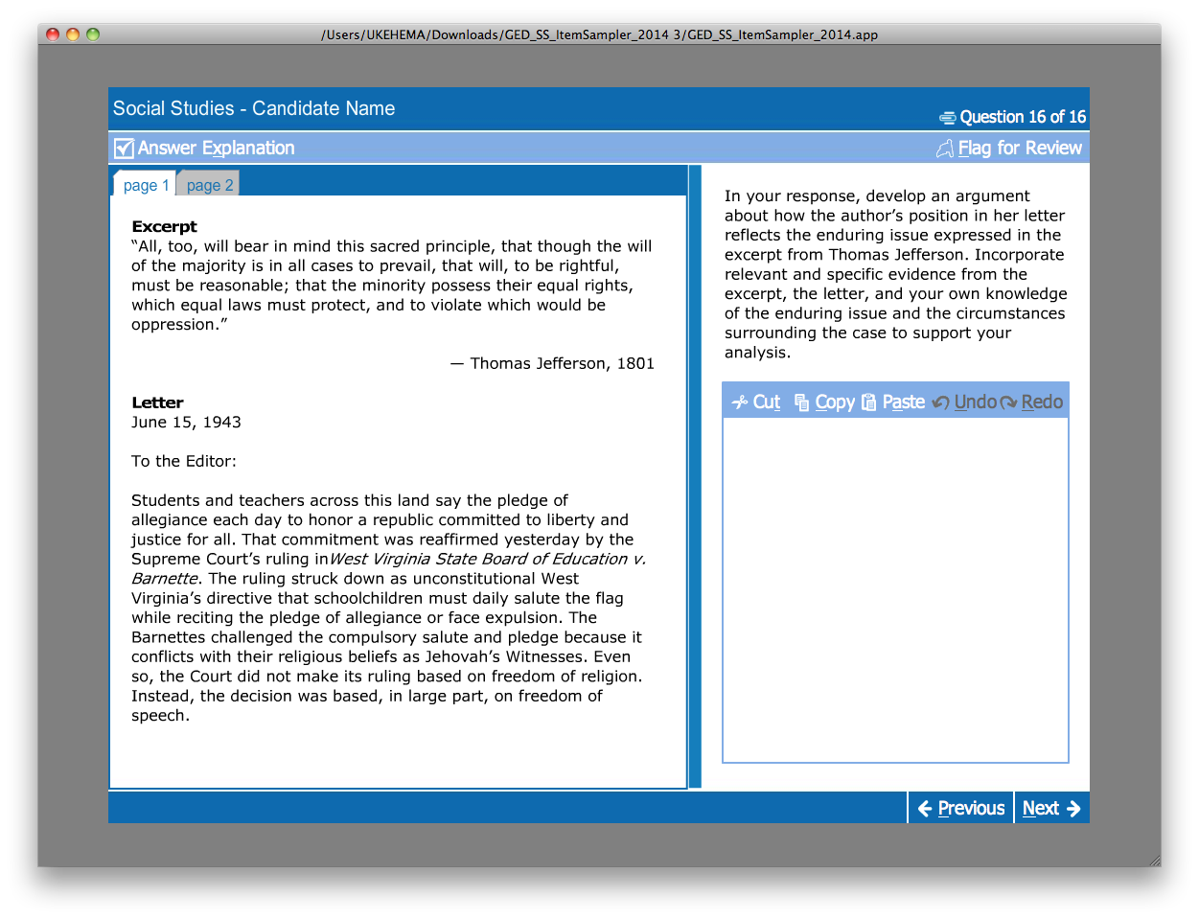
You Are Here
X

Slide 51
Take Note:
Authors-quote, opinion
First prompt-enduring issue
Second prompt-historical context
What’s the connection?

Slide 52
Common Test-taker Mistakes
Enduring issue not mentioned
No connection between the prompts and the enduring issue
Link to historical context missing

Slide 53
SS Checklist
My response:
States the enduring issue
Provides 2-3 sentences that connect the prompts
A sentence or two about the historical context/significance

Slide 54
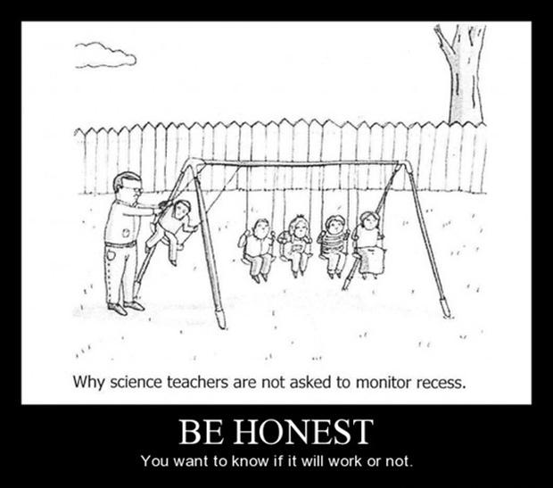
Science

Slide 55
2 questions-various types
10 minutes ea.
3 points ea.

Slide 56

Getting to

Slide 57
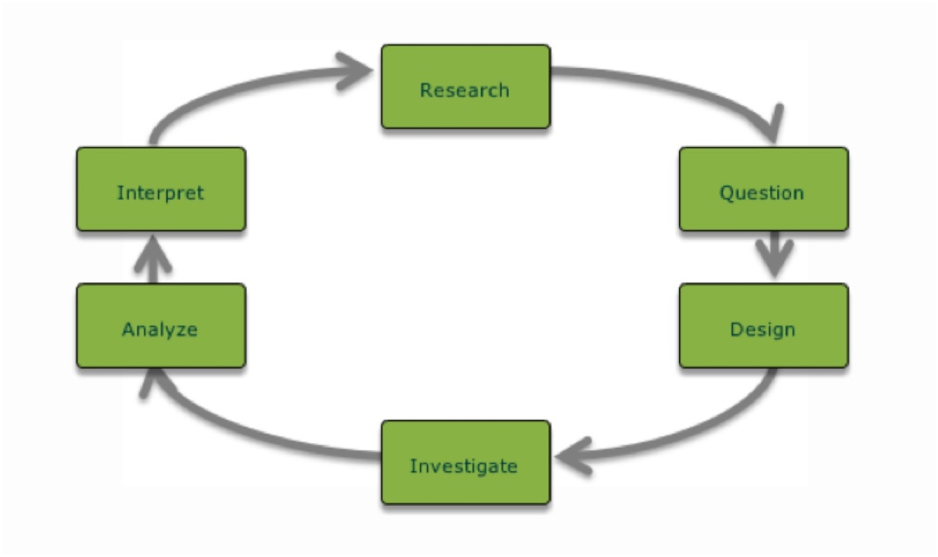
Experimental Design: Scoring Criteria
Controlled Experiment Design
Data Collection
Hypothesis

Slide 58

Farmer’s Hypothesis

Slide 59
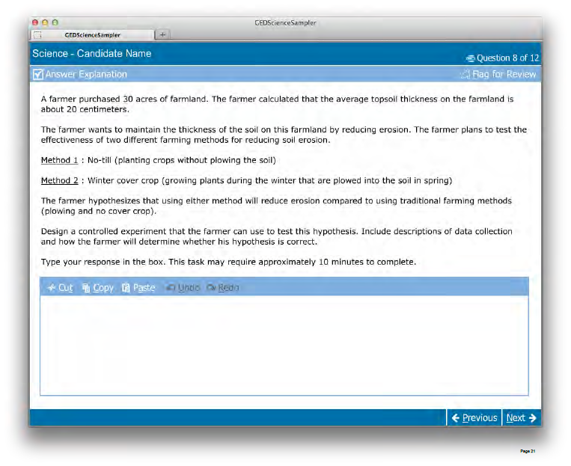
You Are Here:
X
X

Slide 60
Prompt:
Design a controlled experiment that the farmer can use to test this hypothesis. Include descriptions of data collection and how the farmer will determine whether his hypothesis is correct.

Slide 61
Short Answers: Experimental Design
Scientific Method
Steps to Responding
Identify a problem/formulate a question
Make observations and collect data
Formulate a hypothesis
Design and carry out controlled experiments to test the hypothesis
Analyze the results and communicate findings
Read and analyze the prompt
  What’s the hypothesis? Rewrite, underline or highlight it.
  Look for key words that tell you what to do with the hypothesis.
Plan and write
  How will the experiment be conducted?
  What data will be collected?
  How will the data be analyzed?
Check and Revise

Slide 62
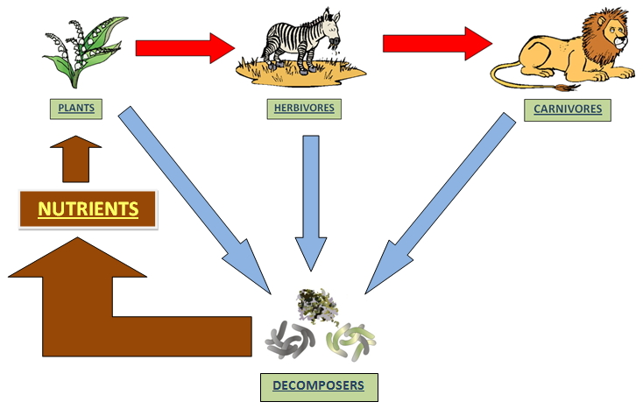
Science-Other Types: Scoring Criteria
Explain the relationship
Use multiple pieces of support
Pulled from the passage

Slide 63
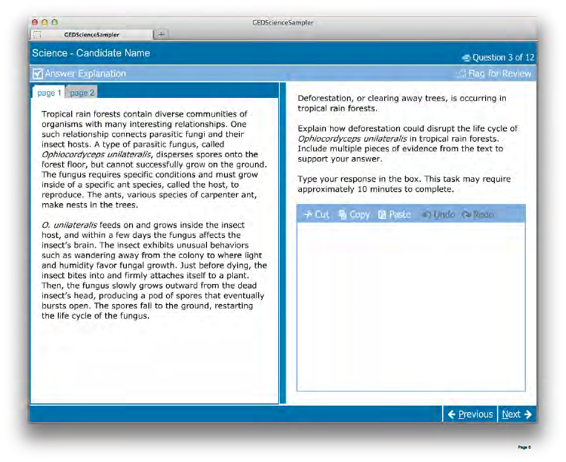
You Are Here:
X

Slide 64
Science: Other Prompt Types
Prompt:
Deforestation, or clearing away trees, is occurring in tropical rain forests.
Explain how deforestation could disrupt the life cycle of Ophiocordyceps unilateralis in tropical rain forests. Include multiple pieces of evidence from the text to support your answer.
Type your response in the box. This task may require approximately 10 minutes to complete.

Slide 65
Take Note-
Experimental Design
What’s the hypothesis?
Describe the design
Describe how the data will be collected including frequency
How will the hypothesis be tested?

Slide 66
Take Note-
Other Types
Describe and analyze the relationship between organisms
Use multiple pieces from the passage as evidence
Determine & describe why the relationship is important

Slide 67
Science Checklist: Exp. Design
My response includes:
An explanation of how the experiment will be designed
A connection between the design and the hypothesis (proof that it works)
Details on data collection and frequency [e.g. data table, chart, etc.]

Slide 68
Science Checklist: Other Types
My response includes:
Explains the specific relationship between the organisms
Details why the relationship is important
Cites multiple pieces (2-3) from the passage as evidence

Slide 69
GEDTS Resources
National Adult Education College and Career Readiness Training Design Initiative: A Train the Trainer Workshop (April 2013)
The 2014 GED Test-Reasoning Through Language Arts: Extended Response Guide for Adult Educators (October 2013)
The 2014 GED Test-Social Studies: Extended Response Guide for Adult Educators (October 2013)
The 2014 GED Test-Science: Short Answer Resource Guide for Adult Educators (October 2013)
Focus on 2014 Content: Social Studies and Science: A Workshop from the GED Testing Service (July 2013)
Educator Scoring Tools
Test Companion
All of these materials can be found on the GEDTS web site:
http://www.gedtestingservice.com/educators/home
Notes:
Score reports and study plans are additional benefits included with the online course. Later this month we will have an online demo of the online course. We have not yet seen the completed products, but if you have any questions on the Kaplan big book, we can try and answer them or will pass your questions along to Kaplan and get back to you with the answers?

Slide 70

Build Confidence

Slide 71

Questions

Slide 72
Contact & Ordering Information
Karen Welch
New Readers Press
(404) 580-1563
kwelch1799@gmail.com
Thank You!

