Slide 1
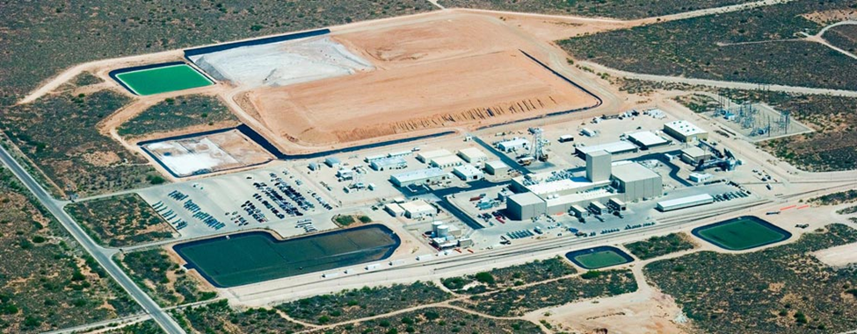
The Waste Isolation Pilot Plant (WIPP)
A Story of Science, Perseverance, Regulatory Frontiers and Politics
Keith Klein, VP Longenecker and Associates (Former Mgr, Carlsbad Area Office )
Notes:
The more you learn about the WIPP story, the more remarkable it becomes. Many of us played a part, large and small during various stages. The story is replete with drama and lessons, including lessons that can serve, and hopefully inspire, us now, even as some of our remaining cleanup challenges may seem almost insurmountable.

Slide 2
A Brief History
1957 - National Academy of Sciences recommends deep salt beds for disposal of radioactive wastes
1974 - Following years of siting studies, Atomic Energy Commission chooses ancient salt bed 26 miles east of Carlsbad, NM for detailed exploratory studies
1979 - Congress authorizes WIPP as an R&D facility to demonstrate safe disposal of defense wastes not regulated by NRC
1981 - First exploratory shaft drilled and first lawsuit filed (by then NM AG Jeff Bingaman)
1985 - EPA establishes disposal regulations for transuranic wastes; DOE and NM agree to compliance terms
1988 to 1991 - Gov. Andrus blocks shipments, DOE declares Construction Complete and tries to administratively withdraw land, NM sues
1992 - Congress enacts Land Withdrawal Act
1999 - First shipment arrives following 10 years of regulatory process, lawsuits, and politics
2019 - Over 12,000 safe shipments and 175,000 containers emplaced
Notes:
Many of you may not have been around or involved …. Or maybe you just take it for granted at this point. Let me begin by highlighting some history of this pioneering effort -- what was to be the world’s first deep geologic repository
1957 to Lyons Kanas to early 70’s, State Senator Joe Grant, NM delegaion 1974 AEC selection back and forth re mission and process. HLW repository?. Delegation concerned/heating up Schlesinger and veto
1979 Congress intervenes authorizes Wipp as r&D to demo. No NRC licensing. Sec’y to enter into written agreement
1981 shft drilled --lawsuit by AG Jeff B -- settled by series of agreements including “consult and cooperate”, state allowed to independently monitor, public allowed to comment, commit to funding highway upgrades 1982 NWPA established role for EPA 1985 EPA establishes regs
Oct 1998 Gov Andrus (blocks RF wastes due to lack of progress on WIPP). State Troopers. Pressure on DOE. Santa Fe heating up
1990 Watkins announces opening of test phase, asks DOI to administratively transfer land 1991 AG Udall sues (Richardson joins) Prelim injunction
1992 LWA! Land control, designates EPA mandates DOE compliance, feds pay $20/m/yr for 14 years
First shipment!! 10 years since construction was complete! All about people, process. Needed to maintain readiness. Receipt of first shipment, March 26, 1999 about 3:30 am the morning was epic! More about that later
2019 20 years later --

Slide 3
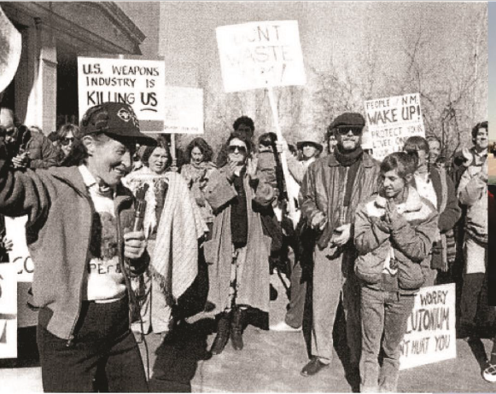
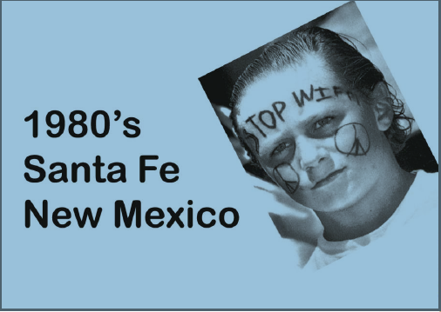
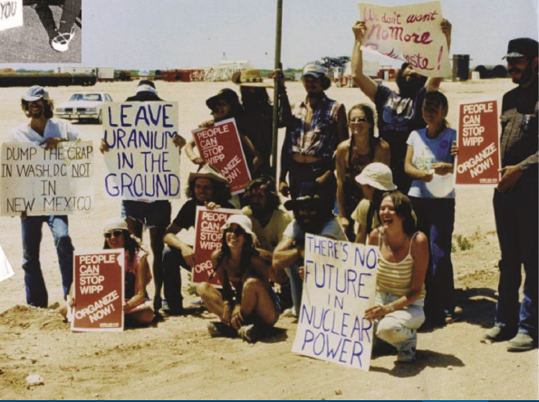
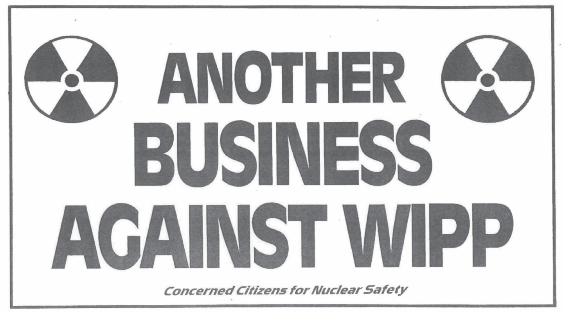
Opposition to WIPP
Notes:
Let me describe the environment in the 70’s and 80’s. Dump the crap in Washington DC not in NM

Slide 4
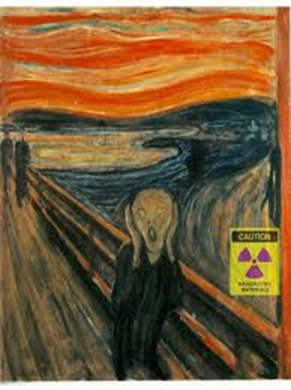
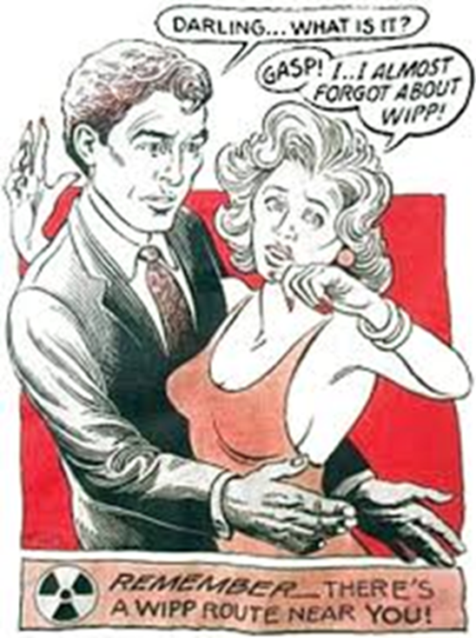
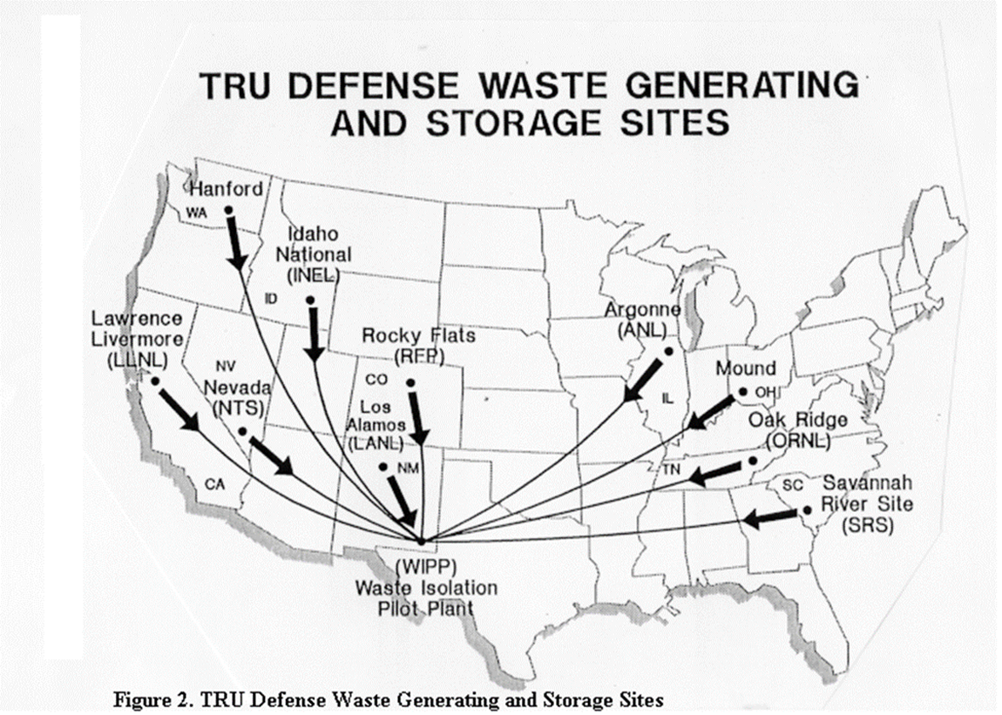
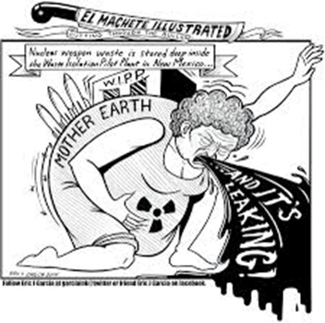
Science and Society in our Republic
Notes:
Only takes a cartoon to instill fear. Much harder to develop trust, confidence and partnerships crossing different institutions and generations
Love the cartoon on top far right -- says …

Slide 5
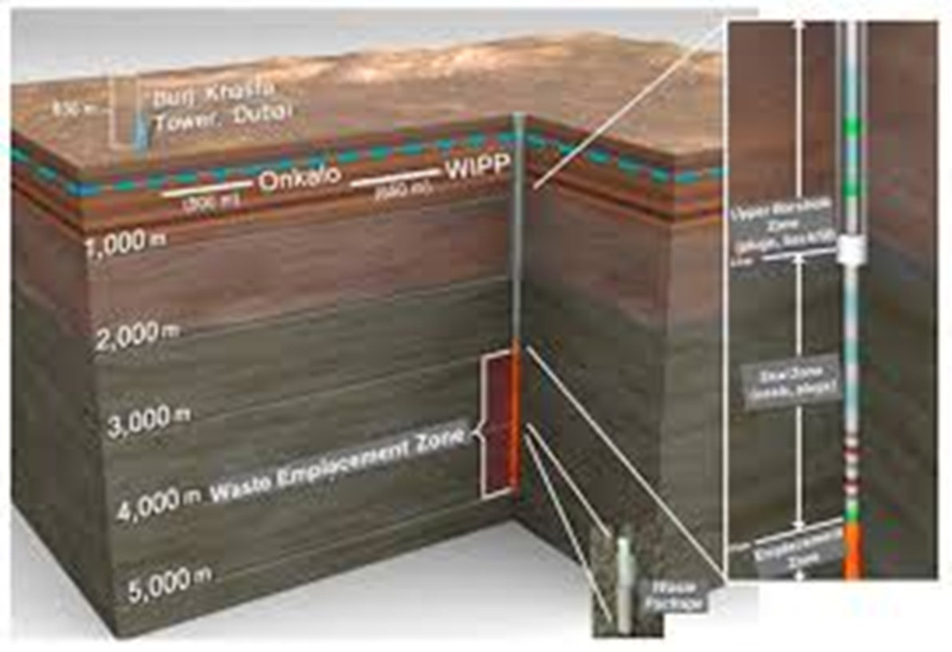
Technical, Regulatory and Legal Frontiers
The Science
Regulatory Frontiers: AEC Authorities; Defense ; Mixed Wastes; Transportation; Land Withdrawal Act; Air Emissions; RCRA; NEPA; Emergency Preparedness and Response; OSHA/Mine Safety; DOE Regs; …..
Lawsuits, law-making , appeals, demonstrations
Notes:
Remember -- none of this had ever been done before. Uncharted territory. Frontiers on many fronts
Science: Dr. Wendell Weart, the Sandia National Laboratories WIPP program manager, who directed WIPP site evaluation studies and became the go-to salt-waste interaction expert. SNL + chief tech advisor. Help from LANL, other DOE labs, USGS, universities, engineering and consulting firms
Public Involvement:
Carlsbad Citizens for Energy Development -- promoting the project and attending hundreds of hearings … often greatly outnumbered by project opponents.
Opposition in northern New Mexico. In the mid-1970s, a bill proposed in the state legislature to block WIPP was narrowly defeated by a House vote of 36-34
Regulatory/Legal: AEC self regulated…..promises made and broken…..lawsuits and settlements….EPA vs State authorities ….Congressional interventions
Some landmark events: LWA
Game on -- Lots of process; lots of agencies; lots of people; lots of lawyers (don’t count as people); lots of communications ----- LOTS of HEADACHES!

Slide 6
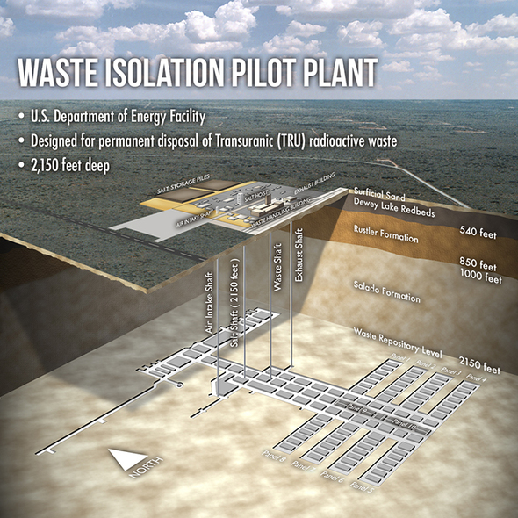
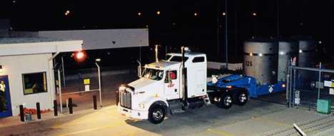
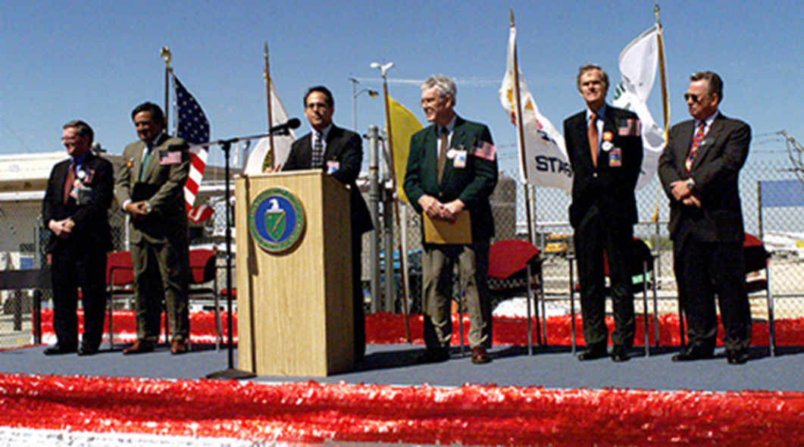
March 1999!!
Left to right:
Sen. Pete Domenici
Sec’y Bill Richardson (previously Congressman opposing WIPP)
DOE Hired Hand
Representative Joe Skeen
Senator Jeff Bingaman (previously NM AG filing Lawsuit against WIPP)
Carlsbad Mayor Gary Perkoski
Missing -- about 5,000 people
https://vimeo.com/329377122
Notes:
Opening very significant from many perspectives.
From EM Site: “An estimated 500 people were onsite in the early morning hours of March 26, 1999. After a fog delay the prior day and hours of waiting, everyone was tired and cold. But that didn’t matter when, at about 3:30 a.m., the lights of the truck were spotted. Cheers and applause quickly broke out.
The noise level grew when the driver honked the horn in the vehicle trap and again when the truck drove onto the site. Flags were waved, hugs were shared, and tears flowed as area residents looked back to the beginnings of WIPP.”
AG Bingaman sued feds 1981 over WIPP’s development and then ended up being the US senator passing enabling legislation in 1992. Bill Richardson was WIPPs most vocal critic in House…. ended up as the US secretary of energy who opened the facility and then became Gov and put more restrictions in permit re tank wastes. As the legendary, three-term New Mexico Governor Bruce King said of the project, “Some of my friends support it, and some oppose it, and I’m for my friends”.

Slide 7
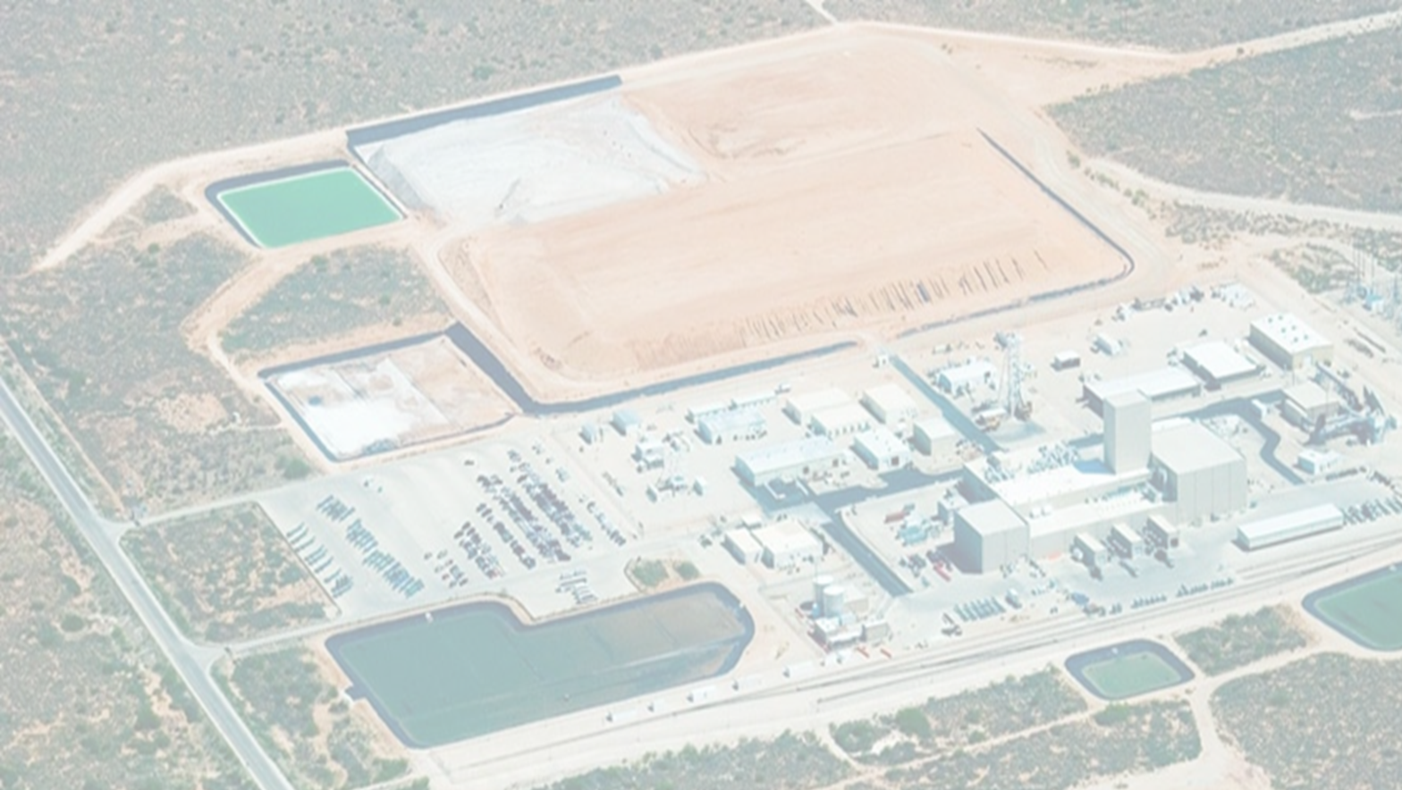
Perseverance and Coordination
1957 - 1999 --- 42 years from concept to reality
Learn-as-you-go siting, performance assessment, “licensing”, political, public involvement, law-making and management processes
Leadership changes (different Administrations; multiple AEC, ERDA, & DOE heads; local leadership changes)
Multiple players (DOE HQ/ALB/Carlsbad, EPA, DOJ, NM Gov/AG/Environmental, prime contractors, Sandia, community, activists, DOT, Law enforcement, OSHA/Mine Safety, etc., etc)
Operational setbacks and learnings
Opportunities for “communication” failures
BUT -- despite years of cynicism and doubt, it happened and it was important
Notes:
Note many EM people who played major roles: George Dials, Ralph Stein; John Aurther; Mark Frei, Mary Anne Sullivan, Ines Triay (also Los Alamos), Dave Moody, Paul Detwiler, Joe Franco, Todd Schrader and those of you in the audience who continue to contribute to its sustenance and success.
Special credit to community leaders like Bob Forrest, John Heaton, ….

Slide 8
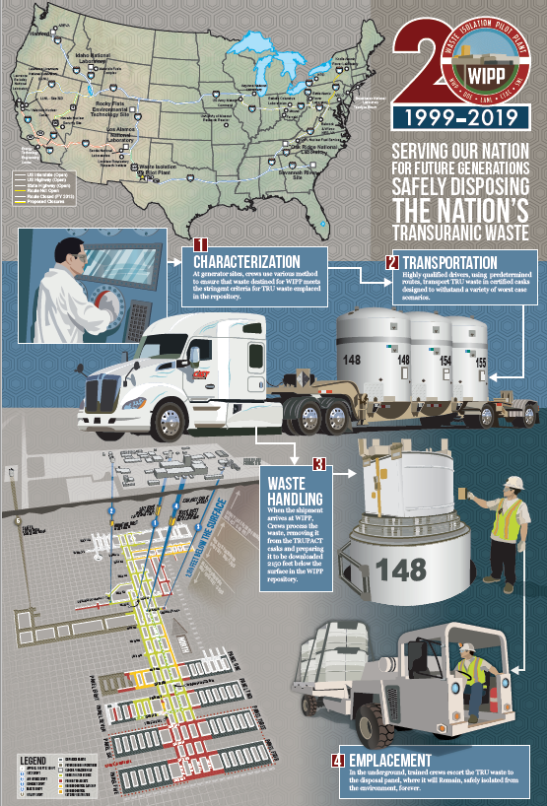
Significance
Importance to Cleanup to Date
  Over 12,000 safe shipments and 175,000 containers emplaced
  Uniquely capable
  Enabled cleanup completion at Rocky Flats
  Idaho, Savannah River, LANL, ……
Importance for Future
  Unique disposal capabilities
  Future possibilities
  Proof we can design, regulate and operate a deep geologic disposal system for isolating long-lived, nuclear wastes …. safely, productively, efficiently

Slide 9
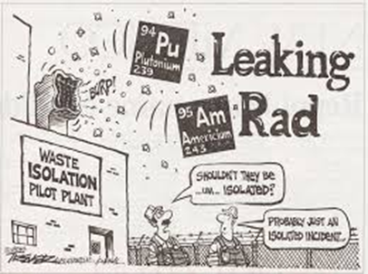
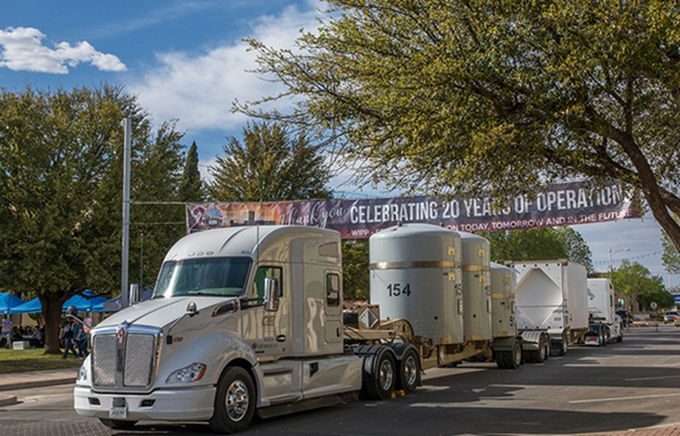
Lessons Learned
It isn’t easy but it can happen -- even with our system of government
Good science -- essential, but not sufficient
The Fear Factor, our Regulatory System and Politics
Under a microscope -- incidents are very costly
Enduring local community activism and support critical
Institutional Commitment -- good people willing to persevere, coordinate, partner, and work with changing layers of management for the common good
Looking Ahead -- Protect our Asset
Notes:
In the spirit of ISMS Feedback and Improvement, let me just close with what I think are some key lessons relevant to this audience and EM’s continuing success
2014 incidents -- a reminder of the cost of incidents despite no known injuries or significant exposure. 2 years to recover
Could we get WIPP or something comparable open today in the current political environment? Don’t now, but …

