Slide 1


Slide 2
Speaker
Subtitle

Slide 3
Victoria Sherry, DNP, CRNP, ANP-BC, AOCNP
Adult Oncology Nurse Practitioner for Thoracic Malignancies
Abramson Cancer Center
University of Pennsylvania Medical Center
Philadelphia, PA

Slide 4

Special Thanks!
Presented by
Supported through independent educational grants from Merck & Co., Inc. and AstraZeneca.

Slide 5

CNE Certification
To receive up to 1.0 ANCC contact hours, please complete the CNE Request and Evaluation form located via the link provided at the end of this presentation.

Slide 6
Learning Objectives
Assess the clinical efficacy, unique response patterns, and safety profiles associated with checkpoint inhibitors in various types of cancers.
Evaluate the signs and symptoms of immune-related adverse events (irAEs) associated with checkpoint inhibitors and understand how to differentiate them from other etiologies.
Review recent ASCO/NCCN guidelines for the management of irAEs and apply these recommendations to optimize patient care.
Using a case-based approach, discuss strategies oncology nurses can employ to overcome real-world challenges to the early recognition and appropriate management of irAEs.

Slide 7

Pre-test

Slide 8
Which of the following statements is true about immune checkpoint inhibitors (ICIs)?
Immune checkpoint inhibitors directly target rapidly-dividing cancer cells
Immune checkpoint inhibitors work faster than chemotherapy
Immune checkpoint inhibitors are more toxic than chemotherapy
Immune checkpoint inhibitors produce more durable response than chemotherapy
Notes:
Answer: D. Immune checkpoint inhibitors produce more durable responses than chemotherapy
Answer Rationale: Unlike chemotherapy, immune checkpoint inhibitors do not target rapidly-dividing cells, rather, they enhance T-cell function so that the immune system can more readily recognize and eliminate tumor cells. When compared to chemotherapy, immune checkpoint inhibitors take longer to demonstrate anti-tumor effects. However, various studies have shown that immune checkpoint inhibitors have a prolonged, durable responses, observed even after therapy has been discontinued. Immune checkpoint inhibitors have unique adverse events, but have been demonstrated to be much better tolerated than chemotherapy.

Slide 9
Which of the following is true regarding immune-related adverse events (irAEs) seen with immune checkpoint inhibitors (ICIs)?
Alopecia (hair loss) is a common toxicity
GI toxicities are rarely seen with ICI treatment
irAEs can occur months after ICI treatment
irAEs occur within 24 hours of therapy
Notes:
Answer: C. irAEs can occur months after ICI treatment
Rationale: Alopecia is an adverse event that is commonly seen with chemotherapy, while GI toxicities are generally common occurrences with immunotherapy. Chemotherapy toxicities are generally immediate, and easily identifiable. The recognition of irAEs with immune checkpoint inhibitors is a bit more difficult since they can arise days to months after treatment with immunotherapy. Thus, it is vital that irAEs are included in the differential diagnosis of any adverse events experienced by patients currently or previously on ICI treatment.

Slide 10
MJ is a 75 yo female who had one dose of pembrolizumab after being misdiagnosed with stage IV lung cancer. After the cancer was downgraded to stage IIB, she switched to chemoradiation. Three weeks into therapy, she developed a bilateral, pruritic rash on arms, chest, and legs.
Knowing that MJ received ICI therapy, your differentials for the rash should include which of the following?
  Delayed IrAE dermatitis
  Radiation dermatitis
  Bug bites
  Sunburn
Notes:
Answer: A. Delayed irAE dermatitis
Rationale: Because irAEs can develop well beyond the first dose of an immune checkpoint inhibitor, potential irAEs should always be included in the differential diagnosis of patients with a history of ICI therapy.

Slide 11
RW is a 53 yo male who is seen in clinic for cycle 5 of nivolumab. He complains that he has been extremely fatigued. Lab results show that his TSH levels are elevated and T4 levels are low.
What do you want to educate RW about autoimmune hypothyroidism?
He will need to start a steroid with a slow taper
He will require lifelong hormone replacement therapy (i.e., levothyroxine)
He will not require any treatment
He will no longer be able to receive immunotherapy
Notes:
Answer: B. He will require lifelong hormone replacement therapy
Rationale: While not common, ICI-mediated endocrine toxicities such as hypothyroidism, often result in permanent organ damage and typically requires life-long hormonal supplementation. Guideline recommendations state that therapy should not be discontinued if this occurs and that patients should not be treated with corticosteroids.

Slide 12

Notes:
Thank you for choosing to participate in “Immune-related Adverse events with Cancer Immunotherapy: Case-based Challenges for the Oncology Nurse”.

Slide 13
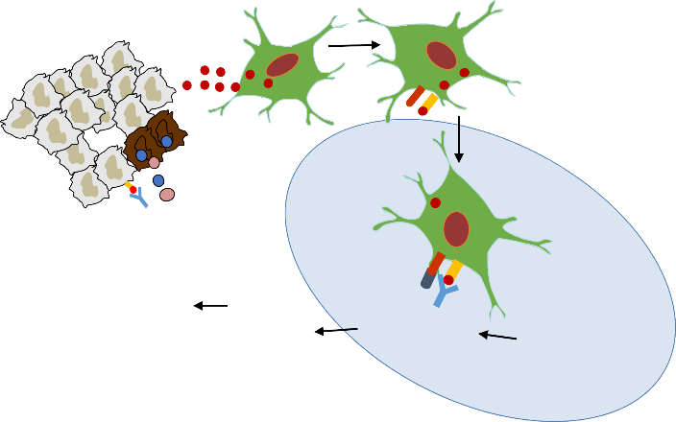













Checkpoint Blockade
Removing the Brakes of the Immune Response
2. Tumor antigen presentation
1. Release of tumor antigen
TUMOR
Tumor antigen
3. Priming and activation of T-cells
B7
MHC
X
5. Cytotoxic T-cells recognize and kill tumor cell
X
After T-cell activation, CTLA-4 is upregulated on cell membrane to downregulate T-cell function
Perforin granzyme
LYMPH NODE
PD-L1
Signal 2 absent
PD-1
B7
PD-1 is expressed on activated T-cells and downregulates T-cell function
_{MHC}
CTLA-4
Signal 1
CD28
X
TCR
T-cell expansion
Activated T -cell
4. Trafficking of cytotoxic T-cells to tumor
CD28
Resting T-cell
Notes:
Cancer is characterized by the accumulation of genetic alterations and the loss of normal cellular regulatory processes. These events lead to the expression of cancer-associated antigens (neoantigens) and presentation of cancer-specific peptides bound to major histocompatibility (MHC) molecules on the surface of cancer cells, distinguishing them from their normal counterparts.
For an anticancer immune response to lead to effective killing of cancer cells, a series of stepwise events must be initiated and allowed to proceed and expand. This multistep process, however, is also characterized by inhibitory factors that lead to immune regulatory feedback mechanisms, which can limit the immune response.
In the first step, tumor antigens are released and captured by dendritic cells (DCs) for processing.
Next, DCs present the captured antigens on MHC molecules to T-cells (step 2), resulting in the priming and activation of effector T-cell responses in the lymph nodes against the cancer specific antigens (step 3)
Thereafter, the activated effector T-cells traffic to (step 4) and infiltrate the tumor bed (step 5), specifically recognize and bind to cancer cells through the interaction between its T-cell receptor (TCR) and its cognate antigen bound to MHC (step 6), and kill their target cancer cell (step 7).
Finally, killing of the cancer cell releases additional neoantigens (step 1 again) to increase the breadth and depth of the response.

Slide 14
CTLA-4 and PD-1/PD-L1 Inhibitors
FDA-approved Agents as of January 2020
Class | Agents
Anti–CTLA-4 | Ipilimumab (Human IgG1 mAb) Tremelimumab* (Human IgG2 mAb)
Anti–PD-1 | Nivolumab (Human IgG4 mAb) Pembrolizumab (Humanized IgG4 mAb) Cemiplimab (Humanized IgG4 mAb)
Anti–PD-L1 | Atezolizumab (Humanized IgG1 mAb) Avelumab (Human IgG1 mAb) Durvalumab (Human IgG1 mAb)
*orphan drug status for malignant mesothelioma and small-cell lung cancer
FDA Prescribing Information.

Slide 15
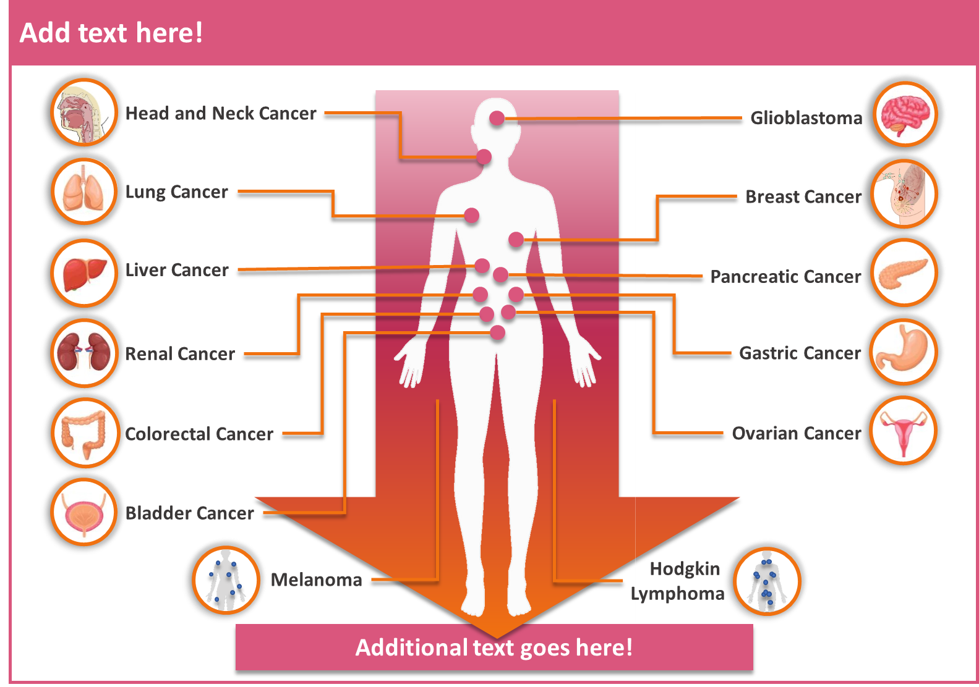
Approved and Emerging Indications
CTLA-4 and PD-1/PD-L1 Inhibitors
Head and Neck Cancer; Esophageal Cancer
Lung Cancer
Breast Cancer
Liver Cancer
Renal Cancer
Gastric Cancer
Ovarian, Endometrial, and Cervical Cancer
MSI-High Tumor
Bladder Cancer
Melanoma, Merkel Cell Carcinoma
Hodgkin Lymphoma; LBCL
FDA Approved Indications
Adapted from https://cancerworld.net/cutting-edge/accelerating-progress-in-immunotherapy/.

Slide 16
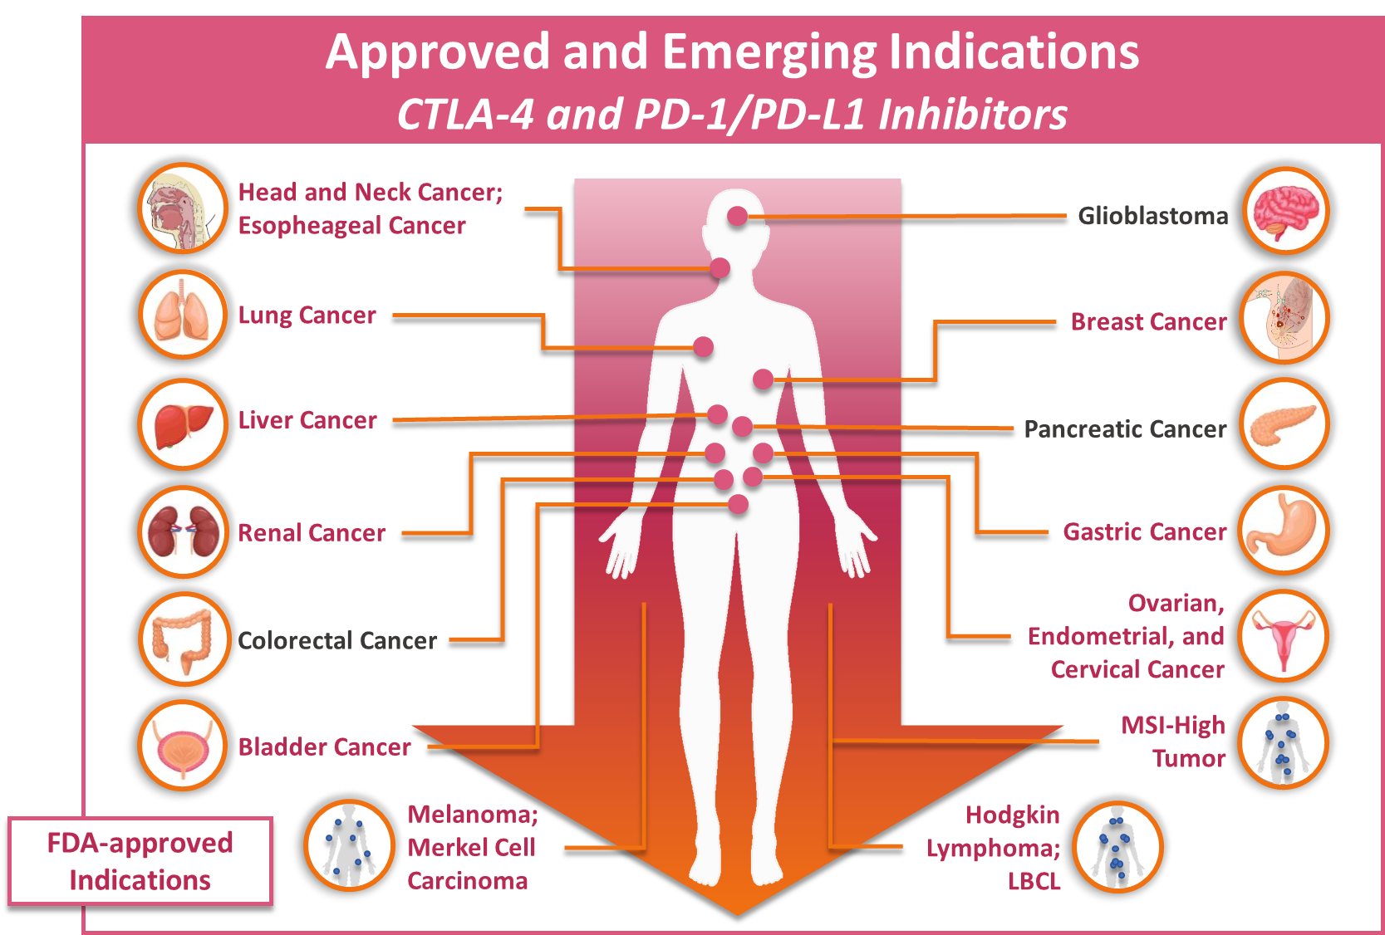
Colorectal Cancer
Adapted from: McIntyre P. Cancerworld. 2016.

Slide 17
Immune Therapy vs Cytotoxic Therapy
 | Immune Therapy | Cytotoxic Therapy
Mechanism of action | Enhance anti-tumor immunity | Direct tumor cell kill
Target | Immune cells | Rapidly dividing cancer cells
Mechanism of toxicity | Loss of immunologic tolerance to self-antigens | Off-target cytotoxicity Drug specific toxicities from metabolism/metabolites
Onset of toxicity | Unpredictable | Predictable
Duration of response | Durable/Prolonged | Limited
Supportive care measures | Targets immune system | Targets adverse effect
Chen DS, Mellman I. Immunity. 2013; Dimberu PM, Leonhardt RM. Yale J Biol Med. 2011; Villadolid J, Amin A. Transl Lung Cancer Res. 2015;
http://www.cancer.org/treatment/treatmentsandsideeffects/treatmenttypes/chemotherapy/how-chemotherapy-drugs-work.

Slide 18
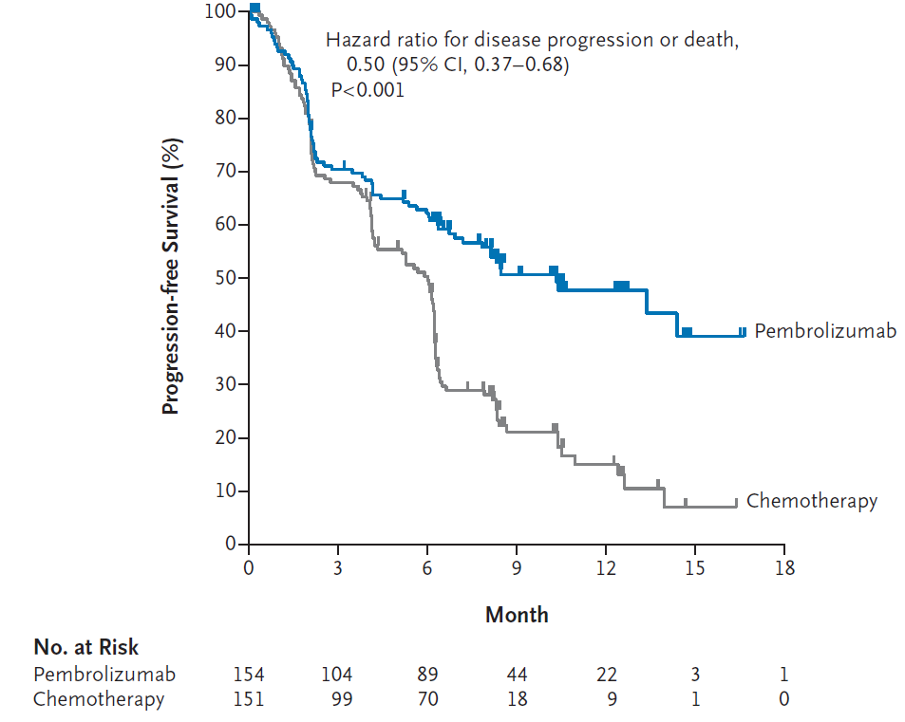
Durable Responses in IO vs. Chemotherapy
Reck M, et al. N Engl J Med. 2016.

Slide 19
Immune-related Adverse Events (irAEs)
Any toxicity with a potential immune-mediated etiology that may or may not require use of an immune-modulating therapy (e.g., steroids) after other diagnoses have been excluded
The nomenclature for organs afflicted with inflammation usually includes the suffix “-itis”
  Thyroiditis (inflammation of the thyroid)
  Pneumonitis (inflammation of the lungs)
  Colitis (inflammation of the colon)
  Pancreatitis (inflammation of the pancreas)
Maughan BL, et al. Front Oncol. 2017.

Slide 20
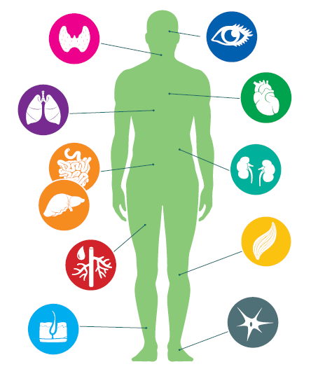
Organs Affected By irAEs
Common
Skin
Thyroid gland
Lung
Colon
Liver
Uncommon/Rare
Pancreas
Kidney
Heart
Muscle/soft tissue
Eye
Hematologic system
Brahmer JR, et al. J Clin Oncol. 2018.
Notes:
Our focus will be on the most common sx

Slide 21
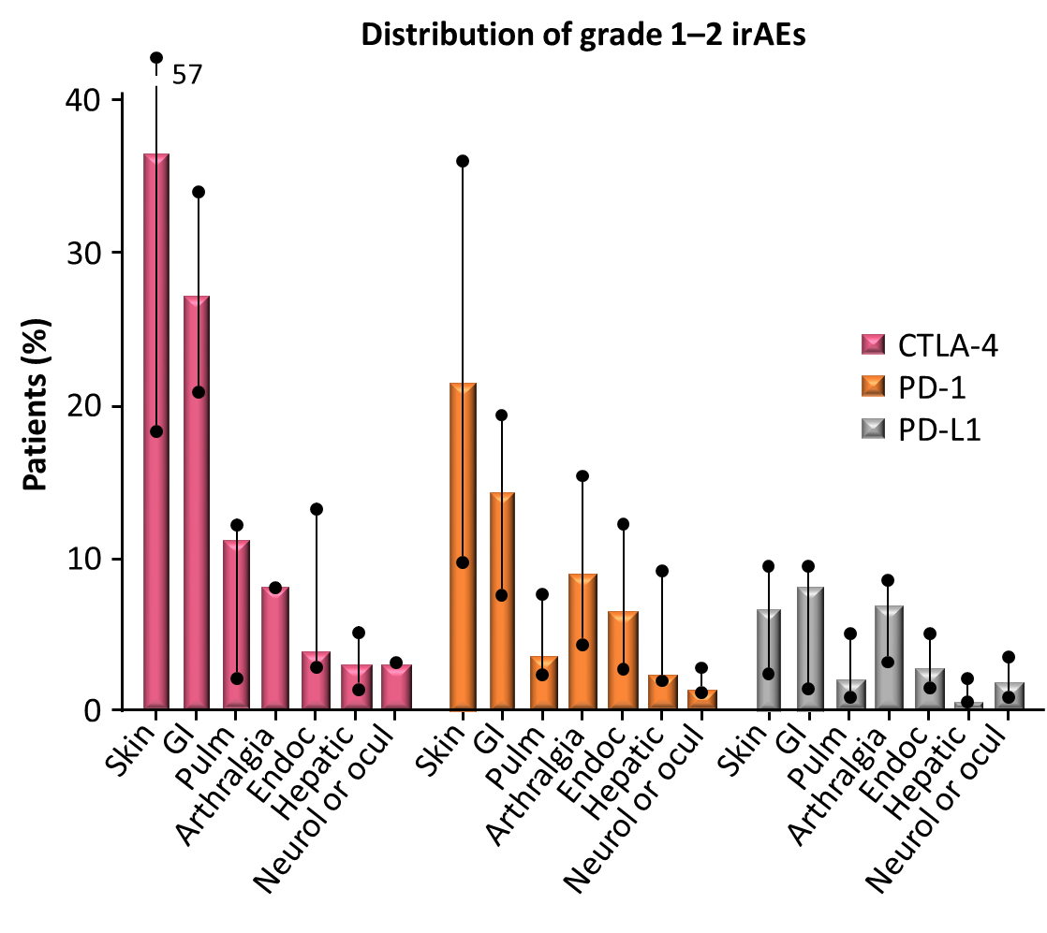
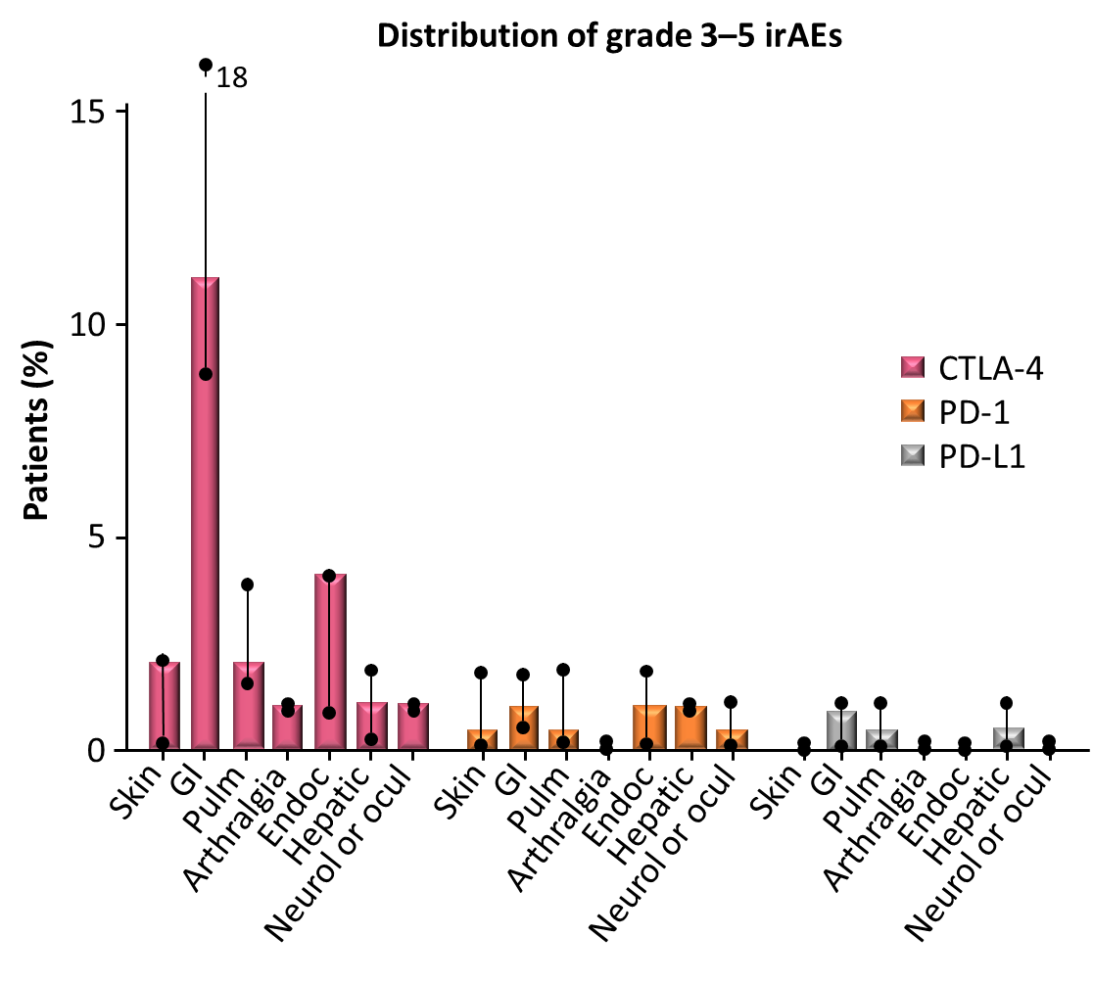
Distribution of irAEs in IO Therapy
Adapted from Brahmer JR, et al. J Clin Oncol. 2018.

Slide 22
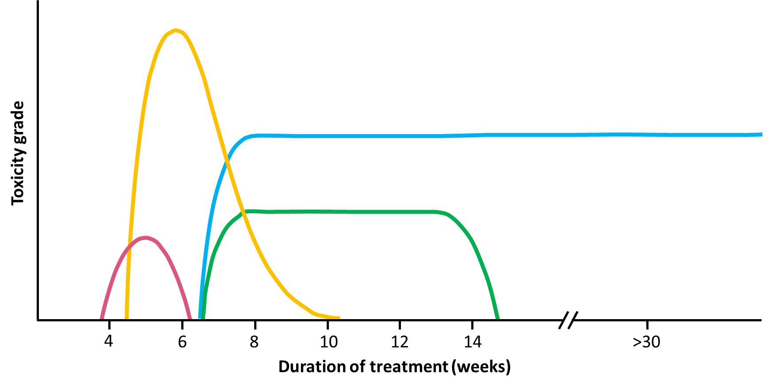
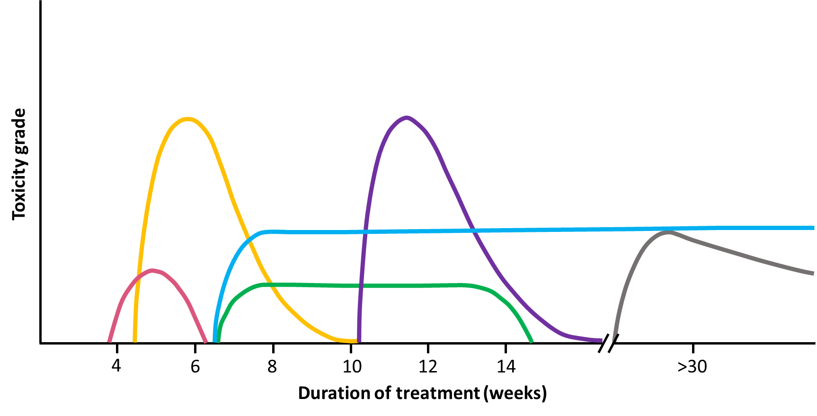

Median Time to Resolution of irAEs
CTLA-4 Blockade
PD-1/PD-L1 Blockade
Adapted from Martins F, et al. Nat Rev Clin Oncol. 2019.
Notes:
The beginning and end of each curve represent the median time to onset and median time to resolution, respectively. Each peak reflects incidence of the AE.
Select AEs generally resolved within several weeks, with the shortest time to resolution for GI events. Endocrine select AEs had the longest median time to resolution, because some events, although clinically resolved and medically controlled, were not considered resolved while there was a continuing need for hormone replacement therapy.
This is important to know b/c with early recognition and prompt treatment, irAEs are almost always reversible with immunosuppression.

Slide 23
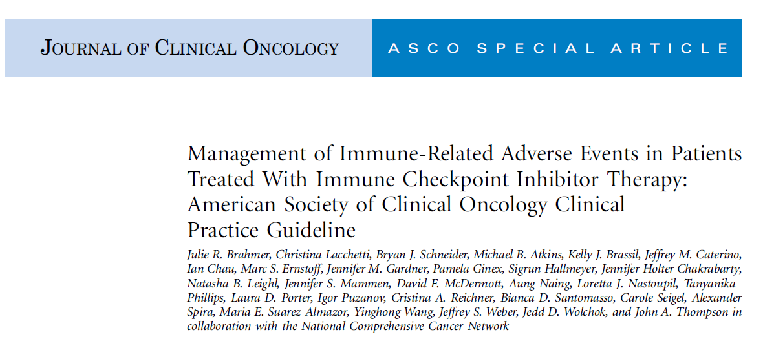
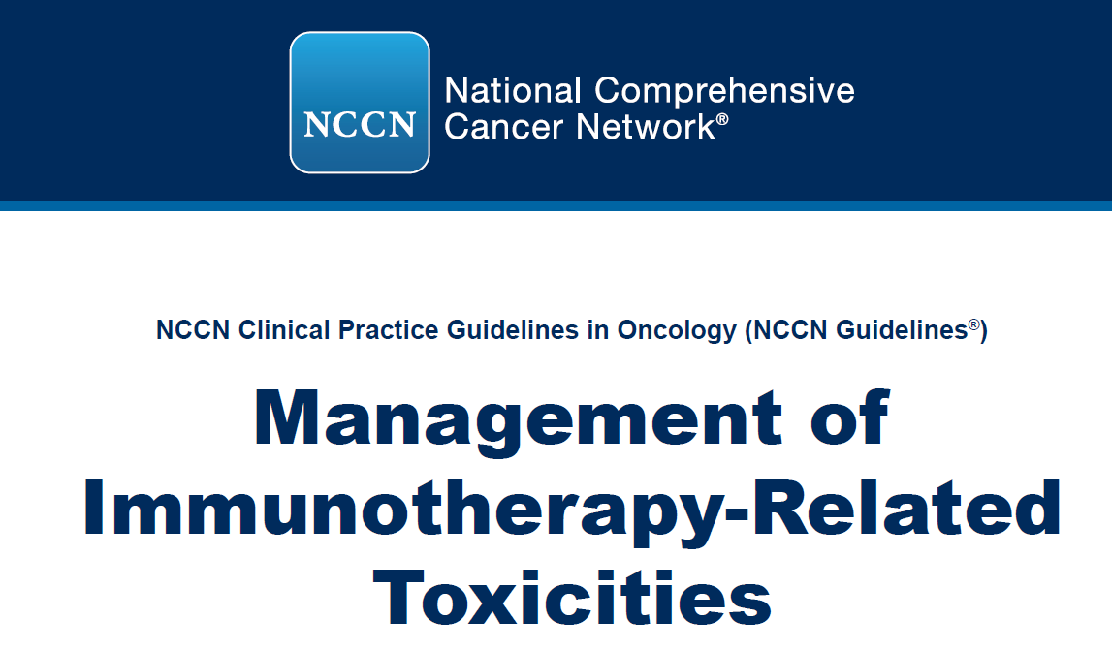
Managing irAEs
2018 ASCO/NCCN Guidelines
Brahmer JR, et al. J Clin Oncol. 2018;
NCCN. Management of Immunotherapy-Related Toxicities. Version 1.2020.
Notes:
Just released in February 2018

Slide 24
Common Terminology Criteria for Adverse Events (CTCAE) v. 5.0
Descriptive terminology to “quantify” the severity of an adverse event (AE)/side effect of treatment.
Grade 1 | Grade 2 | Grade 3 | Grade 4 | Grade 5
Mild; asymptomatic or mild symptoms; clinical or diagnostic observations only; intervention not indicate | Moderate; minimal, local or noninvasive intervention indicated; limiting age-appropriate instrumental ADL | Severe or medically significant but not immediately life-threatening; hospitalization or prolongation of hospitalization indicated; disabling; limiting self care ADL | Life-threatening consequences; urgent intervention indicated | Death related to AE
https://ctep.cancer.gov/protocoldevelopment/electronic_applications/docs/CTCAE_v5_Quick_Reference_8.5x11.pdf.
Notes:
Version 5.0 was published 11.27.17

Slide 25




Case Study
JT is a 70-year-old male never smoker. He is a South African native who works as an endocrinologist in a private practice. He is an avid marathon runner.
In 2012, JT developed a SOB. CTs of the chest, abdomen, and pelvis were performed and showed a LUL nodule. A PET scan confirmed LUL with no other sites of disease.
He underwent a VATS resection of LUL.
Pathology: squamous cell carcinoma, approximately 3 cm, all nodes (-)
Molecular: p53 (+), EGFR, ALK, BRAF (-)
JT is followed yearly with scans

Slide 26

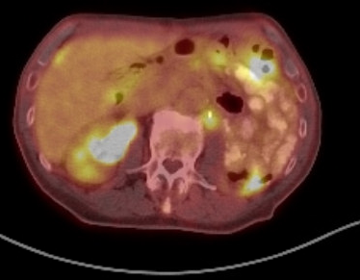
Case Study
In 2015, a routine CT showed a right renal mass. An MRI of the abdomen confirmed a suspicious lesion. JT underwent a left total nephrectomy.
Pathology: metastatic squamous cell carcinoma

Slide 27


Case Study
In September 2015, JT enrolled in a phase II study of pembrolizumab after curative intent treatment for oligometastatic non–small-cell lung cancer (NSCLC).
When seen in clinic for cycle 5 of pembrolizumab, he notes bilateral hand “stiffness” that is worse in the morning but not affecting activities of daily living.
Differential diagnoses?
Metastases
Joint erosion
Arthritis
Notes:
Running 12 miles 3 times a week
Travelled to south africa

Slide 28

Arthralgias
Incidence: (2%–12%)
  More common in anti–PD-1
  Often exacerbation of pre-existing arthritis
Management
NSAIDS/APAP
Prednisone
Refer to rheumatology
JT was managed with naproxen as needed.
Image from: Nall R, et al. Medical News Today. 2017. Haanen JBAG, et al. Ann Oncol. 2017.
Notes:
If inadequately controlled, should hold ICI and initiate oral prednisone 10 to 20 mg/d or equivalent for 4 to 6 weeks.

Slide 29
Case Study
JT completed the pembrolizumab oligometastases study in July 2016, but 4 months later, a PET scan confirmed recurrence in the renal fossa.
A biopsy of the left retroperitoneal lesion was completed.
Pathology: metastatic squamous cell carcinoma
Molecular: P53 (+), PD-L1 (-), TMB high
GENE PROTEIN CHANGE cDNA CHANGE
ARID1A p.P1468Lfs*13 c.4403delC
MSH6 p.P1088Lfs*5 c.3261dupC
TGFBR2 p.K153Sfs*35 c.458delA
TGFBR2 p.P154Afs*3 c.458dupA
RAD50 p.K722Rfs*14 c.2165delA
KMT2C p.K2797Rfs*26 c.8390del
PTCH1 p.Y334* c.1002T>A
RB1 p.R255* c.763C>T
TP53 p.R342* c.1024C>T
CIC p.P509Hfs*14 c.1526delC
CIC p.P1599Qfs*21 c.4796delC
VARIANTS OF UNCERTAIN SIGNIFICANCE (see interpretation and comments):
GENE PROTEIN CHANGE cDNA CHANGE
AKT3 p.R325Q c.974G>A
ALK p.P1139H c.3416C>A
APC p.Q203E c.607C>G
BRAF p.R239* c.715C>T
CIC p.D1448A c.4343A>C
CREBBP p.P937L c.2810C>T
EGFR p.E320K c.958G>A
EPHA3 p.R104Q c.311G>A
EPHA3 p.R883Q c.2648G>A
ERBB2 p.A1232Lfs*70 c.3694delG
ERBB4 p.N1214S c.3641A>G
ERBB4 p.K324E c.970A>G
IGF1R p.H959Y c.2875C>T
KDM6A p.A11T c.31G>A
KMT2C p.G1425S c.4273G>A
MAPK1 p.S266F c.797C>T
MYC p.R372Q c.1115G>A
MYCN p.P44F c.130_131delCCinsTT
NF1 p.D374G c.1121A>G
NOTCH3 p.A1775T c.5323G>A
NTRK3 p.E322K C.964G>A (will check fusion panel)
NTRK3 p.G114E c.341G>A
PIK3CA p.R818H c.2453G>A
PIK3CB p.R955* c.2863C>T
PTCH1 p.I997_C998delinsKF c.2990_2993delinsAATT
RET p.P117S c.349C>T
RET p.G383S c.1147G>A
RNF43 p.S446F c.1337C>T
RNF43 p.P270S c.808C>
SLIT2 p.R253Q c.758G>A
SMARCA4 p.E1468K c.4402G>A

Slide 30
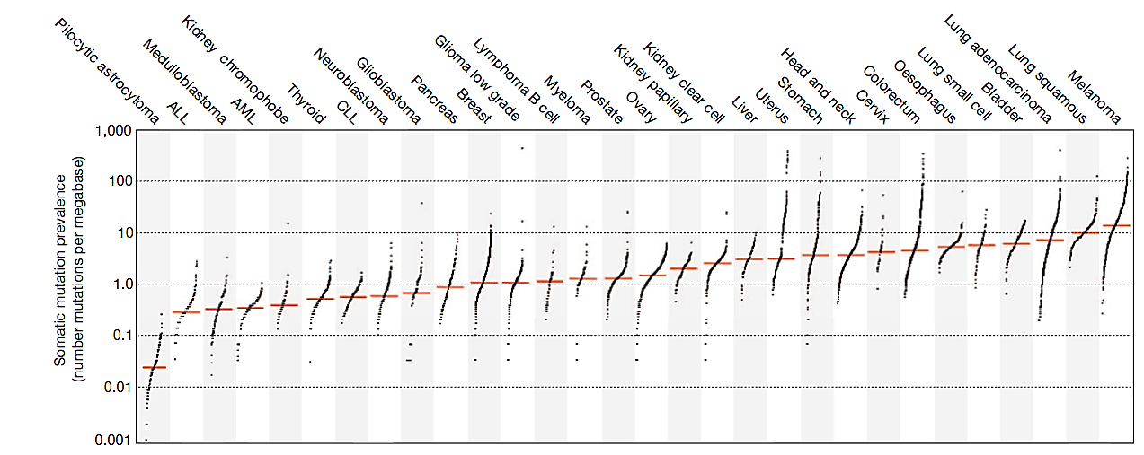
Mutational Burden
A Changing Paradigm
Tumor mutational burden—measurement of mutations carried by tumor cells; a predictive biomarker being studied to evaluate its association with response to immunotherapy
Highest prevalence of mutations
Highest benefit from immune checkpoint inhibitors
Alexandrov LB, et al. Nature. 2013; Langer C, et al. WCLC. 2019. Abstract OA04.05; Garassino M, et al. WCLC. 2019. Abstract OA04.06.
Notes:
This pt had a very high TMB. At the time, it was felt this was correlated to a + response to ICI therapy. New data form World lung showed that TMB does not impact PFS, OS, etc.
somatic mutations was highly variable between and within cancer classes
Certain childhood cancers carried fewest mutations whereas cancers related to chronic mutagenic exposures such as lung (tobacco) and malignant melanoma (UV) exhibited the highest prevalence.

Slide 31
Mutational Burden
A Changing Paradigm
2019: KEYNOTE 021/189 data shows no association with tumor mutational burden.
Alexandrov LB, et al. Nature. 2013; Langer C, et al. WCLC. 2019. Abstract OA04.05.
Notes:
somatic mutations was highly variable between and within cancer classes
Certain childhood cancers carried fewest mutations whereas cancers related to chronic mutagenic exposures such as lung (tobacco) and malignant melanoma (UV) exhibited the highest prevalence.

Slide 32
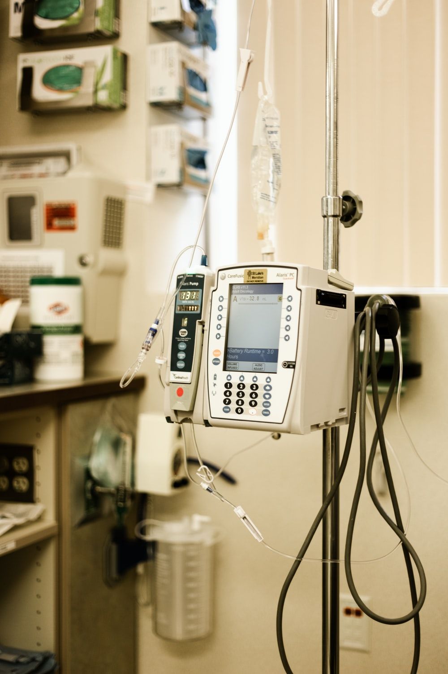

Case Study
Plan: Chemo vs. I/O therapy?
In December 2016, atezolizumab IV every 3 weeks was initiated.

Slide 33
Patient Complaints/Issues While Receiving Atezolizumab
Xerosis, Pruritus, Xerostomia, Taste Alterations
Hypothyroidism
Dyspepsia
Diplopia
Ongoing: Arthritis
Notes:
Xerosis, Pruritis, xerostomia (Sjogrens syndrome)

Slide 34
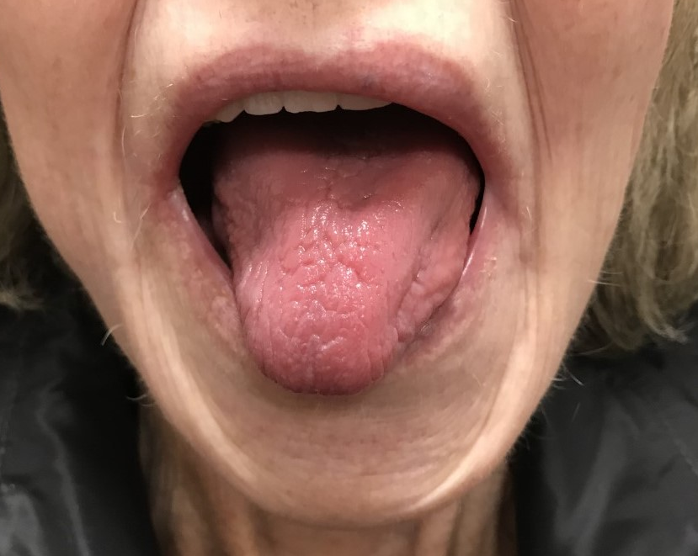
Case Study
JT was seen in clinic prior to cycle 4 of atezolizumab. He complains of dry mouth/taste alterations and pruritic skin.

Slide 35
Xerostomia/Taste Alterations
Differential Diagnoses
  Parotid blockage—parotiditis
  Dehydration
  Medication
  Hypothyroidism

Slide 36
Pruritic Skin
Differential Diagnoses
  Dry skin
  Contact dermatitis
  Allergy
  Medications

Slide 37
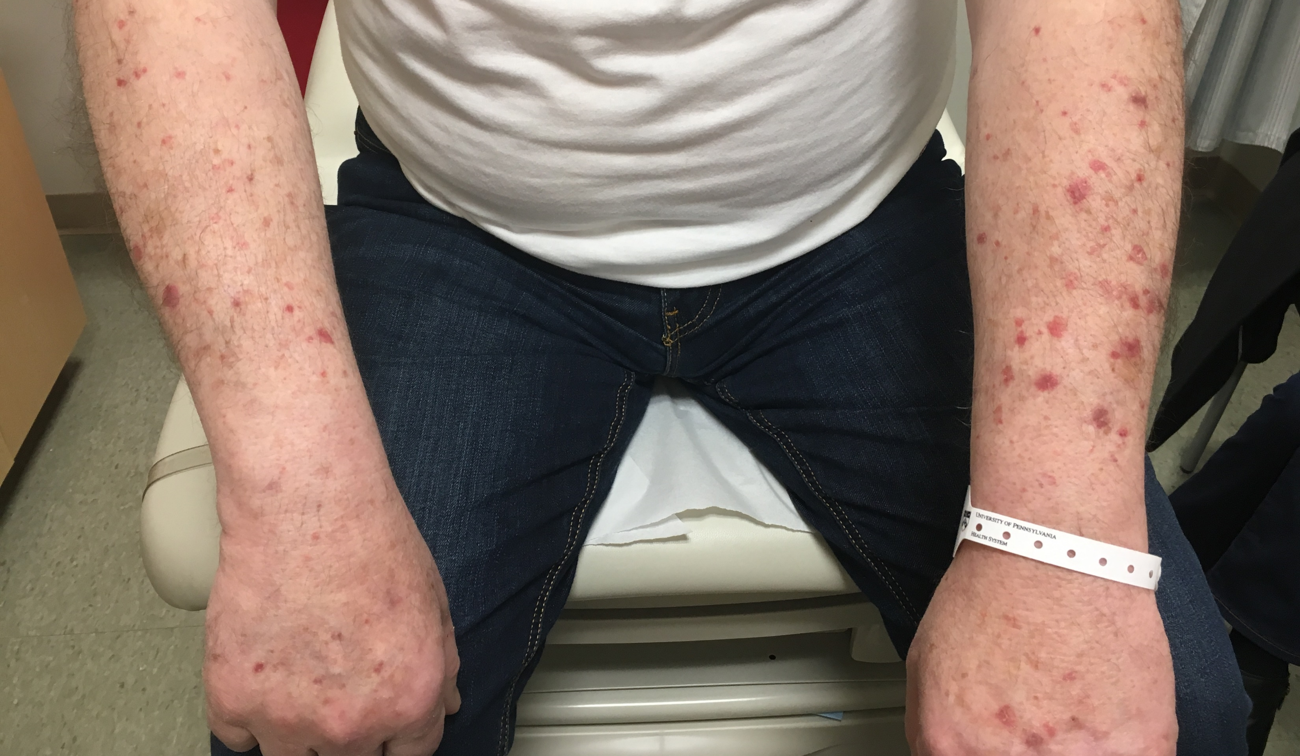
Cutaneous irAE
Pruritus, Xerosis, Xerostomia, Taste Alterations
Incidence: 13%–20% PD-1
Affects QOL
Management
  Topical emollients
  Topical steroids
  Oral antihistamines
  Avoid irritants
  Avoid sun exposure
  Grade 2–3: prednisone 1 mg/kg
JT managed symptoms with hydration, thick emollients, and gum. After trying to avoid steroids, he started a steroid taper and remained on 10 mg prednisone daily for several months.
Phillips GS, et al. JAMA Dermatol. 2019; Haanen JBAG, et al. Ann Oncol. 2017.
Notes:
Pt managed pruritis and dry skin with coconut oil but eventually had to start low dose prednisone

Slide 38
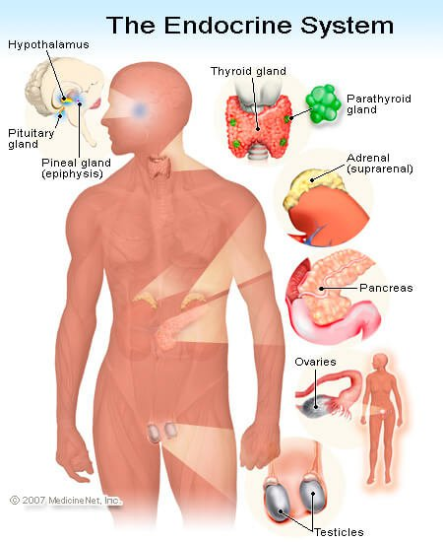
Endocrinopathies
Thyroid dysfunction
  Hypothyroid
  Hyperthyroid
  Thyroiditis
Adrenal insufficiency (rare)
Hypophysitis
Diabetes mellitus type 1
Brahmer JR, et al. J Clin Oncol. 2018; www.medicinenet.com/script/main/art.asp?articlekey=25210.

Slide 39
Endocrinopathies
Hypothyroidism
Incidence: up to 16%
Differential diagnoses
  After obtaining TFTs, unlikely to have a diagnosis other then hyper/hypothyroidism
JT was not symptomatic; incidental finding on routine blood work (check TSH prior to each visit)
Haanen JBAG, et al. Ann Oncol. 2017.

Slide 40
Case Study
JT started levothyroxine (based on 2017 guidelines, not 2018 guidelines), and managed on own.
ENDOCRINE THYROID TSH
Latest Ref Rng & Units 0.27–4.20 uIU/mL
3/16/2017 3.96
4/13/2017 4.62 (H)
5/4/2017 4.93 (H)
9/15/2017 5.19 (H)
11/7/2017 4.97 (H)
11/21/2017 6.77 (H)
11/28/2017 6.56 (H)
12/5/2017 2.85
12/12/2017 2.57
12/19/2017 3.54

Slide 41
GI irAE—Dyspepsia
Upper GI toxicity much less common
Most common → diarrhea: combo (26-45%); CTLA-4 (30-40%); PD-1 (≤19%)
Treatment: steroids with possible additional immunosuppression if refractory (i.e., infliximab)
JT managed the dyspepsia with omeprazole 20 mg daily.

Slide 42

Case Study
JT was seen in clinic prior to cycle 6 and noted binocular diplopia at night when watching TV.

Slide 43
Binocular Diplopia
Differential Diagnoses
  Brain metastases
  Nerve palsy
  Strabismus from thyroid disease
  MG
  Stroke

Slide 44
Neurologic Disorders
Rare
Incidence: 1%
Many different disorders → Guillain-Barré syndrome, MG, peripheral neuropathy, encephalitis
Treatment: steroids 1 mg/kg and then wean

Slide 45
Case Study
JT had an MRI (-) for lesions. Neuro-ophthalmology ordered a single-fiber EMG, which confirmed ocular MG.
At the time, JT was on steroids for pruritis, which helped x 1 week, then returned. Neuro-ophthalmology instructed him to patch one eye as needed for symptomatic relief.

Slide 46
Case Study
Unfortunately, 6 months after ICI initiation, CT chest showed PD in his lungs. JT refused chemo and enrolled in a phase 1b/2 study assessing safety and anti-tumor activity of AMG 820 in combination with pembrolizumab in select advanced solid tumors. A comprehensive metabolic panel was checked at every visit.
GENERAL CHEMISTRIES CREATININE
Latest Ref Rng & Units 0.64–1.27 mg/dL
7/11/2017 1.24
9/1/2017 1.45 (H)
9/7/2017 1.31 (H)
9/15/2017 1.50 (H)
9/28/2017 1.42 (H)
10/5/2017 1.27
Differential diagnoses?
Dehydration
Medications
Hypercalcemia
Recent IV contrast

Slide 47
Case Study
Nephritis
Incidence: ~2%–5%
Management: Grade 1 can hold ICI or observe
Creatinine was never higher than 1.52. JT continued ICI treatment, received IVFs with treatment, consulted pharmacy, and followed a renal diet.
Notes:
Consult nephrology, pharmD to review meds

Slide 48
Case Study
Four months later, a follow-up CT showed PD in RP LN, liver, with increasing left pleural effusion. JT was started on carbo/nab-paclitaxel.
When he had been off ICI therapy x 5 months, he complained of worsening fatigue and weakness.
Differential Diagnoses?
  Chemotherapy induced
  Thyroid disorder
  Depression
  Medications
  Anemia
Notes:
. DIRE should therefore figure prominently in the differential diagnosis of patients presenting with illnesses of unclear etiology, irrespective of intervening treatments or interval post-immunotherapy, both of which can confound diagnosis.

Slide 49
Case Study
JT requested that his testosterone level be tested.
  TESTOSTERONE
  Latest Ref Rng & Units 10/5/2017
  Testosterone 193–740 ng/dL 82 (L)
  Free Testosterone 47–244 pg/mL 7 (L)

Slide 50

Case Study
JT was diagnosed with secondary hypogonadism, which has an incidence of approximately 7.5% and is managed with HRT.
He was referred to urology who prescribed testosterone gel, which would be required lifelong.

Slide 51

Case Study
Further Treatment
March 2018—PD; given nivolumab
October 2018—PD; given pembrolizumab + xrt on RadVax clinical trial (SBRT to right lung)
February 2019—PD; enrolled in phase 1 viagenpumatucel + nivolumab
July 2019 to present—on ipilimumab/nivolumab
July 15 and August 9, 2019—underwent radioembolization to liver lesions
Notes:
“durga” allogeneic cellular vaccine derived from a human lung adenocarcinoma cell line transfected with the gp96-Ig fusion protein that functions as an antigen chaperone for cross presentation and dendritic cell activation.
early data suggest that the addition of HS-110 to nivolumab may restore responsiveness after tumor progression on prior CPI therapy.
AMG 820 can enhance the anti-tumor activity observed historically with pembrolizumab alone and/or overcome lack of response to pembrolizumab monotherapy

Slide 52
Case Study
Presently
Currently, JT has a creatinine of 1.3; receives HRT for hypogonadism and hypothyroidism, and suffers from xerostomia, pruritis, diplopia, and fatigue (worst symptom—especially after SIR-spheres).
Medications
Atorvastatin 20 mg daily
Fluocinonide 0.05% BID
Levothyroxine 88 mcg daily
Megestrol
Meloxicam 7.5 mg BID
Omeprazole 20 mg daily
Prednisone 10 mg daily
Testosterone gel 1.62% transdermal daily
Zolpidem 10 mg qhs
______________________
Meds in 2012: atorvastatin, zolpidem
Notes:
TSH waxes and wanes

Slide 53
What Else Could Impact IO Therapy Efficacy?
We know that treating with steroids for irAEs does not worsen outcomes
  Treating with steroids for other indications was excluded from prior studies
  Remains an open question
Gut microbiome may be an important factor predicting response to immunotherapy
  Patients with cancer frequently receive antibiotics
  Could antibiotics decrease efficacy?
Routy B, et al. Science. 2018.

Slide 54
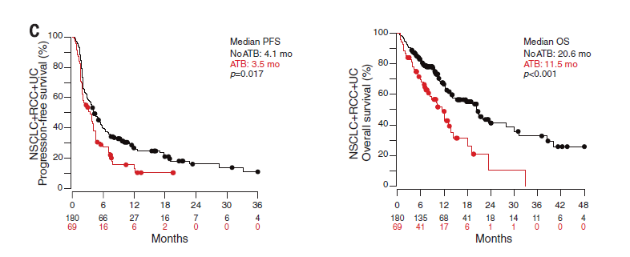
Impact of Antibiotics on PD-1 Response
Progression-free Survival
Overall Survival
Need to consider indication for antibiotics.
  Sometimes patients need treatment!
Routy B, et al. Science. 2018.

Slide 55
Probiotics
Good or Bad?
Small study—46 patients
Probiotics are associated with lower gut microbiome diversity
Diets high in added sugars and processed meat were negatively associated with these bacteria.
Eating fiber has better outcomes
  Five times as likely to respond to anti–PD-1 treatment compared to patients who consumed a low-fiber diet.
Spencer CN, et al. AACR Annual Meeting. 2019. Abstract 2838/24.
Notes:
This was a surprise to us because probiotics are commonly viewed as promoting gut and overall health. However, in this instance the data suggest that’s not necessarily the case
probiotics might actually upset the balance of so-called “good” bacteria in the gut and interfere with the immune response.
melanoma patients were 70 percent less likely to respond to cancer immunotherapy if they were also taking probiotic supplements.
MD Anderson

Slide 56

Does Patient’s SEX Impact Efficacy?
Meta-analysis of 11,351 patients
HR= 0.72 in males
HR = 0.86 in females
P=0.0019
Conforti F, et al. Lancet Oncol. 2018.

Slide 57
Personalized Cancer Immunotherapy?
Success in the majority of patients is limited by a low response rate, high treatment cost, and treatment-related toxicity.
Need to identify predictive and prognostic biomarkers to select the patients who are most likely to benefit from, and respond well to, these therapies.
“Cancer immunogram”
Shindo Y, et al. Cancers (Basel). 2019.

Slide 58
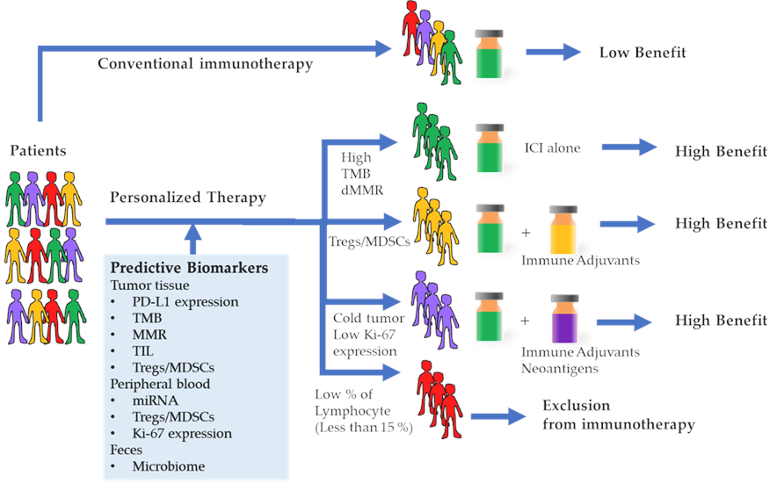
Cancer IO Outcomes Based on Biomarkers
Shindo Y, et al. Cancers (Basel). 2019.

Slide 59
Are irAEs Associated with
Improved Clinical Outcomes?
Melanoma Patients
NSCLC Patients
irAE Status and Treatment Arm | RFS, HR (95% CI) | P
Any irAE
Placebo | 1
Pembro without/before irAE | 0.62 (0.49-0.78) | 0.03
Pembro after irAE onset | 0.37 (0.24-0.57)
Any severe irAE
Placebo | 1
Pembro without/before irAE | 0.55 (0.44-0.68) | 0.43
Pembro after irAE onset | 0.78 (0.32-0.91)
 | HR (95% CI) | P
PFS (unadjusted model)
# of irAEs (+1) | 0.81 (0.65-1.01) | 0.067
PFS (adjusted model)
# of irAEs (+1) | 0.75 (0.56-0.99) | 0.043
Lisberg A, et al. Cancer Immunol. 2018; Eggermont AM, et al. JAMA Oncol. 2020.
Notes:
NSCLC - This single-center analysis revealed that trAEs predicted for improved clinical outcome with pembrolizumab, and when controlling for guarantee-time bias and plausible confounders, this association remained. This observed relationship adds to our understanding of anti-PD-1 therapy and could aid clinicians in identifying patients most likely to benefit from therapy.
Melanoma - Consistent with the reported main analysis in the intent-to-treat population, RFS was longer in the pembrolizumab arm compared with the placebo arm (hazard ratio [HR], 0.56; 98.4% CI, 0.43-0.74) among patients who started treatment. Compared with the placebo arm, the reduction in the hazard of recurrence or death in the pembrolizumab arm was greater after the onset of an irAE than without or before an irAE

Slide 60
DIRE
Defined as new irAEs manifesting ≥90 days after discontinuation of immunotherapy
Systematic review from 2008 to 2018 to determine the median data safety reporting window from existing IO clinical trials
23 cases identified
Median off-treatment interval to DIRE was 6 months (range: 3–28)
Median cumulative immunotherapy exposure was 4 doses (range: 3–42)
Involvement included endocrine, neurologic, GI, pulmonary, cardiac, rheumatologic, and dermatologic irAEs
Couey MA, et al. J Immunother Cancer. 2019.
Notes:
In 2018 a wave of reports surfaced re: delayed autoimmiunity.
Clinical vigilance has the potential to reduce morbidity from diagnostic delay, as irAE are generally manageable with prompt initiation of treatment – or from misdiagnosis - as misattribution can lead to unnecessary or harmful interventions as we describe. DIRE should therefore figure prominently in the differential diagnosis of patients presenting with illnesses of unclear etiology, irrespective of intervening treatments or interval post-immunotherapy, both of which can confound diagnosis. Increased recognition will rest on delineation of DIRE as a clinical diagnostic entity.

Slide 61
DIRE
Impact on Nursing
Not recognizing symptoms can impact patient morbidity
Early recognition is crucial as irAEs are generally manageable with prompt initiation of treatment
DIRE should be considered in the differential diagnosis of patients presenting with illnesses of unclear etiology regardless of what treatment they are on
Couey MA, et al. J Immunother Cancer. 2019.
Notes:
growing numbers of patients will be exposed to immunotherapy before transitioning to routine clinical surveillance.
Clinical vigilance has the potential to reduce morbidity from diagnostic delay
– or from misdiagnosis - as misattribution can lead to unnecessary or harmful interventions
DIRE should be considered in the differential diagnosis of patients presenting with illnesses of unclear etiology, irrespective of intervening treatments or interval post-immunotherapy, both of which can confound diagnosis

Slide 62
Conclusions
Immunotherapy can induce durable responses and can result in prolonged OS
Immune-related adverse events are a unique spectrum of adverse events that can mimic other disease processes; irAEs need to be considered as differential diagnosis in any patient receiving checkpoint inhibition
Early recognition and effective management of irAEs is crucial to optimal use of checkpoint inhibitors
The overarching principle of medical management is STEROIDS

Slide 63
Post-test

Slide 64
Which of the following statements is true about immune checkpoint inhibitors (ICIs)?
Immune checkpoint inhibitors directly target rapidly-dividing cancer cells
Immune checkpoint inhibitors work faster than chemotherapy
Immune checkpoint inhibitors are more toxic than chemotherapy
Immune checkpoint inhibitors produce more durable response than chemotherapy
Notes:
Answer: D. Immune checkpoint inhibitors produce more durable responses than chemotherapy
Answer Rationale: Unlike chemotherapy, immune checkpoint inhibitors do not target rapidly-dividing cells, rather, they enhance T-cell function so that the immune system can more readily recognize and eliminate tumor cells. When compared to chemotherapy, immune checkpoint inhibitors take longer to demonstrate anti-tumor effects. However, various studies have shown that immune checkpoint inhibitors have a prolonged, durable responses, observed even after therapy has been discontinued. Immune checkpoint inhibitors have unique adverse events, but have been demonstrated to be much better tolerated than chemotherapy.

Slide 65
Which of the following is true regarding immune-related adverse events (irAEs) seen with immune checkpoint inhibitors (ICIs)?
Alopecia (hair loss) is a common toxicity
GI toxicities are rarely seen with ICI treatment
irAEs can occur months after ICI treatment
irAEs occur within 24 hours of therapy
Notes:
Answer: C. irAEs can occur months after ICI treatment
Rationale: Alopecia is an adverse event that is commonly seen with chemotherapy, while GI toxicities are generally common occurrences with immunotherapy. Chemotherapy toxicities are generally immediate, and easily identifiable. The recognition of irAEs with immune checkpoint inhibitors is a bit more difficult since they can arise days to months after treatment with immunotherapy. Thus, it is vital that irAEs are included in the differential diagnosis of any adverse events experienced by patients currently or previously on ICI treatment.

Slide 66
MJ is a 75 yo female who had one dose of pembrolizumab after being misdiagnosed with stage IV lung cancer. After the cancer was downgraded to stage IIB, she switched to chemoradiation. Three weeks into therapy, she developed a bilateral, pruritic rash on arms, chest, and legs.
Knowing that MJ received ICI therapy, your differentials for the rash should include which of the following?
  Delayed irAE dermatitis
  Radiation dermatitis
  Bug bites
  Sunburn
Notes:
Answer: A. Delayed irAE dermatitis
Rationale: Because irAEs can develop well beyond the first dose of an immune checkpoint inhibitor, potential irAEs should always be included in the differential diagnosis of patients with a history of ICI therapy.

Slide 67
RW is a 53 yo male who is seen in clinic for cycle 5 of nivolumab. He complains that he has been extremely fatigued. Lab results show that his TSH levels are elevated and T4 levels are low.
What do you want to educate RW about autoimmune hypothyroidism?
He will need to start a steroid with a slow taper
He will require lifelong hormone replacement therapy (i.e., levothyroxine)
He will not require any treatment
He will no longer be able to receive immunotherapy
Notes:
Answer: B. He will require lifelong hormone replacement therapy
Rationale: While not common, ICI-mediated endocrine toxicities such as hypothyroidism, often result in permanent organ damage and typically requires life-long hormonal supplementation. Guideline recommendations state that therapy should not be discontinued if this occurs and that patients should not be treated with corticosteroids.

Slide 68
Questions?

Slide 69
Thank You!
To receive up to 1.0 ANCC contact hour, please complete the evaluation at https://www.surveymonkey.com/r/V2CDR35.

