Slide 1
Presented by:
Bri Wilson
Youth Development Director

Slide 2
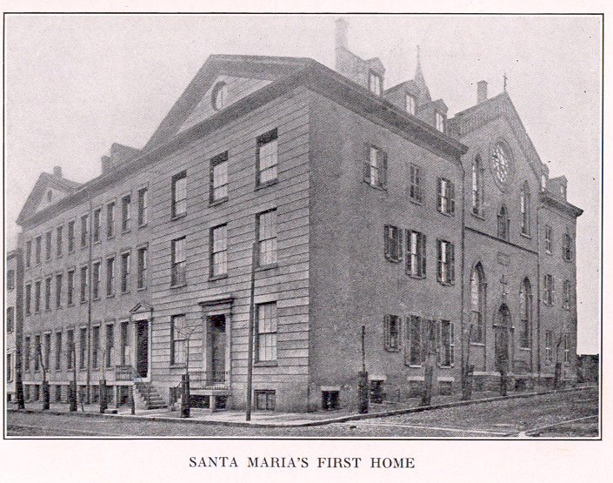
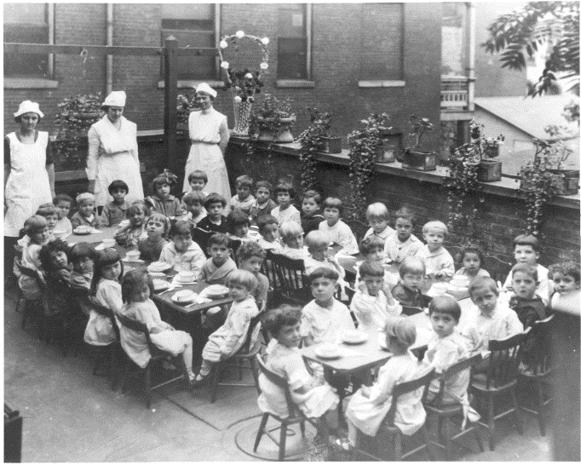
Our History
Santa Maria Italian Educational and Industrial Home (aka Santa Maria Institute)
Founded in 1897 by Sisters of Charity Blandina and Justina Segale, themselves Italian immigrants
Under the auspices of the Sisters of Charity of Cincinnati to address the urgent needs of Italian immigrants in Cincinnati’s Basin
Housing
Education
Language Training
Employment and
Family Stability
3rd and Lytle St.
Bambino Day Nursery

Slide 3
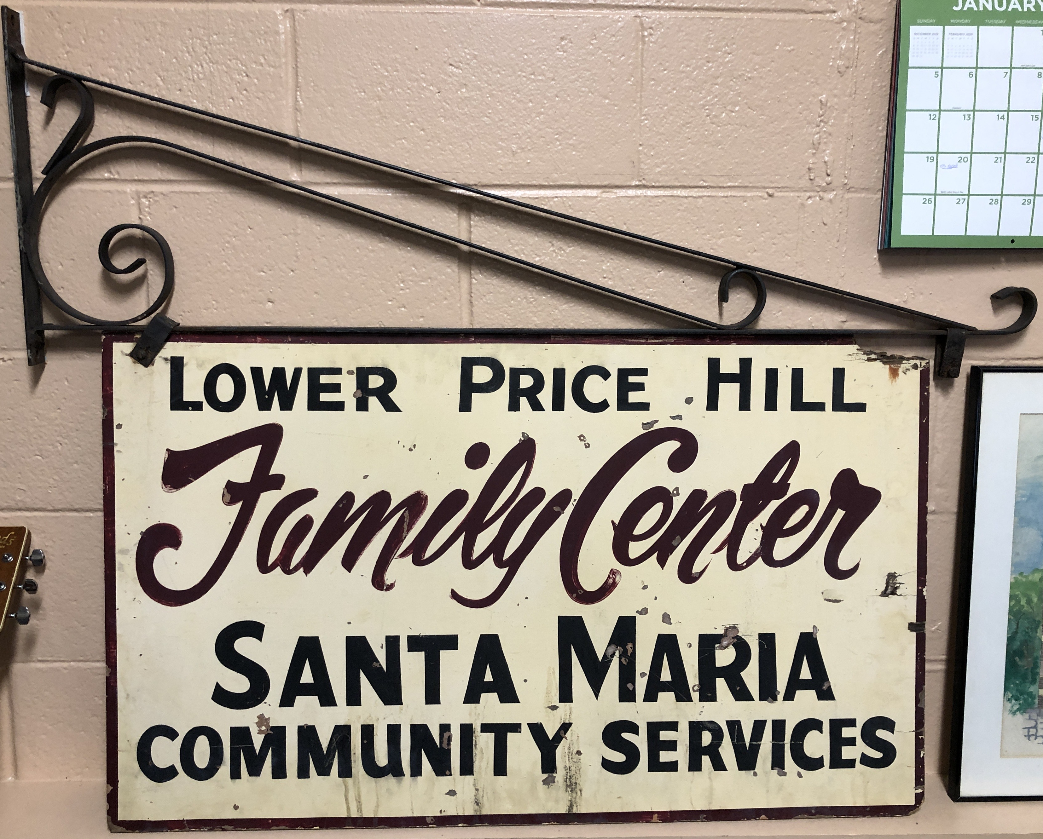
Our History (Continued)
1897 – Founded by Sisters of Charity of Cincinnati Blandina and Justina Segale to serve the Italian immigrant population in the urban core
Served families in the areas of housing, education, literacy assistance, employment, and family stability
1966 – Moved to Price Hill supporting those living below the poverty line
1972 - Became an independent, not-for-profit agency
Presently serves families in the areas of health, education, and financial stability to help them out of poverty and onto the path to self-sufficiency

Slide 4
Individuals Served
In 2022, Santa Maria served a total of 2,558 individuals.
98% had incomes below 200% of the federal poverty level.
Barriers include lack of education, transportation, health insurance, and safe and affordable housing. Any individual is eligible to receive services.
We served people of all ages:
0-5 23%
6-13 13%
14-18 8%
19-25 21%
26-39 24%
40-59 9%
60+ 2%

Slide 5
Individuals Served (continued)
Other (4%)
By Race, Ethnicity and Gender, here is whom we served in 2022:
Race
African-American 34%
White/Caucasian 53%
Multi-racial 9%
Other 4%
Multi (9%)
Non-
Hispanic (56%)
Hispanic (44%)
Black (34%)
Ethnicity
Hispanic/Latino 44%
Not Hispanic/Latino 56%
Gender
Female 65%
Male 35%
White (53%)

Slide 6
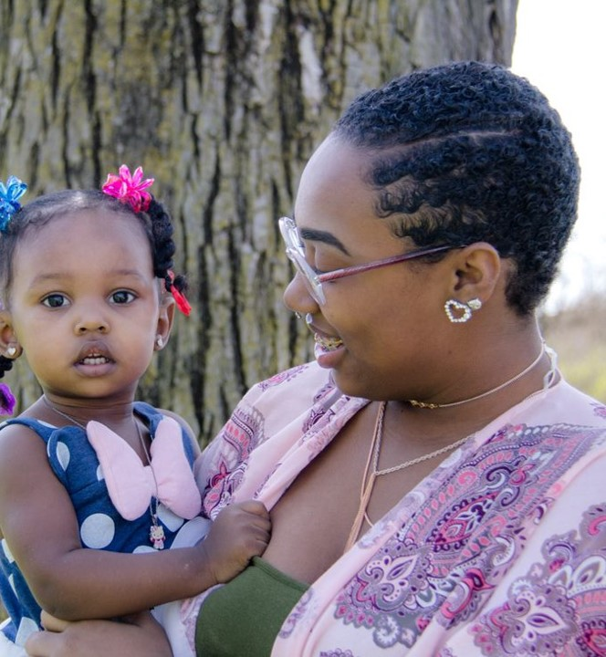
Why We Serve
47% of Price Hill’s 38,770 residents live in poverty. (LPH 72%, EPH 43%, WPH 25%)
36% of families do not make the necessary income to meet basic needs without public subsidies and private/informal assistance. (LPH 48%, EPH 36%, WPH 25%)
$29,970 is the median household income. (LPH $15,257 EPH $28,425, WPH $46,228)
14% of persons age 16+ are unemployed (Cincinnati is 4.7%).
13% of residents do not have a high school education. (LPH 17%, EPH 15%, WPH 8%)
Sources: Cincinnati Neighborhood Profile cincinnati-oh.gov (Queensgate is combined with LPH) City of Cincinnati Developing Price Hill Report, City of Cincinnati Community and Economic Development Report
Notes:
City of Cincinnati Developing Price Hill Report https://economicsresearch.org/wp-content/uploads/2019/01/pricehill.pdf
City of Cincinnati Community and Economic Development Report https://choosecincy.com/wp-content/uploads/2021/11/Annual-Report-2019-2020.pdf
WPH https://www.cincinnati-oh.gov/planning/linkservid/B581A819-F61A-2D56-CDC50A05D249EEA5/showMeta/0/
https://www.cincinnati-oh.gov/sites/oes/assets/West%20Price%20Hill%20-%20CEI.pdf
LPH
https://www.cincinnati-oh.gov/planning/linkservid/B4CE6527-C743-C5E2-6F5F0F5750539630/showMeta/0/
https://www.cincinnati-oh.gov/sites/oes/assets/Lower%20Price%20Hill%20-%20Queensgate%20-%20CEI.pdfw.cincinnati-oh.gov/planning/linkservid/B4CE6527-C743-C5E2-6F5F0F5750539630/showMeta/0/
EPH
https://www.cincinnati-oh.gov/planning/linkservid/B4AEB68A-B22F-200F-0EB19D550B6E482D/showMeta/0/
https://www.cincinnati-oh.gov/sites/oes/assets/East%20Price%20Hill%20-%20CEI.pdf

Slide 7
Our Services
Early Childhood Development & Parenting - Providing healthy beginnings, preschool and kindergarten prep, as well as parent resources, and support, plus free diapers, wipes, car seats and other necessities delivered to homes by a family support worker. (Includes Every Child Succeeds and Promoting Our Preschoolers programs)
Education Advancement - Includes High School Equivalency (HSE) prep and test registration (paid for by Santa Maria), academic advancement, tutoring, and English classes for speakers of other languages, beginners to intermediate levels.
Employment Assistance - Includes job search coaching, interview training, resume and job application help, clothing closet and employment retention and advancement coaching. (Includes Comprehensive Case Management and Employment Program (CCMEP) and Workforce Development programs)
Financial Education - Includes financial tools, education, and coaching, public benefits eligibility and application assistance, housing/tenant stabilization, and credit building and repair
Health & Wellness - Includes health education, screenings, medication referrals, mental health support, and eye and hearing exams as well as regular free health fairs in Price Hill.
Supportive Services - Includes support groups, immigrant outreach, substance abuse prevention education, food distribution, assistance with Legal Aid and social services, parenting supplies and other supports. (Includes Stable Families program and Immigrant Outreach)
Youth Development - Includes social-emotional and life skills development, tutoring, family support, and stability resources for Oyler School students at our Joe Williams Family Center in Lower Price Hill (Includes Family Support Services and Little Free Food Pantry at 2312 Glenway Avenue Cincinnati, OH 45204).

Slide 8
Joe Williams Family Center
Focus on youth and family support
SEL (Social and Emotional) groups
Afterschool programming
Sports league
Family assistance
Violence prevention initiative
Summer programming

Slide 9
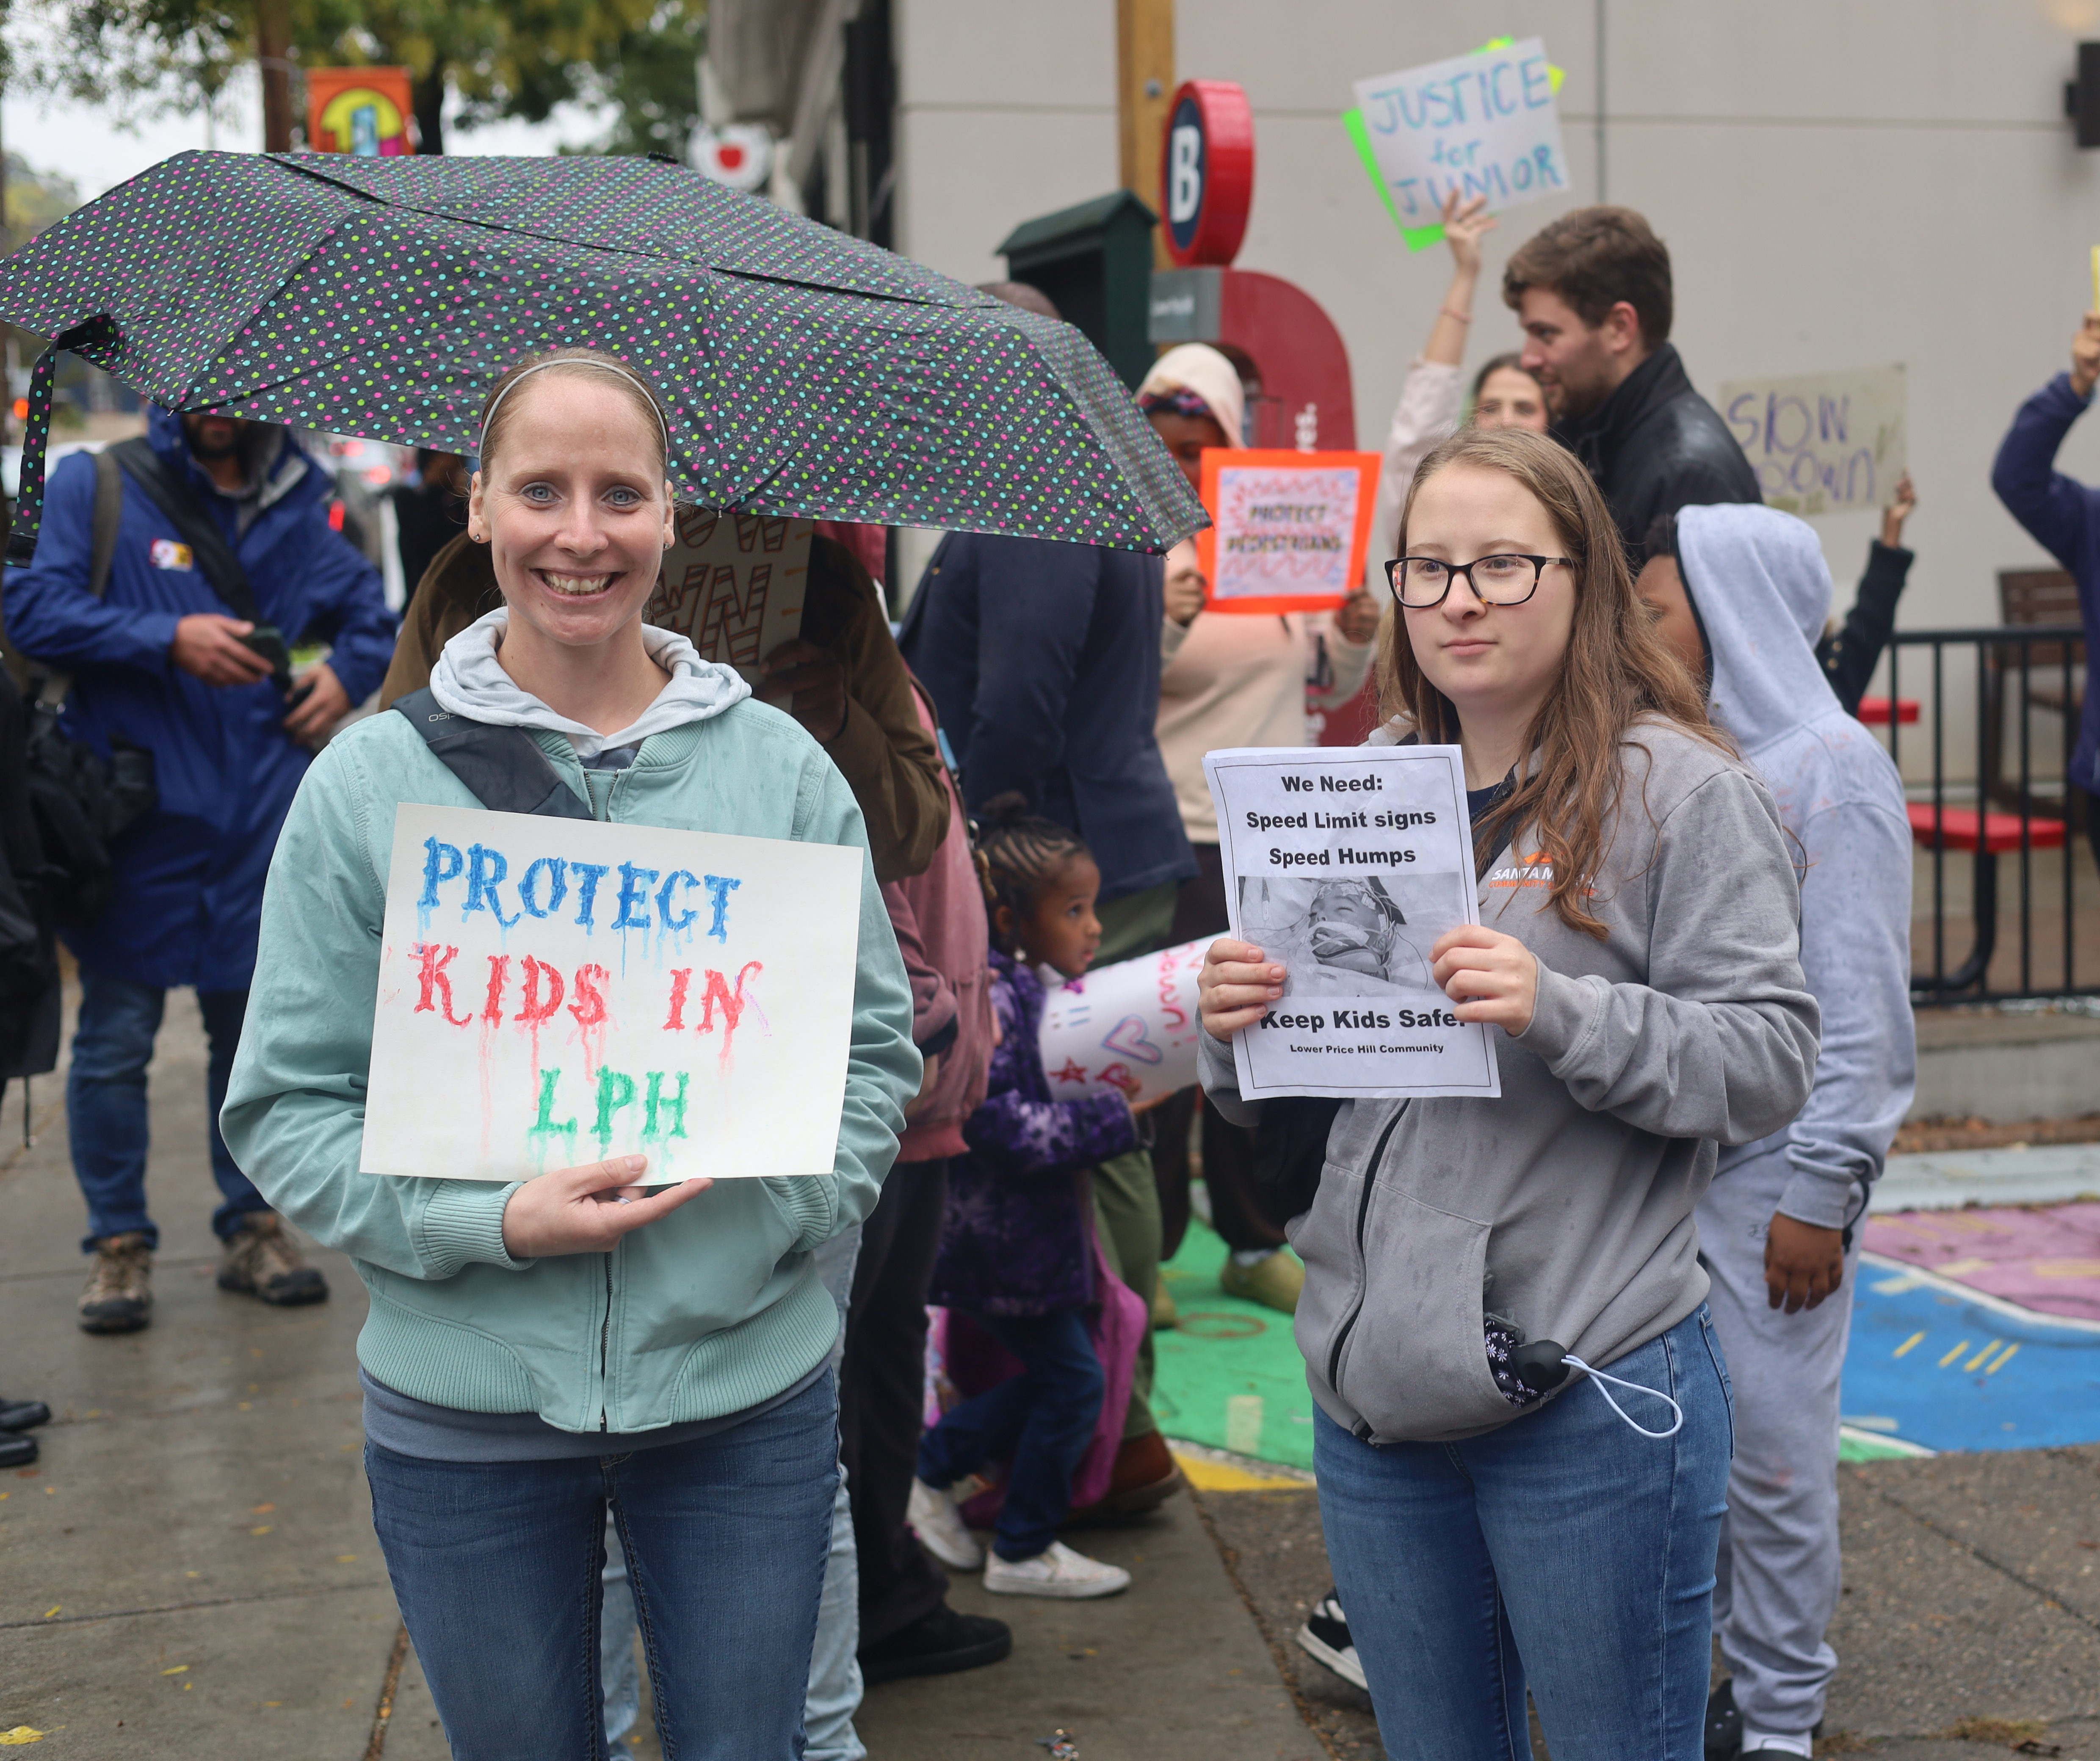
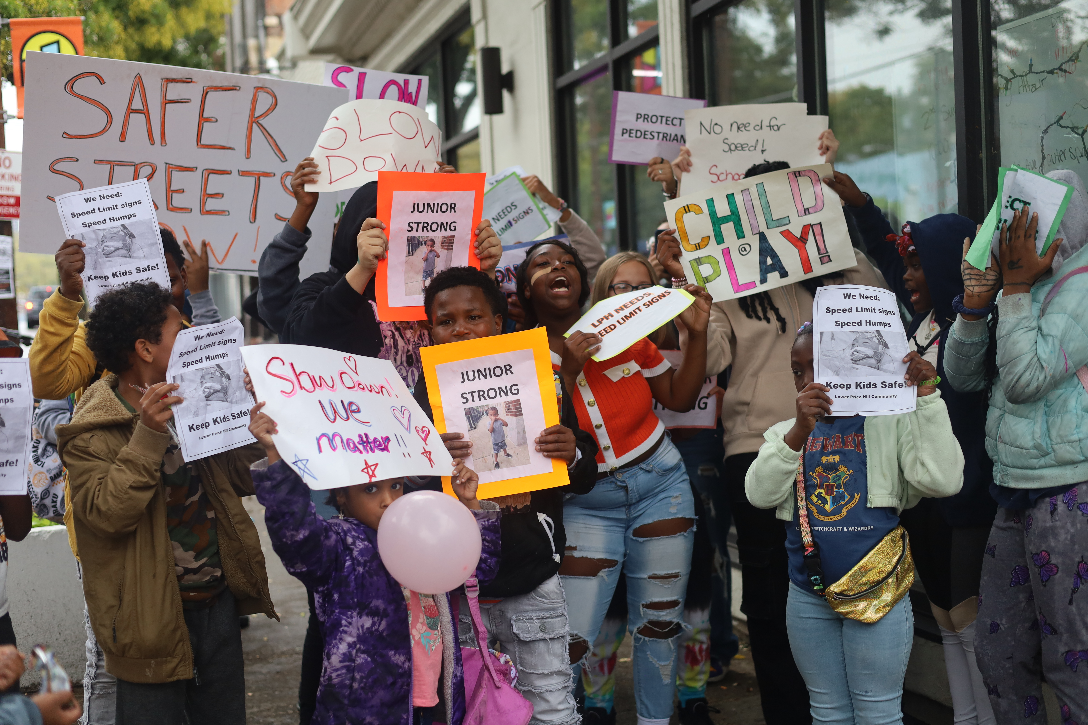
How do we support the community
Provide resource
Collaborate with community partners
Emotional Support
Community events
Price Hill hustle

Slide 10
Needs in the community?
What’s happening in the community?
Unstable housing/Poor living conditions
Health issues
Drug addiction
Domestic violence
What would be beneficial to the community?
Places for connection
More resources
Women support group

Slide 11
Shared prospective
What would be beneficial to the community? What needs can be addressed?
A place for all women to gather, create connections
Proactive and preventative care
Promoting health- (Physical, mental, emotional)
Creating resources and opportunities
Focusing on strengthening
What can be done to reach the community?
Advertise/ Signs/publicity
Street outreach
Consistent hours of operation
Community presence
Notes:
x

Slide 12
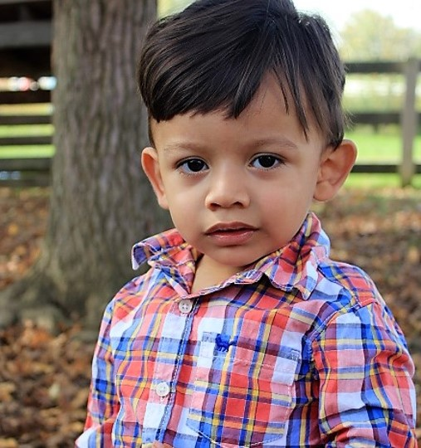
For More Information
Website: www.SantaMaria-Cincy.org
Social Media: @SantaMariaCincy
Email: info@santamaria-cincy.org

